Slide 1
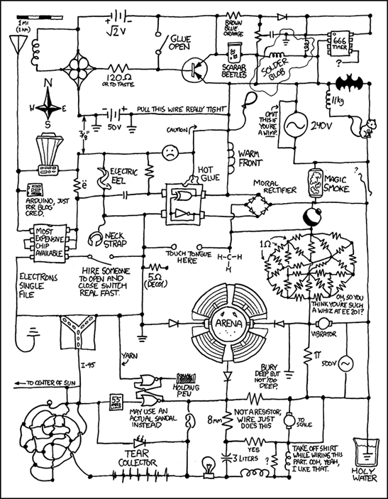
CSE 311: Foundations of Computing
Lecture 5: DNF, CNF and Predicate Logic

Slide 2
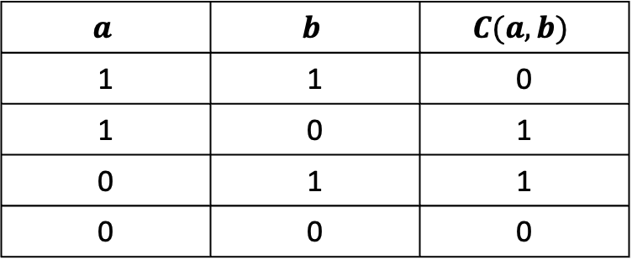


Warm-up Exercise
Create a Boolean Algebra expression for $C$ below in terms of the variables $a$ and $b$
$$a$$ | $$b$$ | $$C(a,b)$$
1 | 1 | 0
1 | 0 | 1
0 | 1 | 1
0 | 0 | 0
$$ab^{′}+a^{′}b$$

Slide 3

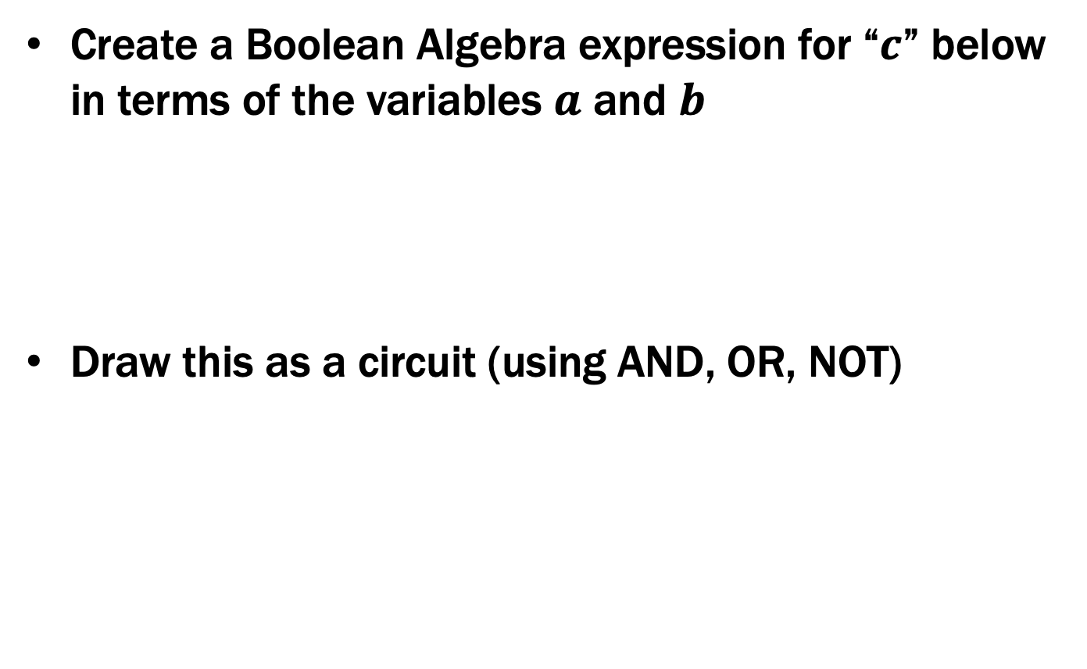
Warm-up Exercise
Create a Boolean Algebra expression for “$c$” below in terms of the variables $a$ and $b$
Draw this as a circuit (using AND, OR, NOT)
$$c=ab^{′}+a^{′}b$$

Slide 4
Combinational Logic Example
Weekday |  | isLecture | c₀ | c₁ | c₂ | c₃
SUN | 000 | 0 | 0 | 1 | 0 | 0
SUN | 000 | 1 | 0 | 0 | 0 | 1
MON | 001 | 0 | 0 | 1 | 0 | 0
MON | 001 | 1 | 0 | 0 | 0 | 1
TUE | 010 | 0 | 0 | 1 | 0 | 0
TUE | 010 | 1 | 0 | 0 | 1 | 0
WED | 011 | 0 | 0 | 1 | 0 | 0
WED | 011 | 1 | 0 | 0 | 1 | 0
THU | 100 | - | 0 | 1 | 0 | 0
FRI | 101 | 0 | 1 | 0 | 0 | 0
FRI | 101 | 1 | 0 | 1 | 0 | 0
SAT | 110 | - | 1 | 0 | 0 | 0
- | 111 | - | 1 | 0 | 0 | 0
case SUNDAY or MONDAY:
return isLecture ? 3 : 1;
case TUESDAY or WEDNESDAY:
return isLecture ? 2 : 1;
case THURSDAY:
return isLecture ? 1 : 1;
case FRIDAY:
return isLecture ? 1 : 0;
case SATURDAY:
return isLecture ? 0 : 0;

Slide 5
Truth Table to Logic (Part 3)
 | d₂d₁d₀ | L | c₀ | c₁ | c₂ | c₃
SUN | 000 | 0 | 0 | 1 | 0 | 0
SUN | 000 | 1 | 0 | 0 | 0 | 1
MON | 001 | 0 | 0 | 1 | 0 | 0
MON | 001 | 1 | 0 | 0 | 0 | 1
TUE | 010 | 0 | 0 | 1 | 0 | 0
TUE | 010 | 1 | 0 | 0 | 1 | 0
WED | 011 | 0 | 0 | 1 | 0 | 0
WED | 011 | 1 | 0 | 0 | 1 | 0
THU | 100 | - | 0 | 1 | 0 | 0
FRI | 101 | 0 | 1 | 0 | 0 | 0
FRI | 101 | 1 | 0 | 1 | 0 | 0
SAT | 110 | - | 1 | 0 | 0 | 0
- | 111 | - | 1 | 0 | 0 | 0
Now, we do c₁:
c₃ = d₂’•d₁’•d₀’•L + d₂’•d₁’•d₀•L
c₂ = d₂’•d₁•d₀’•L + d₂’•d₁•d₀•L

Slide 6
Truth Table to Logic (Part 3)
 | d₂d₁d₀ | L | c₀ | c₁ | c₂ | c₃
SUN | 000 | 0 | 0 | 1 | 0 | 0
SUN | 000 | 1 | 0 | 0 | 0 | 1
MON | 001 | 0 | 0 | 1 | 0 | 0
MON | 001 | 1 | 0 | 0 | 0 | 1
TUE | 010 | 0 | 0 | 1 | 0 | 0
TUE | 010 | 1 | 0 | 0 | 1 | 0
WED | 011 | 0 | 0 | 1 | 0 | 0
WED | 011 | 1 | 0 | 0 | 1 | 0
THU | 100 | - | 0 | 1 | 0 | 0
FRI | 101 | 0 | 1 | 0 | 0 | 0
FRI | 101 | 1 | 0 | 1 | 0 | 0
SAT | 110 | - | 1 | 0 | 0 | 0
- | 111 | - | 1 | 0 | 0 | 0
Now, we do c₁:
d₂’•d₁’•d₀’•L’
d₂’•d₁’•d₀•L’
d₂’•d₁•d₀’•L’
d₂’•d₁•d₀•L’
???
d₂•d₁’•d₀•L
c₃ = d₂’•d₁’•d₀’•L + d₂’•d₁’•d₀•L
c₂ = d₂’•d₁•d₀’•L + d₂’•d₁•d₀•L

Slide 7
Truth Table to Logic (Part 3)
 | d₂d₁d₀ | L | c₀ | c₁ | c₂ | c₃
SUN | 000 | 0 | 0 | 1 | 0 | 0
SUN | 000 | 1 | 0 | 0 | 0 | 1
MON | 001 | 0 | 0 | 1 | 0 | 0
MON | 001 | 1 | 0 | 0 | 0 | 1
TUE | 010 | 0 | 0 | 1 | 0 | 0
TUE | 010 | 1 | 0 | 0 | 1 | 0
WED | 011 | 0 | 0 | 1 | 0 | 0
WED | 011 | 1 | 0 | 0 | 1 | 0
THU | 100 | - | 0 | 1 | 0 | 0
FRI | 101 | 0 | 1 | 0 | 0 | 0
FRI | 101 | 1 | 0 | 1 | 0 | 0
SAT | 110 | - | 1 | 0 | 0 | 0
- | 111 | - | 1 | 0 | 0 | 0
Now, we do c₁:
d₂’•d₁’•d₀’•L’
d₂’•d₁’•d₀•L’
d₂’•d₁•d₀’•L’
d₂’•d₁•d₀•L’
No matter what L is, we always say it’s 1. So, we don’t need L in the expression.
d₂•d₁’•d₀’
d₂•d₁’•d₀•L
c₃ = d₂’•d₁’•d₀’•L + d₂’•d₁’•d₀•L
c₂ = d₂’•d₁•d₀’•L + d₂’•d₁•d₀•L

Slide 8



Truth Table to Logic (Part 4)
c₀ = d₂•d₁’•d₀•L’ + d₂•d₁•d₀’ + d₂•d₁•d₀
c₁ = d₂’•d₁’•d₀’•L’ + d₂’•d₁’•d₀•L’ + d₂’•d₁•d₀’•L’ + d₂’•d₁•d₀•L’ + d₂•d₁’•d₀’ + d₂•d₁’•d₀•L
c₂ = d₂’•d₁•d₀’•L + d₂’•d₁•d₀•L
c₃ = d₂’•d₁’•d₀’•L + d₂’•d₁’•d₀•L
Here’s c₃ as a circuit:
d₂
NOT
AND
d₁
NOT
OR
d₀
AND
NOT
L
Notes:
This procedure shows that {NOT, AND, OR} are universal

Slide 9
Important Corollaries of this Construction
¬, ∧, ∨ can implement any Boolean function
we didn’t need any others to do this
Actually, just ¬, ∧ (or ¬, ∨) are enough
follows by De Morgan’s laws
Actually, just NAND (or NOR)
Prime(65353)

Slide 10
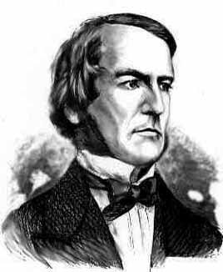
Boolean Algebra
Usual notation used in circuit design
Boolean algebra
a set of elements B containing {0, 1}
binary operations { + , • }
and a unary operation { ’ }
such that the following axioms hold:
For any a, b, c in B: 1. closure: a + b is in B a • b is in B 2. commutativity: a + b = b + a a • b = b • a 3. associativity: a + (b + c) = (a + b) + c a • (b • c) = (a • b) • c 4. distributivity: a + (b • c) = (a + b) • (a + c) a • (b + c) = (a • b) + (a • c) 5. identity: a + 0 = a a • 1 = a 6. complementarity: a + a’ = 1 a • a’ = 0
7. null: a + 1 = 1 a • 0 = 0
8. idempotency: a + a = a a • a = a
9. involution: (a’)’ = a

Slide 11
Simplification using Boolean Algebra
uniting: 10. a • b + a • b’ = a 10D. (a + b) • (a + b’) = a
absorption: 11. a + a • b = a 11D. a • (a + b) = a 12. (a + b’) • b = a • b 12D. (a • b’) + b = a + b
factoring: 13. (a + b) • (a’ + c) = 13D. a • b + a’ • c = a • c + a’ • b (a + c) • (a’ + b)
consensus: 14. (a • b) + (b • c) + (a’ • c) = 14D. (a + b) • (b + c) • (a’ + c) = a • b + a’ • c (a + b) • (a’ + c)
de Morgan’s: 15. (a + b + ...)’ = a’ • b’ • ... 15D. (a • b • ...)’ = a’ + b’ + ...

Slide 12
Simplifying using Boolean Algebra
c3 = d2’•d1’•d0’•L + d2’•d1’•d0•L
= d2’•d1’•(d0’ + d0)•L
= d2’•d1’•1•L
= d2’•d1’•L
d2
NOT
AND
d1
NOT
L

Slide 13
1-bit Binary Adder
A
+ B
S
(C_{OUT})
0 + 0 = 0 (with C_{OUT} = 0)
0 + 1 = 1 (with C_{OUT} = 0)
1 + 0 = 1 (with C_{OUT} = 0)
1 + 1 = 0 (with C_{OUT} = 1)

Slide 14
1-bit Binary Adder
A
+ B
S
(C_{OUT})
0 + 0 = 0 (with C_{OUT} = 0)
0 + 1 = 1 (with C_{OUT} = 0)
1 + 0 = 1 (with C_{OUT} = 0)
1 + 1 = 0 (with C_{OUT} = 1)
Idea: chain these together to add larger numbers
Recall from elementary school:
2 4 8
+ 3 7 5

Slide 15
1-bit Binary Adder
A
+ B
S
(C_{OUT})
0 + 0 = 0 (with C_{OUT} = 0)
0 + 1 = 1 (with C_{OUT} = 0)
1 + 0 = 1 (with C_{OUT} = 0)
1 + 1 = 0 (with C_{OUT} = 1)
Idea: These are chained together with a carry-in
(C_{IN})
A
+ B
S
(C_{OUT})
C_{OUT}
C_{IN}
C_{OUT}
C_{IN}
1 1 0 0
A A A A A
0 1 1 1 0
B B B B B
0 1 1 0 1
S S S S S
1 1 0 1 1

Slide 16
1-bit Binary Adder
C_{IN}
Inputs: A, B, Carry-in
Outputs: Sum, Carry-out
C_{OUT}
A A A A A
B B B B B
S S S S S
A | B | C_{IN} | C_{OUT} | S
0 | 0 | 0 | 0 | 0
0 | 0 | 1 | 0 | 1
0 | 1 | 0 | 0 | 1
0 | 1 | 1 | 1 | 0
1 | 0 | 0 | 0 | 1
1 | 0 | 1 | 1 | 0
1 | 1 | 0 | 1 | 0
1 | 1 | 1 | 1 | 1
A
S
B
C_{OUT}
C_{IN}

Slide 17
1-bit Binary Adder
C_{IN}
Inputs: A, B, Carry-in
Outputs: Sum, Carry-out
C_{OUT}
A A A A A
B B B B B
S S S S S
A | B | C_{IN} | C_{OUT} | S
0 | 0 | 0 | 0 | 0
0 | 0 | 1 | 0 | 1
0 | 1 | 0 | 0 | 1
0 | 1 | 1 | 1 | 0
1 | 0 | 0 | 0 | 1
1 | 0 | 1 | 1 | 0
1 | 1 | 0 | 1 | 0
1 | 1 | 1 | 1 | 1
Derive an expression for S
A’•B’•C_{IN}
A’•B•C_{IN}’
S = A’•B’•C_{IN} + A’•B•C_{IN}’ +
A•B’•C_{IN}’ + A•B•C_{IN}
A•B’•C_{IN}’
A•B•C_{IN}

Slide 18
1-bit Binary Adder
C_{IN}
Inputs: A, B, Carry-in
Outputs: Sum, Carry-out
C_{OUT}
A A A A A
B B B B B
S S S S S
A | B | C_{IN} | C_{OUT} | S
0 | 0 | 0 | 0 | 0
0 | 0 | 1 | 0 | 1
0 | 1 | 0 | 0 | 1
0 | 1 | 1 | 1 | 0
1 | 0 | 0 | 0 | 1
1 | 0 | 1 | 1 | 0
1 | 1 | 0 | 1 | 0
1 | 1 | 1 | 1 | 1
Derive an expression for C_{OUT}
A’•B•C_{IN}
C_{OUT} = A’•B•C_{IN} + A•B’•C_{IN} +
A•B•C_{IN}’ + A•B•C_{IN}
A•B’•C_{IN}
A•B•C_{IN}’
A•B•C_{IN}
S = A’•B’•C_{IN} + A’•B•C_{IN}’ + A•B’•C_{IN}’ + A•B•C_{IN}

Slide 19
1-bit Binary Adder
C_{IN}
Inputs: A, B, Carry-in
Outputs: Sum, Carry-out
C_{OUT}
A A A A A
B B B B B
S S S S S
A | B | C_{IN} | C_{OUT} | S
0 | 0 | 0 | 0 | 0
0 | 0 | 1 | 0 | 1
0 | 1 | 0 | 0 | 1
0 | 1 | 1 | 1 | 0
1 | 0 | 0 | 0 | 1
1 | 0 | 1 | 1 | 0
1 | 1 | 0 | 1 | 0
1 | 1 | 1 | 1 | 1
S = A’•B’•C_{IN} + A’•B•C_{IN}’ + A•B’•C_{IN}’ + A•B•C_{IN}
C_{OUT} = A’•B•C_{IN} + A•B’•C_{IN} + A•B•C_{IN}’ + A•B•C_{IN}

Slide 20
Apply Theorems to Simplify Expressions
The theorems of Boolean algebra can simplify expressions
e.g., full adder’s carry-out function
Cout = A’ B Cin + A B’ Cin + A B Cin’ + A B Cin
= A’ B Cin + A B’ Cin + A B Cin’ + A B Cin + A B Cin
= A’ B Cin + A B Cin + A B’ Cin + A B Cin’ + A B Cin
= (A’ + A) B Cin + A B’ Cin + A B Cin’ + A B Cin
= (1) B Cin + A B’ Cin + A B Cin’ + A B Cin
= B Cin + A B’ Cin + A B Cin’ + A B Cin + A B Cin
= B Cin + A B’ Cin + A B Cin + A B Cin’ + A B Cin
= B Cin + A (B’ + B) Cin + A B Cin’ + A B Cin
= B Cin + A (1) Cin + A B Cin’ + A B Cin
= B Cin + A Cin + A B (Cin’ + Cin)
= B Cin + A Cin + A B (1)
= B Cin + A Cin + A B

Slide 21
Apply Theorems to Simplify Expressions
The theorems of Boolean algebra can simplify expressions
e.g., full adder’s carry-out function
Cout = A’ B Cin + A B’ Cin + A B Cin’ + A B Cin
= A’ B Cin + A B’ Cin + A B Cin’ + A B Cin + A B Cin
= A’ B Cin + A B Cin + A B’ Cin + A B Cin’ + A B Cin
= (A’ + A) B Cin + A B’ Cin + A B Cin’ + A B Cin
= (1) B Cin + A B’ Cin + A B Cin’ + A B Cin
= B Cin + A B’ Cin + A B Cin’ + A B Cin + A B Cin
= B Cin + A B’ Cin + A B Cin + A B Cin’ + A B Cin
= B Cin + A (B’ + B) Cin + A B Cin’ + A B Cin
= B Cin + A (1) Cin + A B Cin’ + A B Cin
= B Cin + A Cin + A B (Cin’ + Cin)
= B Cin + A Cin + A B (1)
= B Cin + A Cin + A B
adding extra terms creates new factoring opportunities

Slide 22
A 2-bit Ripple-Carry Adder
A
B
A₀
B₀
A₁
B₁
A₂
B₂
1-Bit Adder
0
C_{in}
C_{out}
C_{in}
C_{out}
C_{in}
C_{out}
C_{in}
C_{out}
Sum₀
Sum₁
Sum₂
Uses the fact that Sum = A’•B’•C_{IN} + A’•B•C_{IN}’ + A•B’•C_{IN}’ + A•B•C_{IN}
is equivalent to Sum = (A ⊕ B) ⊕ C_{IN}
Sum

Slide 23
Mapping Truth Tables to Logic Gates
A B C F
0 0 0 0
0 0 1 0
0 1 0 1
0 1 1 1
1 0 0 0
1 0 1 1
1 1 0 0
1 1 1 1
Given a truth table:
Write the output in a table
Write the Boolean expression
Minimize the Boolean expression
Draw as gates
Map to available gates
2
F = A’BC’+A’BC+AB’C+ABC
= A’B(C’+C)+AC(B’+B)
= A’B+AC
3
4
5

Slide 24
Canonical Forms
Truth table is the unique signature of a 0/1 function
The same truth table can have many gate realizations
We’ve seen this already
Depends on how good we are at Boolean simplification
Canonical forms
Standard forms for a Boolean expression
We all produce the same expression

Slide 25
Sum-of-Products Canonical Form
AKA Disjunctive Normal Form (DNF)
AKA Minterm Expansion
3
Add the minterms together
F= A’B’C + A’BC + AB’C + ABC’ + ABC’
A | B | C | F
0 | 0 | 0 | 0
0 | 0 | 1 | 1
0 | 1 | 0 | 0
0 | 1 | 1 | 1
1 | 0 | 0 | 0
1 | 0 | 1 | 1
1 | 1 | 0 | 1
1 | 1 | 1 | 1
1
2
Read T rows off
truth table
Convert to
Boolean Algebra
001
A’B’C
011
A’BC
F
101
AB’C
110
ABC’
111
ABC

Slide 26
Sum-of-Products Canonical Form
Product term (or minterm)
ANDed product of literals – input combination for which output is true
each variable appears exactly once, true or inverted (but not both)
A B C minterms 0 0 0 A’B’C’
0 0 1 A’B’C
0 1 0 A’BC’
0 1 1 A’BC
1 0 0 AB’C’
1 0 1 AB’C
1 1 0 ABC’
1 1 1 ABC
F in canonical form: F(A, B, C) = A’B’C + A’BC + AB’C + ABC’ + ABC
canonical form ≠ minimal form F(A, B, C) = A’B’C + A’BC + AB’C + ABC + ABC’
= (A’B’ + A’B + AB’ + AB)C + ABC’
= ((A’ + A)(B’ + B))C + ABC’ = C + ABC’ = ABC’ + C
= AB + C

Slide 27
Product-of-Sums Canonical Form
AKA Conjunctive Normal Form (CNF)
AKA Maxterm Expansion
4
Multiply the maxterms together
F =
1
2
3
A | B | C | F
0 | 0 | 0 | 0
0 | 0 | 1 | 1
0 | 1 | 0 | 0
0 | 1 | 1 | 1
1 | 0 | 0 | 0
1 | 0 | 1 | 1
1 | 1 | 0 | 1
1 | 1 | 1 | 1
Read F rows off
truth table
Negate all
bits
Convert to
Boolean Algebra
F

Slide 28
Product-of-Sums Canonical Form
AKA Conjunctive Normal Form (CNF)
AKA Maxterm Expansion
4
Multiply the maxterms together
F = (A + B + C)(A + B’ + C)(A’ + B + C)
1
2
3
A | B | C | F
0 | 0 | 0 | 0
0 | 0 | 1 | 1
0 | 1 | 0 | 0
0 | 1 | 1 | 1
1 | 0 | 0 | 0
1 | 0 | 1 | 1
1 | 1 | 0 | 1
1 | 1 | 1 | 1
Read F rows off
truth table
Negate all
bits
Convert to
Boolean Algebra
000
111
A + B + C
F
010
101
A + B’ + C
100
011
A’ + B + C

Slide 29
Product-of-Sums: Why does this procedure work?
Useful Facts:
We know (F’)’ = F
We know how to get a minterm expansion for F’
A | B | C | F
0 | 0 | 0 | 0
0 | 0 | 1 | 1
0 | 1 | 0 | 0
0 | 1 | 1 | 1
1 | 0 | 0 | 0
1 | 0 | 1 | 1
1 | 1 | 0 | 1
1 | 1 | 1 | 1
F’ = A’B’C’ + A’BC’ + AB’C’

Slide 30
Product-of-Sums: Why does this procedure work?
Useful Facts:
We know (F’)’ = F
We know how to get a minterm expansion for F’
A | B | C | F
0 | 0 | 0 | 0
0 | 0 | 1 | 1
0 | 1 | 0 | 0
0 | 1 | 1 | 1
1 | 0 | 0 | 0
1 | 0 | 1 | 1
1 | 1 | 0 | 1
1 | 1 | 1 | 1
F’ = A’B’C’ + A’BC’ + AB’C’
Taking the complement of both sides…
(F’)’ = (A’B’C’ + A’BC’ + AB’C’)’
And using DeMorgan/Comp.…
F = (A’B’C’)’ (A’BC’)’ (AB’C’)’
F = (A + B + C)(A + B’ + C)(A’ + B + C)

Slide 31
Product-of-Sums Canonical Form
Sum term (or maxterm)
ORed sum of literals – input combination for which output is false
each variable appears exactly once, true or inverted (but not both)
A B C maxterms 0 0 0 A+B+C
0 0 1 A+B+C’
0 1 0 A+B’+C
0 1 1 A+B’+C’
1 0 0 A’+B+C
1 0 1 A’+B+C’
1 1 0 A’+B’+C
1 1 1 A’+B’+C’
F in canonical form: F(A, B, C) = (A + B + C) (A + B’ + C) (A’ + B + C)
canonical form ≠ minimal form F(A, B, C) = (A + B + C) (A + B’ + C) (A’ + B + C)
= (A + B + C) (A + B’ + C)
(A + B + C) (A’ + B + C)
= (A + C) (B + C)

Slide 32
Predicate Logic

Slide 33
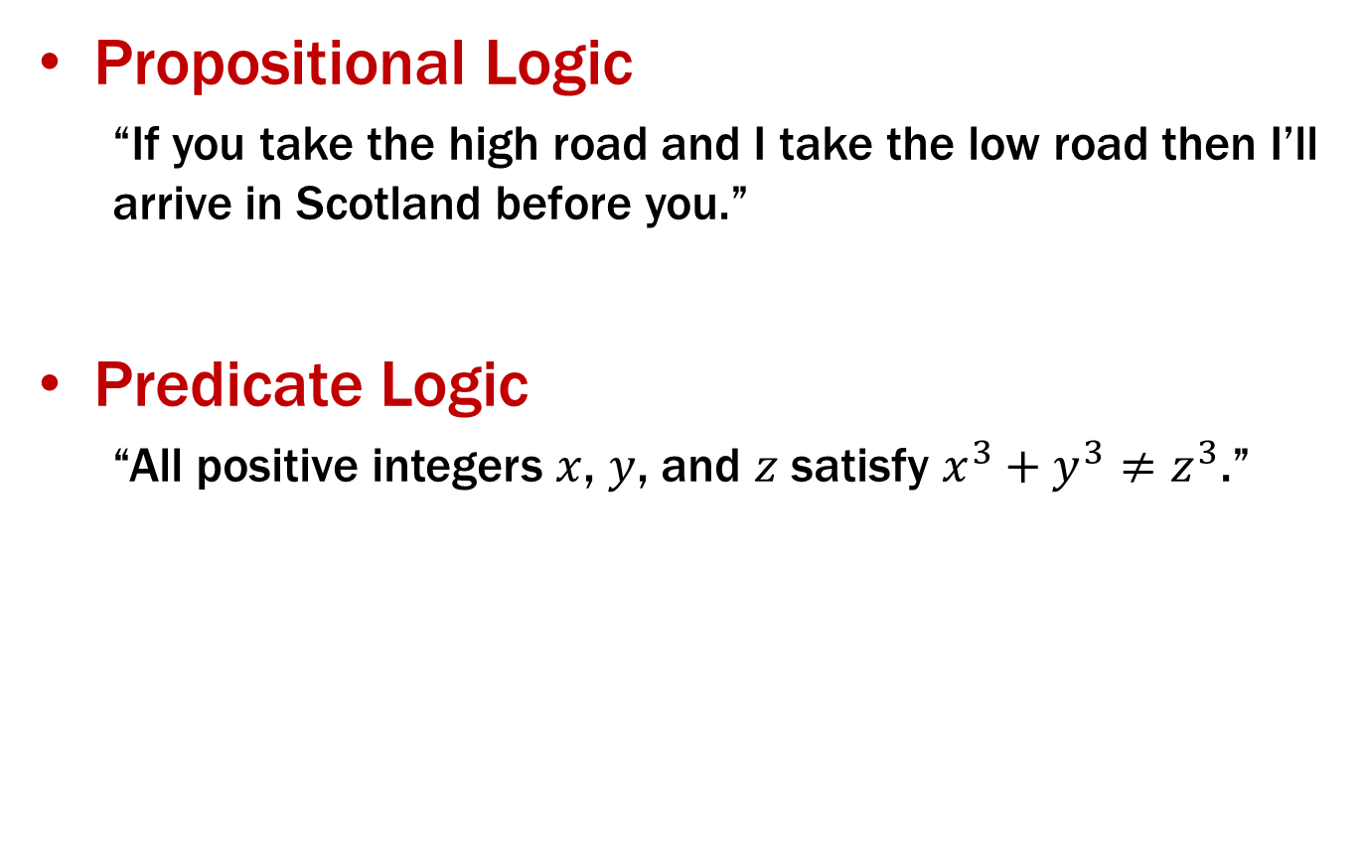
Predicate Logic
Propositional Logic
“If you take the high road and I take the low road then I’ll arrive in Scotland before you.”
Predicate Logic
“All positive integers $x$, $y$, and $z$ satisfy $x^{3}+y^{3}≠z^{3}$.”
Prime(65353)

Slide 34
Predicate Logic
Propositional Logic
Allows us to analyze complex propositions in terms of their simpler constituent parts (a.k.a. atomic propositions) joined by connectives
Predicate Logic
Lets us analyze them at a deeper level by expressing how those propositions depend on the objects they are talking about
Prime(65353)

Slide 35
Predicate Logic
Adds two key notions to propositional logic
Predicates
Quantifiers

Slide 36
Predicates
Predicate
A function that returns a truth value, e.g.,
Cat(x) ::= “x is a cat”
Prime(x) ::= “x is prime”
HasTaken(x, y) ::= “student x has taken course y”
LessThan(x, y) ::= “x < y”
Sum(x, y, z) ::= “x + y = z”
GreaterThan5(x) ::= “x > 5”
HasNChars(s, n) ::= “string s has length n”
Predicates can have varying numbers of arguments and input types.
Prime(65353)

Slide 37
Domain of Discourse
For ease of use, we define one “type”/“domain” that we work over. This non-empty set of objects is called the “domain of discourse”.
For each of the following, what might the domain be?
“x is a cat”, “x barks”, “x ruined my couch”
“x is prime”, “x = 0”, “x < 0”, “x is a power of two”
(3) “student x has taken course y” “x is a pre-req for z”
“mammals” or “sentient beings” or “cats and dogs” or …
“numbers” or “integers” or “integers greater than 5” or …
“students and courses” or “university entities” or …
Relate ∀ and ∃ to ∧ and ∨

Slide 38

Quantifiers
We use quantifiers to talk about collections of objects.
∀x P(x)
P(x) is true for every x in the domain
read as “for all x, P of x”
∃x P(x)
There is an x in the domain for which P(x) is true
read as “there exists x, P of x”
Relate ∀ and ∃ to ∧ and ∨

Slide 39
Quantifiers
We use quantifiers to talk about collections of objects.
Universal Quantifier (“for all”): ∀x P(x)
P(x) is true for every x in the domain
read as “for all x, P of x”
Examples:
∀x Odd(x)
∀x LessThan4(x)
Are these true?
Relate ∀ and ∃ to ∧ and ∨

Slide 40
Quantifiers
We use quantifiers to talk about collections of objects.
Universal Quantifier (“for all”): ∀x P(x)
P(x) is true for every x in the domain
read as “for all x, P of x”
Examples:
∀x Odd(x)
∀x LessThan4(x)
Are these true? It depends on the domain. For example:
{1, 3, -1, -27} | Integers | Odd Integers
True | False | True
True | False | False
Relate ∀ and ∃ to ∧ and ∨

Slide 41

Quantifiers
We use quantifiers to talk about collections of objects.
Existential Quantifier (“exists”): ∃x P(x)
There is an x in the domain for which P(x) is true
read as “there exists x, P of x”
Examples:
∃x Odd(x)
∃x LessThan4(x)
Relate ∀ and ∃ to ∧ and ∨

Slide 42
Quantifiers
We use quantifiers to talk about collections of objects.
Existential Quantifier (“exists”): ∃x P(x)
There is an x in the domain for which P(x) is true
read as “there exists x, P of x”
Examples:
∃x Odd(x)
∃x LessThan4(x)
Are these true? It depends on the domain. For example:
{1, 3, -1, -27} | Integers | Positive Multiples of 5
True | True | True
True | True | False
Relate ∀ and ∃ to ∧ and ∨

