Slide 1
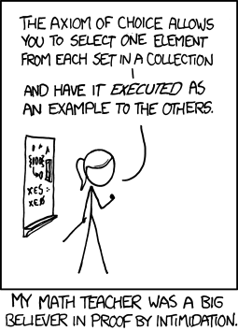
CSE 311: Foundations of Computing
Lecture 9: English Proofs & Proof Strategies

Slide 2
Last class: Inference Rules for Quantifiers
P(c) for some c
∴ ∃x P(x)
∀x P(x)
∴ P(a) for any a
Intro ∃
Elim ∀
∃x P(x)
∴ P(c) for some special** c
“Let a be arbitrary*”...P(a)
∴ ∀x P(x)
Elim ∃
Intro ∀
** c is a NEW name.
* in the domain of P.

Slide 3
A Not so Odd Example
Domain of Discourse
Predicate Definitions
Integers
Even(x) := ∃y (x = 2⋅y)
Odd(x) := ∃y (x = 2⋅y + 1)
Prove “There is an even number”
Formally: prove ∃x Even(x)

Slide 4
A Not so Odd Example
Domain of Discourse
Predicate Definitions
Integers
Even(x) := ∃y (x = 2⋅y)
Odd(x) := ∃y (x = 2⋅y + 1)
Prove “There is an even number”
Formally: prove ∃x Even(x)
1. 2 = 2⋅1 Algebra
∃y (2 = 2⋅y) Intro ∃: 1
Even(2) Definition of Even: 2
4. $\text{}\text{x} \text{E}\text{ven}\text{(}\text{x}\text{)}$ Intro ∃: 3

Slide 5
A Prime Example
Domain of Discourse
Predicate Definitions
Integers
Even(x) := ∃y (x = 2⋅y)
Odd(x) := ∃y (x = 2⋅y + 1)
Prime(x) := “x > 1 and x≠a⋅b for all integers a, b with 1<a<x”
Prove “There is an even prime number”
Formally: prove ∃x (Even(x) ∧ Prime(x))

Slide 6
A Prime Example
Domain of Discourse
Predicate Definitions
Integers
Even(x) := ∃y (x = 2⋅y)
Odd(x) := ∃y (x = 2⋅y + 1)
Prime(x) := “x > 1 and x≠a⋅b for all integers a, b with 1<a<x”
Prove “There is an even prime number”
Formally: prove ∃x (Even(x) ∧ Prime(x))
1. 2 = 2⋅1 Algebra
∃y (2 = 2⋅y) Intro ∃: 1
Even(2) Def of Even: 3
Prime(2) Property of integers
Even(2) ∧ Prime(2) Intro ∧: 2, 4
6. ∃x (Even(x) ∧ Prime(x)) Intro ∃: 5
*
* Later we will further break down “Prime” using quantifiers to prove statements like this

Slide 7
Inference Rules for Quantifiers: First look
P(c) for some c
∴ ∃x P(x)
∀x P(x)
∴ P(a) (for any a)
Intro ∃
Elim ∀
∃x P(x)
∴ P(c) for some special** c
“Let a be arbitrary*”...P(a)
∴ ∀x P(x)
Elim ∃
Intro ∀
* in the domain of P
** By special, we mean that c is a name for a value where P(c) is true. We can’t use anything else about that value, so c has to be a NEW name!
Notes:
We can write “Let a be an object” and then apply Elim For All

Slide 8
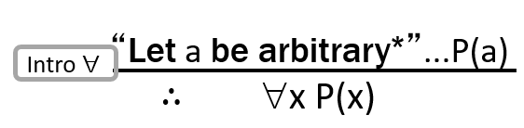
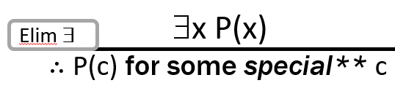

Even and Odd
Even(x) := ∃y (x=2y)
Odd(x) := ∃y (x=2y+1)
Domain: Integers
Prove: “The square of any even number is even.”
Formal proof of: ∀x (Even(x) → Even(x²))
3. ∀x (Even(x)→Even(x²))

Slide 9
Even and Odd
Even(x) := ∃y (x=2y)
Odd(x) := ∃y (x=2y+1)
Domain: Integers
Prove: “The square of any even number is even.”
Formal proof of: ∀x (Even(x) → Even(x²))
Let a be an arbitrary integer
2. Even(a)→Even(a²)
3. ∀x (Even(x)→Even(x²)) Intro ∀: 1,2

Slide 10
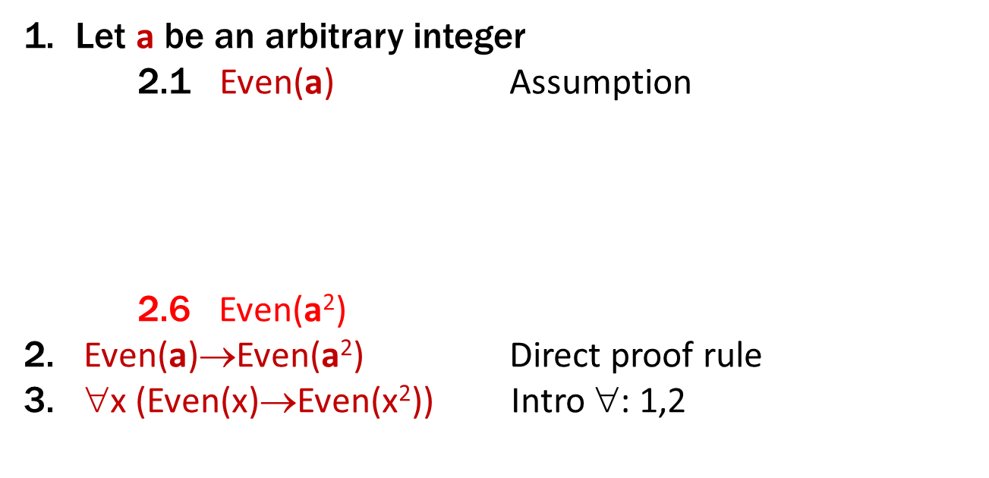
Even and Odd
Even(x) := ∃y (x=2y)
Odd(x) := ∃y (x=2y+1)
Domain: Integers
Prove: “The square of any even number is even.”
Formal proof of: ∀x (Even(x) → Even(x²))
Let a be an arbitrary integer
2.1 Even(a) Assumption
2.6 Even(a²)
2. Even(a)→Even(a²) Direct proof
3. ∀x (Even(x)→Even(x²)) Intro ∀: 1,2

Slide 11
Even and Odd
Even(x) := ∃y (x=2y)
Odd(x) := ∃y (x=2y+1)
Domain: Integers
Prove: “The square of any even number is even.”
Formal proof of: ∀x (Even(x) → Even(x²))
Let a be an arbitrary integer
2.1 Even(a) Assumption
2.2 $∃$y (a = 2y) Definition of Even
2.5$∃$y (a² = 2y)
2.6 Even(a²) Definition of Even
2. Even(a)→Even(a²) Direct Proof
3. ∀x (Even(x)→Even(x²)) Intro ∀: 1,2

Slide 12
Even and Odd
Even(x) := ∃y (x=2y)
Odd(x) := ∃y (x=2y+1)
Domain: Integers
Prove: “The square of any even number is even.”
Formal proof of: ∀x (Even(x) → Even(x²))
Let a be an arbitrary integer
2.1 Even(a) Assumption
2.2 $∃$y (a = 2y) Definition of Even
2.5$∃$y (a² = 2y) Intro ∃:
2.6 Even(a²) Definition of Even
2. Even(a)→Even(a²) Direct proof
3. ∀x (Even(x)→Even(x²)) Intro ∀: 1,2
Need a² = 2c
for some c

Slide 13
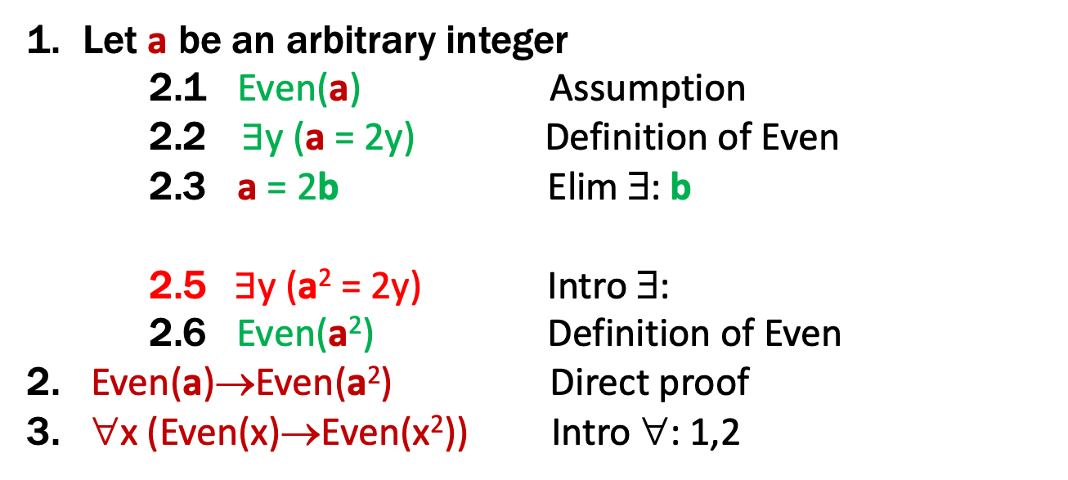
Even and Odd
Even(x) := ∃y (x=2y)
Odd(x) := ∃y (x=2y+1)
Domain: Integers
Prove: “The square of any even number is even.”
Formal proof of: ∀x (Even(x) → Even(x²))
Let a be an arbitrary integer
2.1 Even(a) Assumption
2.2 $∃$y (a = 2y) Definition of Even
2.3 a = 2b Elim ∃: b
2.5$∃$y (a² = 2y) Intro ∃:
2.6 Even(a²) Definition of Even
2. Even(a)→Even(a²) Direct proof
3. ∀x (Even(x)→Even(x²)) Intro ∀: 1,2
Need a² = 2c
for some c

Slide 14
Even and Odd
Even(x) := ∃y (x=2y)
Odd(x) := ∃y (x=2y+1)
Domain: Integers
Prove: “The square of any even number is even.”
Formal proof of: ∀x (Even(x) → Even(x²))
Let a be an arbitrary integer
2.1 Even(a) Assumption
2.2 $∃$y (a = 2y) Definition of Even
2.3 a = 2b Elim ∃: b
2.4 a² = 4b² = 2(2b²) Algebra
2.5$∃$y (a² = 2y) Intro ∃
2.6 Even(a²) Definition of Even
2. Even(a)→Even(a²) Direct Proof
3. ∀x (Even(x)→Even(x²)) Intro ∀: 1,2
Used a² = 2c for c=2b²

Slide 15
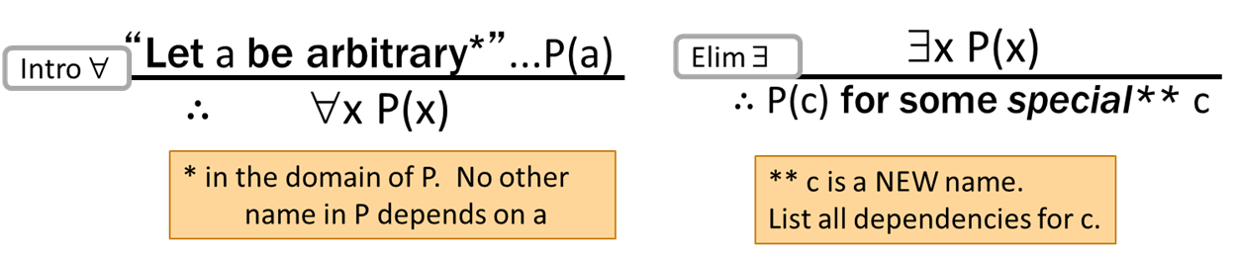
These rules need some caveats…
There are extra conditions on using these rules:
Without those rules, it is possible to infer claims that are false

Slide 16
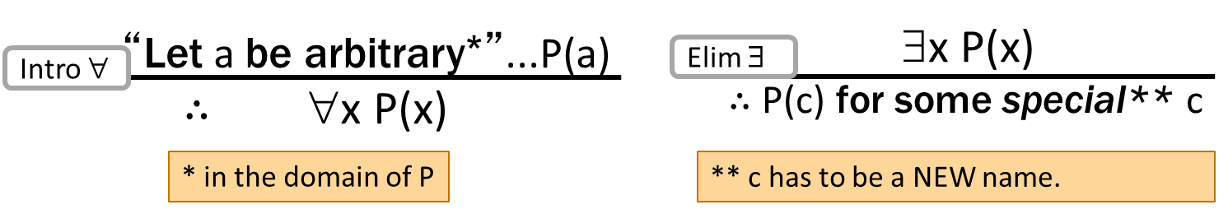
These rules need some caveats…
There are extra conditions on using these rules:
Over integer domain: ∀x ∃y (y ≥ x) is True but ∃y∀x (y ≥ x) is False
BAD “PROOF”
∀x ∃y (y ≥ x) Given
Let a be an arbitrary integer
∃y (y ≥ a) Elim ∀: 1
b ≥ a Elim ∃: 3 (b)
∀x (b ≥ x) Intro ∀: 2,4
∃y∀x (y ≥ x) Intro ∃ : 5

Slide 17
These rules need some caveats…
There are extra conditions on using these rules:
Over integer domain: ∀x ∃y (y ≥ x) is True but ∃y∀x (y ≥ x) is False
BAD “PROOF”
∀x ∃y (y ≥ x) Given
Let a be an arbitrary integer
∃y (y ≥ a) Elim ∀: 1
b ≥ a Elim ∃: 3 (b)
∀x (b ≥ x) Intro ∀: 2,4
∃y∀x (y ≥ x) Intro ∃ : 5
Can’t get rid of a since another name in the same line, b, depends on it!

Slide 18
These rules need some caveats…
There are extra conditions on using these rules:
Over integer domain: ∀x ∃y (y ≥ x) is True but ∃y∀x (y ≥ x) is False
BAD “PROOF”
∀x ∃y (y ≥ x) Given
Let a be an arbitrary integer
∃y (y ≥ a) Elim ∀: 1
b ≥ a Elim ∃: 3 (b)
∀x (b ≥ x) Intro ∀: 2,4
∃y∀x (y ≥ x) Intro ∃ : 5
Can’t get rid of a since another name in the same line, b, depends on it!

Slide 19
Dependencies
Over integer domain: ∀x ∃y (y ≥ x) is True but ∃y∀x (y ≥ x) is False
b depends on a since it appears inside the expression “∃y (y ≥ a)”
BAD “PROOF”
∀x ∃y (y ≥ x) Given
Let a be an arbitrary integer
∃y (y ≥ a) Elim ∀: 1
b ≥ a Elim ∃: 3 (b depends on a)
∀x (b ≥ x) Intro ∀: 2,4
∃y∀x (y ≥ x) Intro ∃ : 5
Can’t Intro ∀ with “Let a be an arbitrary ... P(a)” because P(a) = “b ≥ a” uses object b, which depends on a!

Slide 20
Dependencies
Over integer domain: ∀x ∃y (y ≥ x) is True but ∃y∀x (y ≥ x) is False
b depends on a since it appears inside the expression “∃y (y ≥ a)”
BAD “PROOF”
∀x ∃y (y ≥ x) Given
Let a be an arbitrary integer
∃y (y ≥ a) Elim ∀: 1
b ≥ a Elim ∃: 3 (b depends on a)
∀x (b ≥ x) Intro ∀: 2,4
∃y∀x (y ≥ x) Intro ∃ : 5
Have instead shown ∀x (b(x) ≥ x) where b(x) is a number that is possibly different for each x

Slide 21
Formal Proofs
In principle, formal proofs are the standard for what it means to be “proven” in mathematics
almost all math (and theory CS) done in Predicate Logic
But they are tedious and impractical
e.g., applications of commutativity and associativity
Russell & Whitehead’s formal proof that 1+1 = 2 is several hundred pages long
we allowed ourselves to cite “Arithmetic”, “Algebra”, etc.
Similar situation exists in programming...

Slide 22
Programming
a := ADD(i, 1)
b := MOD(a, n)
c := ADD(arr, b)
d := LOAD(c)
e := ADD(arr, i)
STORE(e, d)
arr[i] = arr[(i+1) % n];
Assembly Language
High-level Language

Slide 23
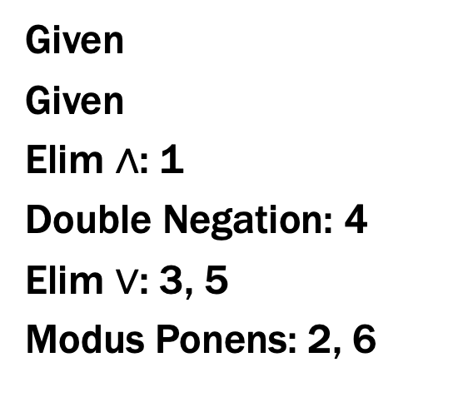
Programming vs Proofs
a := ADD(i, 1)
b := MOD(a, n)
c := ADD(arr, b)
d := LOAD(c)
e := ADD(arr, i)
STORE(e, d)
Given
Given
Elim ∧: 1
Double Negation: 4
Elim $∨$: 3, 5
Modus Ponens: 2, 6
Assembly Language
for Programs
Assembly Language
for Proofs

Slide 24
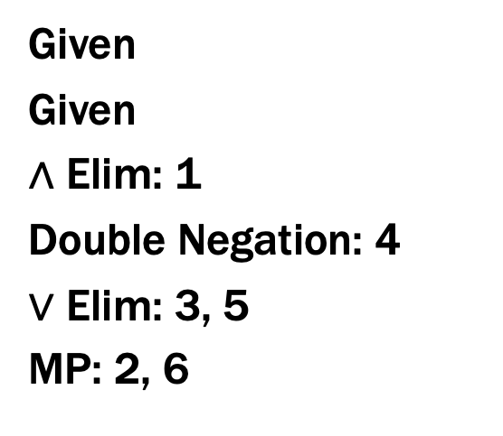
Proofs
Given
Given
∧ Elim: 1
Double Negation: 4
$∨$ Elim: 3, 5
MP: 2, 6
what is the “Java”
for proofs?
Assembly Language
for Proofs
High-level Language
for Proofs

Slide 25
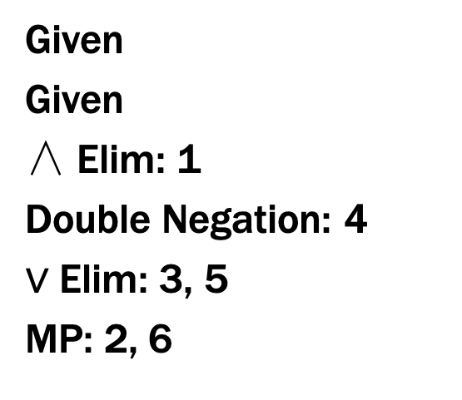
Proofs
Given
Given
∧ Elim: 1
Double Negation: 4
$∨$ Elim: 3, 5
MP: 2, 6
English
?
Assembly Language
for Proofs
High-level Language
for Proofs

Slide 26
Proofs
Given
Given
∧ Elim: 1
Double Negation: 4
$∨$ Elim: 3, 5
MP: 2, 6
Math English
Assembly Language
for Proofs
High-level Language
for Proofs
Notes:
In Math English, “if …, then …” always means implies.

Slide 27
Proofs
Formal proofs follow simple well-defined rules and should be easy for a machine to check
as assembly language is easy for a machine to execute
English proofs correspond to those rules but are designed to be easier for humans to read
also easy to check with practice
(almost all actual math and theory CS is done this way)
English proof is correct if the reader believes they could translate it into a formal proof
(the reader is the “compiler” for English proofs)

Slide 28

Last class: Even and Odd
Even(x) ≡ ∃y (x=2y)
Odd(x) ≡ ∃y (x=2y+1)
Domain: Integers
Prove: “The square of every even number is even.”
Formal proof of: ∀x (Even(x) → Even(x²))
Let a be an arbitrary integer
2.1 Even(a) Assumption
2.2 $∃$y (a = 2y) Definition of Even
2.3 a = 2b Elim ∃: b special depends on a
2.4 a² = 4b² = 2(2b²) Algebra
2.5$∃$y (a² = 2y) Intro ∃
2.6 Even(a²) Definition of Even
2. Even(a)→Even(a²) Direct Proof
3. ∀x (Even(x)→Even(x²)) Intro ∀: 1,2

Slide 29
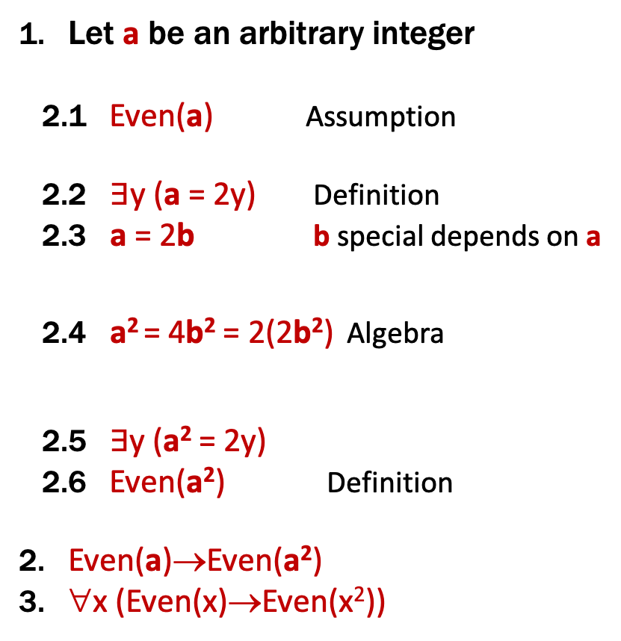
English Proof: Even and Odd
Even(x) ≡ ∃y (x=2y)
Odd(x) ≡ ∃y (x=2y+1)
Domain: Integers
Prove “The square of every even integer is even.”
Let a be an arbitrary integer. Suppose a is even.
Then, by definition, a = 2b for some integer b (dep on a).
Squaring both sides, we get a² = 4b² = 2(2b²).
So a² is, by definition, even.
Since a was arbitrary, we have shown that the square of every even number is even.
Let a be an arbitrary integer
2.1 Even(a) Assumption
2.2 $∃$y (a = 2y) Definition
2.3 a = 2b b special depends on a
2.4 a² = 4b² = 2(2b²) Algebra
2.5$∃$y (a² = 2y)
2.6 Even(a²) Definition
2. Even(a)→Even(a²)
3. ∀x (Even(x)→Even(x²))
Notes:
We skip lines stating “there exists” and just immediately name that object.
We skip lines stating implication proven by direct proof rule.

Slide 30
English Proof: Even and Odd
Even(x) ≡ ∃y (x=2y)
Odd(x) ≡ ∃y (x=2y+1)
Domain: Integers
Prove “The square of every even integer is even.”
Proof: Let a be an arbitrary integer.
Suppose a is even. Then, by definition, a = 2b for some integer b (depending on a). Squaring both sides, we get a² = 4b² = 2(2b²). So a² is, by definition, is even.
Since a was arbitrary, we have shown that the square of every even number is even.
Notes:
Show how to recover the structure from the text: for all a, Even(a) -> Even(a^2).

Slide 31
English Proof: Even and Odd
Even(x) ≡ ∃y (x=2y)
Odd(x) ≡ ∃y (x=2y+1)
Domain: Integers
Prove “The square of every even integer is even.”
Proof: Let a be an arbitrary even integer.
Then, by definition, a = 2b for some integer b (dep on a). Squaring both sides, we get a² = 4b² = 2(2b²). So a² is, by definition, is even.
Since a was arbitrary, we have shown that the square of every even number is even.
∀x (Even(x) → Even(x²))
Notes:
Show how to recover the structure from the text: for all a, Even(a) -> Even(a^2).

Slide 32
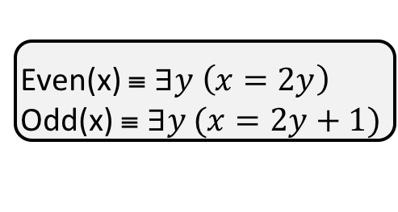
Even and Odd
Predicate Definitions
Even(x) ≡ $∃y \left(x=2y\right)$
Odd(x) ≡ $∃y (x=2y+1)$
Domain of Discourse
Integers
Prove “The sum of two odd numbers is even.”
Formally, prove ∀x ∀y ((Odd(x) ∧ Odd(y))→Even(x+y))

Slide 33
Even and Odd
Predicate Definitions
Even(x) ≡ $∃y \left(x=2y\right)$
Odd(x) ≡ $∃y (x=2y+1)$
Domain of Discourse
Integers
Prove “The sum of two odd numbers is even.”
Formally, prove ∀x ∀y ((Odd(x) ∧ Odd(y))→Even(x+y))
Let x and y be arbitrary integers.
Since x and y were arbitrary, the sum of any odd integers is even.
Let x be an arbitrary integer
Let y be an arbitrary integer
3. (Odd(x) ∧ Odd(y)) → Even(x+y)
4. ∀x ∀y ((Odd(x) ∧ Odd(y)) → Even(x+y)) Intro ∀

Slide 34
Even and Odd
Predicate Definitions
Even(x) ≡ $∃y \left(x=2y\right)$
Odd(x) ≡ $∃y (x=2y+1)$
Domain of Discourse
Integers
Prove “The sum of two odd numbers is even.”
Formally, prove ∀x ∀y ((Odd(x) ∧ Odd(y))→Even(x+y))
Let x and y be arbitrary integers.
Suppose that both are odd.
so x+y is even.
Since x and y were arbitrary, the sum of any odd integers is even.
Let x be an arbitrary integer
Let y be an arbitrary integer
3.1 Odd(x) ∧ Odd(y) Assumption
3.9 Even(x+y)
3. (Odd(x) ∧ Odd(y)) → Even(x+y) DPR
4. ∀x ∀y ((Odd(x) ∧ Odd(y)) → Even(x+y)) Intro ∀

Slide 35
Even and Odd
Predicate Definitions
Even(x) ≡ $∃y \left(x=2y\right)$
Odd(x) ≡ $∃y (x=2y+1)$
Domain of Discourse
Integers
Prove “The sum of two odd numbers is even.”
Formally, prove ∀x ∀y ((Odd(x) ∧ Odd(y))→Even(x+y))
Let x and y be arbitrary integers.
Suppose that both are odd.
so x+y is even.
Since x and y were arbitrary, the sum of any odd integers is even.
Let x be an arbitrary integer
Let y be an arbitrary integer
3.1 Odd(x) ∧ Odd(y) Assumption
3.2 Odd(x) Elim ∧: 2.1
3.3 Odd(y) Elim ∧: 2.1
3.9 Even(x+y)
3. (Odd(x) ∧ Odd(y)) → Even(x+y) DPR
4. ∀x ∀y ((Odd(x) ∧ Odd(y)) → Even(x+y)) Intro ∀

Slide 36
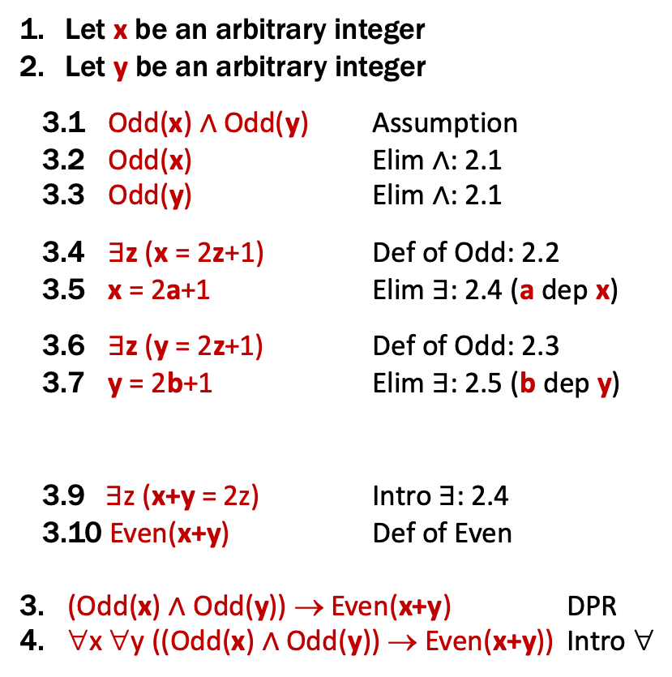
English Proof: Even and Odd
Even(x) ≡ ∃y (x=2y)
Odd(x) ≡ ∃y (x=2y+1)
Domain: Integers
Prove “The sum of two odd numbers is even.”
Let x and y be arbitrary integers.
Suppose that both are odd.
Then, x = 2a+1 for some integer a (depending on x) and
y = 2b+1 for some integer b (depending on y).
so x+y is, by definition, even.
Since x and y were arbitrary, the sum of any odd integers is even.
Let x be an arbitrary integer
Let y be an arbitrary integer
3.1 Odd(x) ∧ Odd(y) Assumption
3.2 Odd(x) Elim ∧: 2.1
3.3 Odd(y) Elim ∧: 2.1
3.4 $∃$z (x = 2z+1) Def of Odd: 2.2
3.5 x = 2a+1 Elim ∃: 2.4 (a dep x)
3.6 $∃$z (y = 2z+1) Def of Odd: 2.3
3.7 y = 2b+1 Elim ∃: 2.5 (b dep y)
3.9$∃$z (x+y = 2z) Intro ∃: 2.4
3.10 Even(x+y) Def of Even
3. (Odd(x) ∧ Odd(y)) → Even(x+y) DPR
4. ∀x ∀y ((Odd(x) ∧ Odd(y)) → Even(x+y)) Intro ∀
Notes:
We skip lines stating “there exists” and just immediately name that object.
We skip lines stating implication proven by direct proof rule.

Slide 37
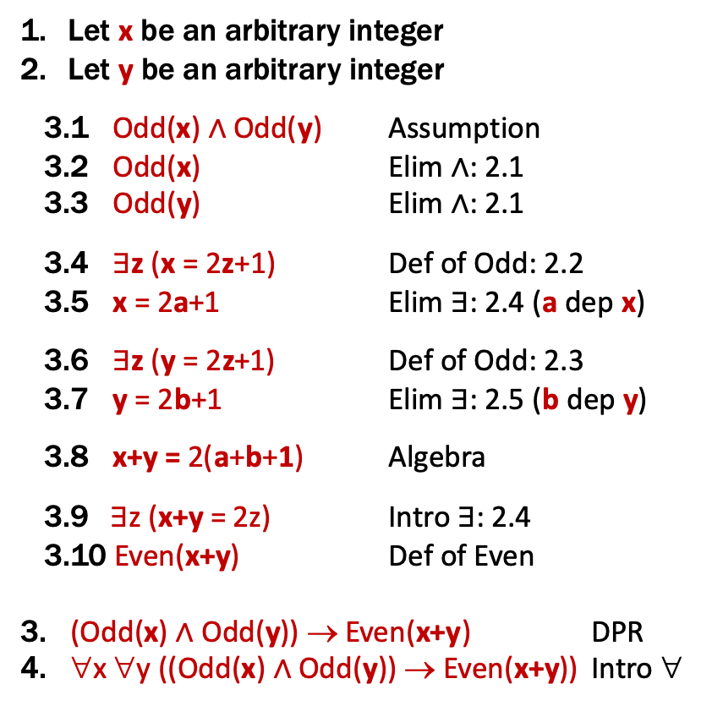
English Proof: Even and Odd
Even(x) ≡ ∃y (x=2y)
Odd(x) ≡ ∃y (x=2y+1)
Domain: Integers
Prove “The sum of two odd numbers is even.”
Let x and y be arbitrary integers.
Suppose that both are odd.
Then, x = 2a+1 for some integer a (depending on x) and
y = 2b+1 for some integer b (depending on y).
Their sum is x+y = ... = 2(a+b+1)
so x+y is, by definition, even.
Since x and y were arbitrary, the sum of any odd integers is even.
Let x be an arbitrary integer
Let y be an arbitrary integer
3.1 Odd(x) ∧ Odd(y) Assumption
3.2 Odd(x) Elim ∧: 2.1
3.3 Odd(y) Elim ∧: 2.1
3.4 $∃$z (x = 2z+1) Def of Odd: 2.2
3.5 x = 2a+1 Elim ∃: 2.4 (a dep x)
3.6 $∃$z (y = 2z+1) Def of Odd: 2.3
3.7 y = 2b+1 Elim ∃: 2.5 (b dep y)
3.8 x+y = 2(a+b+1) Algebra
3.9$∃$z (x+y = 2z) Intro ∃: 2.4
3.10 Even(x+y) Def of Even
3. (Odd(x) ∧ Odd(y)) → Even(x+y) DPR
4. ∀x ∀y ((Odd(x) ∧ Odd(y)) → Even(x+y)) Intro ∀
Notes:
We skip lines stating “there exists” and just immediately name that object.
We skip lines stating implication proven by direct proof rule.

Slide 38
Even and Odd
Predicate Definitions
Even(x) ≡ $∃y \left(x=2y\right)$
Odd(x) ≡ $∃y (x=2y+1)$
Domain of Discourse
Integers
Prove “The sum of two odd numbers is even.”
Proof: Let x and y be arbitrary integers.
Suppose that both are odd. Then, x = 2a+1 for some integer a (depending on x) and y = 2b+1 for some integer b (depending on y). Their sum is x+y = (2a+1) + (2b+1) = 2a+2b+2 = 2(a+b+1), so x+y is, by definition, even.
Since x and y were arbitrary, the sum of any two odd integers is even.

Slide 39
Even and Odd
Predicate Definitions
Even(x) ≡ $∃y \left(x=2y\right)$
Odd(x) ≡ $∃y (x=2y+1)$
Domain of Discourse
Integers
Prove “The sum of two odd numbers is even.”
Proof: Let x and y be arbitrary odd integers.
Then, x = 2a+1 for some integer a (depending on x) and y = 2b+1 for some integer b (depending on y). Their sum is x+y = (2a+1) + (2b+1) = 2a+2b+2 = 2(a+b+1), so x+y is, by definition, even.
Since x and y were arbitrary, the sum of any two odd integers is even.
∀x ∀y ((Odd(x) ∧ Odd(y))→Even(x+y))

Slide 40
Rational Numbers
Domain of Discourse
Real Numbers
A real number x is rational iff there exist integers a and b with b≠0 such that x=a/b.
Rational(x) := ∃a ∃b (((Integer(a) ∧ Integer(b)) ∧ (x=a/b)) ∧ b≠0)

Slide 41
Rationality
Domain of Discourse
Real Numbers
Predicate Definitions
Rational(x) := $∃a ∃b (Integer\left(a\right)∧Integer\left(b\right)∧\left(x=a/b\right)∧\left(b≠0\right))$
Prove: “The product of two rationals is rational.”
Formally, prove ∀x ∀y ((Rational(x) ∧ Rational(y)) → Rational(xy))
Notes:
Note: this is just an implication, with x and y as constants.

Slide 42
Rationality
Domain of Discourse
Real Numbers
Predicate Definitions
Rational(x) := $∃a ∃b (Integer\left(a\right)∧Integer\left(b\right)∧\left(x=a/b\right)∧\left(b≠0\right))$
Prove: “The product of two rationals is rational.”
Proof: Let x and y be arbitrary rationals.
Since x and y were arbitrary, we have shown that the product of any two rationals is rational.
Notes:
English proofs will often skip the first and last parts since they are boilerplate.

Slide 43
Rationality
Domain of Discourse
Real Numbers
Predicate Definitions
Rational(x) := $∃a ∃b (Integer\left(a\right)∧Integer\left(b\right)∧\left(x=a/b\right)∧\left(b≠0\right))$
Prove: “The product of two rationals is rational.”
Proof: Let x and y be arbitrary rationals.
Then, x = a/b for some integers a, b, where b≠0, and y = c/d for some integers c,d, where d≠0.
By definition, then, xy is rational.
Since x and y were arbitrary, we have shown that the product of any two rationals is rational.
Notes:
English proofs will often skip the first and last parts since they are boilerplate.

Slide 44
Rationality
Domain of Discourse
Real Numbers
Predicate Definitions
Rational(x) := $∃a ∃b (Integer\left(a\right)∧Integer\left(b\right)∧\left(x=a/b\right)∧\left(b≠0\right))$
Prove: “The product of two rationals is rational.”
Proof: Let x and y be arbitrary rationals.
Then, x = a/b for some integers a, b, where b≠0, and y = c/d for some integers c,d, where d≠0.
Multiplying, we get that xy = (a/b)(c/d) = (ac)/(bd). Since b and d are both non-zero, so is bd. Furthermore, ac and bd are integers. By definition, then, xy is rational.
Since x and y were arbitrary, we have shown that the product of any two rationals is rational.
Notes:
English proofs will often skip the first and last parts since they are boilerplate.

Slide 45
Rationality
Domain of Discourse
Real Numbers
Predicate Definitions
Rational(x) := $∃a ∃b (Integer\left(a\right)∧Integer\left(b\right)∧\left(x=a/b\right)∧\left(b≠0\right))$
Prove: “The product of two rationals is rational.”
OR “If x and y are rational, then xy is rational.”
Recall that unquantified variables (not constants) are implicitly for-all quantified.
∀x ∀y ((Rational(x) ∧ Rational(y)) → Rational(xy))
Notes:
Note: this is just an implication, with x and y as constants.

Slide 46
Rationality
Domain of Discourse
Real Numbers
Predicate Definitions
Rational(x) := $∃a ∃b (Integer\left(a\right)∧Integer\left(b\right)∧\left(x=a/b\right)∧\left(b≠0\right))$
Prove: “If x and y are rational, then xy is rational.”
Proof: Let x and y be arbitrary rationals. Suppose x and y are rational.
Then, x = a/b for some integers a, b, where b≠0, and y = c/d for some integers c,d, where d≠0.
Multiplying, we get that xy = (a/b)(c/d) = (ac)/(bd). Since b and d are both non-zero, so is bd. Furthermore, ac and bd are integers. By definition, then, xy is rational.
Since x and y were arbitrary, we have shown that the product of any two rationals is rational.
Notes:
English proofs will often skip the first and last parts since they are boilerplate.

Slide 47

Rationality
Domain of Discourse
Real Numbers
Predicate Definitions
Rational(x) := $∃a ∃b (Integer\left(a\right)∧Integer\left(b\right)∧\left(x=a/b\right)∧\left(b≠0\right))$
Prove: “If x and y are rational, then xy is rational.”
Suppose x and y are rational.
Then, x = a/b for some integers a, b, where b≠0 and y = c/d for some integers c,d, where d≠0.
...
1.1 $Rational\left(x\right)∧Rational\left(y\right)$ Assumption
1.4 $∃p ∃q (\left(x=p/q\right)∧Integer\left(p\right)∧Integer\left(q\right)∧\left(q≠0\right))$ Def Rational: 1.2
1.5 $\left(x=a/b\right)∧Integer\left(a\right)∧Integer\left(b\right)∧\left(b≠0\right)$ Elim $∃$: 1.4
1.6 $∃p ∃q \left(\left(x=p/q\right)∧Integer\left(p\right)∧Integer\left(q\right)∧\left(q≠0\right)\right)$
Def Rational: 1.3
1.7 $\left(y=c/d\right)∧Integer\left(c\right)∧Integer\left(d\right)∧\left(d≠0\right)$ Elim $∃$: 1.4

Slide 48

Rationality
Domain of Discourse
Real Numbers
Predicate Definitions
Rational(x) := $∃a ∃b (Integer\left(a\right)∧Integer\left(b\right)∧\left(x=a/b\right)∧\left(b≠0\right))$
Prove: “If x and y are rational, then xy is rational.”
Suppose x and y are rational.
Then, x = a/b for some integers a, b, where b≠0 and y = c/d for some integers c,d, where d≠0.
...
1.1 $Rational\left(x\right)∧Rational\left(y\right)$ Assumption
??
1.4 $∃p ∃q (\left(x=p/q\right)∧Integer\left(p\right)∧Integer\left(q\right)∧\left(q≠0\right))$ Def Rational: 1.2
1.5 $\left(x=a/b\right)∧Integer\left(a\right)∧Integer\left(b\right)∧\left(b≠0\right)$ Elim $∃$: 1.4
1.6 $∃p ∃q \left(\left(x=p/q\right)∧Integer\left(p\right)∧Integer\left(q\right)∧\left(q≠0\right)\right)$
Def Rational: 1.3
1.7 $\left(y=c/d\right)∧Integer\left(c\right)∧Integer\left(d\right)∧\left(d≠0\right)$ Elim $∃$: 1.4

Slide 49

Rationality
Domain of Discourse
Real Numbers
Predicate Definitions
Rational(x) := $∃a ∃b (Integer\left(a\right)∧Integer\left(b\right)∧\left(x=a/b\right)∧\left(b≠0\right))$
Prove: “If x and y are rational, then xy is rational.”
Suppose x and y are rational.
Then, x = a/b for some integers a, b, where b≠0 and y = c/d for some integers c,d, where d≠0.
...
1.1 $Rational\left(x\right)∧Rational\left(y\right)$ Assumption
1.2 $Rational\left(x\right)$ Elim $∧$: 1.1
1.3 $Rational\left(y\right)$ Elim $∧$: 1.1
1.4 $∃p ∃q (\left(x=p/q\right)∧Integer\left(p\right)∧Integer\left(q\right)∧\left(q≠0\right))$ Def Rational: 1.2
1.5 $\left(x=a/b\right)∧Integer\left(a\right)∧Integer\left(b\right)∧\left(b≠0\right)$ Elim $∃$: 1.4
1.6 $∃p ∃q \left(\left(x=p/q\right)∧Integer\left(p\right)∧Integer\left(q\right)∧\left(q≠0\right)\right)$
Def Rational: 1.3
1.7 $\left(y=c/d\right)∧Integer\left(c\right)∧Integer\left(d\right)∧\left(d≠0\right)$ Elim $∃$: 1.4

Slide 50

Rationality
Domain of Discourse
Real Numbers
Predicate Definitions
Rational(x) := $∃a ∃b (Integer\left(a\right)∧Integer\left(b\right)∧\left(x=a/b\right)∧\left(b≠0\right))$
Prove: “If x and y are rational, then xy is rational.”
Multiplying, we get xy = (ac)/(bd).
...
1.5 $\left(x=a/b\right)∧Integer\left(a\right)∧Integer\left(b\right)∧\left(b≠0\right)$
...
1.7 $\left(y=c/d\right)∧Integer\left(c\right)∧Integer\left(d\right)∧\left(d≠0\right)$
1.10 $xy=\left(a/b\right)\left(c/d\right)=\left(ac/bd\right)=(ac)/(bd)$
Algebra

Slide 51

Rationality
Domain of Discourse
Real Numbers
Predicate Definitions
Rational(x) := $∃a ∃b (Integer\left(a\right)∧Integer\left(b\right)∧\left(x=a/b\right)∧\left(b≠0\right))$
Prove: “If x and y are rational, then xy is rational.”
Multiplying, we get xy = (ac)/(bd).
...
1.5 $\left(x=a/b\right)∧Integer\left(a\right)∧Integer\left(b\right)∧\left(b≠0\right)$
...
1.7 $\left(y=c/d\right)∧Integer\left(c\right)∧Integer\left(d\right)∧\left(d≠0\right)$
??
1.10 $xy=\left(a/b\right)\left(c/d\right)=\left(ac/bd\right)=(ac)/(bd)$
Algebra

Slide 52

Rationality
Domain of Discourse
Real Numbers
Predicate Definitions
Rational(x) := $∃a ∃b (Integer\left(a\right)∧Integer\left(b\right)∧\left(x=a/b\right)∧\left(b≠0\right))$
Prove: “If x and y are rational, then xy is rational.”
Multiplying, we get xy = (ac)/(bd).
...
1.5 $\left(x=a/b\right)∧Integer\left(a\right)∧Integer\left(b\right)∧\left(b≠0\right)$
...
1.7 $\left(y=c/d\right)∧Integer\left(c\right)∧Integer\left(d\right)∧\left(d≠0\right)$
1.8 $x=a/b$ Elim $∧$: 1.5
1.9 $y=c/d$ Elim $∧$: 1.7
1.10 $xy=\left(a/b\right)\left(c/d\right)=\left(ac/bd\right)=(ac)/(bd)$
Algebra

Slide 53

Rationality
Domain of Discourse
Real Numbers
Predicate Definitions
Rational(x) := $∃a ∃b (Integer\left(a\right)∧Integer\left(b\right)∧\left(x=a/b\right)∧\left(b≠0\right))$
Prove: “If x and y are rational, then xy is rational.”
Since b and d are non-zero, so is bd.
...
1.5 $\left(x=a/b\right)∧Integer\left(a\right)∧Integer\left(b\right)∧\left(b≠0\right)$
...
1.7 $\left(y=c/d\right)∧Integer\left(c\right)∧Integer\left(d\right)∧\left(d≠0\right)$
...
1.11 $b≠0$ Elim $∧$: 1.5*
1.12 $d≠0$ Elim $∧$: 1.7
1.13 $bd≠0$ Prop of Integer Mult
* Oops, I skipped steps here...

Slide 54

Rationality
Domain of Discourse
Real Numbers
Predicate Definitions
Rational(x) := $∃a ∃b (Integer\left(a\right)∧Integer\left(b\right)∧\left(x=a/b\right)∧\left(b≠0\right))$
Prove: “If x and y are rational, then xy is rational.”
...
1.5 $\left(x=a/b\right)∧(Integer\left(a\right)∧\left(Integer\left(b\right)∧\left(b≠0\right))\right)$
...
1.7 $\left(y=c/d\right)∧(Integer\left(c\right)∧\left(Integer\left(d\right)∧\left(d≠0\right))\right)$
...
1.11 $Integer\left(a\right)∧\left(Integer\left(b\right)∧\left(b≠0\right)\right)$
Elim $∧$: 1.5
1.12 $Integer\left(b\right)∧\left(b≠0\right)$ Elim $∧$: 1.11
1.13 $b≠0$ Elim $∧$: 1.12
We left out the parentheses...

Slide 55

Rationality
Domain of Discourse
Real Numbers
Predicate Definitions
Rational(x) := $∃a ∃b (Integer\left(a\right)∧Integer\left(b\right)∧\left(x=a/b\right)∧\left(b≠0\right))$
Prove: “If x and y are rational, then xy is rational.”
Since b and d are non-zero, so is bd.
...
1.5 $\left(x=a/b\right)∧Integer\left(a\right)∧Integer\left(b\right)∧\left(b≠0\right)$
...
1.7 $\left(y=c/d\right)∧Integer\left(c\right)∧Integer\left(d\right)∧\left(d≠0\right)$
...
1.13 $b≠0$ Elim $∧$: 1.5
...
1.16 $d≠0$ Elim $∧$: 1.7
1.17 $bd≠0$ Prop of Integer Mult

Slide 56

Rationality
Domain of Discourse
Real Numbers
Predicate Definitions
Rational(x) := $∃a ∃b (Integer\left(a\right)∧Integer\left(b\right)∧\left(x=a/b\right)∧\left(b≠0\right))$
Prove: “If x and y are rational, then xy is rational.”
Furthermore, ac and bd are integers.
...
1.5 $\left(x=a/b\right)∧Integer\left(a\right)∧Integer\left(b\right)∧\left(b≠0\right)$
...
1.7 $\left(y=c/d\right)∧Integer\left(c\right)∧Integer\left(d\right)∧\left(d≠0\right)$
...
1.19 $Integer\left(a\right)$ Elim $∧$: 1.5*
...
1.22 $Integer\left(b\right)$ Elim $∧$: 1.5*
...
1.24 $Integer\left(c\right)$ Elim $∧$: 1.7*
...
1.27 $Integer\left(d\right)$ Elim $∧$: 1.7*
1.28 $Integer\left(ac\right)$ Prop of Integer Mult
1.29 $Integer\left(bd\right)$ Prop of Integer Mult

Slide 57

Rationality
Domain of Discourse
Real Numbers
Predicate Definitions
Rational(x) := $∃a ∃b (Integer\left(a\right)∧Integer\left(b\right)∧\left(x=a/b\right)∧\left(b≠0\right))$
Prove: “If x and y are rational, then xy is rational.”
...
1.10 $xy=\left(a/b\right)\left(c/d\right)=\left(ac/bd\right)=(ac)/(bd)$
...
1.17 $bd≠0$ Prop of Integer Mult
...
1.28 $Integer\left(ac\right)$ Prop of Integer Mult
1.29 $Integer\left(bd\right)$ Prop of Integer Mult
1.30 $Integer\left(bd\right)∧\left(bd≠0\right)$ Intro $∧$: 1.29, 1.17
1.31 $Integer\left(ac\right)∧Integer\left(bd\right)∧\left(bd≠0\right)$
Intro $∧$: 1.28, 1.30
1.32 $\left(xy=(a/b)/(c/d)\right)∧Integer\left(ac\right)∧Integer\left(bd\right)∧\left(bd≠0\right)$ Intro $∧$: 1.10, 1.31
1.33$∃p ∃q \left(\left(xy=p/q\right)∧Integer\left(p\right)∧Integer\left(q\right)∧\left(q≠0\right)\right)$
Intro $∃$: 1.32
1.34 $Rational\left(xy\right)$ Def of Rational: 1.3
By definition, then, xy is rational.

Slide 58

Rationality
Domain of Discourse
Real Numbers
Predicate Definitions
Rational(x) := $∃a ∃b (Integer\left(a\right)∧Integer\left(b\right)∧\left(x=a/b\right)∧\left(b≠0\right))$
Prove: “If x and y are rational, then xy is rational.”
Suppose x and y are rational.
Furthermore, ac and bd are integers.
By definition, then, xy is rational.
1.1 $Rational\left(x\right)∧Rational\left(y\right)$ Assumption
...
1.10 $xy=\left(a/b\right)\left(c/d\right)=\left(ac/bd\right)=(ac)/(bd)$
...
1.17 $bd≠0$ Prop of Integer Mult
...
1.28 $Integer\left(ac\right)$ Prop of Integer Mult
1.29 $Integer\left(bd\right)$ Prop of Integer Mult
...
1.34 $Rational\left(xy\right)$ Def of Rational: 1.32
And finally...

Slide 59

Rationality
Domain of Discourse
Real Numbers
Predicate Definitions
Rational(x) := $∃a ∃b (Integer\left(a\right)∧Integer\left(b\right)∧\left(x=a/b\right)∧\left(b≠0\right))$
Prove: “If x and y are rational, then xy is rational.”
Suppose x and y are rational.
Furthermore, ac and bd are integers.
By definition, then, xy is rational.
1.1 $Rational\left(x\right)∧Rational\left(y\right)$ Assumption
...
1.10 $xy=\left(a/b\right)\left(c/d\right)=\left(ac/bd\right)=(ac)/(bd)$
...
1.17 $bd≠0$ Prop of Integer Mult
...
1.28 $Integer\left(ac\right)$ Prop of Integer Mult
1.29 $Integer\left(bd\right)$ Prop of Integer Mult
...
1.34 $Rational\left(xy\right)$ Def of Rational: 1.32
1. $Rational\left(x\right)∧Rational\left(y\right)→Rational\left(xy\right)$
Direct Proof
Notes:
Normal to skip the last part in English proofs.

Slide 60
Rationality
Domain of Discourse
Real Numbers
Predicate Definitions
Rational(x) := $∃a ∃b (Integer\left(a\right)∧Integer\left(b\right)∧\left(x=a/b\right)∧\left(b≠0\right))$
Prove: “If x and y are rational, then xy is rational.”
Proof: Suppose x and y are rational.
Then, x = a/b for some integers a, b, where b≠0, and y = c/d for some integers c,d, where d≠0.
Multiplying, we get that xy = (ac)/(bd). Since b and d are both non-zero, so is bd. Furthermore, ac and bd are integers. By definition, then, xy is rational.
vs more than 35 lines of formal proof

Slide 61
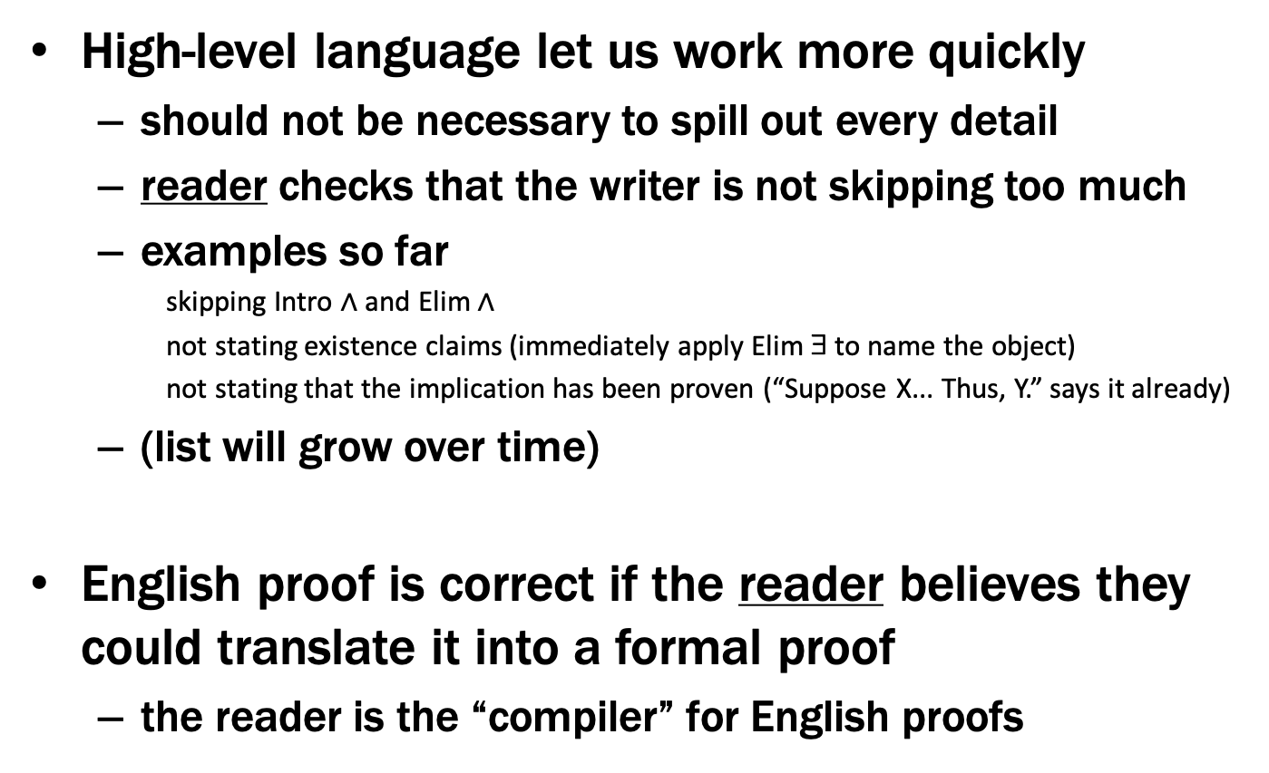
English Proofs
High-level language let us work more quickly
should not be necessary to spill out every detail
reader checks that the writer is not skipping too much
examples so far
skipping Intro $∧$ and Elim $∧$
not stating existence claims (immediately apply Elim ∃ to name the object)
not stating that the implication has been proven (“Suppose X... Thus, Y.” says it already)
(list will grow over time)
English proof is correct if the reader believes they could translate it into a formal proof
the reader is the “compiler” for English proofs

