Slide 1
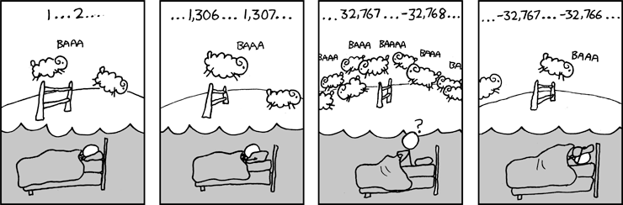
CSE 311: Foundations of Computing
Lecture 12: Modular Arithmetic and Applications

Slide 2
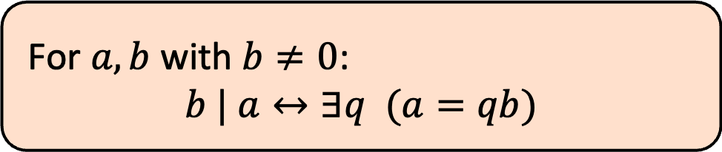
Last Class: Divisibility
Definition: “b divides a”
For $a, b$ with $b≠0$:
$$b | a↔∃q (a=qb)$$
Check Your Understanding. Which of the following are true?
5 | 1 25 | 5 5 | 0 3 | 2
1 | 5 5 | 25 0 | 5 2 | 3
5 | 1 iff 1 = 5k
25 | 5 iff 5 = 25k
5 | 0 iff 0 = 5k
3 | 2 iff 2 = 3k
1 | 5 iff 5 = 1k
5 | 25 iff 25 = 5k
0 | 5 iff 5 = 0k
2 | 3 iff 3 = 2k

Slide 3
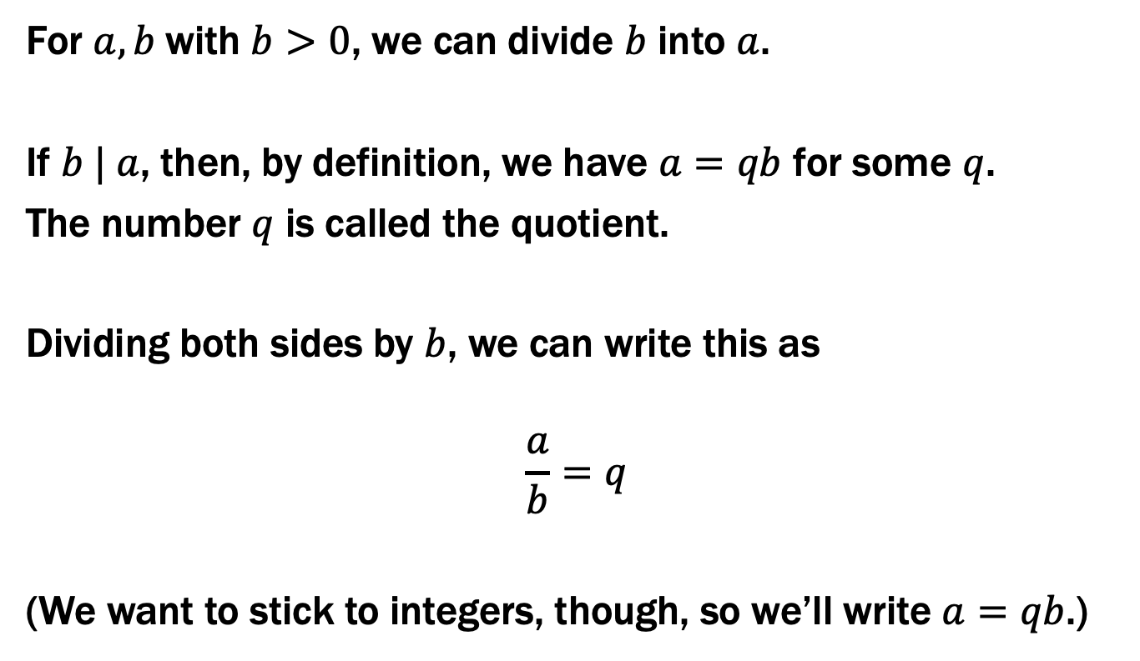
Recall: Elementary School Division
For $a,b$with $b>0$, we can divide $b$ into $a$.
If $b | a$, then, by definition, we have $a=qb$ for some $q$.
The number $q$ is called the quotient.
Dividing both sides by $b$, we can write this as
$$\frac{a}{b}=q$$
(We want to stick to integers, though, so we’ll write $a=qb$.)

Slide 4
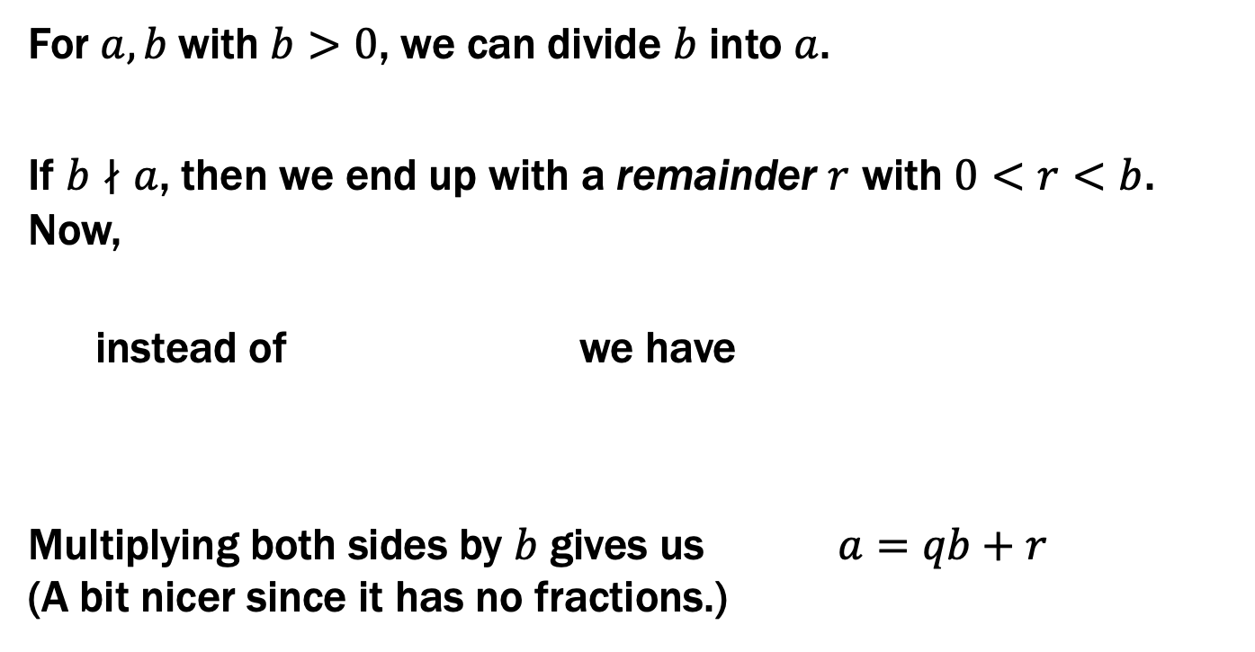
Recall: Elementary School Division
For $a,b$with $b>0$, we can divide $b$ into $a$.
If $b∤a$, then we end up with a remainder $r$ with $0<r<b$. Now,
instead of we have
Multiplying both sides by $b$ gives us $a=qb+r$ (A bit nicer since it has no fractions.)
$$\frac{a}{b}=q$$
$$\frac{a}{b}=q+\frac{r}{b}$$

Slide 5
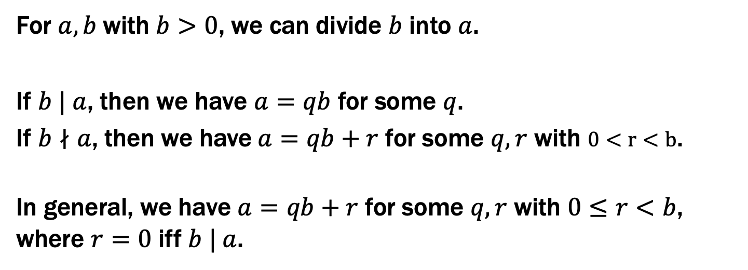
Recall: Elementary School Division
For $a,b$with $b>0$, we can divide $b$ into $a$.
If $b | a$, then we have $a=qb$ for some $q$.
If $b∤a$, then we have $a=qb+r$ for some $q,r$ with $0<r<b$.
In general, we have $a=qb+r$ for some $q,r$ with $0≤r<b$, where $r=0$ iff $b | a$.

Slide 6
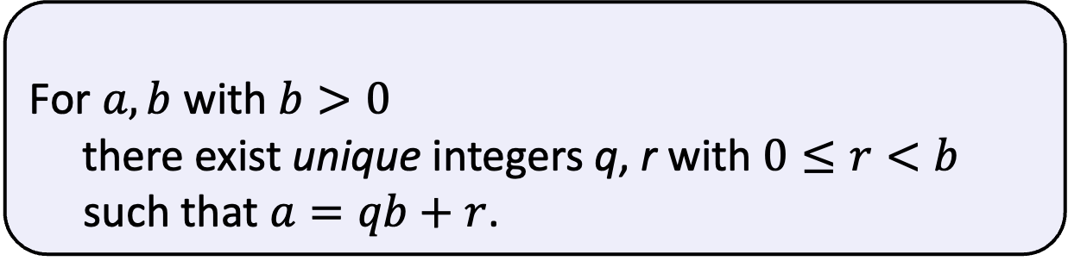
Division Theorem
Domain of Discourse
Integers
Division Theorem
For $a,b$ with $b>0$
there exist unique integers q, r with $0≤r<b$ such that $a=qb+r$.
To put it another way, if we divide b into a, we get a unique quotient and non-negative remainder
q = a div b
r = a mod b
Note: r ≥ 0 even if a < 0.
Not quite the same as a % d.

Slide 7
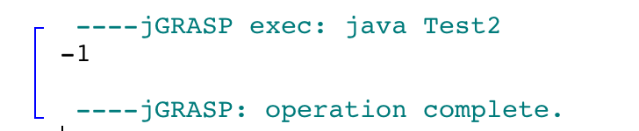
Division Theorem
Domain of Discourse
Integers
Division Theorem
For $a,b$ with $b>0$
there exist unique integers q, r with $0≤r<b$ such that $a=qb+r$.
To put it another way, if we divide b into a, we get a unique quotient and non-negative remainder
q = a div b
r = a mod b
public class Test2 {
public static void main(String args[]) {
int a = -5;
int d = 2;
System.out.println(a % d);
}
}
Note: r ≥ 0 even if a < 0.
Not quite the same as a % d.

Slide 8
div and mod
x = 7 · (x div 7) + (x mod 7)
x mod 7
0 1 2 3 4 5 6 0 1 2 3 4 5 6 0 1
x div 7
0 0 0 0 0 0 0 1 1 1 1 1 1 1 2 2
x
0 1 2 3 4 5 6 7 8 9 10 11 12 13 14 15
7 · 0
7 · 1
7 · 2

Slide 9
Ordinary arithmetic
2 + 3 = 5
+2
+3
-3 -2 -1 0 1 2 3 4 5 6 7

Slide 10

Arithmetic on a Clock
0
6
1
2 + 3 = 5
5
2
4
3
0
6
1
23 = 3 ∙ 7 + 2
5
2
4
3
If $a=7q+r$, then $r (=a \text{mod} b)$ is
where you stop after taking $a$ steps on the clock

Slide 11
Arithmetic, mod 7
(a + b) mod 7
(a × b) mod 7
0
6
1
5
2
4
3
+ | 0 | 1 | 2 | 3 | 4 | 5 | 6
0 | 0 | 1 | 2 | 3 | 4 | 5 | 6
1 | 1 | 2 | 3 | 4 | 5 | 6 | 0
2 | 2 | 3 | 4 | 5 | 6 | 0 | 1
3 | 3 | 4 | 5 | 6 | 0 | 1 | 2
4 | 4 | 5 | 6 | 0 | 1 | 2 | 3
5 | 5 | 6 | 0 | 1 | 2 | 3 | 4
6 | 6 | 0 | 1 | 2 | 3 | 4 | 5
X | 0 | 1 | 2 | 3 | 4 | 5 | 6
0 | 0 | 0 | 0 | 0 | 0 | 0 | 0
1 | 0 | 1 | 2 | 3 | 4 | 5 | 6
2 | 0 | 2 | 4 | 6 | 1 | 3 | 5
3 | 0 | 3 | 6 | 2 | 5 | 1 | 4
4 | 0 | 4 | 1 | 5 | 2 | 6 | 3
5 | 0 | 5 | 3 | 1 | 6 | 4 | 2
6 | 0 | 6 | 5 | 4 | 3 | 2 | 1
Notes:
5 = 0 * 7 + 5
6 = 0 * 7 + 6
7 = 1 * 7 + 0

Slide 12
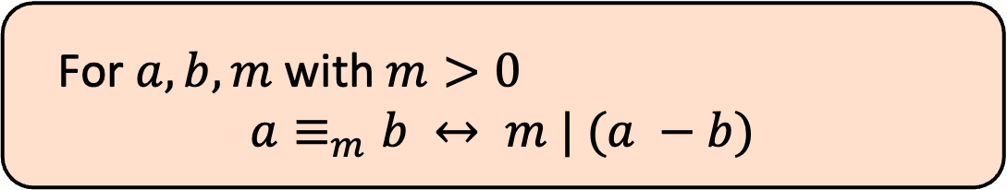
Modular Arithmetic
Domain of Discourse
Integers
Definition: “a is congruent to b modulo m”
For $a, b, m$ with $m>0$
$$a≡_{m}b ↔ m | (a −b)$$
New notion of “sameness” that will help us understand modular arithmetic

Slide 13
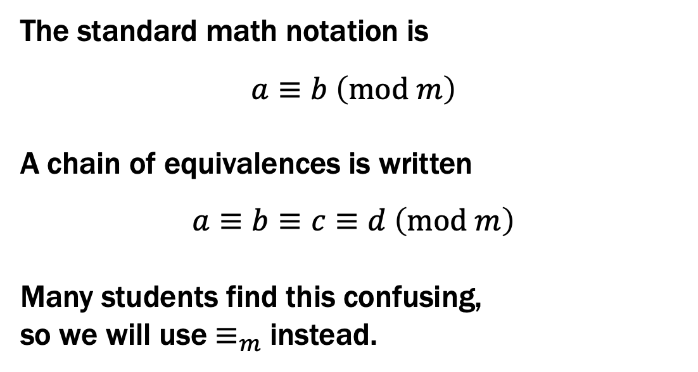
Modular Arithmetic
Domain of Discourse
Integers
Definition: “a is congruent to b modulo m”
For $a, b, m$ with $m>0$
$$a≡_{m}b ↔ m | (a −b)$$
The standard math notation is
$$a≡b \left(mod m\right)$$
A chain of equivalences is written
$$a≡b≡c≡d \left(mod m\right)$$
Many students find this confusing,
so we will use $≡_{m}$ instead.

Slide 14
Modular Arithmetic
Domain of Discourse
Integers
Definition: “a is congruent to b modulo m”
For $a, b, m$ with $m>0$
$$a≡_{m}b ↔ m | (a −b)$$
Check Your Understanding. What do each of these mean?
When are they true?
x ≡₂ 0
-1 ≡₅ 19
y ≡₇ 2
This statement is the same as saying “x is even”; so, any x that is even (including negative even numbers) will work.
This statement is true. 19 - (-1) = 20 which is divisible by 5
This statement is true for y in { ..., -12, -5, 2, 9, 16, ...}. In other words, all y of the form 2+7k for k an integer.

Slide 15
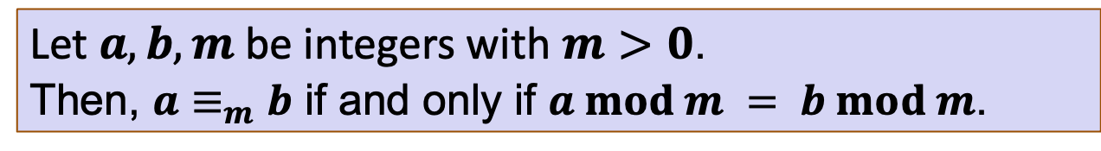
Modular Arithmetic: A Property
Let $a, b, m$be integers with $m>0$. Then, $a≡_{m}b$ if and only if $a mod m = b mod m$.

Slide 16
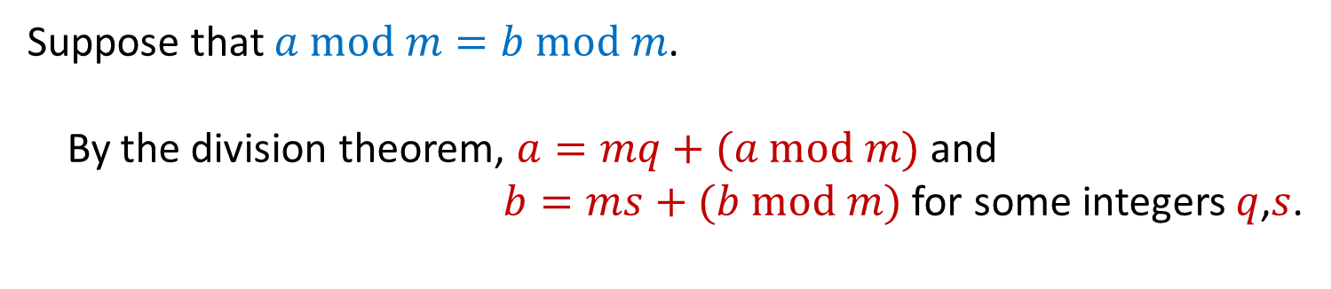

Modular Arithmetic: A Property
Let $a, b, m$be integers with $m>0$. Then, $a≡_{m}b$ if and only if $a mod m = b mod m$.
Suppose that $a mod m=b mod m$.
By the division theorem, $a=mq+(a mod m)$ and
$b=ms+(b mod m)$ for some integers $q$,$s$.
Goal: show $a≡_{m}b$, i.e., $m | (a−b)$.

Slide 17
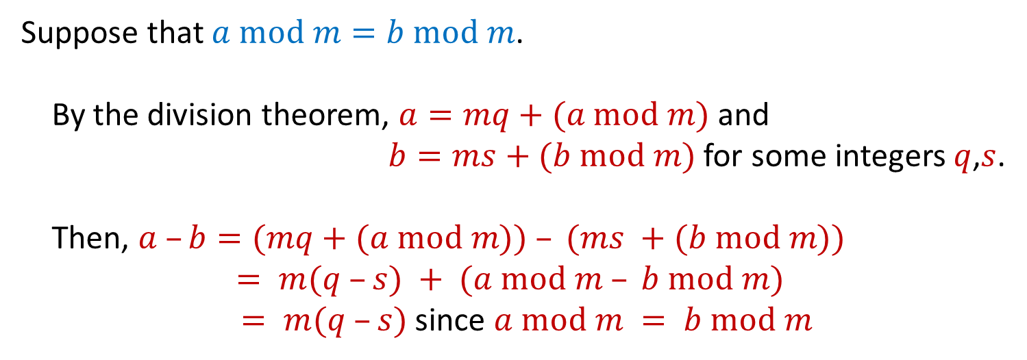
Modular Arithmetic: A Property
Let $a, b, m$be integers with $m>0$. Then, $a≡_{m}b$ if and only if $a mod m = b mod m$.
Suppose that $a mod m=b mod m$.
By the division theorem, $a=mq+(a mod m)$ and
$b=ms+(b mod m)$ for some integers $q$,$s$.
Then, $a –b=(mq+(a mod m)) – (ms +(b mod m))$
$= m(q –s) + (a mod m – b mod m)$
$= m(q –s)$since $a mod m = b mod m$
Goal: show $a≡_{m}b$, i.e., $m | (a−b)$.

Slide 18
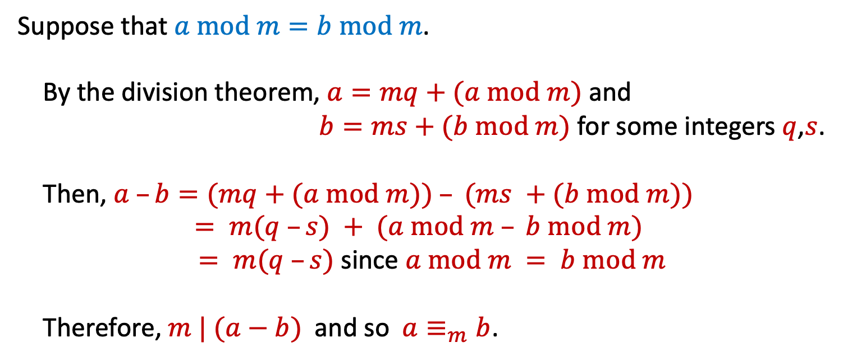
Modular Arithmetic: A Property
Let $a, b, m$be integers with $m>0$. Then, $a≡_{m}b$ if and only if $a mod m = b mod m$.
Suppose that $a mod m=b mod m$.
By the division theorem, $a=mq+(a mod m)$ and
$b=ms+(b mod m)$ for some integers $q$,$s$.
Then, $a –b=(mq+(a mod m)) – (ms +(b mod m))$
$= m(q –s) + (a mod m – b mod m)$
$= m(q –s)$since $a mod m = b mod m$
Therefore, $m | (a−b)$ and so $a≡_{m}b$.

Slide 19
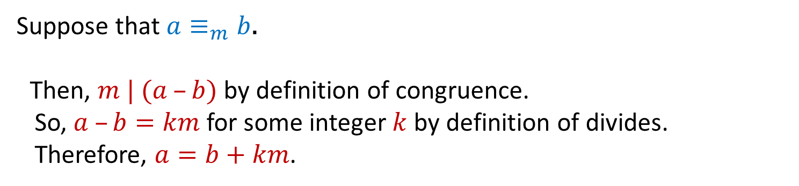
Modular Arithmetic: A Property
Let $a, b, m$be integers with $m>0$. Then, $a≡_{m}b$ if and only if $a mod m = b mod m$.
Suppose that $a≡_{m}b$.
Then, $m | (a –b)$ by definition of congruence.
So, $a –b=km$ for some integer $k$ by definition of divides.
Therefore, $a=b+km$.
Notes:
Alternatively, By the division Theorem,
we have a = mq + (a mod m) = b + km.
That gives us b = m(q + k) + (a mod m)

Slide 20
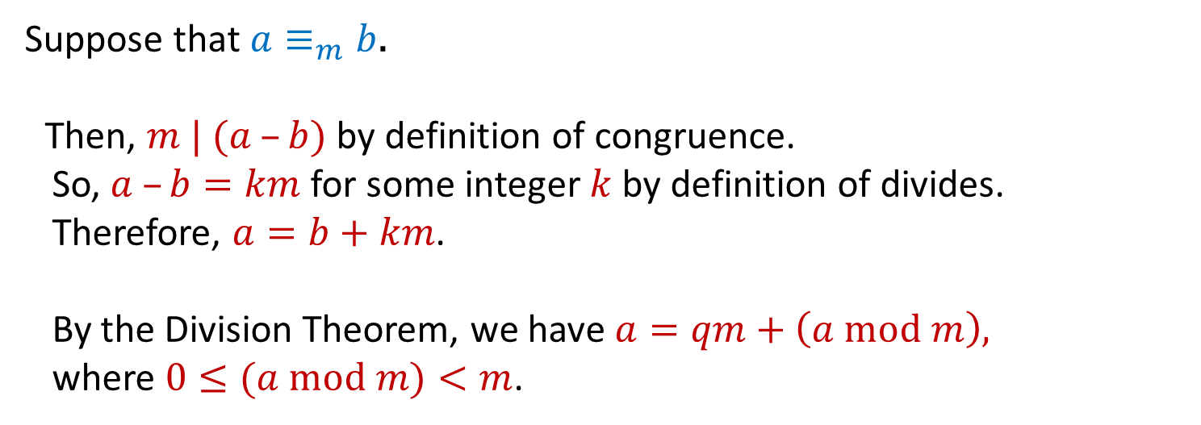
Modular Arithmetic: A Property
Let $a, b, m$be integers with $m>0$. Then, $a≡_{m}b$ if and only if $a mod m = b mod m$.
Suppose that $a≡_{m}b$.
Then, $m | (a –b)$ by definition of congruence.
So, $a –b=km$ for some integer $k$ by definition of divides.
Therefore, $a=b+km$.
By the Division Theorem, we have $a=qm+\left(a mod m\right),$
where $0≤(a mod m)<m$.
Notes:
Alternatively, By the division Theorem,
we have a = mq + (a mod m) = b + km.
That gives us b = m(q + k) + (a mod m)

Slide 21
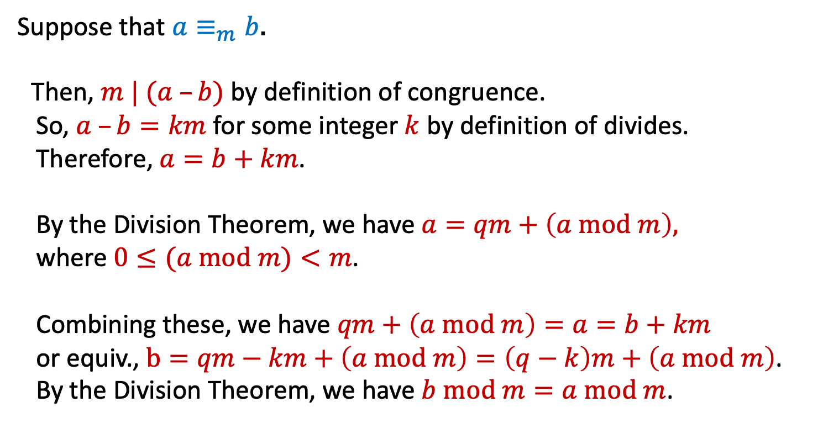
Modular Arithmetic: A Property
Let $a, b, m$be integers with $m>0$. Then, $a≡_{m}b$ if and only if $a mod m = b mod m$.
Suppose that $a≡_{m}b$.
Then, $m | (a –b)$ by definition of congruence.
So, $a –b=km$ for some integer $k$ by definition of divides.
Therefore, $a=b+km$.
By the Division Theorem, we have $a=qm+\left(a mod m\right),$
where $0≤(a mod m)<m$.
Combining these, we have $qm+\left(a mod m\right)=a=b+km$
or equiv., $b=qm−km+\left(a mod m\right)=\left(q−k\right)m+\left(a mod m\right)$.
By the Division Theorem, we have $b mod m=a mod m$.
Notes:
Alternatively, By the division Theorem,
we have a = mq + (a mod m) = b + km.
That gives us b = m(q + k) + (a mod m)

Slide 22
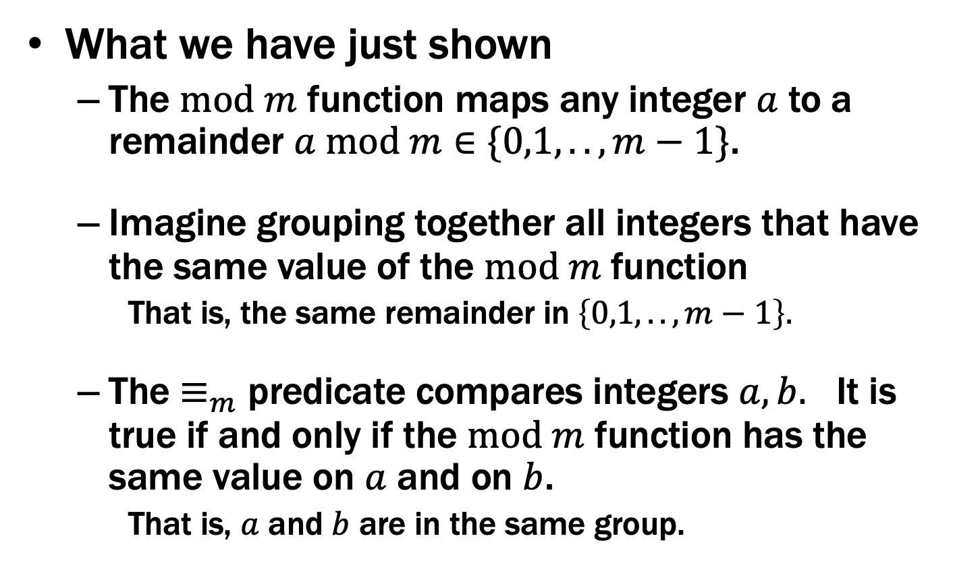

The $mod m$ function vs the$≡_{m}$ predicate
What we have just shown
The $mod m$ function maps any integer $a$ to a remainder $a mod m∈\{0,1,..,m−1\}$.
Imagine grouping together all integers that have the same value of the $mod m$function
That is, the same remainder in $\left\{0,1,..,m−1\right\}.$
The $≡_{m}$ predicate compares integers $a, b.$ It is true if and only if the $mod m$ function has the same value on $a$ and on $b$.
That is, $a$ and $b$ are in the same group.

Slide 23
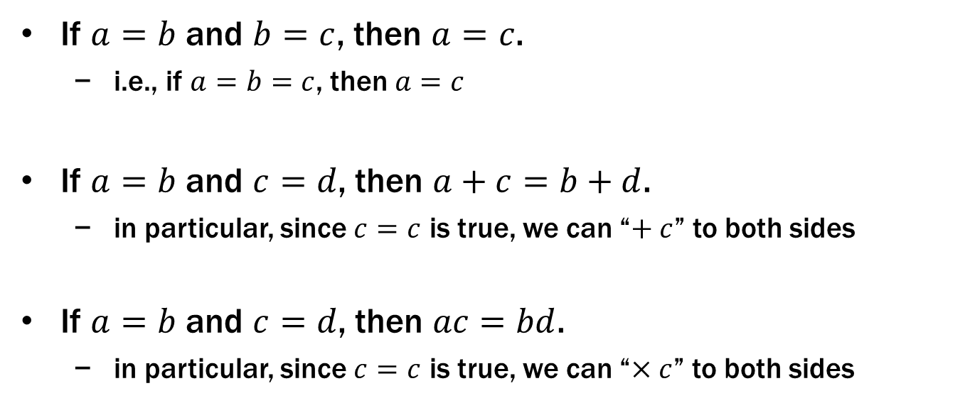
Recall: Familiar Properties of “=”
If $a=b$ and $b=c$, then $a=c$.
i.e., if $a=b=c$, then $a=c$
If $a=b$ and $c=d$, then $a+c=b+d$.
in particular, since $c=c$ is true, we can “$+ c$” to both sides
If $a=b$ and $c=d$, then $ac=bd$.
in particular, since $c=c$ is true, we can “$×c$” to both sides
These are the facts that allow us to use algebra to solve problems

Slide 24
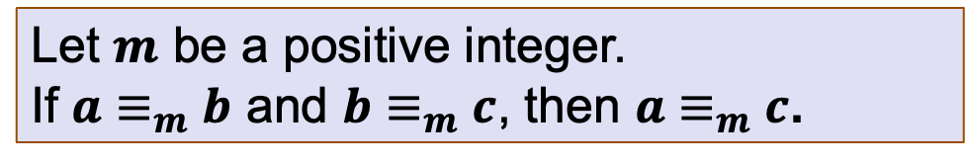
Modular Arithmetic: Basic Property
Let $m$ be a positive integer.
If $a≡_{m}b$ and $b≡_{m}c$, then $a≡_{m}c$.

Slide 25
Modular Arithmetic: Basic Property
Let $m$ be a positive integer.
If $a≡_{m}b$ and $b≡_{m}c$, then $a≡_{m}c$.
Suppose that $a≡_{m}b$ and$b≡_{m}c$.

Slide 26
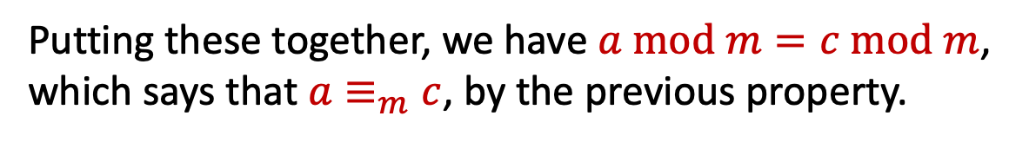
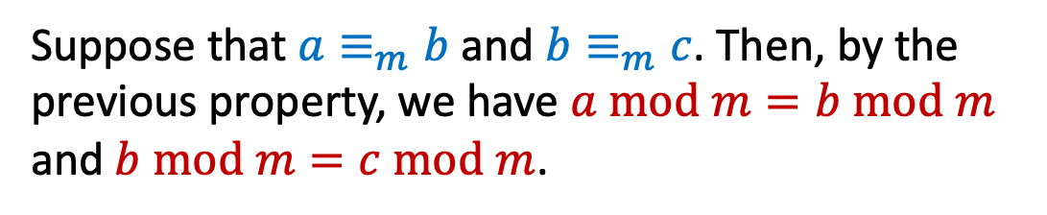
Modular Arithmetic: Basic Property
Let $m$ be a positive integer.
If $a≡_{m}b$ and $b≡_{m}c$, then $a≡_{m}c$.
Suppose that $a≡_{m}b$ and$b≡_{m}c$. Then, by the previous property, we have $a mod m=b mod m$ and $b mod m=c mod m$.
Putting these together, we have $a mod m=c mod m$, which says that $a≡_{m}c$, by the previous property.

Slide 27
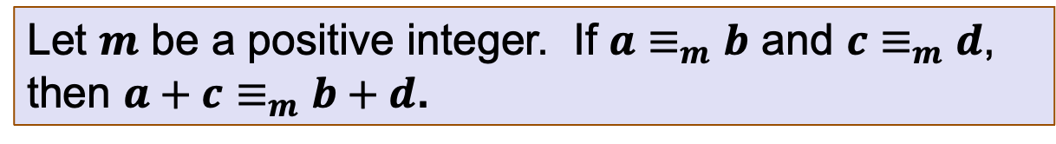
Modular Arithmetic: Addition Property
Let $m$ be a positive integer. If $a≡_{m}b$ and $c≡_{m}d$, then $a+c≡_{m}b+d$.

Slide 28
Modular Arithmetic: Addition Property
Let $m$ be a positive integer. If $a≡_{m}b$ and $c≡_{m}d$, then $a+c≡_{m}b+d$.
Suppose that $a≡_{m}b$ and $c≡_{m}d$.

Slide 29
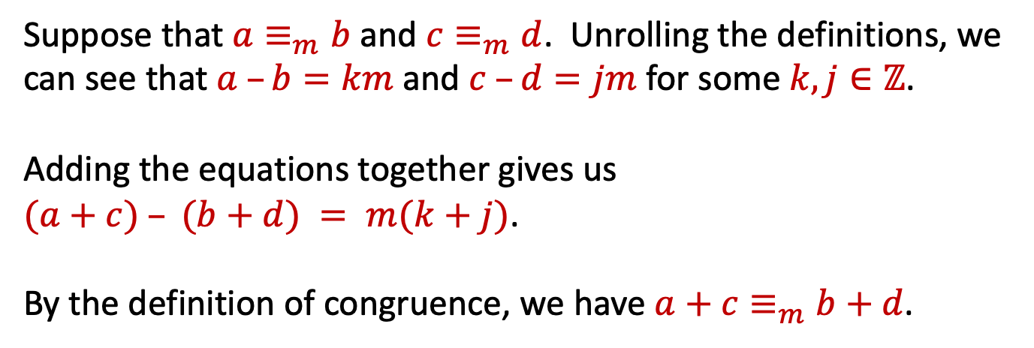
Modular Arithmetic: Addition Property
Let $m$ be a positive integer. If $a≡_{m}b$ and $c≡_{m}d$, then $a+c≡_{m}b+d$.
Suppose that $a≡_{m}b$ and $c≡_{m}d$. Unrolling the definitions, we can see that $a –b=km$ and $c –d=jm$for some $k,j∈ℤ$.
Adding the equations together gives us
$(a+c) – (b+d) = m(k+j)$.
By the definition of congruence, we have $a+c≡_{m}b+d$.

Slide 30
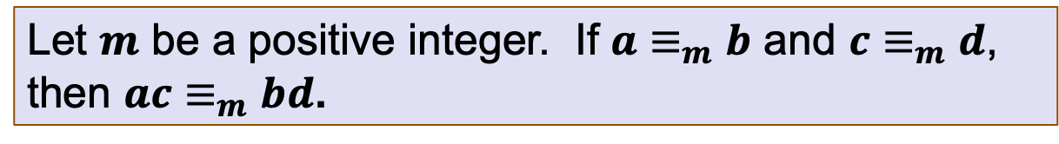
Modular Arithmetic: Multiplication Property
Let $m$ be a positive integer. If $a≡_{m}b$ and $c≡_{m}d$, then $ac≡_{m}bd$.

Slide 31
Modular Arithmetic: Multiplication Property
Let $m$ be a positive integer. If $a≡_{m}b$ and $c≡_{m}d$, then $ac≡_{m}bd$.
Suppose that $a≡_{m}b$ and $c≡_{m}d$.

Slide 32
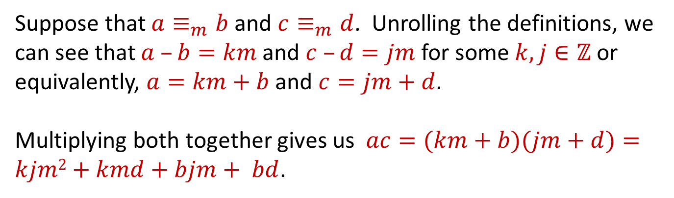
Modular Arithmetic: Multiplication Property
Let $m$ be a positive integer. If $a≡_{m}b$ and $c≡_{m}d$, then $ac≡_{m}bd$.
Suppose that $a≡_{m}b$ and $c≡_{m}d$. Unrolling the definitions, we can see that $a –b=km$ and $c –d=jm$for some $k,j∈ℤ$ or equivalently, $a=km+b$ and $c=jm+d$.
Multiplying both together gives us $ac=(km+b)(jm+d)=kjm2+kmd+bjm+ bd$.

Slide 33
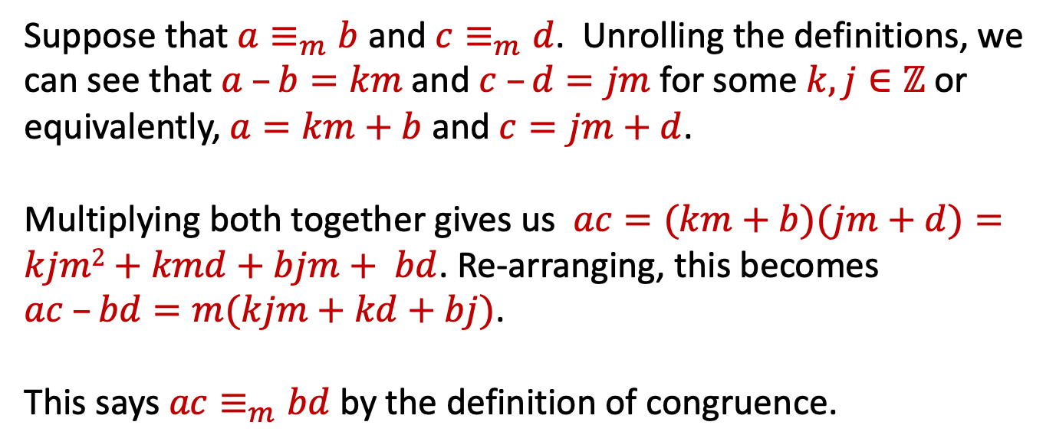
Modular Arithmetic: Multiplication Property
Let $m$ be a positive integer. If $a≡_{m}b$ and $c≡_{m}d$, then $ac≡_{m}bd$.
Suppose that $a≡_{m}b$ and $c≡_{m}d$. Unrolling the definitions, we can see that $a –b=km$ and $c –d=jm$for some $k,j∈ℤ$ or equivalently, $a=km+b$ and $c=jm+d$.
Multiplying both together gives us $ac=(km+b)(jm+d)=kjm2+kmd+bjm+ bd$. Re-arranging, this becomes $ac –bd=m(kjm+kd+bj)$.
This says $ac≡_{m}bd$ by the definition of congruence.

Slide 34
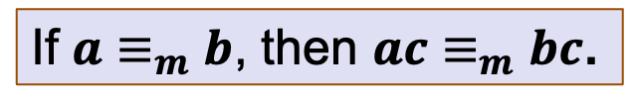
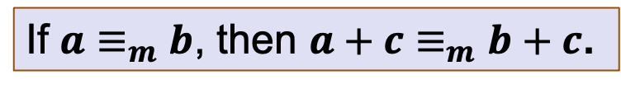
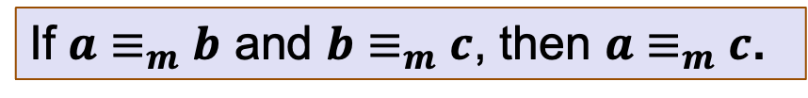
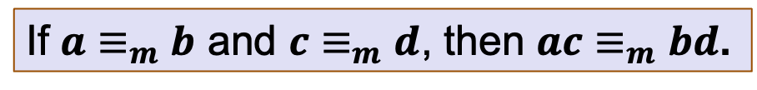
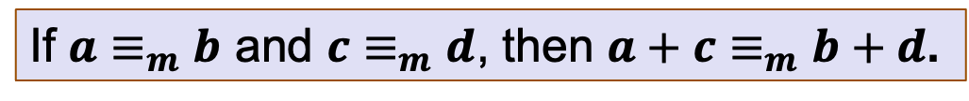
Modular Arithmetic: Properties
If $a≡_{m}b$ and $b≡_{m}c$, then $a≡_{m}c$.
If $a≡_{m}b$ and $c≡_{m}d$, then $a+c≡_{m}b+d$.
Corollary:
If $a≡_{m}b$, then $a+c≡_{m}b+c$.
If $a≡_{m}b$ and $c≡_{m}d$, then $ac≡_{m}bd$.
Corollary:
If $a≡_{m}b$, then $ac≡_{m}bc$.

Slide 35
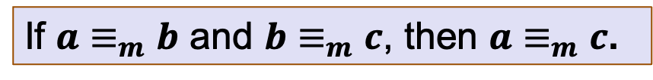
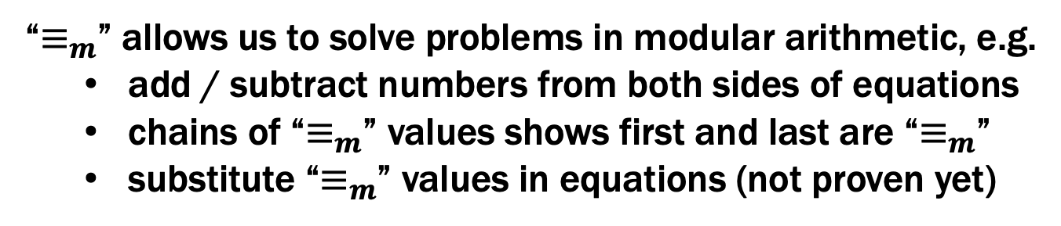

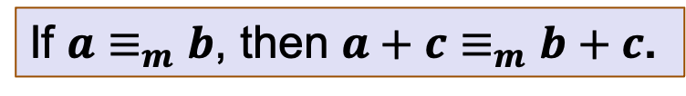
Modular Arithmetic: Properties
If $a≡_{m}b$ and $b≡_{m}c$, then $a≡_{m}c$.
If $a≡_{m}b$, then $a+c≡_{m}b+c$.
If $a≡_{m}b$, then $ac≡_{m}bc$.
“$≡_{m}$” allows us to solve problems in modular arithmetic, e.g.
add / subtract numbers from both sides of equations
chains of “$≡_{m}$” values shows first and last are “$≡_{m}$”
substitute “$≡_{m}$” values in equations (not proven yet)

Slide 36
Example
Let $n$ be an integer. Prove that $n2≡_{4}0$ or $n2≡_{4}1$.
Let’s start by looking a a small example:
0² = 0 ≡₄ 0
1² = 1 ≡₄ 1
2² = 4 ≡₄ 0
3² = 9 ≡₄ 1
4² = 16 ≡₄ 0

Slide 37
Example
Let $n$ be an integer. Prove that $n2≡_{4}0$ or $n2≡_{4}1$.
Case 1 (n is even):
Let’s start by looking a a small example:
0² = 0 ≡₄ 0
1² = 1 ≡₄ 1
2² = 4 ≡₄ 0
3² = 9 ≡₄ 1
4² = 16 ≡₄ 0
It looks like
n ≡₂ 0 → n² ≡₄ 0, and n ≡₂ 1 → n² ≡₄ 1.

Slide 38
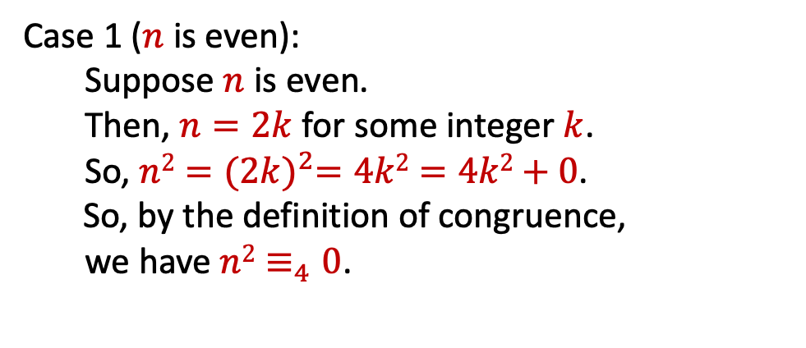
Example
Let $n$ be an integer. Prove that $n2≡_{4}0$ or $n2≡_{4}1$.
Case 1 ($n$ is even):
Suppose $n$ is even.
Then, $n=2k$ for some integer $k$.
So, $n2={(2k)}^{2}=4k2=4k2+0$.
So, by the definition of congruence,
we have $n2≡_{4}0$.
Let’s start by looking a a small example:
0² = 0 ≡₄ 0
1² = 1 ≡₄ 1
2² = 4 ≡₄ 0
3² = 9 ≡₄ 1
4² = 16 ≡₄ 0
It looks like
n ≡₂ 0 → n² ≡₄ 0, and n ≡₂ 1 → n² ≡₄ 1.

Slide 39
Example
Let $n$ be an integer. Prove that $n2≡_{4}0$ or $n2≡_{4}1$.
Case 1 (n is even): Done.
Let’s start by looking a a small example:
0² = 0 ≡₄ 0
1² = 1 ≡₄ 1
2² = 4 ≡₄ 0
3² = 9 ≡₄ 1
4² = 16 ≡₄ 0
Case 2 (n is odd):
It looks like
n ≡₂ 0 → n² ≡₄ 0, and n ≡₂ 1 → n² ≡₄ 1.

Slide 40

Example
Let $n$ be an integer. Prove that $n2≡_{4}0$ or $n2≡_{4}1$.
Case 1 ($n$ is even): Done.
Let’s start by looking a a small example:
0² = 0 ≡₄ 0
1² = 1 ≡₄ 1
2² = 4 ≡₄ 0
3² = 9 ≡₄ 1
4² = 16 ≡₄ 0
Case 2 ($n$ is odd):
Suppose $n$ is odd.
Then, $n=2k+1$ for some integer $k$.
So, $n2={\left(2k+1\right)}^{2}$
= $4k2+4k+1$
$=4(k2+ k) + 1$.
So, by definition of congruence,
we have $n2≡_{4}1$.
It looks like
n ≡₂ 0 → n² ≡₄ 0, and n ≡₂ 1 → n² ≡₄ 1.
Result follows by proof by cases since n is either even or odd

