Slide 1
CSE 311: Foundations of Computing
Lecture 14: Modular Inverse, Exponentiation

Slide 2
Last time: Useful GCD Facts
If a and b are positive integers, then gcd(a, b) = gcd(b, a mod b)
If a is a positive integer, gcd(a, 0) = a.

Slide 3
Euclid’s Algorithm
gcd(a, b) = gcd(b, a mod b) gcd(a, 0) = a
int gcd(int a, int b){ /* Assumes: a >= b, b >= 0 */
if (b == 0) {
return a;
} else {
return gcd(b, a % b);
}
}
Note: gcd(b, a) = gcd(a, b)

Slide 4

Euclid’s Algorithm
Repeatedly use $\gcd\left(a, b\right)=\gcd\left(b, a mod b\right)$ to reduce numbers until you get $gcd⁡(g,0)=g$.
gcd(660,126) =
gcd(660,126)

Slide 5
Euclid’s Algorithm
Repeatedly use $\gcd\left(a, b\right)=\gcd\left(b, a mod b\right)$ to reduce numbers until you get $gcd⁡(g,0)=g$.
gcd(660,126) = gcd(126, 660 mod 126) = gcd(126, 30)
= gcd(30, 126 mod 30) = gcd(30, 6)
= gcd(6, 30 mod 6) = gcd(6, 0)
= 6
gcd(660,126)

Slide 6
Euclid’s Algorithm
Repeatedly use $\gcd\left(a, b\right)=\gcd\left(b, a mod b\right)$ to reduce numbers until you get $gcd⁡(g,0)=g$.
Equations with recursive calls:
gcd(660,126) = gcd(126, 660 mod 126) = gcd(126, 30)
= gcd(30, 126 mod 30) = gcd(30, 6)
= gcd(6, 30 mod 6) = gcd(6, 0)
= 6
Tableau form:
660 = 5 * 126 + 30
126 = 4 * 30 + 6
30 = 5 * 6 + 0
Notes:
Columns are a, q, b, and a mod b.

Slide 7
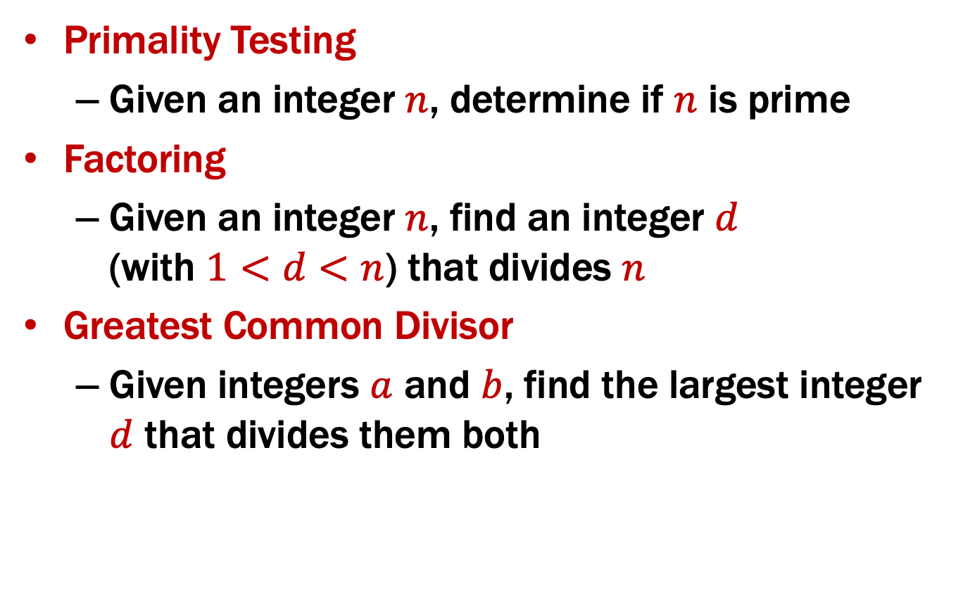
Famous Algorithmic Problems
Primality Testing
Given an integer $n$, determine if $n$ is prime
Factoring
Given an integer $n$, find an integer $d$ (with $1<d<n$) that divides $n$
Greatest Common Divisor
Given integers $a$ and $b$, find the largest integer $d$ that divides them both

Slide 8
Bézout’s theorem
If a and b are positive integers, then there exist integers s and t such that
gcd(a,b) = sa + tb.
$$\text{∀}\text{a}\text{ ∀}\text{b}\text{ ((}\text{a}\text{ > 0 ∧ }\text{b}\text{ > 0) → ∃}\text{s}\text{ ∃}\text{t}\text{ (}\text{gcd}\text{(}\text{a}\text{,}\text{b}\text{) = }\text{sa}\text{ + }\text{st}\text{)}\text{)}$$

Slide 9
Extended Euclidean algorithm
Can use Euclid’s Algorithm to find $s, t$ such that
$\gcd\left(a,b\right)=sa+tb$

Slide 10
Extended Euclidean algorithm
Can use Euclid’s Algorithm to find $s, t$ such that
$\gcd\left(a,b\right)=sa+tb$
Step 1 (Compute GCD & Keep Tableau Information):
gcd(35, 27) = gcd(27, 35 mod 27) = gcd(27, 8) 35 = 1 * 27 + 8
r
a
b
b
a mod b = r
b
a = q * b + r

Slide 11
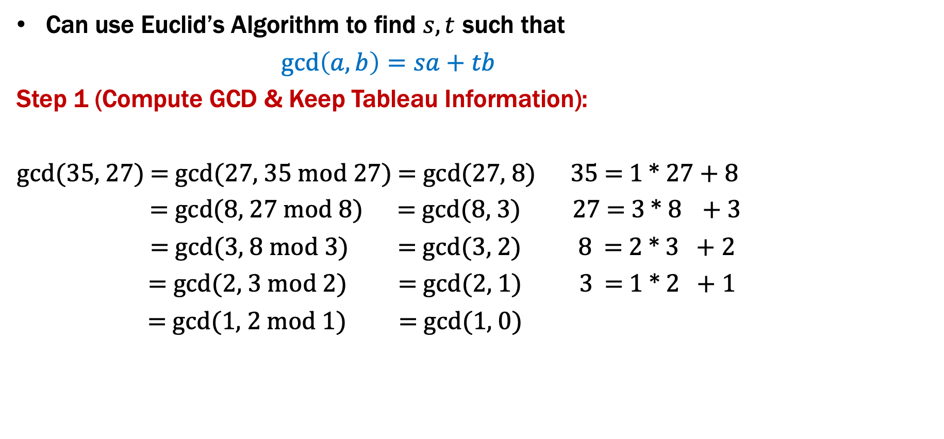
Extended Euclidean algorithm
Can use Euclid’s Algorithm to find $s, t$ such that
$\gcd\left(a,b\right)=sa+tb$
Step 1 (Compute GCD & Keep Tableau Information):
gcd(35, 27) = gcd(27, 35 mod 27) = gcd(27, 8) 35 = 1 * 27 + 8
= gcd(8, 27 mod 8) = gcd(8, 3) 27 = 3 * 8 + 3
= gcd(3, 8 mod 3) = gcd(3, 2) 8 = 2 * 3 + 2
= gcd(2, 3 mod 2) = gcd(2, 1) 3 = 1 * 2 + 1
= gcd(1, 2 mod 1) = gcd(1, 0)
r
a
b
b
a mod b = r
b
a = q * b + r

Slide 12
Extended Euclidean algorithm
Can use Euclid’s Algorithm to find $s, t$ such that
$\gcd\left(a,b\right)=sa+tb$
Step 2 (Solve the equations for r):
a = q * b + r
r = a -- q * b
35 = 1 * 27 + 8
27 = 3 * 8 + 3
8 = 2 * 3 + 2
= 1 * 2 + 1
8 = 35 – 1 * 27

Slide 13
Extended Euclidean algorithm
Can use Euclid’s Algorithm to find $s, t$ such that
$\gcd\left(a,b\right)=sa+tb$
Step 2 (Solve the equations for r):
a = q * b + r
r = a -- q * b
35 = 1 * 27 + 8
27 = 3 * 8 + 3
8 = 2 * 3 + 2
= 1 * 2 + 1
8 = 35 – 1 * 27
3 = 27 – 3 * 8
2 = 8 – 2 * 3
1 = 3 – 1 * 2

Slide 14
Extended Euclidean algorithm
Can use Euclid’s Algorithm to find $s, t$ such that
$\gcd\left(a,b\right)=sa+tb$
Step 3 (Backward Substitute Equations):
8 = 35 – 1 * 27
3 = 27 – 3 * 8
2 = 8 – 2 * 3
1 = 3 – 1 * 2
Notes:
Last equation writes 1 = gcd(35,27) as a linear combination of 3 and 2. Want linear combination of 35 and 27.
Equation just above shows how to write 2 as a linear combination of 8 and 3... makes progress toward what we want (bigger numbers).

Slide 15
Extended Euclidean algorithm
Can use Euclid’s Algorithm to find $s, t$ such that
$\gcd\left(a,b\right)=sa+tb$
Step 3 (Backward Substitute Equations):
Plug in the def of 2
8 = 35 – 1 * 27
3 = 27 – 3 * 8
2 = 8 – 2 * 3
1 = 3 – 1 * 2
1 = 3 – 1 * (8 – 2 * 3)
= 3 – 8 + 2 * 3
= (–1) * 8 + 3 * 3
Re-arrange into
3’s and 8’s

Slide 16
Extended Euclidean algorithm
Can use Euclid’s Algorithm to find $s, t$ such that
$\gcd\left(a,b\right)=sa+tb$
Step 3 (Backward Substitute Equations):
Plug in the def of 2
8 = 35 – 1 * 27
3 = 27 – 3 * 8
2 = 8 – 2 * 3
1 = 3 – 1 * 2
1 = 3 – 1 * (8 – 2 * 3)
= 3 – 8 + 2 * 3
= (–1) * 8 + 3 * 3
= (–1) * 8 + 3 * (27 – 3 * 8)
= (–1) * 8 + 3 * 27 + (–9) * 8
= 3 * 27 + (–10) * 8
Re-arrange into
3’s and 8’s
Plug in the def of 3
Re-arrange into
8’s and 27’s

Slide 17
Extended Euclidean algorithm
Can use Euclid’s Algorithm to find $s, t$ such that
$\gcd\left(a,b\right)=sa+tb$
Step 3 (Backward Substitute Equations):
Plug in the def of 2
8 = 35 – 1 * 27
3 = 27 – 3 * 8
2 = 8 – 2 * 3
1 = 3 – 1 * 2
1 = 3 – 1 * (8 – 2 * 3)
= 3 – 8 + 2 * 3
= (–1) * 8 + 3 * 3
= (–1) * 8 + 3 * (27 – 3 * 8)
= (–1) * 8 + 3 * 27 + (–9) * 8
= 3 * 27 + (–10) * 8
= 3 * 27 + (–10) * (35 – 1 * 27)
= 3 * 27 + (–10) * 35 + 10 * 27
= 13 * 27 + (–10) * 35
Re-arrange into
3’s and 8’s
Plug in the def of 3
Re-arrange into
8’s and 27’s
Re-arrange into
27’s and 35’s

Slide 18


Multiplicative inverse $mod m$
Let $0≤a,b<m$. Then, $b$ is the multiplicative inverse of $a$ (modulo $m$) iff $ab≡_{m}1$.
X | 0 | 1 | 2 | 3 | 4 | 5 | 6 | 7 | 8 | 9
0 | 0 | 0 | 0 | 0 | 0 | 0 | 0 | 0 | 0 | 0
1 | 0 | 1 | 2 | 3 | 4 | 5 | 6 | 7 | 8 | 9
2 | 0 | 2 | 4 | 6 | 8 | 0 | 2 | 4 | 6 | 8
3 | 0 | 3 | 6 | 9 | 2 | 5 | 8 | 1 | 4 | 7
4 | 0 | 4 | 8 | 2 | 6 | 0 | 4 | 8 | 2 | 6
5 | 0 | 5 | 0 | 5 | 0 | 5 | 0 | 5 | 0 | 5
6 | 0 | 6 | 2 | 8 | 4 | 0 | 6 | 2 | 8 | 4
7 | 0 | 7 | 4 | 1 | 8 | 5 | 2 | 9 | 6 | 3
8 | 0 | 8 | 6 | 4 | 2 | 0 | 8 | 6 | 4 | 2
9 | 0 | 9 | 8 | 7 | 6 | 5 | 4 | 3 | 2 | 1
X | 0 | 1 | 2 | 3 | 4 | 5 | 6
0 | 0 | 0 | 0 | 0 | 0 | 0 | 0
1 | 0 | 1 | 2 | 3 | 4 | 5 | 6
2 | 0 | 2 | 4 | 6 | 1 | 3 | 5
3 | 0 | 3 | 6 | 2 | 5 | 1 | 4
4 | 0 | 4 | 1 | 5 | 2 | 6 | 3
5 | 0 | 5 | 3 | 1 | 6 | 4 | 2
6 | 0 | 6 | 5 | 4 | 3 | 2 | 1
mod 7
mod 10
Notes:
With 7, every number has an inverse. With 10, not every number has an inverse.
2, 4, 5, 6, 8 do not have an inverse because they have a common factor with 10

Slide 19
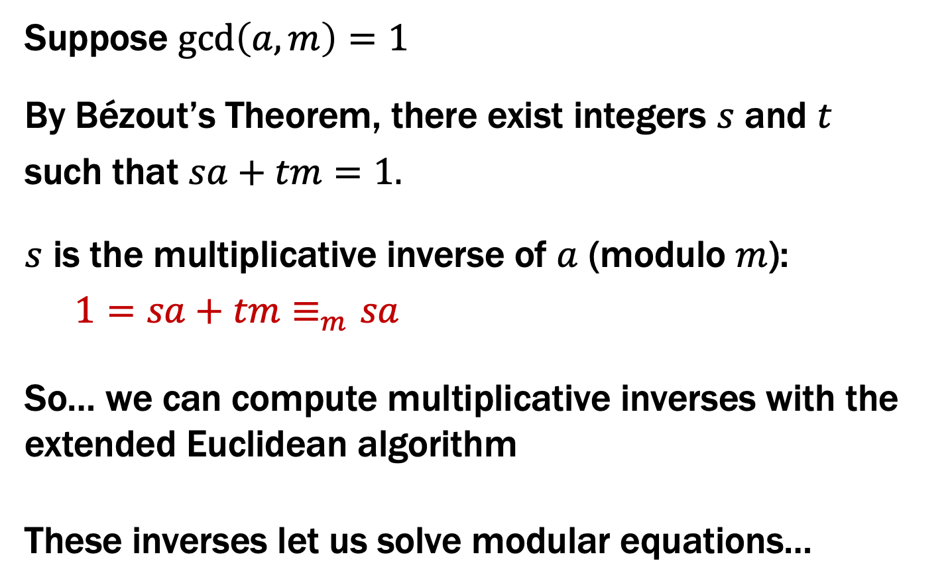
Multiplicative inverse $mod m$
Suppose $gcd\left(a,m\right)=1$
By Bézout’s Theorem, there exist integers $s$ and $t$
such that $sa+tm=1.$
$s$ is the multiplicative inverse of $a$ (modulo $m$):
$1=sa+tm≡_{m}sa$
So… we can compute multiplicative inverses with the extended Euclidean algorithm
These inverses let us solve modular equations…

Slide 20
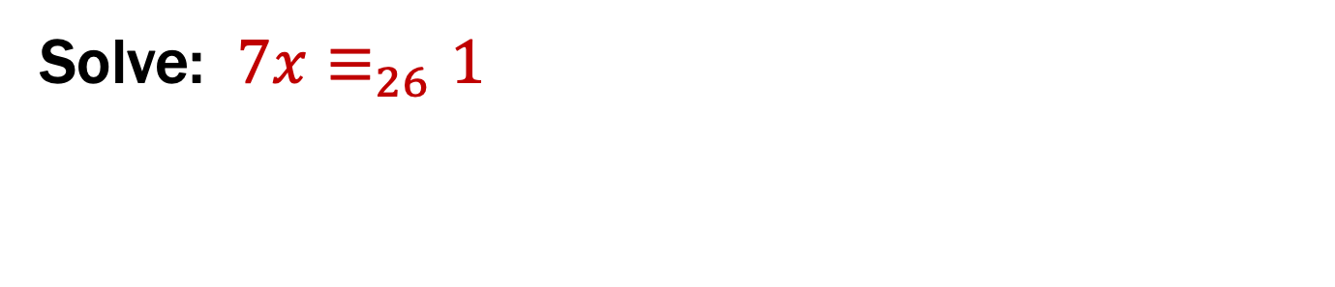
Example
Solve: $7x≡_{26}1$

Slide 21
Example
Solve: $7x≡_{26}1$
$$gcd⁡(26, 7) = gcd⁡(7, 5) = gcd⁡(5, 2) = gcd⁡(2, 1) = 1$$
Notes:
Find GCD
Write tableau (showing remainders)
Rewrite tableau to put remainders on left
Back-substitute

Slide 22
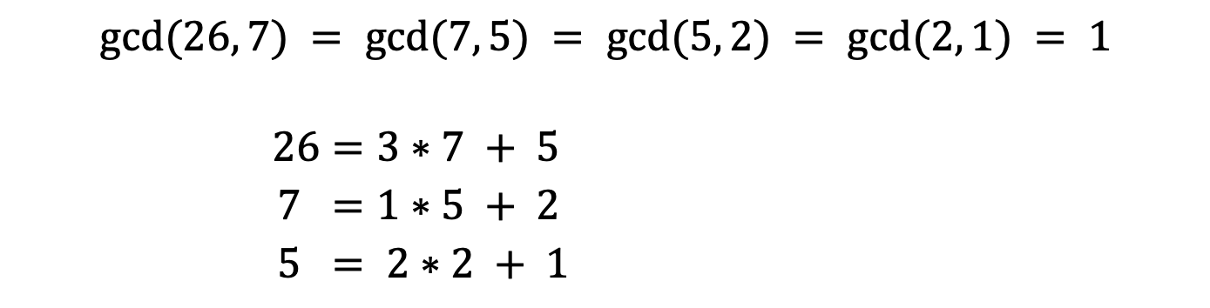
Example
Solve: $7x≡_{26}1$
$$gcd⁡(26, 7) = gcd⁡(7, 5) = gcd⁡(5, 2) = gcd⁡(2, 1) = 1$$
$$26 =3∗7 + 5 5= 26 – 3∗7$$
$$7 =1∗5 + 2 2= 7 – 1∗5$$
$$5 = 2∗2 + 1 1= 5 – 2∗2$$
Notes:
Find GCD
Write tableau (showing remainders)
Rewrite tableau to put remainders on left
Back-substitute

Slide 23
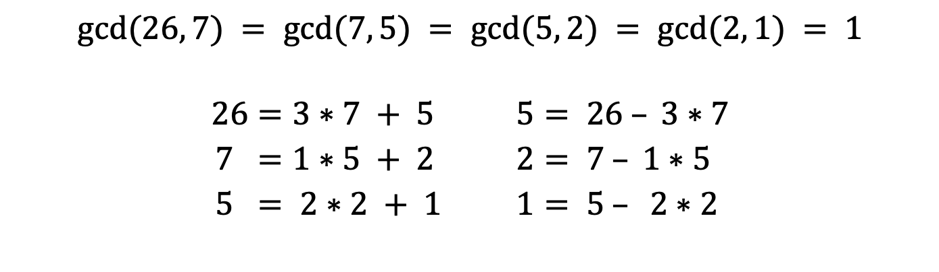
Example
Solve: $7x≡_{26}1$
$$gcd⁡(26, 7) = gcd⁡(7, 5) = gcd⁡(5, 2) = gcd⁡(2, 1) = 1$$
$$26 =3∗7 + 5 5= 26 – 3∗7$$
$$7 =1∗5 + 2 2= 7 – 1∗5$$
$$5 = 2∗2 + 1 1= 5 – 2∗2$$
Notes:
Find GCD
Write tableau (showing remainders)
Rewrite tableau to put remainders on left
Back-substitute

Slide 24
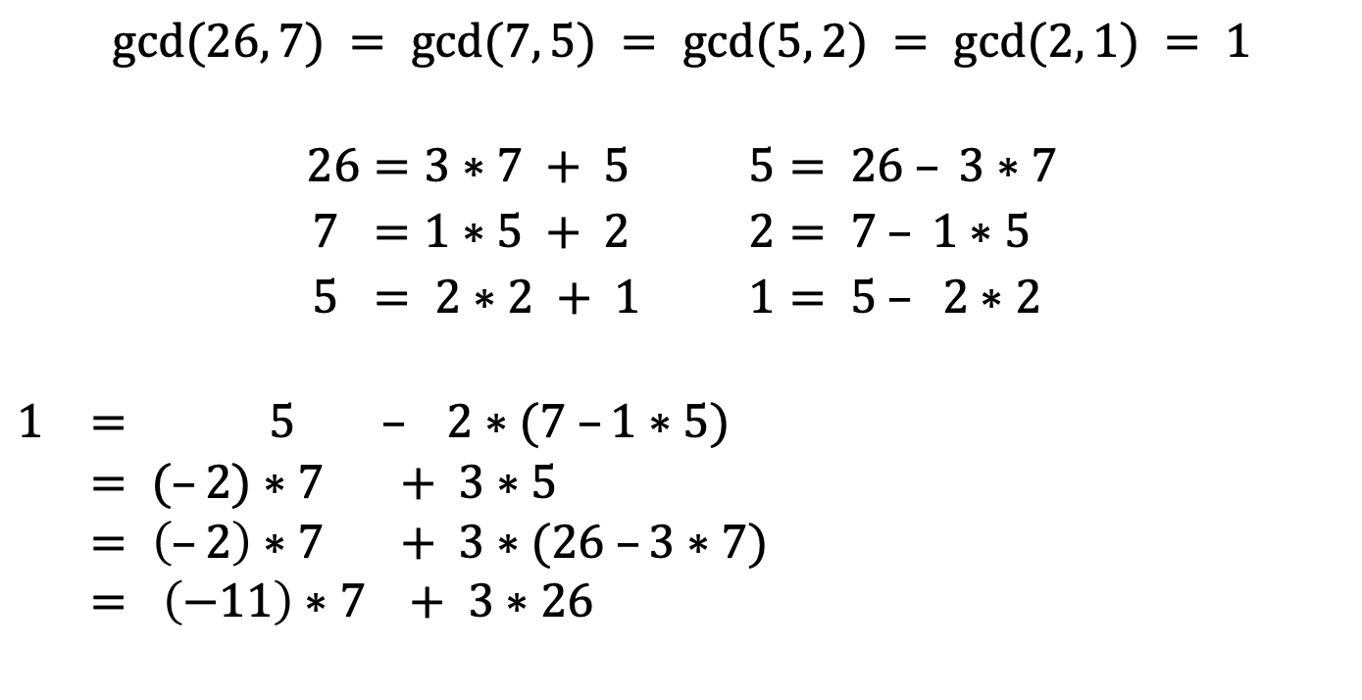
Example
Solve: $7x≡_{26}1$
$$gcd⁡(26, 7) = gcd⁡(7, 5) = gcd⁡(5, 2) = gcd⁡(2, 1) = 1$$
$$26 =3∗7 + 5 5= 26 – 3∗7$$
$$7 =1∗5 + 2 2= 7 – 1∗5$$
$$5 = 2∗2 + 1 1= 5 – 2∗2$$
$$1 = 5 – 2∗(7 –1∗5)$$
$= (–2)∗7 + 3∗5$
$= \left(–2\right)∗7 + 3∗(26 –3∗7)$
$= \left(−11\right)∗7 + 3∗26$
Notes:
Find GCD
Write tableau (showing remainders)
Rewrite tableau to put remainders on left
Back-substitute

Slide 25
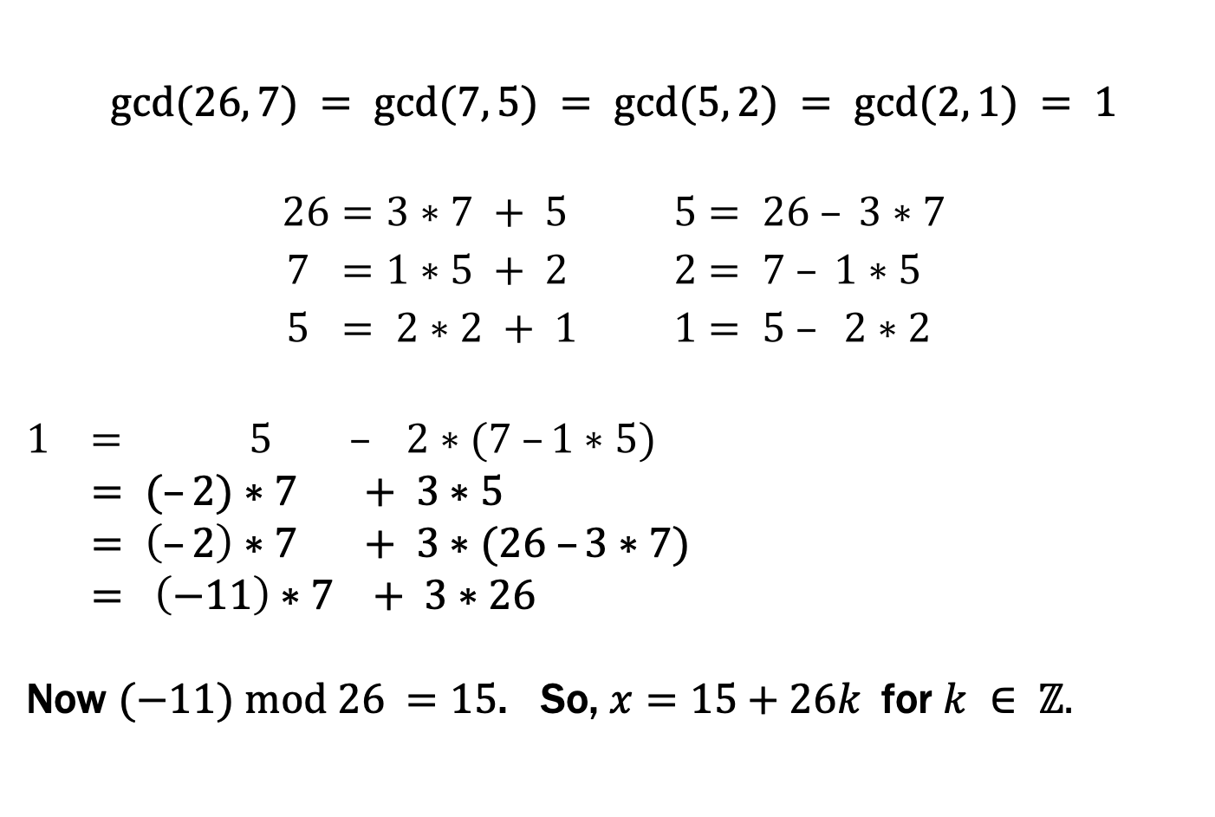
Example
Solve: $7x≡_{26}1$
$$gcd⁡(26, 7) = gcd⁡(7, 5) = gcd⁡(5, 2) = gcd⁡(2, 1) = 1$$
$$26 =3∗7 + 5 5= 26 – 3∗7$$
$$7 =1∗5 + 2 2= 7 – 1∗5$$
$$5 = 2∗2 + 1 1= 5 – 2∗2$$
$$1 = 5 – 2∗(7 –1∗5)$$
$= (–2)∗7 + 3∗5$
$= \left(–2\right)∗7 + 3∗(26 –3∗7)$
$= \left(−11\right)∗7 + 3∗26$
Now $(−11) mod 26 =15$. So, $x=15+26k$for $k ∈ ℤ.$
Multiplicative inverse of 7 modulo 26
Notes:
Find GCD
Write tableau (showing remainders)
Rewrite tableau to put remainders on left
Back-substitute

Slide 26
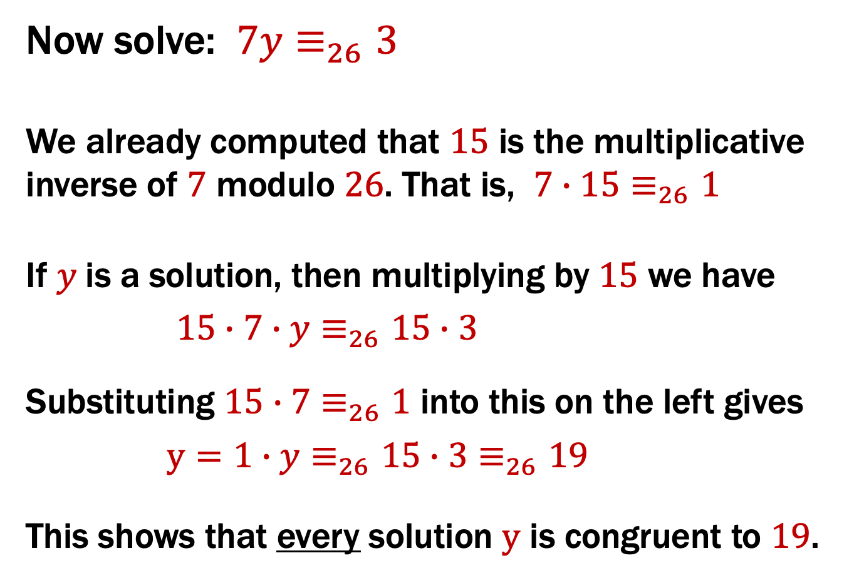
Example of a more general equation
Now solve: $7y≡_{26}3$
We already computed that $15$ is the multiplicative inverse of $7$ modulo $26$. That is, $7∙15≡_{26}1$
If $y$is a solution, then multiplying by $15$ we have
$15∙7∙y≡_{26}15∙3$
Substituting $15∙7≡_{26}1$ into this on the left gives
$y=1∙y≡_{26}15∙3≡_{26}19$
This shows that every solution $y$ is congruent to $19$.

Slide 27
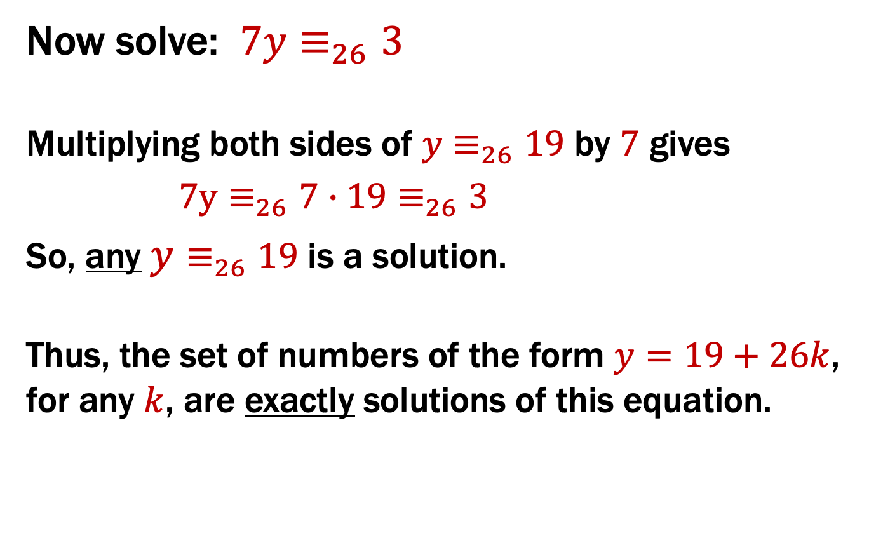
Example of a more general equation
Now solve: $7y≡_{26}3$
Multiplying both sides of $y≡_{26}19$ by $7$ gives
$7y≡_{26}7∙19≡_{26}3$
So, any $y≡_{26}19$ is a solution.
Thus, the set of numbers of the form $y=19+26k$, for any $k$, are exactly solutions of this equation.

Slide 28

Math mod a prime is especially nice
$gcd⁡(a,m)=1$ if $m$ is prime and $0<a<m$ so can always solve these equations mod a prime.
+ | 0 | 1 | 2 | 3 | 4 | 5 | 6
0 | 0 | 1 | 2 | 3 | 4 | 5 | 6
1 | 1 | 2 | 3 | 4 | 5 | 6 | 0
2 | 2 | 3 | 4 | 5 | 6 | 0 | 1
3 | 3 | 4 | 5 | 6 | 0 | 1 | 2
4 | 4 | 5 | 6 | 0 | 1 | 2 | 3
5 | 5 | 6 | 0 | 1 | 2 | 3 | 4
6 | 6 | 0 | 1 | 2 | 3 | 4 | 5
X | 0 | 1 | 2 | 3 | 4 | 5 | 6
0 | 0 | 0 | 0 | 0 | 0 | 0 | 0
1 | 0 | 1 | 2 | 3 | 4 | 5 | 6
2 | 0 | 2 | 4 | 6 | 1 | 3 | 5
3 | 0 | 3 | 6 | 2 | 5 | 1 | 4
4 | 0 | 4 | 1 | 5 | 2 | 6 | 3
5 | 0 | 5 | 3 | 1 | 6 | 4 | 2
6 | 0 | 6 | 5 | 4 | 3 | 2 | 1
mod 7

Slide 29

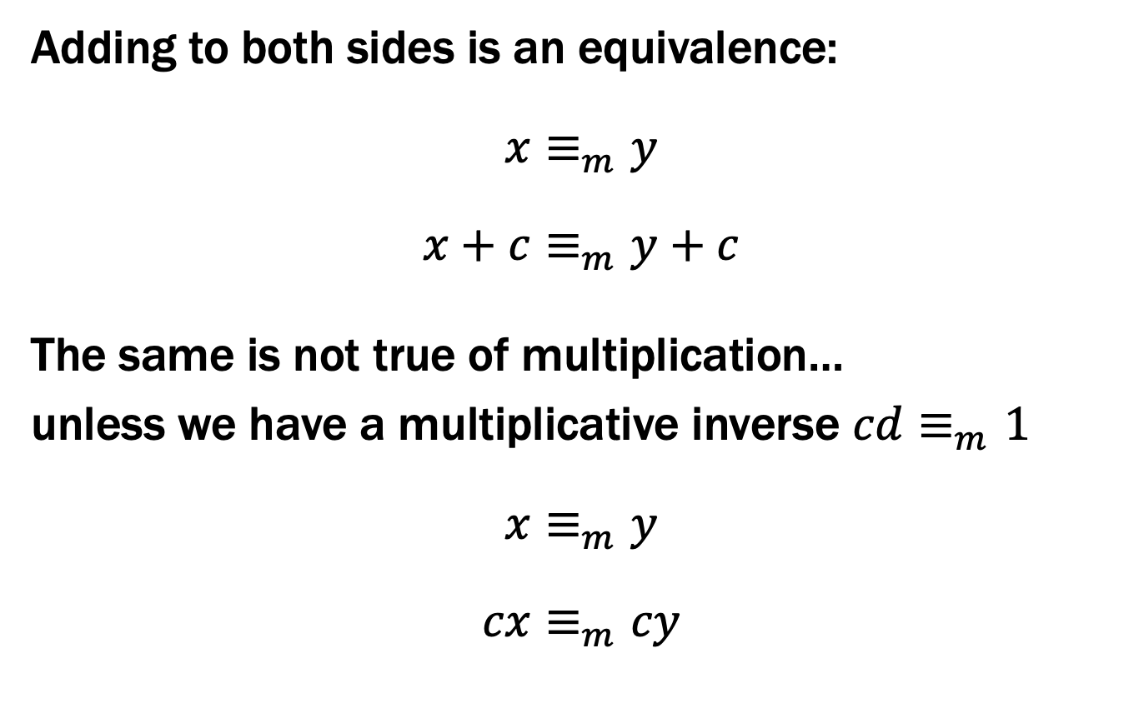



Multiplicative Inverses and Algebra
Adding to both sides is an equivalence:
$$x≡_{m}y$$
$$x+c≡_{m}y+c$$
The same is not true of multiplication…
unless we have a multiplicative inverse $cd≡_{m}1$
$$x≡_{m}y$$
$$cx≡_{m}cy$$
$$−c$$
$$+c$$
$$×c$$
$$×d$$

Slide 30
Modular Exponentiation mod 7
X | 1 | 2 | 3 | 4 | 5 | 6
1 | 1 | 2 | 3 | 4 | 5 | 6
2 | 2 | 4 | 6 | 1 | 3 | 5
3 | 3 | 6 | 2 | 5 | 1 | 4
4 | 4 | 1 | 5 | 2 | 6 | 3
5 | 5 | 3 | 1 | 6 | 4 | 2
6 | 6 | 5 | 4 | 3 | 2 | 1
a | a¹ | a² | a³ | a⁴ | a⁵ | a⁶
1 | 1 | 1 | 1 | 1 | 1 | 1
2 | 2 | 4 | 1 | 2 | 4 | 1
3 | 3 | 2 | 6 | 4 | 5 | 1
4 | 4 | 2 | 1 | 4 | 2 | 1
5 | 5 | 4 | 6 | 2 | 3 | 1
6 | 6 | 1 | 6 | 1 | 6 | 1
Notes:
1 1 1 1 1 1
2 4 1 2 4 1
...

Slide 31
Exponentiation
Compute 78365⁸¹⁴⁵³
Compute 78365⁸¹⁴⁵³ mod 104729
Output is small
need to keep intermediate results small
104,729 is the 10,000th prime

Slide 32
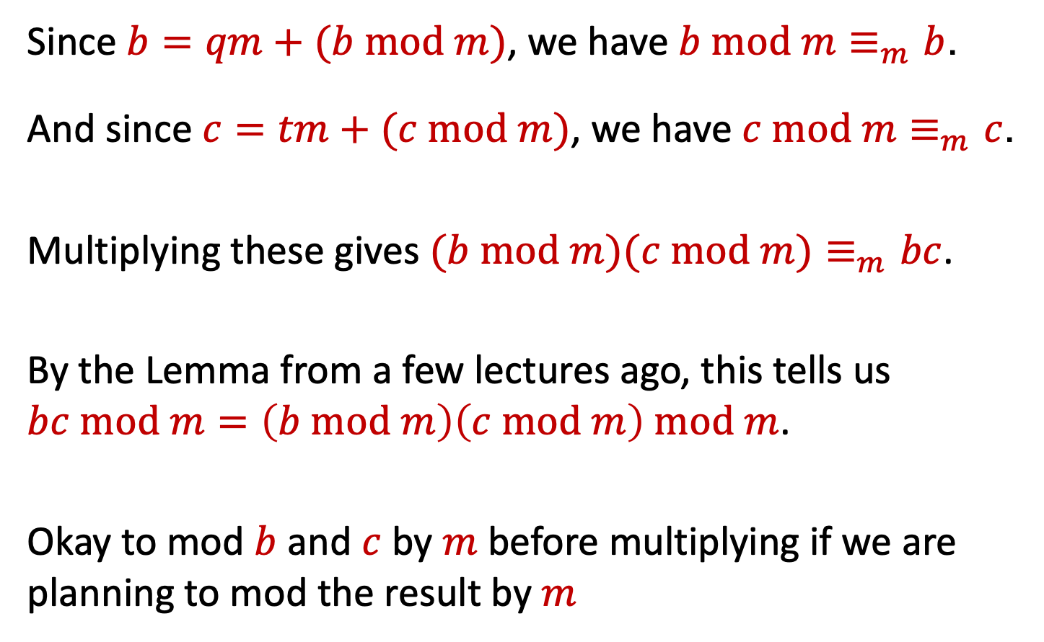
Small Multiplications
Since $b=qm+(b mod m)$, we have $b mod m≡_{m}b$.
And since $c=tm+(c mod m)$, we have $c mod m≡_{m}c$.
Multiplying these gives $(b mod m)(c mod m)≡_{m}bc$.
By the Lemma from a few lectures ago, this tells us $bc mod m=\left(b mod m\right)\left(c mod m\right) mod m$.
Okay to mod $b$ and $c$ by $m$before multiplying if we are planning to mod the result by $m$
Notes:
Solves the case where k is a power of 2

Slide 33
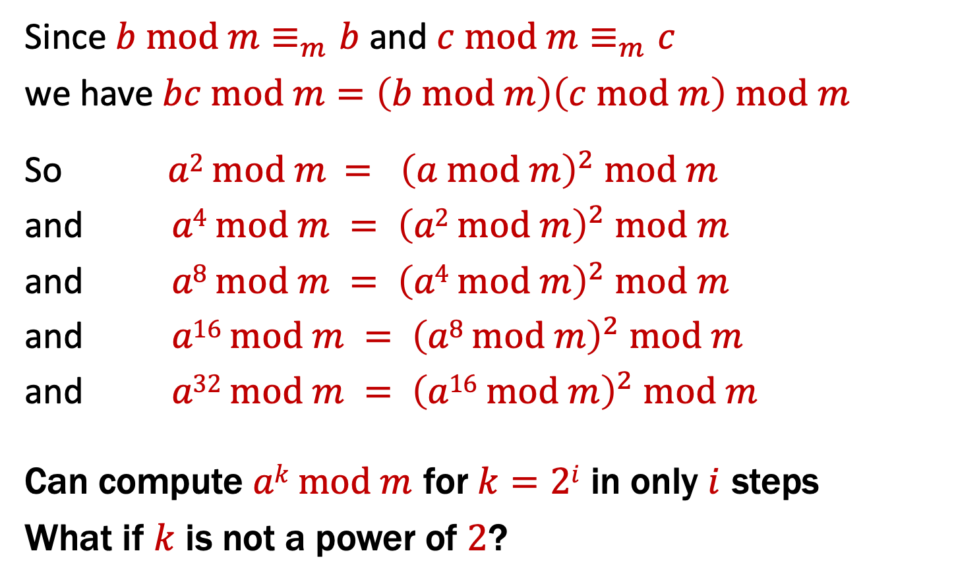
Repeated Squaring – small and fast
Since $b mod m≡_{m}b$ and $c mod m≡_{m}c$
we have $bc mod m=\left(b mod m\right)\left(c mod m\right) mod m$
So $a2 mod m{ = \left(a mod m\right)}^{2} mod m$
and $a4 mod m = {\left(a2 mod m\right)}^{2} mod m$
and $a8 mod m = {\left(a4 mod m\right)}^{2} mod m$
and $a16 mod m = {\left(a8 mod m\right)}^{2} mod m$
and $a32 mod m = {\left(a16 mod m\right)}^{2} mod m$
Can compute $ak mod m$ for $k=2i$ in only $i$ steps
What if $k$ is not a power of $2$?
Notes:
Solves the case where k is a power of 2

Slide 34
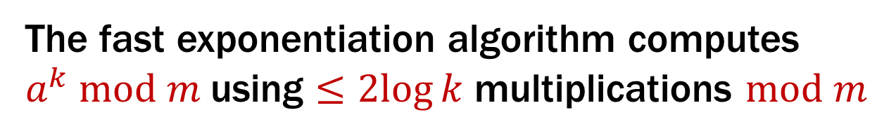
Fast Exponentiation Algorithm
81453 in binary is 10011111000101101
81453 = 2¹⁶ + 2¹³ + 2¹² + 2¹¹ + 2¹⁰ + 2⁹ + 2⁵ + 2³ + 2² + 2⁰
a⁸¹⁴⁵³ = a²¹⁶ · a²¹³ · a²¹² · a²¹¹ · a²¹⁰ · a²⁹ · a²⁵ · a²³ · a²² · a²⁰
a⁸¹⁴⁵³ mod m=
(…(((((a²¹⁶ mod m ·
a²¹³ mod m ) mod m ·
a²¹² mod m) mod m ·
a²¹¹ mod m) mod m ·
a²¹⁰ mod m) mod m ·
a²⁹ mod m) mod m ·
a²⁵ mod m) mod m ·
a²³ mod m) mod m ·
a²² mod m) mod m ·
a²⁰ mod m) mod m
Uses only 16 + 9 = 25 multiplications
The fast exponentiation algorithm computes
$a^{k} mod m$using $≤2log{k}$ multiplications $mod m$

Slide 35
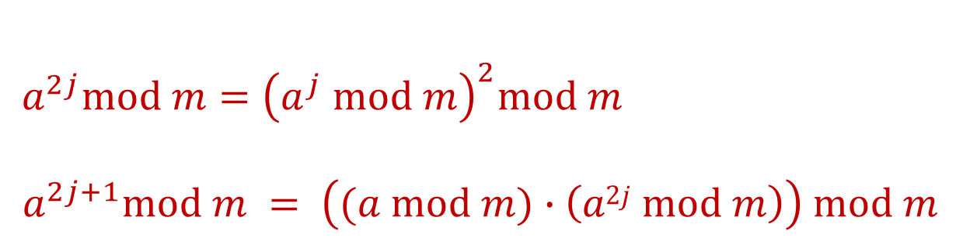

Fast Exponentiation: $ak mod m$ for all $k$
Another way....
$a^{2j}mod m={\left(a^{j} mod m\right)}^{2}mod m$
$$a^{2j+1}mod m = \left((a mod m)∙\left(a2j mod m\right)\right) mod m$$

Slide 36
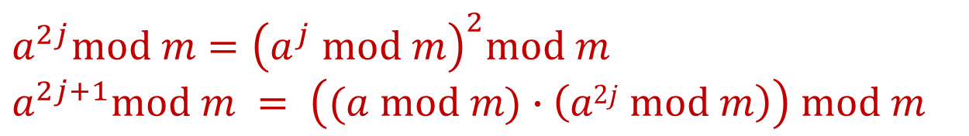
Fast Exponentiation
public static int FastModExp(int a, int k, int modulus) {
if (k == 0) {
return 1;
} else if ((k % 2) == 0) {
long temp = FastModExp(a,k/2,modulus);
return (temp * temp) % modulus;
} else {
long temp = FastModExp(a,k-1,modulus);
return (a * temp) % modulus;
}
}
$$a^{2j}mod m={\left(a^{j} mod m\right)}^{2}mod m$$
$$a^{2j+1}mod m = \left((a mod m)∙\left(a2j mod m\right)\right) mod m$$

Slide 37
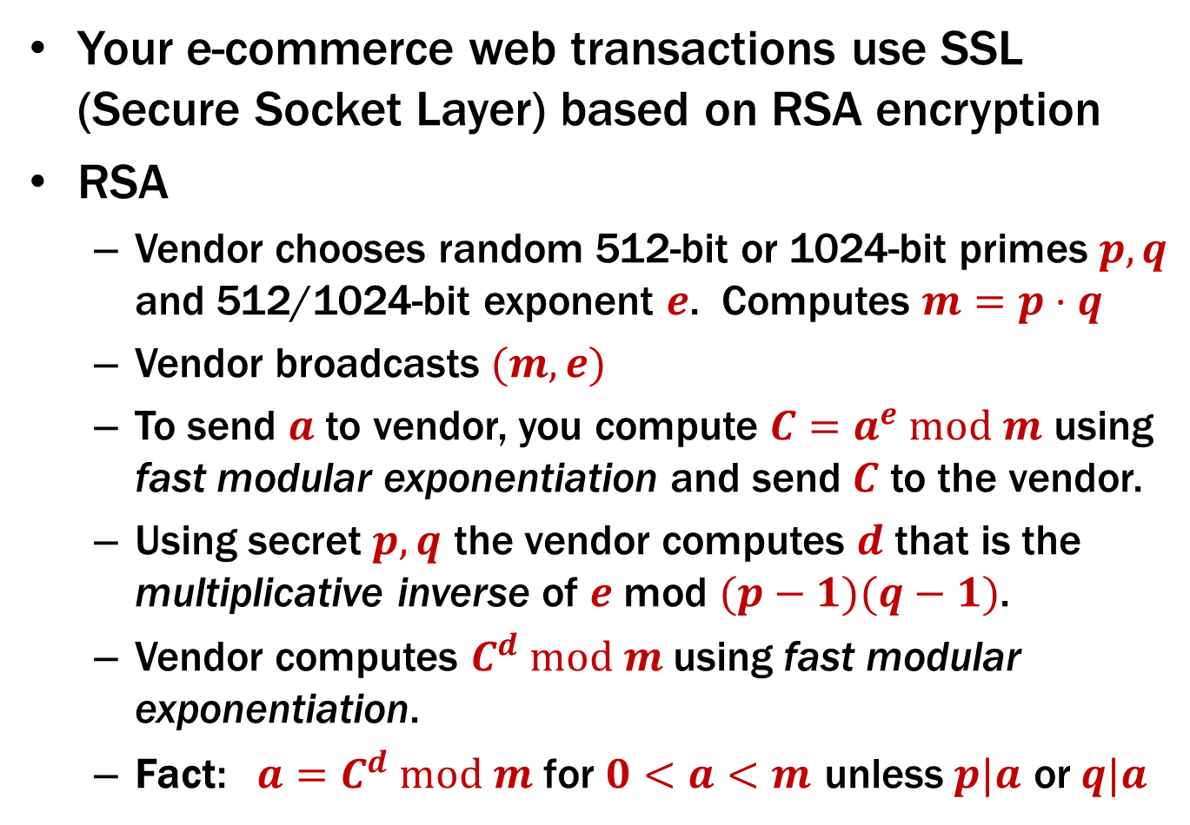
Using Fast Modular Exponentiation
Your e-commerce web transactions use SSL (Secure Socket Layer) based on RSA encryption
RSA
Vendor chooses random 512-bit or 1024-bit primes $p, q$ and 512/1024-bit exponent $e$. Computes $m=p⋅q$
Vendor broadcasts $(m,e)$
To send $a$ to vendor, you compute $C=a^{e} mod m$ using fast modular exponentiation and send $C$ to the vendor.
Using secret $p, q$ the vendor computes $d$ that is the multiplicative inverse of $e$ mod $(p−1)(q−1)$.
Vendor computes $C^{d} mod m$ using fast modular exponentiation.
Fact: $a=C^{d} mod m$ for $0<a<m$ unless $p|a$ or $q|a$

