Slide 1
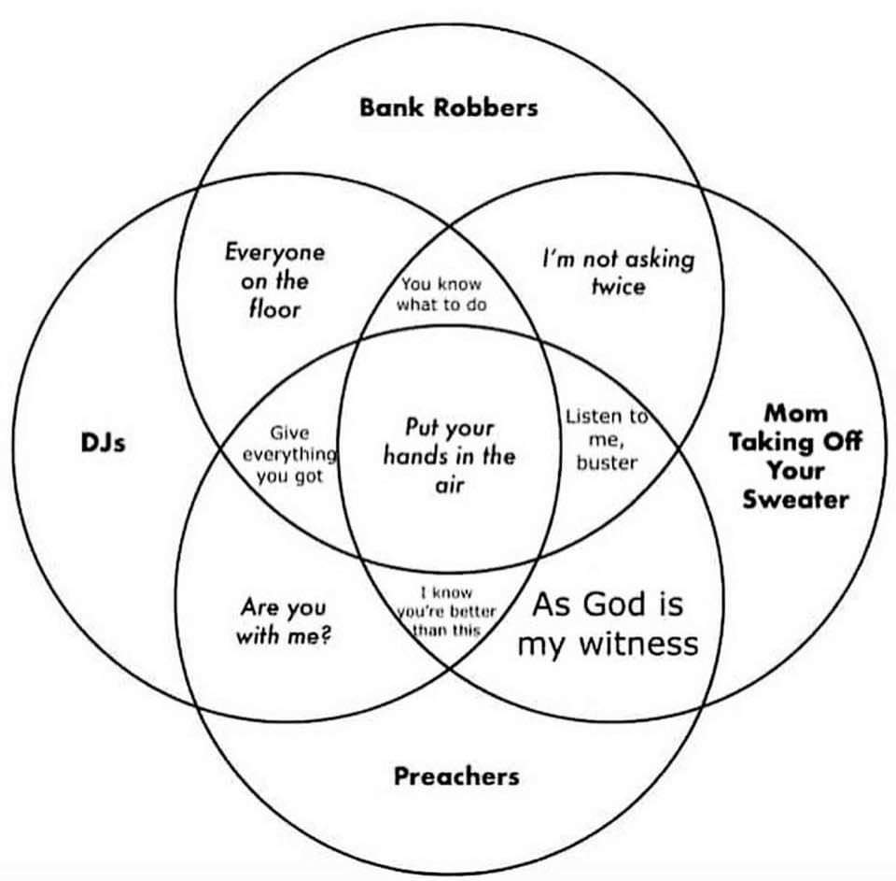
CSE 311: Foundations of Computing
Lecture 14: Set Theory

Slide 2
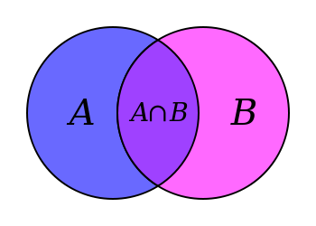
Sets
Sets are collections of objects called elements.
Write a ∈ B to say that a is an element of set B,
and a ∉ B to say that it is not.
Some simple examples
A = {1}
B = {1, 3, 2}
C = {☐, 1}
D = {{17}, 17}
E = {1, 2, 7, cat, dog, ∅, α}
Notes:
Set can answer the question “Is this an element?”

Slide 3
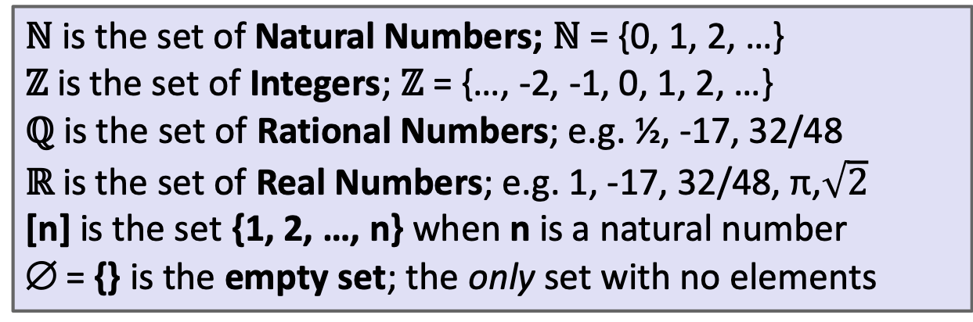
Some Common Sets
ℕ is the set of Natural Numbers; ℕ = {0, 1, 2, …}
ℤ is the set of Integers; ℤ = {…, -2, -1, 0, 1, 2, …}
ℚ is the set of Rational Numbers; e.g. ½, -17, 32/48
ℝ is the set of Real Numbers; e.g. 1, -17, 32/48, π,$\sqrt{2}$
[n] is the set {1, 2, …, n} when n is a natural number
∅ = {} is the empty set; the only set with no elements
Give some examples:
Finite sets,
Multiple domains
N, Z, Q, R
Emptyset
Sets containing sets

Slide 4
Sets can be elements of other sets
For example
A = {{1},{2},{1,2},∅}
B = {1,2}
Then B ∈ A.

Slide 5
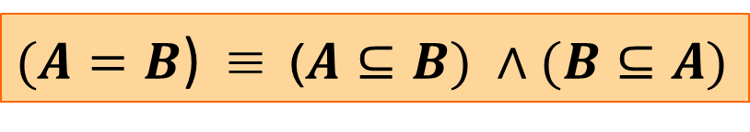
Definitions
A and B are equal if they have the same elements
A is a subset of B if every element of A is also in B
Notes:
A = B ::= ∀ x (x ∈ A ↔ x ∈ B)
A ⊆ B ::= ∀ x (x ∈ A → x ∈ B)
A ⊇ B means B ⊆ A
A ⊂ B means A ⊆ B
A ⊂ B

Slide 6
Definition: Equality
A and B are equal if they have the same elements
A = B ::= ∀ x (x ∈ A ↔ x ∈ B)
A = {1, 2, 3}
B = {3, 4, 5}
C = {3, 4}
D = {4, 3, 3}
E = {3, 4, 3}
F = {4, {3}}
Which sets are equal to each other?
A ⊂ B
Notes:
C = D = E

Slide 7
Definition: Subset
A is a subset of B if every element of A is also in B
A ⊆ B ::= ∀ x (x ∈ A → x ∈ B)
A = {1, 2, 3}
B = {3, 4, 5}
C = {3, 4}
QUESTIONS
∅ ⊆ A?
A ⊆ B?
C ⊆ B?
A ⊂ B
Notes:
Note the domain restriction!

Slide 8
Definition: Subset
A is a subset of B if every element of A is also in B
A ⊆ B ::= ∀ x (x ∈ A → x ∈ B)
Note the domain restriction.
We will use a shorthand restriction to a set
∀x∈A (P(x)) := ∀x (x ∈ A → P(x))
Restricting all quantified variables improves clarity
A ⊂ B

Slide 9
Sets & Logic

Slide 10
Building Sets from Predicates
Every set S defines a predicate “x ∈ S”.
We can also define a set from a predicate P:
S = the set of all x for which P(x) is true
S ::= {x : P(x)}
S ::= {x ∈ U : P(x)} = {x : (x ∈ U) ∧ P(x)}
A ⊂ B

Slide 11
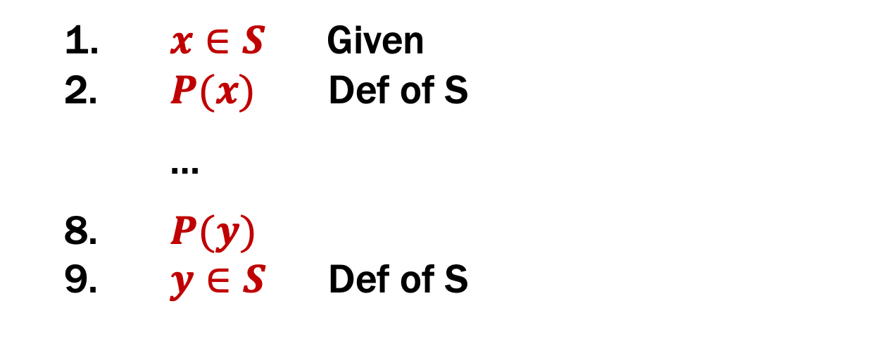
Inference Rules on Sets
When a set is defined this way, we can reason about it using its definition:
S ::= {x : P(x)}
1. $x∈S$ Given
$P(x)$ Def of S
…
8. $P(y)$
9. $y∈S$ Def of S
This will be our only inference rule for sets!
A ⊂ B

Slide 12
Proofs About Sets
Suppose we want to prove A ⊆ B.
A ::= {x : P(x)}
B ::= {x : Q(x)}
This is a predicate:
A ⊆ B ::= ∀x (x ∈ A → x ∈ B)
We need to show that is definition holds
A ⊂ B

Slide 13
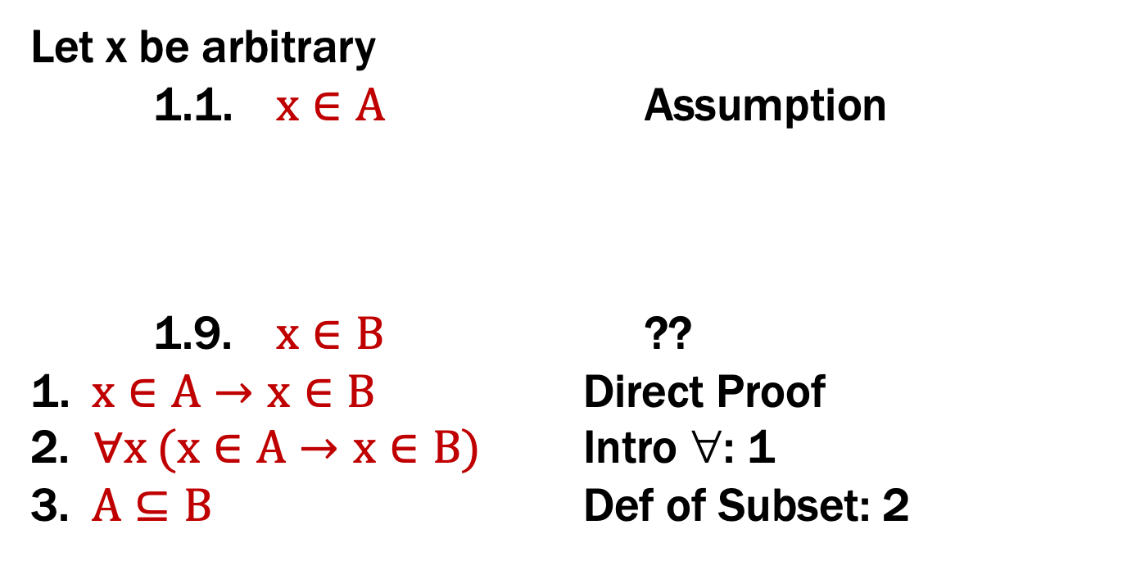
Proofs About Sets
A ::= {x : P(x)}
B ::= {x : Q(x)}
Let x be arbitrary
1.1. $x∈A$ Assumption
1.9. $x∈B$ ??
1. $x∈A→x∈B$ Direct Proof
2. $∀x (x∈A→x∈B)$ Intro ∀: 1
3. $A⊆B$ Def of Subset: 2
A ⊂ B

Slide 14
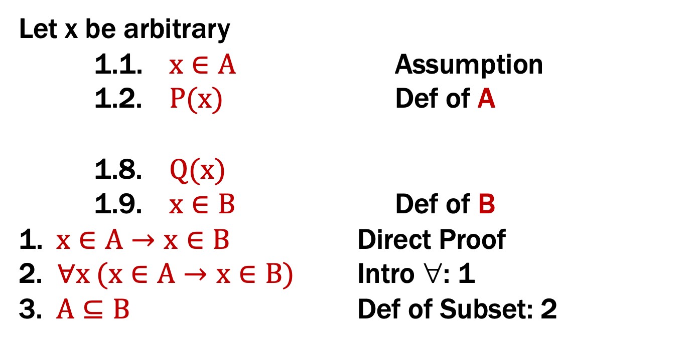
Proofs About Sets
A ::= {x : P(x)}
B ::= {x : Q(x)}
Let x be arbitrary
1.1. $x∈A$ Assumption
1.2. $P(x)$ Def of A
1.8. $Q(x)$
1.9. $x∈B$ Def of B
1. $x∈A→x∈B$ Direct Proof
2. $∀x (x∈A→x∈B)$ Intro ∀: 1
3. $A⊆B$ Def of Subset: 2
A ⊂ B

Slide 15
Proofs About Sets
Prove that A ⊆ B.
Proof: Let x be an arbitrary object.
Suppose that x ∈ P. By definition, this means P(x).
…
Thus, we have Q(x). By definition, this means x ∈ B.
Since x was arbitrary, we have shown, by definition, that A ⊆ B.
A ::= {x : P(x)}
B ::= {x : Q(x)}
A ⊂ B

Slide 16
Operations on Sets

Slide 17
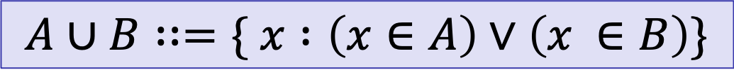
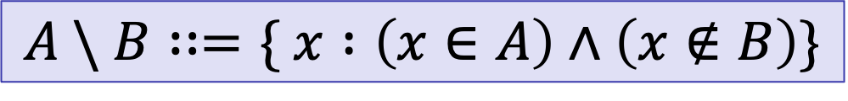
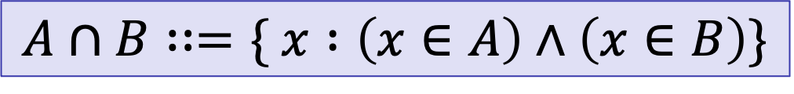
Set Operations
$$A∪B∷=\{ x :\left(x∈A\right)∨\left(x ∈B\right)\}$$
Union
$$A∩B∷=\{ x :\left(x∈A\right)∧\left(x∈B\right)\}$$
Intersection
$$A \backslash B∷=\{ x :\left(x∈A\right)∧\left(x∉B\right)\}$$
Set Difference
A = {1, 2, 3}
B = {3, 5, 6} C = {3, 4}
QUESTIONS
Using A, B, C and set operations, make…
[6] =
{3} =
{1,2} =

Slide 18
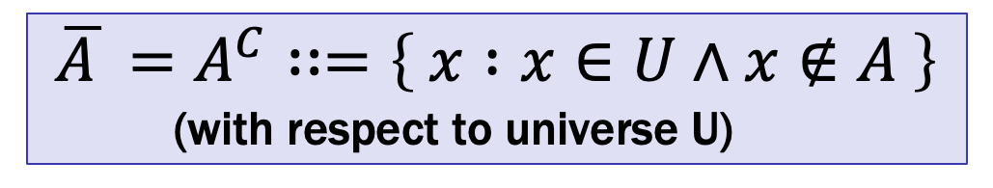
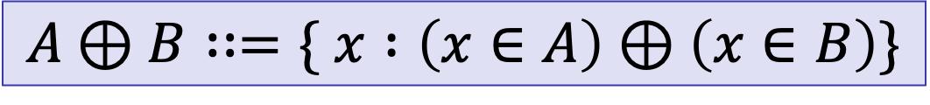
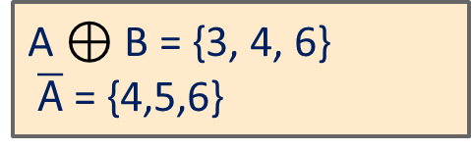
More Set Operations
$$A⊕B∷=\{ x :\left(x∈A\right)⊕\left(x∈B\right)\}$$
Symmetric
Difference
$\overline{A }=A^{C}∷=\left\{ x :x∈U∧x∉A \right\}$
(with respect to universe U)
Complement
A = {1, 2, 3}
B = {1, 2, 4, 6}
Universe:
U = {1, 2, 3, 4, 5, 6}
A $⊕$ B = {3, 4, 6}
$\overline{A}$ = {4,5,6}

Slide 19
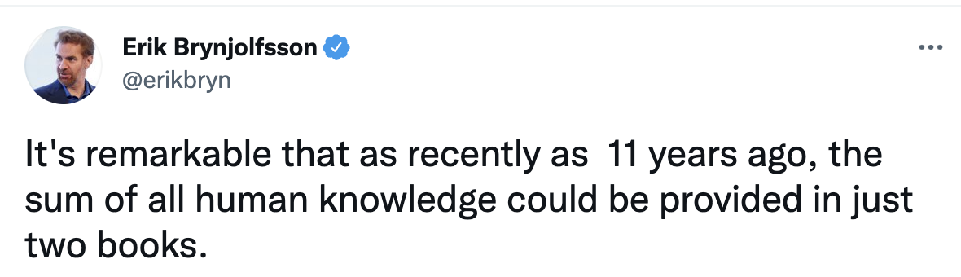



Set Complement

Slide 20
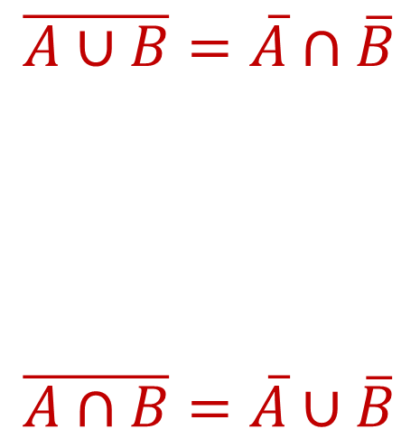
De Morgan’s Laws
Prove A ∪ B = A ∩ B
Begin with x ∈ A ∪ B ↔ x ∈ A ∨ x ∈ B

Slide 21
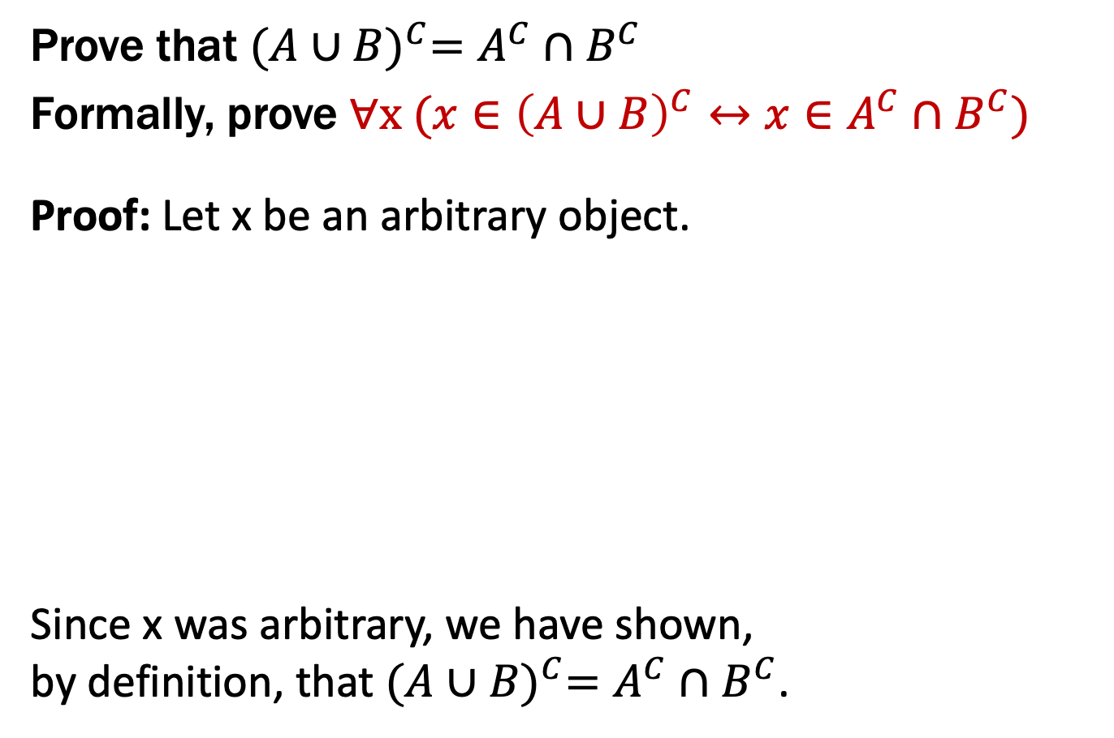
De Morgan’s Laws
Prove that ${(A∪B)}^{C}=A^{C}∩B^{C}$
Formally, prove ∀x ($x∈{\left(A∪B\right)}^{C}↔x∈A^{C}∩B^{C}$)
Proof: Let x be an arbitrary object.
Since x was arbitrary, we have shown, by definition, that ${(A∪B)}^{C}=A^{C}∩B^{C}$.
Prove A ∪ B = A ∩ B
Begin with x ∈ A ∪ B ↔ x ∈ A ∨ x ∈ B
Proof technique:
To show C = D show
x ∈ C → x ∈ D and
x ∈ D → x ∈ C

Slide 22
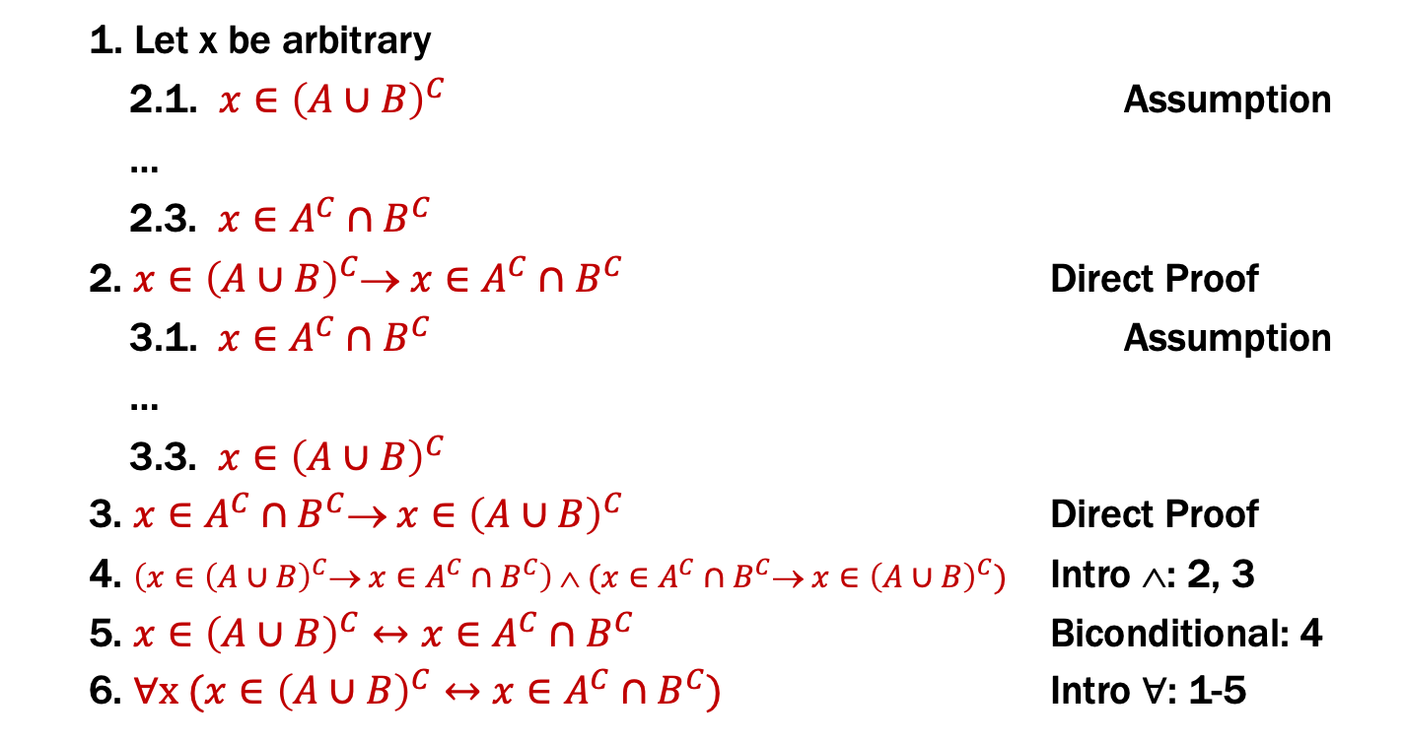
De Morgan’s Laws
Formally, prove ∀x ($x∈{\left(A∪B\right)}^{C}↔x∈A^{C}∩B^{C}$)
1. Let x be arbitrary
2.1. $x∈{\left(A∪B\right)}^{C}$ Assumption
…
2.3. $x∈A^{C}∩B^{C}$
2. $x∈{\left(A∪B\right)}^{C}→ x∈A^{C}∩B^{C}$ Direct Proof
3.1. $x∈A^{C}∩B^{C}$ Assumption
…
3.3. $x∈{\left(A∪B\right)}^{C}$
3. $x∈A^{C}∩B^{C}→ x∈{\left(A∪B\right)}^{C}$ Direct Proof
4. $\left(x∈{\left(A∪B\right)}^{C}→ x∈A^{C}∩B^{C}\right) ∧ (x∈A^{C}∩B^{C}→ x∈{\left(A∪B\right)}^{C})$ Intro $$: 2, 3
5. $x∈{\left(A∪B\right)}^{C}↔x∈A^{C}∩B^{C}$ Biconditional: 4
6. ∀x ($x∈{\left(A∪B\right)}^{C}↔x∈A^{C}∩B^{C}$) Intro ∀: 1-5
Prove A ∪ B = A ∩ B
Begin with x ∈ A ∪ B ↔ x ∈ A ∨ x ∈ B

Slide 23
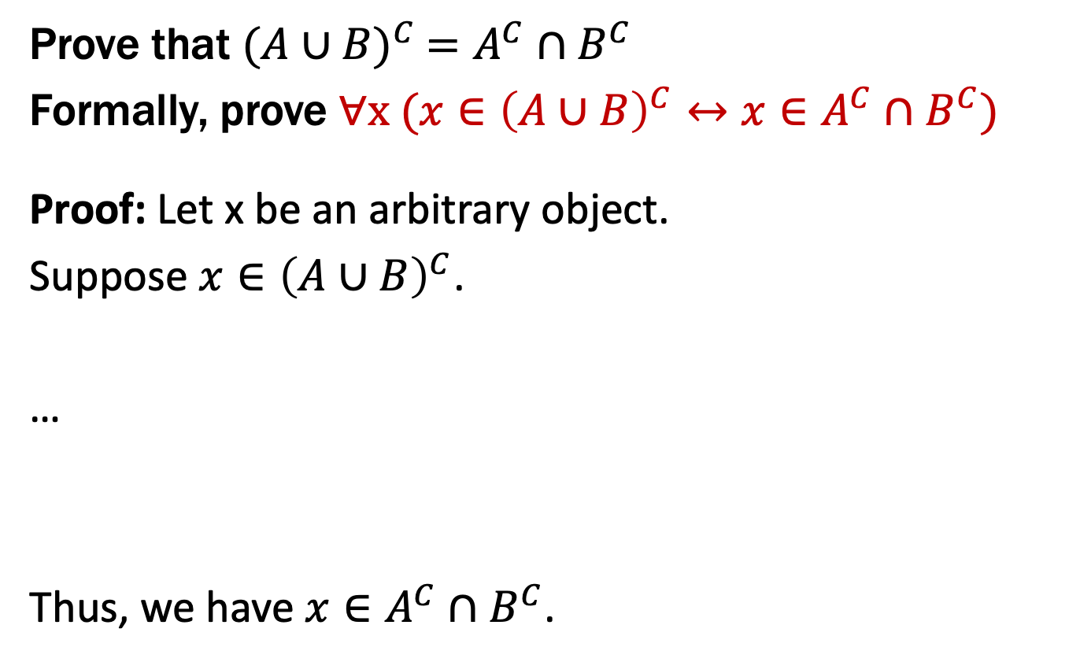
De Morgan’s Laws
Prove that ${(A∪B)}^{C} =A^{C}∩B^{C}$
Formally, prove ∀x ($x∈{\left(A∪B\right)}^{C}↔x∈A^{C}∩B^{C}$)
Proof: Let x be an arbitrary object.
Suppose $x∈{\left(A∪B\right)}^{C}$.
…
Thus, we have $x∈A^{C}∩B^{C}$.
Prove A ∪ B = A ∩ B
Begin with x ∈ A ∪ B ↔ x ∈ A ∨ x ∈ B

Slide 24
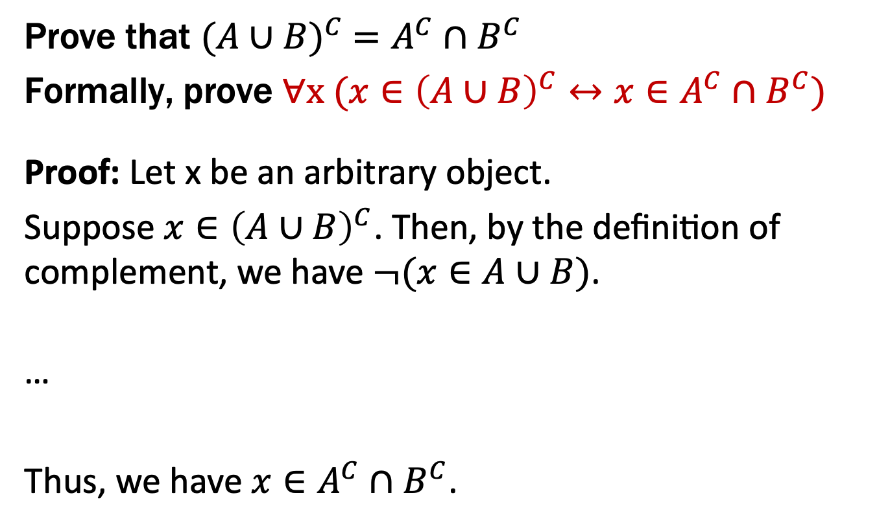
De Morgan’s Laws
Prove that ${(A∪B)}^{C} =A^{C}∩B^{C}$
Formally, prove ∀x ($x∈{\left(A∪B\right)}^{C}↔x∈A^{C}∩B^{C}$)
Proof: Let x be an arbitrary object.
Suppose $x∈{\left(A∪B\right)}^{C}$. Then, by the definition of complement, we have $¬(x∈A∪B)$.
…
Thus, we have $x∈A^{C}∩B^{C}$.
Prove A ∪ B = A ∩ B
Begin with x ∈ A ∪ B ↔ x ∈ A ∨ x ∈ B

Slide 25
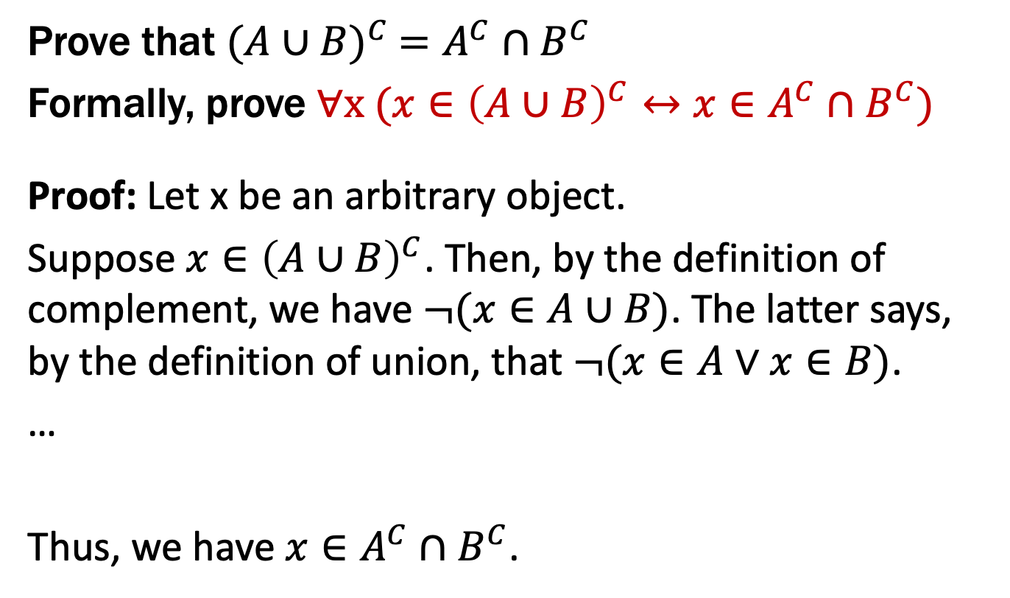
De Morgan’s Laws
Prove that ${(A∪B)}^{C} =A^{C}∩B^{C}$
Formally, prove ∀x ($x∈{\left(A∪B\right)}^{C}↔x∈A^{C}∩B^{C}$)
Proof: Let x be an arbitrary object.
Suppose $x∈{\left(A∪B\right)}^{C}$. Then, by the definition of complement, we have $¬(x∈A∪B)$. The latter says, by the definition of union, that $¬(x∈A∨x∈B)$.
…
Thus, we have $x∈A^{C}∩B^{C}$.
Prove A ∪ B = A ∩ B
Begin with x ∈ A ∪ B ↔ x ∈ A ∨ x ∈ B

Slide 26
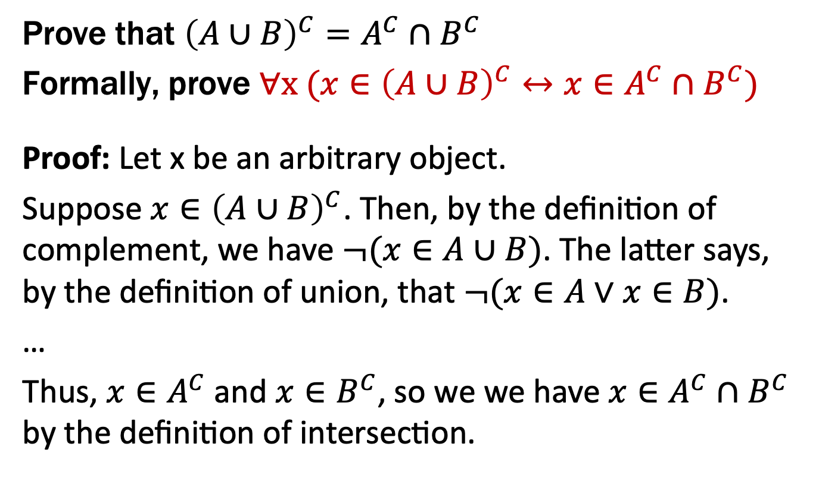
De Morgan’s Laws
Prove that ${\left(A∪B\right)}^{C}=A^{C}∩B^{C}$
Formally, prove ∀x ($x∈{\left(A∪B\right)}^{C}↔x∈A^{C}∩B^{C}$)
Proof: Let x be an arbitrary object.
Suppose $x∈{\left(A∪B\right)}^{C}$. Then, by the definition of complement, we have $¬(x∈A∪B)$. The latter says, by the definition of union, that $¬(x∈A∨x∈B)$.
…
Thus, $x∈A^{C}$ and $x∈B^{C}$, so we we have $x∈A^{C}∩B^{C}$ by the definition of intersection.
Prove A ∪ B = A ∩ B
Begin with x ∈ A ∪ B ↔ x ∈ A ∨ x ∈ B

Slide 27
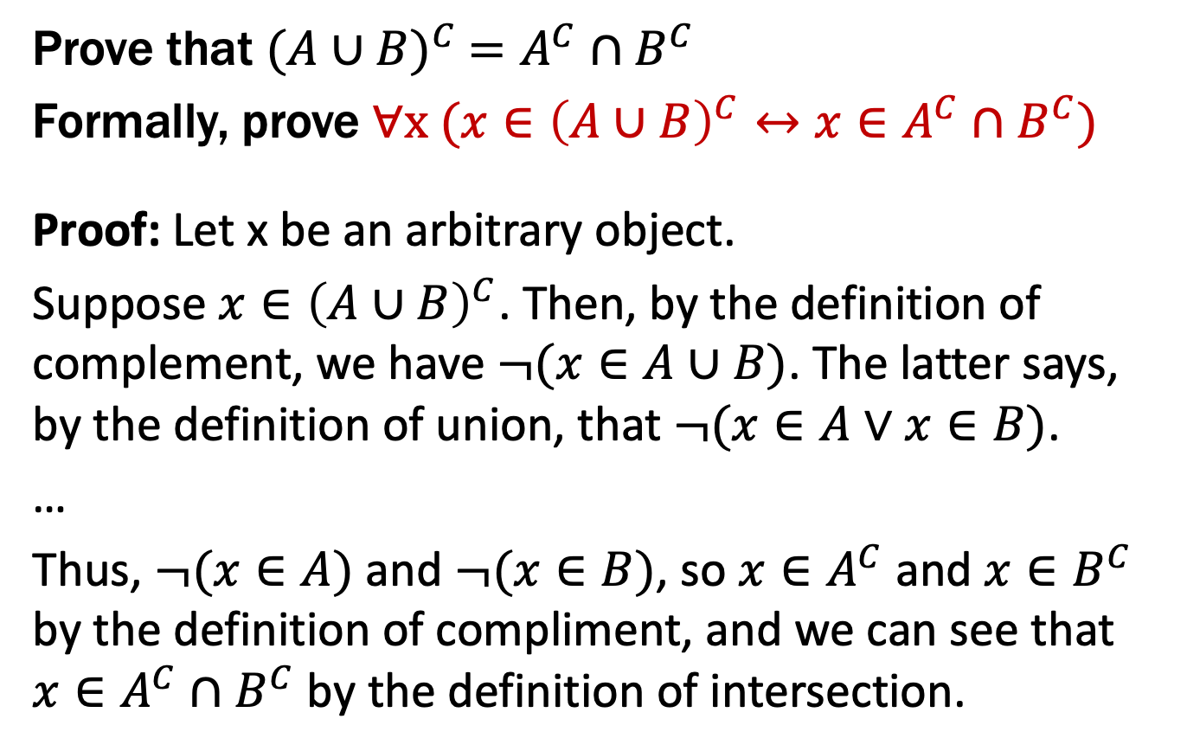
De Morgan’s Laws
Prove that ${(A∪B)}^{C} =A^{C}∩B^{C}$
Formally, prove ∀x ($x∈{\left(A∪B\right)}^{C}↔x∈A^{C}∩B^{C}$)
Proof: Let x be an arbitrary object.
Suppose $x∈{\left(A∪B\right)}^{C}$. Then, by the definition of complement, we have $¬(x∈A∪B)$. The latter says, by the definition of union, that $¬(x∈A∨x∈B)$.
…
Thus, $¬(x∈A)$ and $¬(x∈B)$, so $x∈A^{C}$ and $x∈B^{C}$ by the definition of compliment, and we can see that $x∈A^{C}∩B^{C}$ by the definition of intersection.
Prove A ∪ B = A ∩ B
Begin with x ∈ A ∪ B ↔ x ∈ A ∨ x ∈ B

Slide 28
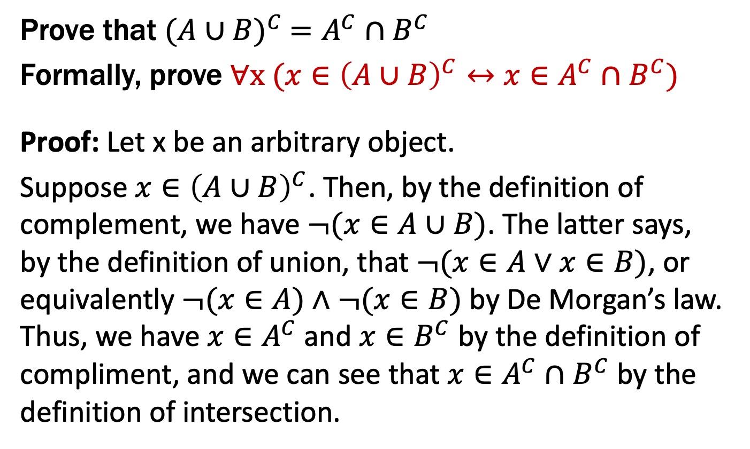
De Morgan’s Laws
Prove that ${(A∪B)}^{C} =A^{C}∩B^{C}$
Formally, prove ∀x ($x∈{\left(A∪B\right)}^{C}↔x∈A^{C}∩B^{C}$)
Proof: Let x be an arbitrary object.
Suppose $x∈{\left(A∪B\right)}^{C}$. Then, by the definition of complement, we have $¬(x∈A∪B)$. The latter says, by the definition of union, that $¬(x∈A∨x∈B)$, or equivalently $¬(x∈A)∧¬(x∈B)$ by De Morgan’s law. Thus, we have $x∈A^{C}$ and $x∈B^{C}$ by the definition of compliment, and we can see that $x∈A^{C}∩B^{C}$ by the definition of intersection.
Prove A ∪ B = A ∩ B
Begin with x ∈ A ∪ B ↔ x ∈ A ∨ x ∈ B
Proof technique:
To show C = D show
x ∈ C → x ∈ D and
x ∈ D → x ∈ C

Slide 29
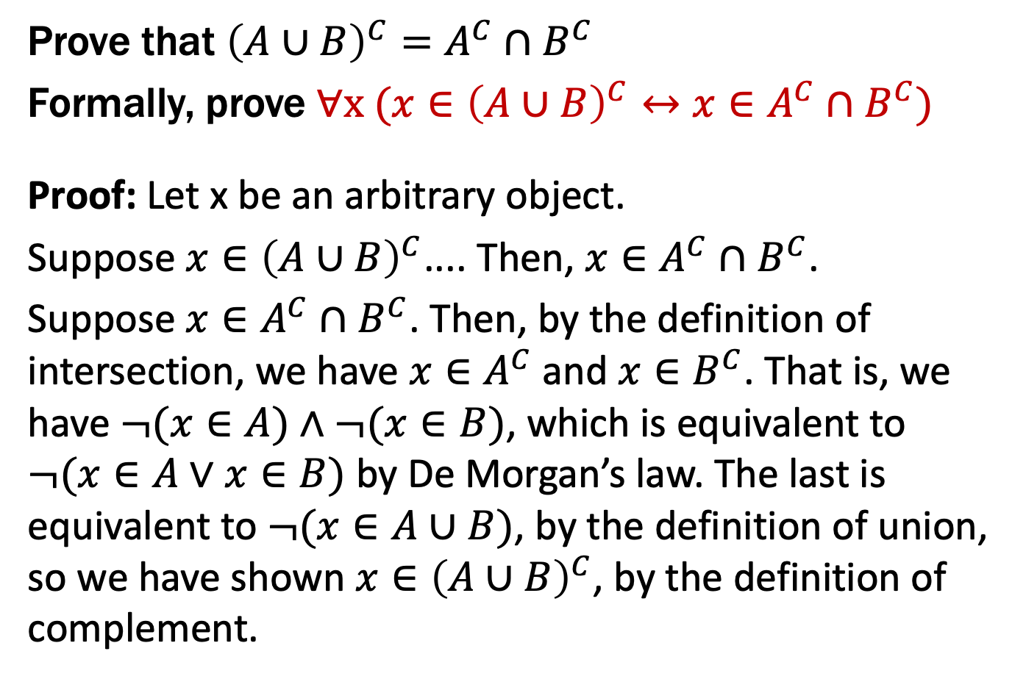
De Morgan’s Laws
Prove that ${\left(A∪B\right)}^{C}=A^{C}∩B^{C}$
Formally, prove ∀x ($x∈{\left(A∪B\right)}^{C}↔x∈A^{C}∩B^{C}$)
Proof: Let x be an arbitrary object.
Suppose $x∈{\left(A∪B\right)}^{C}$.... Then, $x∈A^{C}∩B^{C}$.
Suppose $x∈A^{C}∩B^{C}$. Then, by the definition of intersection, we have $x∈A^{C}$ and $x∈B^{C}$. That is, we have $¬(x∈A)∧¬(x∈B)$, which is equivalent to $¬(x∈A∨x∈B)$ by De Morgan’s law. The last is equivalent to $¬(x∈A∪B)$, by the definition of union, so we have shown $x∈{\left(A∪B\right)}^{C}$, by the definition of complement.
Prove A ∪ B = A ∩ B
Begin with x ∈ A ∪ B ↔ x ∈ A ∨ x ∈ B

Slide 30
Proofs About Set Equality
A lot of repetitive work to show → and ←.
Do we have a way to prove ↔︎ directly?
We can use an equivalence chain to prove that a biconditional holds.
Recall that A ≡ B and (A ↔ B) ≡ T are the same

Slide 31
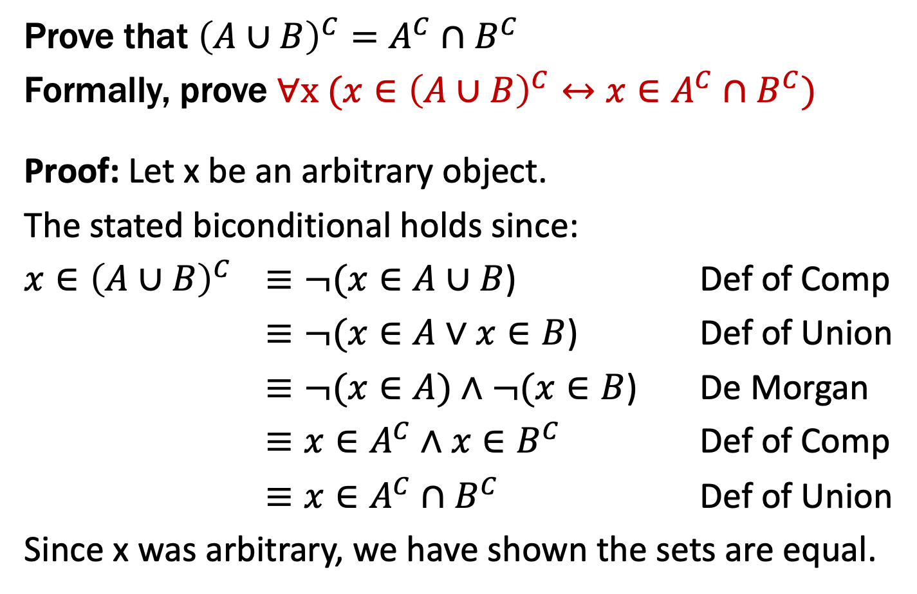
De Morgan’s Laws
Prove that ${\left(A∪B\right)}^{C}=A^{C}∩B^{C}$
Formally, prove ∀x ($x∈{\left(A∪B\right)}^{C}↔x∈A^{C}∩B^{C}$)
Proof: Let x be an arbitrary object.
The stated biconditional holds since:
$x∈{\left(A∪B\right)}^{C}$ $≡¬(x∈A∪B$) Def of Comp
$≡¬(x∈A∨x∈B$) Def of Union
$≡¬(x∈A)∧¬(x∈B$) De Morgan
$≡x∈A^{C}∧x∈B^{C}$ Def of Comp
$≡x∈A^{C}∩B^{C}$ Def of Union
Since x was arbitrary, we have shown the sets are equal.
Chains of equivalences are often easier to read like this rather than as English text
Prove A ∪ B = A ∩ B
Begin with x ∈ A ∪ B ↔ x ∈ A ∨ x ∈ B

Slide 32
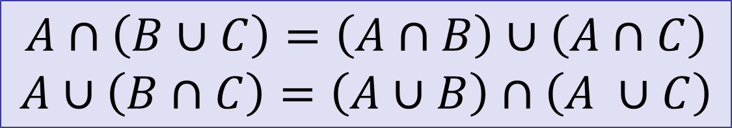
Distributive Laws
$$A∩\left(B∪C\right)=\left(A∩B\right)∪\left(A∩C\right)$$
$$A∪\left(B∩C\right)=\left(A∪B\right)∩\left(A ∪C\right)$$
A
B
A
B
C
C

Slide 33
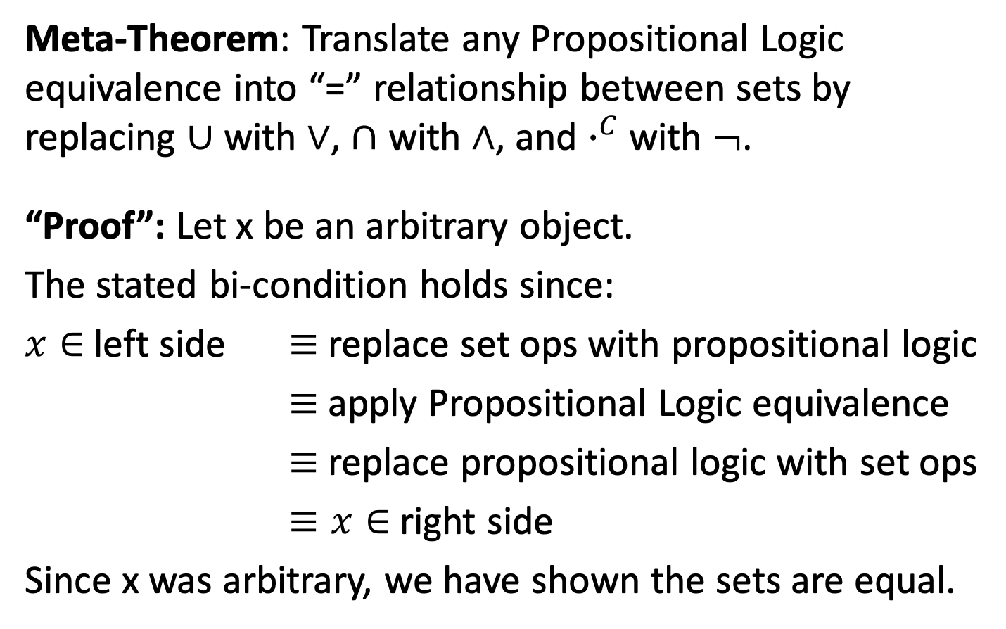
It’s Propositional Logic Again!
Meta-Theorem: Translate any Propositional Logic equivalence into “=” relationship between sets by replacing $∪$ with $∨$, $∩$ with $∧$, and $∙^{C}$ with $¬$.
“Proof”: Let x be an arbitrary object.
The stated bi-condition holds since:
$x∈$ left side $≡$ replace set ops with propositional logic
$≡$ apply Propositional Logic equivalence
$≡$ replace propositional logic with set ops
$≡x∈$ right side
Since x was arbitrary, we have shown the sets are equal.
Prove A ∪ B = A ∩ B
Begin with x ∈ A ∪ B ↔ x ∈ A ∨ x ∈ B

Slide 34
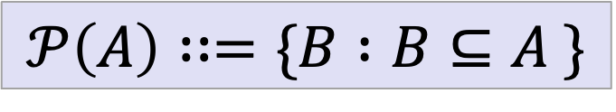
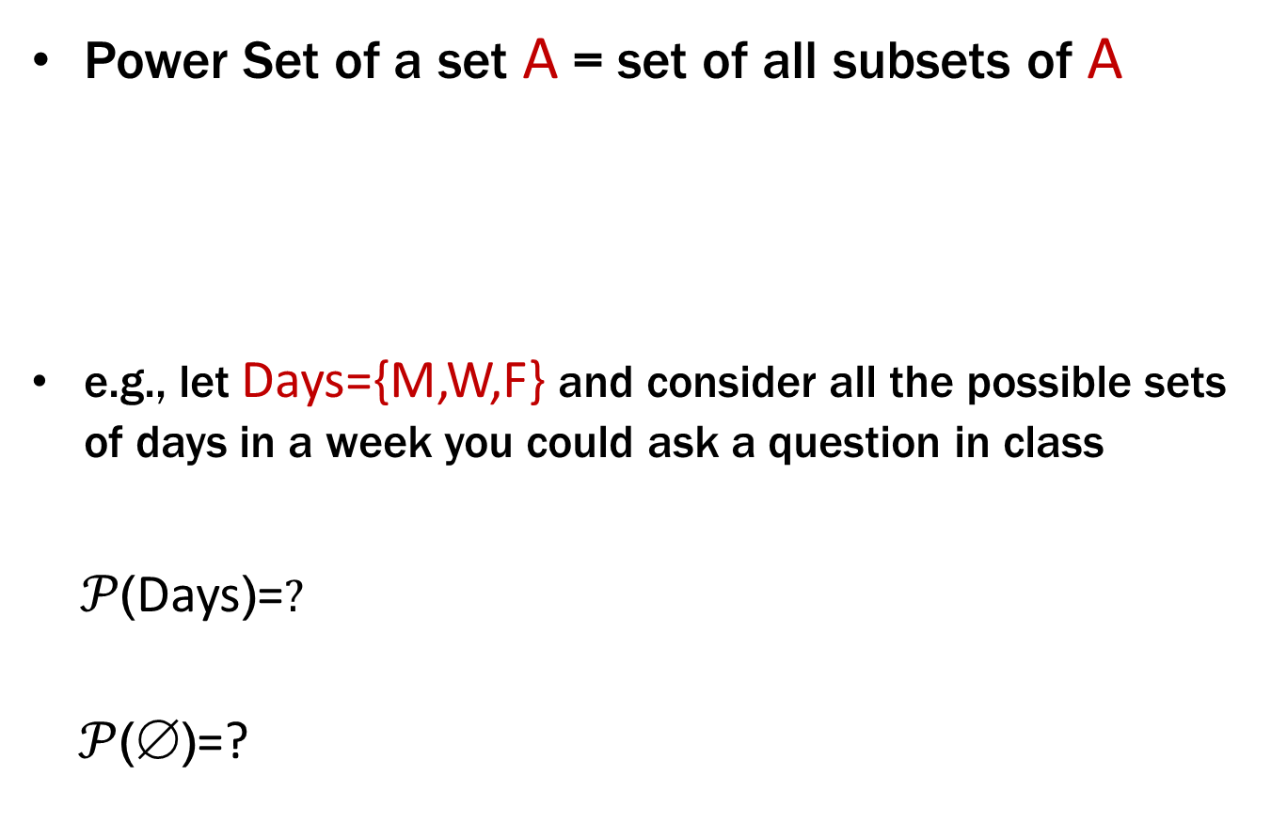
Power Set
Power Set of a set A = set of all subsets of A
e.g., let Days={M,W,F} and consider all the possible sets of days in a week you could ask a question in class
$𝒫$(Days)=$?$
$𝒫$($\text{}$)=?
$$𝒫\left(A\right)∷=\{B :B⊆A \}$$

Slide 35
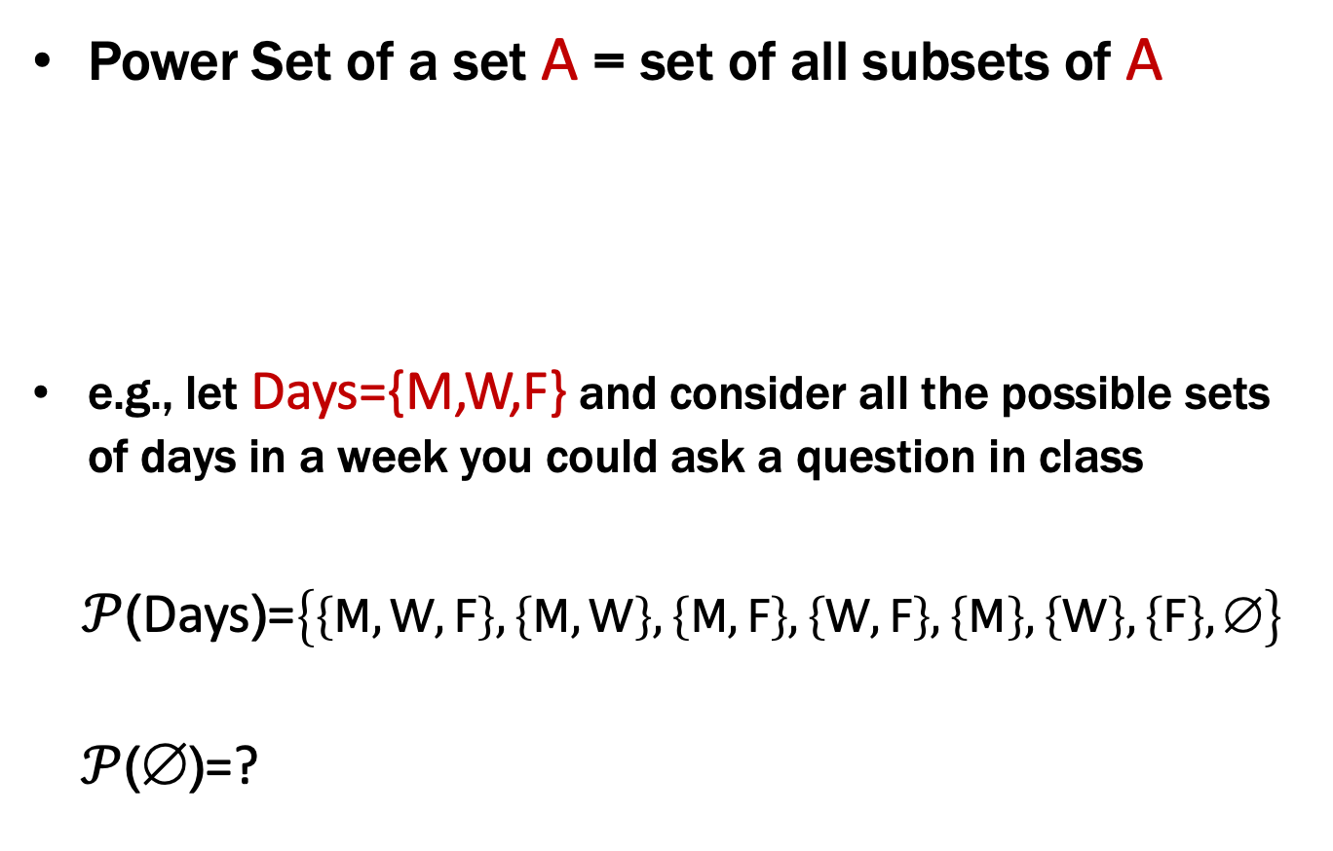
Power Set
Power Set of a set A = set of all subsets of A
e.g., let Days={M,W,F} and consider all the possible sets of days in a week you could ask a question in class
$𝒫$(Days)=$\left\{\left\{M,W,F\right\},\left\{M,W\right\},\left\{M,F\right\},\left\{W,F\right\},\left\{M\right\},\left\{W\right\},\left\{F\right\},\text{∅}\right\}$
$𝒫$($\text{}$)=?
$$𝒫\left(A\right)∷=\{B :B⊆A \}$$

Slide 36
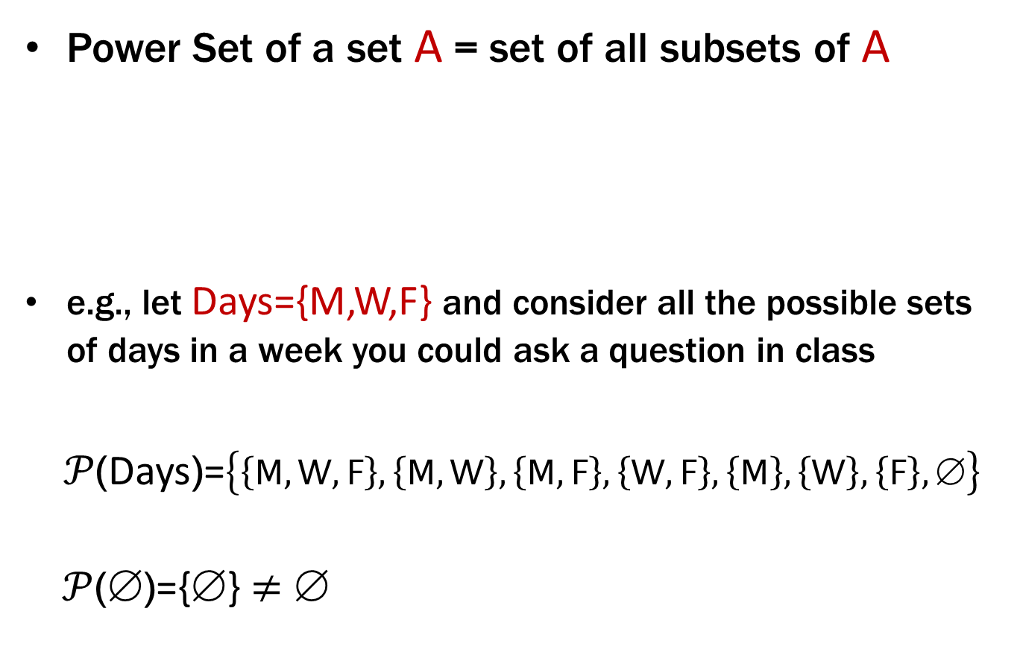
Power Set
Power Set of a set A = set of all subsets of A
e.g., let Days={M,W,F} and consider all the possible sets of days in a week you could ask a question in class
$𝒫$(Days)=$\left\{\left\{M,W,F\right\},\left\{M,W\right\},\left\{M,F\right\},\left\{W,F\right\},\left\{M\right\},\left\{W\right\},\left\{F\right\},\text{∅}\right\}$
$𝒫$($\text{}$)={$\text{}$} ≠ $\text{}$
$$𝒫\left(A\right)∷=\{B :B⊆A \}$$

Slide 37
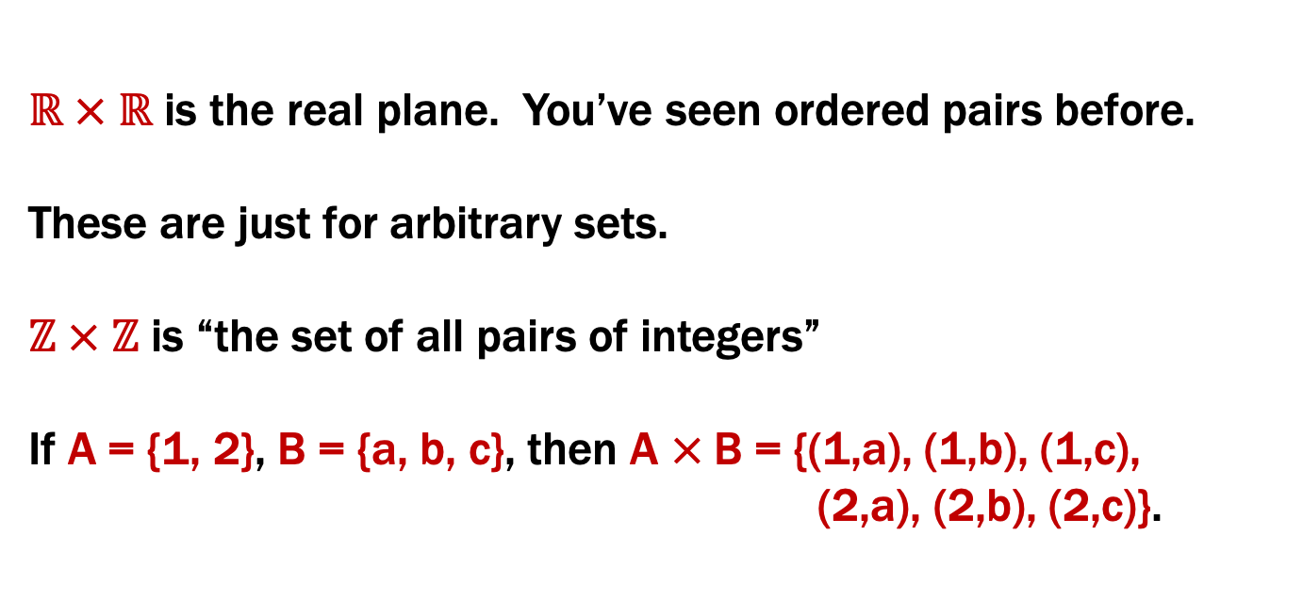
Cartesian Product
$$A×B∷=\{x :∃a∈A, ∃b∈B (x=(a,b)) \}$$
$ℝ × ℝ$ is the real plane. You’ve seen ordered pairs before.
These are just for arbitrary sets.
$ℤ × ℤ$ is “the set of all pairs of integers”
If A = {1, 2}, B = {a, b, c}, then A × B = {(1,a), (1,b), (1,c),
(2,a), (2,b), (2,c)}.

Slide 38
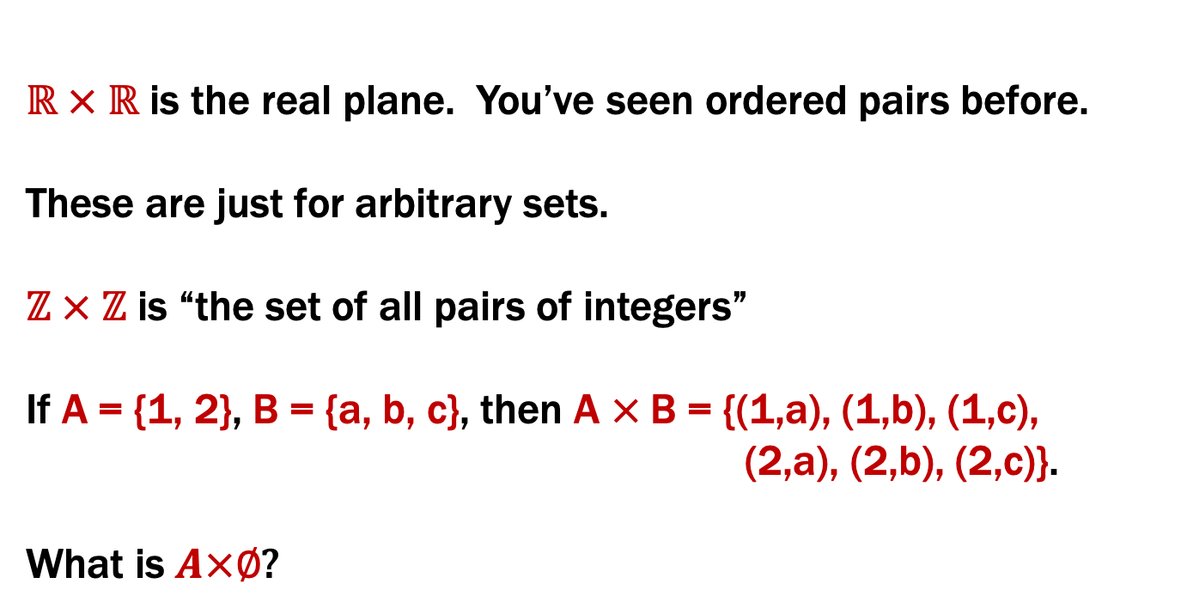
Cartesian Product
$$A×B∷=\{x :∃a∈A, ∃b∈B (x=(a,b)) \}$$
$ℝ × ℝ$ is the real plane. You’ve seen ordered pairs before.
These are just for arbitrary sets.
$ℤ × ℤ$ is “the set of all pairs of integers”
If A = {1, 2}, B = {a, b, c}, then A × B = {(1,a), (1,b), (1,c),
(2,a), (2,b), (2,c)}.
What is $A×∅$?

Slide 39
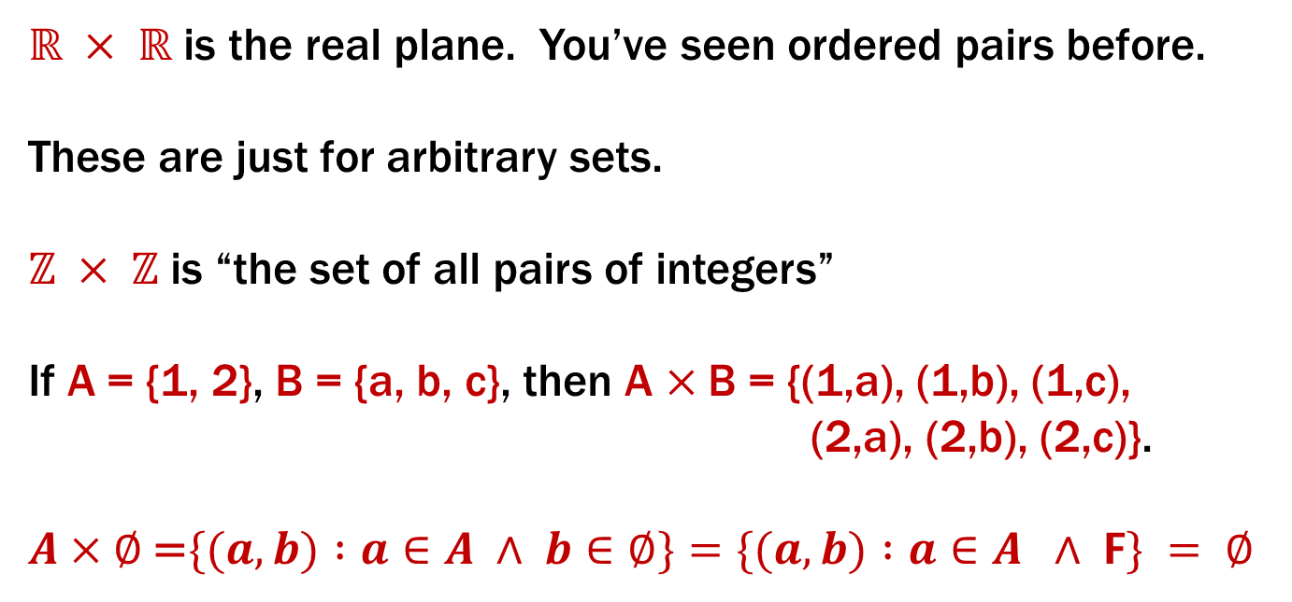
Cartesian Product
$$A×B∷=\{x :∃a∈A, ∃b∈B (x=(a,b)) \}$$
$ℝ × ℝ$ is the real plane. You’ve seen ordered pairs before.
These are just for arbitrary sets.
$ℤ × ℤ$ is “the set of all pairs of integers”
If A = {1, 2}, B = {a, b, c}, then A × B = {(1,a), (1,b), (1,c),
(2,a), (2,b), (2,c)}.
$A×∅$ =$\{(a, b) :a∈A ∧ b∈∅\}=\{(a, b) :a∈A ∧ F\} = ∅$

Slide 40
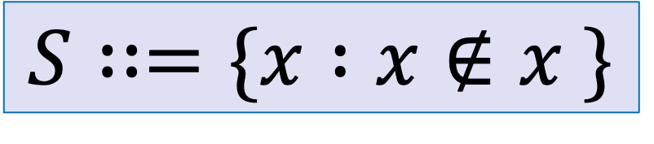
Russell’s Paradox
$$S∷=\{x :x∉x \}$$
Suppose that $S∈S$…

Slide 41
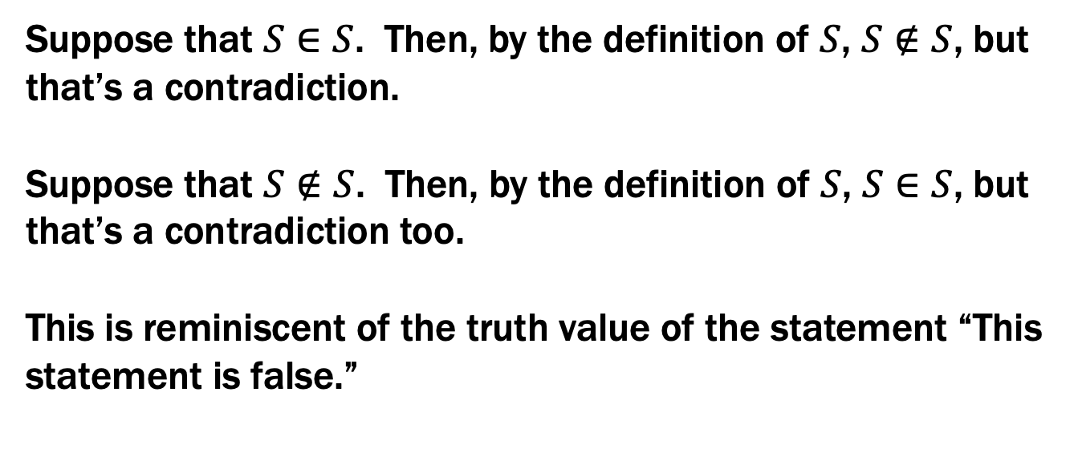
Russell’s Paradox
$$S∷=\{x :x∉x \}$$
Suppose that $S∈S$. Then, by the definition of $S$, $S∉S$, but that’s a contradiction.
Suppose that $S∉S$. Then, by the definition of $S$, $S∈S$, but that’s a contradiction too.
This is reminiscent of the truth value of the statement “This statement is false.”

Slide 42
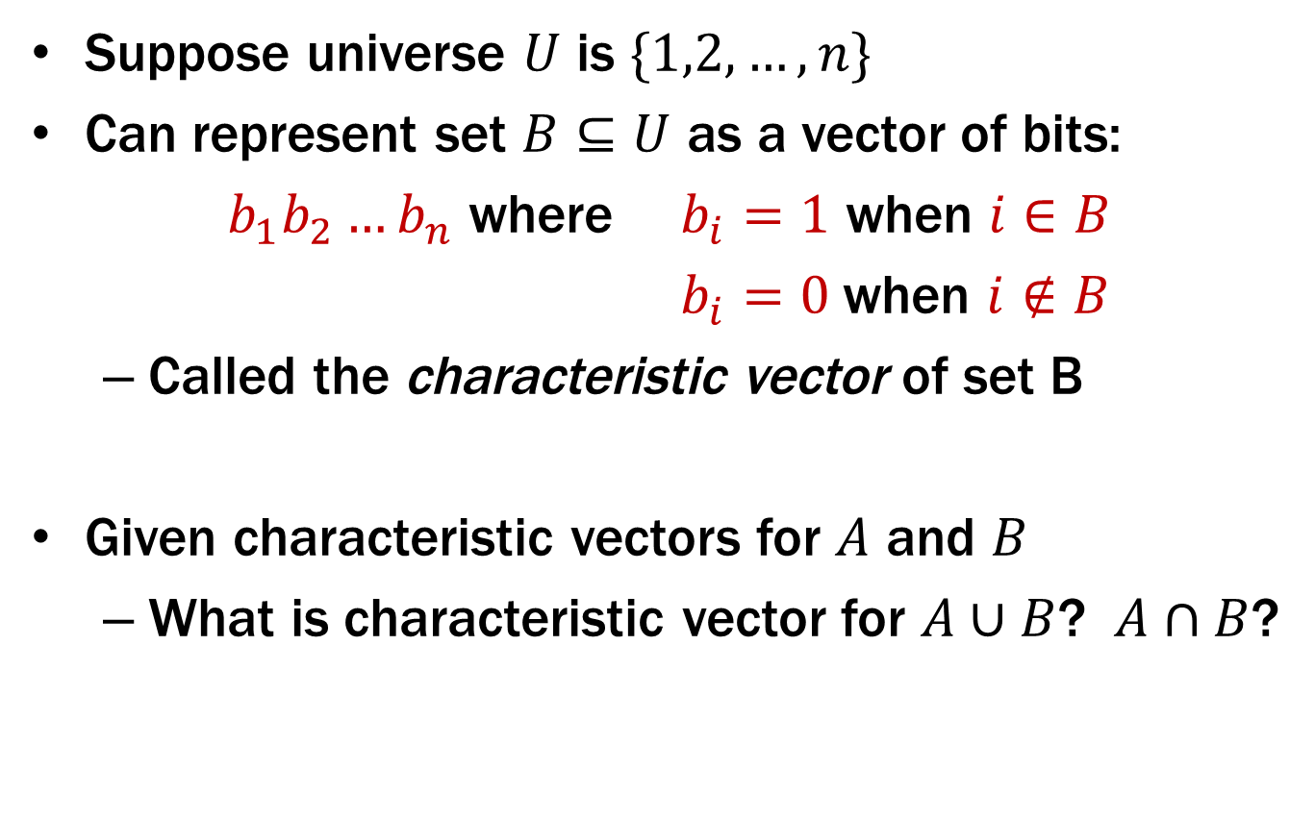
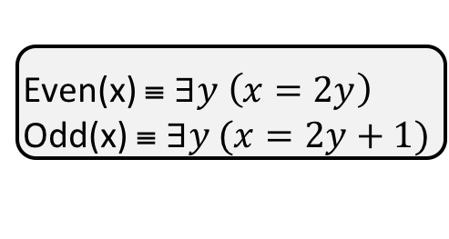
Representing Sets Using Bits
Suppose universe $U$ is $\{1,2,…,n\}$
Can represent set $B⊆U$ as a vector of bits:
$b_{1}b_{2}…b_{n}$ where $b_{i}=1$ when $i∈B$
$b_{i}=0$when $i∉B$
Called the characteristic vector of set B
Given characteristic vectors for $A$ and $B$
What is characteristic vector for $A∪B$? $A∩B$?

Slide 43
Bitwise Operations
01101101 Java: z=x|y ∨ 00110111
01111111
00101010 Java: z=x&y ∧ 00001111
00001010
01101101 Java: z=x^y
⊕ 00110111
01011010

Slide 44
A Useful Identity
If x and y are bits: (x ⊕ y) ⊕ y = ?
What if x and y are bit-vectors?

Slide 45
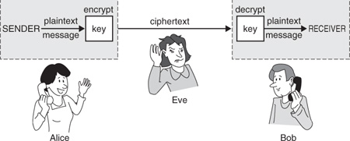
Private Key Cryptography
Alice wants to communicate message secretly to Bob so that eavesdropper Eve who hears their conversation cannot tell what Alice’s message is.
Alice and Bob can get together and privately share a secret key K ahead of time.

