Slide 1
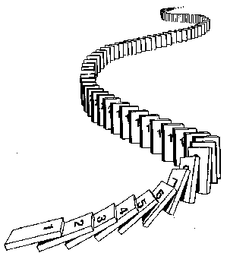
CSE 311: Foundations of Computing
Lecture 15: Induction
Notes:
Only method we have so far for proving P(n) with n in N is Let n be arbitrary …. P(n).

Slide 2
More Logic Induction

Slide 3
Mathematical Induction
Method for proving statements about all natural numbers
A new logical inference rule!
It only applies over the natural numbers
The idea is to use the special structure of the naturals to prove things more easily
Particularly useful for reasoning about programs!
for (int i=0; i < n; n++) { … }
Show P(i) holds after i times through the loop

Slide 4
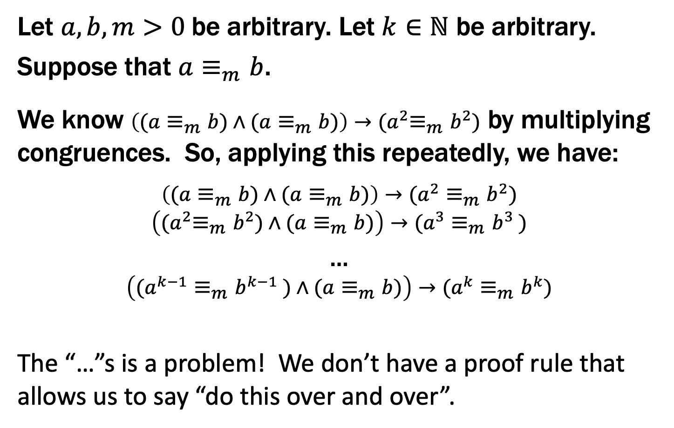
Prove $∀a,b, m>0 ∀ k∈ℕ ((a≡_{m}b)→(a^{k}≡_{m}b^{k}))$
Let $a, b,m>0$ be arbitrary. Let $k∈ℕ$ be arbitrary.
Suppose that $a≡_{m}b$.
We know $\left((a≡_{m}b)∧(a≡_{m}b)\right)→{(a}^{2}≡_{m}b^{2})$ by multiplying congruences. So, applying this repeatedly, we have:
$$\left((a≡_{m}b)∧(a≡_{m}b)\right)→(a^{2}≡_{m}b^{2})$$
$$\left({(a}^{2}≡_{m}b^{2})∧(a≡_{m}b)\right)→(a^{3}≡_{m}b^{3} )$$
…
$$\left((a^{k−1}≡_{m}b^{k−1} )∧(a≡_{m}b)\right)→(a^{k}≡_{m}b^{k})$$
The “…”s is a problem! We don’t have a proof rule that allows us to say “do this over and over”.

Slide 5
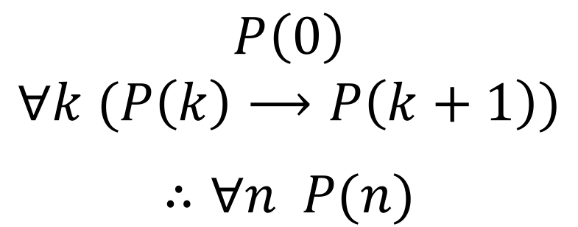
But there such a property of the natural numbers!
Domain: Natural Numbers
$$P\left(0\right)$$
$$∀k (P\left(k\right)⟶P\left(k+1\right))$$
$$∴∀n P(n)$$
Formal steps
Show P(0)
Assume P(k), Prove P(k+1), Conclude P(k)→ P(k+1)
Conclude ∀ k (P(k)→ P(k+1))
Conclude ∀ n P(n)

Slide 6
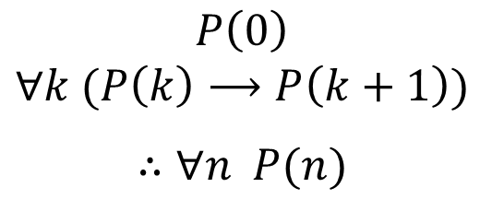
Induction Is A Rule of Inference
Domain: Natural Numbers
$$P\left(0\right)$$
$$∀k (P\left(k\right)⟶P\left(k+1\right))$$
$$∴∀n P(n)$$
How do the givens prove P(3)?
Formal steps
Show P(0)
Assume P(k), Prove P(k+1), Conclude P(k)→ P(k+1)
Conclude ∀ k (P(k)→ P(k+1))
Conclude ∀ n P(n)

Slide 7



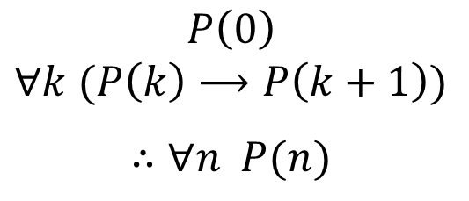



Induction Is A Rule of Inference
Domain: Natural Numbers
$$P\left(0\right)$$
$$∀k (P\left(k\right)⟶P\left(k+1\right))$$
$$∴∀n P(n)$$
How do the givens prove P(5)?
P(0)→P(1) P(1)→P(2) P(2)→P(3) P(3)→P(4 ) P(4)→P(5)
$$P(0)$$
$$P(1)$$
$$P(2)$$
$$P(3)$$
$$P(4)$$
$$P(5)$$
First, we have P(0).
Since P(n) → P(n+1) for all n, we have P(0) → P(1).
Since P(0) is true and P(0) → P(1), by Modus Ponens, P(1) is true.
Since P(n) → P(n+1) for all n, we have P(1) → P(2).
Since P(1) is true and P(1) → P(2), by Modus Ponens, P(2) is true.
Formal steps
Show P(0)
Assume P(k), Prove P(k+1), Conclude P(k)→ P(k+1)
Conclude ∀ k (P(k)→ P(k+1))
Conclude ∀ n P(n)
Notes:
P(0) Given
P(0) -> P(1) Elim forall
P(1) MP
…

Slide 8
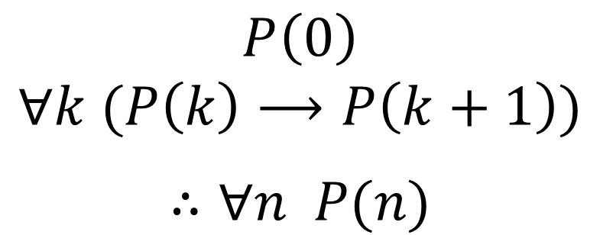
Using The Induction Rule In A Formal Proof
$$P\left(0\right)$$
$$∀k (P\left(k\right)⟶P\left(k+1\right))$$
$$∴∀n P(n)$$

Slide 9
Using The Induction Rule In A Formal Proof
$$P\left(0\right)$$
$$∀k (P\left(k\right)⟶P\left(k+1\right))$$
$$∴∀n P(n)$$
1. P(0)
Let k be an arbitrary integer ≥ 0
3.1. Assume that P(k) is true
3.2. ...
3.3. Prove P(k+1) is true
P(k) → P(k+1) Direct Proof Rule
∀k (P(k) → P(k+1)) Intro ∀: 2, 3
∀n P(n) Induction: 1, 4

Slide 10
Using The Induction Rule In A Formal Proof
$$P\left(0\right)$$
$$∀k (P\left(k\right)⟶P\left(k+1\right))$$
$$∴∀n P(n)$$
1. P(0)
Let k be an arbitrary integer ≥ 0
3.1. Assume that P(k) is true
3.2. ...
3.3. Prove P(k+1) is true
P(k) → P(k+1) Direct Proof Rule
∀k (P(k) → P(k+1)) Intro ∀: 2, 3
∀n P(n) Induction: 1, 4

Slide 11
Using The Induction Rule In A Formal Proof
$$P\left(0\right)$$
$$∀k (P\left(k\right)⟶P\left(k+1\right))$$
$$∴∀n P(n)$$
1. P(0)
Let k be an arbitrary integer ≥ 0
3.1. P(k) Assumption
3.2. ...
3.3. P(k+1)
P(k) → P(k+1) Direct Proof Rule
∀k (P(k) → P(k+1)) Intro ∀: 2, 3
∀n P(n) Induction: 1, 4

Slide 12
Translating to an English Proof
$$P\left(0\right)$$
$$∀k (P\left(k\right)⟶P\left(k+1\right))$$
$$∴∀n P(n)$$
Base Case
1. Prove P(0)
Let k be an arbitrary integer ≥ 0
3.1. Suppose that P(k) is true
3.2. ...
3.3. Prove P(k+1) is true
P(k) → P(k+1) Direct Proof Rule
∀k (P(k) → P(k+1)) Intro ∀: 2, 3
∀n P(n) Induction: 1, 4
Inductive
Hypothesis
Inductive
Step
Conclusion

Slide 13
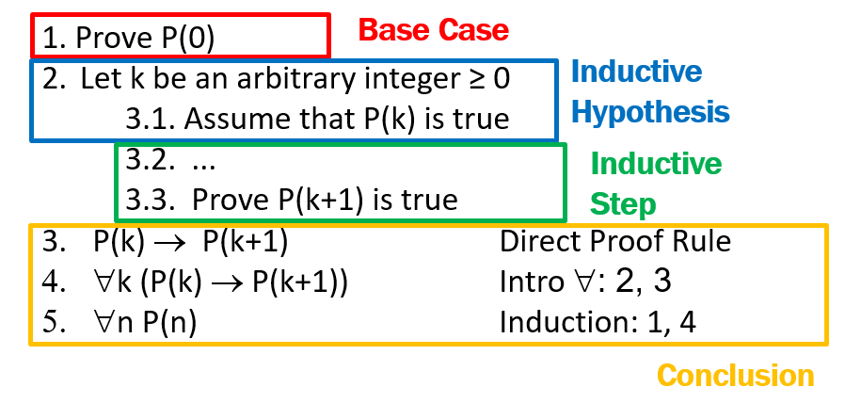
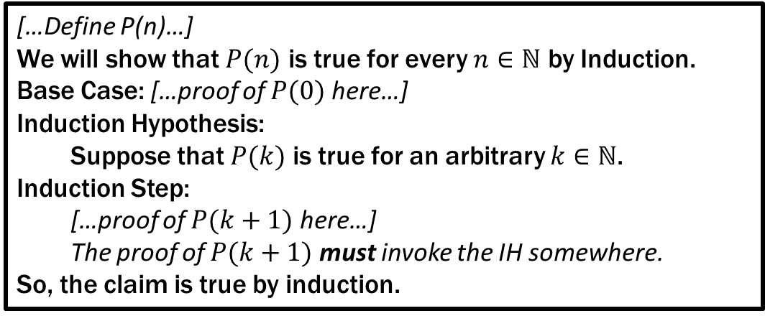
Translating to an English Proof
Induction English Proof Template
[…Define P(n)…]
We will show that $P(n)$ is true for every $n∈ℕ$ by Induction.
Base Case: […proof of $P(0)$ here…]
Induction Hypothesis:
Suppose that $P(k)$ is true for an arbitrary $k∈ℕ$.
Induction Step:
[…proof of $P(k+1)$ here…]
The proof of $P(k+1)$ must invoke the IH somewhere.
So, the claim is true by induction.

Slide 14
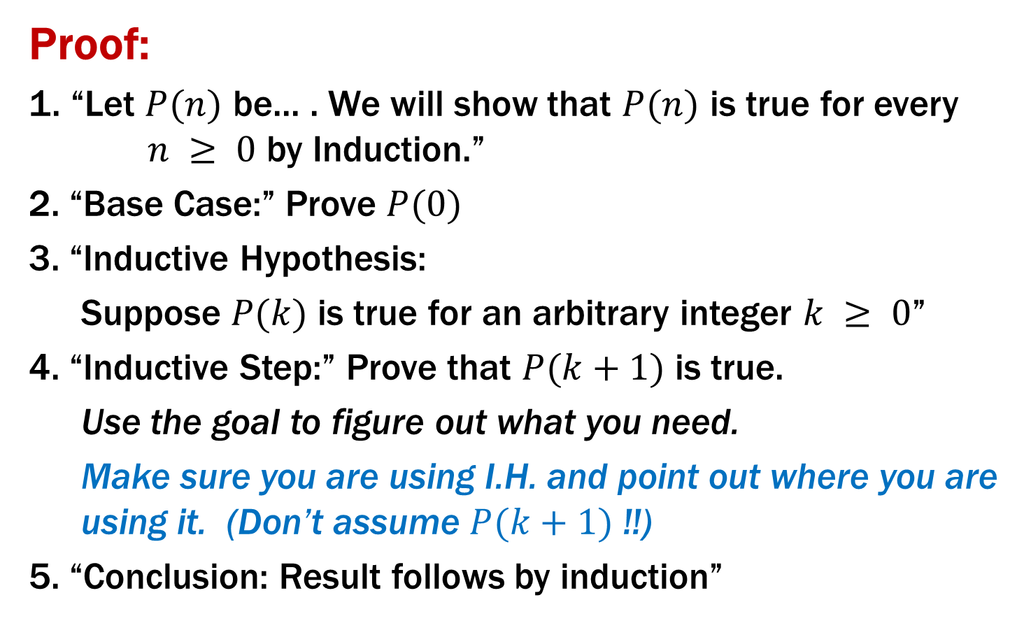
Inductive Proofs In 5 Easy Steps
Proof:
1. “Let $P(n)$ be... . We will show that $P(n)$ is true for every $n ≥ 0$ by Induction.”
2. “Base Case:” Prove $P(0)$
3. “Inductive Hypothesis:
Suppose $P(k)$ is true for an arbitrary integer $k ≥ 0$”
4. “Inductive Step:” Prove that $P(k+1)$ is true.
Use the goal to figure out what you need.
Make sure you are using I.H. and point out where you are using it. (Don’t assume $P(k+1)$ !!)
5. “Conclusion: Result follows by induction”

Slide 15
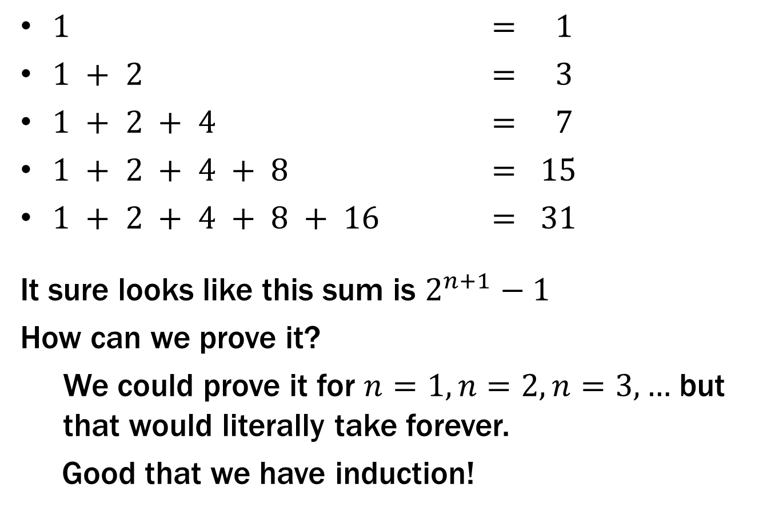
What is $1 + 2 + 4 + … + 2n$ ?
$1 + 2 + 4 + 8 + 16 = 1$
$1 + 2 + 4 + 8 + 16 = 3$
$1 + 2 + 4 + 8 + 16 = 7$
$1 + 2 + 4 + 8 + 16 = 15$
$1 + 2 + 4 + 8 + 16 = 31$
It sure looks like this sum is $2^{n+1}−1$
How can we prove it?
We could prove it for $n=1, n=2, n=3,…$ but that would literally take forever.
Good that we have induction!

Slide 16
Prove $1 + 2 + 4 + … + 2n =2^{n+1}– 1$

Slide 17
Prove $1 + 2 + 4 + … + 2n =2^{n+1}– 1$
Let P(n) be “2⁰ + 2¹ + … + 2^{n} = 2^{n+1} – 1”. We will show P(n) is true for all natural numbers by induction.
Base Case (n=0): 2⁰ = 1 = 2 – 1 = 2⁰⁺¹ – 1
Induction Hypothesis: Suppose that P(k) is true for some arbitrary integer k ≥ 0.
Induction Step:
Goal: Show P(k+1), i.e. show 1 + 2 + … + 2^{k} + 2^{k+1} = 2^{k+2} – 1
1 + 2 + … + 2^{k} = 2^{k+1} – 1 by IH
Adding 2^{k+1} to both sides, we get:
1 + 2 + … + 2^{k} + 2^{k+1} = 2^{k+1} + 2^{k+1} – 1
Note that 2^{k+1} + 2^{k+1} = 2(2^{k+1}) = 2^{k+2}.
So, we have 1 + 2 + … + 2^{k} + 2^{k+1} = 2^{k+2} – 1, which is
exactly P(k+1).
5. Thus P(k) is true for all k ∈ℕ, by induction.
Examples to show its true
P(0)
P(k) → P(k+1)

Slide 18
Prove $1 + 2 + 4 + … + 2n =2^{n+1}– 1$
Let P(n) be “2⁰ + 2¹ + … + 2^{n} = 2^{n+1} – 1”. We will show P(n) is true for all natural numbers by induction.
Base Case (n=0): 2⁰ = 1 = 2 – 1 = 2⁰⁺¹ – 1 so P(0) is true.
Induction Hypothesis: Suppose that P(k) is true for some arbitrary integer k ≥ 0.
Induction Step:
Goal: Show P(k+1), i.e. show 1 + 2 + … + 2^{k} + 2^{k+1} = 2^{k+2} – 1
1 + 2 + … + 2^{k} = 2^{k+1} – 1 by IH
Adding 2^{k+1} to both sides, we get:
1 + 2 + … + 2^{k} + 2^{k+1} = 2^{k+1} + 2^{k+1} – 1
Note that 2^{k+1} + 2^{k+1} = 2(2^{k+1}) = 2^{k+2}.
So, we have 1 + 2 + … + 2^{k} + 2^{k+1} = 2^{k+2} – 1, which is
exactly P(k+1).
5. Thus P(k) is true for all k ∈ℕ, by induction.
Examples to show its true
P(0)
P(k) → P(k+1)

Slide 19
Prove $1 + 2 + 4 + … + 2n =2^{n+1}– 1$
Let P(n) be “2⁰ + 2¹ + … + 2^{n} = 2^{n+1} – 1”. We will show P(n) is true for all natural numbers by induction.
Base Case (n=0): 2⁰ = 1 = 2 – 1 = 2⁰⁺¹ – 1 so P(0) is true.
Induction Hypothesis: Suppose that P(k) is true for some arbitrary integer k ≥ 0, i.e., that 2⁰ + 2¹ + … + 2^{k} = 2^{k+1} – 1.
Goal: Show P(k+1I.e.,), i.e. show 1 + 2 + … + 2^{k} + 2^{k+1} = 2^{k+2} – 1
1 + 2 + … + 2^{k} = 2^{k+1} – 1 by IH
Adding 2^{k+1} to both sides, we get:
1 + 2 + … + 2^{k} + 2^{k+1} = 2^{k+1} + 2^{k+1} – 1
Note that 2^{k+1} + 2^{k+1} = 2(2^{k+1}) = 2^{k+2}.
So, we have 1 + 2 + … + 2^{k} + 2^{k+1} = 2^{k+2} – 1, which is
exactly P(k+1).
5. Thus P(k) is true for all k ∈ℕ, by induction.
Examples to show its true
P(0)
P(k) → P(k+1)

Slide 20
Prove $1 + 2 + 4 + … + 2n =2^{n+1}– 1$
Let P(n) be “2⁰ + 2¹ + … + 2^{n} = 2^{n+1} – 1”. We will show P(n) is true for all natural numbers by induction.
Base Case (n=0): 2⁰ = 1 = 2 – 1 = 2⁰⁺¹ – 1 so P(0) is true.
Induction Hypothesis: Suppose that P(k) is true for some arbitrary integer k ≥ 0, i.e., that 2⁰ + 2¹ + … + 2^{k} = 2^{k+1} – 1.
Induction Step:
Goal: Show P(k+1), i.e. show 2⁰ + 2¹ + … + 2^{k} + 2^{k+1} = 2^{k+2} – 1
1 + 2 + … + 2^{k} = 2^{k+1} – 1 by IH
Adding 2^{k+1} to both sides, we get:
1 + 2 + … + 2^{k} + 2^{k+1} = 2^{k+1} + 2^{k+1} – 1
Note that 2^{k+1} + 2^{k+1} = 2(2^{k+1}) = 2^{k+2}.
So, we have 1 + 2 + … + 2^{k} + 2^{k+1} = 2^{k+2} – 1, which is
exactly P(k+1).
5. Thus P(k) is true for all k ∈ℕ, by induction.
Examples to show its true
P(0)
P(k) → P(k+1)

Slide 21
Prove $1 + 2 + 4 + … + 2n =2^{n+1}– 1$
Let P(n) be “2⁰ + 2¹ + … + 2^{n} = 2^{n+1} – 1”. We will show P(n) is true for all natural numbers by induction.
Base Case (n=0): 2⁰ = 1 = 2 – 1 = 2⁰⁺¹ – 1 so P(0) is true.
Induction Hypothesis: Suppose that P(k) is true for some arbitrary integer k ≥ 0, i.e., that 2⁰ + 2¹ + … + 2^{k} = 2^{k+1} – 1.
Induction Step:
2⁰ + 2¹ + … + 2^{k} = 2^{k+1} – 1 by IH
Adding 2^{k+1} to both sides, we get:
2⁰ + 2¹ + … + 2^{k} + 2^{k+1} = 2^{k+1} + 2^{k+1} – 1
Note that 2^{k+1} + 2^{k+1} = 2(2^{k+1}) = 2^{k+2}.
So, we have 2⁰ + 2¹ + … + 2^{k} + 2^{k+1} = 2^{k+2} – 1, which is
exactly P(k+1).
5. Thus P(k) is true for all k ∈ℕ, by induction.
Examples to show its true
P(0)
P(k) → P(k+1)

Slide 22
Prove $1 + 2 + 4 + … + 2n =2^{n+1}– 1$
Let P(n) be “2⁰ + 2¹ + … + 2^{n} = 2^{n+1} – 1”. We will show P(n) is true for all natural numbers by induction.
Base Case (n=0): 2⁰ = 1 = 2 – 1 = 2⁰⁺¹ – 1 so P(0) is true.
Induction Hypothesis: Suppose that P(k) is true for some arbitrary integer k ≥ 0, i.e., that 2⁰ + 2¹ + … + 2^{k} = 2^{k+1} – 1.
Induction Step:
We can calculate
2⁰ + 2¹ + … + 2^{k} + 2^{k+1} = (2⁰+2¹+ … + 2^{k}) + 2^{k+1}
= (2^{k+1} – 1) + 2^{k+1} by the IH
= 2(2^{k+1}) – 1
= 2^{k+2} – 1,
which is exactly P(k+1).
5. Thus P(k) is true for all k ∈ℕ, by induction.
Examples to show its true
P(0)
P(k) → P(k+1)
Alternative way of writing the inductive step

Slide 23
Prove $1 + 2 + 4 + … + 2n =2^{n+1}– 1$
Let P(n) be “2⁰ + 2¹ + … + 2^{n} = 2^{n+1} – 1”. We will show P(n) is true for all natural numbers by induction.
Base Case (n=0): 2⁰ = 1 = 2 – 1 = 2⁰⁺¹ – 1 so P(0) is true.
Induction Hypothesis: Suppose that P(k) is true for some arbitrary integer k ≥ 0, i.e., that 2⁰ + 2¹ + … + 2^{k} = 2^{k+1} – 1.
Induction Step:
We can calculate
2⁰ + 2¹ + … + 2^{k} + 2^{k+1} = (2⁰+2¹+ … + 2^{k}) + 2^{k+1}
= (2^{k+1} – 1) + 2^{k+1} by the IH
= 2(2^{k+1}) – 1
= 2^{k+2} – 1,
which is exactly P(k+1).
5. Thus P(n) is true for all n ∈ℕ, by induction.
Examples to show its true
P(0)
P(k) → P(k+1)

Slide 24
Prove $1 + 2 + 3 + … + n = n(n+1)/2$

Slide 25
Prove$1 + 2 + 3 + … + n = n(n+1)/2$
Let P(n) be “0 + 1 + 2 + … + n = n(n+1)/2”. We will show P(n) is true for all natural numbers by induction.
Base Case (n=0): 0 = 0(0+1)/2. Therefore P(0) is true.
Induction Hypothesis: Suppose that P(k) is true for some arbitrary integer k ≥ 0.
Induction Step:
Goal: Show P(k+1), i.e. show 1 + 2 + … + (n+1) = (n+1)(n+2)/2
1 + 2 + … + n = n(n+1)/2 by IH
Adding n+1 to both sides, we get:
1 + 2 + … + n + (n+1) = n(n+1)/2 + (n+1)
Now n(n+1)/2 + (n+1) = (n+1)(n/2 + 1) = (n+1)(n+2)/2.
So, we have 1 + 2 + … + n + (n+1) = (n+1)(n+2)/2, which is
exactly P(k+1).
5. Thus P(k) is true for all k ∈ℕ, by induction.
Examples to show its true
P(0)
P(k) → P(k+1)

Slide 26
Prove$1 + 2 + 3 + … + n = n(n+1)/2$
Let P(n) be “0 + 1 + 2 + … + n = n(n+1)/2”. We will show P(n) is true for all natural numbers by induction.
Base Case (n=0): 0 = 0(0+1)/2. Therefore P(0) is true.
Induction Hypothesis: Suppose that P(k) is true for some arbitrary integer k ≥ 0.
Induction Step:
Goal: Show P(k+1), i.e. show 1 + 2 + … + (n+1) = (n+1)(n+2)/2
1 + 2 + … + n = n(n+1)/2 by IH
Adding n+1 to both sides, we get:
1 + 2 + … + n + (n+1) = n(n+1)/2 + (n+1)
Now n(n+1)/2 + (n+1) = (n+1)(n/2 + 1) = (n+1)(n+2)/2.
So, we have 1 + 2 + … + n + (n+1) = (n+1)(n+2)/2, which is
exactly P(k+1).
5. Thus P(k) is true for all k ∈ℕ, by induction.
Examples to show its true
P(0)
P(k) → P(k+1)

Slide 27
Prove$1 + 2 + 3 + … + n = n(n+1)/2$
Let P(n) be “0 + 1 + 2 + … + n = n(n+1)/2”. We will show P(n) is true for all natural numbers by induction.
Base Case (n=0): 0 = 0(0+1)/2. Therefore P(0) is true.
Induction Hypothesis: Suppose that P(k) is true for some arbitrary integer k ≥ 0. I.e., suppose 1 + 2 + …+ k = k(k+1)/2
1 + 2 + … + n n(n+1)/2 by IH
Adding n+1 to both sides, we get:
1 + 2 + … + n + (n+1) = n(n+1)/2 + (n+1)
Now n(n+1)/2 + (n+1) = (n+1)(n/2 + 1) = (n+1)(n+2)/2.
So, we have 1 + 2 + … + n + (n+1) = (n+1)(n+2)/2, which is
exactly P(k+1).
5. Thus P(k) is true for all k ∈ℕ, by induction.
Examples to show its true
P(0)
P(k) → P(k+1)

Slide 28
Prove$1 + 2 + 3 + … + n = n(n+1)/2$
Let P(n) be “0 + 1 + 2 + … + n = n(n+1)/2”. We will show P(n) is true for all natural numbers by induction.
Base Case (n=0): 0 = 0(0+1)/2. Therefore P(0) is true.
Induction Hypothesis: Suppose that P(k) is true for some arbitrary integer k ≥ 0. I.e., suppose 1 + 2 + …+ k = k(k+1)/2
Induction Step:
Goal: Show P(k+1), i.e. show 1 + 2 + …+ k+ (k+1) = (k+1)(k+2)/2
1 + 2 + … + n = n(n+1)/2 by IH
Adding n+1 to both sides, we get:
1 + 2 + … + n + (n+1) = n(n+1)/2 + (n+1)
Now n(n+1)/2 + (n+1) = (n+1)(n/2 + 1) = (n+1)(n+2)/2.
So, we have 1 + 2 + … + n + (n+1) = (n+1)(n+2)/2, which is
exactly P(k+1).
5. Thus P(k) is true for all k ∈ℕ, by induction.
Examples to show its true
P(0)
P(k) → P(k+1)

Slide 29
Prove$1 + 2 + 3 + … + n = n(n+1)/2$
Let P(n) be “0 + 1 + 2 + … + n = n(n+1)/2”. We will show P(n) is true for all natural numbers by induction.
Base Case (n=0): 0 = 0(0+1)/2. Therefore P(0) is true.
Induction Hypothesis: Suppose that P(k) is true for some arbitrary integer k ≥ 0. I.e., suppose 1 + 2 + …+ k = k(k+1)/2
Induction Step:
1 + 2 + … + k + (k+1) = (1 + 2 + … + k) + (k+1)
= k(k+1)/2 + (k+1) by IH
= (k+1)(k/2 + 1)
= (k+1)(k+2)/2
So, we have shown 1 + 2 + … + k + (k+1) = (k+1)(k+2)/2,
which is exactly P(k+1).
5. Thus P(n) is true for all n ∈ℕ, by induction.
Examples to show its true
P(0)
P(k) → P(k+1)

Slide 30

Another example of a pattern
$20 − 1 = 1 − 1 = 0 = 3⋅0$
$22 − 1 = 4 − 1 = 3 = 3⋅1$
$24 − 1 = 16 − 1 = 15 = 3⋅5$
$26 − 1 = 64 − 1 = 63 = 3⋅21$
$28 − 1 = 256 − 1 = 255 = 3⋅85$
$⋯$

Slide 31

Prove: $3∣{(2}^{2n}−1)$ for all $n≥0$
Examples to show its true
P(0)
P(k) → P(k+1)

Slide 32

Prove: $3∣{(2}^{2n}−1$) for all $n≥0$
Let P(n) be “3 | (2^{2n} – 1)”. We will show P(n) is true for all natural numbers by induction.
Base Case (n=0): 2^{2∙0}-1=1-1=0=3∙0 Therefore P(0) is true.
Induction Hypothesis: Suppose that P(k) is true for some arbitrary integer k ≥ 0.
Induction Step:
Goal: Show P(k+1), i.e. show 3 | 2^{2(k+1)} - 1
By IH 2^{2k} – 1 = 3j for some integer j
So 2^{2(k+1)} – 1 = 2^{2k+2} – 1 = 4(2^{2k}) – 1 = 4(3j+1) – 1
= 12j+3 = 3(4j+1)
Therefore 3 | 2^{2(k+1)} - 1 which is exactly P(k+1).
5. Thus P(k) is true for all k ∈ℕ, by induction.
Examples to show its true
P(0)
P(k) → P(k+1)

Slide 33
Prove: $3∣{(2}^{2n}−1$) for all $n≥0$
Let P(n) be “3 | (2^{2n} – 1)”. We will show P(n) is true for all natural numbers by induction.
Base Case (n=0): 2^{2∙0}-1=1-1=0=3∙0 Therefore P(0) is true.
Induction Hypothesis: Suppose that P(k) is true for some arbitrary integer k ≥ 0.
Induction Step:
Goal: Show P(k+1), i.e. show 3 | 2^{2(k+1)} - 1
By IH 2^{2k} – 1 = 3j for some integer j
So 2^{2(k+1)} – 1 = 2^{2k+2} – 1 = 4(2^{2k}) – 1 = 4(3j+1) – 1
= 12j+3 = 3(4j+1)
Therefore 3 | 2^{2(k+1)} - 1 which is exactly P(k+1).
5. Thus P(k) is true for all k ∈ℕ, by induction.
Examples to show its true
P(0)
P(k) → P(k+1)

Slide 34
Prove: $3∣{(2}^{2n}−1)$ for all $n≥0$
Let P(n) be “3 | (2^{2n} – 1)”. We will show P(n) is true for all natural numbers by induction.
Base Case (n=0): 2^{2∙0}-1=1-1=0=3∙0 Therefore P(0) is true.
Induction Hypothesis: Suppose that P(k) is true for some arbitrary integer k ≥ 0. I.e., suppose that 3 | (2^{2k} – 1)
By IH 2^{2k} – 1 = 3j for some integer j
So 2^{2(k+1)} – 1 = 2^{2k+2} – 1 = 4(2^{2k}) – 1 = 4(3j+1) – 1
= 12j+3 = 3(4j+1)
Therefore 3 | 2^{2(k+1)} - 1 which is exactly P(k+1).
5. Thus P(k) is true for all k ∈ℕ, by induction.
Examples to show its true
P(0)
P(k) → P(k+1)

Slide 35
Prove: $3∣{(2}^{2n}−1)$ for all $n≥0$
Let P(n) be “3 | (2^{2n} – 1)”. We will show P(n) is true for all natural numbers by induction.
Base Case (n=0): 2^{2∙0}-1=1-1=0=3∙0 Therefore P(0) is true.
Induction Hypothesis: Suppose that P(k) is true for some arbitrary integer k ≥ 0. I.e., suppose that 3 | (2^{2k} – 1)
Induction Step:
Goal: Show P(k+1), i.e. show 3 | (2^{2(k+1)} – 1)
By IH 2^{2k} – 1 = 3j for some integer j
So 2^{2(k+1)} – 1 = 2^{2k+2} – 1 = 4(2^{2k}) – 1 = 4(3j+1) – 1
= 12j+3 = 3(4j+1)
Therefore 3 | 2^{2(k+1)} - 1 which is exactly P(k+1).
5. Thus P(k) is true for all k ∈ℕ, by induction.
Examples to show its true
P(0)
P(k) → P(k+1)

Slide 36
Prove: $3∣{(2}^{2n}−1$) for all $n≥0$
Let P(n) be “3 | (2^{2n} – 1)”. We will show P(n) is true for all natural numbers by induction.
Base Case (n=0): 2^{2∙0}-1=1-1=0=3∙0 Therefore P(0) is true.
Induction Hypothesis: Suppose that P(k) is true for some arbitrary integer k ≥ 0. I.e., suppose that 3 | (2^{2k} – 1)
Induction Step:
By IH, 3 | (2^{2k} – 1) so 2^{2k} – 1 = 3j for some integer j
So 2^{2(k+1)} – 1 = 2^{2k+2} – 1 = 4(2^{2k}) – 1 = 4(3j+1) – 1
= 12j+3 = 3(4j+1)
Therefore 3 | (2^{2(k+1)} – 1) which is exactly P(k+1).
5. Thus P(n) is true for all n ∈ ℕ, by induction.
Examples to show its true
P(0)
P(k) → P(k+1)

