Slide 1
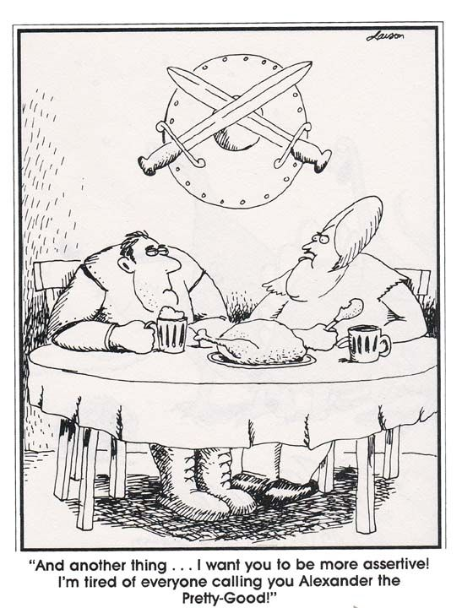
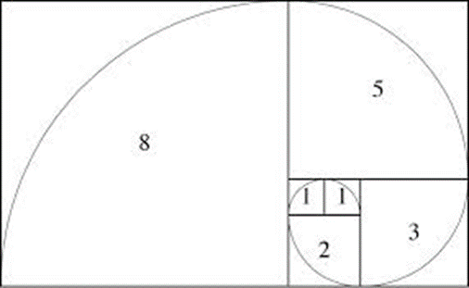
CSE 311: Foundations of Computing
Lecture 17: Recursion & Strong Induction Applications: Fibonacci & Euclid

Slide 2
Recall: Induction Rule of Inference
Domain: Natural Numbers
$$P\left(0\right)$$
$$∀k (P\left(k\right)⟶P\left(k+1\right))$$
$$∴∀n P(n)$$
How do the givens prove P(5)?
P(0)→P(1) P(1)→P(2) P(2)→P(3) P(3)→P(4 ) P(4)→P(5)
$$P(0)$$
$$P(1)$$
$$P(2)$$
$$P(3)$$
$$P(4)$$
$$P(5)$$
Formal steps
Show P(0)
Assume P(k), Prove P(k+1), Conclude P(k)→ P(k+1)
Conclude ∀ k (P(k)→ P(k+1))
Conclude ∀ n P(n)

Slide 3
Recall: Induction Rule of Inference
Domain: Natural Numbers
$$P\left(0\right)$$
$$∀k (P\left(k\right)⟶P\left(k+1\right))$$
$$∴∀n P(n)$$
How do the givens prove P(5)?
P(0)→P(1) P(1)→P(2) P(2)→P(3) P(3)→P(4 ) P(4)→P(5)
$$P(0)$$
$$P(1)$$
$$P(2)$$
$$P(3)$$
$$P(4)$$
$$P(5)$$
We made it harder than we needed to ...
When we proved $P(2)$ we knew BOTH $P(0)$ and $P(1)$
When we proved $P(3)$ we knew $P(0)$ and $P(1)$ and $P\left(2\right)$
When we proved $P(4)$ we knew $P(0)$,$P(1)$,$P\left(2\right), P(3)$
etc.
That’s the essence of the idea of Strong Induction.
Formal steps
Show P(0)
Assume P(k), Prove P(k+1), Conclude P(k)→ P(k+1)
Conclude ∀ k (P(k)→ P(k+1))
Conclude ∀ n P(n)

Slide 4
Strong Induction
$P\left(0\right) ∀k \left(∀j \left(0≤j≤k→P\left(j\right)\right)→P\left(k+1\right)\right)$
$∴∀n P(n)$

Slide 5
Strong Induction
$P\left(0\right) ∀k \left(∀j \left(0≤j≤k→P\left(j\right)\right)→P\left(k+1\right)\right)$
$∴∀n P(n)$
Strong induction for $P$ follows from ordinary induction for $Q$
where
$$Q\left(k\right) ∷= ∀j \left(0≤j≤k→P\left(j\right)\right)$$
Note that $Q\left(0\right)=P(0)$ and $Q(k+1)≡Q(k) ∧P\left(k+1\right)$
and $∀n Q\left(n\right)≡∀n P(n)$

Slide 6
Inductive Proofs In 5 Easy Steps
1. “Let $P(n)$ be... . We will show that $P(n)$ is true for all integers $n≥b$ by induction.”
2. “Base Case:” Prove $P(b)$
3. “Inductive Hypothesis:
Assume that for some arbitrary integer $k≥b,$
$P(k) \text{is} \text{true}$”
4. “Inductive Step:” Prove that $P(k+1)$ is true:
Use the goal to figure out what you need.
Make sure you are using I.H. and point out where you are using it. (Don’t assume $P(k+1)$ !!)
5. “Conclusion: $P(n)$ is true for all integers $n≥b$”

Slide 7
Strong Inductive Proofs In 5 Easy Steps
1. “Let $P(n)$ be... . We will show that $P(n)$ is true for all integers $n≥b$ by strong induction.”
2. “Base Case:” Prove $P(b)$
3. “Inductive Hypothesis:
Assume that for some arbitrary integer $k≥b,$
$P(j)$ is true for every integer $j$from $b$to $k$”
4. “Inductive Step:” Prove that $P(k+1)$ is true:
Use the goal to figure out what you need.
Make sure you are using I.H. (that $P(b),…,P(k)$ are true) and point out where you are using it. (Don’t assume $P(k+1)$ !!)
5. “Conclusion: $P(n)$ is true for all integers $n≥b$”

Slide 8
Recall: Fundamental Theorem of Arithmetic
Every integer > 1 has a unique prime factorization
48 = 2 • 2 • 2 • 2 • 3
591 = 3 • 197
45,523 = 45,523
321,950 = 2 • 5 • 5 • 47 • 137
1,234,567,890 = 2 • 3 • 3 • 5 • 3,607 • 3,803
We use strong induction to prove that a factorization into
primes exists, but not that it is unique.

Slide 9
Every integer $≥2$ is a product of (one or more) primes.
Examples to show its true
P(0)
P(k) → P(k+1)

Slide 10
Every integer $≥2$ is a product of (one or more) primes.
Let P(n) be “n is a product of some list of primes”. We will show that P(n) is true for all integers n $≥$2 by strong induction.
Base Case (n=2): 2 is prime, so it is a product of primes. Therefore P(2) is true.
Inductive : Suppose that for some arbitrary integer k ≥ 2, P(j) is true for every integer j between 2 and k
Inductive Step:
Goal: Show P(k+1); i.e. k+1 is a product of primes
Case: k+1 is prime: Then by definition k+1 is a product of primes
Case: k+1 is composite: Then k+1=ab for some integers a and b where 2 ≤ a, b ≤ k. By our IH, P(a) and P(b) are true so we have a = p₁p₂ $⋯$p_{m} and b = q₁q₂ $⋯$ for some primes p₁,p₂,..., p_{m}, q₁,q₂,..., q_{n}.
Thus, k+1 = ab = p₁p₂ $⋯$ p_{m}q₁q₂ $⋯$q_{n} which is a product of primes. Since k ≥ 1, one of these cases must happen and so P(k+1) is true:
5. Thus P(n) is true for all integers n $≥$2, by induction.
Examples to show its true
P(0)
P(k) → P(k+1)

Slide 11
Every integer $≥2$ is a product of (one or more) primes.
Let P(n) be “n is a product of some list of primes”. We will show that P(n) is true for all integers n $≥$2 by strong induction.
Base Case (n=2): 2 is prime, so it is a product of (one) prime. Therefore P(2) is true.
Inductive : Suppose that for some arbitrary integer k ≥ 2, P(j) is true for every integer j between 2 and k
Inductive Step:
Goal: Show P(k+1); i.e. k+1 is a product of primes
Case: k+1 is prime: Then by definition k+1 is a product of primes
Case: k+1 is composite: Then k+1=ab for some integers a and b where 2 ≤ a, b ≤ k. By our IH, P(a) and P(b) are true so we have a = p₁p₂ $⋯$p_{m} and b = q₁q₂ $⋯$ for some primes p₁,p₂,..., p_{m}, q₁,q₂,..., q_{n}.
Thus, k+1 = ab = p₁p₂ $⋯$ p_{m}q₁q₂ $⋯$q_{n} which is a product of primes. Since k ≥ 1, one of these cases must happen and so P(k+1) is true:
5. Thus P(n) is true for all integers n $≥$2, by induction.
Examples to show its true
P(0)
P(k) → P(k+1)

Slide 12
Every integer $≥2$ is a product of (one or more) primes.
Let P(n) be “n is a product of some list of primes”. We will show that P(n) is true for all integers n $≥$2 by strong induction.
Base Case (n=2): 2 is prime, so it is a product of (one) prime. Therefore P(2) is true.
Inductive Hyp: Suppose that for some arbitrary integer k ≥ 2, P(j) is true for every integer j between 2 and k
Inductive Step:
Goal: Show P(k+1); i.e. k+1 is a product of primes
Case: k+1 is prime: Then by definition k+1 is a product of primes
Case: k+1 is composite: Then k+1=ab for some integers a and b where 2 ≤ a, b ≤ k. By our IH, P(a) and P(b) are true so we have a = p₁p₂ $⋯$p_{m} and b = q₁q₂ $⋯$q_{n} for some primes p₁,p₂,..., p_{m}, q₁,q₂,..., q_{n}.
Thus, k+1 = ab = p₁p₂ $⋯$ p_{m}q₁q₂ $⋯$q_{n} which is a product of primes. Since k ≥ 1, one of these cases must happen and so P(k+1) is true:
5. Thus P(n) is true for all integers n $≥$2, by induction.
Examples to show its true
P(0)
P(k) → P(k+1)

Slide 13
Every integer $≥2$ is a product of (one or more) primes.
Let P(n) be “n is a product of some list of primes”. We will show that P(n) is true for all integers n $≥$2 by strong induction.
Base Case (n=2): 2 is prime, so it is a product of (one) prime. Therefore P(2) is true.
Inductive Hyp: Suppose that for some arbitrary integer k ≥ 2, P(j) is true for every integer j between 2 and k
Inductive Step:
Goal: Show P(k+1); i.e. k+1 is a product of primes
Case: k+1 is prime: Then by definition k+1 is a product of primes
Case: k+1 is composite: Then k+1=ab for some integers a and b where 2 ≤ a, b ≤ k. By our IH, P(a) and P(b) are true so we have a = p₁p₂ $⋯$p_{m} and b = q₁q₂ $⋯$q_{n} for some primes p₁,p₂,..., p_{m}, q₁,q₂,..., q_{n}.
Thus, k+1 = ab = p₁p₂ $⋯$ p_{m}q₁q₂ $⋯$q_{n} which is a product of primes. Since k ≥ 1, one of these cases must happen and so P(k+1) is true:
5. Thus P(n) is true for all integers n $≥$2, by induction.
Examples to show its true
P(0)
P(k) → P(k+1)

Slide 14
Every integer $≥2$ is a product of (one or more) primes.
Let P(n) be “n is a product of some list of primes”. We will show that P(n) is true for all integers n $≥$2 by strong induction.
Base Case (n=2): 2 is prime, so it is a product of (one) prime. Therefore P(2) is true.
Inductive Hyp: Suppose that for some arbitrary integer k ≥ 2, P(j) is true for every integer j between 2 and k
Inductive Step:
Goal: Show P(k+1); i.e. k+1 is a product of primes
Case: k+1 is prime: Then by definition k+1 is a product of primes
Case: k+1 is composite: Then k+1=ab for some integers a and b where 2 ≤ a, b ≤ k. By our IH, P(a) and P(b) are true so we have a = p₁p₂ $⋯$p_{m} and b = q₁q₂ $⋯$ for some primes p₁,p₂,..., p_{m}, q₁,q₂,..., q_{n}.
Thus, k+1 = ab = p₁p₂ $⋯$ p_{m}q₁q₂ $⋯$q_{n} which is a product of primes. Since k ≥ 1, one of these cases must happen and so P(k+1) is true:
5. Thus P(n) is true for all integers n $≥$2, by induction.
Examples to show its true
P(0)
P(k) → P(k+1)

Slide 15
Every integer $≥2$ is a product of (one or more) primes.
Let P(n) be “n is a product of some list of primes”. We will show that P(n) is true for all integers n $≥$2 by strong induction.
Base Case (n=2): 2 is prime, so it is a product of (one) prime. Therefore P(2) is true.
Inductive Hyp: Suppose that for some arbitrary integer k ≥ 2, P(j) is true for every integer j between 2 and k
Inductive Step:
Goal: Show P(k+1); i.e. k+1 is a product of primes
Case: k+1 is prime: Then by definition k+1 is a product of primes
Case: k+1 is composite: Then k+1=ab for some integers a and b where 2 ≤ a, b ≤ k. By our IH, P(a) and P(b) are true so we have a = p₁p₂ $⋯$p_{m} and b = q₁q₂ $⋯$q_{n} for some primes p₁,p₂,..., p_{m}, q₁,q₂,..., q_{n}.
Thus, k+1 = ab = p₁p₂ $⋯$ p_{m}q₁q₂ $⋯$q_{n} which is a product of primes. Since k ≥ 1, one of these cases must happen and so P(k+1) is true:
5. Thus P(n) is true for all integers n $≥$2, by induction.
Examples to show its true
P(0)
P(k) → P(k+1)

Slide 16
Every integer $≥2$ is a product of (one or more) primes.
Let P(n) be “n is a product of some list of primes”. We will show that P(n) is true for all integers n $≥$2 by strong induction.
Base Case (n=2): 2 is prime, so it is a product of (one) prime. Therefore P(2) is true.
Inductive Hyp: Suppose that for some arbitrary integer k ≥ 2, P(j) is true for every integer j between 2 and k
Inductive Step:
Goal: Show P(k+1); i.e. k+1 is a product of primes
Case: k+1 is prime: Then by definition k+1 is a product of primes
Case: k+1 is composite: Then k+1=ab for some integers a and b where 2 ≤ a, b ≤ k. By our IH, P(a) and P(b) are true so we have a = p₁p₂ $⋯$p_{r} and b = q₁q₂ $⋯$q_{s} for some primes p₁,p₂,..., p_{r}, q₁,q₂,..., q_{s}.
Thus, k+1 = ab = p₁p₂ $⋯$ p_{r}q₁q₂ $⋯$q_{s} which is a product of primes. Since k ≥ 2, one of these cases must happen and so P(k+1) is true.
5. Thus P(n) is true for all integers n $≥$2, by induction.
Examples to show its true
P(0)
P(k) → P(k+1)

Slide 17
Every integer $≥2$ is a product of (one or more) primes.
Let P(n) be “n is a product of some list of primes”. We will show that P(n) is true for all integers n $≥$2 by strong induction.
Base Case (n=2): 2 is prime, so it is a product of (one) prime. Therefore P(2) is true.
Inductive Hyp: Suppose that for some arbitrary integer k ≥ 2, P(j) is true for every integer j between 2 and k
Inductive Step:
Goal: Show P(k+1); i.e. k+1 is a product of primes
Case: k+1 is prime: Then by definition k+1 is a product of primes
Case: k+1 is composite: Then k+1=ab for some integers a and b where 2 ≤ a, b ≤ k. By our IH, P(a) and P(b) are true so we have a = p₁p₂ $⋯$p_{r} and b = q₁q₂ $⋯$q_{s} for some primes p₁,p₂,..., p_{r}, q₁,q₂,..., q_{s}.
Thus, k+1 = ab = p₁p₂ $⋯$ p_{r}q₁q₂ $⋯$q_{s} which is a product of primes. Since k ≥ 2, one of these cases must happen and so P(k+1) is true.
5. Thus P(n) is true for all integers n $≥$2, by strong induction.
Examples to show its true
P(0)
P(k) → P(k+1)

Slide 18
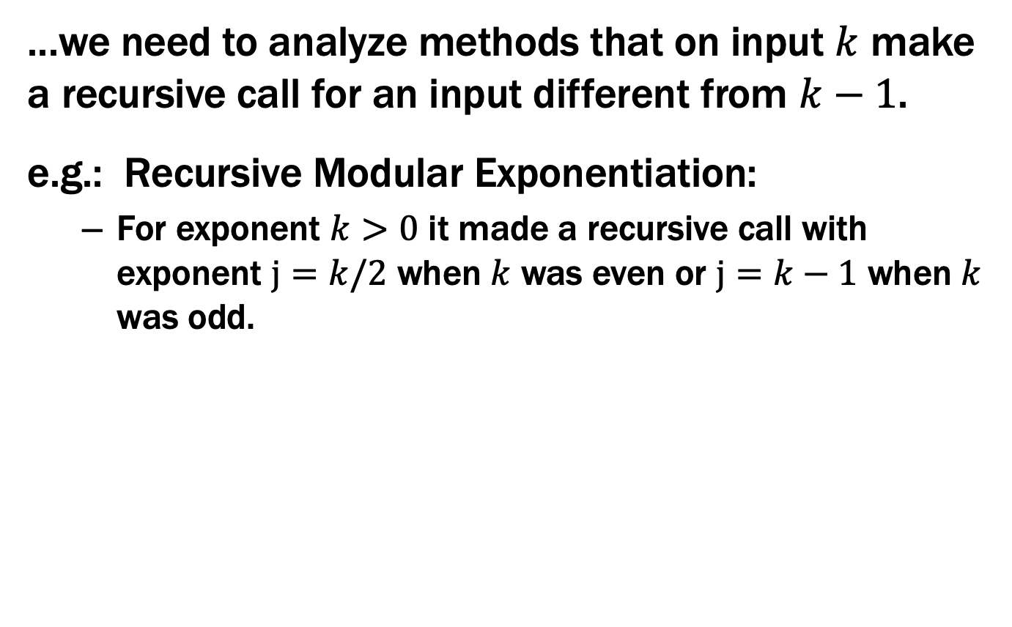
Strong Induction is particularly useful when...
...we need to analyze methods that on input $k$ make a recursive call for an input different from $k−1$.
e.g.: Recursive Modular Exponentiation:
For exponent $k>0$ it made a recursive call with exponent $j=k/2$ when $k$ was even or $j=k−1$ when $k$ was odd.

Slide 19
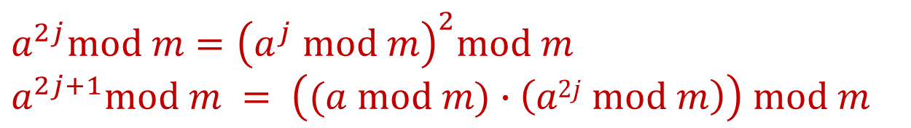
Fast Exponentiation
public static int FastModExp(int a, int k, int modulus) {
if (k == 0) {
return 1;
} else if ((k % 2) == 0) {
long temp = FastModExp(a,k/2,modulus);
return (temp * temp) % modulus;
} else {
long temp = FastModExp(a,k-1,modulus);
return (a * temp) % modulus;
}
}
$$a^{2j}mod m={\left(a^{j} mod m\right)}^{2}mod m$$
$$a^{2j+1}mod m = \left((a mod m)∙\left(a2j mod m\right)\right) mod m$$

Slide 20
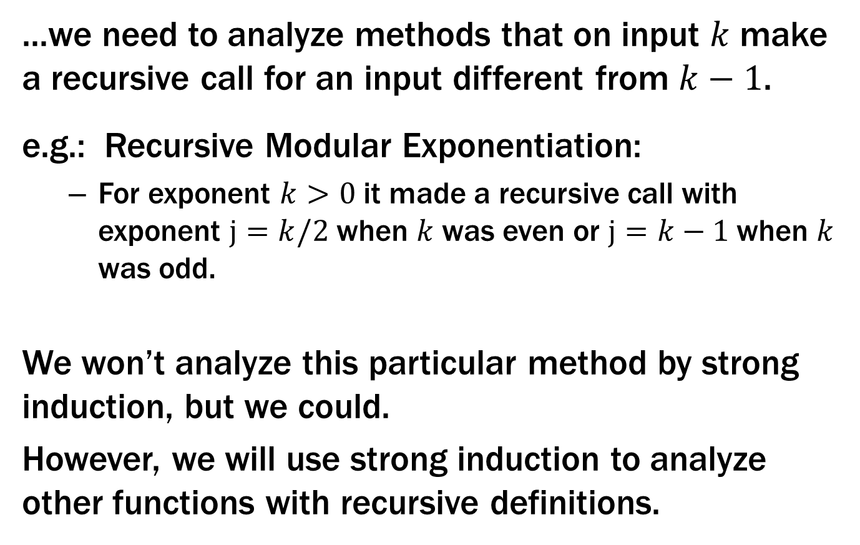
Strong Induction is particularly useful when...
...we need to analyze methods that on input $k$ make a recursive call for an input different from $k−1$.
e.g.: Recursive Modular Exponentiation:
For exponent $k>0$ it made a recursive call with exponent $j=k/2$ when $k$ was even or $j=k−1$ when $k$ was odd.
We won’t analyze this particular method by strong induction, but we could.
However, we will use strong induction to analyze other functions with recursive definitions.

Slide 21
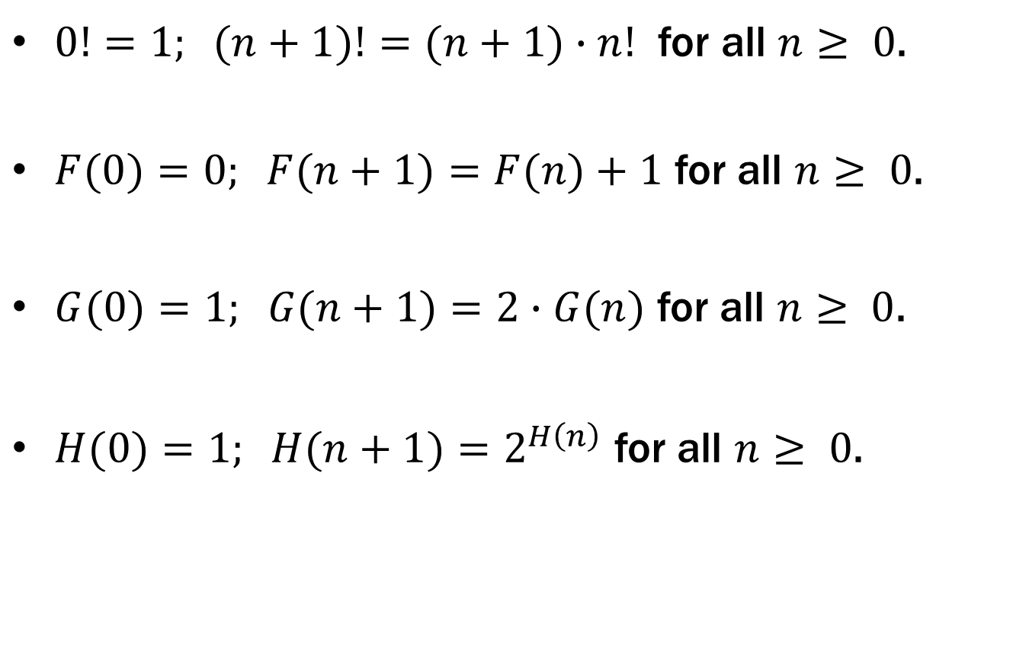
Recursive definitions of functions
$0!=1; (n+1)!=(n+1)∙n!$ for all $n≥ 0$.
$F(0)=0; F(n+1)=F(n)+1$ for all $n≥ 0$.
$G(0)=1; G(n+1)=2∙G(n)$ for all $n≥ 0$.
$H(0)=1; H(n+1)=2^{H\left(n\right)}$ for all $n≥ 0$.

Slide 22

Prove $n!≤nn$ for all $n≥1$
Let P(n) be “n! ≤ n^{n}”. We will show that P(n) is true for all integers n ≥ 1 by induction.
Base Case (n=1): 1!=1∙0!=1∙1=1=1¹ so P(1) is true.
Inductive Hypothesis: Suppose that P(k) is true for some arbitrary integer k ≥ 1. I.e., suppose k! ≤ k^{k}.
Examples to show its true
P(0)
P(k) → P(k+1)

Slide 23
Prove $n!≤nn$ for all $n≥1$
Let P(n) be “n! ≤ n^{n}”. We will show that P(n) is true for all integers n ≥ 1 by induction.
Base Case (n=1): 1!=1∙0!=1∙1=1=1¹ so P(1) is true.
Inductive Hypothesis: Suppose that P(k) is true for some arbitrary integer k ≥ 1. I.e., suppose k! ≤ k^{k}.
Inductive Step:
Goal: Show P(k+1), i.e. show (k+1)! ≤ (k+1)^{k+1}
(k+1)! = (k+1)∙k! by definition of !
≤ (k+1)∙ k^{k} by the IH
≤ (k+1)∙ (k+1)^{k} since k ≥ 0
= (k+1)^{k+1}
Therefore P(k+1) is true.
5. Thus P(n) is true for all n ≥ 1, by induction.
Examples to show its true
P(0)
P(k) → P(k+1)

Slide 24
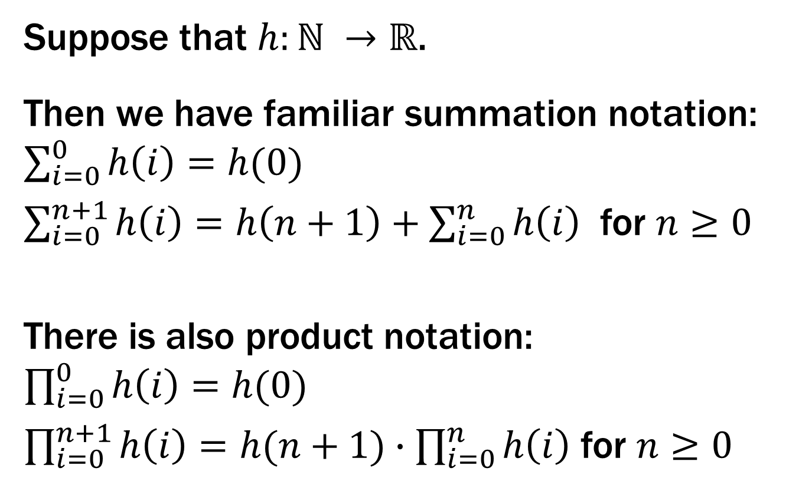
More Recursive Definitions
Suppose that $h:ℕ →ℝ$.
Then we have familiar summation notation: $\sum_{i=0}^{0}{h\left(i\right)=h(0)}$
$\sum_{i=0}^{n+1}{h\left(i\right)=h\left(n+1\right)+\sum_{i=0}^{n}{h\left(i\right)}}$ for $n≥0$
There is also product notation: $\prod_{i=0}^{0}{h\left(i\right)=h(0)}$
$\prod_{i=0}^{n+1}{h\left(i\right)=h(n+1)∙\prod_{i=0}^{n}{h\left(i\right)}}$ for $n≥0$

Slide 25
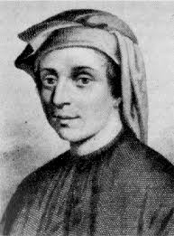


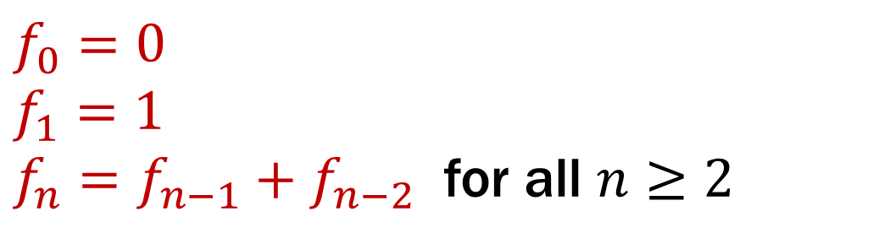
Fibonacci Numbers
$f_{0}=0$
$f_{1}=1$
$f_{n}=f_{n−1}+f_{n−2}$ for all $n≥2$

Slide 26
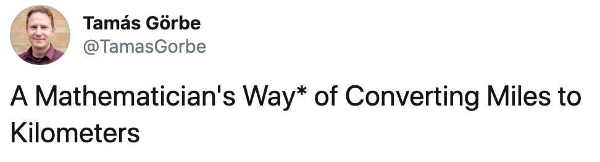
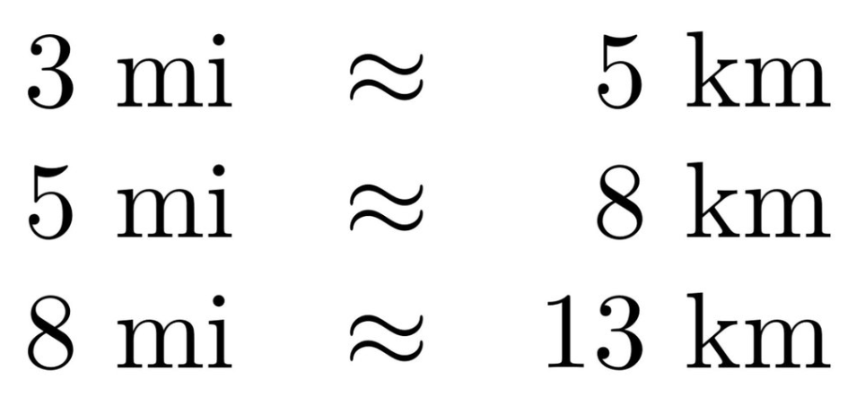
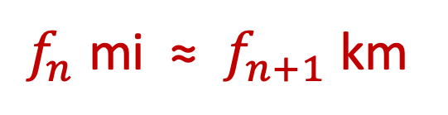
Fibonacci Numbers
$f_{0}=0$
$f_{1}=1$
$f_{n}=f_{n−1}+f_{n−2}$ for all $n≥2$
$f_{n}$ mi ≈ $f_{n+1}$ km

Slide 27
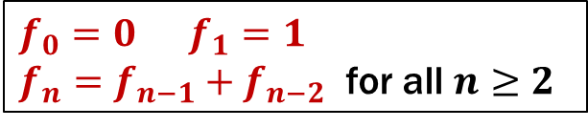
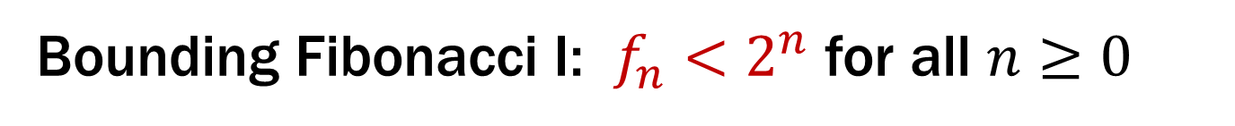
Bounding Fibonacci I: $f_{n}<2^{n}$ for all $n≥0$
Let P(n) be “f_{n} < 2^{n}”. We prove that P(n) is true for all integers n ≥ 0 by strong induction.
Base Case: f₀=0 < 1= 2⁰ so P(0) is true.
Inductive Hypothesis: Assume that for some arbitrary integer k ≥ 0, P(j) is true for every integer j from 0 to k.
Inductive Step: Goal: Show P(k+1); that is, f_{k+1} ≤ 2^{k+1}
Case k+1 = 1: Then f₁ = 1 ≤ 2¹ so P(k+1) is true here.
Case k+1 ≥ 2: Then f_{k+1} = f_{k} + f_{k-1} by definition
≤ 2^{k} + 2^{k-1} by the IH ≤ 2^{k} + 2^{k} = 2∙2^{k} = 2^{k+1} so P(k+1) is true in this case.
5. Therefore by strong induction, f_{n} ≤ 2^{n} for all integers n ≥ 0.
$f_{0}=0 f_{1}=1$
$f_{n}=f_{n−1}+f_{n−2}$ for all $n≥2$

Slide 28
Bounding Fibonacci I: $f_{n}<2^{n}$ for all $n≥0$
Let P(n) be “f_{n} < 2^{n}”. We prove that P(n) is true for all integers n ≥ 0 by strong induction.
Base Case: f₀=0 < 1= 2⁰ so P(0) is true.
Inductive Hypothesis: Assume that for some arbitrary integer k ≥ 0, P(j) is true for every integer j from 0 to k.
Inductive Step: Goal: Show P(k+1); that is, f_{k+1} ≤ 2^{k+1}
Case k+1 = 1: Then f₁ = 1 ≤ 2¹ so P(k+1) is true here.
Case k+1 ≥ 2: Then f_{k+1} = f_{k} + f_{k-1} by definition
≤ 2^{k} + 2^{k-1} by the IH ≤ 2^{k} + 2^{k} = 2∙2^{k} = 2^{k+1} so P(k+1) is true in this case.
5. Therefore by strong induction, f_{n} ≤ 2^{n} for all integers n ≥ 0.
$f_{0}=0 f_{1}=1$
$f_{n}=f_{n−1}+f_{n−2}$ for all $n≥2$

Slide 29
Bounding Fibonacci I: $f_{n}<2^{n}$ for all $n≥0$
Let P(n) be “f_{n} < 2^{n}”. We prove that P(n) is true for all integers n ≥ 0 by strong induction.
Base Case: f₀=0 < 1= 2⁰ so P(0) is true.
Inductive Hypothesis: Assume that for some arbitrary integer k ≥ 0, we have f_{j} < 2^{j} for every integer j from 0 to k.
Inductive Step: Goal: Show P(k+1); that is, f_{k+1} < 2^{k+1}
Case k+1 = 1: Then f₁ = 1 ≤ 2¹ so P(k+1) is true here.
Case k+1 ≥ 2: Then f_{k+1} = f_{k} + f_{k-1} by definition
≤ 2^{k} + 2^{k-1} by the IH ≤ 2^{k} + 2^{k} = 2∙2^{k} = 2^{k+1} so P(k+1) is true in this case.
5. Therefore by strong induction, f_{n} ≤ 2^{n} for all integers n ≥ 0.
$f_{0}=0 f_{1}=1$
$f_{n}=f_{n−1}+f_{n−2}$ for all $n≥2$

Slide 30
Bounding Fibonacci I: $f_{n}<2^{n}$ for all $n≥0$
Let P(n) be “f_{n} < 2^{n}”. We prove that P(n) is true for all integers n ≥ 0 by strong induction.
Base Case: f₀=0 < 1= 2⁰ so P(0) is true.
Inductive Hypothesis: Assume that for some arbitrary integer k ≥ 0, we have f_{j} < 2^{j} for every integer j from 0 to k.
Inductive Step: Goal: Show P(k+1); that is, f_{k+1} < 2^{k+1}
Case k+1 = 1: Then f₁ = 1 ≤ 2¹ so P(k+1) is true here.
Case k+1 ≥ 2: Then f_{k+1} = f_{k} + f_{k-1} by definition
≤ 2^{k} + 2^{k-1} by the IH ≤ 2^{k} + 2^{k} = 2∙2^{k} = 2^{k+1} so P(k+1) is true in this case.
5. Therefore by strong induction, f_{n} ≤ 2^{n} for all integers n ≥ 0.
$f_{0}=0 f_{1}=1$
$f_{n}=f_{n−1}+f_{n−2}$ for all $n≥2$

Slide 31
Bounding Fibonacci I: $f_{n}<2^{n}$ for all $n≥0$
Let P(n) be “f_{n} < 2^{n}”. We prove that P(n) is true for all integers n ≥ 0 by strong induction.
Base Case: f₀=0 < 1= 2⁰ so P(0) is true.
Inductive Hypothesis: Assume that for some arbitrary integer k ≥ 0, we have f_{j} < 2^{j} for every integer j from 0 to k.
Inductive Step: Goal: Show P(k+1); that is, f_{k+1} < 2^{k+1}
Case k+1 = 1: Then f₁ = 1 ≤ 2¹ so P(k+1) is true here.
Case k+1 ≥ 2: Then f_{k+1} = f_{k} + f_{k-1} by definition
≤ 2^{k} + 2^{k-1} by the IH ≤ 2^{k} + 2^{k} = 2∙2^{k} = 2^{k+1} so P(k+1) is true in this case.
5. Therefore by strong induction, f_{n} ≤ 2^{n} for all integers n ≥ 0.
$f_{0}=0 f_{1}=1$
$f_{n}=f_{n−1}+f_{n−2}$ for all $n≥2$

Slide 32
Bounding Fibonacci I: $f_{n}<2^{n}$ for all $n≥0$
Let P(n) be “f_{n} < 2^{n}”. We prove that P(n) is true for all integers n ≥ 0 by strong induction.
Base Case: f₀=0 < 1= 2⁰ so P(0) is true.
Inductive Hypothesis: Assume that for some arbitrary integer k ≥ 0, we have f_{j} < 2^{j} for every integer j from 0 to k.
Inductive Step: Goal: Show P(k+1); that is, f_{k+1} < 2^{k+1}
Case k+1 = 1: Then f₁ = 1 < 2 = 2¹ so P(k+1) is true here.
Case k+1 ≥ 2: Then f_{k+1} = f_{k} + f_{k-1} by definition
< 2^{k} + 2^{k-1} by the IH since k-1 ≥ 0 < 2^{k} + 2^{k} = 2∙2^{k} = 2^{k+1} so P(k+1) is true in this case.
These are the only cases so P(k+1) follows.
Therefore by strong induction,
f_{n} < 2^{n} for all integers n ≥ 0.
$f_{0}=0 f_{1}=1$
$f_{n}=f_{n−1}+f_{n−2}$ for all $n≥2$

Slide 33
Bounding Fibonacci I: $f_{n}<2^{n}$ for all $n≥0$
Let P(n) be “f_{n} < 2^{n}”. We prove that P(n) is true for all integers n ≥ 0 by strong induction.
Base Case: f₀=0 < 1= 2⁰ so P(0) is true.
Inductive Hypothesis: Assume that for some arbitrary integer k ≥ 0, we have f_{j} < 2^{j} for every integer j from 0 to k.
Inductive Step: Goal: Show P(k+1); that is, f_{k+1} < 2^{k+1}
Case k+1 = 1: Then f₁ = 1 < 2 = 2¹ so P(k+1) is true here.
Case k+1 ≥ 2: Then f_{k+1} = f_{k} + f_{k-1} by definition
< 2^{k} + 2^{k-1} by the IH since k-1 ≥ 0
< 2^{k} + 2^{k} = 2∙2^{k}
= 2^{k+1}
so P(k+1) is true in this case.
These are the only cases so P(k+1) follows.
$f_{0}=0 f_{1}=1$
$f_{n}=f_{n−1}+f_{n−2}$ for all $n≥2$

Slide 34
Bounding Fibonacci I: $f_{n}<2^{n}$ for all $n≥0$
Let P(n) be “f_{n} < 2^{n}”. We prove that P(n) is true for all integers n ≥ 0 by strong induction.
Base Case: f₀=0 < 1= 2⁰ so P(0) is true.
Inductive Hypothesis: Assume that for some arbitrary integer k ≥ 0, we have f_{j} < 2^{j} for every integer j from 0 to k.
Inductive Step: Goal: Show P(k+1); that is, f_{k+1} < 2^{k+1}
Case k+1 = 1: Then f₁ = 1 < 2 = 2¹ so P(k+1) is true here.
Case k+1 ≥ 2: Then f_{k+1} = f_{k} + f_{k-1} by definition
< 2^{k} + 2^{k-1} by the IH since k-1 ≥ 0 < 2^{k} + 2^{k} = 2∙2^{k} = 2^{k+1} so P(k+1) is true in this case.
These are the only cases so P(k+1) follows.
Therefore by strong induction,
f_{n} < 2^{n} for all integers n ≥ 0.
$f_{0}=0 f_{1}=1$
$f_{n}=f_{n−1}+f_{n−2}$ for all $n≥2$

Slide 35
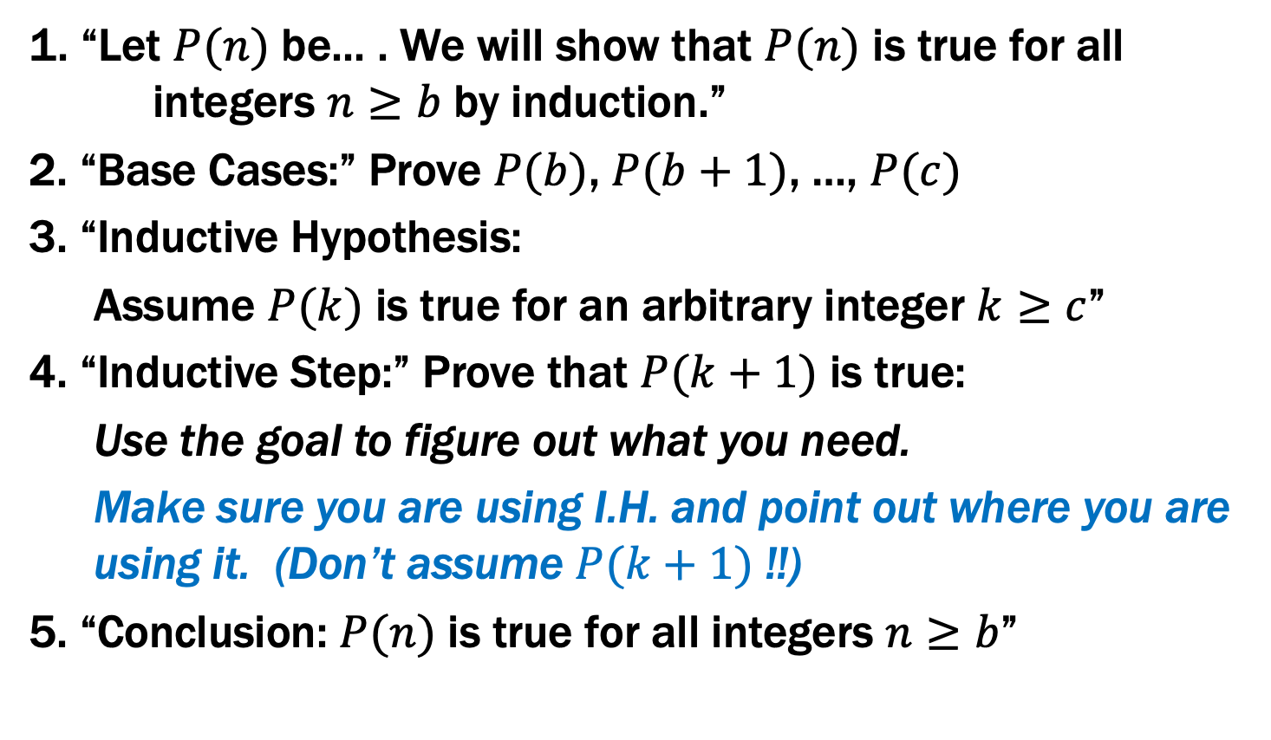
Inductive Proofs with Multiple Base Cases
1. “Let $P(n)$ be... . We will show that $P(n)$ is true for all integers $n≥b$ by induction.”
2. “Base Cases:” Prove $P(b)$, $P(b+1)$, …, $P(c)$
3. “Inductive Hypothesis:
Assume $P(k)$ is true for an arbitrary integer $k≥c$”
4. “Inductive Step:” Prove that $P(k+1)$ is true:
Use the goal to figure out what you need.
Make sure you are using I.H. and point out where you are using it. (Don’t assume $P(k+1)$ !!)
5. “Conclusion: $P(n)$ is true for all integers $n≥b$”

Slide 36
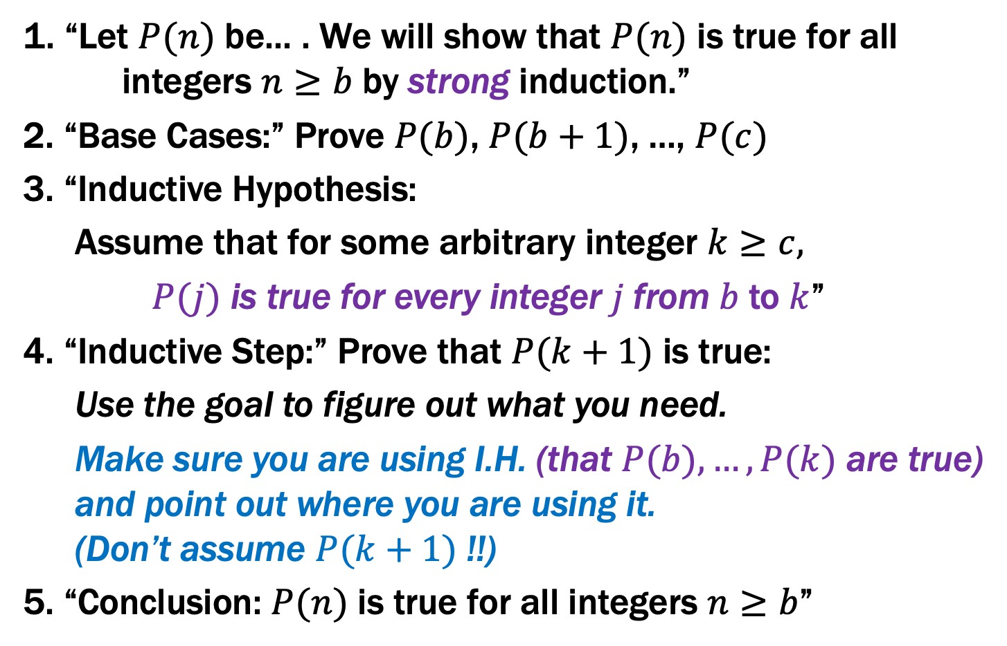
Inductive Proofs With Multiple Base Cases
1. “Let $P(n)$ be... . We will show that $P(n)$ is true for all integers $n≥b$ by strong induction.”
2. “Base Cases:” Prove $P(b)$, $P(b+1)$, …, $P(c)$
3. “Inductive Hypothesis:
Assume that for some arbitrary integer $k≥c,$
$P(j)$ is true for every integer $j$from $b$to $k$”
4. “Inductive Step:” Prove that $P(k+1)$ is true:
Use the goal to figure out what you need.
Make sure you are using I.H. (that $P(b),…,P(k)$ are true) and point out where you are using it. (Don’t assume $P(k+1)$ !!)
5. “Conclusion: $P(n)$ is true for all integers $n≥b$”

Slide 37
Bounding Fibonacci I: $f_{n}<2^{n}$ for all $n≥0$
Let P(n) be “f_{n} < 2^{n}”. We prove that P(n) is true for all integers n ≥ 0 by strong induction.
Base Cases: f₀ = 0 < 1 = 2⁰ so P(0) is true. f₁ = 1 < 2 = 2¹ so P(1) is true.
Inductive Hypothesis: Assume that for some arbitrary integer k ≥ 1, we have f_{j} < 2^{j} for every integer j from 0 to k.
Inductive Step: Goal: Show P(k+1); that is, f_{k+1} < 2^{k+1}
We have f_{k+1} = f_{k} + f_{k-1} by definition since k+1 ≥ 2
< 2^{k} + 2^{k-1} by the IH since k-1 ≥ 0 < 2^{k} + 2^{k} = 2∙2^{k} = 2^{k+1} so P(k+1) is true.
Therefore, by strong induction, f_{n} < 2^{n} for all integers n ≥ 0.
$f_{0}=0 f_{1}=1$
$f_{n}=f_{n−1}+f_{n−2}$ for all $n≥2$

Slide 38
Bounding Fibonacci II: $f_{n}≥2^{n/2 − 1}$ for all $n≥2$
Let P(n) be “f_{n} ≥ 2^{n/2 -1} ”. We prove that P(n) is true for all integers n ≥ 2 by strong induction.
Base Case: f₂ = f₁ + f₀ = 1 and 2^{2/2 – 1} = 2⁰ = 1 so P(2) is true.
Inductive Hypothesis: Assume that for some arbitrary integer k ≥ 2, P(j) is true for every integer j from 2 to k.
Inductive Step: Goal: Show P(k+1); that is, f_{k+1} ≥ 2^{(k+1)/2 -1}
Case k+1 = 3: Then f_{k+1} = f₃ = f₂ + f₁ =2 ≥ 2^{1/2} = 2^{3/2-1}=2^{(k+1)/2 -1}
Case k+1 ≥ 4: f_{k+1} = f_{k} + f_{k-1} by definition
≥ 2^{k/2-1} + 2^{(k-1)/2-1} by the IH since k-1 ≥ 2 ≥ 2^{(k-1)/2-1} + 2^{(k-1)/2-1} = 2^{(k-1)/2} = 2^{(k+1)/2 -1} So P(k+1) is true in both cases.
Therefore by strong induction, f_{n} ≥ 2^{n/2 -1} for all integers n ≥ 0.
$f_{0}=0 f_{1}=1$
$f_{n}=f_{n−1}+f_{n−2}$ for all $n≥2$

Slide 39
Bounding Fibonacci II: $f_{n}≥2^{n/2 − 1}$ for all $n≥2$
Let P(n) be “f_{n} ≥ 2^{n/2 -1} ”. We prove that P(n) is true for all integers n ≥ 2 by strong induction.
Base Case: f₂ = f₁ + f₀ = 1 and 2^{2/2 – 1} = 2⁰ = 1 so P(2) is true.
Inductive Hypothesis: Assume that for some arbitrary integer k ≥ 2, P(j) is true for every integer j from 2 to k.
Inductive Step: Goal: Show P(k+1); that is, f_{k+1} ≥ 2^{(k+1)/2 -1}
Case k+1 = 3: Then f_{k+1} = f₃ = f₂ + f₁ =2 ≥ 2^{1/2} = 2^{3/2-1}=2^{(k+1)/2 -1}
Case k+1 ≥ 4: f_{k+1} = f_{k} + f_{k-1} by definition
≥ 2^{k/2-1} + 2^{(k-1)/2-1} by the IH since k-1 ≥ 2 ≥ 2^{(k-1)/2-1} + 2^{(k-1)/2-1} = 2^{(k-1)/2} = 2^{(k+1)/2 -1} So P(k+1) is true in both cases.
Therefore by strong induction, f_{n} ≥ 2^{n/2 -1} for all integers n ≥ 0.
$f_{0}=0 f_{1}=1$
$f_{n}=f_{n−1}+f_{n−2}$ for all $n≥2$

Slide 40
Bounding Fibonacci II: $f_{n}≥2^{n/2 − 1}$ for all $n≥2$
Let P(n) be “f_{n} ≥ 2^{n/2 -1} ”. We prove that P(n) is true for all integers n ≥ 2 by strong induction.
Base Case: f₂ = f₁ + f₀ = 1 and 2^{2/2 – 1} = 2⁰ = 1 so P(2) is true.
Inductive Hypothesis: Assume that for some arbitrary integer k ≥ 2, P(j) is true for every integer j from 2 to k.
Inductive Step: Goal: Show P(k+1); that is, f_{k+1} ≥ 2^{(k+1)/2 -1}
Case k+1 = 3: Then f_{k+1} = f₃ = f₂ + f₁ =2 ≥ 2^{1/2} = 2^{3/2-1}=2^{(k+1)/2 -1}
Case k+1 ≥ 4: f_{k+1} = f_{k} + f_{k-1} by definition
≥ 2^{k/2-1} + 2^{(k-1)/2-1} by the IH since k-1 ≥ 2 ≥ 2^{(k-1)/2-1} + 2^{(k-1)/2-1} = 2^{(k-1)/2} = 2^{(k+1)/2 -1} So P(k+1) is true in both cases.
Therefore by strong induction, f_{n} ≥ 2^{n/2 -1} for all integers n ≥ 0.
$f_{0}=0 f_{1}=1$
$f_{n}=f_{n−1}+f_{n−2}$ for all $n≥2$

Slide 41
Bounding Fibonacci II: $f_{n}≥2^{n/2 − 1}$ for all $n≥2$
Let P(n) be “f_{n} ≥ 2^{n/2 -1} ”. We prove that P(n) is true for all integers n ≥ 2 by strong induction.
Base Case: f₂ = f₁ + f₀ = 1 and 2^{2/2 – 1} = 2⁰ = 1 so P(2) is true.
Inductive Hypothesis: Assume that for some arbitrary integer k ≥ 2, P(j) is true for every integer j from 2 to k.
Inductive Step: Goal: Show P(k+1); that is, f_{k+1} ≥ 2^{(k+1)/2 -1}
Case k+1 = 3: Then f_{k+1} = f₃ = f₂ + f₁ =2 ≥ 2^{1/2} = 2^{3/2-1}=2^{(k+1)/2 -1}
Case k+1 ≥ 4: f_{k+1} = f_{k} + f_{k-1} by definition
≥ 2^{k/2-1} + 2^{(k-1)/2-1} by the IH since k-1 ≥ 2 ≥ 2^{(k-1)/2-1} + 2^{(k-1)/2-1} = 2^{(k-1)/2} = 2^{(k+1)/2 -1} So P(k+1) is true in both cases.
Therefore by strong induction, f_{n} ≥ 2^{n/2 -1} for all integers n ≥ 0.
$f_{0}=0 f_{1}=1$
$f_{n}=f_{n−1}+f_{n−2}$ for all $n≥2$

Slide 42
Bounding Fibonacci II: $f_{n}≥2^{n/2 − 1}$ for all $n≥2$
Let P(n) be “f_{n} ≥ 2^{n/2 -1} ”. We prove that P(n) is true for all integers n ≥ 2 by strong induction.
Base Case: f₂ = f₁ + f₀ = 1 and 2^{2/2 – 1} = 2⁰ = 1 so P(2) is true.
Inductive Hypothesis: Assume that for some arbitrary integer k ≥ 2, P(j) is true for every integer j from 2 to k.
Inductive Step: Goal: Show P(k+1); that is, f_{k+1} ≥ 2^{(k+1)/2 -1}
Case k+1 = 3: Then f_{k+1} = f₃ = f₂ + f₁ =2 ≥ 2^{1/2} = 2^{3/2-1}=2^{(k+1)/2 -1}
Case k+1 ≥ 4: f_{k+1} = f_{k} + f_{k-1} by definition
≥ 2^{k/2-1} + 2^{(k-1)/2-1} by the IH since k-1 ≥ 2 ≥ 2^{(k-1)/2-1} + 2^{(k-1)/2-1} = 2^{(k-1)/2} = 2^{(k+1)/2 -1} So P(k+1) is true in both cases.
Therefore by strong induction, f_{n} ≥ 2^{n/2 -1} for all integers n ≥ 0.
No need for cases for the definition here:
f_{k+1} = f_{k} + f_{k-1} since k+1 ≥ 2
Now just want to apply the IH to get P(k) and P(k-1)
Problem: Though we can get P(k) since k ≥ 2,
k-1 may only be 1 so we can’t conclude P(k-1)
Solution: Separate cases for when k-1=1 (or k+1=3).
$f_{0}=0 f_{1}=1$
$f_{n}=f_{n−1}+f_{n−2}$ for all $n≥2$

Slide 43
Bounding Fibonacci II: $f_{n}≥2^{n/2 − 1}$ for all $n≥2$
Let P(n) be “f_{n} ≥ 2^{n/2 -1} ”. We prove that P(n) is true for all integers n ≥ 2 by strong induction.
Base Cases: f₂ = f₁ + f₀ = 1 and 2^{2/2 – 1} = 2⁰ = 1 so P(2) holds f₃ = f₂ + f₁ = 2 ≥ 2^{1/2} = 2^{3/2-1} so P(3) holds
Inductive Hypothesis: Assume that for some arbitrary integer k ≥ 3, P(j) is true for every integer j from 2 to k.
Inductive Step: Goal: Show P(k+1); that is, f_{k+1} ≥ 2^{(k+1)/2 -1}
We have f_{k+1} = f_{k} + f_{k-1} by definition since k+1 ≥ 2
≥ 2^{k/2-1} + 2^{(k-1)/2-1} by the IH since k-1 ≥ 2 ≥ 2^{(k-1)/2-1} + 2^{(k-1)/2-1} = 2^{(k-1)/2} = 2^{(k+1)/2 -1} so P(k+1) is true.
Therefore by strong induction, f_{n} ≥ 2^{n/2 -1} for all integers n ≥ 0.
$f_{0}=0 f_{1}=1$
$f_{n}=f_{n−1}+f_{n−2}$ for all $n≥2$

Slide 44
Bounding Fibonacci II: $f_{n}≥2^{n/2 − 1}$ for all $n≥2$
Let P(n) be “f_{n} ≥ 2^{n/2 -1} ”. We prove that P(n) is true for all integers n ≥ 2 by strong induction.
Base Cases: f₂ = f₁ + f₀ = 1 and 2^{2/2 – 1} = 2⁰ = 1 so P(2) holds f₃ = f₂ + f₁ = 2 ≥ 2^{1/2} = 2^{3/2-1} =2^{(k+1)/2 -1} so P(3) holds
Inductive Hypothesis: Assume that for some arbitrary integer k ≥ 3, P(j) is true for every integer j from 2 to k.
Inductive Step: Goal: Show P(k+1); that is, f_{k+1} ≥ 2^{(k+1)/2 -1}
We have f_{k+1} = f_{k} + f_{k-1} by definition since k+1 ≥ 2
≥ 2^{k/2-1} + 2^{(k-1)/2-1} by the IH since k-1 ≥ 2 ≥ 2^{(k-1)/2-1} + 2^{(k-1)/2-1} = 2^{(k-1)/2} = 2^{(k+1)/2 -1} so P(k+1) is true.
Therefore by strong induction, f_{n} ≥ 2^{n/2 -1} for all integers n ≥ 2.
$f_{0}=0 f_{1}=1$
$f_{n}=f_{n−1}+f_{n−2}$ for all $n≥2$

Slide 45
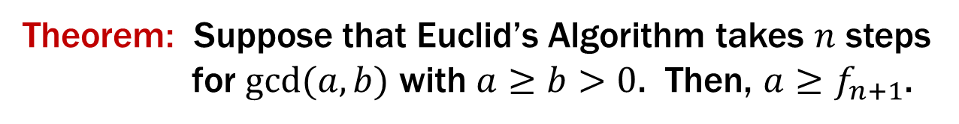
Running time of Euclid’s algorithm
Theorem: Suppose that Euclid’s Algorithm takes $n$ steps
for $gcd⁡(a,b)$ with $a≥b>0$. Then, $a≥f_{n+1}$.

Slide 46
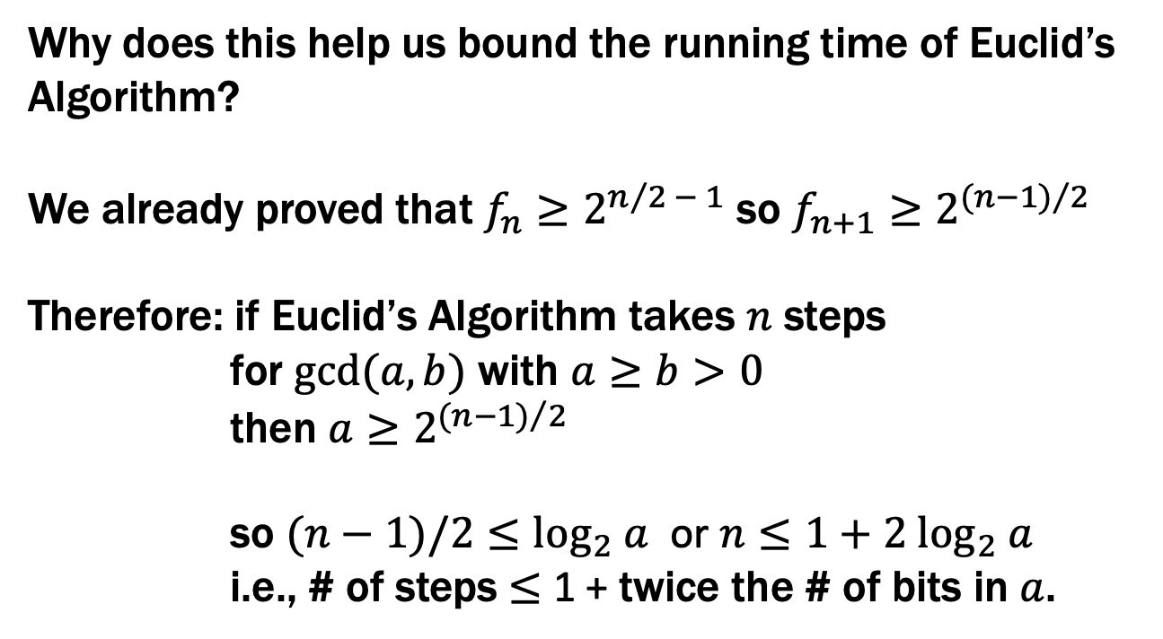
Running time of Euclid’s algorithm
Theorem: Suppose that Euclid’s Algorithm takes $n$ steps
for $gcd⁡(a,b)$ with $a≥b>0$. Then, $a≥f_{n+1}$.
Why does this help us bound the running time of Euclid’s Algorithm?
We already proved that $f_{n}≥2^{n/2 − 1}$ so $f_{n+1}≥2^{{(n−1)}/2}$
Therefore: if Euclid’s Algorithm takes $n$ steps
for $gcd⁡(a,b)$ with $a≥b>0$
then $a≥2^{{(n−1)}/2}$
so $(n−1)/2≤\log_{2} a$ or $n≤1+2 \log_{2} a$
i.e., # of steps ≤ 1 + twice the # of bits in $a$.

Slide 47
Running time of Euclid’s algorithm
Theorem: Suppose that Euclid’s Algorithm takes $n$ steps
for $gcd⁡(a,b)$ with $a≥b>0$. Then, $a≥f_{n+1}$.
An informal way to get the idea: Consider an n step gcd calculation starting with r_{n+1}=a and r_{n}=b:
r_{n+1} = q_{n}r_{n} + r_{n-1}
r_{n} = q_{n-1}r_{n-1} + r_{n-2}
…
r₃ = q₂r₂ + r₁
r₂ = q₁r₁
Now r₁ ≥ 1 and each q_{k} must be ≥ 1. If we replace all the q_{K}’s by 1 and replace r₁ by 1 , we can only reduce the r_{k}’s. After that reduction, r_{k}=f_{k} for every k.
For all k ≥ 2, r_{k-1}= r_{k+1} mod r_{k}

Slide 48

Running time of Euclid’s algorithm
Theorem: Suppose that Euclid’s Algorithm takes $n$ steps
for $gcd⁡(a,b)$ with $a≥b>0$. Then, $a≥f_{n+1}$.
We go by strong induction on n.
Let P(n) be “gcd(a,b) with a ≥ b>0 takes n steps → a ≥ f_{n+1}” for all n ≥ 1.
Base Case: n=1 Suppose Euclid’s Algorithm with a ≥ b > 0 takes 1 step. By assumption, a ≥ b ≥ 1 = f₂ so P(1) holds.
Induction Hypothesis: Suppose that for some integer k ≥ 1, P(j) is true for all integers j s.t. 1 ≤ j ≤ k

Slide 49
Running time of Euclid’s algorithm
Theorem: Suppose that Euclid’s Algorithm takes $n$ steps
for $gcd⁡(a,b)$ with $a≥b>0$. Then, $a≥f_{n+1}$.
We go by strong induction on n.
Let P(n) be “gcd(a,b) with a ≥ b>0 takes n steps → a ≥ f_{n+1}” for all n ≥ 1.
Base Case: n=1 Suppose Euclid’s Algorithm with a ≥ b > 0 takes 1 step. By assumption, a ≥ b ≥ 1 = f₂ so P(1) holds.
Induction Hypothesis: Suppose that for some integer k ≥ 1, P(j) is true for all integers j s.t. 1 ≤ j ≤ k
Inductive Step: We want to show: if gcd(a,b) with a ≥ b > 0 takes k+1 steps, then a ≥ f_{k+2.}

Slide 50
Running time of Euclid’s algorithm
Induction Hypothesis: Suppose that for some integer k ≥ 1, P(j) is true for all integers j s.t. 1 ≤ j ≤ k
Inductive Step: Goal: if gcd(a,b) with a ≥ b>0 takes k+1 steps, then a ≥ f_{k+2.}
Now if k+1=2, then Euclid’s algorithm on a and b can be written as
a = q₂b + r₁
b = q₁r₁
and r₁ > 0.
Also, since a ≥ b > 0, we must have q₂ ≥ 1 and b ≥ 1.
So a = q₂b + r₁ ≥ b + r₁ ≥ 1+1 = 2 = f₃ = f_{k+2} as required.
Notes:
Need to show a is at least 2
a >= 1 * 1 + 1 = 2

Slide 51
Running time of Euclid’s algorithm
Induction Hypothesis: Suppose that for some integer k ≥ 1, P(j) is true for all integers j s.t. 1 ≤ j ≤ k
Inductive Step: Goal: if gcd(a,b) with a ≥ b>0 takes k+1 steps, then a ≥ f_{k+2.}
Next suppose that k+1 ≥ 3 so for the first 3 steps of Euclid’s algorithm on a and b we have
a = q_{k+1} b + r_{k}
b = q_{k} r_{k} + r_{k-1}
r_{k} = q_{k-1} r_{k-1} + r_{k-2}
and there are k-2 more steps after this.

Slide 52
Running time of Euclid’s algorithm
Induction Hypothesis: Suppose that for some integer k ≥ 1, P(j) is true for all integers j s.t. 1 ≤ j ≤ k
Inductive Step: Goal: if gcd(a,b) with a ≥ b>0 takes k+1 steps, then a ≥ f_{k+2.}
Next suppose that k+1 ≥ 3 so for the first 3 steps of Euclid’s algorithm on a and b we have
a = q_{k+1} b + r_{k}
b = q_{k} r_{k} + r_{k-1}
r_{k} = q_{k-1} r_{k-1} + r_{k-2}
and there are k-2 more steps after this. Note that this means that the gcd(b, r_{k}) takes k steps and gcd(r_{k}, r_{k-1}) takes k-1 steps.
So since k, k-1 ≥ 1, by the IH we have b ≥ f_{k+1} and r_{k} ≥ f_{k}.
Notes:
a = q b + r >= b + r >= f_{k+1} + f_k = f_{k+2}.

Slide 53
Running time of Euclid’s algorithm
Induction Hypothesis: Suppose that for some integer k ≥ 1, P(j) is true for all integers j s.t. 1 ≤ j ≤ k
Inductive Step: Goal: if gcd(a,b) with a ≥ b>0 takes k+1 steps, then a ≥ f_{k+2.}
Next suppose that k+1 ≥ 3 so for the first 3 steps of Euclid’s algorithm on a and b we have
a = q_{k+1} b + r_{k}
b = q_{k} r_{k} + r_{k-1}
r_{k} = q_{k-1} r_{k-1} + r_{k-2}
and there are k-2 more steps after this. Note that this means that the gcd(b, r_{k}) takes k steps and gcd(r_{k}, r_{k-1}) takes k-1 steps.
So since k, k-1 ≥ 1, by the IH we have b ≥ f_{k+1} and r_{k} ≥ f_{k}.
Also, since a ≥ b, we must have q_{k+1} ≥ 1.
So a = q_{k+1}b + r_{k} ≥ b + r_{k} ≥ f_{k+1}+ f_{k}= f_{k+2} as required.

