Slide 1

CSE 311: Foundations of Computing
Lecture 18: Recursively Defined Functions & Sets

Slide 2
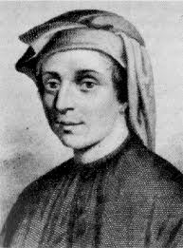
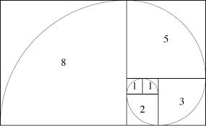

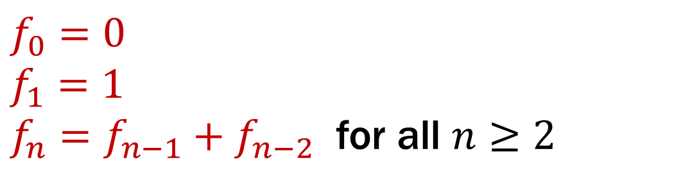
Last time: Fibonacci Numbers
$f_{0}=0$
$f_{1}=1$
$f_{n}=f_{n−1}+f_{n−2}$ for all $n≥2$

Slide 3
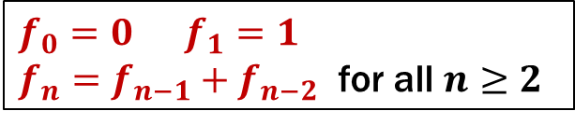
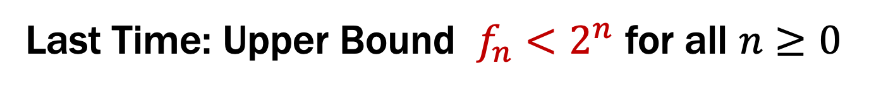
Last Time: Upper Bound $f_{n}<2^{n}$ for all $n≥0$
Let P(n) be “f_{n} < 2^{n}”. We prove that P(n) is true for all integers n ≥ 0 by strong induction.
Base Case: f₀=0 < 1= 2⁰ so P(0) is true.
Inductive Hypothesis: Assume that for some arbitrary integer k ≥ 0, we have f_{j} < 2^{j} for every integer j from 0 to k.
Inductive Step: Goal: Show P(k+1); that is, f_{k+1} < 2^{k+1}
Case k+1 = 1: Then f₁ = 1 < 2 = 2¹ so P(k+1) is true here.
Case k+1 ≥ 2: Then f_{k+1} = f_{k} + f_{k-1} by definition
< 2^{k} + 2^{k-1} by the IH since k-1 ≥ 0 < 2^{k} + 2^{k} = 2∙2^{k} = 2^{k+1} so P(k+1) is true in this case.
These are the only cases so P(k+1) follows.
Therefore by strong induction,
f_{n} < 2^{n} for all integers n ≥ 0.
$f_{0}=0 f_{1}=1$
$f_{n}=f_{n−1}+f_{n−2}$ for all $n≥2$

Slide 4
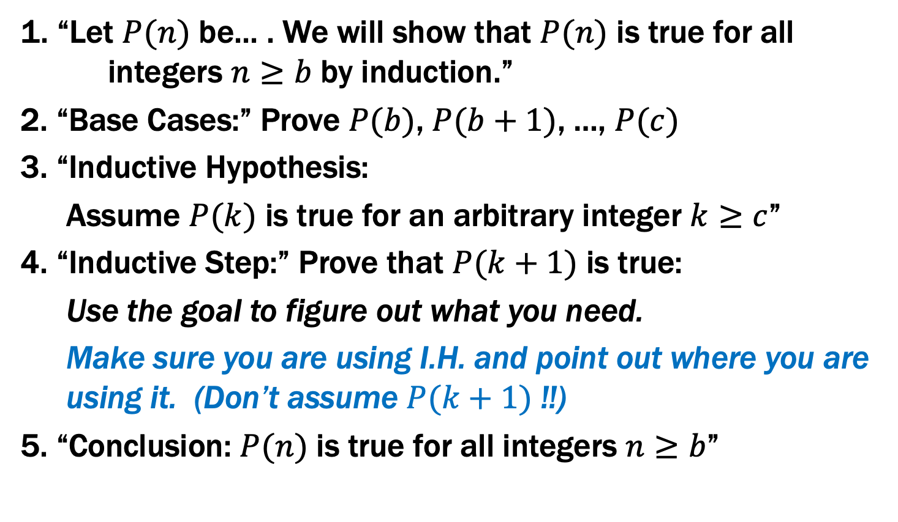
Inductive Proofs with Multiple Base Cases
1. “Let $P(n)$ be... . We will show that $P(n)$ is true for all integers $n≥b$ by induction.”
2. “Base Cases:” Prove $P(b)$, $P(b+1)$, …, $P(c)$
3. “Inductive Hypothesis:
Assume $P(k)$ is true for an arbitrary integer $k≥c$”
4. “Inductive Step:” Prove that $P(k+1)$ is true:
Use the goal to figure out what you need.
Make sure you are using I.H. and point out where you are using it. (Don’t assume $P(k+1)$ !!)
5. “Conclusion: $P(n)$ is true for all integers $n≥b$”

Slide 5
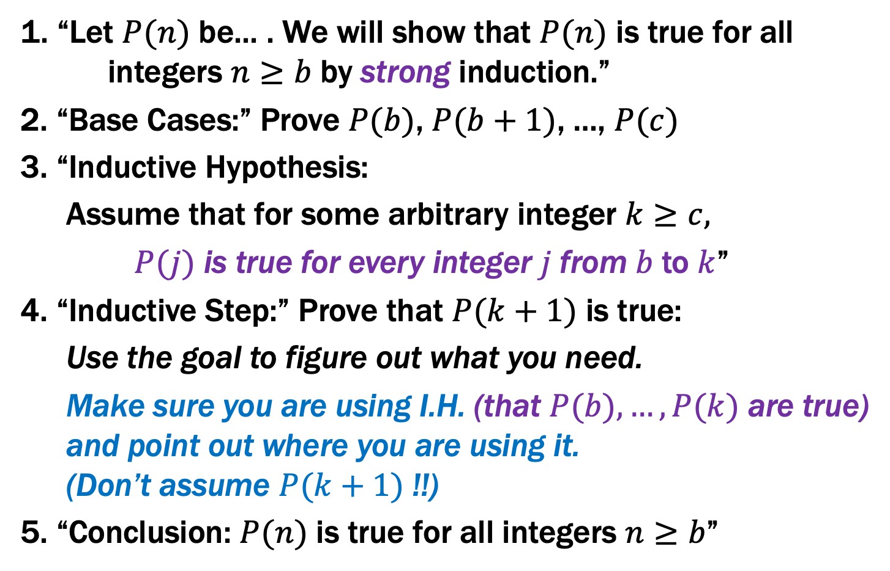
Inductive Proofs With Multiple Base Cases
1. “Let $P(n)$ be... . We will show that $P(n)$ is true for all integers $n≥b$ by strong induction.”
2. “Base Cases:” Prove $P(b)$, $P(b+1)$, …, $P(c)$
3. “Inductive Hypothesis:
Assume that for some arbitrary integer $k≥c,$
$P(j)$ is true for every integer $j$from $b$to $k$”
4. “Inductive Step:” Prove that $P(k+1)$ is true:
Use the goal to figure out what you need.
Make sure you are using I.H. (that $P(b),…,P(k)$ are true) and point out where you are using it. (Don’t assume $P(k+1)$ !!)
5. “Conclusion: $P(n)$ is true for all integers $n≥b$”

Slide 6
Bounding Fibonacci II: $f_{n}≥2^{n/2 − 1}$ for all $n≥2$
Let P(n) be “f_{n} ≥ 2^{n/2 -1} ”. We prove that P(n) is true for all integers n ≥ 2 by strong induction.
Base Case: f₂ = f₁ + f₀ = 1 and 2^{2/2 – 1} = 2⁰ = 1 so P(2) is true.
Inductive Hypothesis: Assume that for some arbitrary integer k ≥ 2, P(j) is true for every integer j from 2 to k.
Inductive Step: Goal: Show P(k+1); that is, f_{k+1} ≥ 2^{(k+1)/2 -1}
Case k+1 = 3: Then f_{k+1} = f₃ = f₂ + f₁ =2 ≥ 2^{1/2} = 2^{3/2-1}=2^{(k+1)/2 -1}
Case k+1 ≥ 4: f_{k+1} = f_{k} + f_{k-1} by definition
≥ 2^{k/2-1} + 2^{(k-1)/2-1} by the IH since k-1 ≥ 2 ≥ 2^{(k-1)/2-1} + 2^{(k-1)/2-1} = 2^{(k-1)/2} = 2^{(k+1)/2 -1} So P(k+1) is true in both cases.
Therefore by strong induction, f_{n} ≥ 2^{n/2 -1} for all integers n ≥ 0.
$f_{0}=0 f_{1}=1$
$f_{n}=f_{n−1}+f_{n−2}$ for all $n≥2$

Slide 7
Bounding Fibonacci II: $f_{n}≥2^{n/2 − 1}$ for all $n≥2$
Let P(n) be “f_{n} ≥ 2^{n/2 -1} ”. We prove that P(n) is true for all integers n ≥ 2 by strong induction.
Base Case: f₂ = f₁ + f₀ = 1 and 2^{2/2 – 1} = 2⁰ = 1 so P(2) is true.
Inductive Hypothesis: Assume that for some arbitrary integer k ≥ 2, P(j) is true for every integer j from 2 to k.
Inductive Step: Goal: Show P(k+1); that is, f_{k+1} ≥ 2^{(k+1)/2 -1}
Case k+1 = 3: Then f_{k+1} = f₃ = f₂ + f₁ =2 ≥ 2^{1/2} = 2^{3/2-1}=2^{(k+1)/2 -1}
Case k+1 ≥ 4: f_{k+1} = f_{k} + f_{k-1} by definition
≥ 2^{k/2-1} + 2^{(k-1)/2-1} by the IH since k-1 ≥ 2 ≥ 2^{(k-1)/2-1} + 2^{(k-1)/2-1} = 2^{(k-1)/2} = 2^{(k+1)/2 -1} So P(k+1) is true in both cases.
Therefore by strong induction, f_{n} ≥ 2^{n/2 -1} for all integers n ≥ 0.
$f_{0}=0 f_{1}=1$
$f_{n}=f_{n−1}+f_{n−2}$ for all $n≥2$

Slide 8
Bounding Fibonacci II: $f_{n}≥2^{n/2 − 1}$ for all $n≥2$
Let P(n) be “f_{n} ≥ 2^{n/2 -1} ”. We prove that P(n) is true for all integers n ≥ 2 by strong induction.
Base Case: f₂ = f₁ + f₀ = 1 and 2^{2/2 – 1} = 2⁰ = 1 so P(2) is true.
Inductive Hypothesis: Assume that for some arbitrary integer k ≥ 2, P(j) is true for every integer j from 2 to k.
Inductive Step: Goal: Show P(k+1); that is, f_{k+1} ≥ 2^{(k+1)/2 -1}
Case k+1 = 3: Then f_{k+1} = f₃ = f₂ + f₁ =2 ≥ 2^{1/2} = 2^{3/2-1}=2^{(k+1)/2 -1}
Case k+1 ≥ 4: f_{k+1} = f_{k} + f_{k-1} by definition
≥ 2^{k/2-1} + 2^{(k-1)/2-1} by the IH since k-1 ≥ 2 ≥ 2^{(k-1)/2-1} + 2^{(k-1)/2-1} = 2^{(k-1)/2} = 2^{(k+1)/2 -1} So P(k+1) is true in both cases.
Therefore by strong induction, f_{n} ≥ 2^{n/2 -1} for all integers n ≥ 0.
$f_{0}=0 f_{1}=1$
$f_{n}=f_{n−1}+f_{n−2}$ for all $n≥2$

Slide 9
Bounding Fibonacci II: $f_{n}≥2^{n/2 − 1}$ for all $n≥2$
Let P(n) be “f_{n} ≥ 2^{n/2 -1} ”. We prove that P(n) is true for all integers n ≥ 2 by strong induction.
Base Case: f₂ = f₁ + f₀ = 1 and 2^{2/2 – 1} = 2⁰ = 1 so P(2) is true.
Inductive Hypothesis: Assume that for some arbitrary integer k ≥ 2, P(j) is true for every integer j from 2 to k.
Inductive Step: Goal: Show P(k+1); that is, f_{k+1} ≥ 2^{(k+1)/2 -1}
Case k+1 = 3: Then f_{k+1} = f₃ = f₂ + f₁ =2 ≥ 2^{1/2} = 2^{3/2-1}=2^{(k+1)/2 -1}
Case k+1 ≥ 4: f_{k+1} = f_{k} + f_{k-1} by definition
≥ 2^{k/2-1} + 2^{(k-1)/2-1} by the IH since k-1 ≥ 2 ≥ 2^{(k-1)/2-1} + 2^{(k-1)/2-1} = 2^{(k-1)/2} = 2^{(k+1)/2 -1} So P(k+1) is true in both cases.
Therefore by strong induction, f_{n} ≥ 2^{n/2 -1} for all integers n ≥ 0.
$f_{0}=0 f_{1}=1$
$f_{n}=f_{n−1}+f_{n−2}$ for all $n≥2$

Slide 10
Bounding Fibonacci II: $f_{n}≥2^{n/2 − 1}$ for all $n≥2$
Let P(n) be “f_{n} ≥ 2^{n/2 -1} ”. We prove that P(n) is true for all integers n ≥ 2 by strong induction.
Base Case: f₂ = f₁ + f₀ = 1 and 2^{2/2 – 1} = 2⁰ = 1 so P(2) is true.
Inductive Hypothesis: Assume that for some arbitrary integer k ≥ 2, P(j) is true for every integer j from 2 to k.
Inductive Step: Goal: Show P(k+1); that is, f_{k+1} ≥ 2^{(k+1)/2 -1}
Case k+1 = 3: Then f_{k+1} = f₃ = f₂ + f₁ =2 ≥ 2^{1/2} = 2^{3/2-1}=2^{(k+1)/2 -1}
Case k+1 ≥ 4: f_{k+1} = f_{k} + f_{k-1} by definition
≥ 2^{k/2-1} + 2^{(k-1)/2-1} by the IH since k-1 ≥ 2 ≥ 2^{(k-1)/2-1} + 2^{(k-1)/2-1} = 2^{(k-1)/2} = 2^{(k+1)/2 -1} So P(k+1) is true in both cases.
Therefore by strong induction, f_{n} ≥ 2^{n/2 -1} for all integers n ≥ 0.
No need for cases for the definition here:
f_{k+1} = f_{k} + f_{k-1} since k+1 ≥ 2
Now just want to apply the IH to get P(k) and P(k-1)
Problem: Though we can get P(k) since k ≥ 2,
k-1 may only be 1 so we can’t conclude P(k-1)
Solution: Separate cases for when k-1=1 (or k+1=3).
$f_{0}=0 f_{1}=1$
$f_{n}=f_{n−1}+f_{n−2}$ for all $n≥2$

Slide 11
Bounding Fibonacci II: $f_{n}≥2^{n/2 − 1}$ for all $n≥2$
Let P(n) be “f_{n} ≥ 2^{n/2 -1} ”. We prove that P(n) is true for all integers n ≥ 2 by strong induction.
Base Cases: f₂ = f₁ + f₀ = 1 and 2^{2/2 – 1} = 2⁰ = 1 so P(2) holds f₃ = f₂ + f₁ = 2 ≥ 2^{1/2} = 2^{3/2-1} so P(3) holds
Inductive Hypothesis: Assume that for some arbitrary integer k ≥ 3, P(j) is true for every integer j from 2 to k.
Inductive Step: Goal: Show P(k+1); that is, f_{k+1} ≥ 2^{(k+1)/2 -1}
We have f_{k+1} = f_{k} + f_{k-1} by definition since k+1 ≥ 2
≥ 2^{k/2-1} + 2^{(k-1)/2-1} by the IH since k-1 ≥ 2 ≥ 2^{(k-1)/2-1} + 2^{(k-1)/2-1} = 2^{(k-1)/2} = 2^{(k+1)/2 -1} so P(k+1) is true.
Therefore by strong induction, f_{n} ≥ 2^{n/2 -1} for all integers n ≥ 0.
$f_{0}=0 f_{1}=1$
$f_{n}=f_{n−1}+f_{n−2}$ for all $n≥2$

Slide 12
Bounding Fibonacci II: $f_{n}≥2^{n/2 − 1}$ for all $n≥2$
Let P(n) be “f_{n} ≥ 2^{n/2 -1} ”. We prove that P(n) is true for all integers n ≥ 2 by strong induction.
Base Cases: f₂ = f₁ + f₀ = 1 and 2^{2/2 – 1} = 2⁰ = 1 so P(2) holds f₃ = f₂ + f₁ = 2 ≥ 2^{1/2} = 2^{3/2-1} =2^{(k+1)/2 -1} so P(3) holds
Inductive Hypothesis: Assume that for some arbitrary integer k ≥ 3, P(j) is true for every integer j from 2 to k.
Inductive Step: Goal: Show P(k+1); that is, f_{k+1} ≥ 2^{(k+1)/2 -1}
We have f_{k+1} = f_{k} + f_{k-1} by definition since k+1 ≥ 2
≥ 2^{k/2-1} + 2^{(k-1)/2-1} by the IH since k-1 ≥ 2 ≥ 2^{(k-1)/2-1} + 2^{(k-1)/2-1} = 2^{(k-1)/2} = 2^{(k+1)/2 -1} so P(k+1) is true.
Therefore by strong induction, f_{n} ≥ 2^{n/2 -1} for all integers n ≥ 2.
$f_{0}=0 f_{1}=1$
$f_{n}=f_{n−1}+f_{n−2}$ for all $n≥2$

Slide 13
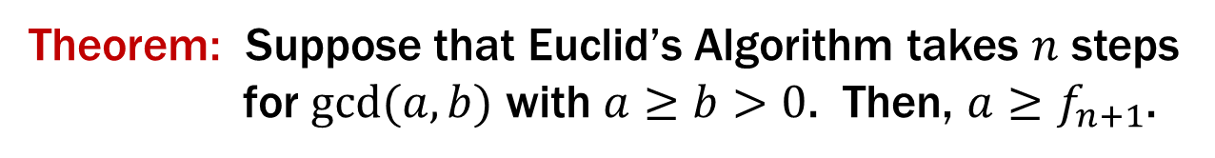
Running time of Euclid’s algorithm
Theorem: Suppose that Euclid’s Algorithm takes $n$ steps
for $gcd⁡(a,b)$ with $a≥b>0$. Then, $a≥f_{n+1}$.

Slide 14
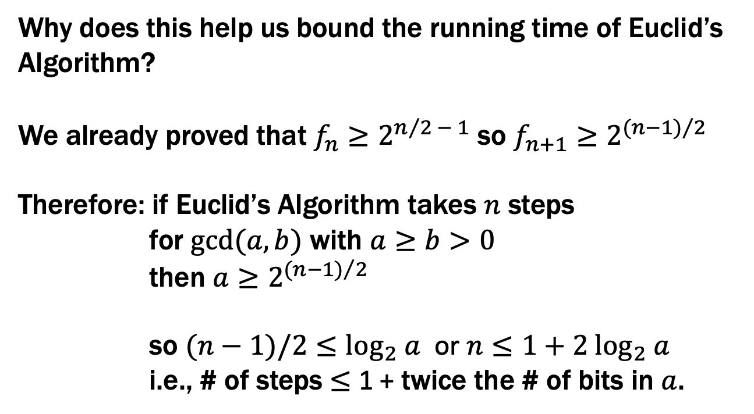
Running time of Euclid’s algorithm
Theorem: Suppose that Euclid’s Algorithm takes $n$ steps
for $gcd⁡(a,b)$ with $a≥b>0$. Then, $a≥f_{n+1}$.
Why does this help us bound the running time of Euclid’s Algorithm?
We already proved that $f_{n}≥2^{n/2 − 1}$ so $f_{n+1}≥2^{{(n−1)}/2}$
Therefore: if Euclid’s Algorithm takes $n$ steps
for $gcd⁡(a,b)$ with $a≥b>0$
then $a≥2^{{(n−1)}/2}$
so $(n−1)/2≤\log_{2} a$ or $n≤1+2 \log_{2} a$
i.e., # of steps ≤ 1 + twice the # of bits in $a$.

Slide 15
Running time of Euclid’s algorithm
Theorem: Suppose that Euclid’s Algorithm takes $n$ steps
for $gcd⁡(a,b)$ with $a≥b>0$. Then, $a≥f_{n+1}$.
An informal way to get the idea: Consider an n step gcd calculation starting with r_{n+1}=a and r_{n}=b:
r_{n+1} = q_{n}r_{n} + r_{n-1}
r_{n} = q_{n-1}r_{n-1} + r_{n-2}
…
r₃ = q₂r₂ + r₁
r₂ = q₁r₁
Now r₁ ≥ 1 and each q_{k} must be ≥ 1. If we replace all the q_{K}’s by 1 and replace r₁ by 1 , we can only reduce the r_{k}’s. After that reduction, r_{k}=f_{k} for every k.
For all k ≥ 2, r_{k-1}= r_{k+1} mod r_{k}

Slide 16

Running time of Euclid’s algorithm
Theorem: Suppose that Euclid’s Algorithm takes $n$ steps
for $gcd⁡(a,b)$ with $a≥b>0$. Then, $a≥f_{n+1}$.
We go by strong induction on n.
Let P(n) be “gcd(a,b) with a ≥ b>0 takes n steps → a ≥ f_{n+1}” for all n ≥ 1.
Base Case: n=1 Suppose Euclid’s Algorithm with a ≥ b > 0 takes 1 step. By assumption, a ≥ b ≥ 1 = f₂ so P(1) holds.
Induction Hypothesis: Suppose that for some integer k ≥ 1, P(j) is true for all integers j s.t. 1 ≤ j ≤ k
Inductive Step: We want to show: if gcd(a,b) with a ≥ b > 0 takes k+1 steps, then a ≥ f_{k+2.}

Slide 17
Running time of Euclid’s algorithm
Induction Hypothesis: Suppose that for some integer k ≥ 1, P(j) is true for all integers j s.t. 1 ≤ j ≤ k
Inductive Step: Goal: if gcd(a,b) with a ≥ b>0 takes k+1 steps, then a ≥ f_{k+2.}
Now if k+1=2, then Euclid’s algorithm on a and b can be written as
a = q₂b + r₁
b = q₁r₁
and r₁ > 0.
Also, since a ≥ b > 0, we must have q₂ ≥ 1 and b ≥ 1.
So a = q₂b + r₁ ≥ b + r₁ ≥ 1+1 = 2 = f₃ = f_{k+2} as required.
Notes:
Need to show a is at least 2
a >= 1 * 1 + 1 = 2

Slide 18
Running time of Euclid’s algorithm
Induction Hypothesis: Suppose that for some integer k ≥ 1, P(j) is true for all integers j s.t. 1 ≤ j ≤ k
Inductive Step: Goal: if gcd(a,b) with a ≥ b>0 takes k+1 steps, then a ≥ f_{k+2.}
Next suppose that k+1 ≥ 3 so for the first 3 steps of Euclid’s algorithm on a and b we have
a = q_{k+1} b + r_{k}
b = q_{k} r_{k} + r_{k-1}
r_{k} = q_{k-1} r_{k-1} + r_{k-2}
and there are k-2 more steps after this. Note that this means that the gcd(b, r_{k}) takes k steps and gcd(r_{k}, r_{k-1}) takes k-1 steps.
So since k, k-1 ≥ 1, by the IH we have b ≥ f_{k+1} and r_{k} ≥ f_{k}.
Also, since a ≥ b, we must have q_{k+1} ≥ 1.
So a = q_{k+1}b + r_{k} ≥ b + r_{k} ≥ f_{k+1}+ f_{k}= f_{k+2} as required.

Slide 19
Last time: Recursive definitions of functions
$0!=1; (n+1)!=(n+1)∙n!$ for all $n≥ 0$.
$F(0)=0; F(n+1)=F(n)+1$ for all $n≥ 0$.
$G(0)=1; G(n+1)=2∙G(n)$ for all $n≥ 0$.
$H(0)=1; H(n+1)=2^{H\left(n\right)}$ for all $n≥ 0$.

Slide 20
Last time: Recursive definitions of functions
Recursive functions allow general computation
saw examples not expressible with simple expressions
So far, we have considered only simple data
inputs and outputs were just integers
We need general data as well...
these will also be described recursively
will allow us to describe data of real programs
e.g., strings, lists, trees, expressions, propositions, …
We’ll start simple: sets of numbers

Slide 21
Recursive Definitions of Sets (Data)
Natural numbers
Basis: 0 ∈ S
Recursive: If x ∈ S, then x+1 ∈ S
Even numbers
Basis: 0 ∈ S
Recursive: If x ∈ S, then x+2 ∈ S

Slide 22
Recursive Definition of Sets
Recursive definition of set S
Basis Step: 0 ∈ S
Recursive Step: If x ∈ S, then x + 2 ∈ S
Exclusion Rule: Every element in S follows from the basis step and a finite number of recursive steps.
We need the exclusion rule because otherwise S=ℕ would satisfy the other two parts. However, we won’t always write it down on these slides.

Slide 23
Recursive Definitions of Sets
Natural numbers
Basis: 0 ∈ S
Recursive: If x ∈ S, then x+1 ∈ S
Even numbers
Basis: 0 ∈ S
Recursive: If x ∈ S, then x+2 ∈ S
Powers of 3:
Basis: 1 ∈ S
Recursive: If x ∈ S, then 3x ∈ S.
Basis: (0, 0) ∈ S, (1, 1) ∈ S
Recursive: If (n-1, x) ∈ S and (n, y) ∈ S,
then (n+1, x + y) ∈ S.
?

Slide 24
Recursive Definitions of Sets
Natural numbers
Basis: 0 ∈ S
Recursive: If x ∈ S, then x+1 ∈ S
Even numbers
Basis: 0 ∈ S
Recursive: If x ∈ S, then x+2 ∈ S
Powers of 3:
Basis: 1 ∈ S
Recursive: If x ∈ S, then 3x ∈ S.
Basis: (0, 0) ∈ S, (1, 1) ∈ S
Recursive: If (n-1, x) ∈ S and (n, y) ∈ S,
then (n+1, x + y) ∈ S.
Fibonacci numbers

Slide 25
Last time: Recursive definitions of functions
Before, we considered only simple data
inputs and outputs were just integers
Proved facts about those functions with induction
n! ≤ n^{n}
f_{n} < 2^{n} and f_{n} ≥ 2^{n/2-1}
How do we prove facts about functions that work with more complex (recursively defined) data?
we need a more sophisticated form of induction

Slide 26
Structural Induction
How to prove ∀ 𝑥 ∈ 𝑆, 𝑃(𝑥) is true:
Base Case: Show that 𝑃(𝑢) is true for all specific elements 𝑢 of 𝑆 mentioned in the Basis step
Inductive Hypothesis: Assume that 𝑃 is true for some arbitrary values of each of the existing named elements mentioned in the Recursive step
Inductive Step: Prove that 𝑃(𝑤) holds for each of the new elements 𝑤 constructed in the Recursive step using the named elements mentioned in the Inductive Hypothesis
Conclude that ∀ 𝑥 ∈ 𝑆, 𝑃(𝑥)

Slide 27
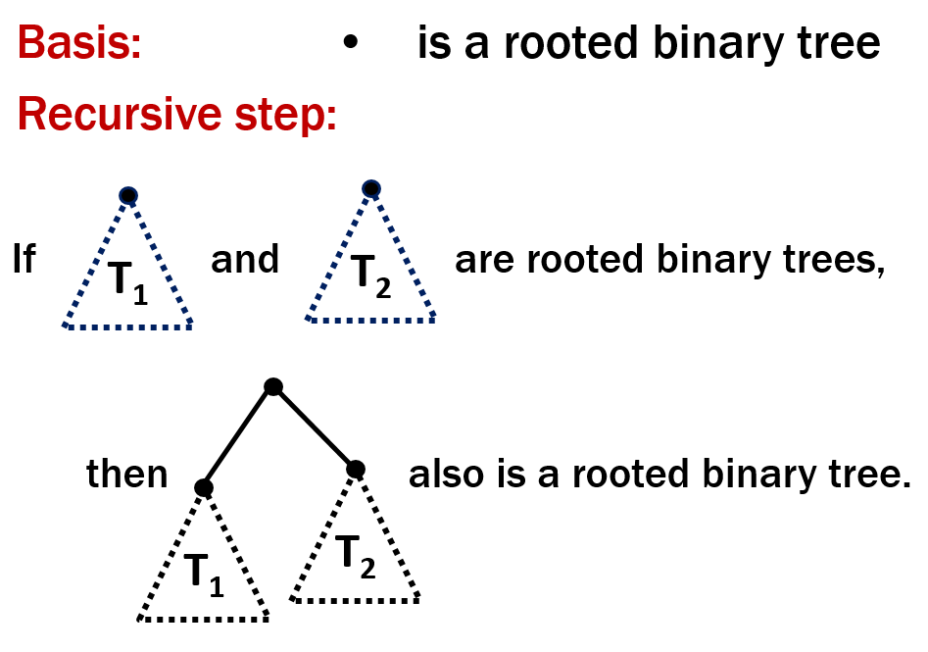
Structural Induction
How to prove ∀ 𝑥 ∈ 𝑆, 𝑃(𝑥) is true:
Base Case: Show that 𝑃(𝑢) is true for all specific elements 𝑢 of 𝑆 mentioned in the Basis step
Inductive Hypothesis: Assume that 𝑃 is true for some arbitrary values of each of the existing named elements mentioned in the Recursive step
Inductive Step: Prove that 𝑃(𝑤) holds for each of the new elements 𝑤 constructed in the Recursive step using the named elements mentioned in the Inductive Hypothesis
Conclude that ∀ 𝑥 ∈ 𝑆, 𝑃(𝑥)

Slide 28
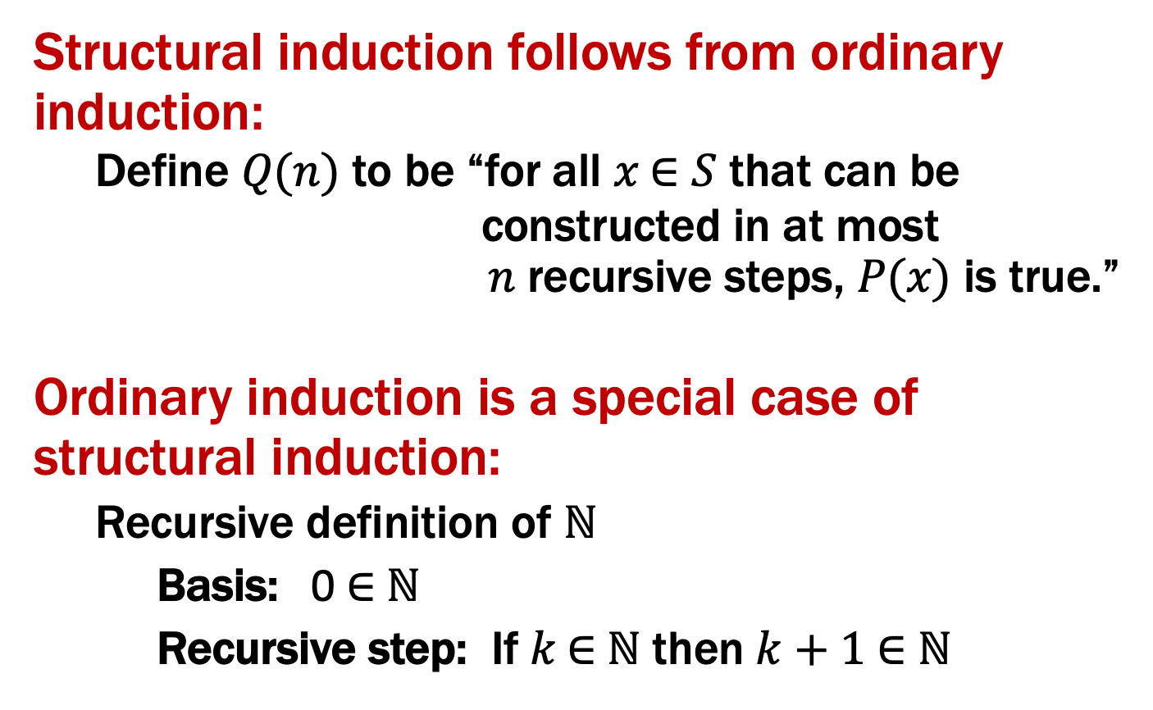
Structural Induction vs. Ordinary Induction
Structural induction follows from ordinary induction:
Define 𝑄(𝑛) to be “for all 𝑥 ∈ 𝑆 that can be constructed in at most 𝑛 recursive steps, 𝑃(𝑥) is true.”
Ordinary induction is a special case of structural induction:
Recursive definition of ℕ
Basis: 0 ∈ ℕ
Recursive step: If 𝑘 ∈ ℕ then $k+1$ ∈ ℕ

Slide 29
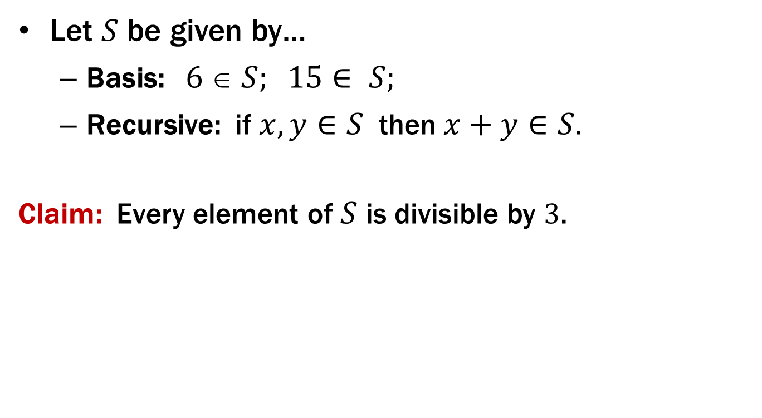
Using Structural Induction
Let $S$ be given by…
Basis: $6  S; 15∈ S;$
Recursive: if $x, y∈S$ then $x+y∈S$.
Claim: Every element of $S$ is divisible by 3.

Slide 30

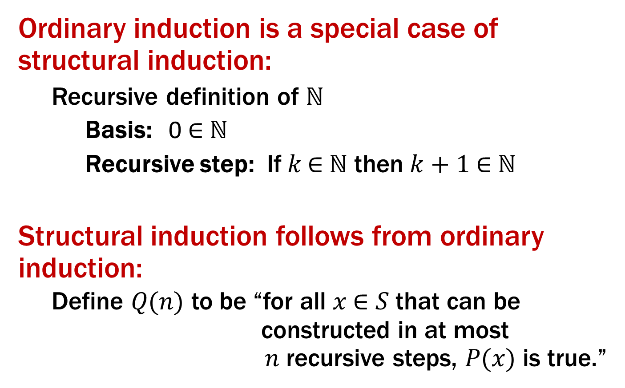
Claim: Every element of $S$ is divisible by 3.
1. Let P(x) be “3|x”. We prove that P(x) is true for all x ∈ S by structural induction.
2. Base Case: 3|6 and 3|15 so P(6) and P(15) are true
3. Inductive Hypothesis: Suppose that P(x) and P(y) are true for some arbitrary x,y ∈ S
4. Inductive Step: Goal: Show P(x+y)
Since P(x) is true, 3|x and so x=3m for some integer m and since P(y) is true, 3|y and so y=3n for some integer n. Therefore x+y=3m+3n=3(m+n) and thus 3|(x+y).
Hence P(x+y) is true.
5. Therefore by induction 3|x for all x ∈ S.
Basis: $6  S; 15∈ S;$
Recursive: if $x, y∈S$ then $x+y∈S$

Slide 31
Claim: Every element of $S$ is divisible by 3.
1. Let P(x) be “3|x”. We prove that P(x) is true for all x ∈ S by structural induction.
2. Base Case: 3|6 and 3|15 so P(6) and P(15) are true
3. Inductive Hypothesis: Suppose that P(x) and P(y) are true for some arbitrary x,y ∈ S
4. Inductive Step: Goal: Show P(x+y)
Since P(x) is true, 3|x and so x=3m for some integer m and since P(y) is true, 3|y and so y=3n for some integer n. Therefore x+y=3m+3n=3(m+n) and thus 3|(x+y).
Hence P(x+y) is true.
5. Therefore by induction 3|x for all x ∈ S.
Basis: $6  S; 15∈ S;$
Recursive: if $x, y∈S$ then $x+y∈S$

Slide 32
Claim: Every element of $S$ is divisible by 3.
1. Let P(x) be “3|x”. We prove that P(x) is true for all x ∈ S by structural induction.
2. Base Case: 3|6 and 3|15 so P(6) and P(15) are true
3. Inductive Hypothesis: Suppose that P(x) and P(y) are true for some arbitrary x,y ∈ S
4. Inductive Step: Goal: Show P(x+y)
Since P(x) is true, 3|x and so x=3m for some integer m and since P(y) is true, 3|y and so y=3n for some integer n. Therefore x+y=3m+3n=3(m+n) and thus 3|(x+y).
Hence P(x+y) is true.
5. Therefore by induction 3|x for all x ∈ S.
Basis: $6  S; 15∈ S;$
Recursive: if $x, y∈S$ then $x+y∈S$

Slide 33
Claim: Every element of $S$ is divisible by 3.
1. Let P(x) be “3|x”. We prove that P(x) is true for all x ∈ S by structural induction.
2. Base Case: 3|6 and 3|15 so P(6) and P(15) are true
3. Inductive Hypothesis: Suppose that P(x) and P(y) are true for some arbitrary x,y ∈ S
4. Inductive Step: Goal: Show P(x+y)
Since P(x) is true, 3|x and so x=3m for some integer m and since P(y) is true, 3|y and so y=3n for some integer n. Therefore x+y=3m+3n=3(m+n) and thus 3|(x+y).
Hence P(x+y) is true.
5. Therefore by induction 3|x for all x ∈ S.
Basis: $6  S; 15∈ S;$
Recursive: if $x, y∈S$ then $x+y∈S$

Slide 34
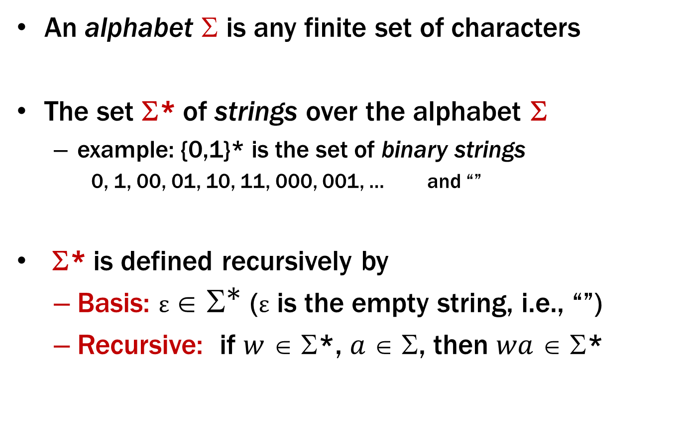
Strings
An alphabet $$ is any finite set of characters
The set Σ* of strings over the alphabet Σ
example: {0,1}* is the set of binary strings
0, 1, 00, 01, 10, 11, 000, 001, … and “”
Σ* is defined recursively by
Basis: $ε ∈ {\text{Σ}}^{\text{∗}}$ (ε is the empty string, i.e., “”)
Recursive: if $w$ ∈ Σ*, $a$ ∈ Σ, then $wa$ ∈ Σ*

Slide 35
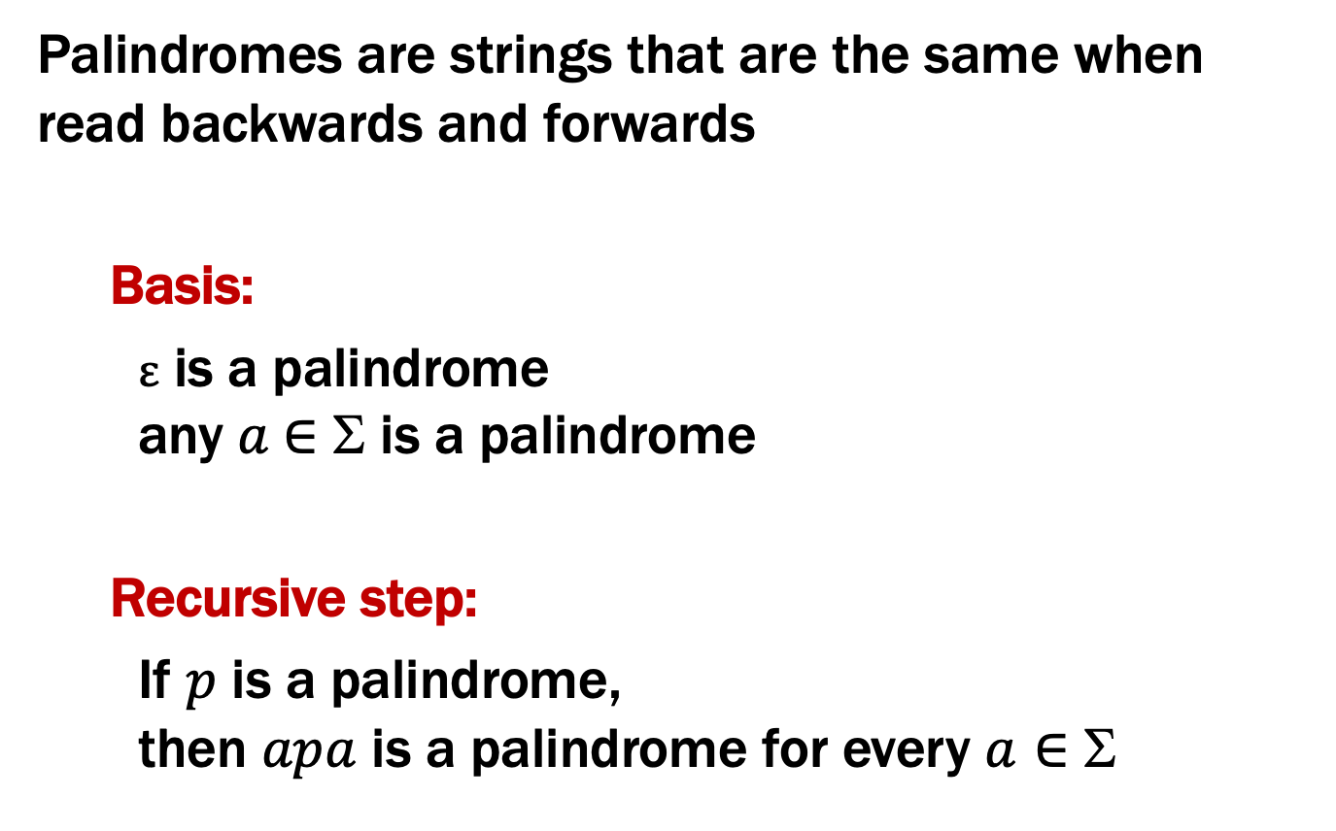
Palindromes
Palindromes are strings that are the same when read backwards and forwards
Basis:
ε is a palindrome any $a$∈ Σ is a palindrome
Recursive step:
If $p$ is a palindrome, then $apa$ is a palindrome for every $a∈$ Σ

Slide 36
All Binary Strings with no 1’s before 0’s
Basis:
ε ∈ S
Recursive:
If x ∈ S, then 0 • x ∈ S
If x ∈ S, then x1 ∈ S
Those have no 1s before 0s.
But is that every such string?

Slide 37
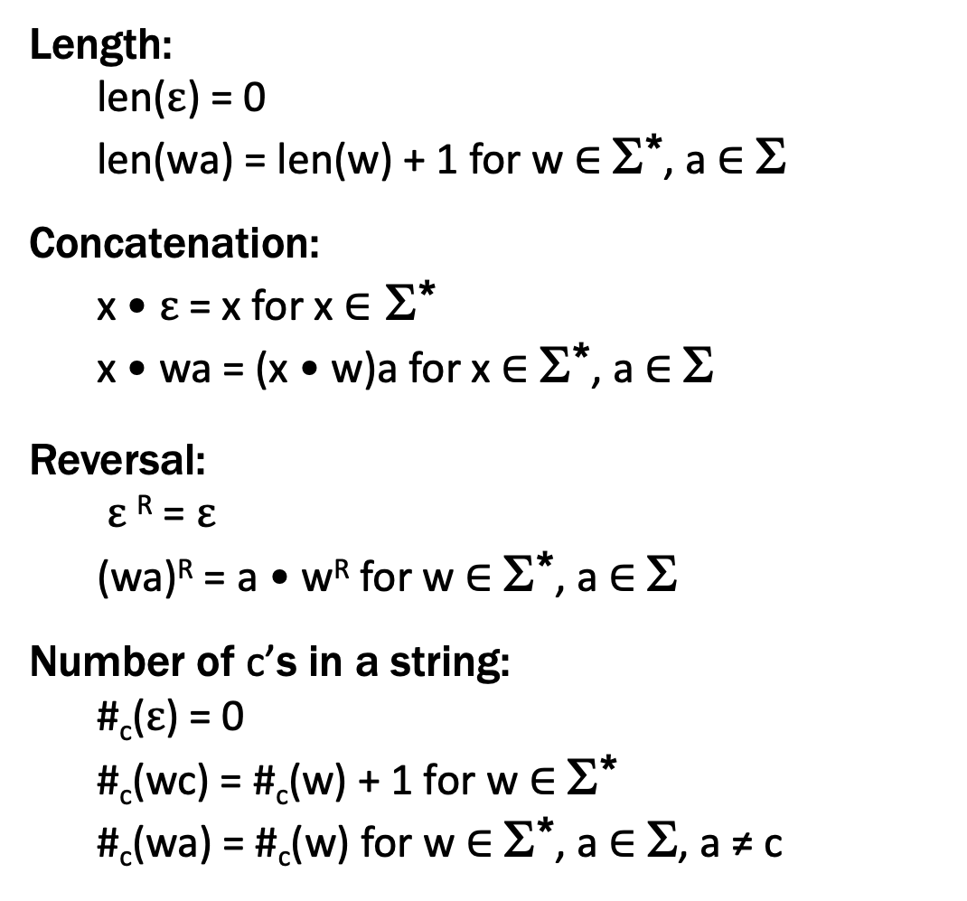
Functions on Recursively Defined Sets (on Σ*)
Length:
len($ε$) = 0
len(wa) = len(w) + 1 for w ∈ Σ*, a ∈ Σ
Concatenation:
x • $ε$ = x for x ∈ Σ*
x • wa = (x • w)a for x ∈ Σ*, a ∈ Σ
Reversal:
$ε$^{R} = $ε$
(wa)^{R} = a • w^{R} for w ∈ Σ*, a ∈ Σ
Number of c’s in a string:
#_{c}($ε$) = 0
#_{c}(wc) = #_{c}(w) + 1 for w ∈ Σ*
#_{c}(wa) = #_{c}(w) for w ∈ Σ*, a ∈ Σ, a ≠ c
defined by cases
concat(x,y) or x • y
defined by cases
on the shape of y
reverse(x) or x^{R}
more cases (3 total)
separate c vs a ≠ c
Notes:
These are defined by cases

Slide 38
Claim: len(x•y) = len(x) + len(y) for all x,y ∈ Σ*

Slide 39
Claim: len(x•y) = len(x) + len(y) for all x,y ∈ Σ*
Let P(y) be “len(x•y) = len(x) + len(y) for all x ∈ Σ* ” .
We prove P(y) for all y ∈ Σ* by structural induction.

Slide 40

Claim: len(x•y) = len(x) + len(y) for all x,y ∈ Σ*
Let P(y) be “len(x•y) = len(x) + len(y) for all x ∈ Σ* ” .
We prove P(y) for all y ∈ Σ* by structural induction.
Base Case (y = $ε$): Let x ∈ Σ* be arbitrary. Then, len(x • $ε$) = len(x) =
len(x) + len($ε$) since len($ε$)=0. Since x was arbitrary, P($ε$) holds.
Inductive Hypothesis: Assume that P(w) is true for some arbitrary w ∈ Σ*
Inductive Step: Goal: Show that P(wa) is true for every a ∈ Σ
Let a ∈ Σ. Let x ∈ Σ*. Then len(x•wa) = len((x•w)a) by defn of •
= len(x•w)+1 by defn of len
= len(x)+len(w)+1 by I.H.
= len(x)+len(wa) by defn of len
Therefore len(x•wa)= len(x)+len(wa) for all x ∈ Σ*, so P(wa) is true.
So, by induction len(x•y) = len(x) + len(y) for all x,y ∈ Σ*

Slide 41
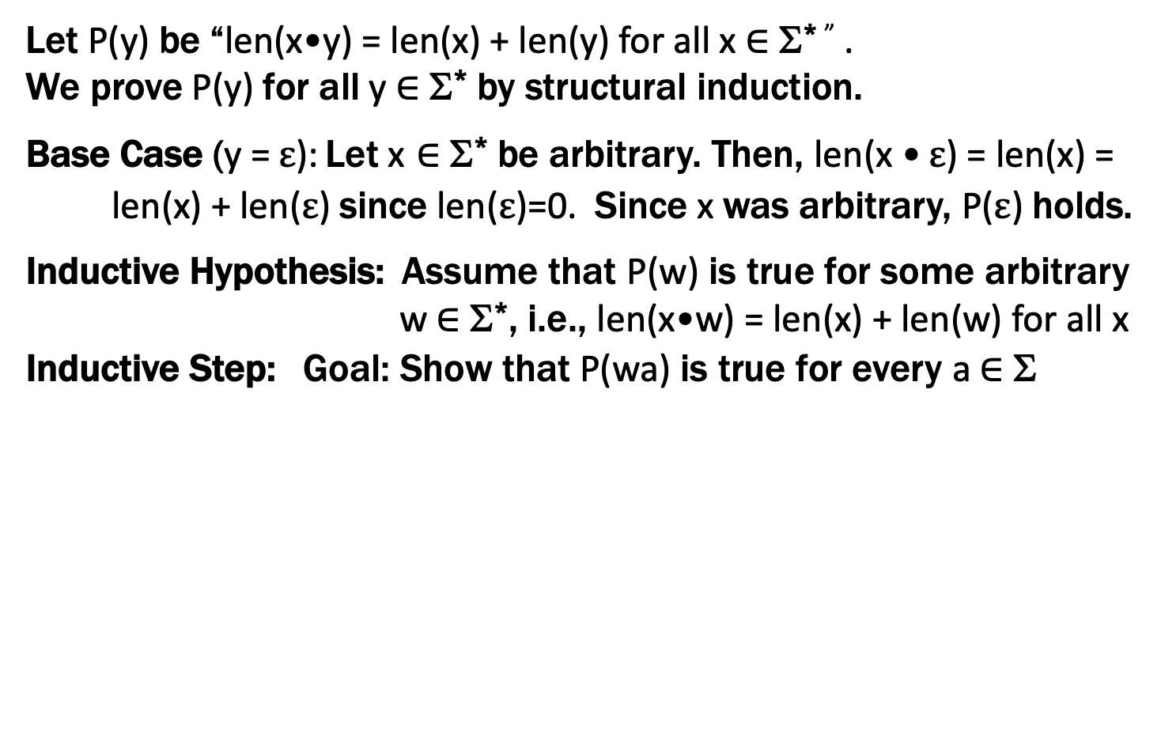
Claim: len(x•y) = len(x) + len(y) for all x,y ∈ Σ*
Let P(y) be “len(x•y) = len(x) + len(y) for all x ∈ Σ* ” .
We prove P(y) for all y ∈ Σ* by structural induction.
Base Case (y = $ε$): Let x ∈ Σ* be arbitrary. Then, len(x • $ε$) = len(x) =
len(x) + len($ε$) since len($ε$)=0. Since x was arbitrary, P($ε$) holds.
Inductive Hypothesis: Assume that P(w) is true for some arbitrary w ∈ Σ*, i.e., len(x•w) = len(x) + len(w) for all x
Inductive Step: Goal: Show that P(wa) is true for every a ∈ Σ
Let a ∈ Σ. Let x ∈ Σ*. Then len(x•wa) = len((x•w)a) by defn of •
= len(x•w)+1 by defn of len
= len(x)+len(w)+1 by I.H.
= len(x)+len(wa) by defn of len
Therefore len(x•wa)= len(x)+len(wa) for all x ∈ Σ*, so P(wa) is true.
So, by induction len(x•y) = len(x) + len(y) for all x,y ∈ Σ*

Slide 42
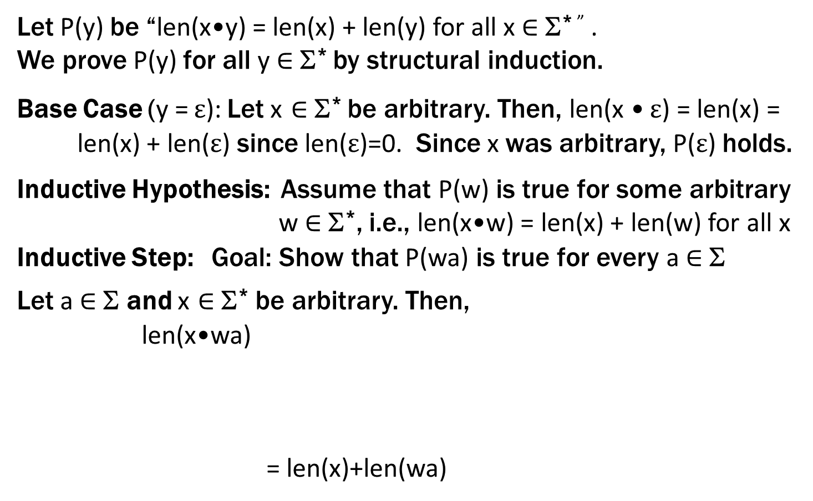
Claim: len(x•y) = len(x) + len(y) for all x,y ∈ Σ*
Let P(y) be “len(x•y) = len(x) + len(y) for all x ∈ Σ* ” .
We prove P(y) for all y ∈ Σ* by structural induction.
Base Case (y = $ε$): Let x ∈ Σ* be arbitrary. Then, len(x • $ε$) = len(x) =
len(x) + len($ε$) since len($ε$)=0. Since x was arbitrary, P($ε$) holds.
Inductive Hypothesis: Assume that P(w) is true for some arbitrary w ∈ Σ*, i.e., len(x•w) = len(x) + len(w) for all x
Inductive Step: Goal: Show that P(wa) is true for every a ∈ Σ
Let a ∈ Σ and x ∈ Σ* be arbitrary. Then,
len(x•wa)
= len(x)+len(wa)

Slide 43
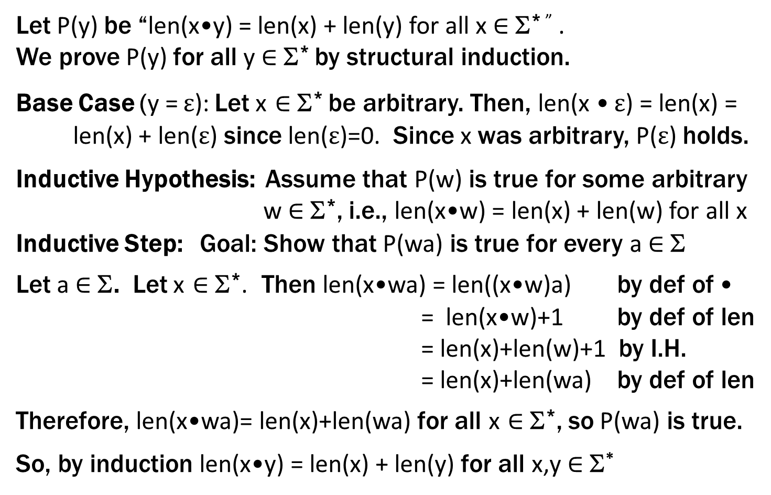
Claim: len(x•y) = len(x) + len(y) for all x,y ∈ Σ*
Let P(y) be “len(x•y) = len(x) + len(y) for all x ∈ Σ* ” .
We prove P(y) for all y ∈ Σ* by structural induction.
Base Case (y = $ε$): Let x ∈ Σ* be arbitrary. Then, len(x • $ε$) = len(x) =
len(x) + len($ε$) since len($ε$)=0. Since x was arbitrary, P($ε$) holds.
Inductive Hypothesis: Assume that P(w) is true for some arbitrary w ∈ Σ*, i.e., len(x•w) = len(x) + len(w) for all x
Inductive Step: Goal: Show that P(wa) is true for every a ∈ Σ
Let a ∈ Σ. Let x ∈ Σ*. Then len(x•wa) = len((x•w)a) by def of •
= len(x•w)+1 by def of len
= len(x)+len(w)+1 by I.H.
= len(x)+len(wa) by def of len
Therefore, len(x•wa)= len(x)+len(wa) for all x ∈ Σ*, so P(wa) is true.
So, by induction len(x•y) = len(x) + len(y) for all x,y ∈ Σ*

