Slide 1
Midterm
Midterm in class Monday
Covers material up to ordinary induction (HW5)
Closed book, closed notes
will provide reference sheets
No calculators
arithmetic is intended to be straightforward
(only a small point deduction anyway)

Slide 2
Midterm
5 problems covering:
Logic / English translation
Circuits / Boolean algebra / normal forms
Modular equations
Induction
Set theory
(any English proofs would have templates)
10 minutes per problem
write quickly
focus on the overall structure of the solution

Slide 3

CSE 311: Foundations of Computing
Lecture 19: Structural Induction

Slide 4
Last time: Recursive Definitions of Sets
Even numbers
Basis: 0 ∈ S
Recursive: If x ∈ S, then x+2 ∈ S
Powers of 3
Basis: 1 ∈ S
Recursive: If x ∈ S, then 3x ∈ S.
Fibonacci numbers
Basis: (0, 0) ∈ S, (1, 1) ∈ S
Recursive: If (n-1, x) ∈ S and (n, y) ∈ S,
then (n+1, x + y) ∈ S.

Slide 5
Last time: Structural Induction
How to prove ∀ 𝑥 ∈ 𝑆, 𝑃(𝑥) is true:
Base Case: Show that 𝑃(𝑢) is true for all specific elements 𝑢 of 𝑆 mentioned in the Basis step
Inductive Hypothesis: Assume that 𝑃 is true for some arbitrary values of each of the existing named elements mentioned in the Recursive step
Inductive Step: Prove that 𝑃(𝑤) holds for each of the new elements 𝑤 constructed in the Recursive step using the named elements mentioned in the Inductive Hypothesis
Conclude that ∀ 𝑥 ∈ 𝑆, 𝑃(𝑥)

Slide 6

Last time: Structural vs. Ordinary Induction
Ordinary induction is a special case of structural induction:
Recursive definition of ℕ
Basis: 0 ∈ ℕ
Recursive step: If 𝑘 ∈ ℕ, then $k+1$ ∈ ℕ

Slide 7
Last time: Recursive Definitions
Recursively defined functions and sets are our mathematical models of code and the data it uses
any recursively defined set can be translated into a Java
any recursively defined function can be translated into a Java function
some (but not all) can be written more cleanly as loops
Can now do proofs about CS-specific objects

Slide 8
Lists of Integers
Basis: nil ∈ List
Recursive step:
if L ∈ List and a ∈ ℤ,
then a :: L ∈ List
Examples:
nil []
1 :: nil [1]
1 :: 2 :: nil [1, 2]
1 :: 2 :: 3 :: nil [1, 2, 3]

Slide 9
Functions on Lists
Length:
len(nil) := 0
len(a :: L) := len(L) + 1 for any L ∈ List and a ∈ ℤ
Concatenation:
concat(nil, R) := R for any R ∈ List
concat(a :: L, R) := a :: concat(L, R) for any L, R ∈ List and
any a ∈ ℤ
Notes:
These are defined by cases

Slide 10
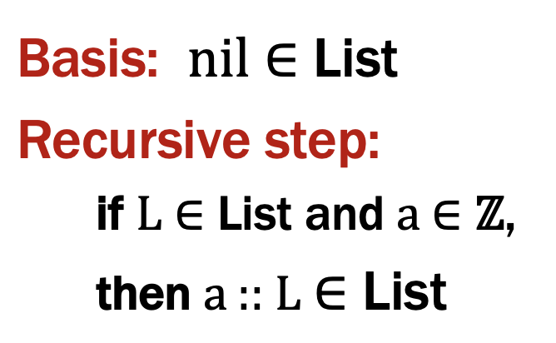
Last time: Structural Induction
How to prove ∀ 𝑥 ∈ 𝑆, 𝑃(𝑥) is true:
Base Case: Show that 𝑃(𝑢) is true for all specific elements 𝑢 of 𝑆 mentioned in the Basis step
Inductive Hypothesis: Assume that 𝑃 is true for some arbitrary values of each of the existing named elements mentioned in the Recursive step
Inductive Step: Prove that 𝑃(𝑤) holds for each of the new elements 𝑤 constructed in the Recursive step using the named elements mentioned in the Inductive Hypothesis
Conclude that ∀ 𝑥 ∈ 𝑆, 𝑃(𝑥)

Slide 11
Claim: len(concat(L, R)) = len(L) + len(R) for all L ∈ List

Slide 12
Claim: len(concat(L, R)) = len(L) + len(R) for all L ∈ List
Let P(L) be “len(concat(L, R)) = len(L) + len(R)” .
We prove P(L) for all L ∈ List by structural induction.

Slide 13
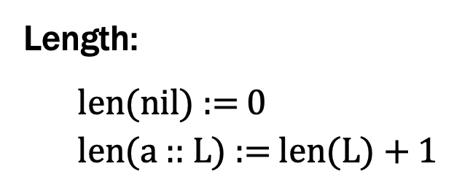
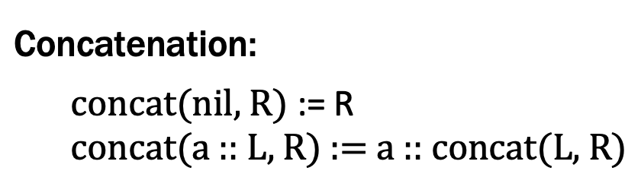
Claim: len(concat(L, R)) = len(L) + len(R) for all L ∈ List
Let P(L) be “len(concat(L, R)) = len(L) + len(R)” .
We prove P(L) for all L ∈ List by structural induction.
Base Case (nil):

Slide 14
Claim: len(concat(L, R)) = len(L) + len(R) for all L ∈ List
Let P(L) be “len(concat(L, R)) = len(L) + len(R)” .
We prove P(L) for all L ∈ List by structural induction.
Base Case (nil):
len(concat(nil, R)) = len(R) def of concat
= 0 + len(R)
= len(nil) + len(R) def of len

Slide 15
Claim: len(concat(L, R)) = len(L) + len(R) for all L ∈ List
Let P(L) be “len(concat(L, R)) = len(L) + len(R)” .
We prove P(L) for all L ∈ List by structural induction.
Base Case (nil): We have len(concat(nil, R)) = len(R) = 0 + len(R) = len(nil) + len(R), showing P(nil).
Inductive Hypothesis: Assume that P(L) is true for some arbitrary L ∈ List, i.e., len(concat(L, R)) = len(L) + len(R).

Slide 16
Claim: len(concat(L, R)) = len(L) + len(R) for all L ∈ List
Let P(L) be “len(concat(L, R)) = len(L) + len(R)” .
We prove P(L) for all L ∈ List by structural induction.
Base Case (nil): We have len(concat(nil, R)) = len(R) = 0 + len(R) = len(nil) + len(R), showing P(nil).
Inductive Hypothesis: Assume that P(L) is true for some arbitrary L ∈ List, i.e., len(concat(L, R)) = len(L) + len(R).
Inductive Step: Goal: Show that P(a :: L) is true

Slide 17
Claim: len(concat(L, R)) = len(L) + len(R) for all L ∈ List
Let P(L) be “len(concat(L, R)) = len(L) + len(R)” .
We prove P(L) for all L ∈ List by structural induction.
Base Case (nil): We have len(concat(nil, R)) = len(R) = 0 + len(R) = len(nil) + len(R), showing P(nil).
Inductive Hypothesis: Assume that P(L) is true for some arbitrary L ∈ List, i.e., len(concat(L, R)) = len(L) + len(R).
Inductive Step: Goal: Show that P(a :: L) is true

Slide 18
Claim: len(concat(L, R)) = len(L) + len(R) for all L ∈ List
Let P(L) be “len(concat(L, R)) = len(L) + len(R)” .
We prove P(L) for all L ∈ List by structural induction.
Base Case (nil): We have len(concat(nil, R)) = len(R) = 0 + len(R) = len(nil) + len(R), showing P(nil).
Inductive Hypothesis: Assume that P(L) is true for some arbitrary L ∈ List, i.e., len(concat(L, R)) = len(L) + len(R).
Inductive Step: Goal: Show that P(a :: L) is true
We can calculate
len(concat(a :: L, R)) = len(a :: concat(L, R)) def of concat
= 1 + len(concat(L, R)) def of len
= 1 + len(L) + len(R) IH
= len(a :: L) + len(R) def of len
which is P(a :: L).

Slide 19
Claim: len(concat(L, R)) = len(L) + len(R) for all L ∈ List
Let P(L) be “len(concat(L, R)) = len(L) + len(R)” .
We prove P(L) for all L ∈ List by structural induction.
Base Case (nil): We have len(concat(nil, R)) = len(R) = 0 + len(R) = len(nil) + len(R), showing P(nil).
Inductive Hypothesis: Assume that P(L) is true for some arbitrary L ∈ List, i.e., len(concat(L, R)) = len(L) + len(R).
Inductive Step: Goal: Show that P(a :: L) is true
We can calculate
len(concat(a :: L, R)) = len(a :: concat(L, R)) def of concat
= 1 + len(concat(L, R)) def of len
= 1 + len(L) + len(R) IH
= len(a :: L) + len(R) def of len
which is P(a :: L).
By induction, we have shown the claim holds for all L ∈ List.

Slide 20
Claim: len(concat(L, R)) = len(L) + len(R) for all L, R ∈ List

Slide 21
Claim: len(concat(L, R)) = len(L) + len(R) for all L, R ∈ List
Let P(L) be “len(concat(L, R)) = len(L) + len(R) for all R ∈ List ” .
We prove P(L) for all L ∈ List by structural induction.

Slide 22
Claim: len(concat(L, R)) = len(L) + len(R) for all L, R ∈ List
Let P(L) be “len(concat(L, R)) = len(L) + len(R) for all R ∈ List ” .
We prove P(L) for all L ∈ List by structural induction.
Base Case (nil): Let R ∈ List be arbitrary. Then,

Slide 23
Claim: len(concat(L, R)) = len(L) + len(R) for all L, R ∈ List
Let P(L) be “len(concat(L, R)) = len(L) + len(R) for all R ∈ List ” .
We prove P(L) for all L ∈ List by structural induction.
Base Case (nil): Let R ∈ List be arbitrary. Then,
len(concat(nil, R)) = len(R) def of concat
= 0 + len(R)
= len(nil) + len(R) def of len
Since R was arbitrary, P(nil) holds.

Slide 24
Claim: len(concat(L, R)) = len(L) + len(R) for all L, R ∈ List
Let P(L) be “len(concat(L, R)) = len(L) + len(R) for all R ∈ List ” .
We prove P(L) for all L ∈ List by structural induction.
Base Case (nil): Let R ∈ List be arbitrary. Then, len(concat(nil, R)) = len(R) = 0 + len(R) = len(nil) + len(R), showing P(nil).
Inductive Hypothesis: Assume that P(L) is true for some arbitrary L ∈ List, i.e., len(concat(L, R)) = len(L) + len(R) for all R ∈ List.

Slide 25
Claim: len(concat(L, R)) = len(L) + len(R) for all L, R ∈ List
Let P(L) be “len(concat(L, R)) = len(L) + len(R) for all R ∈ List ” .
We prove P(L) for all L ∈ List by structural induction.
Base Case (nil): Let R ∈ List be arbitrary. Then, len(concat(nil, R)) = len(R) = 0 + len(R) = len(nil) + len(R), showing P(nil).
Inductive Hypothesis: Assume that P(L) is true for some arbitrary L ∈ List, i.e., len(concat(L, R)) = len(L) + len(R) for all R ∈ List.
Inductive Step: Goal: Show that P(a :: L) is true

Slide 26
Claim: len(concat(L, R)) = len(L) + len(R) for all L, R ∈ List
Let P(L) be “len(concat(L, R)) = len(L) + len(R) for all R ∈ List ” .
We prove P(L) for all L ∈ List by structural induction.
Base Case (nil): Let R ∈ List be arbitrary. Then, len(concat(nil, R)) = len(R) = 0 + len(R) = len(nil) + len(R), showing P(nil).
Inductive Hypothesis: Assume that P(L) is true for some arbitrary L ∈ List, i.e., len(concat(L, R)) = len(L) + len(R) for all R ∈ List.
Inductive Step: Goal: Show that P(a :: L) is true
Let R ∈ List be arbitrary. Then,

Slide 27
Claim: len(concat(L, R)) = len(L) + len(R) for all L, R ∈ List
Let P(L) be “len(concat(L, R)) = len(L) + len(R) for all R ∈ List ” .
We prove P(L) for all L ∈ List by structural induction.
Base Case (nil): Let R ∈ List be arbitrary. Then, len(concat(nil, R)) = len(R) = 0 + len(R) = len(nil) + len(R), showing P(nil).
Inductive Hypothesis: Assume that P(L) is true for some arbitrary L ∈ List, i.e., len(concat(L, R)) = len(L) + len(R) for all R ∈ List.
Inductive Step: Goal: Show that P(a :: L) is true
Let R ∈ List be arbitrary. Then, we can calculate
len(concat(a :: L, R)) = len(a :: concat(L, R)) def of concat
= 1 + len(concat(L, R)) def of len
= 1 + len(L) + len(R) IH
= len(a :: L) + len(R) def of len
Since R was arbitrary, we have shown P(a :: L).
By induction, we have shown the claim holds for all L ∈ List.

Slide 28
Rooted Binary Trees
Basis: • is a rooted binary tree

Slide 29
Rooted Binary Trees
Basis: • is a rooted binary tree
Recursive step:
If and are rooted binary trees,
then also is a rooted binary tree.
T₁
T₂
T₂
T₁

Slide 30
Defining Functions on Rooted Binary Trees
size(•) ::= 1
size ( ) ::= 1 + size(T₁) + size(T₂)
height(•) ::= 0
height ( ) ::= 1 + max{height(T₁), height(T₂)}
T₁
T₂
T₁
T₂

Slide 31
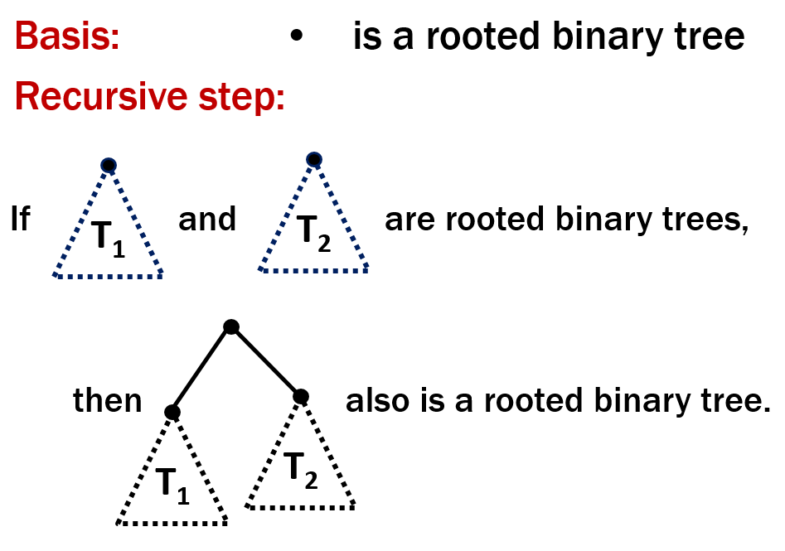
Last time: Structural Induction
How to prove ∀ 𝑥 ∈ 𝑆, 𝑃(𝑥) is true:
Base Case: Show that 𝑃(𝑢) is true for all specific elements 𝑢 of 𝑆 mentioned in the Basis step
Inductive Hypothesis: Assume that 𝑃 is true for some arbitrary values of each of the existing named elements mentioned in the Recursive step
Inductive Step: Prove that 𝑃(𝑤) holds for each of the new elements 𝑤 constructed in the Recursive step using the named elements mentioned in the Inductive Hypothesis
Conclude that ∀ 𝑥 ∈ 𝑆, 𝑃(𝑥)

Slide 32
Claim: For every rooted binary tree T, size(T) ≤ 2^{height(T) + 1} - 1

Slide 33
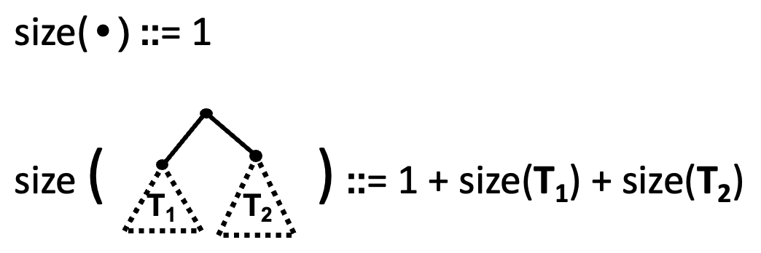
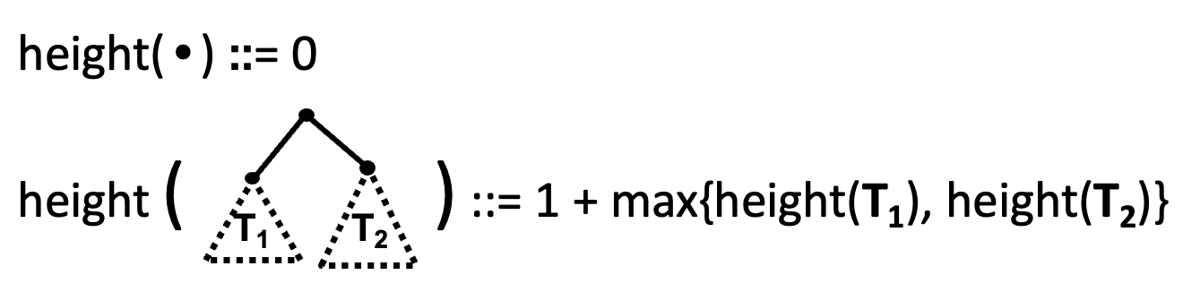
Claim: For every rooted binary tree T, size(T) ≤ 2^{height(T) + 1} - 1
1. Let P(T) be “size(T) ≤ 2^{height(T)+1}–1”. We prove P(T) for all rooted binary trees T by structural induction.
2. Base Case: size(•)=1, height(•)=0 and 1=2¹–1=2⁰⁺¹–1 so P(•) is true.
3. Inductive Hypothesis: Suppose that P(T₁) and P(T₂) are true for some rooted binary trees T₁ and T₂.
4. Inductive Step: Goal: Prove P( ).
By defn, size( ) =1+size(T₁)+size(T₂)
≤ 1+2^{height(T1)+1}–1+2^{height(T2)+1}-1 by IH for T₁ and T₂
≤ 2^{height(T1)+1}+2^{height(T2)+1}–1
≤ 2(2^{max(height(T1),height(T2))+1})–1
≤ 2(2^{height(} ⁾)–1 ≤ 2^{height( )+1} –1
which is what we wanted to show.
5. So, the P(T) is true for all rooted bin. trees by structural induction.

Slide 34
Claim: For every rooted binary tree T, size(T) ≤ 2^{height(T) + 1} - 1
1. Let P(T) be “size(T) ≤ 2^{height(T)+1}–1”. We prove P(T) for all rooted binary trees T by structural induction.
2. Base Case: size(•)=1, height(•)=0, and 2⁰⁺¹–1=2¹–1=1 so P(•) is true.
3. Inductive Hypothesis: Suppose that P(T₁) and P(T₂) are true for some rooted binary trees T₁ and T₂.
4. Inductive Step: Goal: Prove P( ).
By defn, size( ) =1+size(T₁)+size(T₂)
≤ 1+2^{height(T1)+1}–1+2^{height(T2)+1}-1 by IH for T₁ and T₂
≤ 2^{height(T1)+1}+2^{height(T2)+1}–1
≤ 2(2^{max(height(T1),height(T2))+1})–1
≤ 2(2^{height(} ⁾)–1 ≤ 2^{height( )+1} –1
which is what we wanted to show.
5. So, the P(T) is true for all rooted bin. trees by structural induction.

Slide 35
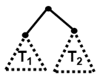
Claim: For every rooted binary tree T, size(T) ≤ 2^{height(T) + 1} - 1
1. Let P(T) be “size(T) ≤ 2^{height(T)+1}–1”. We prove P(T) for all rooted binary trees T by structural induction.
2. Base Case: size(•)=1, height(•)=0, and 2⁰⁺¹–1=2¹–1=1 so P(•) is true.
3. Inductive Hypothesis: Suppose that P(T₁) and P(T₂) are true for some rooted binary trees T₁ and T₂, i.e., size(T_{k}) ≤ 2^{height(Tk) + 1} – 1 for k=1,2
4. Inductive Step: Goal: Prove P( ).
By defn, size( ) =1+size(T₁)+size(T₂)
≤ 1+2^{height(T1)+1}–1+2^{height(T2)+1}-1 by IH for T₁ and T₂
≤ 2^{height(T1)+1}+2^{height(T2)+1}–1
≤ 2(2^{max(height(T1),height(T2))+1})–1
≤ 2(2^{height(} ⁾)–1 ≤ 2^{height( )+1} –1
which is what we wanted to show.
5. So, the P(T) is true for all rooted bin. trees by structural induction.

Slide 36
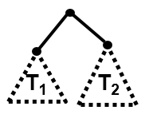

Claim: For every rooted binary tree T, size(T) ≤ 2^{height(T) + 1} - 1
1. Let P(T) be “size(T) ≤ 2^{height(T)+1}–1”. We prove P(T) for all rooted binary trees T by structural induction.
2. Base Case: size(•)=1, height(•)=0, and 2⁰⁺¹–1=2¹–1=1 so P(•) is true.
3. Inductive Hypothesis: Suppose that P(T₁) and P(T₂) are true for some rooted binary trees T₁ and T₂, i.e., size(T_{k}) ≤ 2^{height(Tk) + 1} – 1 for k=1,2
4. Inductive Step: Goal: Prove P( ).
size( ) ≤ 2^{height( )+1} – 1

Slide 37
Claim: For every rooted binary tree T, size(T) ≤ 2^{height(T) + 1} - 1
1. Let P(T) be “size(T) ≤ 2^{height(T)+1}–1”. We prove P(T) for all rooted binary trees T by structural induction.
2. Base Case: size(•)=1, height(•)=0, and 2⁰⁺¹–1=2¹–1=1 so P(•) is true.
3. Inductive Hypothesis: Suppose that P(T₁) and P(T₂) are true for some rooted binary trees T₁ and T₂, i.e., size(T_{k}) ≤ 2^{height(Tk) + 1} – 1 for k=1,2
4. Inductive Step: Goal: Prove P( ).
By def, size( ) =1+size(T₁)+size(T₂)
≤ 1+2^{height(T1)+1}–1+2^{height(T2)+1}-1 by IH for T₁ and T₂
≤ 2^{height(T1)+1}+2^{height(T2)+1}–1
≤ 2(2^{max(height(T1),height(T2))+1})–1
≤ 2(2^{height(} ⁾) – 1 ≤ 2^{height( )+1} – 1
which is what we wanted to show.
5. So, the P(T) is true for all rooted binary trees by structural induction.

Slide 38
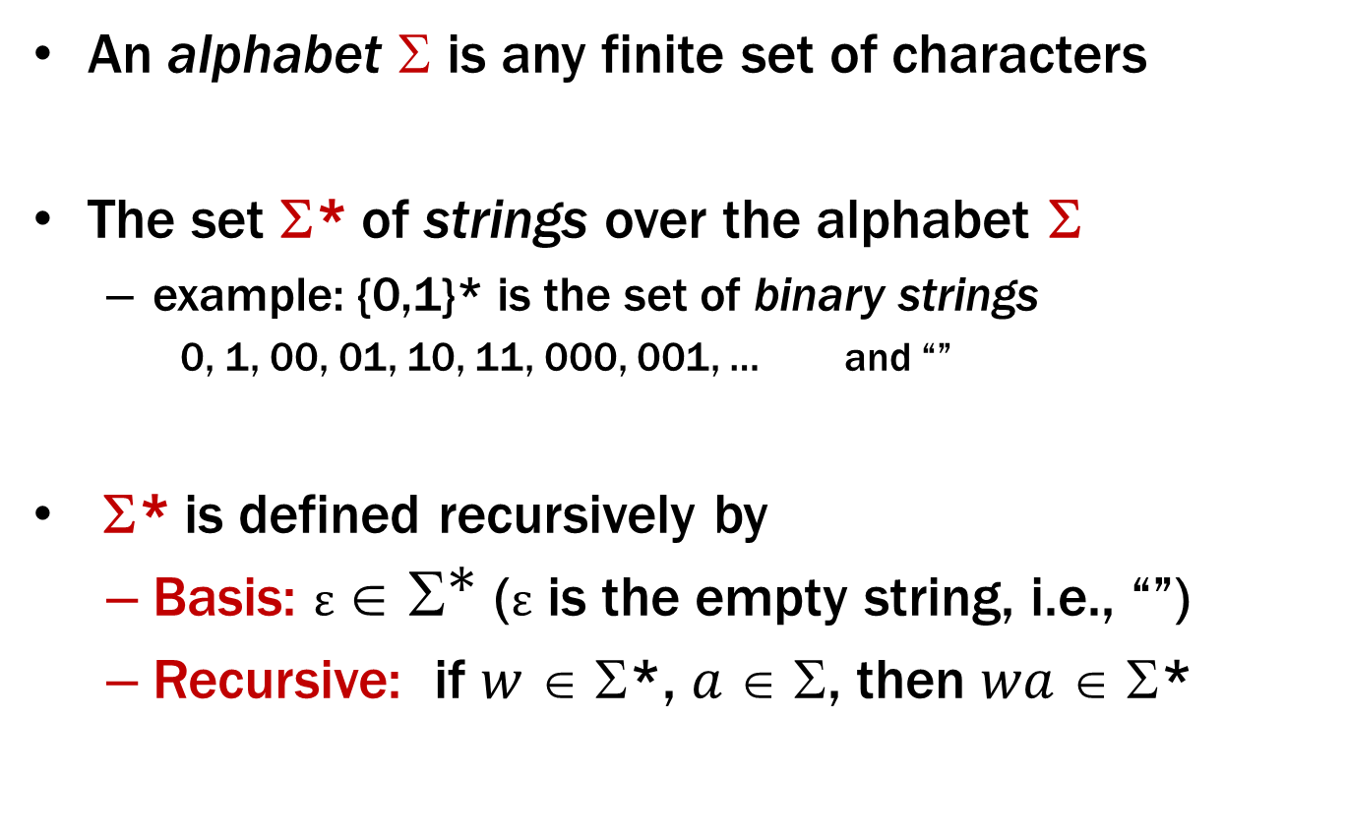
Strings
An alphabet $$ is any finite set of characters
The set Σ* of strings over the alphabet Σ
example: {0,1}* is the set of binary strings
0, 1, 00, 01, 10, 11, 000, 001, … and “”
Σ* is defined recursively by
Basis: $ε ∈ {\text{Σ}}^{\text{∗}}$ (ε is the empty string, i.e., “”)
Recursive: if $w$ ∈ Σ*, $a$ ∈ Σ, then $wa$ ∈ Σ*

Slide 39
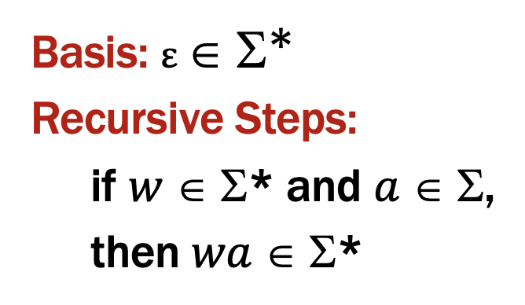
Last time: Structural Induction
How to prove ∀ 𝑥 ∈ 𝑆, 𝑃(𝑥) is true:
Base Case: Show that 𝑃(𝑢) is true for all specific elements 𝑢 of 𝑆 mentioned in the Basis step
Inductive Hypothesis: Assume that 𝑃 is true for some arbitrary values of each of the existing named elements mentioned in the Recursive step
Inductive Step: Prove that 𝑃(𝑤) holds for each of the new elements 𝑤 constructed in the Recursive step using the named elements mentioned in the Inductive Hypothesis
Conclude that ∀ 𝑥 ∈ 𝑆, 𝑃(𝑥)

Slide 40
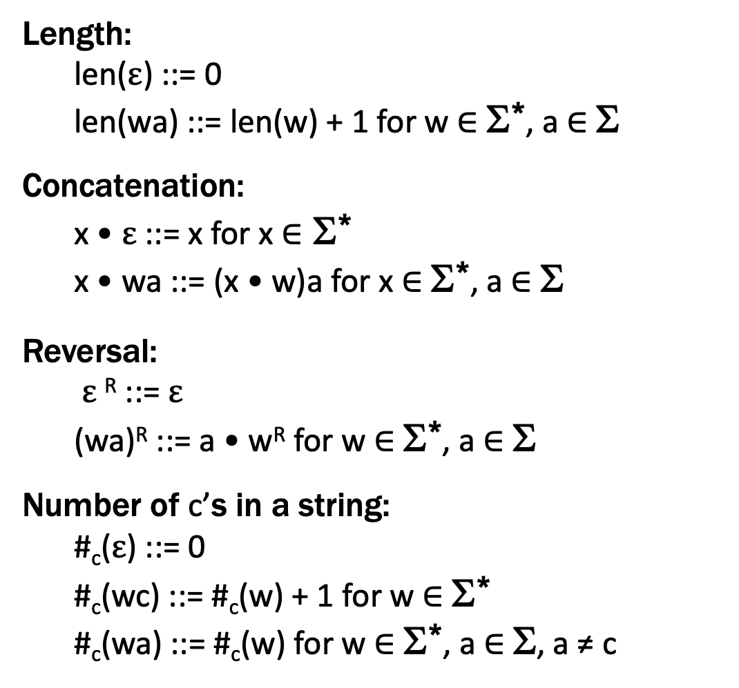
Functions on Recursively Defined Sets (on Σ*)
Length:
len($ε$) ::= 0
len(wa) ::= len(w) + 1 for w ∈ Σ*, a ∈ Σ
Concatenation:
x • $ε$ ::= x for x ∈ Σ*
x • wa ::= (x • w)a for x ∈ Σ*, a ∈ Σ
Reversal:
$ε$^{R} ::= $ε$
(wa)^{R} ::= a • w^{R} for w ∈ Σ*, a ∈ Σ
Number of c’s in a string:
#_{c}($ε$) ::= 0
#_{c}(wc) ::= #_{c}(w) + 1 for w ∈ Σ*
#_{c}(wa) ::= #_{c}(w) for w ∈ Σ*, a ∈ Σ, a ≠ c
separate cases for
c vs a ≠ c
Notes:
These are defined by cases

Slide 41
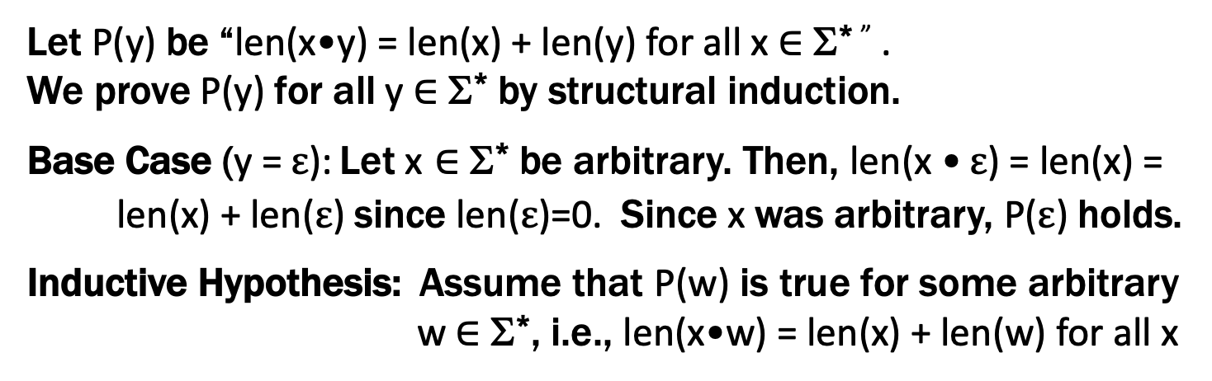
Claim: len(x•y) = len(x) + len(y) for all x,y ∈ Σ*
Let P(y) be “len(x•y) = len(x) + len(y) for all x ∈ Σ* ” .
We prove P(y) for all y ∈ Σ* by structural induction.
Base Case (y = $ε$): Let x ∈ Σ* be arbitrary. Then, len(x • $ε$) = len(x) =
len(x) + len($ε$) since len($ε$)=0. Since x was arbitrary, P($ε$) holds.
Inductive Hypothesis: Assume that P(w) is true for some arbitrary w ∈ Σ*, i.e., len(x•w) = len(x) + len(w) for all x

Slide 42
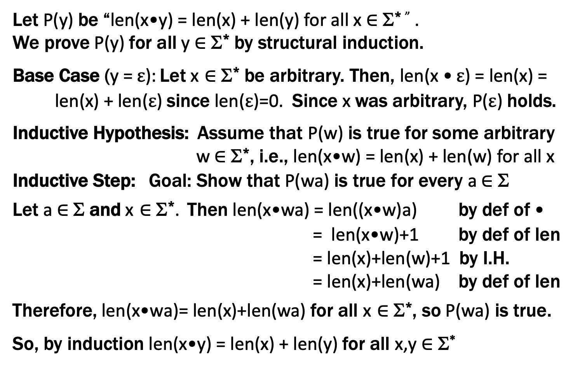
Claim: len(x•y) = len(x) + len(y) for all x,y ∈ Σ*
Does this look familiar?
Let P(y) be “len(x•y) = len(x) + len(y) for all x ∈ Σ* ” .
We prove P(y) for all y ∈ Σ* by structural induction.
Base Case (y = $ε$): Let x ∈ Σ* be arbitrary. Then, len(x • $ε$) = len(x) =
len(x) + len($ε$) since len($ε$)=0. Since x was arbitrary, P($ε$) holds.
Inductive Hypothesis: Assume that P(w) is true for some arbitrary w ∈ Σ*, i.e., len(x•w) = len(x) + len(w) for all x
Inductive Step: Goal: Show that P(wa) is true for every a ∈ Σ
Let a ∈ Σ and x ∈ Σ*. Then len(x•wa) = len((x•w)a) by def of •
= len(x•w)+1 by def of len
= len(x)+len(w)+1 by I.H.
= len(x)+len(wa) by def of len
Therefore, len(x•wa)= len(x)+len(wa) for all x ∈ Σ*, so P(wa) is true.
So, by induction len(x•y) = len(x) + len(y) for all x,y ∈ Σ*

Slide 43
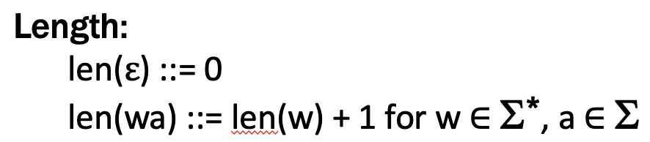
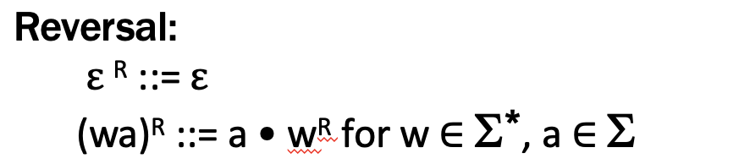
Claim: len(x^{R}) = len(x) for all x ∈ Σ*
Let P(x) be “len(x^{R}) = len(x)”.
We will prove P(x) for all x ∈ Σ* by structural induction.

Slide 44

Claim: len(x^{R}) = len(x) for all x ∈ Σ*
Let P(x) be “len(x^{R}) = len(x)”.
We will prove P(x) for all x ∈ Σ* by structural induction.
Base Case (x = $ε$): Then, len($ε^{R}$) = len($ε$) by def of string reverse.

Slide 45
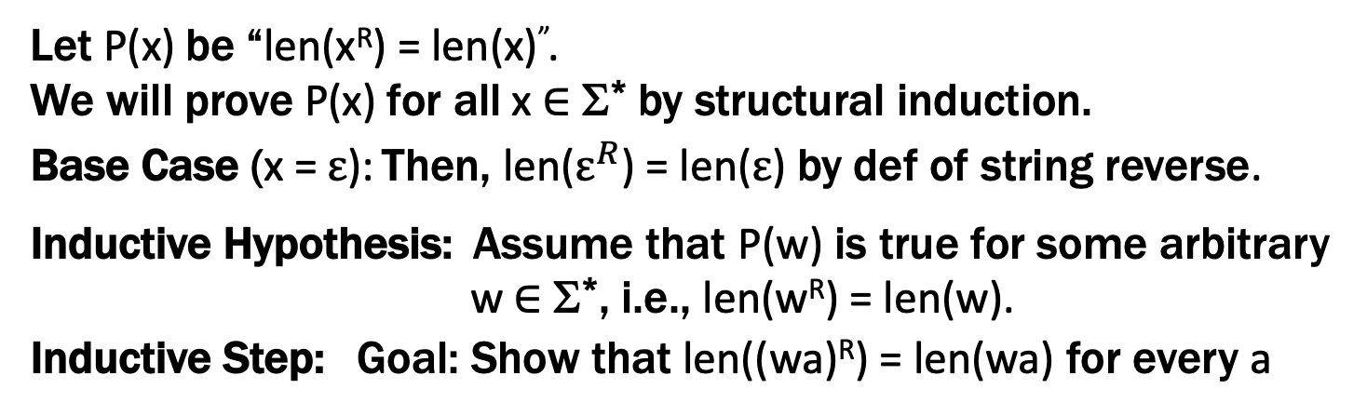
Claim: len(x^{R}) = len(x) for all x ∈ Σ*
Let P(x) be “len(x^{R}) = len(x)”.
We will prove P(x) for all x ∈ Σ* by structural induction.
Base Case (x = $ε$): Then, len($ε^{R}$) = len($ε$) by def of string reverse.
Inductive Hypothesis: Assume that P(w) is true for some arbitrary w ∈ Σ*, i.e., len(w^{R}) = len(w).
Inductive Step: Goal: Show that len((wa)^{R}) = len(wa) for every a

Slide 46
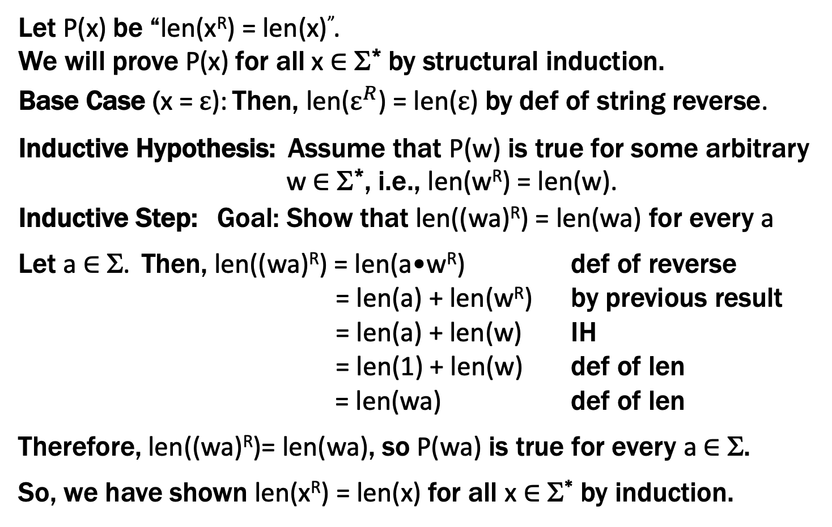
Claim: len(x^{R}) = len(x) for all x ∈ Σ*
Let P(x) be “len(x^{R}) = len(x)”.
We will prove P(x) for all x ∈ Σ* by structural induction.
Base Case (x = $ε$): Then, len($ε^{R}$) = len($ε$) by def of string reverse.
Inductive Hypothesis: Assume that P(w) is true for some arbitrary w ∈ Σ*, i.e., len(w^{R}) = len(w).
Inductive Step: Goal: Show that len((wa)^{R}) = len(wa) for every a
Let a ∈ Σ. Then, len((wa)^{R}) = len(a•w^{R}) def of reverse
= len(a) + len(w^{R}) by previous result
= len(a) + len(w) IH
= len(1) + len(w) def of len
= len(wa) def of len
Therefore, len((wa)^{R})= len(wa), so P(wa) is true for every a ∈ Σ.
So, we have shown len(x^{R}) = len(x) for all x ∈ Σ* by induction.

Slide 47
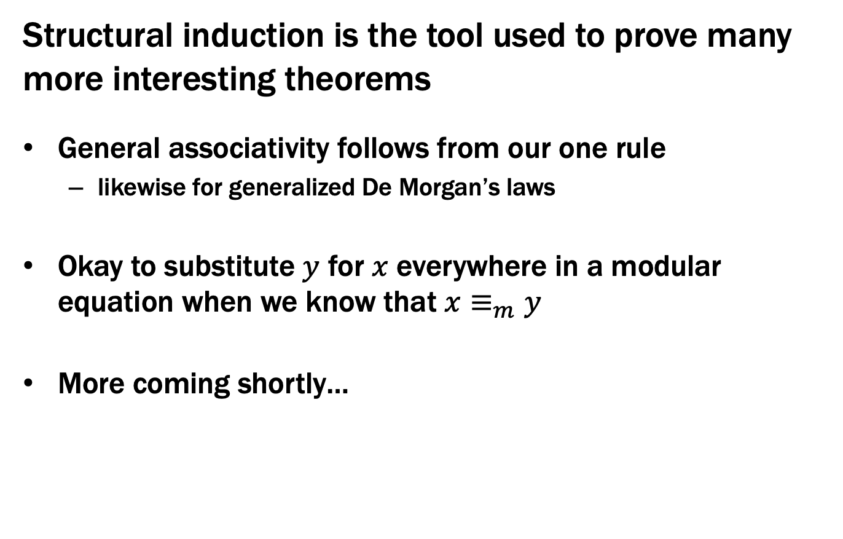
More Theorems
Structural induction is the tool used to prove many more interesting theorems
General associativity follows from our one rule
likewise for generalized De Morgan’s laws
Okay to substitute $y$ for $x$ everywhere in a modular equation when we know that $x≡_{m}y$
More coming shortly…

