Slide 1
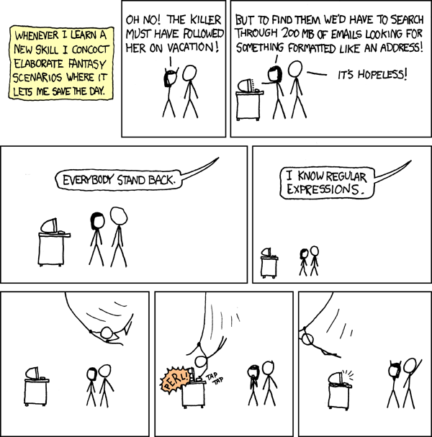
CSE 311: Foundations of Computing
Lecture 20: Structural Induction, Regular Expressions

Slide 2
Previously on 311: Recursive Definitions
Examples we saw fall in two categories
new types of data
subsets of previously-defined data
New Types | Subsets
Natural Numbers Lists Trees Strings | Even Numbers Powers of 3 Fibonacci Numbers

Slide 3
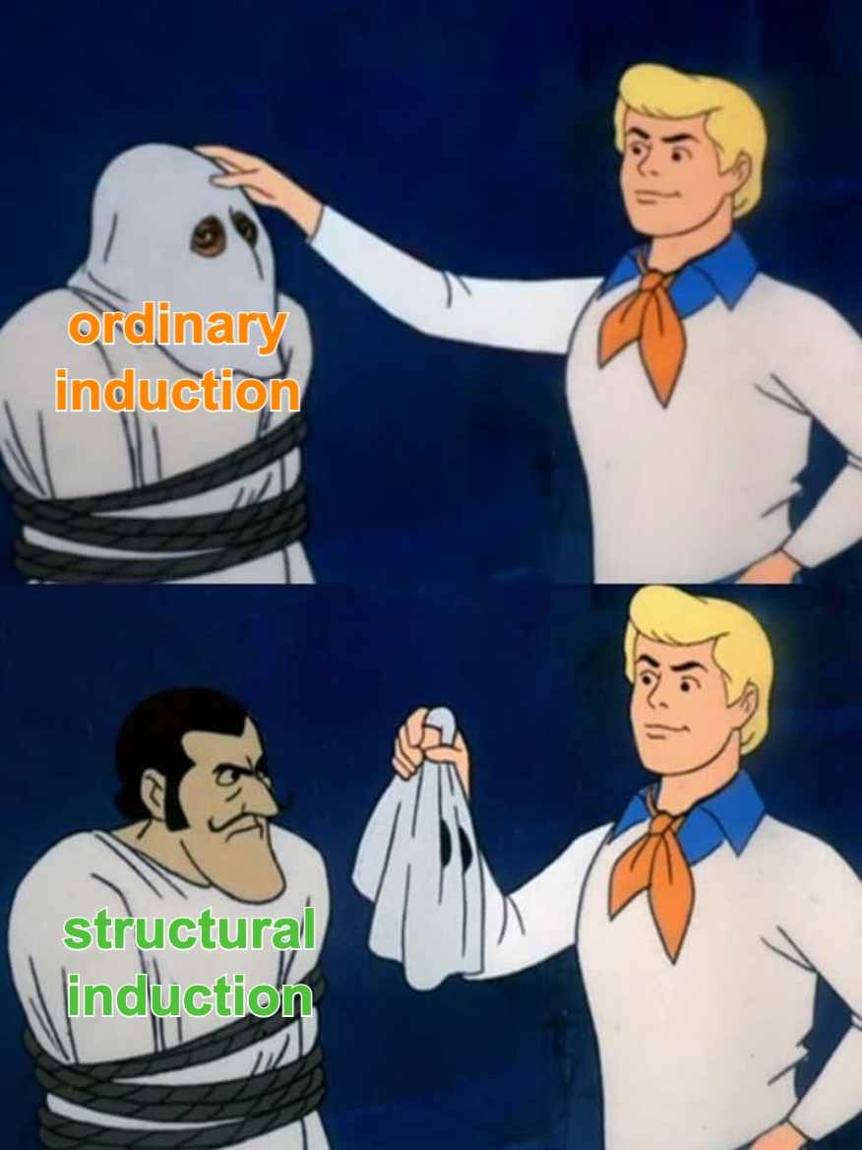
Last time: Structural Induction

Slide 4
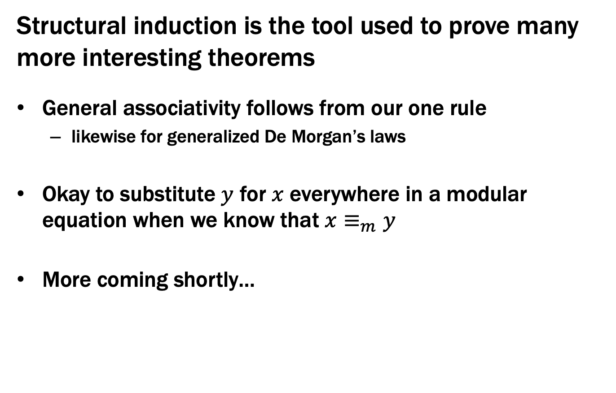
Last time: Structural Induction
Structural induction is the tool used to prove many more interesting theorems
General associativity follows from our one rule
likewise for generalized De Morgan’s laws
Okay to substitute $y$ for $x$ everywhere in a modular equation when we know that $x≡_{m}y$
More coming shortly…

Slide 5
Theoretical Computer Science

Slide 6
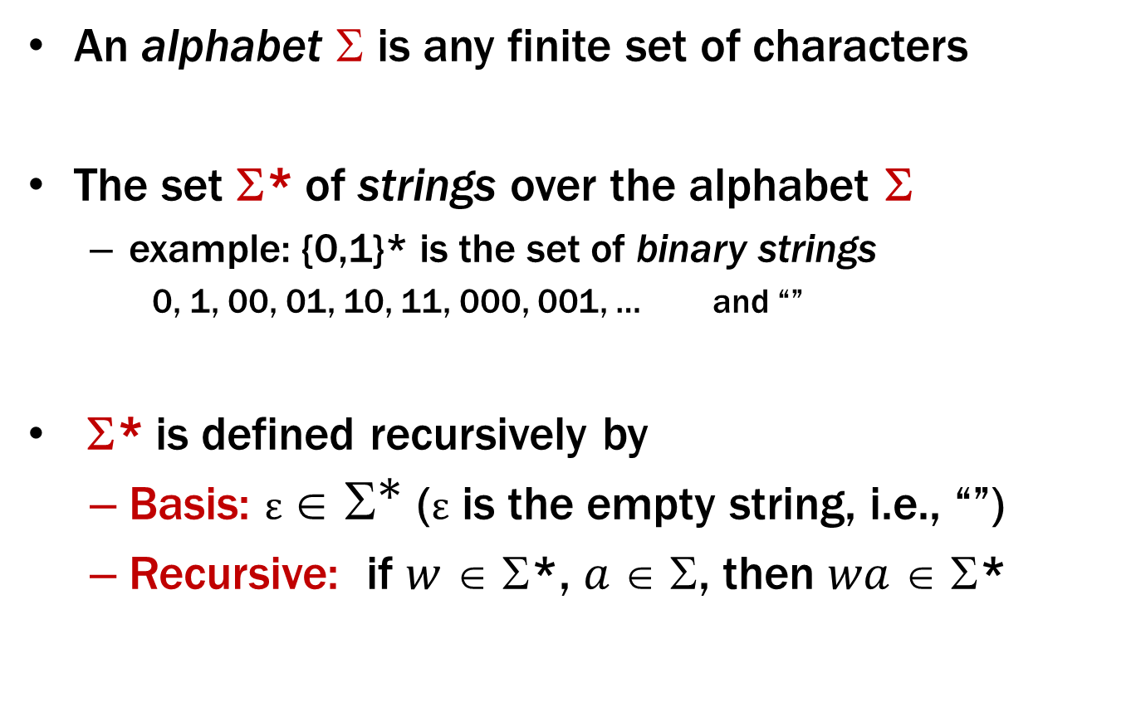
Strings
An alphabet $$ is any finite set of characters
The set Σ* of strings over the alphabet Σ
example: {0,1}* is the set of binary strings
0, 1, 00, 01, 10, 11, 000, 001, … and “”
Σ* is defined recursively by
Basis: $ε ∈ {\text{Σ}}^{\text{∗}}$ (ε is the empty string, i.e., “”)
Recursive: if $w$ ∈ Σ*, $a$ ∈ Σ, then $wa$ ∈ Σ*

Slide 7
Languages: Sets of Strings
Subsets of strings are called languages
Examples:
Σ* = All strings over alphabet Σ
Palindromes over Σ
Binary strings that don’t have a 0 after a 1
Binary strings with an equal # of 0’s and 1’s
Legal variable names in Java/C/C++
Syntactically correct Java/C/C++ programs
Valid English sentences

Slide 8
Foreword on Intro to Theory C.S.
Look at different ways of defining languages
See which are more expressive than others
i.e., which can define more languages
Later: connect ways of defining languages to different types of (restricted) computers
computers capable of recognizing those languages i.e., distinguishing strings in the language from not
Consequence: computers that recognize more expressive languages are more powerful

Slide 9
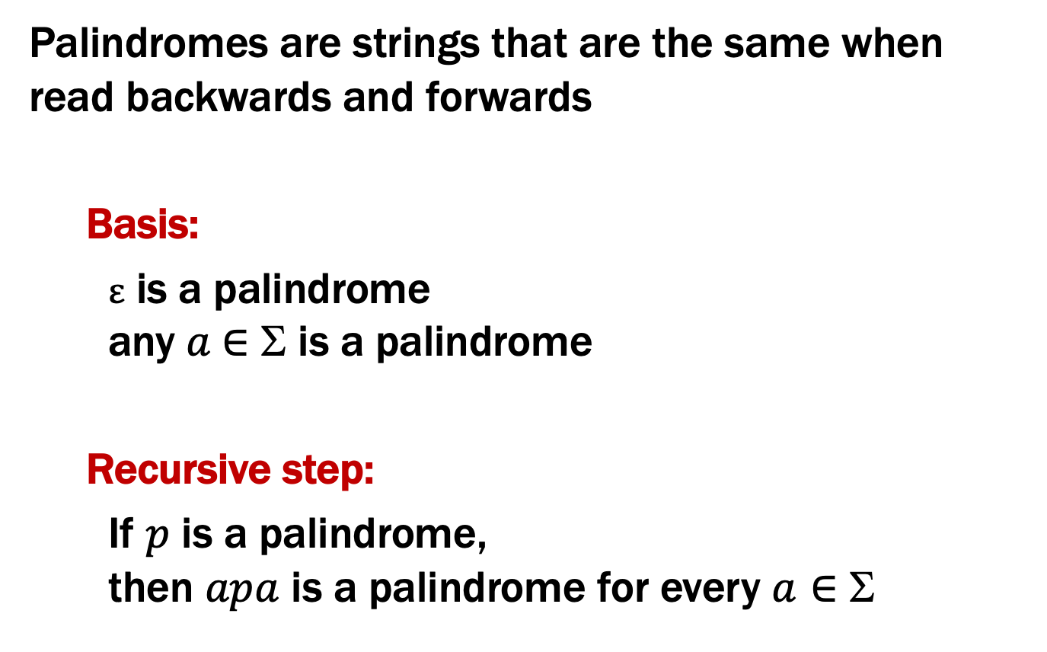
Palindromes
Palindromes are strings that are the same when read backwards and forwards
Basis:
ε is a palindrome any $a$∈ Σ is a palindrome
Recursive step:
If $p$ is a palindrome, then $apa$ is a palindrome for every $a∈$ Σ

Slide 10
Regular Expressions
Regular expressions over Σ
Basis:
ε is a regular expression (could also include ∅)
a is a regular expression for any a ∈ Σ
Recursive step:
If A and B are regular expressions, then so are:
A ∪ B
AB
A*

Slide 11
Each Regular Expression is a “pattern”
ε matches only the empty string
a matches only the one-character string a
A ∪ B matches all strings that either A matches or B matches (or both)
AB matches all strings that have a first part that A matches followed by a second part that B matches
A* matches all strings that have any number of strings (even 0) that A matches, one after another (ε ∪ A ∪ AA ∪ AAA ∪ …)
Definition of the language matched by a regular expression

Slide 12
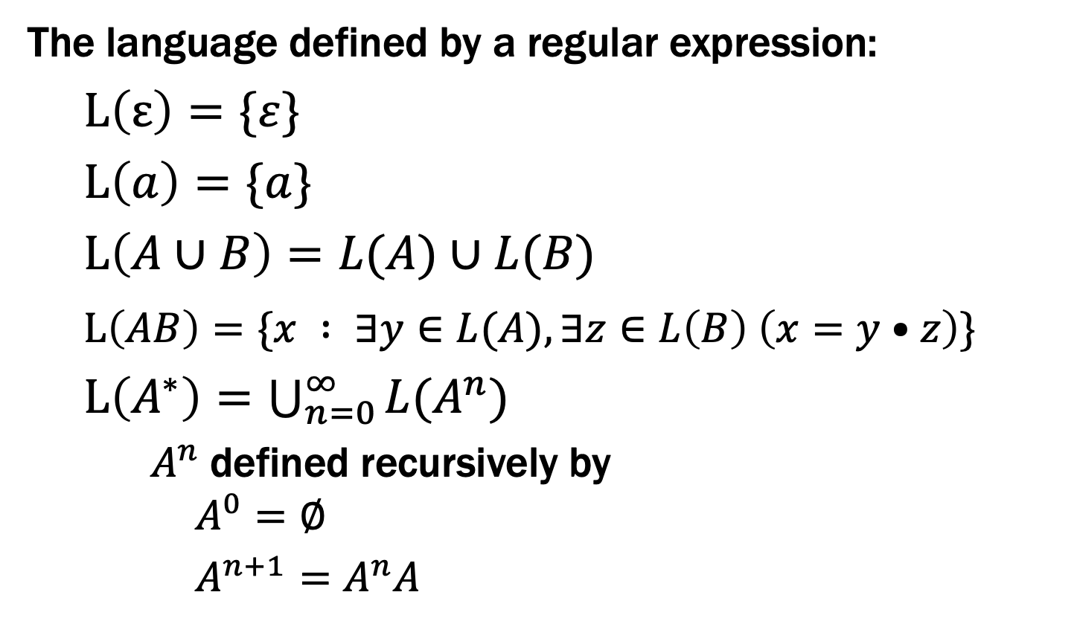
Language of a Regular Expression
The language defined by a regular expression:
$L\left(ε\right)=\{ε\}$
$L\left(a\right)=\{a\}$
$L\left(A∪B\right)=L(A)∪L(B)$
$L\left(AB\right)=\{x : ∃y∈L(A),∃z∈L\left(B\right) \left(x=y•z\right)\}$
$L\left(A^{∗}\right)=\bigcup_{n=0}^{∞}{{L(A}^{n})}$
$A^{n}$defined recursively by $A^{0}=∅$
$A^{n+1}=A^{n}A$

Slide 13
Examples
001*
0*1*

Slide 14
Examples
001*
0*1*
{00, 001, 0011, 00111, …}
Any number of 0’s followed by any number of 1’s

Slide 15
Examples
(0 ∪ 1) 0 (0 ∪ 1) 0
(0*1*)*

Slide 16
Examples
(0 ∪ 1) 0 (0 ∪ 1) 0
(0*1*)*
{0000, 0010, 1000, 1010}
All binary strings

Slide 17
Examples
All binary strings that contain 0110
(0 ∪ 1)* 0110 (0 ∪ 1)*

Slide 18
Examples
All binary strings that contain 0110
All binary strings that begin with a string of doubled characters (00 or 11) followed by 01010 or 10001
(0 ∪ 1)* 0110 (0 ∪ 1)*
(00 ∪ 11)* (01010 ∪ 10001) (0 ∪ 1)*

Slide 19
Examples
All binary strings that have an even # of 1’s

Slide 20
Examples
All binary strings that have an even # of 1’s
e.g., 0*(10*10*)*

Slide 21
Examples
All binary strings that have an even # of 1’s
All binary strings that don’t contain 101
e.g., 0*(10*10*)*
Notes:
Every pair of 1s are separated by 0 or 2+ 0s.
Alternatively, can take a state machine approach (0 union 11 union 100)* (empty union 1 union 10)

Slide 22
Examples
All binary strings that have an even # of 1’s
All binary strings that don’t contain 101
e.g., 0*(10*10*)*
e.g., 0*(1 ⋃ 1000*)*(ε ⋃ 10)
at least two 0s between 1s

Slide 23
Regular Expressions in Practice
Used to define the “tokens”: e.g., legal variable names, keywords in programming languages and compilers
Used in grep, a program that does pattern matching searches in UNIX/LINUX
Pattern matching using regular expressions is an essential feature of PHP
We can use regular expressions in programs to process strings!

Slide 24
Regular Expressions in Java
Pattern p = Pattern.compile("a*b");
Matcher m = p.matcher("aaaaab");
boolean b = m.matches();
[01] a 0 or a 1 ^ start of string $ end of string
[0-9] any single digit \. period \, comma \- minus
. any single character
ab a followed by b (AB)
(a|b) a or b (A ∪ B) a? zero or one of a (A ∪ ε) a* zero or more of a A*
a+ one or more of a AA*
e.g. ^[\-+]?[0-9]*(\.|\,)?[0-9]+$
General form of decimal number e.g. 9.12 or -9,8 (Europe)

Slide 25
Limitations of Regular Expressions
Not all languages can be specified by regular expressions
Even some easy things like
Palindromes
Strings with equal number of 0’s and 1’s
But also more complicated structures in programming languages
Matched parentheses
Properly formed arithmetic expressions
etc.

Slide 26
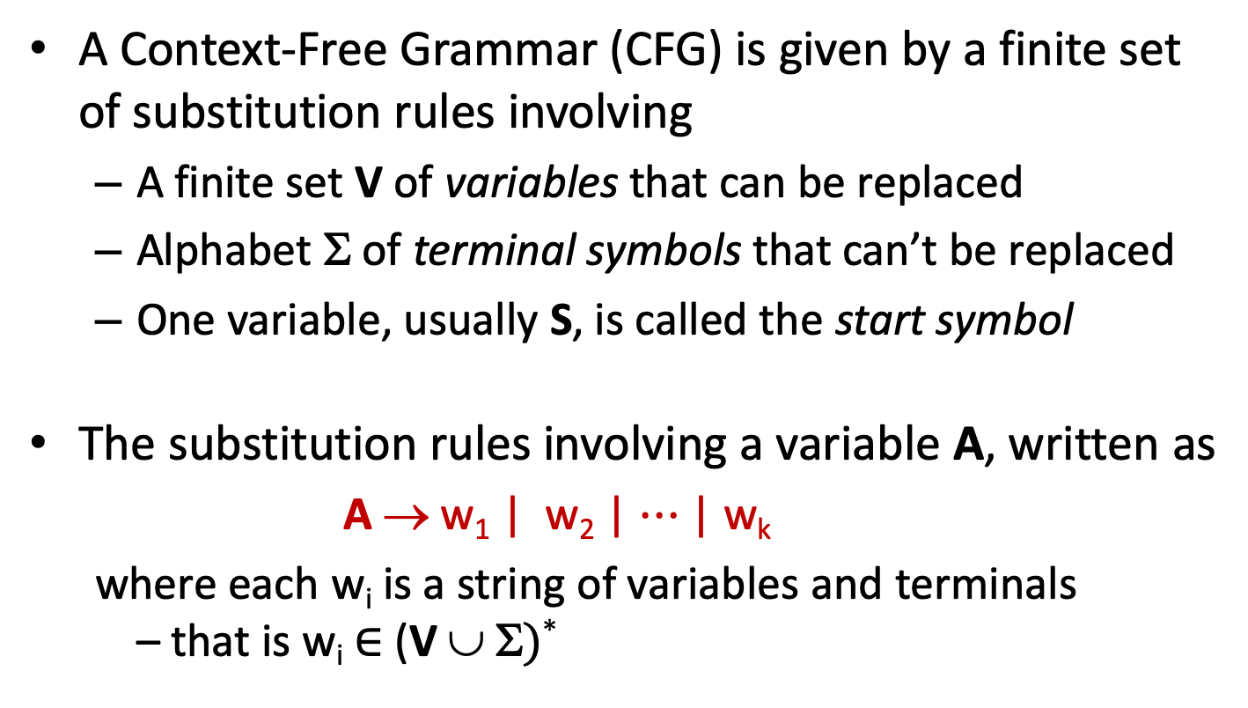
Context-Free Grammars
A Context-Free Grammar (CFG) is given by a finite set of substitution rules involving
A finite set V of variables that can be replaced
Alphabet Σ of terminal symbols that can’t be replaced
One variable, usually S, is called the start symbol
The substitution rules involving a variable A, written as
A → w₁ | w₂ | $⋯$ | w_{k}
where each w_{i} is a string of variables and terminals – that is w_{i} ∈ (V ∪ Σ)*

Slide 27
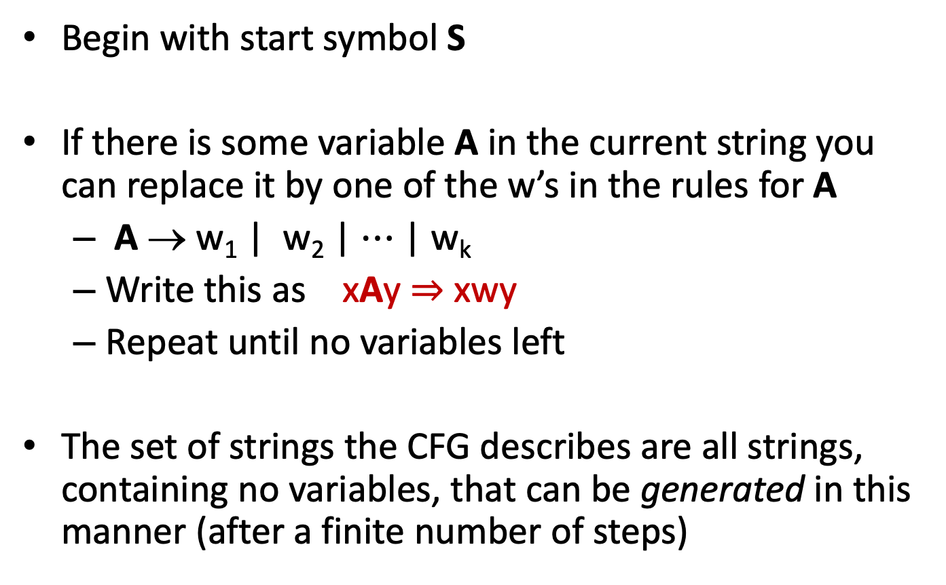
How CFGs generate strings
Begin with start symbol S
If there is some variable A in the current string you can replace it by one of the w’s in the rules for A
A → w₁ | w₂ | $⋯$ | w_{k}
Write this as xAy ⇒ xwy
Repeat until no variables left
The set of strings the CFG describes are all strings, containing no variables, that can be generated in this manner (after a finite number of steps)
Notes:
Note that A can appear in x and y.

Slide 28
Example Context-Free Grammars
Example: S → 0S0 | 1S1 | 0 | 1 | ε

Slide 29
Example Context-Free Grammars
Example: S → 0S0 | 1S1 | 0 | 1 | ε
The set of all binary palindromes

Slide 30
Example Context-Free Grammars
Example: S → 0S0 | 1S1 | 0 | 1 | ε
Example: S → 0S | S1 | ε
The set of all binary palindromes

Slide 31
Example Context-Free Grammars
Example: S → 0S0 | 1S1 | 0 | 1 | ε
Example: S → 0S | S1 | ε
The set of all binary palindromes
0*1*

