Slide 1
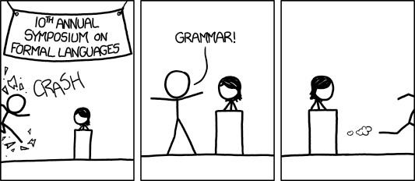
CSE 311: Foundations of Computing
Lecture 21: Context-Free Grammars
[Audience looks around]
“What is going on? There must be some context we’re missing”

Slide 2
Last time: Regular Expressions
Regular expressions over Σ
Basis:
ε is a regular expression (could also include ∅)
a is a regular expression for any a ∈ Σ
Recursive step:
If A and B are regular expressions then so are:
A ∪ B
AB
A*

Slide 3
Last time: Regular Expression is a “pattern”
ε matches the empty string
a matches the one character string a
A ∪ B matches all strings that either A matches or B matches (or both)
AB matches all strings that have a first part that A matches followed by a second part that B matches
A* matches all strings that have any number of strings (even 0) that A matches, one after another
Definition of the language matched by a regular expression

Slide 4
Limitations of Regular Expressions
Not all languages can be specified by regular expressions
Even some easy things like
Palindromes
Strings with equal number of 0’s and 1’s
But also more complicated structures in programming languages
Matched parentheses
Properly formed arithmetic expressions
etc.

Slide 5
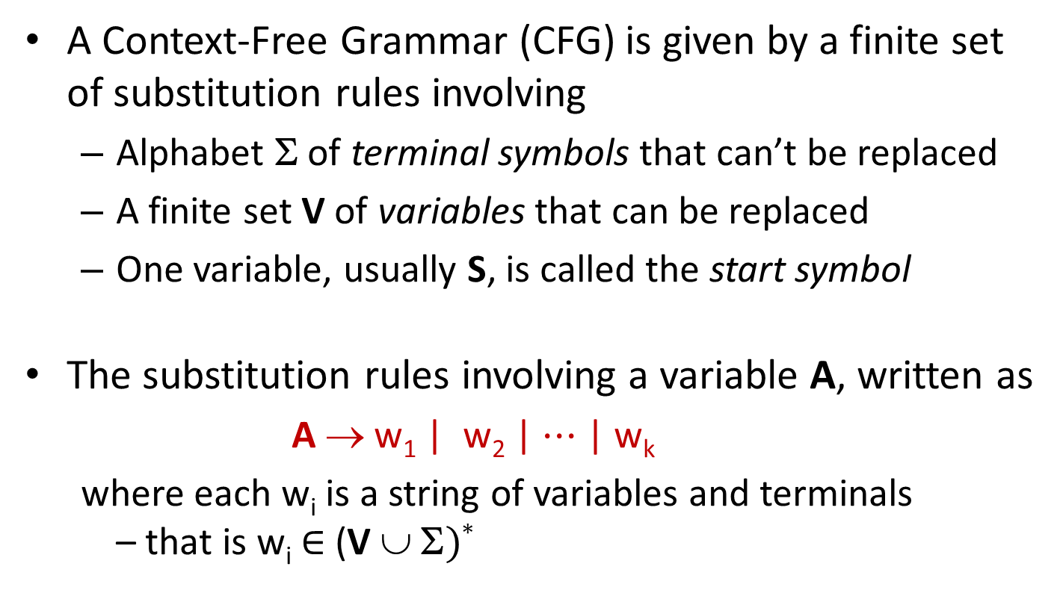
Context-Free Grammars
A Context-Free Grammar (CFG) is given by a finite set of substitution rules involving
Alphabet Σ of terminal symbols that can’t be replaced
A finite set V of variables that can be replaced
One variable, usually S, is called the start symbol
The substitution rules involving a variable A, written as
A → w₁ | w₂ | $⋯$ | w_{k}
where each w_{i} is a string of variables and terminals – that is w_{i} ∈ (V ∪ Σ)*

Slide 6
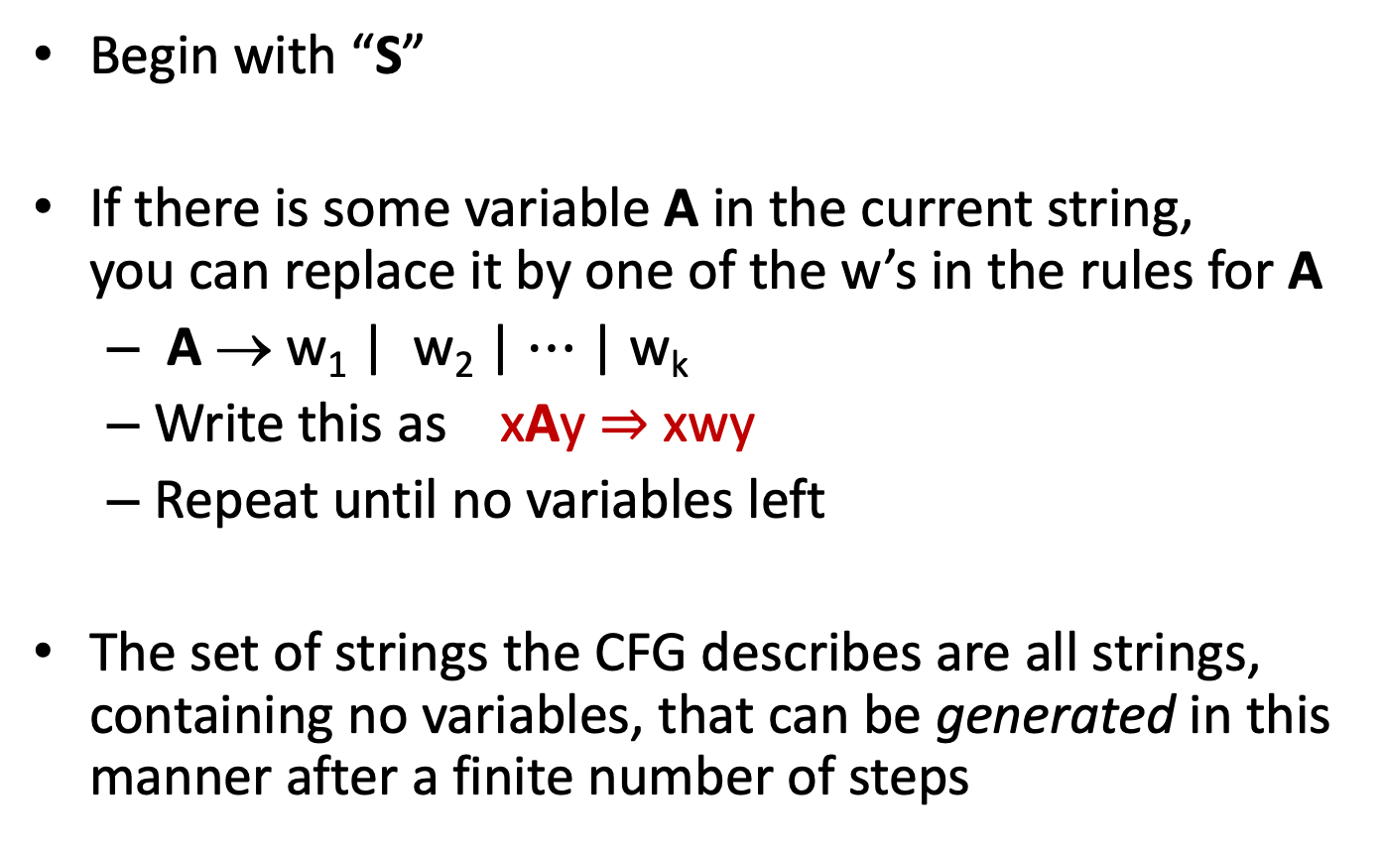
How CFGs generate strings
Begin with “S”
If there is some variable A in the current string, you can replace it by one of the w’s in the rules for A
A → w₁ | w₂ | $⋯$ | w_{k}
Write this as xAy ⇒ xwy
Repeat until no variables left
The set of strings the CFG describes are all strings, containing no variables, that can be generated in this manner after a finite number of steps
Notes:
Note that A can appear in x and y.

Slide 7
Example Context-Free Grammars
Example: S → 0S | S1 | ε

Slide 8
Example Context-Free Grammars
Example: S → 0S | S1 | ε
0*1*

Slide 9
Example Context-Free Grammars
Example: S → 0S | S1 | ε
Example: S → 0S0 | 1S1 | 0 | 1 | ε
0*1*

Slide 10
Example Context-Free Grammars
Example: S → 0S | S1 | ε
Example: S → 0S0 | 1S1 | 0 | 1 | ε
0*1*
The set of all binary palindromes

Slide 11

Example Context-Free Grammars
Grammar for $\left\{0^{n}1^{n}:n≥0\right\}$
(i.e., matching 0*1* but with same number of 0’s and 1’s)

Slide 12
Example Context-Free Grammars
Grammar for $\left\{0^{n}1^{n}:n≥0\right\}$
(i.e., matching 0*1* but with same number of 0’s and 1’s)
S → 0S1 | ε

Slide 13
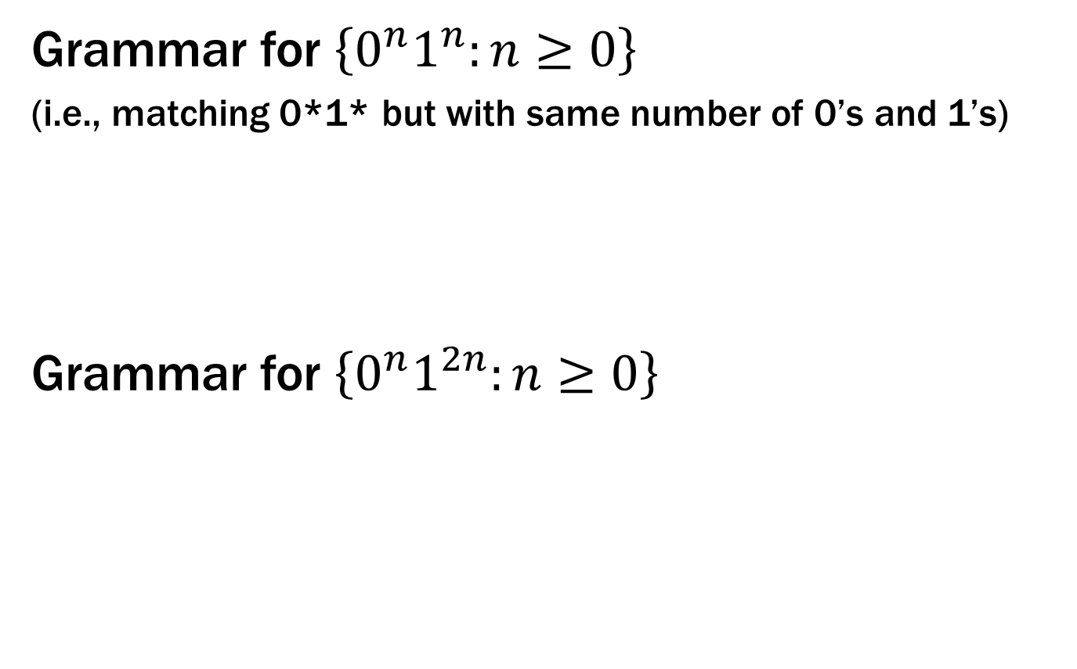
Example Context-Free Grammars
Grammar for $\left\{0^{n}1^{n}:n≥0\right\}$
(i.e., matching 0*1* but with same number of 0’s and 1’s)
Grammar for $\left\{0^{n}1^{2n}:n≥0\right\}$
S → 0S1 | ε

Slide 14
Example Context-Free Grammars
Grammar for $\left\{0^{n}1^{n}:n≥0\right\}$
(i.e., matching 0*1* but with same number of 0’s and 1’s)
Grammar for $\left\{0^{n}1^{2n}:n≥0\right\}$
S → 0S1 | ε
S → 0S11 | ε

Slide 15
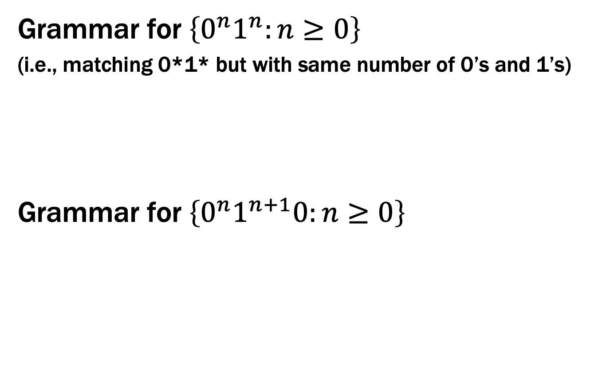
Example Context-Free Grammars
Grammar for $\left\{0^{n}1^{n}:n≥0\right\}$
(i.e., matching 0*1* but with same number of 0’s and 1’s)
Grammar for $\left\{0^{n}1^{n+1}0:n≥0\right\}$
S → 0S1 | ε

Slide 16
Example Context-Free Grammars
Grammar for $\left\{0^{n}1^{n}:n≥0\right\}$
(i.e., matching 0*1* but with same number of 0’s and 1’s)
Grammar for $\left\{0^{n}1^{n+1}0:n≥0\right\}$
S → 0S1 | ε
S → A 10
A → 0A1 | ε

Slide 17
Example Context-Free Grammars
Example: S → (S) | SS | ε

Slide 18
Example Context-Free Grammars
Example: S → (S) | SS | ε
The set of all strings of matched parentheses

Slide 19
Example Context-Free Grammars
Binary strings with equal numbers of 0s and 1s (not just 0^{n}1^{n}, also 0101, 0110, etc.)
S → SS | 0S1 | 1S0 | ε

Slide 20

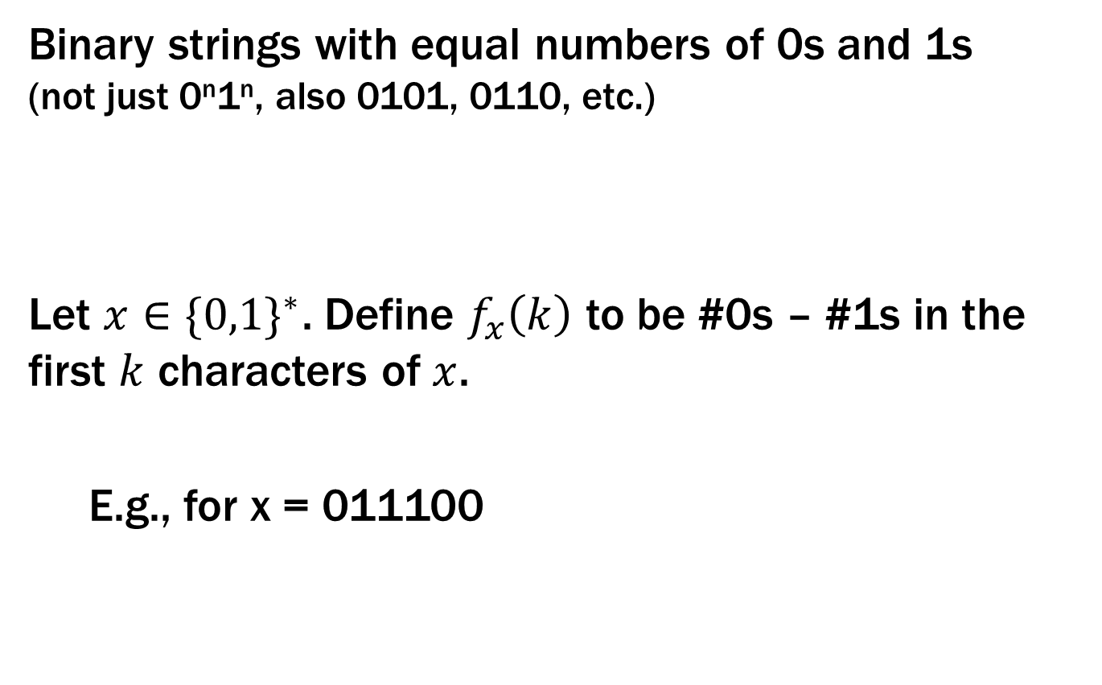
Example Context-Free Grammars
Binary strings with equal numbers of 0s and 1s (not just 0^{n}1^{n}, also 0101, 0110, etc.)
Let $x∈{\{0,1\}}^{∗}$. Define $f_{x}\left(k\right)$ to be #0s – #1s in the first $k$ characters of $x$.
E.g., for x = 011100
S → SS | 0S1 | 1S0 | ε
$$f$$
0 1 2 3 4 5 6

Slide 21
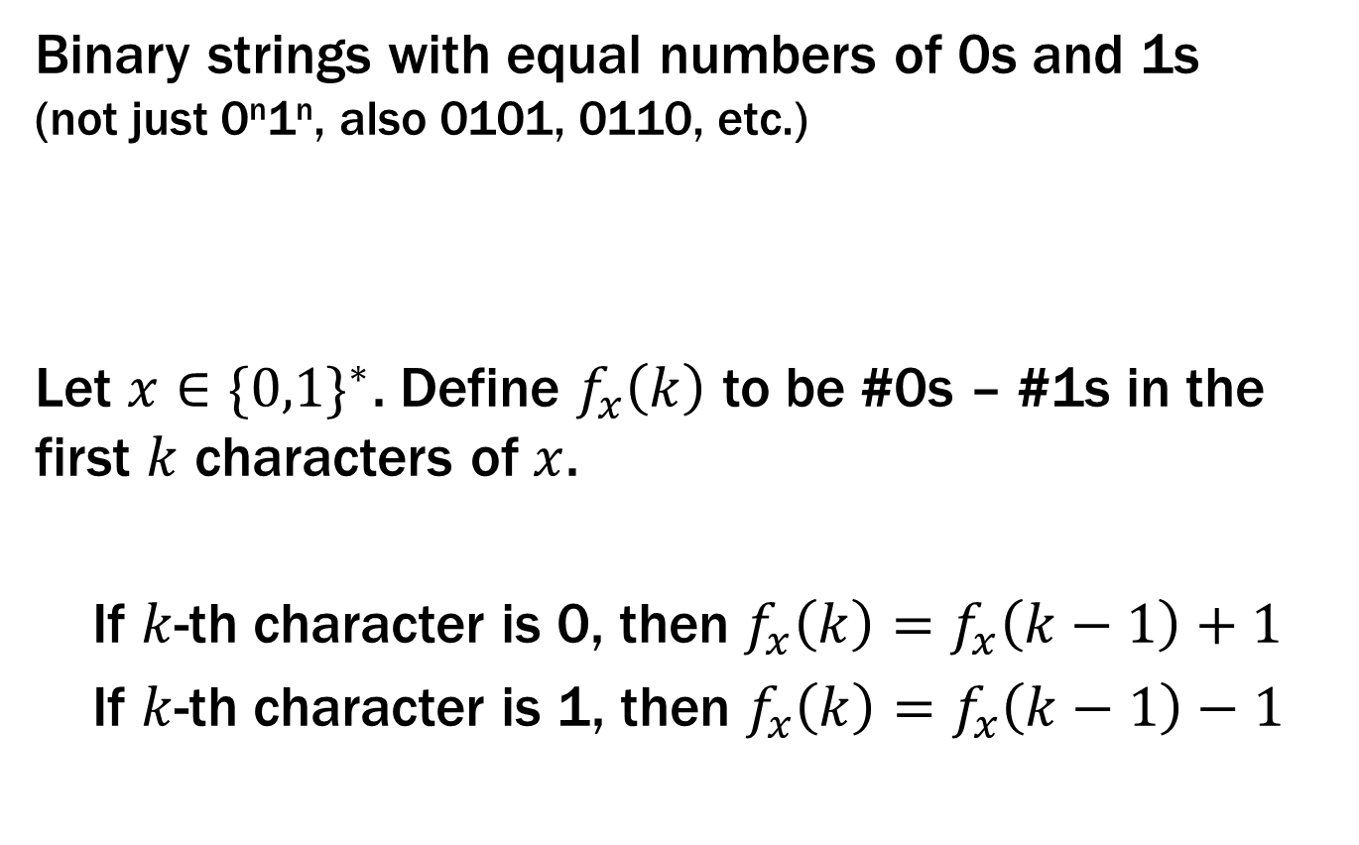
Example Context-Free Grammars
Binary strings with equal numbers of 0s and 1s (not just 0^{n}1^{n}, also 0101, 0110, etc.)
Let $x∈{\{0,1\}}^{∗}$. Define $f_{x}\left(k\right)$ to be #0s – #1s in the first $k$ characters of $x$.
If $k$-th character is 0, then $f_{x}\left(k\right)=f_{x}\left(k−1\right)+1$
If $k$-th character is 1, then $f_{x}\left(k\right)=f_{x}\left(k−1\right)−1$
S → SS | 0S1 | 1S0 | ε

Slide 22

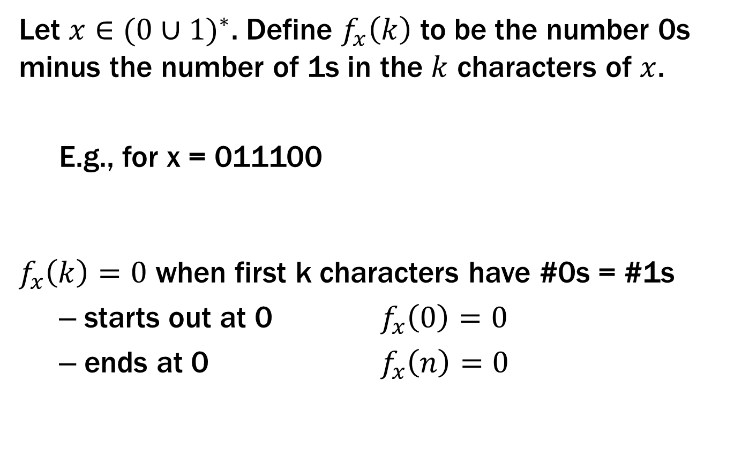
Example Context-Free Grammars
Let $x∈{(0∪1)}^{∗}$. Define $f_{x}\left(k\right)$ to be the number 0s minus the number of 1s in the $k$ characters of $x$.
E.g., for x = 011100
$f_{x}\left(k\right)=0$ when first k characters have #0s = #1s
starts out at 0 $f_{x}\left(0\right)=0$
ends at 0 $f_{x}\left(n\right)=0$
$$f$$
0 1 2 3 4 5 6

Slide 23
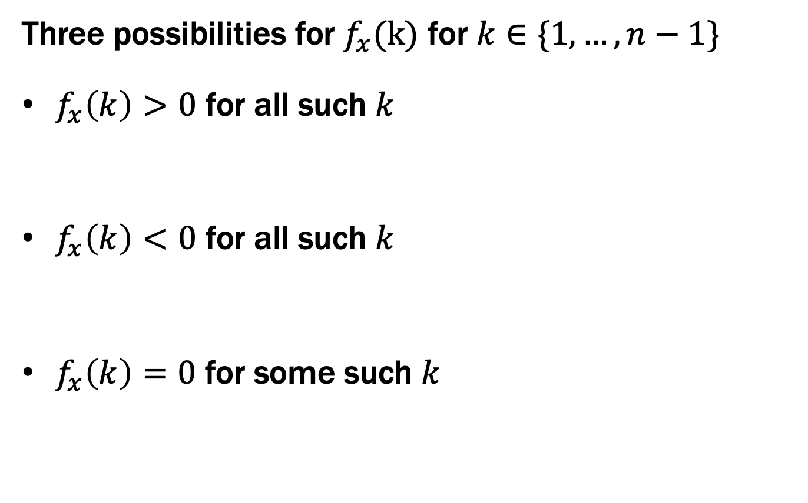
Example Context-Free Grammars
Three possibilities for $f_{x}(k)$ for $k∈\{1, …,n−1\}$
$f_{x}\left(k\right)>0$ for all such $k$
$f_{x}\left(k\right)<0$ for all such $k$
$f_{x}\left(k\right)=0$ for some such $k$
0 1 n-1 n
S → 0S1
0 1 n-1 n
S → 1S0
0 1 n-1 n
S → SS

Slide 24
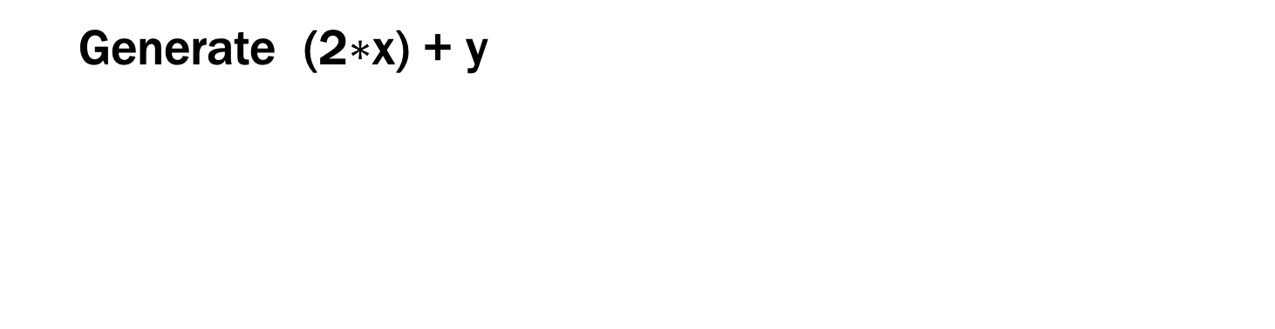
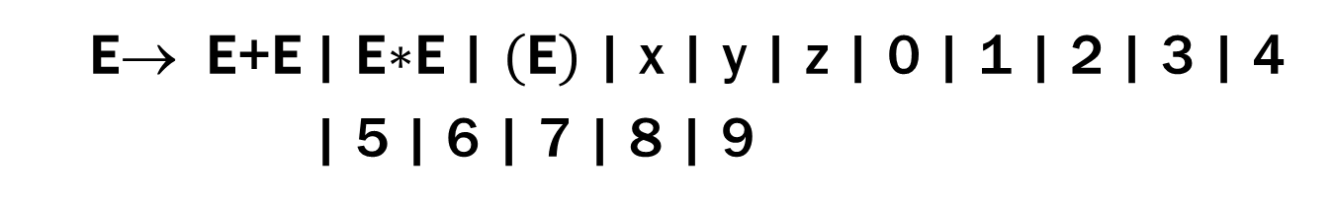
Simple Arithmetic Expressions
E→ E+E | E$∗$E | (E) | x | y | z | 0 | 1 | 2 | 3 | 4
| 5 | 6 | 7 | 8 | 9
Generate (2$∗$x) + y

Slide 25
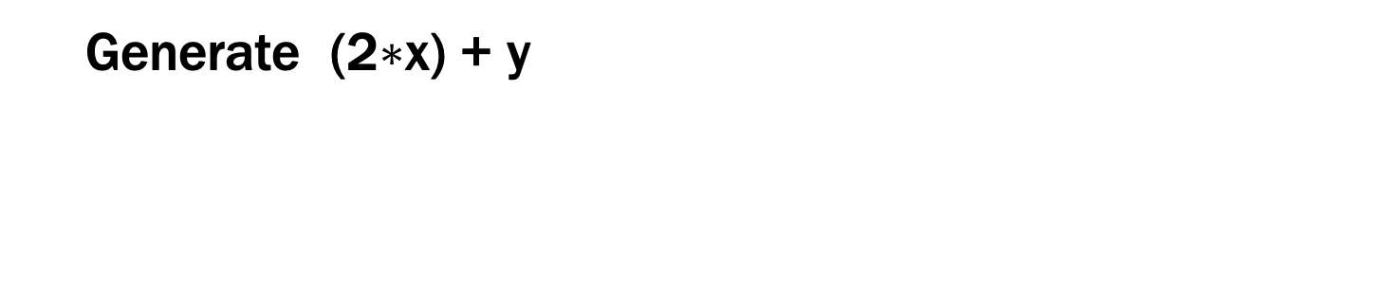
Simple Arithmetic Expressions
E→ E+E | E$∗$E | (E) | x | y | z | 0 | 1 | 2 | 3 | 4
| 5 | 6 | 7 | 8 | 9
Generate (2$∗$x) + y
E ⇒ E+E ⇒ (E)+E ⇒ (E$∗$E)+E ⇒ (2$∗$E)+E ⇒ (2$∗$x)+E ⇒ (2$∗$x)+y

Slide 26
Parse Trees
Suppose that grammar G generates a string x
A parse tree of x for G has
Root labeled S (start symbol of G)
The children of any node labeled A are labeled by symbols of w left-to-right for some rule A → w
The symbols of x label the leaves ordered left-to-right
S
S → 0S0 | 1S1 | 0 | 1 | ε
0
S
0
1
S
1
Parse tree of 01110
1

Slide 27
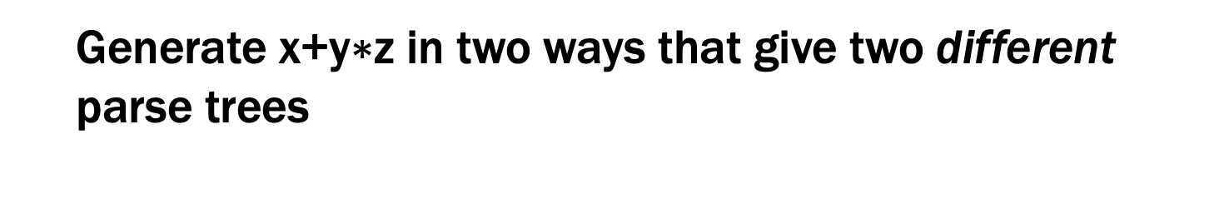
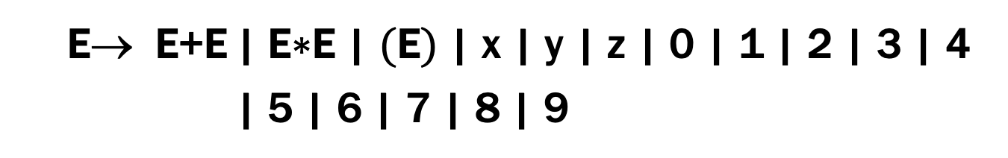
Simple Arithmetic Expressions
E→ E+E | E$∗$E | (E) | x | y | z | 0 | 1 | 2 | 3 | 4
| 5 | 6 | 7 | 8 | 9
Generate x+y$∗$z in two ways that give two different parse trees

Slide 28
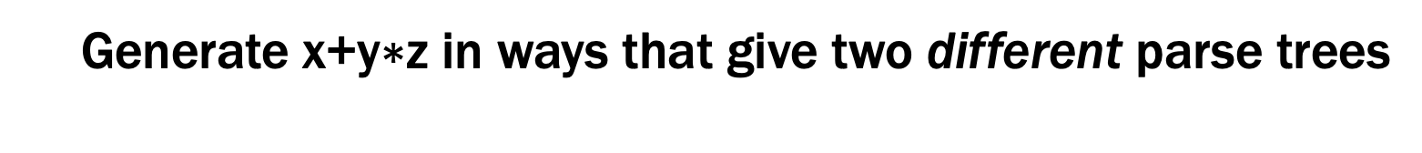
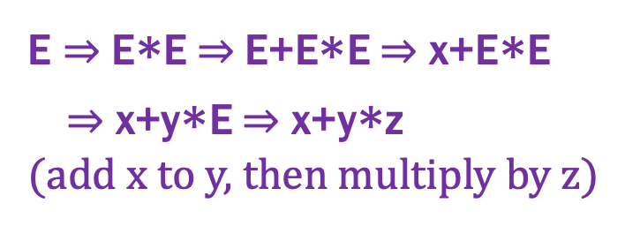
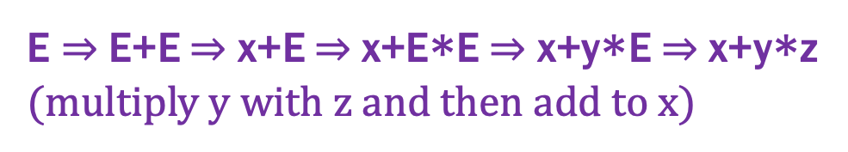
Simple Arithmetic Expressions
E→ E+E | E$∗$E | (E) | x | y | z | 0 | 1 | 2 | 3 | 4
| 5 | 6 | 7 | 8 | 9
Generate x+y$∗$z in ways that give two different parse trees
E
E ⇒ E+E ⇒ x+E ⇒ x+E$∗$E ⇒ x+y$∗$E ⇒ x+y$∗$z
(multiply y with z and then add to x)
E
+
E
E
x
E
E
E ⇒ E$∗$E ⇒ E+E$∗$E ⇒ x+E$∗$E
⇒ x+y$∗$E ⇒ x+y$∗$z
(add x to y, then multiply by z)
*
E
*
E
y
z
E
+
E
z
x
y

Slide 29
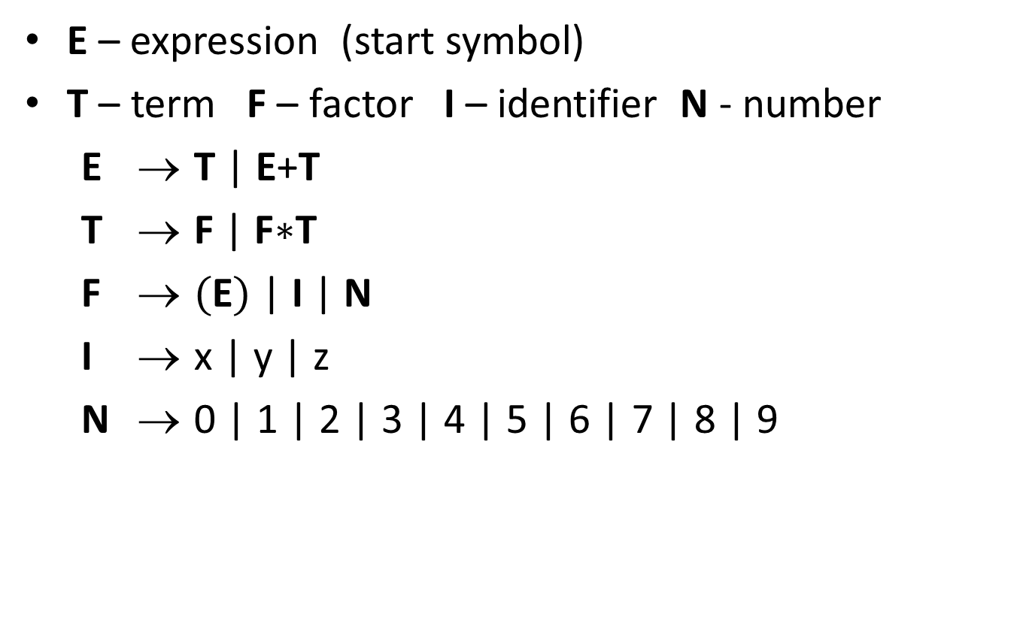
building precedence in simple arithmetic expressions
E – expression (start symbol)
T – term F – factor I – identifier N - number
E → T | E+T
T → F | F$∗$T
F → (E) | I | N
I → x | y | z
N → 0 | 1 | 2 | 3 | 4 | 5 | 6 | 7 | 8 | 9
No longer
allows:
E
E
*
E
E
+
E
z
x
y
Notes:
Children of T are only F or T, neither of which matches a “+”.

Slide 30
building precedence in simple arithmetic expressions
E – expression (start symbol)
T – term F – factor I – identifier N - number
E → T | E+T
T → F | F$∗$T
F → (E) | I | N
I → x | y | z
N → 0 | 1 | 2 | 3 | 4 | 5 | 6 | 7 | 8 | 9
E
T
F
*
T
?
+
x
y
z
Notes:
Children of T are only F or T, neither of which matches a “+”.

Slide 31
building precedence in simple arithmetic expressions
E – expression (start symbol)
T – term F – factor I – identifier N - number
E → T | E+T
T → F | F$∗$T
F → (E) | I | N
I → x | y | z
N → 0 | 1 | 2 | 3 | 4 | 5 | 6 | 7 | 8 | 9
Still
allows:
E
E
+
E
x
E
*
E
y
z
Notes:
Children of T are only F or T, neither of which matches a “+”.

Slide 32
building precedence in simple arithmetic expressions
E – expression (start symbol)
T – term F – factor I – identifier N - number
E → T | E+T
T → F | F$∗$T
F → (E) | I | N
I → x | y | z
N → 0 | 1 | 2 | 3 | 4 | 5 | 6 | 7 | 8 | 9
E
E
+
T
x
F
*
T
y
z
Notes:
Children of T are only F or T, neither of which matches a “+”.

Slide 33
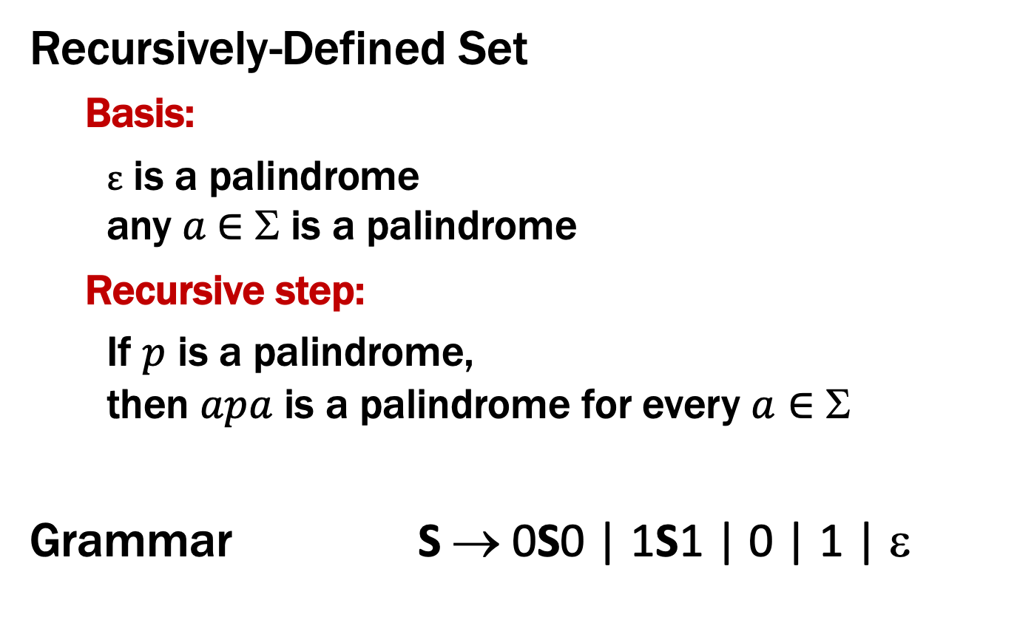
Two ways to Define Binary Palindromes
Recursively-Defined Set
Basis:
ε is a palindrome any $a$∈ Σ is a palindrome
Recursive step:
If $p$ is a palindrome, then $apa$ is a palindrome for every $a∈$ Σ
Grammar S → 0S0 | 1S1 | 0 | 1 | ε

Slide 34
CFGs and recursively-defined sets of strings
A CFG with the start symbol S as its only variable recursively defines the set of strings of terminals that S can generate
A CFG with more than one variable is a simultaneous recursive definition of the sets of strings generated by each of its variables
sometimes necessary to use more than one

Slide 35
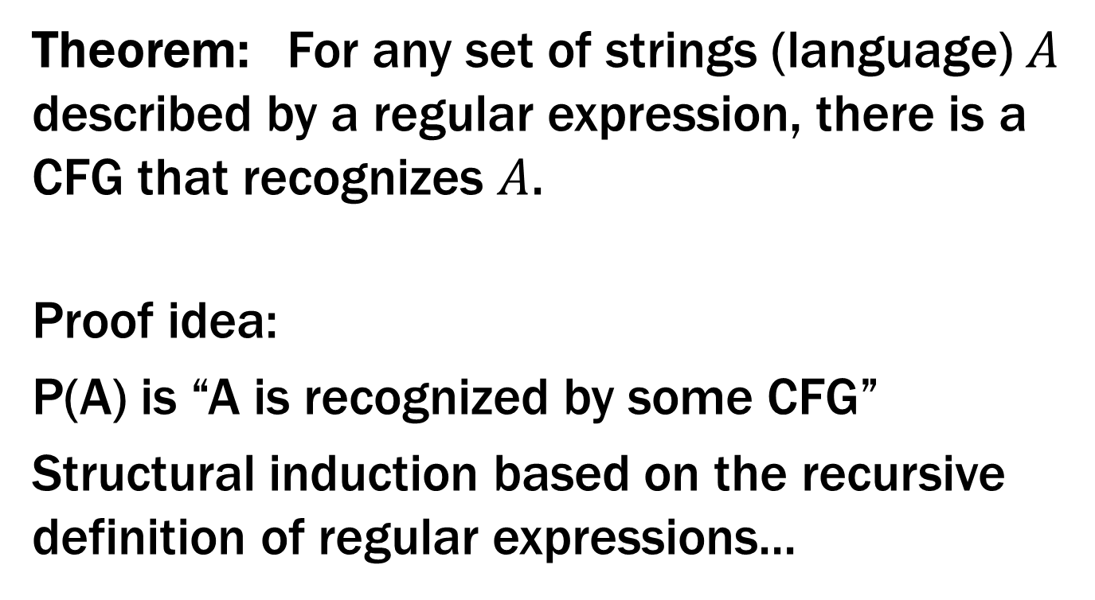
CFGs and Regular Expressions
Theorem: For any set of strings (language) $A$ described by a regular expression, there is a CFG that recognizes $A$.
Proof idea:
P(A) is “A is recognized by some CFG”
Structural induction based on the recursive definition of regular expressions...

Slide 36
Regular Expressions over Σ
Basis:
ɛ is a regular expression
a is a regular expression for any a ∈ Σ
Recursive step:
If A and B are regular expressions then so are:
A ∪ B
AB
A*

Slide 37

CFGs are more general than REs
CFG to match RE ε
S → ε
CFG to match RE a (for any $a$ ∈ Σ)
S → a

Slide 38
CFGs are more general than REs
Suppose CFG with start symbol S₁ matches RE A CFG with start symbol S₂ matches RE B
CFG to match RE A ∪ B
S → S₁ | S₂ + rules from original CFGs
CFG to match RE AB
S → S₁ S₂ + rules from original CFGs

Slide 39
CFGs are more general than REs
Suppose CFG with start symbol S₁ matches RE A
CFG to match RE A* (= ε ∪ A ∪ AA ∪ AAA ∪ ... )
S → S₁ S | ε + rules from CFG with S₁

Slide 40
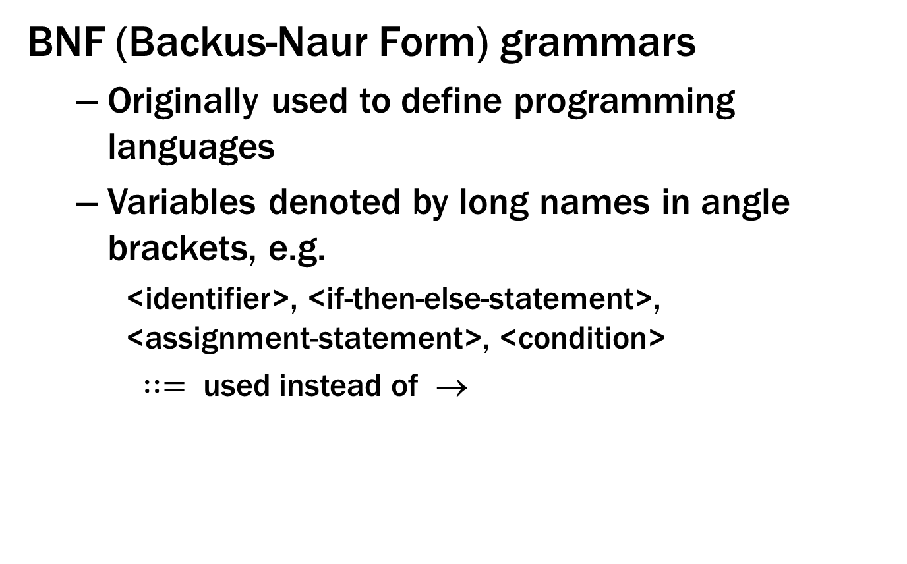
Backus-Naur Form (The same thing…)
BNF (Backus-Naur Form) grammars
Originally used to define programming languages
Variables denoted by long names in angle brackets, e.g.
<identifier>, <if-then-else-statement>, <assignment-statement>, <condition>
$∷=$ used instead of →

Slide 41
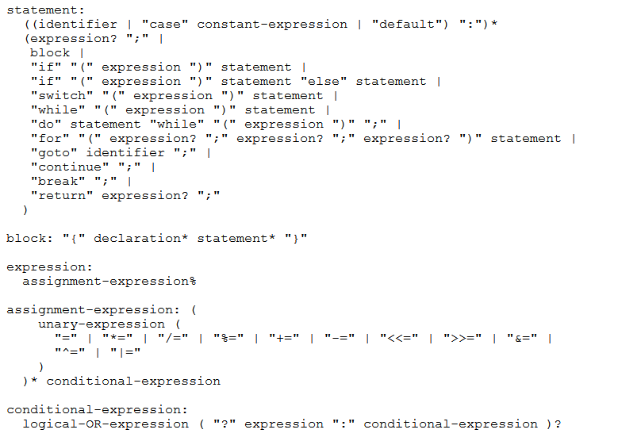
BNF for C

Slide 42
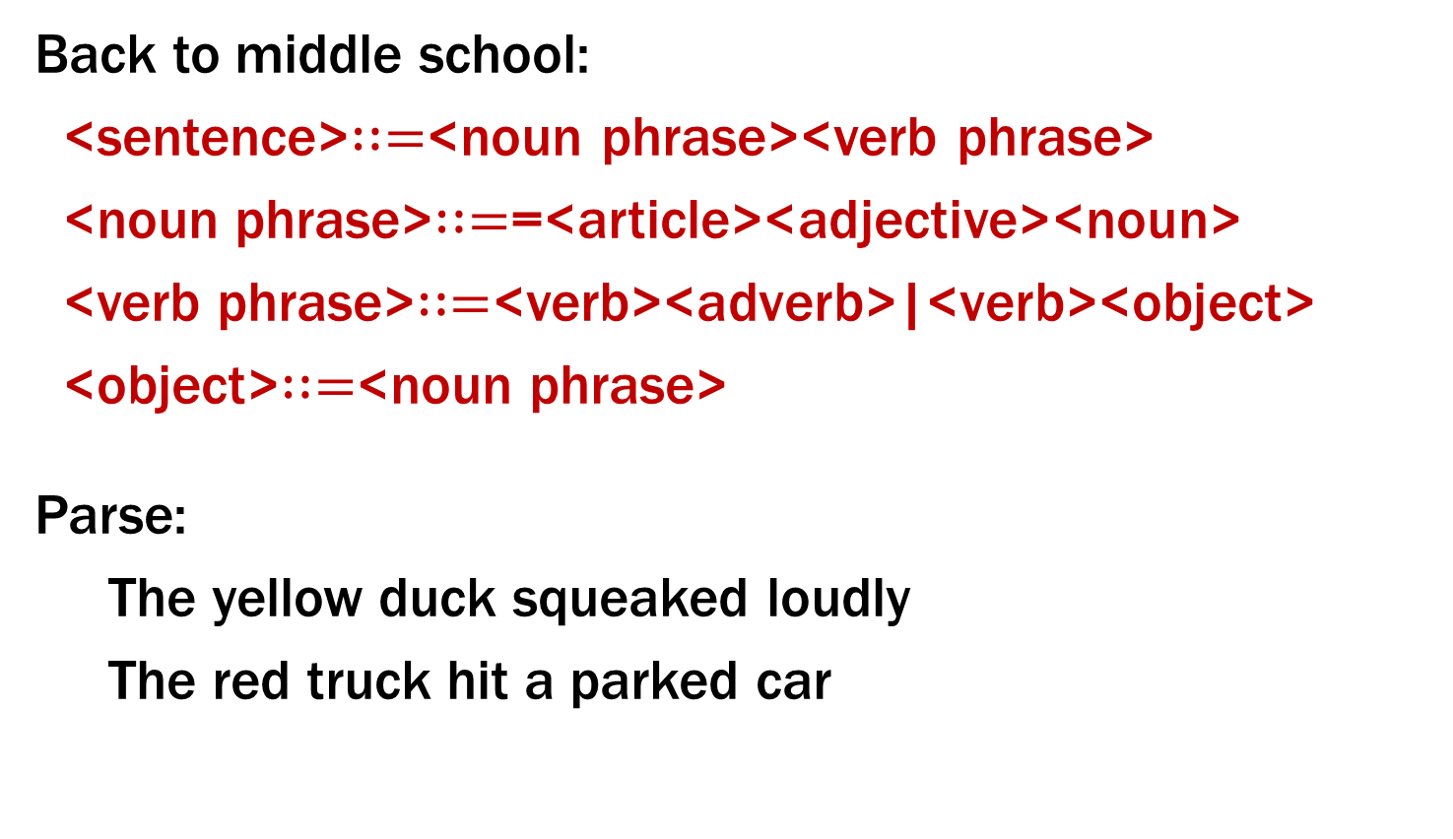
BNF for (Simple) English
Back to middle school:
<sentence>$∷=$<noun phrase><verb phrase>
<noun phrase>$∷=$=<article><adjective><noun>
<verb phrase>$∷=$<verb><adverb>|<verb><object>
<object>$∷=$<noun phrase>
Parse:
The yellow duck squeaked loudly
The red truck hit a parked car
Notes:
Issues about parse trees and meaning matter here also.

