Slide 1
CSE 311: Foundations of Computing
Lecture 22: Relations and Directed Graphs

Slide 2
Last time: Languages — REs and CFGs
Saw two new ways of defining languages
Regular Expressions (0 ∪ 1)* 0110 (0 ∪ 1)*
easy to understand (declarative)
Context-free Grammars S → SS | 0S1 | 1S0 | ε
more expressive
(≈ recursively-defined sets)
We will connect these to machines shortly.
But first, we need some new math terminology….

Slide 3
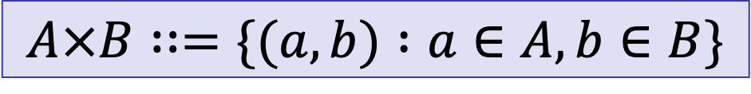
Alternative Set Notation
We defined Cartesian Product as
Alternative notation for this is
“The set of all (a, b) such that a ∈ A and b ∈ B”
$$A×B∷=\{x :∃a∈A, ∃b∈B (x=(a,b)) \}$$
$$A×B∷=\{(a,b) :a∈A, b∈B\}$$

Slide 4
Relations
Let A and B be sets,
A binary relation from A to B is a subset of A × B
Let A be a set,
A binary relation on A is a subset of A × A

Slide 5
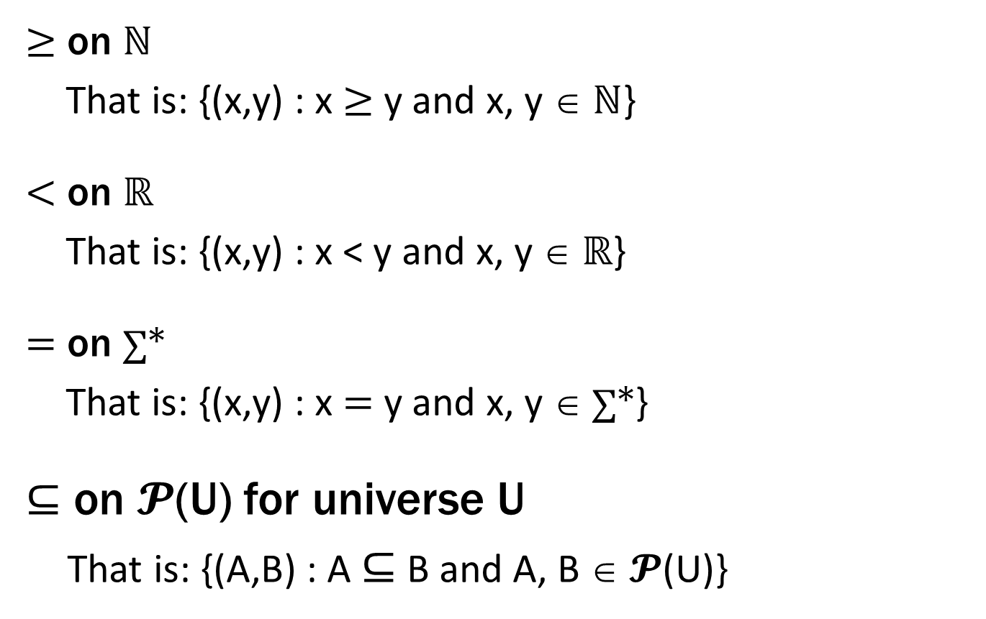
Relations You Already Know
≥ on ℕ
That is: {(x,y) : x ≥ y and x, y ∈ ℕ}
< on ℝ
That is: {(x,y) : x < y and x, y ∈ ℝ}
= on ∑*
That is: {(x,y) : x = y and x, y ∈ ∑*}
$⊆$ on 𝓟(U) for universe U
That is: {(A,B) : A $⊆$ B and A, B ∈ 𝓟(U)}
Notes:
Alternative notation. Name “relation” comes from examples like these

Slide 6
More Relation Examples
R₁ = {(a, 1), (a, 2), (b, 1), (b, 3), (c, 3)}
R₂ = {(x, y) : x ≡₅ y }
R₃ = {(c₁, c₂) : c₁ is a prerequisite of c₂ }
R₄ = {(s, c) : student s has taken course c }

Slide 7
Properties of Relations
Let R be a relation on A.
R is reflexive iff (a,a) ∈ R for every a ∈ A
R is symmetric iff (a,b) ∈ R implies (b,a) ∈ R
R is antisymmetric iff (a,b) ∈ R and a ≠ b implies (b,a) $∉$ R
R is transitive iff (a,b)∈ R and (b,c)∈ R implies (a,c) ∈ R

Slide 8

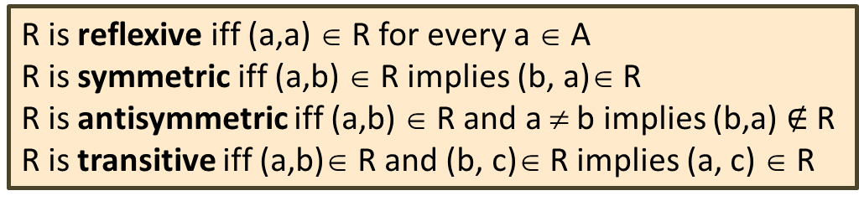
Which relations have which properties?
≥ on ℕ :
< on ℝ :
= on ∑* :
$⊆$ on 𝓟(U):
R₂ = {(x, y) : x ≡₅ y}:
R₃ = {(c₁, c₂) : c₁ is a prerequisite of c₂ }:
R is reflexive iff (a,a) ∈ R for every a ∈ A
R is symmetric iff (a,b) ∈ R implies (b, a)∈ R
R is antisymmetric iff (a,b) ∈ R and a ≠ b implies (b,a) $∉$ R
R is transitive iff (a,b)∈ R and (b, c)∈ R implies (a, c) ∈ R

Slide 9
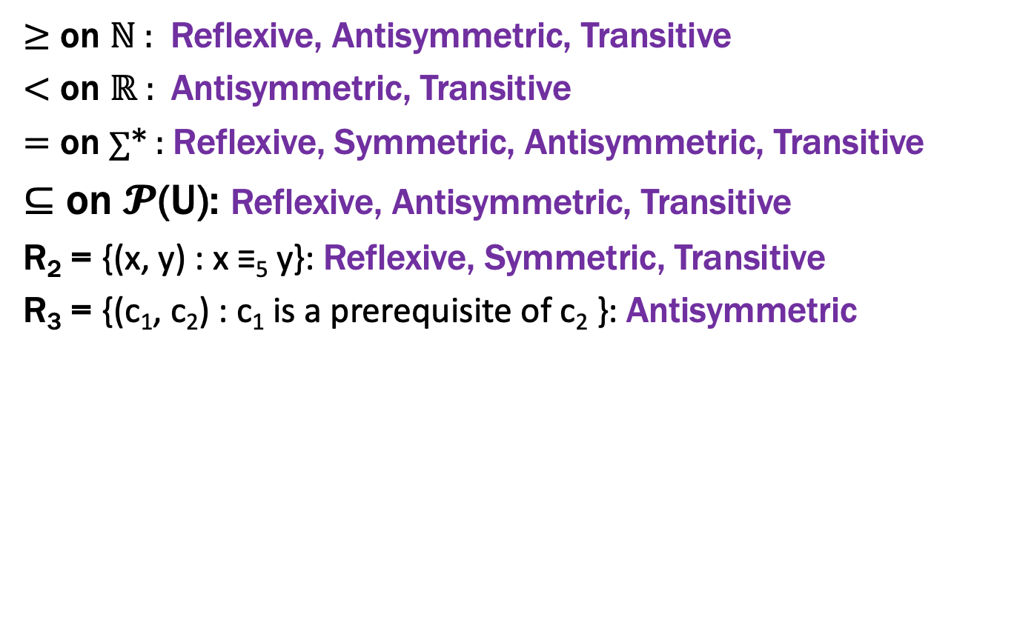
Which relations have which properties?
≥ on ℕ : Reflexive, Antisymmetric, Transitive
< on ℝ : Antisymmetric, Transitive
= on ∑* : Reflexive, Symmetric, Antisymmetric, Transitive
$⊆$ on 𝓟(U): Reflexive, Antisymmetric, Transitive
R₂ = {(x, y) : x ≡₅ y}: Reflexive, Symmetric, Transitive
R₃ = {(c₁, c₂) : c₁ is a prerequisite of c₂ }: Antisymmetric
R is reflexive iff (a,a) ∈ R for every a ∈ A
R is symmetric iff (a,b) ∈ R implies (b, a)∈ R
R is antisymmetric iff (a,b) ∈ R and a ≠ b implies (b,a) $∉$ R
R is transitive iff (a,b)∈ R and (b, c)∈ R implies (a, c) ∈ R

Slide 10
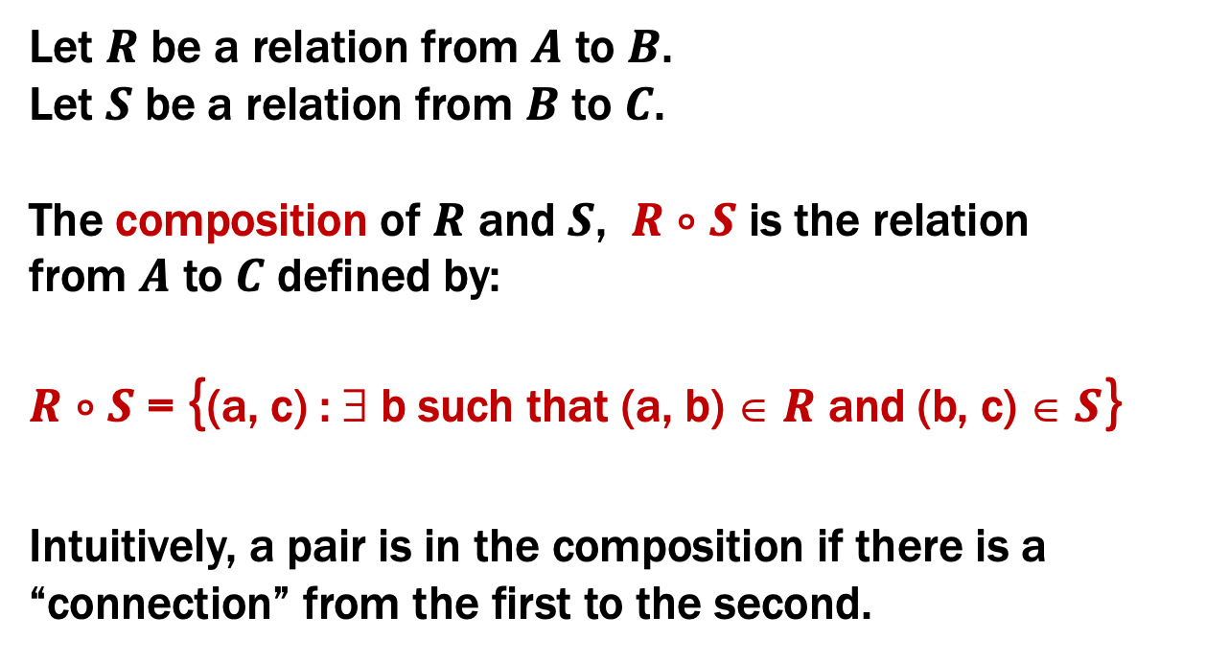
Combining Relations
Let $R$ be a relation from $A$ to $B$.
Let $S$ be a relation from $B$ to $C$.
The composition of $R$ and $S$, $R$ $∘$ $S$ is the relation
from $A$ to $C$ defined by:
$R$ $∘$ $S$ = {(a, c) : ∃ b such that (a, b) ∈ $R$ and (b, c) ∈ $S$}
Intuitively, a pair is in the composition if there is a “connection” from the first to the second.

Slide 11

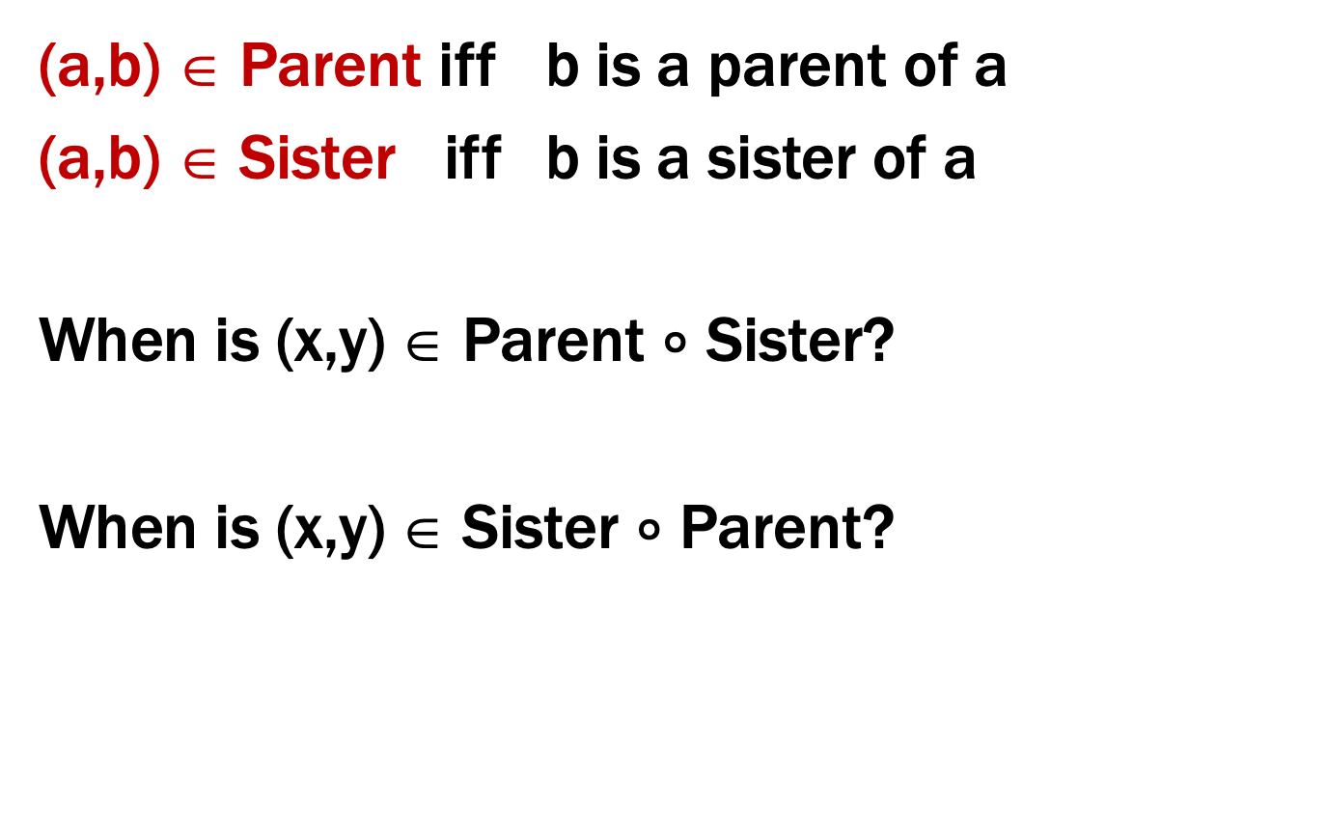
Examples
(a,b) ∈ Parent iff b is a parent of a
(a,b) ∈ Sister iff b is a sister of a
When is (x,y) ∈ Parent $∘$ Sister?
When is (x,y) ∈ Sister $∘$ Parent?
R $∘$ S = {(a, c) : ∃ b such that (a,b)∈ R and (b,c)∈ S}
Notes:
1. Aunt
2. Is it Parent? No, Parent cap HasSister

Slide 12
Examples
Using only the relations Parent, Child, Father, Son, Brother, Sibling, Husband
and composition, express the following:
Uncle: b is an uncle of a
Cousin: b is a cousin of a
Notes:
Uncle = Parent circ Brother
Cousin = Parent circ Sibling circ Child

Slide 13
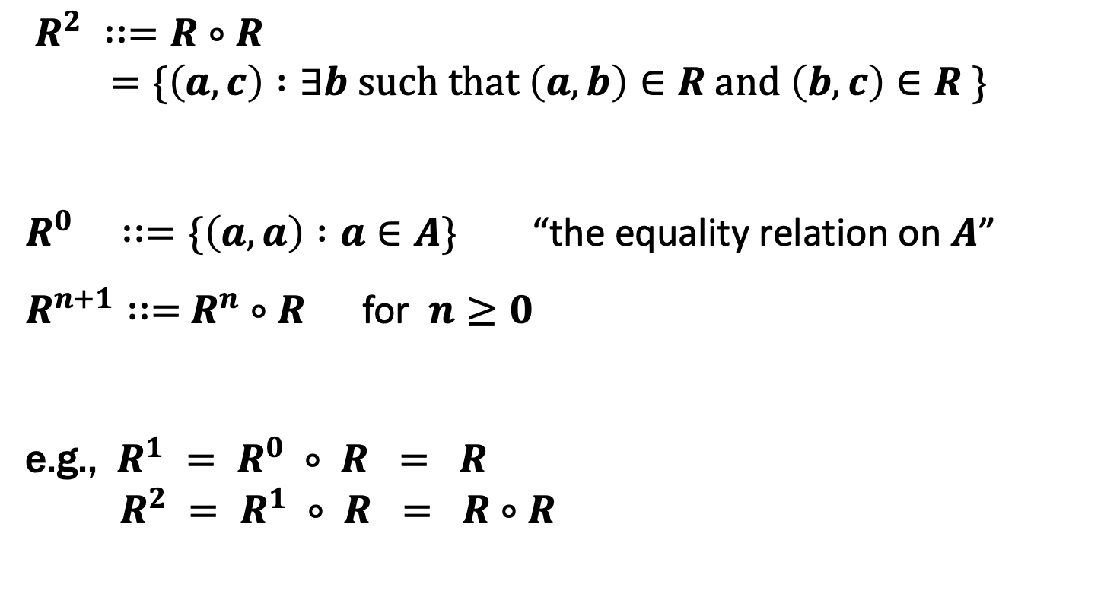
Powers of a Relation
$R^{2} ∷=R∘R$
$=\{\left(a,c\right) :∃b such that \left(a,b\right)∈R and \left(b,c\right)∈R \}$
$R^{0} ∷=\{\left(a,a\right) :a∈A\}$ “the equality relation on $A$”
$R^{n+1}∷=$ $R^{n}$ $∘$ $R$ for $n≥0$
e.g., $R^{1} = R^{0} ∘ R = R$
$R^{2} = R^{1} ∘ R = R∘R$

Slide 14
Non-constructive Definitions
Recursively defined sets and functions describe these objects by explaining how to construct / compute them
But sets can also be defined non-constructively:
How can we define functions non-constructively?
(useful for writing a function specification)
S = {x : P(x)}

Slide 15

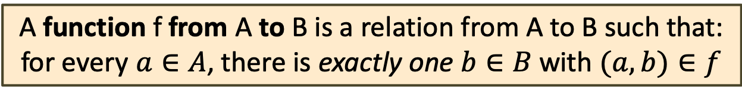

Functions
A function $f :A →B$ (A as input and B as output) is a special type of relation.
A function f from A to B is a relation from A to B such that:
for every $a∈A$, there is exactly one $b∈B$ with $(a,b)∈f$
I.e., for every input $a∈A$, there is one output $b∈B$.
We denote this $b$ by $f(a)$.
(When attempting to define a function this way, we sometimes say the function is “well defined” if the exactly one part holds)

Slide 16
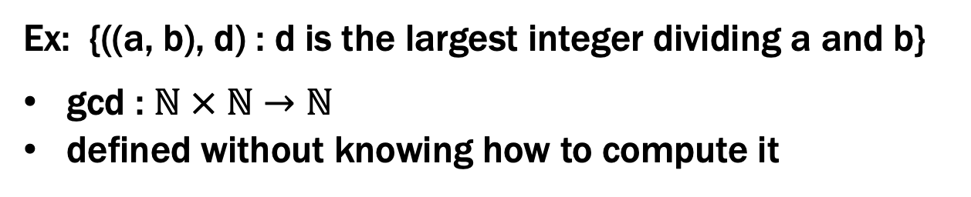
Functions
A function $f :A →B$ (A as input and B as output) is a special type of relation.
A function f from A to B is a relation from A to B such that:
for every $a∈A$, there is exactly one $b∈B$ with $(a,b)∈f$
Ex: {((a, b), d) : d is the largest integer dividing a and b}
gcd : ℕ × ℕ $→$ ℕ
defined without knowing how to compute it
Notes:
Gcd is an example

Slide 17
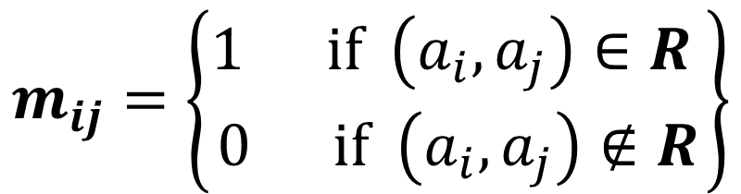

Matrix Representation
Relation $R$ on $A=\{a_{1},…, a_{p}\}$
$$m_{ij}=\left\{\begin{matrix}1 if \left(a_{i},a_{j}\right)∈R \\ 0 if \left(a_{i},a_{j}\right)∉R\end{matrix}\right\}$$
{ (1, 1), (1, 2), (1, 4), (2, 1), (2, 3), (3, 2), (3, 3), (4, 2), (4, 3) }
 | 1 | 2 | 3 | 4
1 | 1 | 1 | 0 | 1
2 | 1 | 0 | 1 | 0
3 | 0 | 1 | 1 | 0
4 | 0 | 1 | 1 | 0

Slide 18
Directed Graphs
V – vertices
E – edges (relation on vertices)
G = (V, E)
Notes:
Visual representation of a relation

Slide 19
Directed Graphs
V – vertices
E – edges (relation on vertices)
G = (V, E)
Path: v₀, v₁, …, v_{k} with each (v_{i}, v_{i+1}) in E

Slide 20
Directed Graphs
V – vertices
E – edges (relation on vertices)
G = (V, E)
Path: v₀, v₁, …, v_{k} with each (v_{i}, v_{i+1}) in E
Simple Path: none of v₀ , …, v_{k} repeated
Cycle: v₀= v_{k}
Simple Cycle: v₀= v_{k ,} none of v₁, …, v_{k} repeated

Slide 21
Directed Graphs
V – vertices
E – edges (relation on vertices)
G = (V, E)
Path: v₀, v₁, …, v_{k} with each (v_{i}, v_{i+1}) in E
Simple Path: none of v₀ , …, v_{k} repeated
Cycle: v₀= v_{k}
Simple Cycle: v₀= v_{k ,} none of v₁, …, v_{k} repeated

Slide 22
Directed Graphs
V – vertices
E – edges (relation on vertices)
G = (V, E)
Path: v₀, v₁, …, v_{k} with each (v_{i}, v_{i+1}) in E
Simple Path: none of v₀ , …, v_{k} repeated
Cycle: v₀= v_{k}
Simple Cycle: v₀= v_{k ,} none of v₁, …, v_{k} repeated

Slide 23
Representation of Relations
Directed Graph Representation (Digraph)
{(a, b), (a, a), (b, a), (c, a), (c, d), (c, e) (d, e) }
b
c
a
d
e

Slide 24
Representation of Relations
Directed Graph Representation (Digraph)
{(a, b), (a, a), (b, a), (c, a), (c, d), (c, e) (d, e) }
b
c
a
d
e

Slide 25
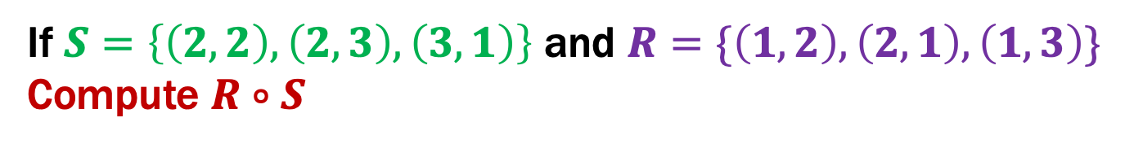
Relational Composition using Digraphs
If $S=\left\{\left(2,2\right), \left(2,3\right), \left(3,1\right)\right\}$ and $R=\{\left(1,2\right),\left(2,1\right),\left(1,3\right)\}$
Compute $R∘S$
2
2
1
1
3
3

Slide 26
Relational Composition using Digraphs
If $S=\left\{\left(2,2\right), \left(2,3\right), \left(3,1\right)\right\}$ and $R=\{\left(1,2\right),\left(2,1\right),\left(1,3\right)\}$
Compute $R∘S$
2
2
1
1
3
3

Slide 27
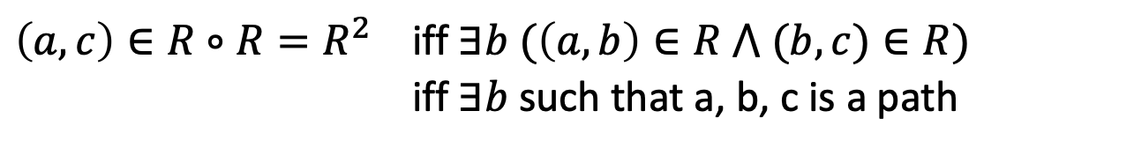

Relational Composition using Digraphs
If $R=\left\{\left(1,2\right), \left(2,1\right), \left(1,3\right)\right\}$ and $R=\{\left(1,2\right),\left(2,1\right),\left(1,3\right)\}$
Compute $R∘R$
2
2
1
1
3
3
$\left(a,c\right)∈{R∘R=R}^{2}$ iff $∃b (\left(a,b\right)∈R ⋀ (b,c)∈R)$
iff $∃b$ such that a, b, c is a path
Notes:
Any edge can be used either as the first step or the second step.

Slide 28
Relational Composition using Digraphs
If $R=\left\{\left(1,2\right), \left(2,1\right), \left(1,3\right)\right\}$ and $R=\{\left(1,2\right),\left(2,1\right),\left(1,3\right)\}$
Compute $R∘R$
2
2
1
1
3
3
$\left(a,c\right)∈{R∘R=R}^{2}$ iff $∃b (\left(a,b\right)∈R ⋀ (b,c)∈R)$
iff $∃b$ such that a, b, c is a path
Notes:
Any edge can be used either as the first step or the second step.

Slide 29
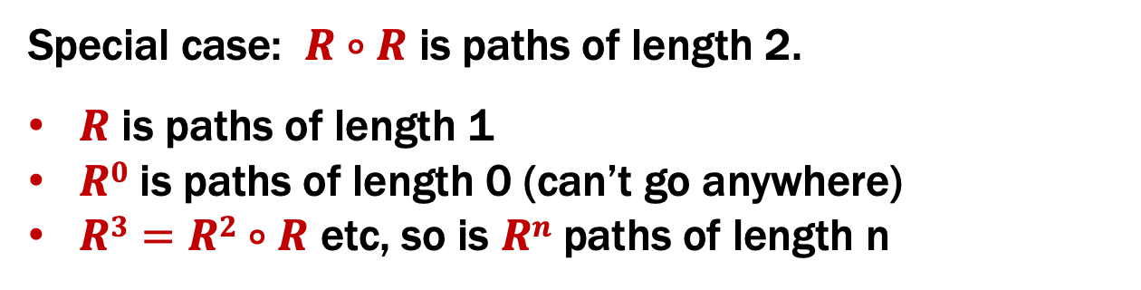
Relational Composition using Digraphs
If $R=\left\{\left(1,2\right), \left(2,1\right), \left(1,3\right)\right\}$ and $R=\{\left(1,2\right),\left(2,1\right),\left(1,3\right)\}$
Compute $R∘R$
2
2
1
1
3
3
Special case: $R∘R$ is paths of length 2.
$R$ is paths of length 1
$R0$ is paths of length 0 (can’t go anywhere)
$R3=R2∘R$ etc, so is $Rn$ paths of length n
Notes:
Any edge can be used either as the first step or the second step.

Slide 30
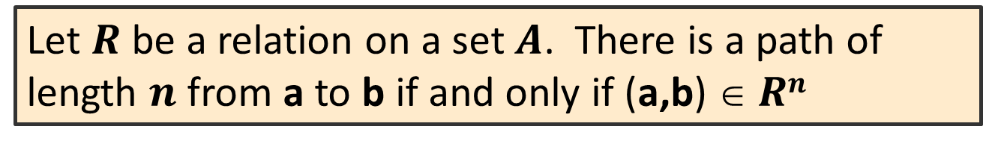
Paths in Relations and Graphs
Def: The length of a path in a graph is the number of edges in it (counting repetitions if edge used > once).
Let $R$ be a relation on a set $A$. There is a path of length $n$ from a to b if and only if (a,b) $ Rn$

Slide 31
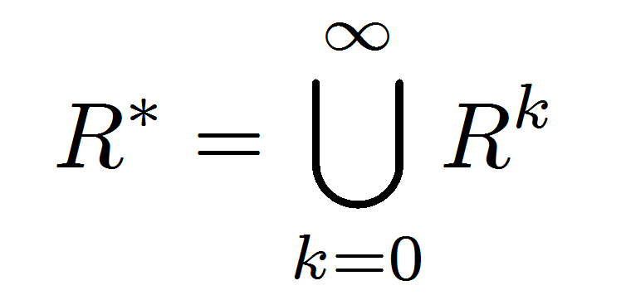
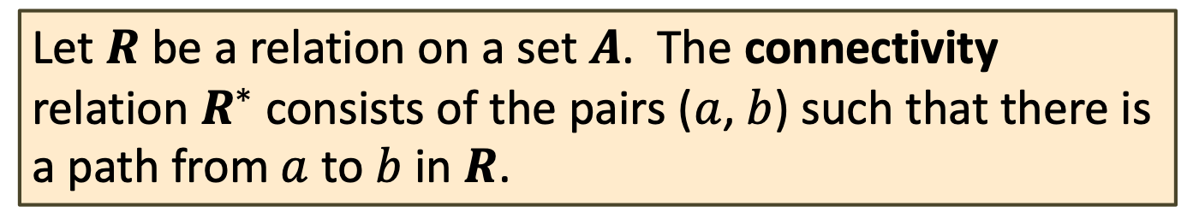
Connectivity In Graphs
Def: Two vertices in a graph are connected iff there is a path between them.
Let $R$ be a relation on a set $A$. The connectivity relation $R^{∗}$ consists of the pairs ($a$,$b$) such that there is a path from $a$ to $b$ in $R$.
Note: The text uses the wrong definition of this quantity.
What the text defines (ignoring k=0) is usually called R⁺

Slide 32
How Properties of Relations show up in Graphs
Let R be a relation on A.
R is reflexive iff (a,a) ∈ R for every a ∈ A
R is symmetric iff (a,b) ∈ R implies (b, a)∈ R
R is antisymmetric iff (a,b) ∈ R and a ≠ b implies (b,a) $∉$ R
R is transitive iff (a,b)∈ R and (b, c)∈ R implies (a, c) ∈ R

Slide 33
How Properties of Relations show up in Graphs
Let R be a relation on A.
R is reflexive iff (a,a) ∈ R for every a ∈ A
at every node
R is symmetric iff (a,b) ∈ R implies (b, a)∈ R
or
R is antisymmetric iff (a,b) ∈ R and a ≠ b implies (b,a) $∉$ R
or
or
R is transitive iff (a,b)∈ R and (b, c)∈ R implies (a, c) ∈ R

Slide 34
Transitive-Reflexive Closure
Add the minimum possible number of edges to make the relation transitive and reflexive.

Slide 35

Transitive-Reflexive Closure
Relation with the minimum possible number of extra edges to make the relation both transitive and reflexive.
The transitive-reflexive closure of a relation $R$ is the connectivity relation $R$*

Slide 36
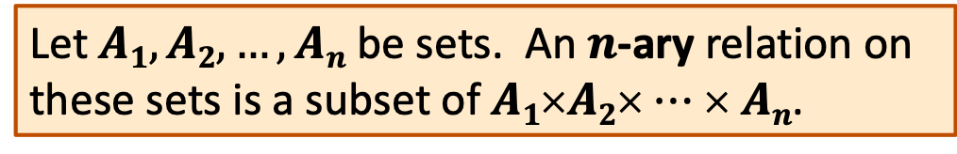

$n$-ary Relations
Let $A1, A2, …, An$ be sets. An $n$-ary relation on
these sets is a subset of $A1$×$A2$× $⋯$× $An$.

Slide 37
Relational Databases
STUDENT
Student_Name | ID_Number | Office | GPA
Knuth | 328012098 | 022 | 4.00
Von Neuman | 481080220 | 555 | 3.78
Russell | 238082388 | 022 | 3.85
Einstein | 238001920 | 022 | 2.11
Newton | 1727017 | 333 | 3.61
Karp | 348882811 | 022 | 3.98
Bernoulli | 2921938 | 022 | 3.21

Slide 38


Database Operations: Projection
Office
022
555
333
Find all offices: $Π_{Office}\left(STUDENT\right)$
Office | GPA
022 | 4.00
555 | 3.78
022 | 3.85
022 | 2.11
333 | 3.61
022 | 3.98
022 | 3.21
Find offices and GPAs: $Π_{Office, GPA}\left(STUDENT\right)$

Slide 39
Database Operations: Selection
Find students with GPA > 3.9 : σ_{GPA>3.9}(STUDENT)
Student_Name | ID_Number | Office | GPA
Knuth | 328012098 | 022 | 4.00
Karp | 348882811 | 022 | 3.98
Retrieve the name and GPA for students with GPA > 3.9: Π_{Student_Name,GPA}(σ_{GPA>3.9}(STUDENT))
Student_Name | GPA
Knuth | 4.00
Karp | 3.98

Slide 40
Relational Databases
STUDENT
Student_Name | ID_Number | Office | GPA | Course
Knuth | 328012098 | 022 | 4.00 | CSE311
Knuth | 328012098 | 022 | 4.00 | CSE351
Von Neuman | 481080220 | 555 | 3.78 | CSE311
Russell | 238082388 | 022 | 3.85 | CSE312
Russell | 238082388 | 022 | 3.85 | CSE344
Russell | 238082388 | 022 | 3.85 | CSE351
Newton | 1727017 | 333 | 3.61 | CSE312
Karp | 348882811 | 022 | 3.98 | CSE311
Karp | 348882811 | 022 | 3.98 | CSE312
Karp | 348882811 | 022 | 3.98 | CSE344
Karp | 348882811 | 022 | 3.98 | CSE351
Bernoulli | 2921938 | 022 | 3.21 | CSE351
What’s not so nice?
Notes:
What’s wrong:
Redundant data: we repeat all the GPAs and all the Office numbers
Missing data: we lost Einstein

Slide 41
Relational Databases
STUDENT
TAKES
Student_Name | ID_Number | Office | GPA
Knuth | 328012098 | 022 | 4.00
Von Neuman | 481080220 | 555 | 3.78
Russell | 238082388 | 022 | 3.85
Einstein | 238001920 | 022 | 2.11
Newton | 1727017 | 333 | 3.61
Karp | 348882811 | 022 | 3.98
Bernoulli | 2921938 | 022 | 3.21
ID_Number | Course
328012098 | CSE311
328012098 | CSE351
481080220 | CSE311
238082388 | CSE312
238082388 | CSE344
238082388 | CSE351
1727017 | CSE312
348882811 | CSE311
348882811 | CSE312
348882811 | CSE344
348882811 | CSE351
2921938 | CSE351
Better

Slide 42
Database Operations: Natural Join
Student ⋈ Takes
Student_Name | ID_Number | Office | GPA | Course
Knuth | 328012098 | 022 | 4.00 | CSE311
Knuth | 328012098 | 022 | 4.00 | CSE351
Von Neuman | 481080220 | 555 | 3.78 | CSE311
Russell | 238082388 | 022 | 3.85 | CSE312
Russell | 238082388 | 022 | 3.85 | CSE344
Russell | 238082388 | 022 | 3.85 | CSE351
Newton | 1727017 | 333 | 3.61 | CSE312
Karp | 348882811 | 022 | 3.98 | CSE311
Karp | 348882811 | 022 | 3.98 | CSE312
Karp | 348882811 | 022 | 3.98 | CSE344
Karp | 348882811 | 022 | 3.98 | CSE351
Bernoulli | 2921938 | 022 | 3.21 | CSE351

