Slide 1
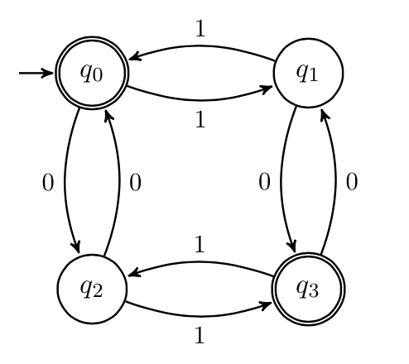
CSE 311: Foundations of Computing
Lecture 23: Finite State Machines

Slide 2
Last time: Relations & Composition
Let A and B be sets,
A binary relation from A to B is a subset of A × B
Let A be a set,
A binary relation on A is a subset of A × A

Slide 3
Last time: Directed Graphs
V – vertices
E – edges, ordered pairs of vertices
G = (V, E)

Slide 4
How Properties of Relations show up in Graphs
Let R be a relation on A.
R is reflexive iff (a,a) ∈ R for every a ∈ A
R is symmetric iff (a,b) ∈ R implies (b, a)∈ R
R is antisymmetric iff (a,b) ∈ R and a ≠ b implies (b,a) $∉$ R
R is transitive iff (a,b)∈ R and (b, c)∈ R implies (a, c) ∈ R

Slide 5
How Properties of Relations show up in Graphs
Let R be a relation on A.
R is reflexive iff (a,a) ∈ R for every a ∈ A
at every node
R is symmetric iff (a,b) ∈ R implies (b, a)∈ R
or
R is antisymmetric iff (a,b) ∈ R and a ≠ b implies (b,a) $∉$ R
or
or
R is transitive iff (a,b)∈ R and (b, c)∈ R implies (a, c) ∈ R

Slide 6
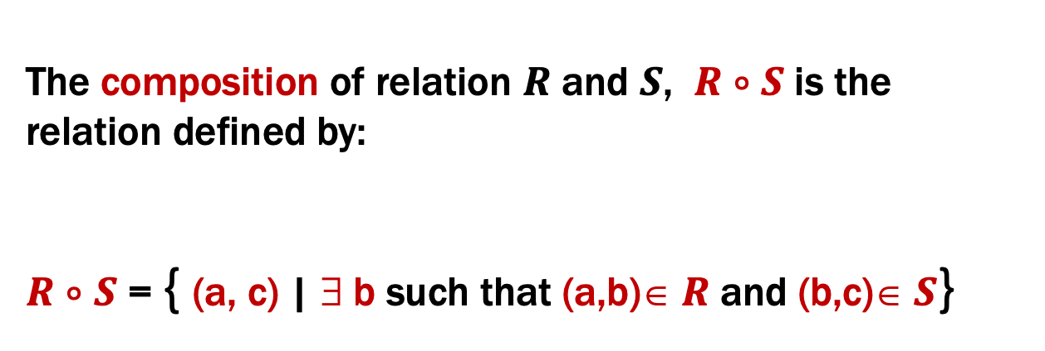
Last time: Relation Composition
The composition of relation $R$ and $S$, $R$ $∘S$ is the relation defined by:
$R$ $∘$ $S$ = { (a, c) | ∃ b such that (a,b)∈ $R$ and (b,c)∈ $S$}

Slide 7
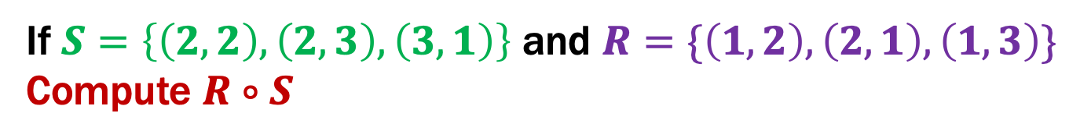
Last time: Relational Composition using Digraphs
If $S=\left\{\left(2,2\right), \left(2,3\right), \left(3,1\right)\right\}$ and $R=\{\left(1,2\right),\left(2,1\right),\left(1,3\right)\}$
Compute $R∘S$
2
2
1
1
3
3

Slide 8

Relational Composition using Digraphs
If $R=\left\{\left(1,2\right), \left(2,1\right), \left(1,3\right)\right\}$ and $R=\{\left(1,2\right),\left(2,1\right),\left(1,3\right)\}$
Compute $R∘R$
2
2
1
1
3
3
$\left(a,c\right)∈{R∘R=R}^{2}$ iff $∃b (\left(a,b\right)∈R ⋀ (b,c)∈R)$
Notes:
Any edge can be used either as the first step or the second step.

Slide 9
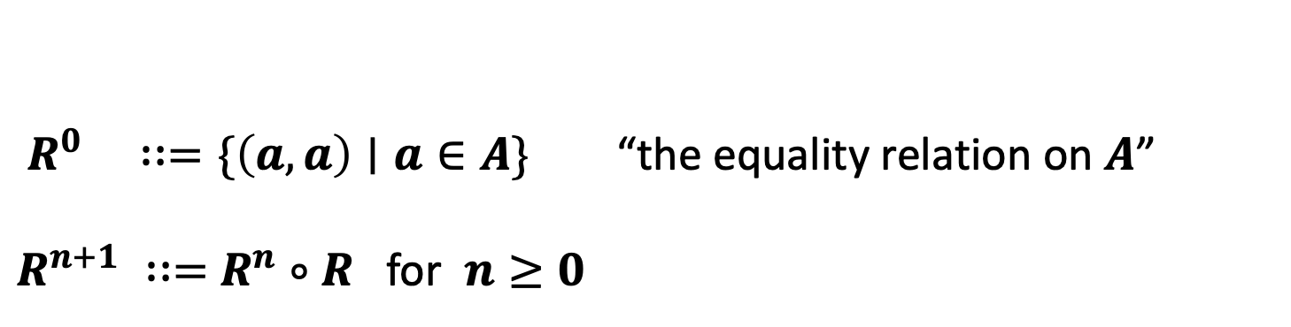
Last time: Powers of a Relation
$R^{0} ∷=\{\left(a,a\right)∣a∈A\}$ “the equality relation on $A$”
$R^{n+1} ∷=$ $R^{n}$ $∘$ $R$ for $n≥0$

Slide 10
Last time: Paths in Directed Graphs
V – vertices
E – edges (relation on vertices)
G = (V, E)
Path: v₀, v₁, …, v_{k} with each (v_{i}, v_{i+1}) in E

Slide 11
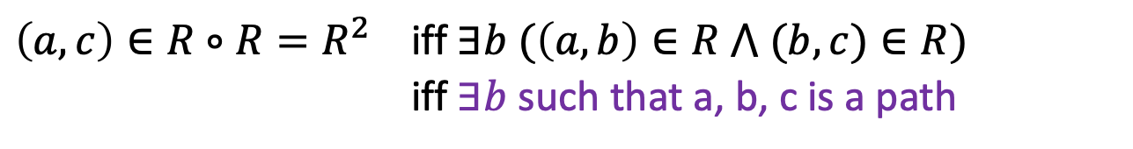
Relational Composition using Digraphs
If $R=\left\{\left(1,2\right), \left(2,1\right), \left(1,3\right)\right\}$ and $R=\{\left(1,2\right),\left(2,1\right),\left(1,3\right)\}$
Compute $R∘R$
2
2
1
1
3
3
$\left(a,c\right)∈{R∘R=R}^{2}$ iff $∃b (\left(a,b\right)∈R ⋀ (b,c)∈R)$
iff $∃b$ such that a, b, c is a path
Notes:
Any edge can be used either as the first step or the second step.

Slide 12
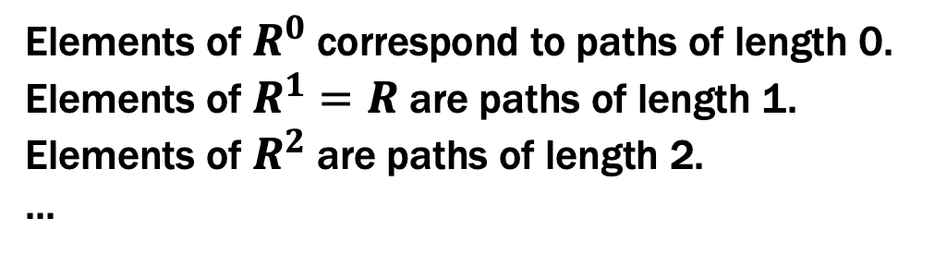
Paths in Relations
Def: The length of a path in a graph is the number of edges in it (counting repetitions if edge used > once).
Elements of $R^{0}$ correspond to paths of length 0.
Elements of $R^{1}=R$ are paths of length 1.
Elements of $R^{2}$ are paths of length 2.
...

Slide 13
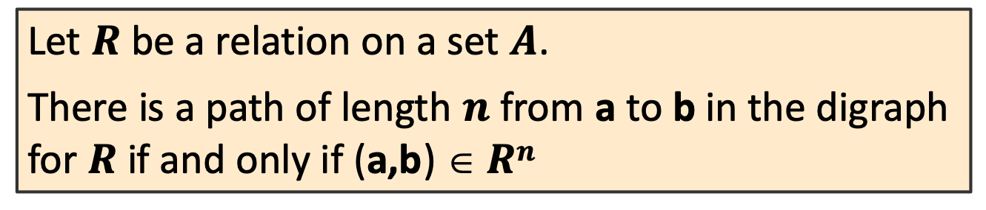
Paths in Relations
Def: The length of a path in a graph is the number of edges in it (counting repetitions if edge used > once).
Let $R$ be a relation on a set $A$.
There is a path of length $n$ from a to b in the digraph for $R$ if and only if (a,b) $ Rn$

Slide 14
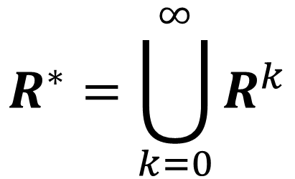
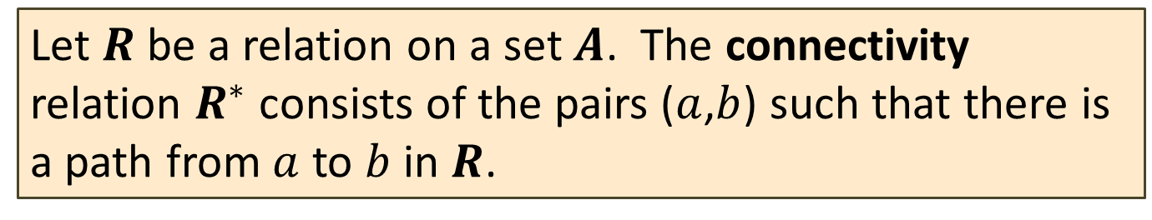
Connectivity In Graphs
Def: Two vertices in a graph are connected iff there is a path between them.
Let $R$ be a relation on a set $A$. The connectivity relation $R^{∗}$ consists of the pairs ($a$,$b$) such that there is a path from $a$ to $b$ in $R$.
$$R^{∗}=\bigcup_{k=0}^{∞}{R^{k}}$$
Note: Rosen text uses the wrong definition of this quantity.
What the text defines (ignoring k=0) is usually called R⁺

Slide 15
Transitive-Reflexive Closure
Add the minimum possible number of edges to make the relation transitive and reflexive.
Notes:
Example: transitive closure of prerequisites from course catalog is everything you must take before that class

Slide 16
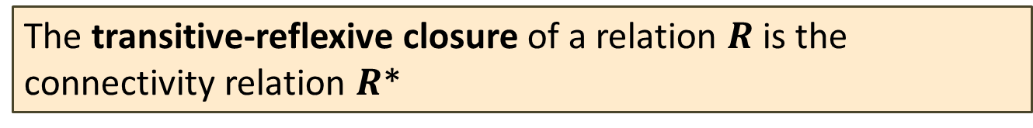
Transitive-Reflexive Closure
Relation with the minimum possible number of extra edges to make the relation both transitive and reflexive.
The transitive-reflexive closure of a relation $R$ is the connectivity relation $R$*

Slide 17
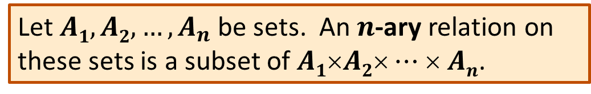
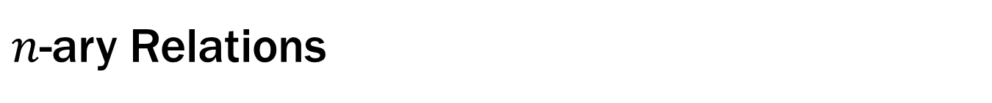
$n$-ary Relations
Let $A1, A2, …, A_{n}$ be sets. An $n$-ary relation on
these sets is a subset of $A1$×$A2$× $⋯$× $An$.

Slide 18
Relational Databases
STUDENT
Student_Name | ID_Number | Office | GPA
Knuth | 328012098 | 022 | 4.00
Von Neuman | 481080220 | 555 | 3.78
Russell | 238082388 | 022 | 3.85
Einstein | 238001920 | 022 | 2.11
Newton | 1727017 | 333 | 3.61
Karp | 348882811 | 022 | 3.98
Bernoulli | 2921938 | 022 | 3.21

Slide 19
Back to Languages

Slide 21
Selecting strings using labeled graphs as “machines”
Notes:
Example: 1101

Slide 22
Finite State Machines
The “double circle” means “the input is good if it ends here”
“Start here”
“If I get this symbol, follow the arrow…”
The circles are called “states”
We’re only in a single state at any point in time…

Slide 23
Which strings does this machine say are OK?

Slide 24
Which strings does this machine say are OK?
The set of all binary strings that end in 0

Slide 25
Finite State Machines
States
Transitions on input symbols
Start state and final states
The “language recognized” by the machine is the set of strings that reach a final state from the start
0
0
Old State | 0 | 1
s₀ | s₀ | s₁
s₁ | s₀ | s₂
s₂ | s₀ | s₃
s₃ | s₃ | s₃
s₀
1
s₁
1
s₂
1
s₃
0
0,1

Slide 26
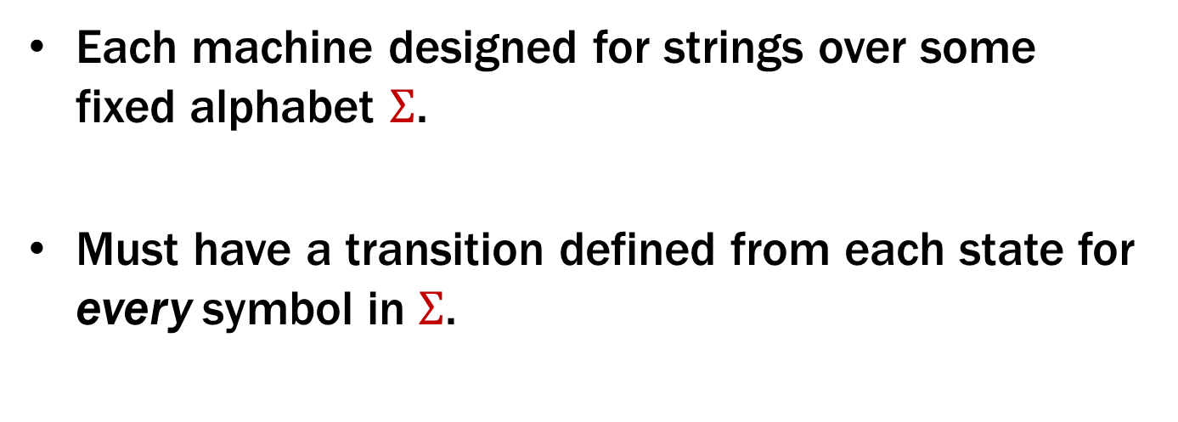
Finite State Machines
Each machine designed for strings over some fixed alphabet $Σ$.
Must have a transition defined from each state for every symbol in $Σ$.
0
0
Old State | 0 | 1
s₀ | s₀ | s₁
s₁ | s₀ | s₂
s₂ | s₀ | s₃
s₃ | s₃ | s₃
s₀
1
s₁
1
s₂
1
s₃
0
0,1

Slide 27
What language does this machine recognize?
0
0
Old State | 0 | 1
s₀ | s₀ | s₁
s₁ | s₀ | s₂
s₂ | s₀ | s₃
s₃ | s₃ | s₃
s₀
1
s₁
1
s₂
1
s₃
0
0,1

Slide 28
What language does this machine recognize?
The set of all binary strings that contain 111
or don’t end in 1
0
0
Old State | 0 | 1
s₀ | s₀ | s₁
s₁ | s₀ | s₂
s₂ | s₀ | s₃
s₃ | s₃ | s₃
s₀
1
s₁
1
s₂
1
s₃
0
0,1

Slide 29
Applications of FSMs (a.k.a. Finite Automata)
Implementation of regular expression matching in programs like grep
Control structures for sequential logic in digital circuits
Algorithms for communication and cache-coherence protocols
Each agent runs its own FSM
Design specifications for reactive systems
Components are communicating FSMs

Slide 30
Applications of FSMs (a.k.a. Finite Automata)
Formal verification of systems
Is an unsafe state reachable?
Computer games
FSMs implement non-player characters
Minimization algorithms for FSMs can be extended to more general models used in
Text prediction
Speech recognition

Slide 31
Strings over {0, 1, 2}
M₁: Strings with an even number of 2’s
s₀
s₁
Notes:
What information are we going to keep track of in a state?

Slide 32
Strings over {0, 1, 2}
M₁: Strings with an even number of 2’s
2
0,1
0,1
s₀
s₁
2

Slide 33
Strings over {0, 1, 2}
M₂: Strings where the sum of digits mod 3 is 0
Notes:
What information are we going to keep track of in a state?

Slide 34
FSM as abstraction of Java code
boolean sumCongruentToZero(String str) {
int sum = 0;
for (int i = 0; i < str.length(); i++) {
if (str.charAt(i) == '2’)
sum = (sum + 2) % 3;
if (str.charAt(i) == '1’)
sum = (sum + 1) % 3;
}
return sum == 0;
}
Notes:
What information are we going to keep track of in a state?

Slide 35
Strings over {0, 1, 2}
M₂: Strings where the sum of digits mod 3 is 0
t₁
t₀
t₂
Notes:
What information are we going to keep track of in a state?

Slide 36
Strings over {0, 1, 2}
M₂: Strings where the sum of digits mod 3 is 0
0
t₁
1
1
0
2
2
0
t₀
2
t₂
1

Slide 37
FSM as abstraction of Java code
boolean sumCongruentToZero(String str) {
int sum = 0; // state
for (int i = 0; i < str.length(); i++) {
if (str.charAt(i) == '2’)
sum = (sum + 2) % 3;
if (str.charAt(i) == '1’)
sum = (sum + 1) % 3;
}
return sum == 0;
}
FSMs can model Java code with
a finite number of fixed-size variables
that makes one pass through input
Notes:
What information are we going to keep track of in a state?

Slide 38
FSM to Java code
int[][] TRANSITION = {...};
boolean sumCongruentToZero(String str) {
int state = 0;
for (int i = 0; i < str.length(); i++) {
int d = str.charAt(i) - ‘0’;
state = TRANSITION[state][d];
}
return state == 0;
}
Notes:
What information are we going to keep track of in a state?

Slide 39
Strings over {0, 1, 2}
M₁: Strings with an even number of 2’s
M₂: Strings where the sum of digits mod 3 is 0
2
0,1
0,1
s₀
s₁
2
0
t₁
1
1
0
2
2
0
t₀
2
t₂
1

Slide 40
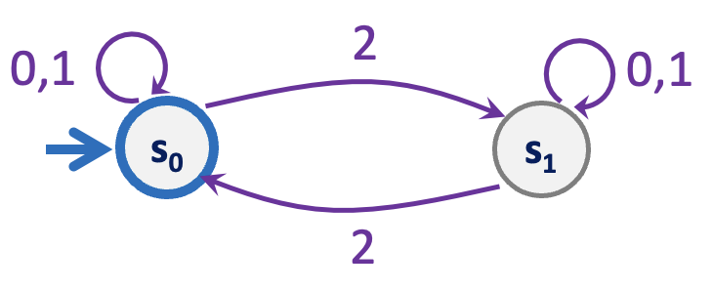
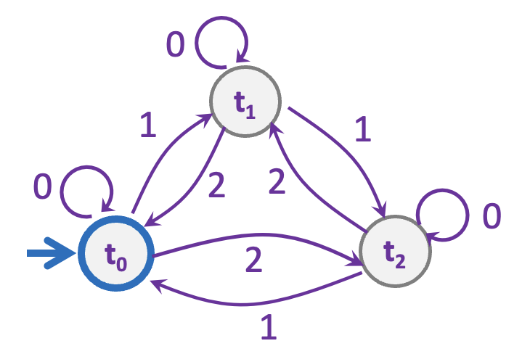
Strings over {0,1,2} w/ even number of 2’s AND mod 3 sum 0
s₀t₀
s₁t₀
s₀t₁
s₁t₁
s₀t₂
s₁t₂

Slide 41
Strings over {0,1,2} w/ even number of 2’s AND mod 3 sum 0
0
0
s₀t₀
s₁t₀
2
2
1
1
0
0
s₀t₁
2
2
s₁t₁
1
1
1
1
2
2
s₀t₂
s₁t₂
0
0

Slide 42
Strings over {0,1,2} w/ even number of 2’s OR mod 3 sum 0
0
0
s₀t₀
s₁t₀
2
2
1
1
0
0
s₀t₁
2
2
s₁t₁
1
1
1
1
2
2
s₀t₂
s₁t₂
0
0

Slide 43
Strings over {0,1,2} w/ even number of 2’s XOR mod 3 sum 0
0
0
s₀t₀
s₁t₀
2
2
1
1
0
0
s₀t₁
2
2
s₁t₁
1
1
1
1
2
2
s₀t₂
s₁t₂
0
0

Slide 44
What language does this machine recognize?
1
s₀
s₁
1
0
0
0
0
1
s₂
s₃
1

Slide 45
What language does this machine recognize?
1
s₀
s₁
1
0
0
0
0
1
s₂
s₃
1
The set of all binary strings with # of 1’s ≣ # of 0’s (mod 2)
(both are even or both are odd).

Slide 46
The set of binary strings with a 1 in the 3rd position from the start
Notes:
Q: Keep track of what?

Slide 47
The set of binary strings with a 1 in the 3rd position from the start
R
0,1
0
s₀
0,1
s₁
0,1
s₂
1
A
0,1

Slide 48
The set of binary strings with a 1 in the 3rd position from the end
Notes:
Q: Keep track of what? (Last 3 digits)

Slide 49
3 bit shift register
“Remember the last three bits”
001
1
011
1
0
1
1
1
0
000
1
010
101
0
111
1
0
0
1
0
0
100
0
110

Slide 50
The set of binary strings with a 1 in the 3rd position from the end
0
1
0
1
0
1
0
1
00
01
10
11
1
1
1
1
0
0
0
0
001
1
011
1
0
1
1
1
0
000
1
010
101
0
111
1
0
0
1
0
0
100
0
110

Slide 51
The set of binary strings with a 1 in the 3rd position from the end
001
1
011
1
0
1
1
1
0
000
1
010
101
0
111
1
0
0
1
0
0
100
0
110

Slide 52
The beginning versus the end
R
0
0,1
s₀
0,1
s₁
0,1
s₂
1
A
0,1
001
1
011
1
0
1
1
1
0
000
1
010
101
0
111
1
0
0
0
1
0
100
0
110

Slide 53
Adding Output to Finite State Machines
So far we have considered finite state machines that just accept/reject strings
called “Deterministic Finite Automata” or DFAs
Now we consider finite state machines with output
These are the kinds used as controllers

Slide 54


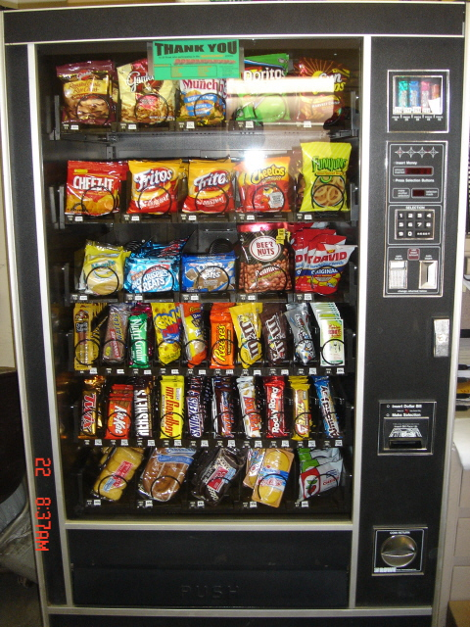
Vending Machine
Enter 15 cents in dimes or nickels
Press S or B for a candy bar

Slide 55
Vending Machine, v0.1
D
D
0
N
5
N
10
N, D
15
B, S
Basic transitions on N (nickel), D (dime), B (butterfinger), S (snickers)

Slide 56
Vending Machine, v0.2
0
D
N
15
D
D
B
0’ [B]
5
10
N
S
N
N
D
15’ [N]
B
S
N
0” [S]
D
Adding output to states: N – Nickel, S – Snickers, B – Butterfinger

Slide 57
Vending Machine, v1.0
B,S
0
D
N
15
B,S
D
B,S
B
D
B,S
D
N
S
N
0’ [B]
N
5
10
N
D
15’ [N]
B
N
S
D
B,S
N
N
0” [S]
D
B
15” [D]
S
D
Adding additional “unexpected” transitions to cover all symbols for each state

