Slide 1
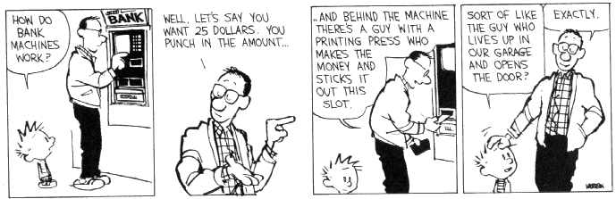
CSE 311: Foundations of Computing
Lecture 24: FSM Minimization & NFAs

Slide 2
Last class: Finite State Machines
States
Transitions on input symbols
Start state and final states
The “language recognized” by the machine is the set of strings that reach a final state from the start
0
0
Old State | 0 | 1
s₀ | s₀ | s₁
s₁ | s₀ | s₂
s₂ | s₀ | s₃
s₃ | s₃ | s₃
s₀
1
s₁
1
s₂
1
s₃
0
0,1

Slide 3
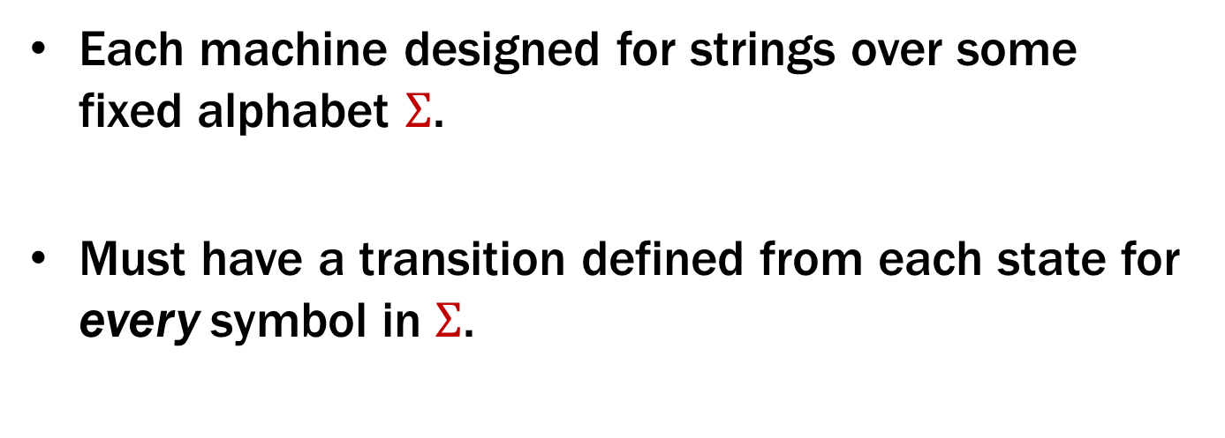
Last class: Finite State Machines
Each machine designed for strings over some fixed alphabet $Σ$.
Must have a transition defined from each state for every symbol in $Σ$.
0
0
Old State | 0 | 1
s₀ | s₀ | s₁
s₁ | s₀ | s₂
s₂ | s₀ | s₃
s₃ | s₃ | s₃
s₀
1
s₁
1
s₂
1
s₃
0
0,1

Slide 4
State Machine Design Recipe
Given a language, how do you design a state machine for it?
Need enough states to:
Decide whether to accept or reject at the end
Update the state on each new character
Notes:
What information are we going to keep track of in a state?

Slide 5
State Machine Design Recipe
M₂: Strings where the sum of digits mod 3 is 0
Notes:
What information are we going to keep track of in a state?

Slide 6
State Machine Design Recipe
M₂: Strings where the sum of digits mod 3 is 0
Can we get away with two states?
One for 0 mod 3 and one for everything else
Notes:
What information are we going to keep track of in a state?

Slide 7
State Machine Design Recipe
M₂: Strings where the sum of digits mod 3 is 0
Can we get away with two states?
One for 0 mod 3 and one for everything else
This would be enough to decide at the end!
But can’t update the state on each new character
Notes:
What information are we going to keep track of in a state?

Slide 8
State Machine Design Recipe
M₂: Strings where the sum of digits mod 3 is 0
Can we get away with two states?
One for 0 mod 3 and one for everything else
This would be enough to decide at the end!
But can’t update the state on each new character:
If you’re in the “not 0 mod 3” state, and the next character is 1, which state should you go to?
Notes:
What information are we going to keep track of in a state?

Slide 9
State Machine Design Recipe
M₂: Strings where the sum of digits mod 3 is 0
So, we need three states.
What information should we track?
t₁
t₀
t₂
Notes:
What information are we going to keep track of in a state?

Slide 10
Strings over {0, 1, 2}
M₂: Strings where the sum of digits mod 3 is 0
0
t₁
1
1
0
2
2
0
t₀
2
t₂
1

Slide 11
State Machine Design Recipe
Given a language, how do you design a state machine for it?
Need enough states to:
Decide whether to accept or reject at the end
Update the state on each new character
Notes:
What information are we going to keep track of in a state?

Slide 12
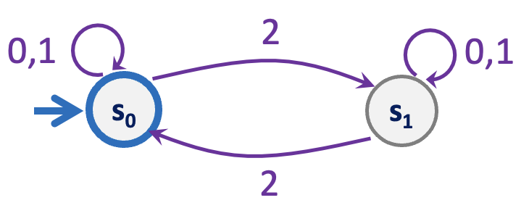
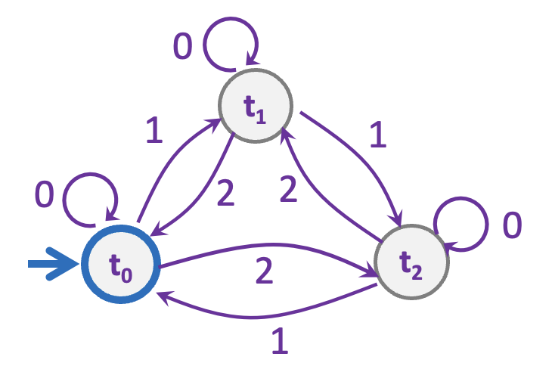
Strings over {0,1,2} w/ even number of 2’s AND mod 3 sum 0
s₀t₀
s₁t₀
s₀t₁
s₁t₁
s₀t₂
s₁t₂

Slide 13
Strings over {0,1,2} w/ even number of 2’s and mod 3 sum 0
0
0
s₀t₀
s₁t₀
2
2
1
1
0
0
s₀t₁
2
2
s₁t₁
1
1
1
1
2
2
s₀t₂
s₁t₂
0
0

Slide 14
Strings over {0,1,2} w/ even number of 2’s OR mod 3 sum 0
0
0
s₀t₀
s₁t₀
2
2
1
1
0
0
s₀t₁
2
2
s₁t₁
1
1
1
1
2
2
s₀t₂
s₁t₂
0
0

Slide 15
The set of binary strings with a 1 in the 3rd position from the start
Notes:
Q: Keep track of what?

Slide 16
The set of binary strings with a 1 in the 3rd position from the start
R
0,1
0
s₀
0,1
s₁
0,1
s₂
1
A
0,1

Slide 17
The set of binary strings with a 1 in the 3rd position from the end
Notes:
Q: Keep track of what? (Last 3 digits)

Slide 18
3 bit shift register
“Remember the last three bits”
001
1
011
1
0
1
1
1
0
000
1
010
101
0
111
1
0
0
1
0
0
100
0
110

Slide 19
The set of binary strings with a 1 in the 3rd position from the end
0
1
0
1
0
1
0
1
00
01
10
11
1
1
1
1
0
0
0
0
001
1
011
1
0
1
1
1
0
000
1
010
101
0
111
1
0
0
1
0
0
100
0
110

Slide 20
The set of binary strings with a 1 in the 3rd position from the end
001
1
011
1
0
1
1
1
0
000
1
010
101
0
111
1
0
0
1
0
0
100
0
110

Slide 21
The beginning versus the end
R
0
0,1
s₀
0,1
s₁
0,1
s₂
1
A
0,1
001
1
011
1
0
1
1
1
0
000
1
010
101
0
111
1
0
0
0
1
0
100
0
110

Slide 22
Adding Output to Finite State Machines
So far, we have considered finite state machines that just accept/reject strings
called “Deterministic Finite Automata” or DFAs
Now we consider finite state machines with output
These are the kinds used as controllers

Slide 23


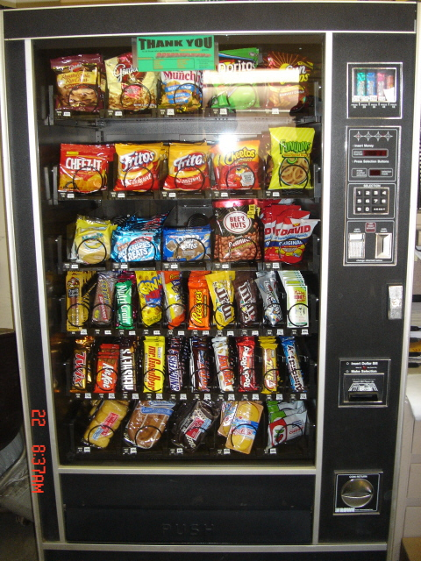
Vending Machine
Enter 15 cents in dimes or nickels
Press S or B for a candy bar

Slide 24
Vending Machine, v0.1
D
D
0
N
5
N
10
N, D
15
B, S
Basic transitions on N (nickel), D (dime), B (butterfinger), S (snickers)

Slide 25
Vending Machine, v0.2
0
D
N
15
D
D
B
0’ [B]
5
10
N
S
N
N
D
15’ [N]
B
S
N
0” [S]
D
Adding output to states: N – Nickel, S – Snickers, B – Butterfinger

Slide 26
Vending Machine, v1.0
B,S
0
D
N
15
B,S
D
B,S
B
D
B,S
D
N
S
N
0’ [B]
N
5
10
N
D
15’ [N]
B
N
S
D
B,S
N
N
0” [S]
D
B
15” [D]
S
D
Adding additional “unexpected” transitions to cover all symbols for each state

Slide 27
State Minimization
Many different FSMs (DFAs) for the same problem
Take a given FSM and try to reduce its state set by combining states
Algorithm will always produce the unique minimal equivalent machine (up to renaming of states) but we won’t prove this
Notes:
When running into problems building the machine, we usually solve it by add more states. What if we add too many?

Slide 28
State Minimization Algorithm
Put states into groups
Try to find groups that can be collapsed into one state
states can keep track of information that isn’t necessary to determine whether to accept or reject
Group states together until we can prove that collapsing them can change the accept/reject result
find a specific string x such that:
starting from state A, following edges according to x ends in accept
starting from state B, following edges according to x ends in reject
(algorithm below could be modified to show these strings)
Notes:
Idea: Groups of states that could be collapsed. Wait until we have proof that we need to keep track of which we are in.

Slide 29
State Minimization Algorithm
Put states into groups based on their outputs (whether they accept or reject)
Notes:
Idea: Groups of states that could be collapsed. Wait until we have proof that we need to keep track of which we are in.

Slide 30
State Minimization Algorithm
Put states into groups based on their outputs (whether they accept or reject)
Repeat the following until no change happens
If there is a symbol s so that not all states in a group G agree on which group s leads to, split G into smaller groups based on which group the states go to on s
Finally, convert groups to states
s
s
s
G₂
G₁₀
G₂
s
G₁
s
s
s
G₃
G₁₁
G₃
s
Notes:
Idea: Groups of states that could be collapsed. Wait until we have proof that we need to keep track of which we are in.

Slide 31
State Minimization Example
present next state output state 0 1 2 3 S0 S0 S1 S2 S3 1 S1 S0 S3 S1 S5 0 S2 S1 S3 S2 S4 1 S3 S1 S0 S4 S5 0 S4 S0 S1 S2 S5 1 S5 S1 S4 S0 S5 0
0
2
S0
0
S1
1
2
3
3
0
1
0
1
S2
S3
state transition table
1
2
3
2
3
Put states into groups based on their
outputs (or whether they accept or reject)
1
2
2
S4
3
S5
0
0
1
3

Slide 32
State Minimization Example
present next state output state 0 1 2 3 S0 S0 S1 S2 S3 1 S1 S0 S3 S1 S5 0 S2 S1 S3 S2 S4 1 S3 S1 S0 S4 S5 0 S4 S0 S1 S2 S5 1 S5 S1 S4 S0 S5 0
0
2
S0
0
S1
1
2
3
3
0
1
0
1
state transition table
S2
S3
1
2
Put states into groups based on their
outputs (or whether they accept or reject)
2
3
3
1
2
2
S4
3
S5
0
0
1
3

Slide 33
State Minimization Example
present next state output state 0 1 2 3 S0 S0 S1 S2 S3 1 S1 S0 S3 S1 S5 0 S2 S1 S3 S2 S4 1 S3 S1 S0 S4 S5 0 S4 S0 S1 S2 S5 1 S5 S1 S4 S0 S5 0
0
2
S0
0
S1
1
2
3
3
0
1
0
1
state transition table
S2
S3
1
2
Put states into groups based on their
outputs (or whether they accept or reject)
2
3
3
1
2
2
S4
3
S5
0
If there is a symbol s so that not all states in
a group G agree on which group s leads to,
split G based on which group the states go
to on s
0
1
3

Slide 34
State Minimization Example
present next state output state 0 1 2 3 S0 S0 S1 S2 S3 1 S1 S0 S3 S1 S5 0 S2 S1 S3 S2 S4 1 S3 S1 S0 S4 S5 0 S4 S0 S1 S2 S5 1 S5 S1 S4 S0 S5 0
0
2
S0
0
S1
1
2
3
3
0
1
0
1
state transition table
S2
S3
1
2
Put states into groups based on their
outputs (or whether they accept or reject)
2
3
3
1
2
2
S4
3
S5
0
If there is a symbol s so that not all states in
a group G agree on which group s leads to,
split G based on which group the states go
to on s
0
1
3

Slide 35
State Minimization Example
present next state output state 0 1 2 3 S0 S0 S1 S2 S3 1 S1 S0 S3 S1 S5 0 S2 S1 S3 S2 S4 1 S3 S1 S0 S4 S5 0 S4 S0 S1 S2 S5 1 S5 S1 S4 S0 S5 0
0
2
S0
0
S1
1
2
3
3
0
1
0
1
state transition table
S2
S3
1
2
Put states into groups based on their
outputs (or whether they accept or reject)
2
3
3
1
2
2
S4
3
S5
0
If there is a symbol s so that not all states in
a group G agree on which group s leads to,
split G based on which group the states go
to on s
0
1
3

Slide 36
State Minimization Example
present next state output state 0 1 2 3 S0 S0 S1 S2 S3 1 S1 S0 S3 S1 S5 0 S2 S1 S3 S2 S4 1 S3 S1 S0 S4 S5 0 S4 S0 S1 S2 S5 1 S5 S1 S4 S0 S5 0
0
2
S0
0
S1
1
2
3
3
0
1
0
1
state transition table
S2
S3
1
2
Put states into groups based on their
outputs (or whether they accept or reject)
2
3
3
1
2
2
S4
3
S5
0
If there is a symbol s so that not all states in
a group G agree on which group s leads to,
split G based on which group the states go
to on s
0
1
3

Slide 37
State Minimization Example
present next state output state 0 1 2 3 S0 S0 S1 S2 S3 1 S1 S0 S3 S1 S5 0 S2 S1 S3 S2 S4 1 S3 S1 S0 S4 S5 0 S4 S0 S1 S2 S5 1 S5 S1 S4 S0 S5 0
0
2
S0
0
S1
1
2
3
3
0
1
0
1
state transition table
S2
S3
1
2
Put states into groups based on their
outputs (or whether they accept or reject)
2
3
3
1
2
2
S4
3
S5
0
If there is a symbol s so that not all states in
a group G agree on which group s leads to,
split G based on which group the states go
to on s
0
1
3

Slide 38
State Minimization Example
present next state output state 0 1 2 3 S0 S0 S1 S2 S3 1 S1 S0 S3 S1 S5 0 S2 S1 S3 S2 S4 1 S3 S1 S0 S4 S5 0 S4 S0 S1 S2 S5 1 S5 S1 S4 S0 S5 0
0
2
S0
0
S1
1
2
3
3
0
1
0
1
state transition table
S2
S3
1
2
3
2
3
1
Finally convert groups to states:
Can combine states S0-S4 and
S3-S5.
In table replace all S4 with S0
and all S5 with S3
2
2
S4
3
S5
0
0
1
3

Slide 39
Minimized Machine
present next state output state 0 1 2 3 S0 S0 S1 S2 S3 1 S1 S0 S3 S1 S3 0 S2 S1 S3 S2 S0 1 S3 S1 S0 S0 S3 0
0
2
S0
0
S1
1
2
3
0
1,3
3
1,2
state transition table
0
S2
S3
1
2
3

Slide 40
A Simpler Minimization Example
1
s₀
s₁
1
0
0
0
0
1
s₂
s₃
1
The set of all binary strings with # of 1’s ≣ # of 0’s (mod 2).
Notes:
Machine keeps track of whether #1s is odd and whether #0s is odd. (Product construction)

Slide 41
A Simpler Minimization Example
1
Split states into accept/reject groups
s₀
s₁
1
0
0
0
0
Every symbol causes the DFA to go from one group to the other so neither group needs to be split
1
s₂
s₃
1

Slide 42
Minimized DFA
0,1
s₀s₃
s₁s₂
0,1
The set of all binary strings with # of 1’s ≣ # of 0’s (mod 2).
= The set of all binary strings with even length.

Slide 43
Nondeterministic Finite Automata (NFA)
Graph with start state, final states, edges labeled by symbols (like DFA) but
Not required to have exactly 1 edge out of each state labeled by each symbol--- can have 0 or >1
Also can have edges labeled by empty string ε
Definition: x is in the language recognized by an NFA if and only if some valid execution of the machine gets to an accept state
s₀
1
s₁
1
s₂
1
s₃
0,1
0,1

Slide 44
Consider This NFA
0,1
1
1
s₁
s₂
s₃
1
s₀
0
1
s₅
s₄
1
What language does this NFA accept?

Slide 45
Consider This NFA
0,1
1
1
s₁
s₂
s₃
1
s₀
0
1
s₅
s₄
1
What language does this NFA accept?
10(10)* ⋃ 111 (0 ⋃ 1)*

Slide 46
NFA ε-moves
2
0,1
0,1
s₀
s₁
ε
2
q
0
t₁
1
1
0
ε
2
2
0
t₀
2
t₂
1

Slide 47
NFA ε-moves
Strings over {0,1,2} w/even # of 2’s OR sum to 0 mod 3
2
0,1
0,1
s₀
s₁
ε
2
q
0
t₁
1
1
0
ε
2
2
0
t₀
2
t₂
1

Slide 48
NFA for set of binary strings with a 1 in the 3rd position from the end

Slide 49
NFA for set of binary strings with a 1 in the 3rd position from the end
0,1
1
0,1
0,1
s₃
s₂
s₁
s₀

Slide 50
Compare with the smallest DFA
0,1
1
0,1
0,1
s₃
s₂
s₁
s₀
001
1
011
1
0
1
1
1
0
000
1
010
101
0
111
1
0
0
1
0
0
100
0
110

Slide 51
Summary of NFAs
Generalization of DFAs
drop two restrictions of DFAs
every DFA is an NFA
Seem to be more powerful
designing is easier than with DFAs
Seem related to regular expressions

