Slide 1

CSE 311: Foundations of Computing
Lecture 26: Languages vs Representations: Limitations of Finite Automata and Regular Expressions

Slide 2
Last time: Algorithms for Regular Languages
We have seen algorithms for
RE to NFA
NFA to DFA
DFA/NFA to RE (not tested)
DFA minimization
Practice three of these in HW.
(May also be on the final.)

Slide 3
The story so far...
REs
⊆
CFGs
≡
DFAs
≡
NFAs
Languages represented by DFA, NFAs, or regular expressions
are called Regular Languages

Slide 4
Regular expressions ≡ NFAs ≡ DFAs
We have shown how to build an optimal DFA for every regular expression
Build NFA
Convert NFA to DFA using subset construction
Minimize resulting DFA
Thus, we could now implement a RegExp library
most RegExp libraries actually simulate the NFA
(even better: one can combine the two approaches: apply DFA minimization lazily while simulating the NFA)

Slide 5
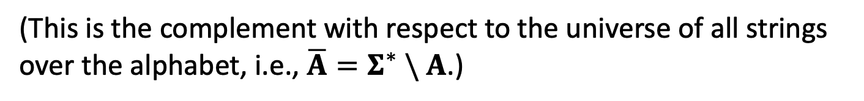
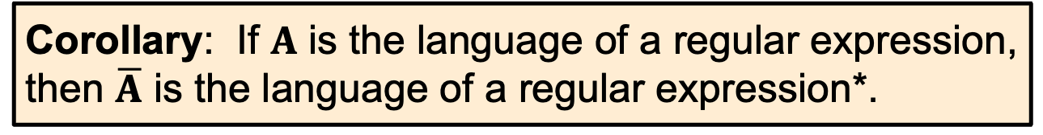
Example Corollary of These Results
Corollary: If $A$ is the language of a regular expression, then $\overline{A}$ is the language of a regular expression*.
(This is the complement with respect to the universe of all strings over the alphabet, i.e., ${\overline{A}=Σ}^{∗} \backslash A$.)

Slide 6
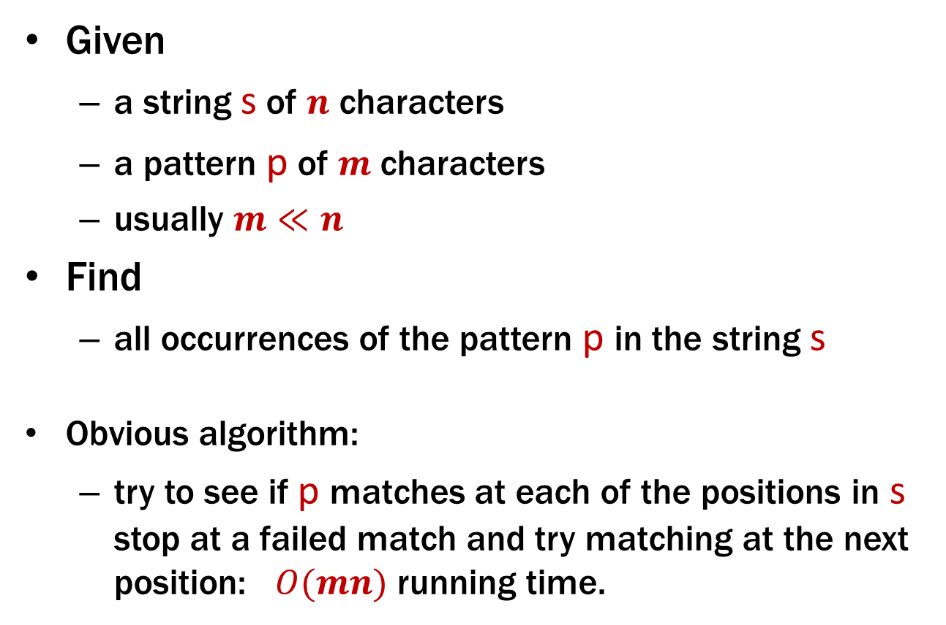
Application of FSMs: Pattern matching
Given
a string s of $n$ characters
a pattern p of $m$ characters
usually $m≪n$
Find
all occurrences of the pattern p in the string s
Obvious algorithm:
try to see if p matches at each of the positions in s stop at a failed match and try matching at the next position: $O(mn)$ running time.

Slide 7

Application of FSMs: Pattern Matching
With DFAs can do this in $O(m+n)$ time.
See Extra Credit problem on HW8 for some ideas of how to get to O(m² + n).

Slide 8
Last time: NFA to DFA
0,1
0
a,b
∅
a
0
1
1
ɛ
1
1
c
b
0
c
b
0
1
0
0
0,1
1
b,c
a,b,c
NFA
0
DFA
Notes:
Key idea: what nodes are reachable by some path matching input so far.

Slide 9
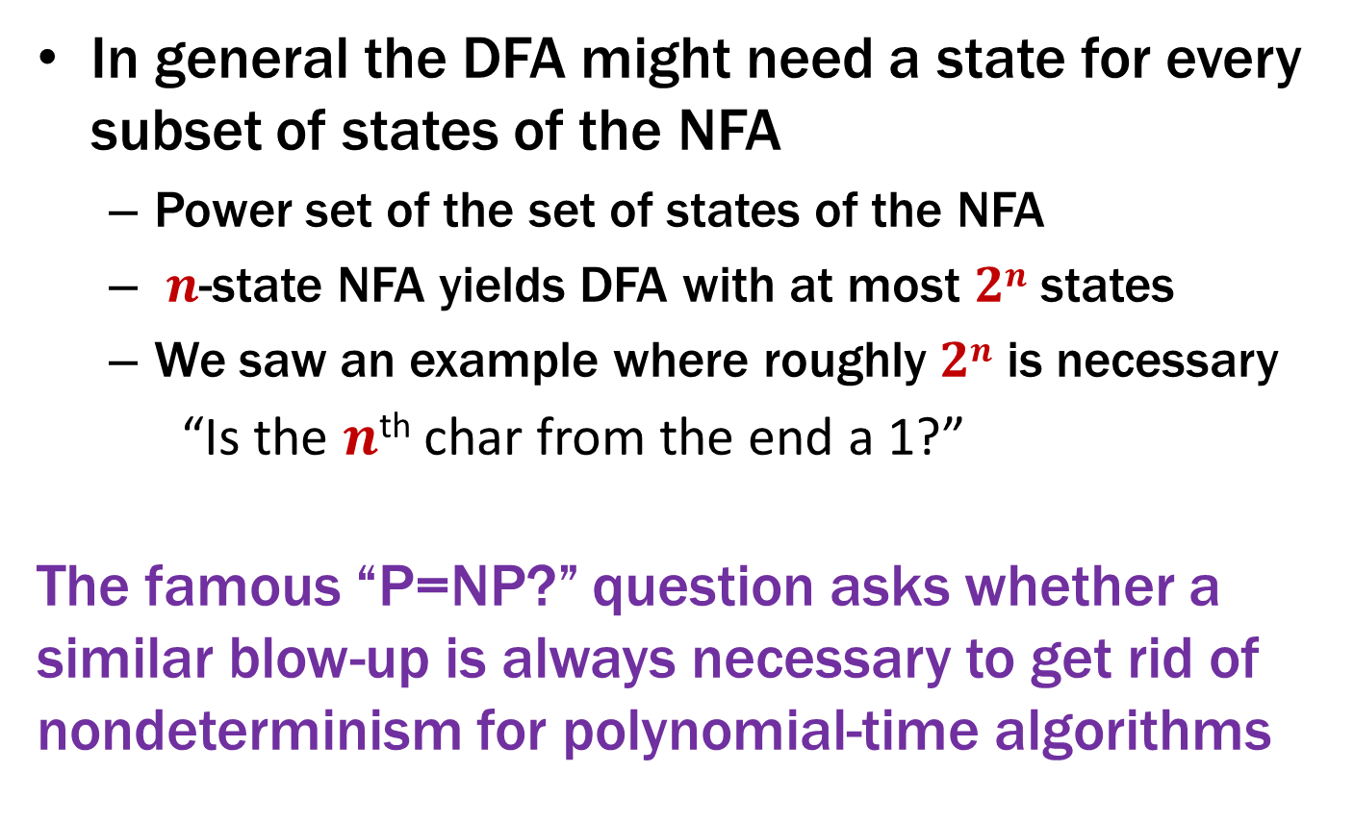
Exponential Blow-up in Simulating Nondeterminism
In general the DFA might need a state for every subset of states of the NFA
Power set of the set of states of the NFA
$n$-state NFA yields DFA with at most $2n$ states
We saw an example where roughly $2n$ is necessary
“Is the $n$^{th} char from the end a 1?”
The famous “P=NP?” question asks whether a similar blow-up is always necessary to get rid of nondeterminism for polynomial-time algorithms
Notes:
A lot more here... E.g., PSPACE = NSPACE. See CSE 341

Slide 10
The story so far...
REs
⊆
CFGs
≡
DFAs
≡
NFAs

Slide 11
What languages have DFAs? CFGs?
All of them?

Slide 12
Languages and Representations!
All
Context-Free
Regular
DFA
NFA
Regex
0*
Finite
{001, 10, 12}

Slide 13
Languages and Representations!
All
Context-Free
Warmup:
All finite languages are regular.
Regular
DFA
NFA
Regex
0*
Finite
{001, 10, 12}

Slide 14
DFAs Recognize Any Finite Language

Slide 15
DFAs Recognize Any Finite Language
Construct a DFA for each string in the language.
Then, put them together using the union construction.

Slide 16
Languages and Machines!
All
Context-Free
Warmup 2:
Surprising example here
Regular
DFA
NFA
Regex
0*
Finite
{001, 10, 12}

Slide 17
An Interesting Infinite Regular Language
L = {x∊ {0, 1}*: x has an equal number of substrings 01 and 10}.
L is infinite.
0, 00, 000, …
L is regular. How could this be?
That seems to require comparing counts...
easy for a CFG
but seems hard for DFAs!

Slide 18
An Interesting Infinite Regular Language
L = {x∊ {0, 1}*: x has an equal number of substrings 01 and 10}.
L is infinite.
0, 00, 000, …
L is regular. How could this be? It is just the set of binary strings that are empty or begin and end with the same character!
0
1
1
0
s₁
s₂
0
s₀
1
0
0
1
s₃
s₄
1

Slide 19
Languages and Representations!
All
Context-Free
???
Main Event:
Prove there is a context-free language that isn’t regular.
Regular
DFA
NFA
Regex
0*
Finite
{001, 10, 12}

Slide 20

The language of “Binary Palindromes” is Context-Free
S → $ε$ | 0 | 1 | 0S0 | 1S1

Slide 21
Is the language of “Binary Palindromes” Regular ?
Intuition (NOT A PROOF!):
Q: What would a DFA need to keep track of to decide?
A: It would need to keep track of the “first part” of the input in order to check the second part against it
…but there are an infinite # of possible first parts and we only have finitely many states.
Proof idea: any machine that does not remember the entire first half will be wrong for some inputs
Notes:
Ex: if machine has 10 states, then consider palindromes of length 8. Need to remember 2^4 = 16 different strings.

Slide 22
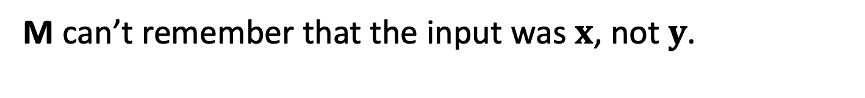
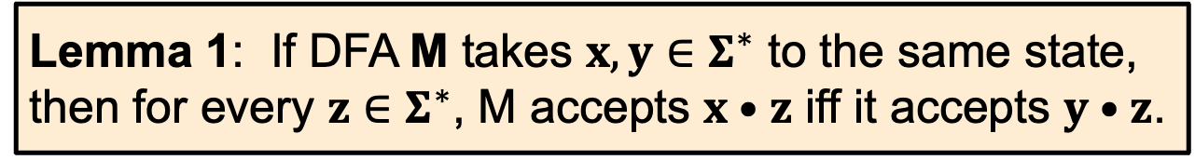
Useful Lemmas about DFAs
Lemma 1: If DFA M takes $x,y∈Σ^{∗}$ to the same state, then for every $z∈Σ^{∗}$, M accepts $x•z$ iff it accepts $y•z$.
M can’t remember that the input was $x$, not $y$.
x
x•z = x₁ x₂ … x_{n} z₁ z₂ … z_{k}
y•z = y₁ y₂ … y_{m} z₁ z₂ … z_{k}
z
y

Slide 23
Useful Lemmas about DFAs
Lemma 2: If DFA M has n states and a set S contains more than n strings, then M takes at least two strings from S to the same state.
M can’t take n+1 or more strings to different states because it doesn’t have n+1 different states.
So, some pair of strings must go to the same state.

Slide 24
B = {binary palindromes} can’t be recognized by any DFA
Suppose for contradiction that some DFA, M, recognizes B.
We will show M accepts or rejects a string it shouldn’t.
Consider S = {1, 01, 001, 0001, 00001, ...} = {0^{n}1 : n ≥ 0}.

Slide 25
B = {binary palindromes} can’t be recognized by any DFA
Suppose for contradiction that some DFA, M, accepts B.
We will show M accepts or rejects a string it shouldn’t.
Consider S = {1, 01, 001, 0001, 00001, ...} = {0^{n}1 : n ≥ 0}.
Since there are finitely many states in M and infinitely many strings in S, by Lemma 2, there exist strings 0ª1 ∈ S and 0^{b}1 ∈ S with a≠b that end in the same state of M.
SUPER IMPORTANT POINT: You do not get to choose what a and b are. Remember, we’ve just proven they exist…we must take the ones we’re given!

Slide 26
B = {binary palindromes} can’t be recognized by any DFA
Suppose for contradiction that some DFA, M, accepts B.
We will show M accepts or rejects a string it shouldn’t.
Consider S = {1, 01, 001, 0001, 00001, ...} = {0^{n}1 : n ≥ 0}.
Since there are finitely many states in M and infinitely many strings in S, by Lemma 2, there exist strings 0ª1 ∈ S and 0^{b}1 ∈ S with a≠b that end in the same state of M.
Now, consider appending 0ª to both strings.
0ªa1
0ª
q
0 ^{b}1

Slide 27
B = {binary palindromes} can’t be recognized by any DFA
Suppose for contradiction that some DFA, M, accepts B.
We will show M accepts or rejects a string it shouldn’t.
Consider S = {1, 01, 001, 0001, 00001, ...} = {0^{n}1 : n ≥ 0}.
Since there are finitely many states in M and infinitely many strings in S, by Lemma 2, there exist strings 0ª1 ∈ S and 0^{b}1 ∈ S with a≠b that end in the same state of M.
Now, consider appending 0ª to both strings.
Since 0ª1 and 0^{b}1 end in the same state, 0ª10ª and 0^{b}10ª also end in the same state, call it q. But then M makes a mistake: q needs to be an accept state since 0ª10ª ∈ B, but M would accept 0^{b}10ª ∉ B, which is an error.
0ªa1
0ª
q
0 ^{b}1

Slide 28
B = {binary palindromes} can’t be recognized by any DFA
Suppose for contradiction that some DFA, M, accepts B.
We will show M accepts or rejects a string it shouldn’t.
Consider S = {1, 01, 001, 0001, 00001, ...} = {0^{n}1 : n ≥ 0}.
Since there are finitely many states in M and infinitely many strings in S, by Lemma 2, there exist strings 0ª1 ∈ S and 0^{b}1 ∈ S with a≠b that end in the same state of M.
Now, consider appending 0ª to both strings.
Since 0ª1 and 0^{b}1 end in the same state, 0ª10ª and 0^{b}10ª also end in the same state, call it q. But then M makes a mistake: q needs to be an accept state since 0ª10ª ∈ B, but M would accept 0^{b}10ª ∉ B, which is an error.
This proves that M does not recognize B, contradicting our assumption that it does. Thus, no DFA recognizes B.

Slide 29
Showing that a Language L is not regular
“Suppose for contradiction that some DFA M recognizes L.”
Consider an INFINITE set S of prefixes (which we intend to complete later).
“Since S is infinite and M has finitely many states, there must be two strings s_{a} and s_{b} in S for s_{a} ≠ s_{b} that end up at the same state of M.”
Consider appending the (correct) completion t to each of the two strings.
“Since s_{a} and s_{b} both end up at the same state of M, and we appended the same string t, both s_{a}t and s_{b}t end at the same state q of M. Since s_{a}t ∈ L and s_{b}t ∉ L, M does not recognize L.”
“Thus, no DFA recognizes L.”

Slide 30
Showing that a Language L is not regular
The choice of S is the creative part of the proof
You must find an infinite set S with the property that no two strings can be taken to the same state
i.e., for every pair of strings S there is an “accept” completion that the two strings DO NOT SHARE

Slide 31
Prove A = {0^{n}1^{n} : n ≥ 0} is not regular
Suppose for contradiction that some DFA, M, recognizes A.
Let S =

Slide 32
Prove A = {0^{n}1^{n} : n ≥ 0} is not regular
Suppose for contradiction that some DFA, M, recognizes A.
Let S = {0^{n} : n ≥ 0}. Since S is infinite and M has finitely many states, there must be two strings, 0ª and 0^{b} for some a ≠ b that end in the same state in M.

Slide 33
Prove A = {0^{n}1^{n} : n ≥ 0} is not regular
Suppose for contradiction that some DFA, M, recognizes A.
Let S = {0^{n} : n ≥ 0}. Since S is infinite and M has finitely many states, there must be two strings, 0ª and 0^{b} for some a ≠ b that end in the same state in M.
Consider appending 1ª to both strings.

Slide 34
Prove A = {0^{n}1^{n} : n ≥ 0} is not regular
Suppose for contradiction that some DFA, M, recognizes A.
Let S = {0^{n} : n ≥ 0}. Since S is infinite and M has finitely many states, there must be two strings, 0ª and 0^{b} for some a ≠ b that end in the same state in M.
Consider appending 1ª to both strings.
Note that 0ª1ª ∈ A, but 0^{b}1ª ∉ A since a ≠ b. But they both end up in the same state of M, call it q. Since 0ª1ª ∈ A, state q must be an accept state but then M would incorrectly accept 0^{b}1ª ∉ A so M does not recognize A.
Thus, no DFA recognizes A.

Slide 35
Prove P = {balanced parentheses} is not regular
Suppose for contradiction that some DFA, M, accepts P.
Let S =

Slide 36
Prove P = {balanced parentheses} is not regular
Suppose for contradiction that some DFA, M, recognizes P.
Let S = { (^{n} : n ≥ 0}. Since S is infinite and M has finitely many states, there must be two strings, (ª and (^{b} for some a ≠ b that end in the same state in M.

Slide 37
Prove P = {balanced parentheses} is not regular
Suppose for contradiction that some DFA, M, recognizes P.
Let S = { (^{n} : n ≥ 0}. Since S is infinite and M has finitely many states, there must be two strings, (ª and (^{b} for some a ≠ b that end in the same state in M.
Consider appending )ª to both strings.

Slide 38
Prove P = {balanced parentheses} is not regular
Suppose for contradiction that some DFA, M, recognizes P.
Let S = { (^{n} : n ≥ 0}. Since S is infinite and M has finitely many states, there must be two strings, (ª and (^{b} for some a ≠ b that end in the same state in M.
Consider appending )ª to both strings.
Note that (ª)ª ∈ P, but (^{b})ª ∉ P since a ≠ b. But they both end up in the same state of M, call it q. Since (ª)ª ∈ P, state q must be an accept state but then M would incorrectly accept (^{b})ª ∉ P so M does not recognize P.
Thus, no DFA recognizes P.

Slide 39
Showing that a Language L is not regular
“Suppose for contradiction that some DFA M recognizes L.”
Consider an INFINITE set S of prefixes (which we intend to complete later). It is imperative that for every pair of strings in our set there is an “accept” completion that the two strings DO NOT SHARE.
“Since S is infinite and M has finitely many states, there must be two strings s_{a} and s_{b} in S for s_{a} ≠ s_{b} that end up at the same state of M.”
Consider appending the (correct) completion t to each of the two strings.
“Since s_{a} and s_{b} both end up at the same state of M, and we appended the same string t, both s_{a}t and s_{b}t end at the same state q of M. Since s_{a}t ∈ L and s_{b}t ∉ L, M does not recognize L.”
“Thus, no DFA recognizes L.”

Slide 40
Fact: This method is optimal
Suppose that for a language L, the set S is a largest set of prefixes with the property that, for every pair s_{a}≠ s_{b} ∈ S, there is some string t such that one of s_{a}t, s_{b}t is in L but the other isn’t.
If S is infinite, then L is not regular
If S is finite, then the minimal DFA for L has precisely |S| states, one reached by each member of S.

Slide 41
Fact: This method is optimal
Suppose that for a language L, the set S is a largest set of prefixes with the property that, for every pair s_{a}≠ s_{b} ∈ S, there is some string t such that one of s_{a}t, s_{b}t is in L but the other isn’t.
If S is infinite, then L is not regular
If S is finite, then the minimal DFA for L has precisely |S| states, one reached by each member of S.
Corollary: Our minimization algorithm was correct.
we separated exactly those states for which some t would make one accept and another not accept

Slide 42
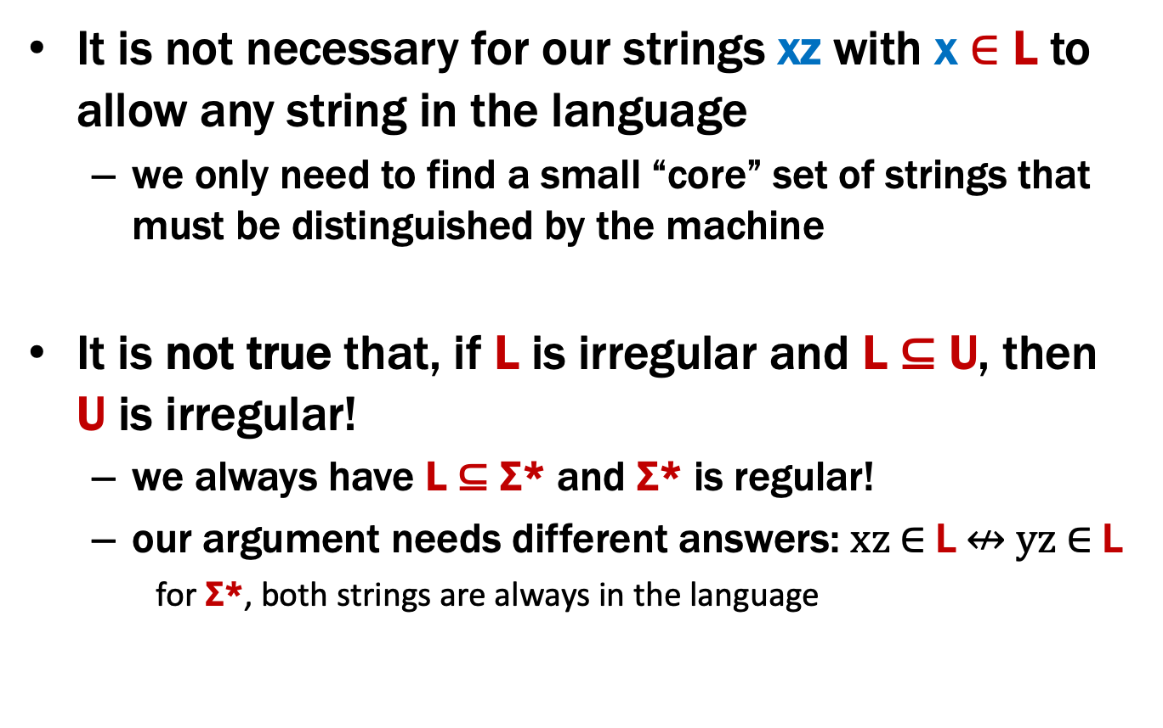
Important Notes
It is not necessary for our strings xz with x ∈ L to allow any string in the language
we only need to find a small “core” set of strings that must be distinguished by the machine
It is not true that, if L is irregular and L ⊆ U, then U is irregular!
we always have L ⊆ Σ* and Σ* is regular!
our argument needs different answers: xz ∈ L $↮$ yz ∈ L
for Σ*, both strings are always in the language
Do not claim in your proof that, because L ⊆ U, U is also irregular

Slide 43
B = {binary palindromes} can’t be recognized by any DFA
The general proof strategy is:
Assume (for contradiction) that some DFA (call it M) exists that recognizes B

Slide 44
B = {binary palindromes} can’t be recognized by any DFA
The general proof strategy is:
Assume (for contradiction) that some DFA (call it M) exists that recognizes B
Our goal is to show that M actually does not recognize B
How can a DFA fail to recognize B?
when it accepts or rejects a string it shouldn’t.

Slide 45
B = {binary palindromes} can’t be recognized by any DFA
The general proof strategy is:
Assume (for contradiction) that some DFA (call it M) exists that recognizes B
Our goal is to show that M actually does not recognize B, i.e., it accepts or rejects a string that it shouldn’t
“M recognizes B” AND “M doesn’t recognize B”, which is a contradiction

Slide 46
B = {binary palindromes} can’t be recognized by any DFA
The general proof strategy is:
Assume (for contradiction) that some DFA (call it M) exists that recognizes B
We want to show: M accepts or rejects a string it shouldn’t.
Key Idea 1: If two strings “collide” at any point, a DFA can no longer distinguish between them!
x
x•z = x₁ x₂ … x_{n} z₁ z₂ … z_{k}
y•z = y₁ y₂ … y_{m} z₁ z₂ … z_{k}
z
y
M is correct iff ∀z ∈ Σ* (x•z ∈ B ↔ y•z ∈ B)
M is incorrect iff ∃ z ∈ Σ* (x•z ∈ B $↮$ y•z ∈ B)
Notes:
Answer for xz = answer for yz

Slide 47
B = {binary palindromes} can’t be recognized by any DFA
The general proof strategy is:
Assume (for contradiction) that some DFA (call it M) exists that recognizes B
We want to show: M accepts or rejects a string it shouldn’t.
Key Idea 1: If two strings “collide” at any point, a DFA can no longer distinguish between them!
Key Idea 2: Our machine M has a finite number of states which means if we have infinitely many strings, two of them must collide!
x
z
y

Slide 48
B = {binary palindromes} can’t be recognized by any DFA
The general proof strategy is:
Assume (for contradiction) that some DFA (call it M) exists that recognizes B
We want to show: M accepts or rejects a string it shouldn’t.
We choose an INFINITE set S of prefixes (which we intend to complete later). It is critical that for every pair of strings in our set there is an “accept” completion that the two strings DO NOT SHARE.
x,y
z
1
01
001
0001
00001
.............
______
______
______
______
______
x
z
y
Notes:
For every pair x, y, there is some z such that xz is in the language and yz is not

Slide 49
B = {binary palindromes} can’t be recognized by any DFA
The general proof strategy is:
Assume (for contradiction) that some DFA (call it M) exists that recognizes B
We want to show: M accepts or rejects a string it shouldn’t.
We choose an INFINITE set S of prefixes (which we intend to complete later). It is imperative that for every pair of strings in our set there is an “accept” completion that the two strings DO NOT SHARE.
x,y
z
1
01
001
0001
00001
.............
______
______
______
______
______
x
z
y
Notes:
Infinite set of strings that *must be distinguished* (because we can append some z and get different answers)

Slide 50
B = {binary palindromes} can’t be recognized by any DFA
Suppose for contradiction that some DFA, M, accepts B.
We will show M accepts or rejects a string it shouldn’t.
Consider S = {1, 01, 001, 0001, 00001, ...} = {0^{n}1 : n ≥ 0}.
Since there are finitely many states in M and infinitely many strings in S, by Lemma 2, there exist strings 0ª1 ∈ S and 0^{b}1 ∈ S with a≠b that end in the same state of M.
Now, consider appending 0ª to both strings.
Key Idea 1: If two strings “collide” at any point, a DFA can no longer distinguish between them!
0ªa1
q
0 ^{b}1

