Slide 1
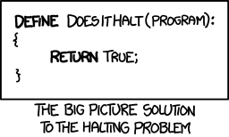
CSE 311: Foundations of Computing
Lecture 28: Undecidability

Slide 2
Final exam Monday, Review session Sunday
Monday at either 2:30-4:20 (B) or 4:30-6:20 (A)
CSE2 G20
bring your UW ID
1 hour and 50 minutes
Comprehensive: Full probs only on topics that were covered in homework. May have small probs on other topics.
reference sheets will be included
Review session: Sunday at 3pm in CSE2 G20
bring your questions

Slide 3
Final Exam
9 problems covering:
DFA / NFA / RE / CFG design
DFA / NFA / RE algorithms
Irregularity
Number theory
Set theory
Strong induction
Structural induction
Small questions on anything else
(any English proofs would be translations or templates)

Slide 4
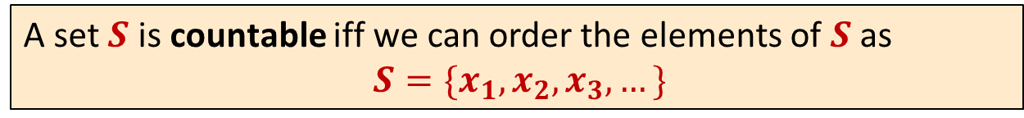
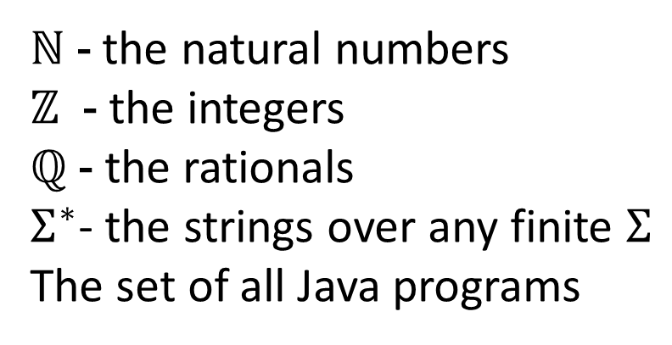
Last time: Countable sets
A set $S$ is countable iff we can order the elements of $S$ as
$S=\{x_{1},x_{2},x_{3},…\}$
Countable sets:
ℕ - the natural numbers
$ℤ$ - the integers
ℚ - the rationals
$Σ^{∗}$- the strings over any finite $Σ$
The set of all Java programs
}
Shown
by
“dovetailing”

Slide 5
Last time: Not every set is countable
Theorem [Cantor]:
The set of real numbers between 0 and 1 is not countable.
Proof using “diagonalization”.

Slide 6
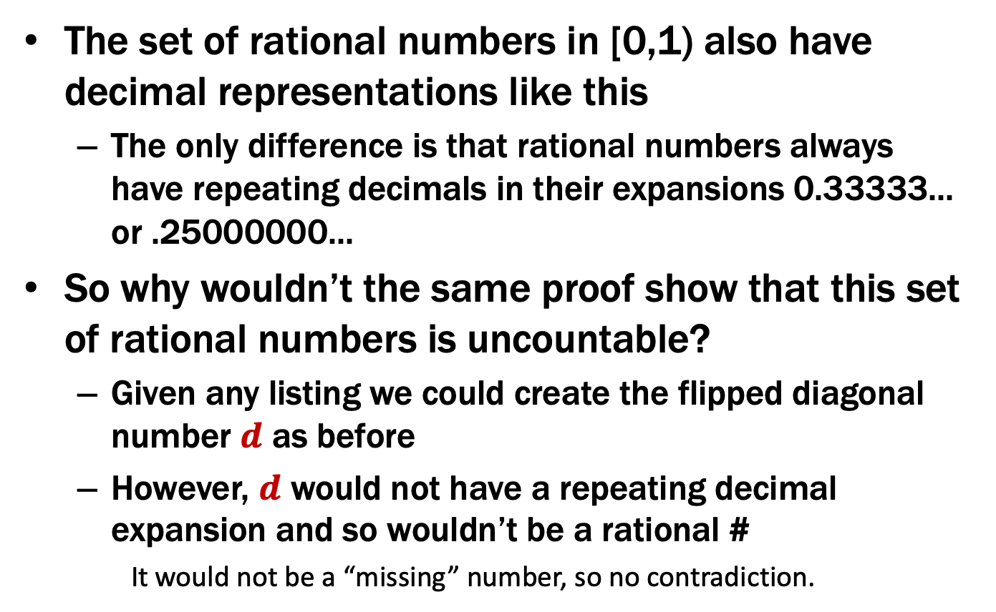
A note on this proof
The set of rational numbers in [0,1) also have decimal representations like this
The only difference is that rational numbers always have repeating decimals in their expansions 0.33333... or .25000000...
So why wouldn’t the same proof show that this set of rational numbers is uncountable?
Given any listing we could create the flipped diagonal number $d$ as before
However, $d$ would not have a repeating decimal expansion and so wouldn’t be a rational #
It would not be a “missing” number, so no contradiction.

Slide 7
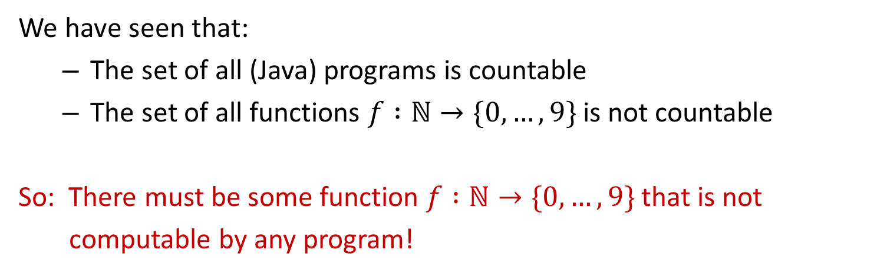
Uncomputable functions
We have seen that:
The set of all (Java) programs is countable
The set of all functions $f :ℕ→\{0,…,9\}$ is not countable
So: There must be some function $f :ℕ→\{0,…,9\}$ that is not
computable by any program!

Slide 8
Recall our language picture
All
Java
Context-Free
Binary Palindromes
Regular
DFA
NFA
Regex
0*
Finite
{001, 10, 12}

Slide 9
Uncomputable functions
Interesting… maybe.
Can we produce an explicit function that is uncomputable?

Slide 10
A “Simple” Program
11
34
17
52
26
13
40
20
10
5
16
8
4
2
1
public static void collatz(n) {
if (n == 1) {
return 1;
}
if (n % 2 == 0) {
return collatz(n/2)
}
else {
return collatz(3*n + 1)
}
}
What does this program do?
… on n=11?
… on n=10000000000000000001?

Slide 11
A “Simple” Program
public static void collatz(n) {
if (n == 1) {
return 1;
}
if (n % 2 == 0) {
return collatz(n/2)
}
else {
return collatz(3*n + 1)
}
}
What does this program do?
… on n=11?
… on n=10000000000000000001?
Nobody knows whether or not this program halts on all inputs!

Slide 12
Some Notation
We’re going to be talking about Java code.
CODE(P) will mean “the code of the program P”
So, consider the following function:
public String P(String x) {
return new String(Arrays.sort(x.toCharArray());
}
What is P(CODE(P))?
“(((())))..;AACPSSaaabceeggghiiiilnnnnnooprrrrrrrrrrrsssttttttuuwxxyy{}”

Slide 13
The Halting Problem
CODE(P) means “the code of the program P”
The Halting Problem
Given: - CODE(P) for any program P
- input x
Output: true if P halts on input x
false if P does not halt on input x

Slide 14
Undecidability of the Halting Problem
CODE(P) means “the code of the program P”
Theorem [Turing]: There is no program that solves the Halting Problem
The Halting Problem
Given: - CODE(P) for any program P
- input x
Output: true if P halts on input x
false if P does not halt on input x

Slide 15
Proof by contradiction
Suppose that H is a Java program that solves the Halting problem.
x

Slide 16
Proof by contradiction
Suppose that H is a Java program that solves the Halting problem.
Then we can write this program:
public static void D(String s) {
if (H(s,s)) {
while (true); // don’t halt
} else {
return; // halt
}
}
public static bool H(String s, String x) { ... }
Does D(CODE(D)) halt?

Slide 17
public static void D(s) {
if (H(s,s)) {
while (true); // don’t halt
} else {
return; // halt
}
}
Does D(CODE(D)) halt?

Slide 18
public static void D(s) {
if (H(s,s)) {
while (true); // don’t halt
} else {
return; // halt
}
}
Does D(CODE(D)) halt?
H solves the halting problem implies that H(CODE(D),s) is true iff D(s) halts, H(CODE(D),s) is false iff not
Suppose that D(CODE(D)) halts.
Then, by definition of H it must be that
H(CODE(D), CODE(D)) is true
Which by the definition of D means D(CODE(D)) doesn’t halt
Suppose that D(CODE(D)) doesn’t halt.
Then, by definition of H it must be that
H(CODE(D), CODE(D)) is false
Which by the definition of D means D(CODE(D)) halts

Slide 19
public static void D(s) {
if (H(s,s)) {
while (true); // don’t halt
} else {
return; // halt
}
}
Does D(CODE(D)) halt?
H solves the halting problem implies that H(CODE(D),s) is true iff D(s) halts, H(CODE(D),s) is false iff not
Suppose that D(CODE(D)) halts.
Then, by definition of H it must be that
H(CODE(D), CODE(D)) is true
Which by the definition of D means D(CODE(D)) doesn’t halt
Suppose that D(CODE(D)) doesn’t halt.
Then, by definition of H it must be that
H(CODE(D), CODE(D)) is false
Which by the definition of D means D(CODE(D)) halts

Slide 20
public static void D(s) {
if (H(s,s)) {
while (true); // don’t halt
} else {
return; // halt
}
}
Does D(CODE(D)) halt?
H solves the halting problem implies that H(CODE(D),s) is true iff D(s) halts, H(CODE(D),s) is false iff not
Suppose that D(CODE(D)) halts.
Then, by definition of H it must be that
H(CODE(D), CODE(D)) is true
Which by the definition of D means D(CODE(D)) doesn’t halt
Suppose that D(CODE(D)) doesn’t halt.
Then, by definition of H it must be that
H(CODE(D), CODE(D)) is false
Which by the definition of D means D(CODE(D)) halts

Slide 21
public static void D(s) {
if (H(s,s)) {
while (true); // don’t halt
} else {
return; // halt
}
}
Does D(CODE(D)) halt?
H solves the halting problem implies that H(CODE(D),s) is true iff D(s) halts, H(CODE(D),s) is false iff not
Suppose that D(CODE(D)) halts.
Then, by definition of H it must be that
H(CODE(D), CODE(D)) is true
Which by the definition of D means D(CODE(D)) doesn’t halt
Suppose that D(CODE(D)) doesn’t halt.
Then, by definition of H it must be that
H(CODE(D), CODE(D)) is false
Which by the definition of D means D(CODE(D)) halts

Slide 22
public static void D(s) {
if (H(s,s)) {
while (true); // don’t halt
} else {
return; // halt
}
}
Does D(CODE(D)) halt?
H solves the halting problem implies that H(CODE(D),s) is true iff D(s) halts, H(CODE(D),s) is false iff not
Suppose that D(CODE(D)) halts.
Then, by definition of H it must be that
H(CODE(D), CODE(D)) is true
Which by the definition of D means D(CODE(D)) doesn’t halt
Suppose that D(CODE(D)) doesn’t halt.
Then, by definition of H it must be that
H(CODE(D), CODE(D)) is false
Which by the definition of D means D(CODE(D)) halts

Slide 23
public static void D(s) {
if (H(s,s)) {
while (true); // don’t halt
} else {
return; // halt
}
}
Does D(CODE(D)) halt?
H solves the halting problem implies that H(CODE(D),s) is true iff D(s) halts, H(CODE(D),s) is false iff not
Suppose that D(CODE(D)) halts.
Then, by definition of H it must be that
H(CODE(D), CODE(D)) is true
Which by the definition of D means D(CODE(D)) doesn’t halt
Suppose that D(CODE(D)) doesn’t halt.
Then, by definition of H it must be that
H(CODE(D), CODE(D)) is false
Which by the definition of D means D(CODE(D)) halts
The ONLY assumption was that the program H exists so that assumption must have been false.
Contradiction!

Slide 24
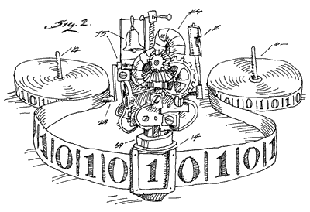
Done
We proved that there is no computer program that can solve the Halting Problem.
There was nothing special about Java* [Church-Turing thesis]
This tells us that there is no compiler that can check our programs and guarantee to find any infinite loops they might have.

Slide 25
Terminology
With state machines, we say that a machine “recognizes” the language L iff
it accepts x ∈ Σ* if x ∈ L
it rejects x ∈ Σ* if x ∉ L
With Java programs / general computation, we say that the computer “decides” the language L iff
it halts with output 1 on input x ∈ Σ* if x ∈ L
it halts with output 0 on input x ∈ Σ* if x ∉ L
(difference is the possibility that machine doesn’t halt)
If no machine decides L, then L is “undecidable”

Slide 26
Where did the idea for creating D come from?
public static void D(s) {
if (H(s,s) == true) {
while (true); // don’t halt
} else {
return; // halt
}
}
D halts on input code(P) iff H(code(P),code(P)) outputs false
iff P doesn’t halt on input code(P)

Slide 27
Connection to diagonalization
Write <P> for CODE(P)
<P₁> <P₂> <P₃> <P₄> <P₅> <P₆> ....
Some possible inputs x
P₁
P₂
P₃
P₄
P₅
P₆
P₇
P₈
P₉
.
.
This listing of all programs really does exist since the set of all Java programs is countable
All programs P
The goal of this “diagonal” argument is not to show that the listing is incomplete but rather to show that a “flipped” diagonal element is not in the listing

Slide 28
Connection to diagonalization
Write <P> for CODE(P)
<P₁> <P₂> <P₃> <P₄> <P₅> <P₆> ....
Some possible inputs x
P₁
P₂
P₃
P₄
P₅
P₆
P₇
P₈
P₉
.
.
0 1 1 0 1 1 1 0 0 0 1 ...
1 1 0 1 0 1 1 0 1 1 1 ...
1 0 1 0 0 0 0 0 0 0 1 ...
0 1 1 0 1 0 1 1 0 1 0 ...
0 1 1 1 1 1 1 0 0 0 1 ...
1 1 0 0 0 1 1 0 1 1 1 ...
1 0 1 1 0 0 0 0 0 0 1 ...
0 1 1 1 1 0 1 1 0 1 0 ...
. . . . . . . . . . . .
. . . . . . . . . . . .
All programs P
(P,x) entry is 1 if program P halts on input x
and 0 if it runs forever

Slide 29
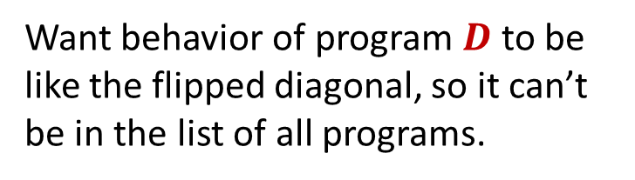
Connection to diagonalization
Write <P> for CODE(P)
<P₁> <P₂> <P₃> <P₄> <P₅> <P₆> ....
Some possible inputs x
P₁
P₂
P₃
P₄
P₅
P₆
P₇
P₈
P₉
.
.
1
0 1 1 0 1 1 1 0 0 0 1 ...
1 1 0 1 0 1 1 0 1 1 1 ...
1 0 1 0 0 0 0 0 0 0 1 ...
0 1 1 0 1 0 1 1 0 1 0 ...
0 1 1 1 1 1 1 0 0 0 1 ...
1 1 0 0 0 1 1 0 1 1 1 ...
1 0 1 1 0 0 0 0 0 0 1 ...
0 1 1 1 1 0 1 1 0 1 0 ...
. . . . . . . . . . . .
. . . . . . . . . . . .
Want behavior of program $D$to be like the flipped diagonal, so it can’t be in the list of all programs.
0
0
1
0
All programs P
0
All programs P
1
0
(P,x) entry is 1 if program P halts on input x
and 0 if it runs forever
(P,x) entry is 1 if program P halts on input x
and 0 if it runs forever

Slide 30
Where did the idea for creating D come from?
public static void D(s) {
if (H(s,s) == true) {
while (true); /* don’t halt */
}
else {
return; /* halt */
}
}
D halts on input code(P) iff H(code(P),code(P)) outputs false
iff P doesn’t halt on input code(P)
Therefore, for any program P, D differs from P on input code(P)

Slide 31
The Halting Problem isn’t the only hard problem
Can use the fact that the Halting Problem is undecidable to show that other problems are undecidable
General method (a “reduction”):
Prove that, if there were a program deciding B, then there would be a program deciding the Halting Problem.
“B decidable → Halting Problem decidable”
Contrapositive:
“Halting Problem undecidable → B undecidable”
Therefore, B is undecidable

Slide 32
A CSE 142 assignment
Students should write a Java program that:
Prints “Hello” to the console
Eventually exits
GradeIt, PracticeIt, etc. need to grade these
How do we write that grading program?
We can’T: THIS IS IMPOSSIBLE!

Slide 33
Another undecidable problem
CSE 142 Grading problem:
Input: CODE(Q)
Output:
True if Q outputs “HELLO” and exits
False if Q does not do that
Theorem: The CSE 142 Grading is undecidable.
Proof idea: Show that, if there is a program T to decide CSE 142 grading, then there is a program H to decide the Halting Problem for code(P) and input x.

Slide 34
Another undecidable problem
Theorem: The CSE 142 Grading is undecidable.
Proof: Suppose there is a program T that decide CSE 142 grading problem. Then, there is a program H to decide the Halting Problem for code(P) and input x by
transform P (with input x) into the following program Q

Slide 35
Another undecidable problem
public class Q {
private static String x = “...”;
public static void main(String[] args) {
PrintStream out = System.out;
System.setOut(new PrintStream(
new WriterOutputStream(new StringWriter()));
System.setIn(new ReaderInputStream(new StringReader(x)));
P.main(args);
out.println(“HELLO”);
}
}
class P {
public static void main(String[] args) { ... }
...
}

Slide 36
Another undecidable problem
Theorem: The CSE 142 Grading is undecidable.
Proof: Suppose there is a program T that decide CSE 142 grading problem. Then, there is a program H to decide the Halting Problem for code(P) and input x by
transform P (with input x) into the following program Q
run T on code(Q)
if it returns true, then P halted
must halt in order to print “HELLO”
if it returns false, then P did not halt
program Q can’t output anything other than “HELLO”

Slide 37
More Reductions
Can use undecidability of these problems to show that other problems are undecidable.
For instance:
$EQUIV(P,Q)$ : True if $P\left(x\right)$ and $Q(x)$ have the same
behavior for every input $x$
False otherwise

Slide 38
Rice’s theorem
Not every problem on programs is undecidable!
Which of these is decidable?
Input CODE(P) and x Output: true if P prints “ERROR” on input x after less than 100 steps false otherwise
Input CODE(P) and x Output: true if P prints “ERROR” on input x after more than 100 steps false otherwise
Rice’s Theorem:
Any “non-trivial” property of the input-output behavior of Java programs is undecidable.
Notes:
Suppose program Q has the property and “while (true);” does not. (Other case is similar.) Run the property decider on a program that does P followed by Q. If P never halts, then it has the behavior of the second program. If P does halt, then it has the behavior of Q.

Slide 39
Rice’s theorem
Not every problem on programs is undecidable!
Which of these is decidable?
Input CODE(P) and x Output: true if P prints “ERROR” on input x after less than 100 steps false otherwise
Input CODE(P) and x Output: true if P prints “ERROR” on input x after more than 100 steps false otherwise
ARE DIFFICULT
Rice’s Theorem (a.k.a. Compilers Suck Theorem - informal):
Any “non-trivial” property of the input-output behavior of Java programs is undecidable.
Notes:
Suppose program Q has the property and “while (true);” does not. (Other case is similar.) Run the property decider on a program that does P followed by Q. If P never halts, then it has the behavior of the second program. If P does halt, then it has the behavior of Q.

Slide 40
CFGs are complicated
We know can answer almost any question about REs
Do two RegExps recognize the same language?
But many problems about CFGs are undecidable!
Do two CFGs generate the same language?
Is there any string that two CFGs both generate?
more general: “CFG intersection” problem
Does a CFG generate every string?

Slide 41
Takeaway from undecidability
You can’t rely on the idea of improved compilers and programming languages to eliminate all programming errors
truly safe languages can’t possibly do general computation
Document your code
there is no way you can expect someone else to figure out what your program does with just your code; since in general it is provably impossible to do this!

