Slide 1
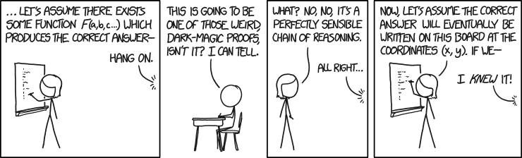
CSE 311: Foundations of Computing
Lecture 7: Propositional & Predicate Logic Proofs

Slide 2
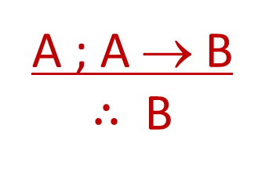
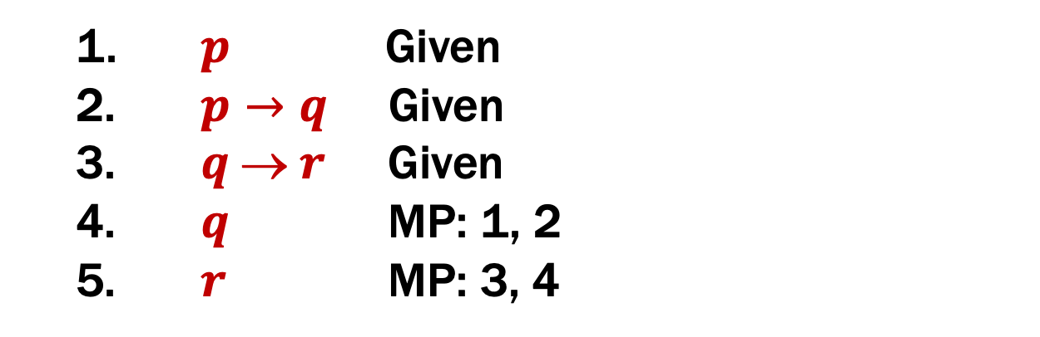
Last class: My First Proof!
Show that r follows from p, p → q, and q → r
1. $p$ Given
$p→q$ Given
$q  r$ Given
$q$ MP: 1, 2
$r$ MP: 3, 4
Modus Ponens

Slide 3
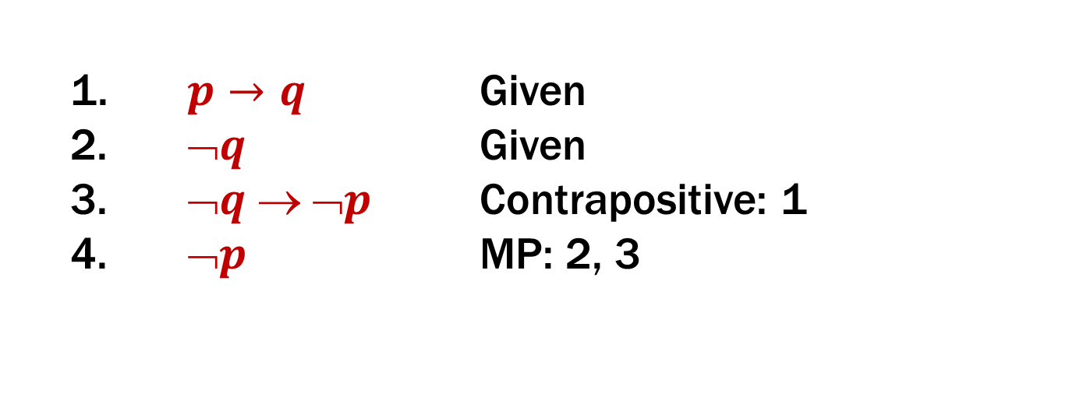
Last class: Proofs can use equivalences too
Show that ¬p follows from p → q and ¬q
1. $p→q$ Given
$➢q$ Given
$➢q  ➢p$ Contrapositive: 1
$➢p$ MP: 2, 3
Modus Ponens

Slide 4
Last class: Propositional Inference Rules
Two inference rules per binary connective, one to eliminate it and one to introduce it
A ∧ B
∴ A, B
A ; B
∴ A ∧ B
Elim ∧
Intro ∧
A ∨ B ; ¬A
∴ B
A x
∴ A ∨ B, B ∨ A
Elim ∨
Intro ∨
A ; A → B
∴ B
A ⇒ B
∴ A → B
Modus Ponens
Direct Proof

Slide 5
Proofs
Show that r follows from p, p → q and (p ∧ q) → r
How To Start:
We have givens, find the ones that go
together and use them. Now, treat new
things as givens, and repeat.
A ; A → B
∴ B
A ∧ B
∴ A, B
A ; B
∴ A ∧ B

Slide 6
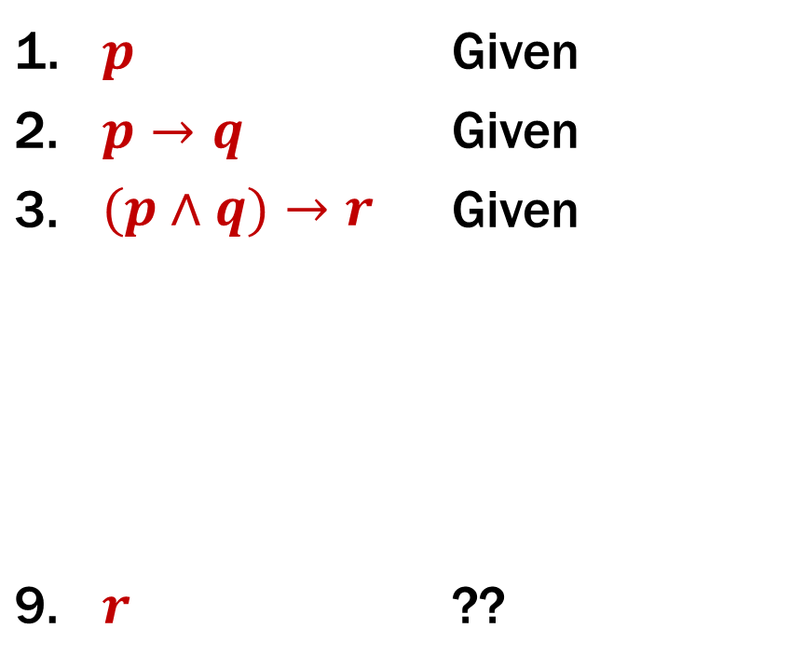
Proofs
Show that r follows from p, p → q and (p ∧ q) → r
A ; A → B
∴ B
1. | $$p$$ | Given
2. | $$p→q$$ | Given
3. | $$(p∧q)→r$$ | Given
9. | $$r$$ | ??
A ∧ B
∴ A, B
A ; B
∴ A ∧ B

Slide 7
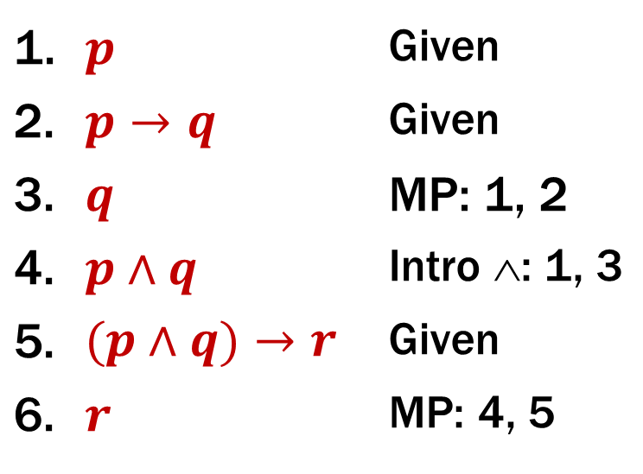

Proofs
Show that $r$ follows from$p, p→q,$ and $(p∧q)→r$
1. | $$p$$ | Given
2. | $$p→q$$ | Given
3. | $$q$$ | MP: 1, 2
4. | $$p∧q$$ | Intro ∧: 1, 3
5. | $$(p∧q)→r$$ | Given
6. | $$r$$ | MP: 4, 5
Two visuals of the same proof.
We will use the top one, but if the bottom one helps you think about it, that’s great!
$$p ; p→q$$
MP
$p$ ;
$$q$$
Intro ∧
$$p∧q ;$$
$$(p∧q)→r$$
MP
$$r$$

Slide 8

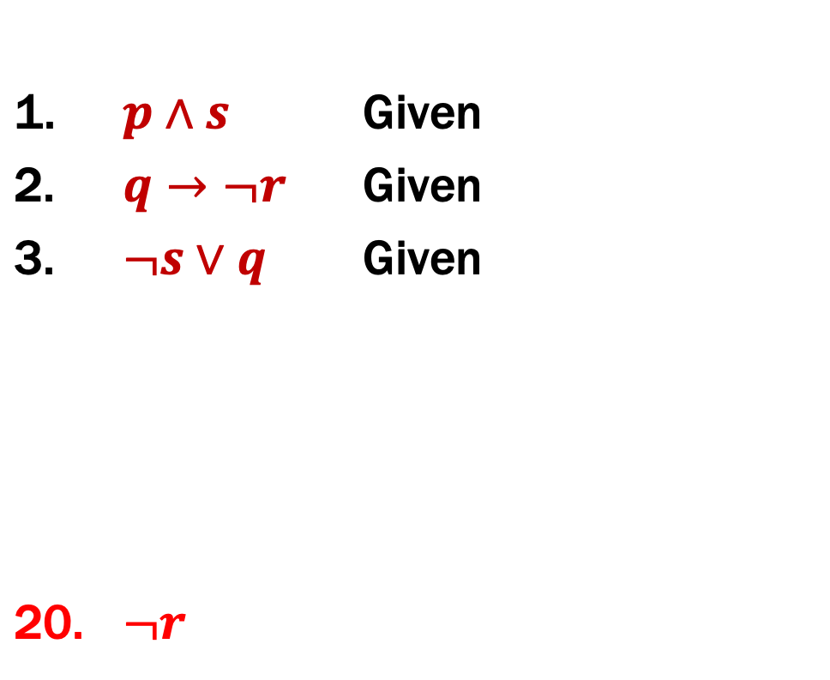
Proofs
Prove that ¬r follows from p ∧ s, q → ¬r, and ¬s ∨ q.
1. | $$p∧s$$ | Given
2. | $$q→¬r$$ | Given
3. | $$¬s∨q$$ | Given
20. | $$¬r$$
First: Write down givens and goal
Idea: Work backwards!

Slide 9

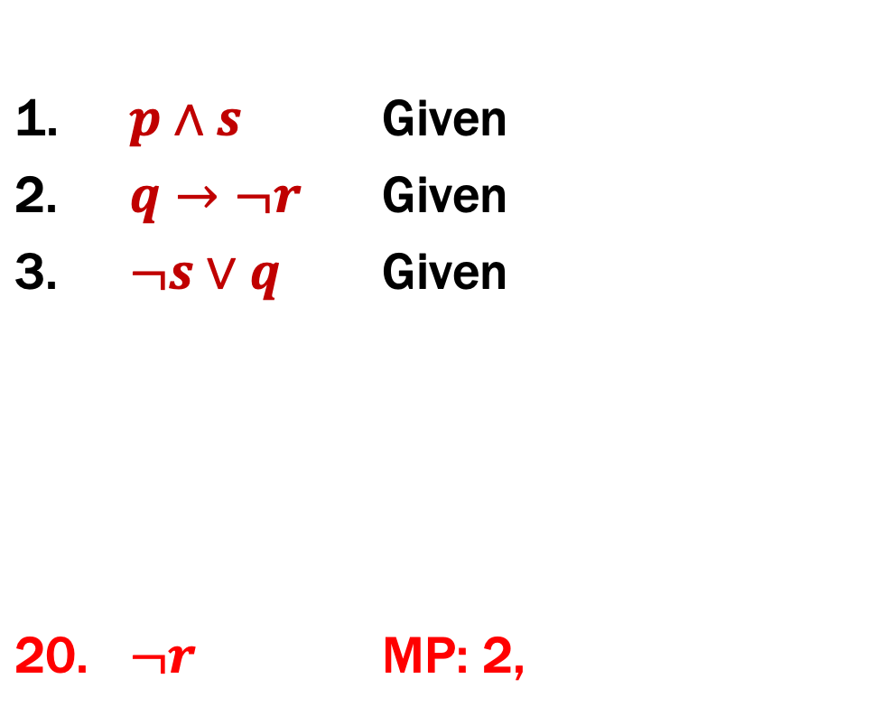
Proofs
Prove that ¬r follows from p ∧ s, q → ¬r, and ¬s ∨ q.
1. | $$p∧s$$ | Given
2. | $$q→¬r$$ | Given
3. | $$¬s∨q$$ | Given
20. | $$¬r$$ | MP: 2,
Idea: Work backwards!
We want to eventually get $➢r$. How?
We can use $q→¬r$ to get there.
The justification between 2 and 20 looks like “elim →” which is MP.

Slide 10
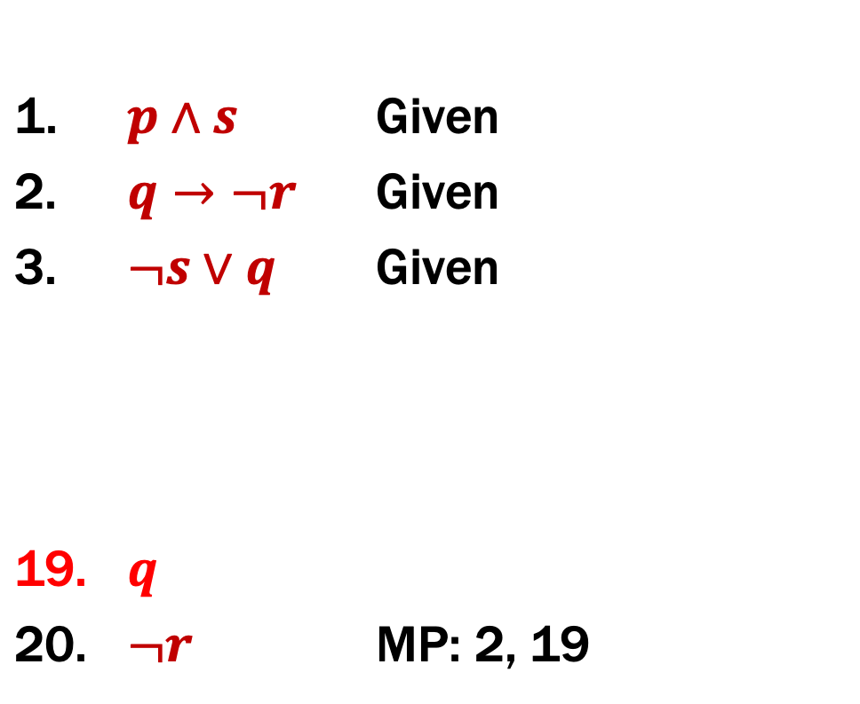
Proofs
Prove that ¬r follows from p ∧ s, q → ¬r, and ¬s ∨ q.
1. | $$p∧s$$ | Given
2. | $$q→¬r$$ | Given
3. | $$¬s∨q$$ | Given
19. | $$q$$
20. | $$¬r$$ | MP: 2, 19
Idea: Work backwards!
We want to eventually get $¬r$. How?
Now, we have a new “hole”
We need to prove $q$…
Notice that at this point, if we prove $q$, we’ve proven $¬r$…

Slide 11
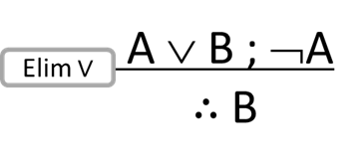
Proofs
Prove that ¬r follows from p ∧ s, q → ¬r, and ¬s ∨ q.
1. | $$p∧s$$ | Given
2. | $$q→¬r$$ | Given
3. | $$¬s∨q$$ | Given
19. | $$q$$
20. | $$¬r$$ | MP: 2, 19
This looks like or-elimination.

Slide 12
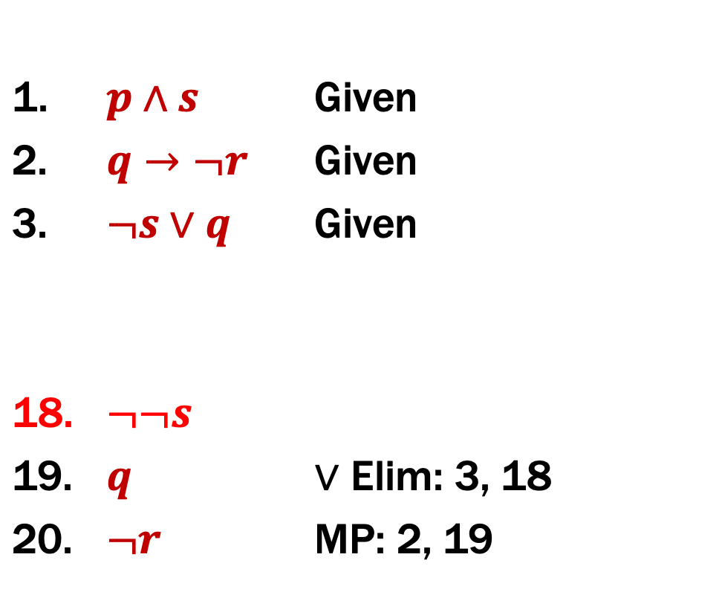
Proofs
Prove that ¬r follows from p ∧ s, q → ¬r, and ¬s ∨ q.
1. | $$p∧s$$ | Given
2. | $$q→¬r$$ | Given
3. | $$¬s∨q$$ | Given
18. | $$¬¬s$$
19. | $$q$$ | $∨$ Elim: 3, 18
20. | $$¬r$$ | MP: 2, 19
$¬¬s$ doesn’t show up in the givens but
$s$does and we can use equivalences

Slide 13
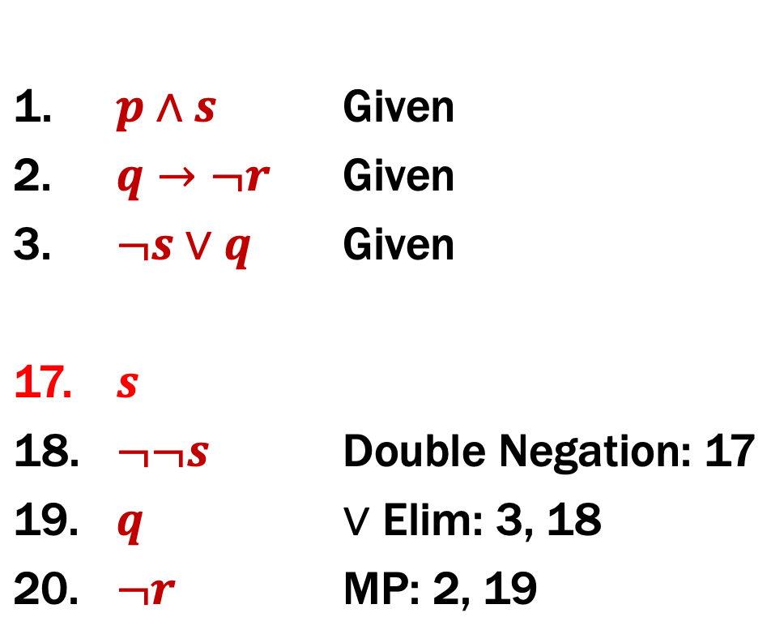
Proofs
Prove that ¬r follows from p ∧ s, q → ¬r, and ¬s ∨ q.
1. | $$p∧s$$ | Given
2. | $$q→¬r$$ | Given
3. | $$¬s∨q$$ | Given
17. | $$s$$
18. | $$¬¬s$$ | Double Negation: 17
19. | $$q$$ | $∨$ Elim: 3, 18
20. | $$¬r$$ | MP: 2, 19

Slide 14
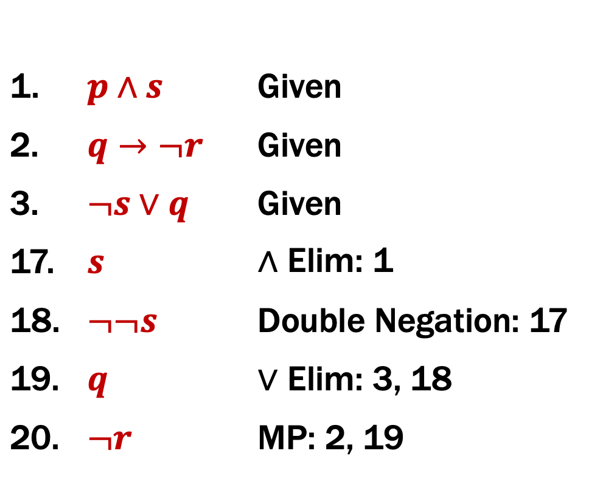
Proofs
Prove that ¬r follows from p ∧ s, q → ¬r, and ¬s ∨ q.
1. | $$p∧s$$ | Given
2. | $$q→¬r$$ | Given
3. | $$¬s∨q$$ | Given
17. | $$s$$ | ∧ Elim: 1
18. | $$¬¬s$$ | Double Negation: 17
19. | $$q$$ | $∨$ Elim: 3, 18
20. | $$¬r$$ | MP: 2, 19
No holes left! We just
need to clean up a bit.

Slide 15
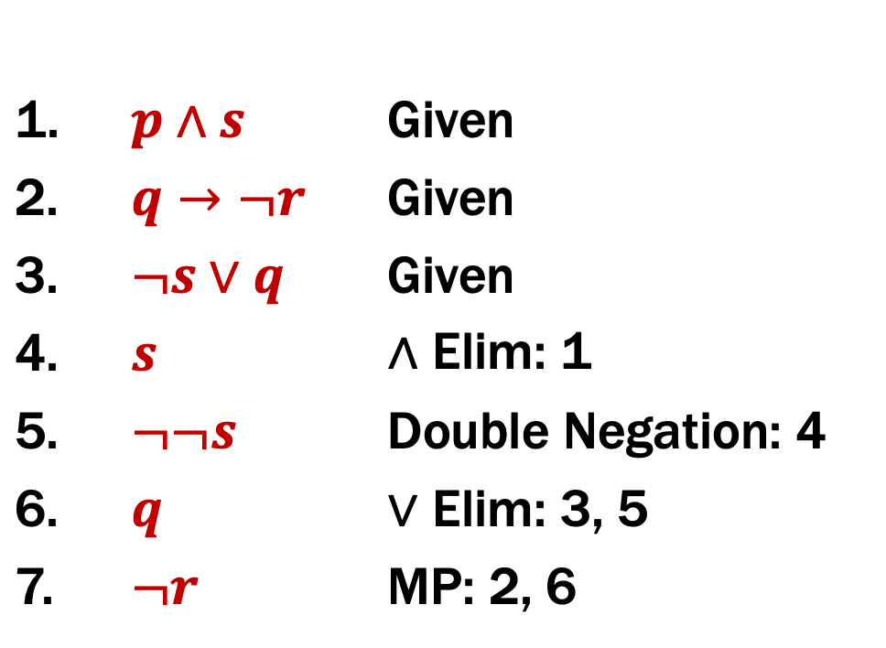
Proofs
Prove that ¬r follows from p ∧ s, q → ¬r, and ¬s ∨ q.
1. | $$p∧s$$ | Given
2. | $$q→¬r$$ | Given
3. | $$¬s∨q$$ | Given
4. | $$s$$ | ∧ Elim: 1
5. | $$¬¬s$$ | Double Negation: 4
6. | $$q$$ | $∨$ Elim: 3, 5
7. | $$¬r$$ | MP: 2, 6

Slide 16
Important: Applications of Inference Rules
You can use equivalences to make substitutions
of any sub-formula.
e.g. $\left(p→ r\right) ∨ q≡\left(¬p ∨ r\right) ∨ q$
Inference rules only can be applied to whole formulas (not correct otherwise).
e.g. 1. $p→r$ given
2. $(p  q)  r$ intro ∨ from 1.
Does not follow! e.g . p=F, q=T, r=F

Slide 17
Last class: Propositional Inference Rules
Two inference rules per binary connective, one to eliminate it and one to introduce it
A ∧ B
∴ A, B
A ; B
∴ A ∧ B
Elim ∧
Intro ∧
A ∨ B ; ¬A
∴ B
A x
∴ A ∨ B, B ∨ A
Elim ∨
Intro ∨
A ; A → B
∴ B
A ⇒ B
∴ A → B
Modus Ponens
Direct Proof
Not like other rules

Slide 18
Last class: New Perspective
Rather than comparing A and B as columns,
zooming in on just the rows where A is true:
Given that A is true, we see that B is also true.
p | q | A | B
T | T | T | T
T | F | T | T
F | T | F
F | F | F
A ⇒ B

Slide 19
Last class: New Perspective
Rather than comparing A and B as columns,
zooming in on just the rows where B is true:
When we zoom out, what have we proven?
p | q | A | B | A → B
T | T | T | T | T
T | F | T | T | T
F | T | F | T | T
F | F | F | F | T
(A → B) ≡ T

Slide 20
To Prove An Implication: $A→B$
A ⇒ B
∴ A → B
We use the direct proof rule
The “pre-requisite” A ⇒ B for the direct proof rule is a proof that “Given A, we can prove B.”
The direct proof rule:
If you have such a proof then you can conclude
that A → B is true

Slide 21

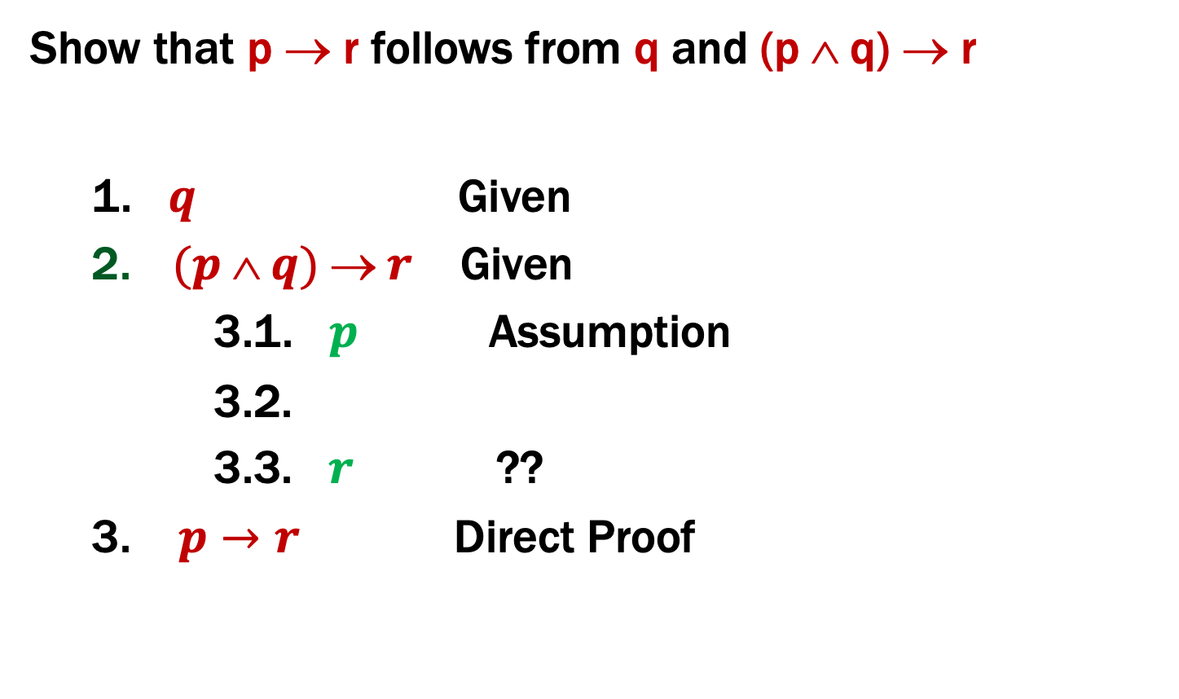
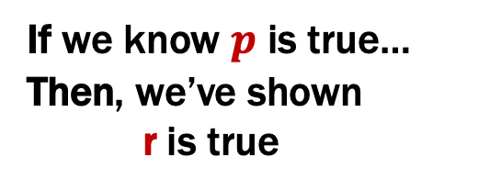
Proofs using the direct proof rule
Show that p → r follows from q and (p ∧ q) → r
1. $q$ Given
$(p  q)  r$ Given
3.1. $p$ Assumption
3.2.
3.3. $r$ ??
3. $p→r$ Direct Proof
This is a
proof
of $p→r$
If we know $p$ is true…
Then, we’ve shown
r is true

Slide 22
Proofs using the direct proof rule
Show that p → r follows from q and (p ∧ q) → r
1. $q$ Given
$(p  q)  r$ Given
3.1. $p$ Assumption
3.2. $p  q$ Intro ∧: 1, 3.1
3.3. $r$ MP: 2, 3.2
3. $p→r$ Direct Proof

Slide 23
Example
Prove: (p ∧ q) → (p ∨ q)
There MUST be an application of the
Direct Proof Rule (or an equivalence)
to prove this implication.
Where do we start? We have no givens…

Slide 24

Example
Prove: (p ∧ q) → (p ∨ q)
1.1. $p  q$ Assumption
1.9. $p  q$ ??
1. $(p∧q)  (p  q)$ Direct Proof

Slide 25
Example
Prove: (p ∧ q) → (p ∨ q)
1.1. $p  q$ Assumption
1.2. $p$ Elim ∧: 1.1
1.3. $p  q$ Intro ∨: 1.2
1. $(p∧q)  (p  q)$ Direct Proof

Slide 26
One General Proof Strategy
Look at the rules for introducing connectives to see how you would build up the formula you want to prove from pieces of what is given
Use the rules for eliminating connectives to break down the given formulas so that you get the pieces you need to do 1.
Write the proof beginning with what you figured out for 2 followed by 1.

Slide 27
Example
Prove: ((p → q) ∧ (q → r)) → (p → r)

Slide 28
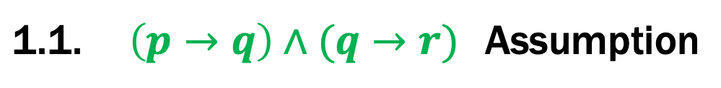

Example
Prove: ((p → q) ∧ (q → r)) → (p → r)
1.1. | $$\left(p→q\right)∧(q→r)$$ | Assumption
1.? | $$p→r$$
1. | $$\left(\left(p→q\right)∧\left(q→r\right)\right)→(p→r)$$ | Direct Proof

Slide 29
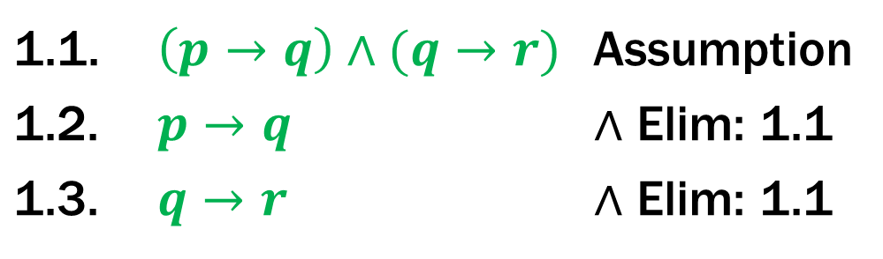
Example
Prove: ((p → q) ∧ (q → r)) → (p → r)
1.1. | $$\left(p→q\right)∧(q→r)$$ | Assumption
1.2. | $$p→q$$ | $∧$ Elim: 1.1
1.3. | $$q→r$$ | $∧$ Elim: 1.1
1.? | $$p→r$$
1. | $$\left(\left(p→q\right)∧\left(q→r\right)\right)→(p→r)$$ | Direct Proof

Slide 30
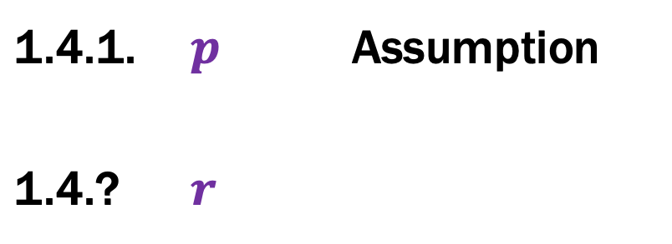
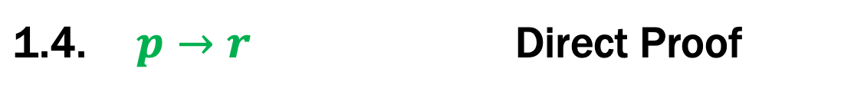
Example
Prove: ((p → q) ∧ (q → r)) → (p → r)
1.1. | $$\left(p→q\right)∧(q→r)$$ | Assumption
1.2. | $$p→q$$ | $∧$ Elim: 1.1
1.3. | $$q→r$$ | $∧$ Elim: 1.1
1.4.1. | $$p$$ | Assumption
1.4.? | $$r$$
1.4. | $$p→r$$ | Direct Proof
1. | $$\left(\left(p→q\right)∧\left(q→r\right)\right)→(p→r)$$ | Direct Proof

Slide 31
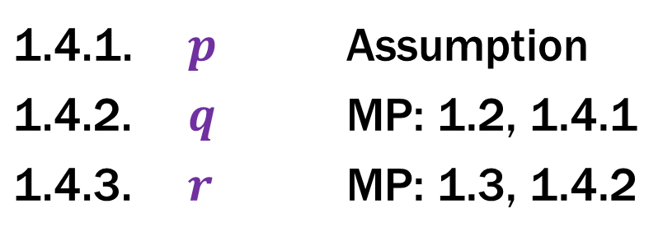
Example
Prove: ((p → q) ∧ (q → r)) → (p → r)
1.1. | $$\left(p→q\right)∧(q→r)$$ | Assumption
1.2. | $$p→q$$ | $∧$ Elim: 1.1
1.3. | $$q→r$$ | $∧$ Elim: 1.1
1.4.1. | $$p$$ | Assumption
1.4.2. | $$q$$ | MP: 1.2, 1.4.1
1.4.3. | $$r$$ | MP: 1.3, 1.4.2
1.4. | $$p→r$$ | Direct Proof
1. | $$\left(\left(p→q\right)∧\left(q→r\right)\right)→(p→r)$$ | Direct Proof

Slide 32
Inference Rules for Quantifiers: First look
P(c) for some c
∴ ∃x P(x)
∀x P(x)
∴ P(a) (for any a)
Intro ∃
Elim ∀
∃x P(x)
∴ P(c) for some special** c
Elim ∃
Intro ∀
** By special, we mean that c is a name for a value where P(c) is true. We can’t use anything else about that value, so c has to be a NEW name!
Notes:
We can write “Let a be an object” and then apply Elim For All

Slide 33
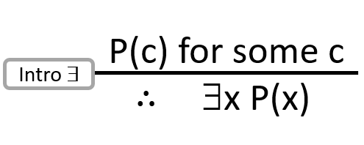
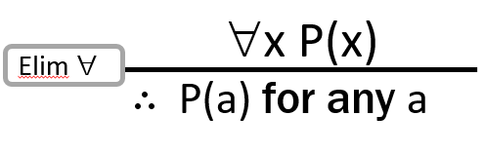

My First Predicate Logic Proof
Domain of Discourse
Integers
Prove ∀x P(x) → ∃x P(x)
5. $x P\left(x\right)→ ∃x P\left(x\right)$
The main connective is implication
so Direct Proof seems good

Slide 34
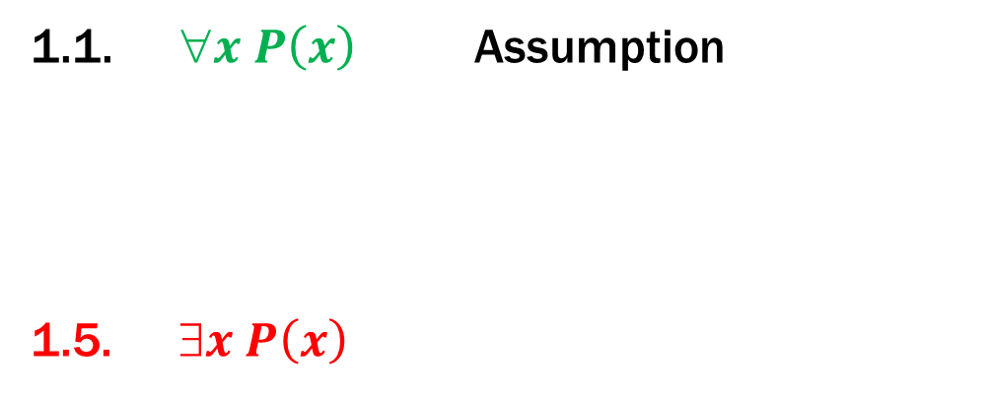
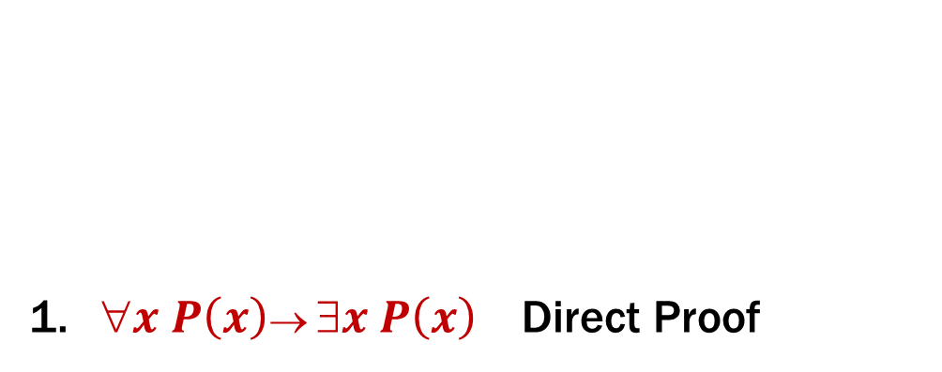
My First Predicate Logic Proof
Domain of Discourse
Integers
Prove ∀x P(x)) → ∃x P(x)
1.1. $x P\left(x\right)$ Assumption
1.5. $x P\left(x\right)$
1. $x P\left(x\right)→ ∃x P\left(x\right)$ Direct Proof
We need an ∃ we don’t have
so “intro ∃” rule makes sense

Slide 35
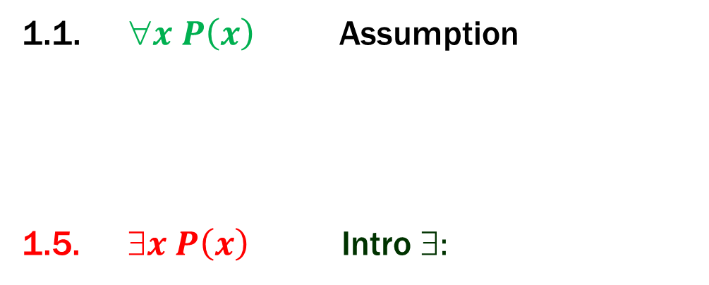

My First Predicate Logic Proof
Domain of Discourse
Integers
Prove ∀x P(x) → ∃x P(x)
1.1. $x P\left(x\right)$ Assumption
1.5. $x P\left(x\right)$ Intro ∃:
1. $x P\left(x\right)→ ∃x P\left(x\right)$ Direct Proof
We need an ∃ we don’t have
so “intro ∃” rule makes sense
That requires P(c)
for some c.

Slide 36
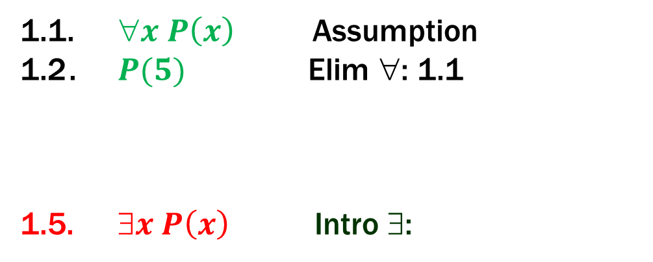

My First Predicate Logic Proof
Domain of Discourse
Integers
Prove ∀x P(x) → ∃x P(x)
1.1. $x P\left(x\right)$ Assumption
1.2 . $P(5)$ Elim ∀: 1.1
1.5. $x P\left(x\right)$ Intro ∃:
1. $x P\left(x\right)→ ∃x P\left(x\right)$ Direct Proof
We need an ∃ we don’t have
so “intro ∃” rule makes sense
That requires P(c)
for some c.

Slide 37

My First Predicate Logic Proof
Domain of Discourse
Integers
Prove ∀x P(x) → ∃x P(x)
1.1. $x P\left(x\right)$ Assumption
1.2 . $P(5)$ Elim ∀: 1.1
1.5. $x P\left(x\right)$ Intro ∃: 1.2
1. $x P\left(x\right)→ ∃x P\left(x\right)$ Direct Proof

Slide 38
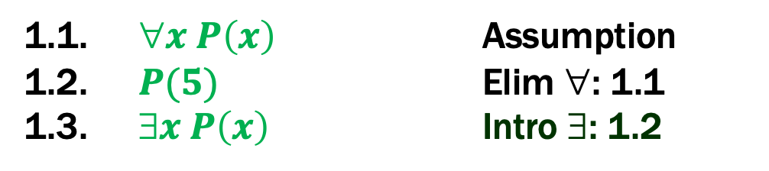
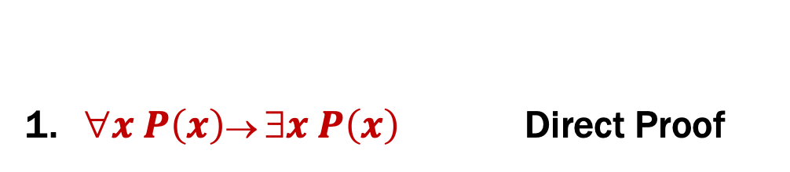
My First Predicate Logic Proof
Prove ∀x P(x) → ∃x P(x)
1.1. $x P\left(x\right)$ Assumption
1.2. $P(5)$ Elim ∀: 1.1
1.3. $x P\left(x\right)$ Intro ∃: 1.2
1. $x P\left(x\right)→ ∃x P\left(x\right)$ Direct Proof
Working forwards as well as backwards:
In applying “Intro ∃” rule we didn’t know what expression
we might be able to prove P(c) for, so we worked forwards
to figure out what might work.

Slide 39
Predicate Logic Proofs
Can use
Predicate logic inference rules
whole formulas only
Predicate logic equivalences (De Morgan’s)
even on subformulas
Propositional logic inference rules
whole formulas only
Propositional logic equivalences
even on subformulas

Slide 40
Predicate Logic Proofs with more content
In propositional logic we could just write down other propositional logic statements as “givens”
Here, we also want to be able to use domain knowledge so proofs are about something specific
Example:
Given the basic properties of arithmetic on integers, define:
Domain of Discourse
Integers
Predicate Definitions
Even(x) := ∃y (x = 2⋅y)
Odd(x) := ∃y (x = 2⋅y + 1)

Slide 41
A Not so Odd Example
Domain of Discourse
Predicate Definitions
Integers
Even(x) := ∃y (x = 2⋅y)
Odd(x) := ∃y (x = 2⋅y + 1)
Prove “There is an even number”
Formally: prove ∃x Even(x)

Slide 42
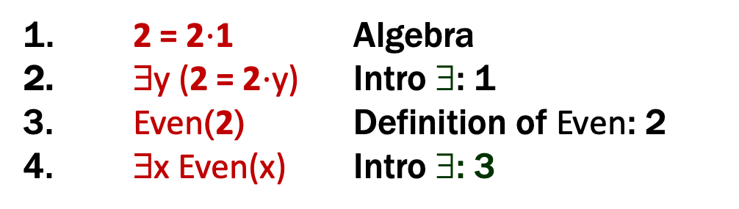
A Not so Odd Example
Domain of Discourse
Predicate Definitions
Integers
Even(x) := ∃y (x = 2⋅y)
Odd(x) := ∃y (x = 2⋅y + 1)
Prove “There is an even number”
Formally: prove ∃x Even(x)
1. 2 = 2⋅1 Algebra
∃y (2 = 2⋅y) Intro ∃: 1
Even(2) Definition of Even: 2
4. $\text{}\text{x} \text{E}\text{ven}\text{(}\text{x}\text{)}$ Intro ∃: 3

Slide 43
A Prime Example
Domain of Discourse
Predicate Definitions
Integers
Even(x) := ∃y (x = 2⋅y)
Odd(x) := ∃y (x = 2⋅y + 1)
Prime(x) := “x > 1 and x≠a⋅b for all integers a, b with 1<a<x”
Prove “There is an even prime number”
Formally: prove ∃x (Even(x) ∧ Prime(x))

Slide 44
A Prime Example
Domain of Discourse
Predicate Definitions
Integers
Even(x) := ∃y (x = 2⋅y)
Odd(x) := ∃y (x = 2⋅y + 1)
Prime(x) := “x > 1 and x≠a⋅b for all integers a, b with 1<a<x”
Prove “There is an even prime number”
Formally: prove ∃x (Even(x) ∧ Prime(x))
1. 2 = 2⋅1 Algebra
∃y (2 = 2⋅y) Intro ∃: 1
Even(2) Def of Even: 3
Prime(2) Property of integers
Even(2) ∧ Prime(2) Intro ∧: 2, 4
6. ∃x (Even(x) ∧ Prime(x)) Intro ∃: 5
*
* Later we will further break down “Prime” using quantifiers to prove statements like this

Slide 45
Inference Rules for Quantifiers: First look
P(c) for some c
∴ ∃x P(x)
∀x P(x)
∴ P(a) (for any a)
Intro ∃
Elim ∀
∃x P(x)
∴ P(c) for some special** c
“Let a be arbitrary*”...P(a)
∴ ∀x P(x)
Elim ∃
Intro ∀
* in the domain of P
** By special, we mean that c is a name for a value where P(c) is true. We can’t use anything else about that value, so c has to be a NEW name!
Notes:
We can write “Let a be an object” and then apply Elim For All

Slide 46
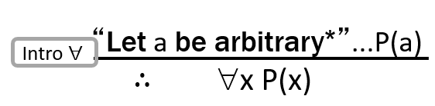
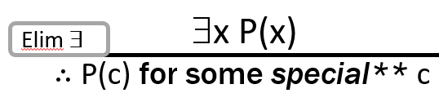
Even and Odd
Even(x) := ∃y (x=2y)
Odd(x) := ∃y (x=2y+1)
Domain: Integers
Prove: “The square of any even number is even.”
Formal proof of: ∀x (Even(x) → Even(x²))
3. ∀x (Even(x)→Even(x²))

Slide 47
Even and Odd
Even(x) := ∃y (x=2y)
Odd(x) := ∃y (x=2y+1)
Domain: Integers
Prove: “The square of any even number is even.”
Formal proof of: ∀x (Even(x) → Even(x²))
Let a be an arbitrary integer
2. Even(a)→Even(a²)
3. ∀x (Even(x)→Even(x²)) Intro ∀: 1,2

Slide 48
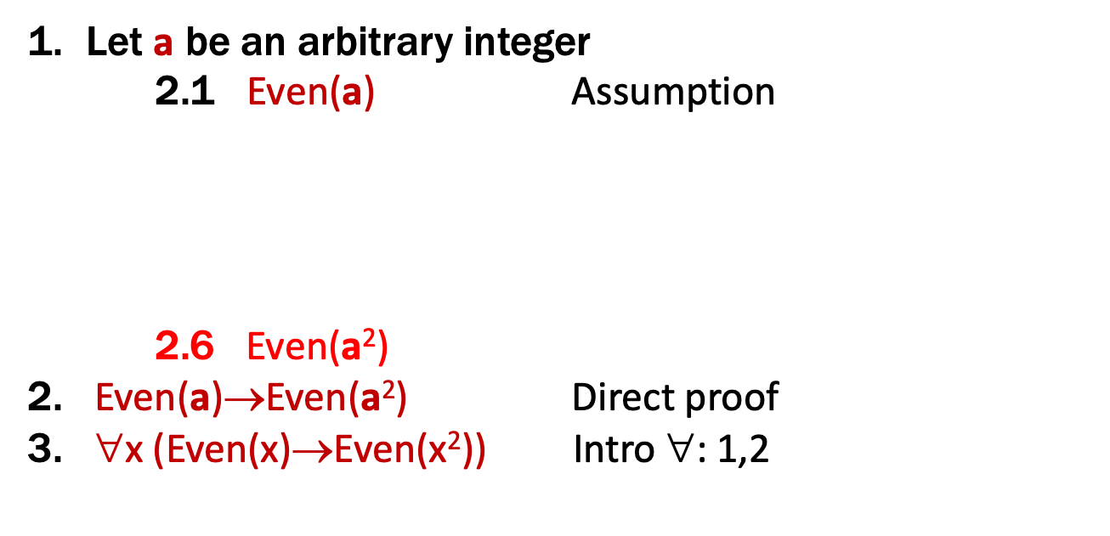
Even and Odd
Even(x) := ∃y (x=2y)
Odd(x) := ∃y (x=2y+1)
Domain: Integers
Prove: “The square of any even number is even.”
Formal proof of: ∀x (Even(x) → Even(x²))
Let a be an arbitrary integer
2.1 Even(a) Assumption
2.6 Even(a²)
2. Even(a)→Even(a²) Direct proof
3. ∀x (Even(x)→Even(x²)) Intro ∀: 1,2

Slide 49
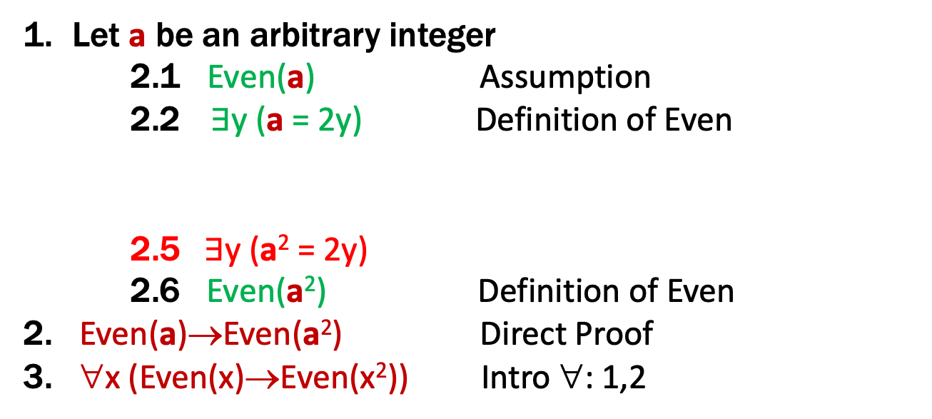
Even and Odd
Even(x) := ∃y (x=2y)
Odd(x) := ∃y (x=2y+1)
Domain: Integers
Prove: “The square of any even number is even.”
Formal proof of: ∀x (Even(x) → Even(x²))
Let a be an arbitrary integer
2.1 Even(a) Assumption
2.2 $∃$y (a = 2y) Definition of Even
2.5$∃$y (a² = 2y)
2.6 Even(a²) Definition of Even
2. Even(a)→Even(a²) Direct Proof
3. ∀x (Even(x)→Even(x²)) Intro ∀: 1,2

Slide 50
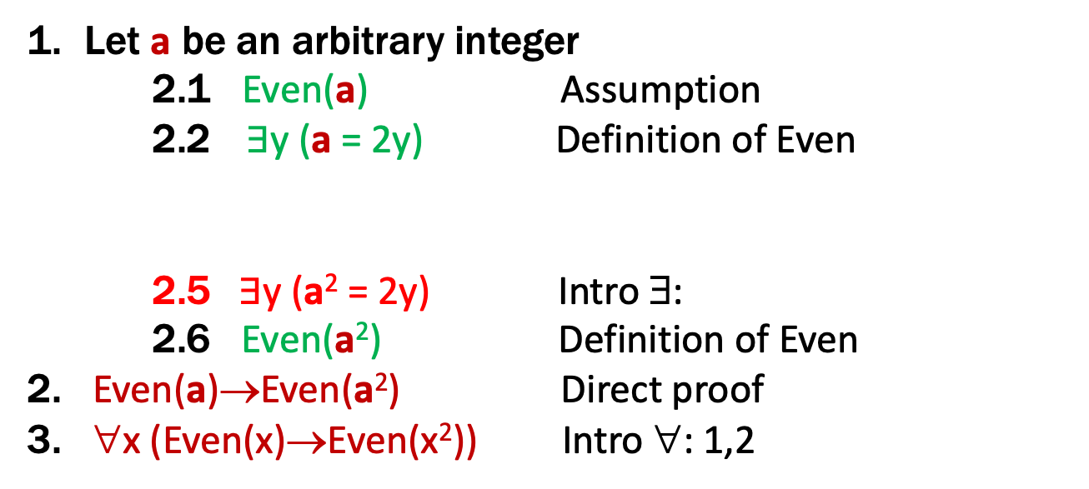
Even and Odd
Even(x) := ∃y (x=2y)
Odd(x) := ∃y (x=2y+1)
Domain: Integers
Prove: “The square of any even number is even.”
Formal proof of: ∀x (Even(x) → Even(x²))
Let a be an arbitrary integer
2.1 Even(a) Assumption
2.2 $∃$y (a = 2y) Definition of Even
2.5$∃$y (a² = 2y) Intro ∃:
2.6 Even(a²) Definition of Even
2. Even(a)→Even(a²) Direct proof
3. ∀x (Even(x)→Even(x²)) Intro ∀: 1,2
Need a² = 2c
for some c

Slide 51
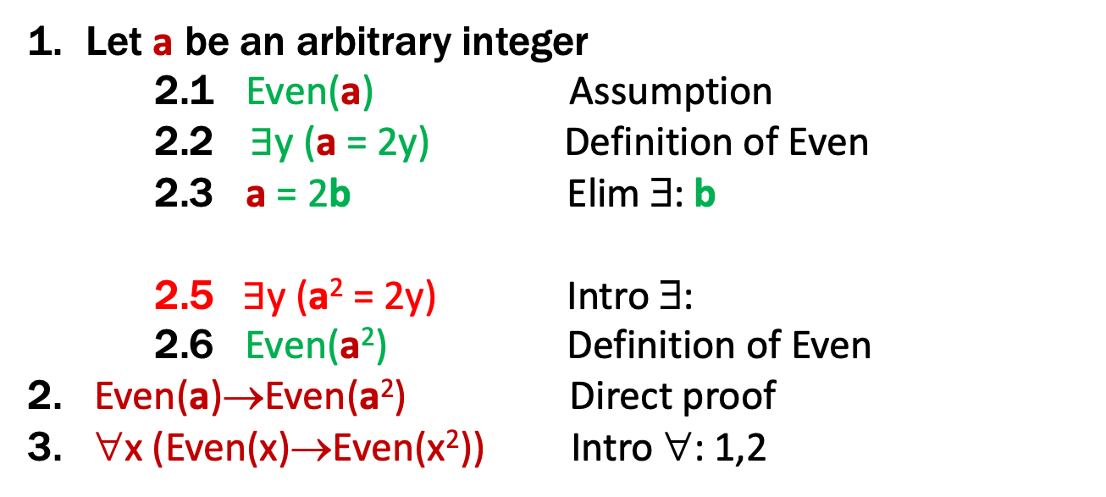
Even and Odd
Even(x) := ∃y (x=2y)
Odd(x) := ∃y (x=2y+1)
Domain: Integers
Prove: “The square of any even number is even.”
Formal proof of: ∀x (Even(x) → Even(x²))
Let a be an arbitrary integer
2.1 Even(a) Assumption
2.2 $∃$y (a = 2y) Definition of Even
2.3 a = 2b Elim ∃: b
2.5$∃$y (a² = 2y) Intro ∃:
2.6 Even(a²) Definition of Even
2. Even(a)→Even(a²) Direct proof
3. ∀x (Even(x)→Even(x²)) Intro ∀: 1,2
Need a² = 2c
for some c

Slide 52
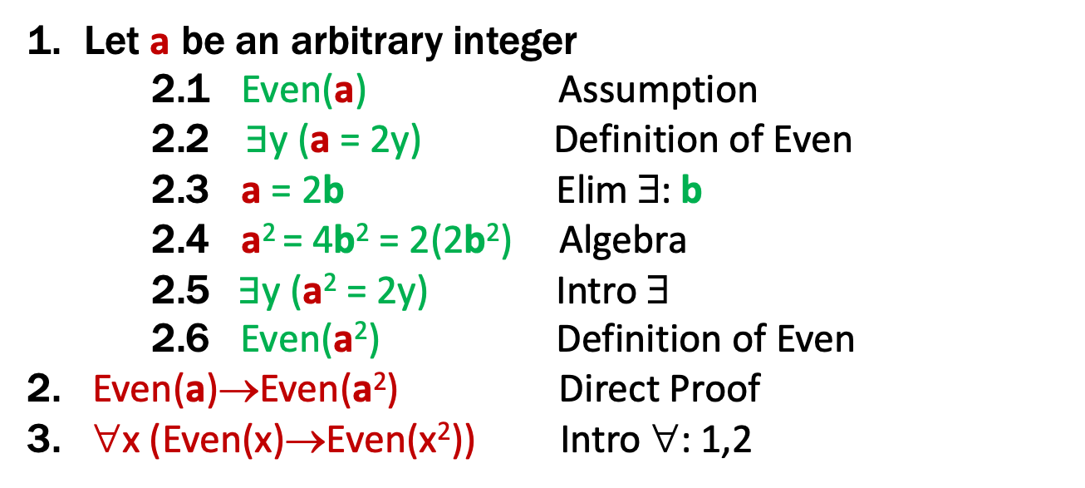
Even and Odd
Even(x) := ∃y (x=2y)
Odd(x) := ∃y (x=2y+1)
Domain: Integers
Prove: “The square of any even number is even.”
Formal proof of: ∀x (Even(x) → Even(x²))
Let a be an arbitrary integer
2.1 Even(a) Assumption
2.2 $∃$y (a = 2y) Definition of Even
2.3 a = 2b Elim ∃: b
2.4 a² = 4b² = 2(2b²) Algebra
2.5$∃$y (a² = 2y) Intro ∃
2.6 Even(a²) Definition of Even
2. Even(a)→Even(a²) Direct Proof
3. ∀x (Even(x)→Even(x²)) Intro ∀: 1,2
Used a² = 2c for c=2b²

Slide 53
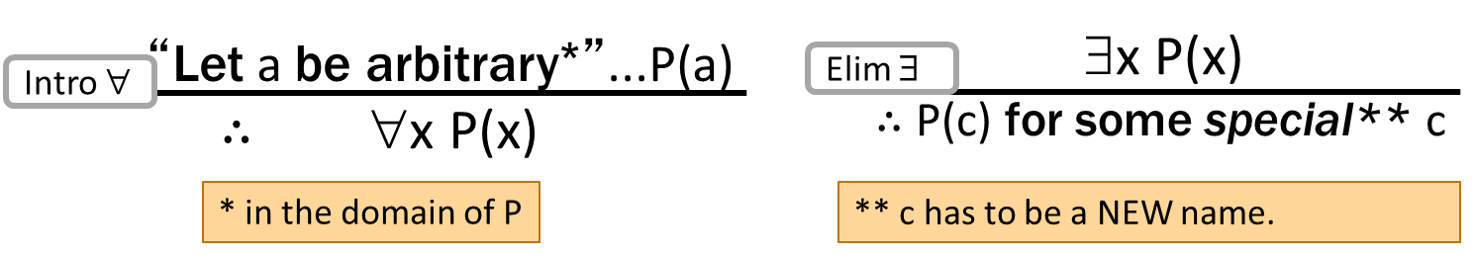
These rules need more caveats…
There are extra conditions on using these rules:
Over integer domain: ∀x ∃y (y ≥ x) is True but ∃y∀x (y ≥ x) is False
BAD “PROOF”
∀x ∃y (y ≥ x) Given
Let a be an arbitrary integer
∃y (y ≥ a) Elim ∀: 1
b ≥ a Elim ∃: b
∀x (b ≥ x) Intro ∀: 2,4
∃y∀x (y ≥ x) Intro ∃ : 5

Slide 54
These rules need more caveats…
There are extra conditions on using these rules:
Over integer domain: ∀x ∃y (y ≥ x) is True but ∃y∀x (y ≥ x) is False
BAD “PROOF”
∀x ∃y (y ≥ x) Given
Let a be an arbitrary integer
∃y (y ≥ a) Elim ∀: 1
b ≥ a Elim ∃: b
∀x (b ≥ x) Intro ∀: 2,4
∃y∀x (y ≥ x) Intro ∃ : 5
Can’t get rid of a since another name in the same line, b, depends on it!

Slide 55
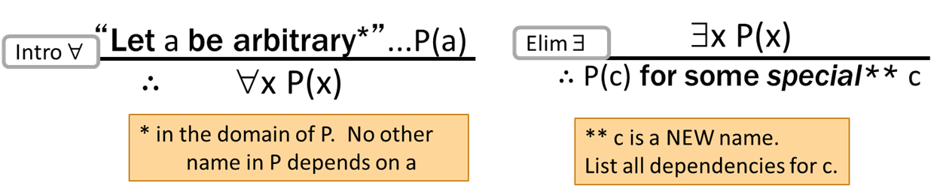
These rules need more caveats…
There are extra conditions on using these rules:
Over integer domain: ∀x ∃y (y ≥ x) is True but ∃y∀x (y ≥ x) is False
BAD “PROOF”
∀x ∃y (y ≥ x) Given
Let a be an arbitrary integer
∃y (y ≥ a) Elim ∀: 1
b ≥ a Elim ∃: b special depends on a
∀x (b ≥ x) Intro ∀: 2,4
∃y∀x (y ≥ x) Intro ∃ : 5
Can’t get rid of a since another name in the same line, b, depends on it!

Slide 56
Inference Rules for Quantifiers: Full version
P(c) for some c
∴ ∃x P(x)
∀x P(x)
∴ P(a) for any a
Intro ∃
Elim ∀
∃x P(x)
∴ P(c) for some special** c
“Let a be arbitrary*”...P(a)
∴ ∀x P(x)
Elim ∃
Intro ∀
** c is a NEW name.
List all dependencies for c.
* in the domain of P. No other name in P depends on a

Slide 57
English Proofs
We often write proofs in English rather than as fully formal proofs
They are more natural to read
English proofs follow the structure of the corresponding formal proofs
Formal proof methods help to understand how proofs really work in English...
... and give clues for how to produce them.

