Slide 1
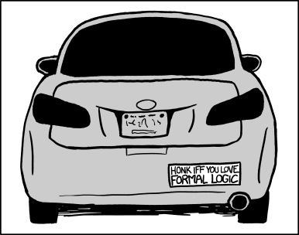
CSE 311: Foundations of Computing I
Lecture 1: Propositional Logic

Slide 2
What is logic and why do we need it?
Logic is a language, like English or Java, with its own
words and rules for combining words into sentences (syntax)
ways to assign meaning to words and sentences (semantics)
Why learn another language?
We know English and Java already?

Slide 3
Why not use English?
Turn right here…
We saw her duck
Buffalo buffalo Buffalo buffalo buffalo buffalo Buffalo buffalo
Natural languages can be unclear or imprecise

Slide 4
Why not use English?
Turn right here…
We saw her duck
Buffalo buffalo Buffalo buffalo buffalo buffalo Buffalo buffalo
Natural languages can be unclear or imprecise
Does “right” mean the direction or now?
Does “duck” mean the animal or crouch down?
This means “Bison from Buffalo, that bison from Buffalo bully, themselves bully bison from Buffalo.

Slide 5
Why learn a new language?
We need a language of reasoning to
state sentences more precisely
state sentences more concisely
understand sentences more quickly
Formal logic has these properties

Slide 6
Propositions: building blocks of logic
A proposition is a statement that
is either true or false
is “well-formed”

Slide 7
Propositions: building blocks of logic
A proposition is a statement that
is either true or false
is “well-formed”
All cats are mammals
true
All mammals are cats
false

Slide 8
Are These Propositions?
2 + 2 = 5
x + 2 = 5389, where x is my PIN number
Akjsdf!
Who are you?
Every positive even integer can be written as the sum of two primes.

Slide 9
Are These Propositions?
2 + 2 = 5
x + 2 = 5389, where x is my PIN number
Akjsdf!
Who are you?
Every positive even integer can be written as the sum of two primes.
This is a proposition. It’s okay for propositions to be false.
This is a proposition. We don’t need to know what x is.
Not a proposition because it’s gibberish.
This is a question which means it doesn’t have a truth value.
This is a proposition. We don’t know if it’s true or false, but we know it’s one of them!

Slide 10
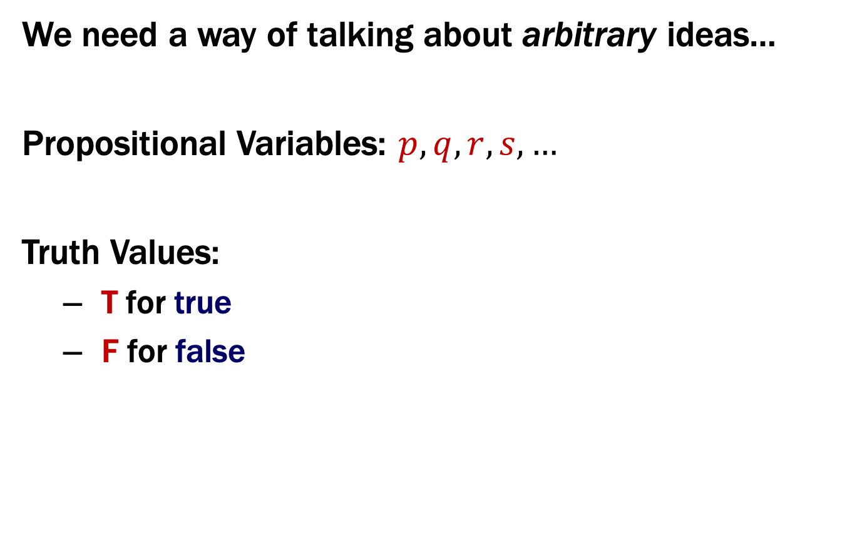
Propositions
We need a way of talking about arbitrary ideas…
Propositional Variables: $p, q, r, s,…$
Truth Values:
T for true
F for false

Slide 11
Familiar from Java
Java boolean represents a truth value
constants true and false
variables hold unknown values
Operators that calculate new truth values from given ones
unary: not (!)
binary: and (&&), or (||)

Slide 12
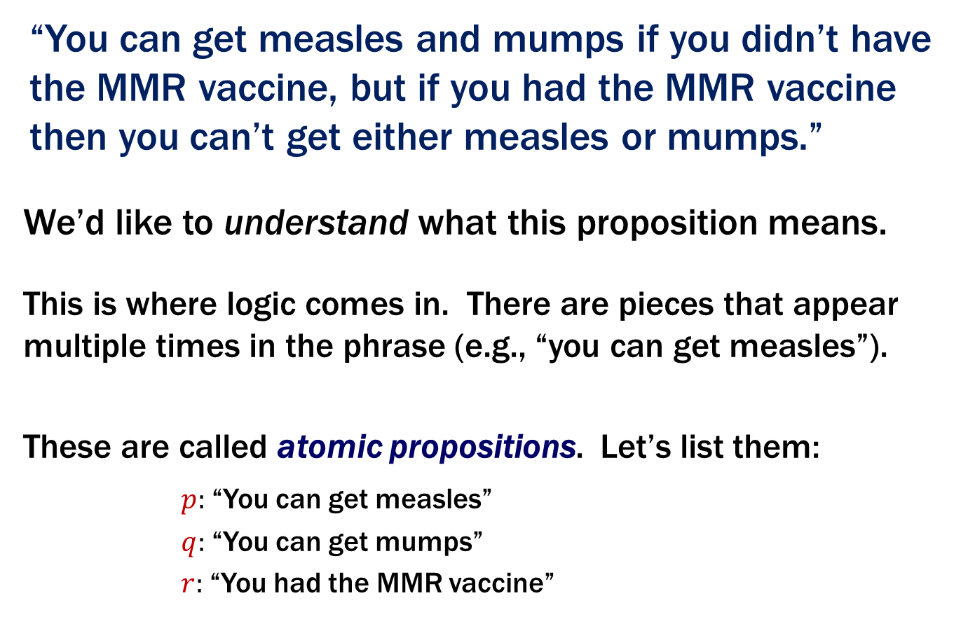
A Proposition
“You can get measles and mumps if you didn’t have the MMR vaccine, but if you had the MMR vaccine then you can’t get either measles or mumps.”
We’d like to understand what this proposition means.
This is where logic comes in. There are pieces that appear multiple times in the phrase (e.g., “you can get measles”).
These are called atomic propositions. Let’s list them:
$p:$“You can get measles”
$q:$“You can get mumps”
$r:$“You had the MMR vaccine”

Slide 13
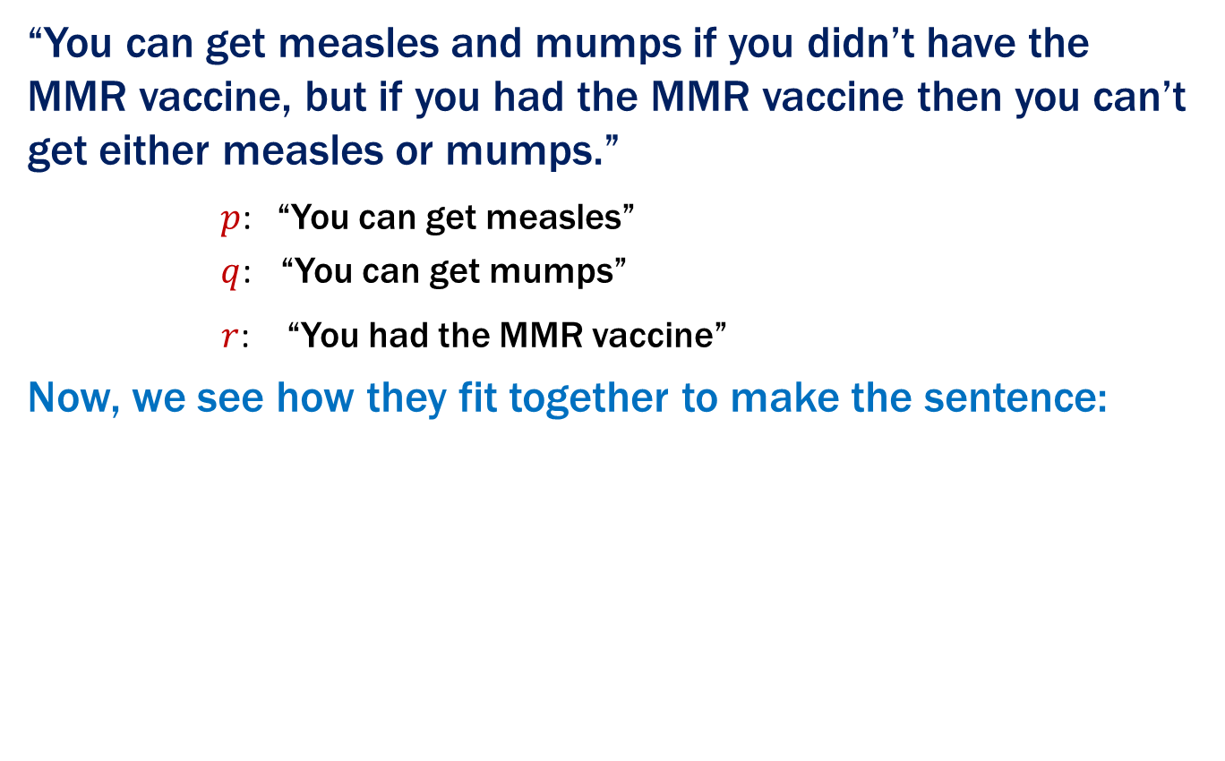
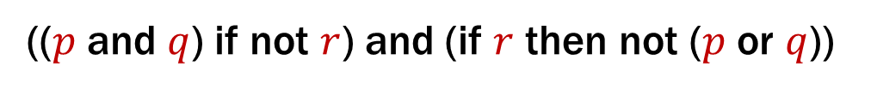
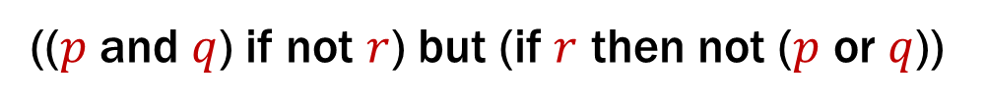
Vaccine Sentence is a Compound Proposition
“You can get measles and mumps if you didn’t have the MMR vaccine, but if you had the MMR vaccine then you can’t get either measles or mumps.”
$p$: “You can get measles”
$q$: “You can get mumps”
$r$: “You had the MMR vaccine”
Now, we see how they fit together to make the sentence:
(($p$ and $q$) if not $r$) but (if $r$ then not ($p$ or $q$))
“but” is just an unexpected “and”
(($p$ and $q$) if not $r$) and (if $r$ then not ($p$ or $q$))
To fully translate to formal language we need connectives

Slide 14
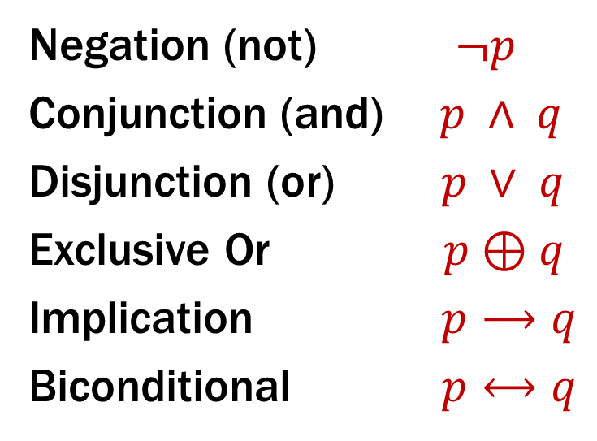
Logical Connectives
Negation (not) $¬p$
Conjunction (and) $p ∧ q$
Disjunction (or) $p ∨ q$
Exclusive Or $p⊕q$
Implication $p⟶q$
Biconditional $p⟷q$
These build new propositions from simpler ones
The truth values for these new propositions are given by truth tables.

Slide 15
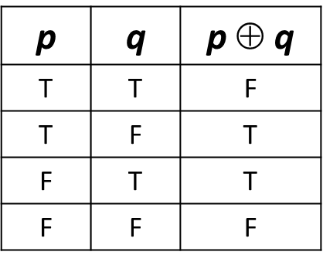

Some Truth Tables
p | ¬p
T | F
F | T
p | q | p ∧ q
T | T | T
T | F | F
F | T | F
F | F | F
p | q | p ∨ q
T | T | T
T | F | T
F | T | T
F | F | F
p | q | p $$ q
T | T | F
T | F | T
F | T | T
F | F | F
Logic forces us to distinguish $$ from $$

Slide 16
Implication
“If it’s raining, then I have my umbrella”
It’s useful to think of implications as promises. That is “Did I lie?”
p | q | p → q
T | T | T
T | F | F
F | T | T
F | F | T
 | It’s raining | It’s not raining
I have my umbrella
I do not have my umbrella

Slide 17
Implication
“If it’s raining, then I have my umbrella”
It’s useful to think of implications as promises. That is “Did I lie?”
The only lie is when:
(a) It’s raining AND
(b) I don’t have my umbrella
p | q | p → q
T | T | T
T | F | F
F | T | T
F | F | T
 | It’s raining | It’s not raining
I have my umbrella | No | No
I do not have my umbrella | Yes | No

Slide 18
Implication
“If the Seahawks won, then I was at the game.”
What’s the one scenario where I lied?
p | q | p → q
T | T | T
T | F | F
F | T | T
F | F | T
 | I was at the game | I wasn’t at the game
Seahawks won
Seahawks lost

Slide 19
Implication
“If the Seahawks won, then I was at the game.”
What’s the one scenario where I lied?
p | q | p → q
T | T | T
T | F | F
F | T | T
F | F | T
 | I was at the game | I wasn’t at the game
Seahawks won | Ok | I lied
Seahawks lost | Ok | Ok

Slide 20
Implication
“If it’s raining, then I have my umbrella”
Are these true?
2 + 2 = 4 → earth is a planet
2 + 2 = 5 → 26 is prime
Implication is not a causal relationship!
p | q | p → q
T | T | T
T | F | F
F | T | T
F | F | T

Slide 21
Implication
“If it’s raining, then I have my umbrella”
Are these true?
2 + 2 = 4 → earth is a planet
2 + 2 = 5 → 26 is prime
Implication is not a causal relationship!
p | q | p → q
T | T | T
T | F | F
F | T | T
F | F | T
The fact that these are unrelated doesn’t make the statement false! “2 + 2 = 4” is true; “earth is a planet” is true. T→ T is true. So, the statement is true.
Again, these statements may or may not be related. “2 + 2 = 5” is false; so, the implication is true. (Whether 26 is prime or not is irrelevant).

Slide 22
$$p→q$$
(1) “I have a billion dollars if I am a billionaire”
(2) “I have a billion dollars only if I am a billionaire”
These sentences are implications in opposite directions:
“Billionaires must have a billion dollars”
“People who have a billion dollars are billionaires”
So, the implications are:
If I am a billionaire, then I have a billion dollars.
If I have a billion dollars, then I am a billionaire.

Slide 23
$$p → q$$
p | q | p → q
T | T | T
T | F | F
F | T | T
F | F | T
Implication:
p implies q
whenever p is true q must be true
if p then q
q if p
p is sufficient for q
p only if q
q is necessary for p

Slide 24

Biconditional: $p ↔ q$
p if and only if q (p iff q)
p is true exactly when q is true
p implies q and q implies p
p is necessary and sufficient for q
p | q | p ↔ q
T | T | T
T | F | F
F | T | F
F | F | T

Slide 25
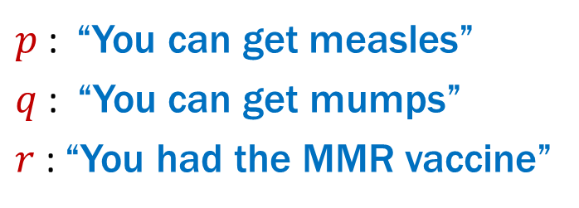
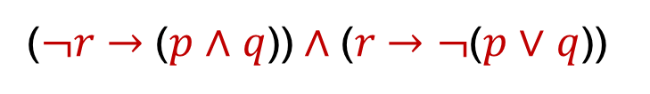
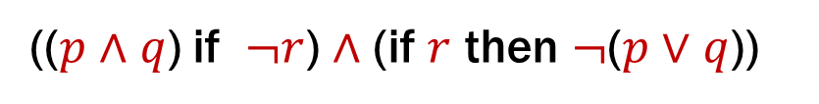
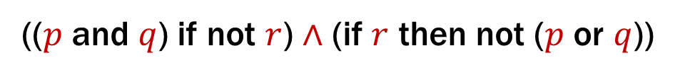
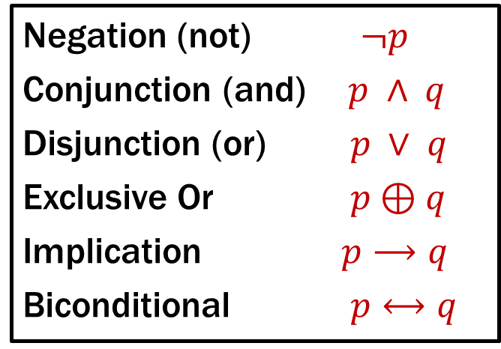
Back to the Vaccine Sentence…
Negation (not) $¬p$
Conjunction (and) $p ∧ q$
Disjunction (or) $p ∨ q$
Exclusive Or $p⊕q$
Implication $p⟶q$
Biconditional $p⟷q$
$p$: “You can get measles”
$q$: “You can get mumps”
$r$: “You had the MMR vaccine”
“You can get measles and mumps if you didn’t have the MMR vaccine, but if you had the MMR vaccine then you can’t get either measles or mumps.”
(($p$ and $q$) if not $r$) $∧$ (if $r$ then not ($p$ or $q$))
(($p$ $∧$ $q$) if $¬r$) $∧$ (if $r$ then $¬$($p$ $∨$ $q$))
($¬r$ $→$ ($p$ $∧$ $q$)) $∧$ ($r$ $→¬$($p$ $∨$ $q$))

Slide 26

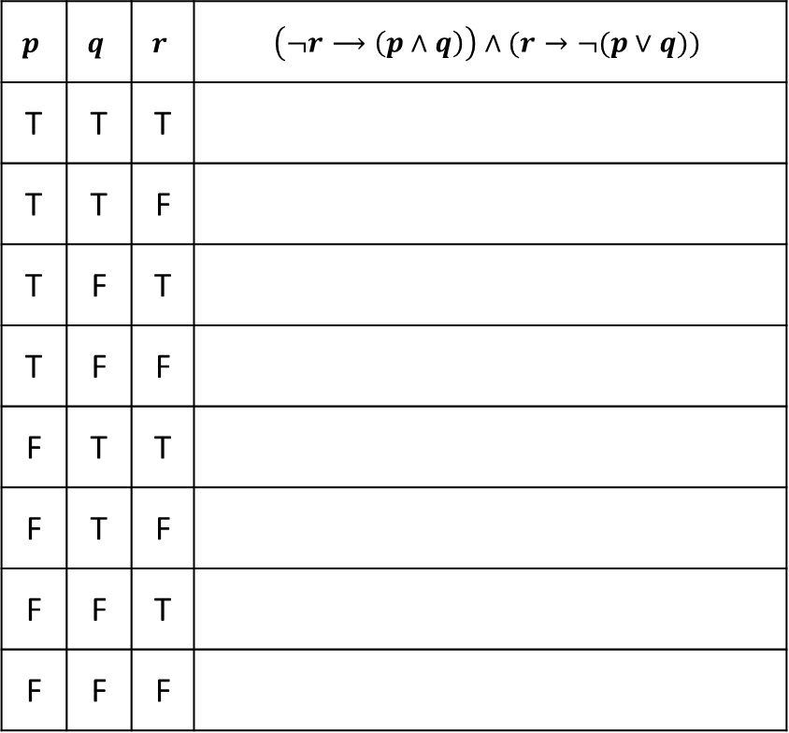
Analyzing the Vaccine Sentence with a Truth Table
($¬r$ $→$ ($p$ $∧$ $q$)) $∧$ ($r$ $→¬$($p$ $∨$ $q$))
$$p$$ | $$q$$ | $$r$$ | $$\left(¬r⟶\left(p∧q\right)\right)∧(r→¬(p∨q))$$
T | T | T
T | T | F
T | F | T
T | F | F
F | T | T
F | T | F
F | F | T
F | F | F

Slide 27
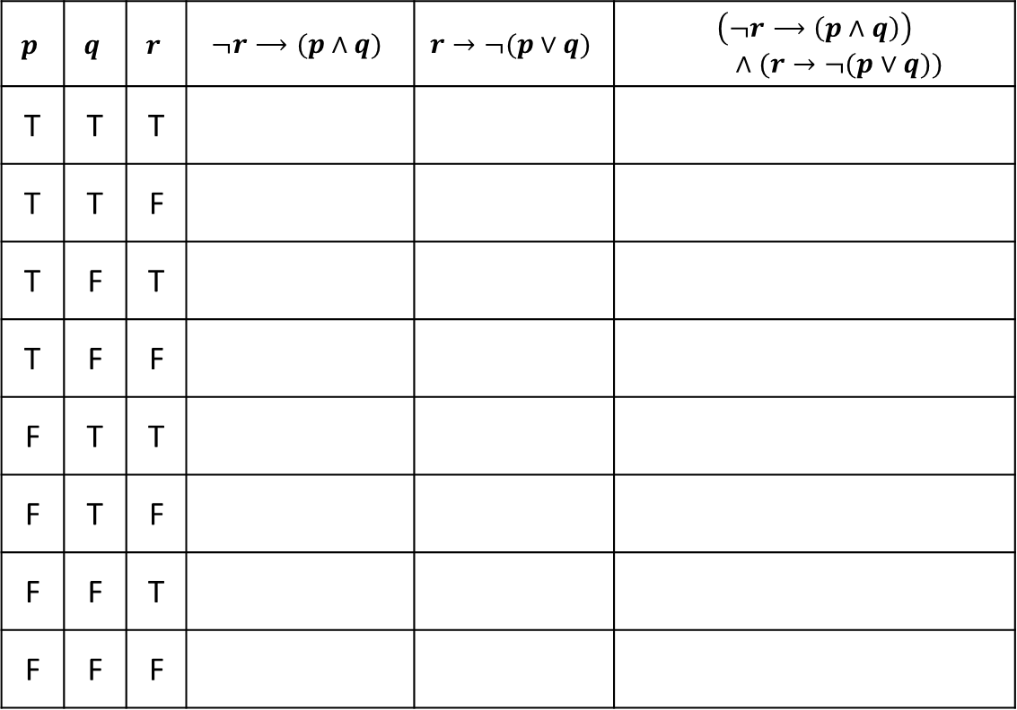
Analyzing the Vaccine Sentence with a Truth Table
($¬r$ $→$ ($p$ $∧$ $q$)) $∧$ ($r$ $→¬$($p$ $∨$ $q$))
$$p$$ | $$q$$ | $$r$$ | $$¬r⟶(p∧q)$$ | $$r→¬(p∨q)$$ | $$\left(¬r⟶\left(p∧q\right)\right)$$ $∧(r→¬(p∨q))$
T | T | T
T | T | F
T | F | T
T | F | F
F | T | T
F | T | F
F | F | T
F | F | F

Slide 28
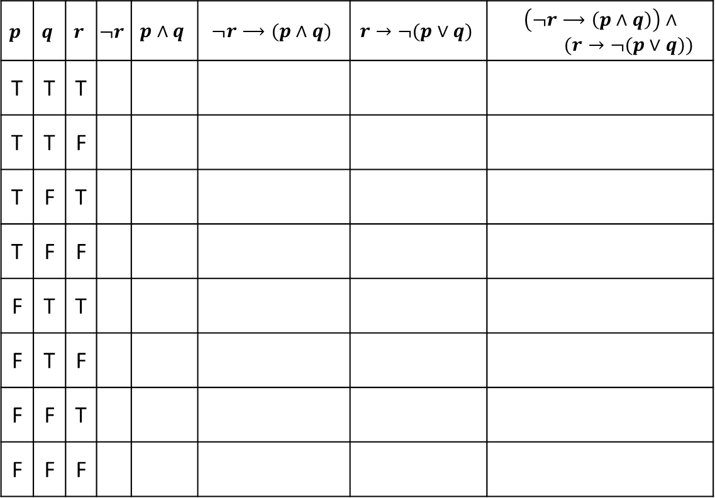
Analyzing the Vaccine Sentence with a Truth Table
($¬r$ $→$ ($p$ $∧$ $q$)) $∧$ ($r$ $→¬$($p$ $∨$ $q$))
$$p$$ | $$q$$ | $$r$$ | $$¬r$$ | $$p∧q$$ | $$¬r⟶(p∧q)$$ | $$r→¬(p∨q)$$ | $$\left(¬r⟶\left(p∧q\right)\right)∧$$ $(r→¬(p∨q))$
T | T | T
T | T | F
T | F | T
T | F | F
F | T | T
F | T | F
F | F | T
F | F | F

Slide 29
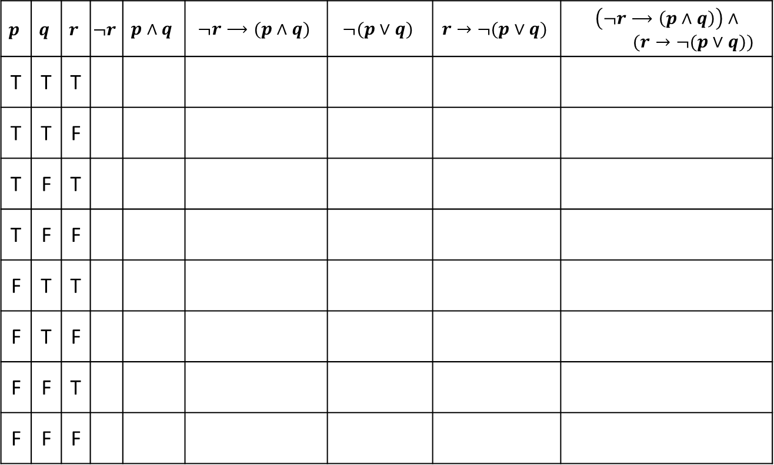
Analyzing the Vaccine Sentence with a Truth Table
($¬r$ $→$ ($p$ $∧$ $q$)) $∧$ ($r$ $→¬$($p$ $∨$ $q$))
$$p$$ | $$q$$ | $$r$$ | $$¬r$$ | $$p∧q$$ | $$¬r⟶(p∧q)$$ | $$¬(p∨q)$$ | $$r→¬(p∨q)$$ | $$\left(¬r⟶\left(p∧q\right)\right)∧$$ $(r→¬(p∨q))$
T | T | T
T | T | F
T | F | T
T | F | F
F | T | T
F | T | F
F | F | T
F | F | F

Slide 30
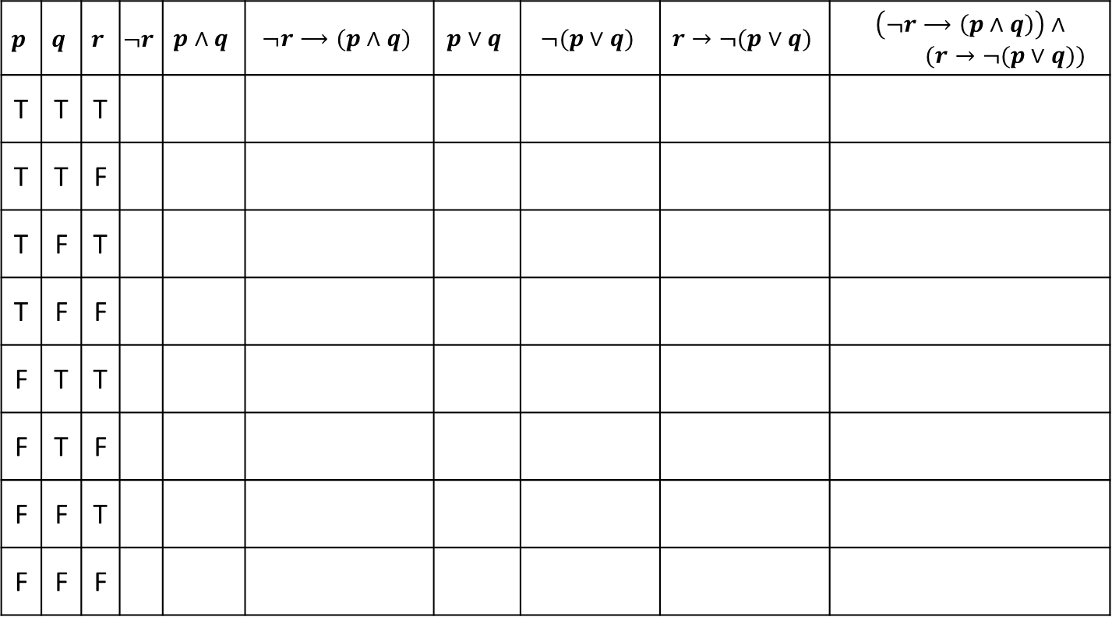
Analyzing the Vaccine Sentence with a Truth Table
($¬r$ $→$ ($p$ $∧$ $q$)) $∧$ ($r$ $→¬$($p$ $∨$ $q$))
$$p$$ | $$q$$ | $$r$$ | $$¬r$$ | $$p∧q$$ | $$¬r⟶(p∧q)$$ | $$p∨q$$ | $$¬(p∨q)$$ | $$r→¬(p∨q)$$ | $$\left(¬r⟶\left(p∧q\right)\right)∧$$ $(r→¬(p∨q))$
T | T | T
T | T | F
T | F | T
T | F | F
F | T | T
F | T | F
F | F | T
F | F | F

Slide 31
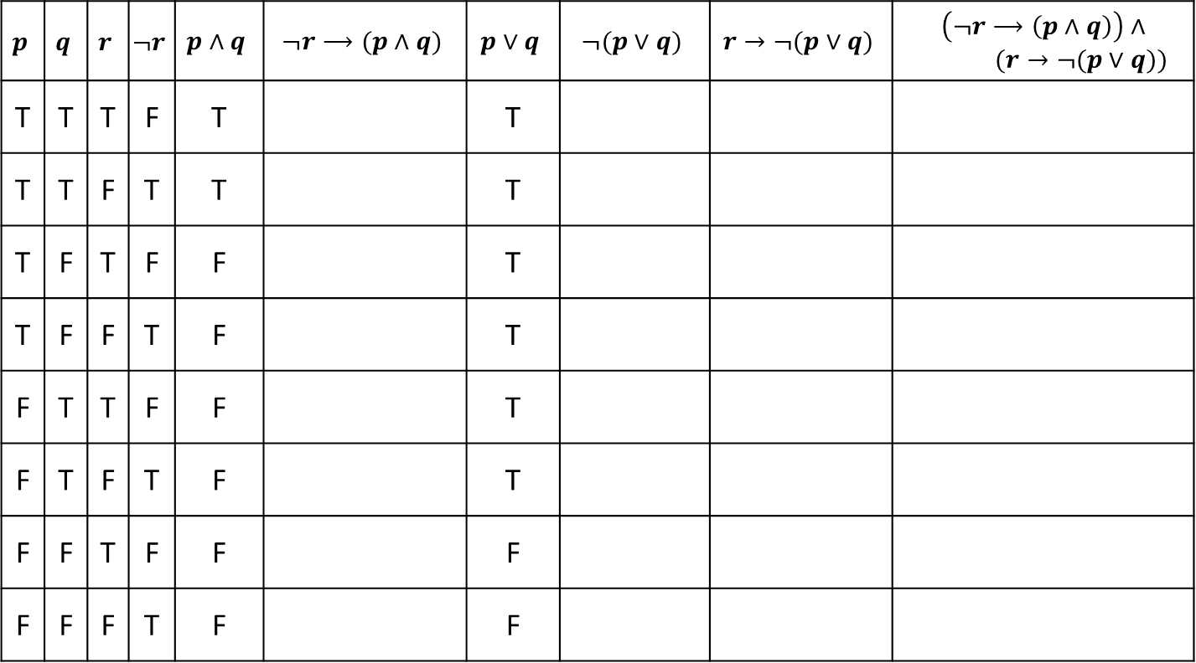
Analyzing the Vaccine Sentence with a Truth Table
($¬r$ $→$ ($p$ $∧$ $q$)) $∧$ ($r$ $→¬$($p$ $∨$ $q$))
$$p$$ | $$q$$ | $$r$$ | $$¬r$$ | $$p∧q$$ | $$¬r⟶(p∧q)$$ | $$p∨q$$ | $$¬(p∨q)$$ | $$r→¬(p∨q)$$ | $$\left(¬r⟶\left(p∧q\right)\right)∧$$ $(r→¬(p∨q))$
T | T | T | F | T |  | T
T | T | F | T | T |  | T
T | F | T | F | F |  | T
T | F | F | T | F |  | T
F | T | T | F | F |  | T
F | T | F | T | F |  | T
F | F | T | F | F |  | F
F | F | F | T | F |  | F

Slide 32
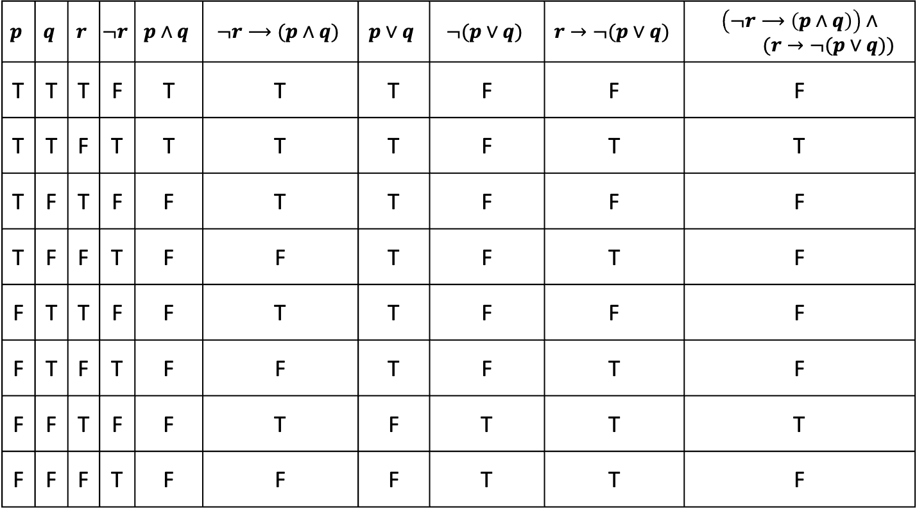
Analyzing the Vaccine Sentence with a Truth Table
($¬r$ $→$ ($p$ $∧$ $q$)) $∧$ ($r$ $→¬$($p$ $∨$ $q$))
$$p$$ | $$q$$ | $$r$$ | $$¬r$$ | $$p∧q$$ | $$¬r⟶(p∧q)$$ | $$p∨q$$ | $$¬(p∨q)$$ | $$r→¬(p∨q)$$ | $$\left(¬r⟶\left(p∧q\right)\right)∧$$ $(r→¬(p∨q))$
T | T | T | F | T | T | T | F | F | F
T | T | F | T | T | T | T | F | T | T
T | F | T | F | F | T | T | F | F | F
T | F | F | T | F | F | T | F | T | F
F | T | T | F | F | T | T | F | F | F
F | T | F | T | F | F | T | F | T | F
F | F | T | F | F | T | F | T | T | T
F | F | F | T | F | F | F | T | T | F
Notes:
To see if a claim like this is correct, you need to check all the F rows.

Slide 33
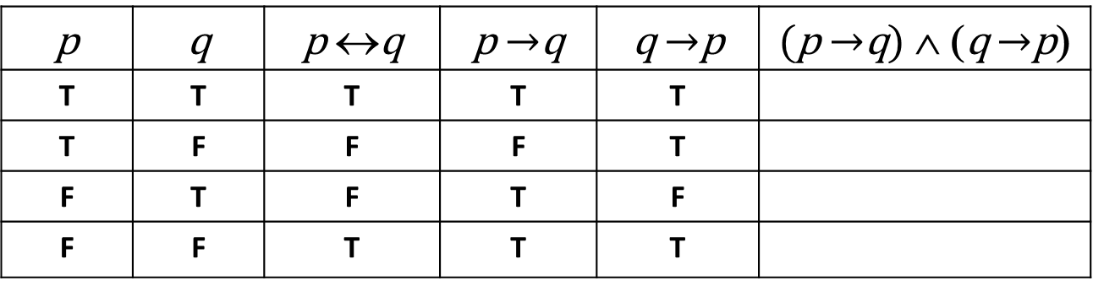

Biconditional: $p↔q$
p if and only if q (p iff q)
p is true exactly when q is true
p implies q and q implies p
p is necessary and sufficient for q
p | q | p ↔q | p $→$q | q $→$p | (p $→$q) ∧ (q $→$p)
T | T | T | T | T
T | F | F | F | T
F | T | F | T | F
F | F | T | T | T

Slide 34
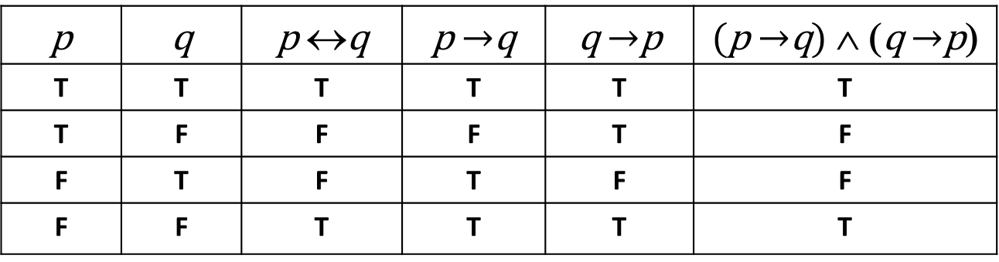
Biconditional: $p↔q$
p if and only if q (p iff q)
p is true exactly when q is true
p implies q and q implies p
p is necessary and sufficient for q
p | q | p ↔q | p $→$q | q $→$p | (p $→$q) ∧ (q $→$p)
T | T | T | T | T | T
T | F | F | F | T | F
F | T | F | T | F | F
F | F | T | T | T | T

Slide 35
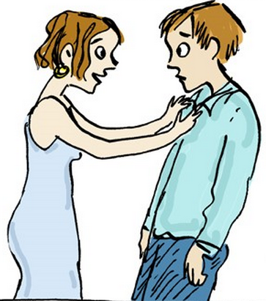
A first application of logic
“If I were to ask you out, would your answer to that question be the same as your answer to this one?”
Notes:
Any answer must be yes:
If he says no, his answer to the other question is different, so it’s yes.

