Slide 1
CSE 311: Foundations of Computing
Lecture 2: Logical Equivalence

Slide 2
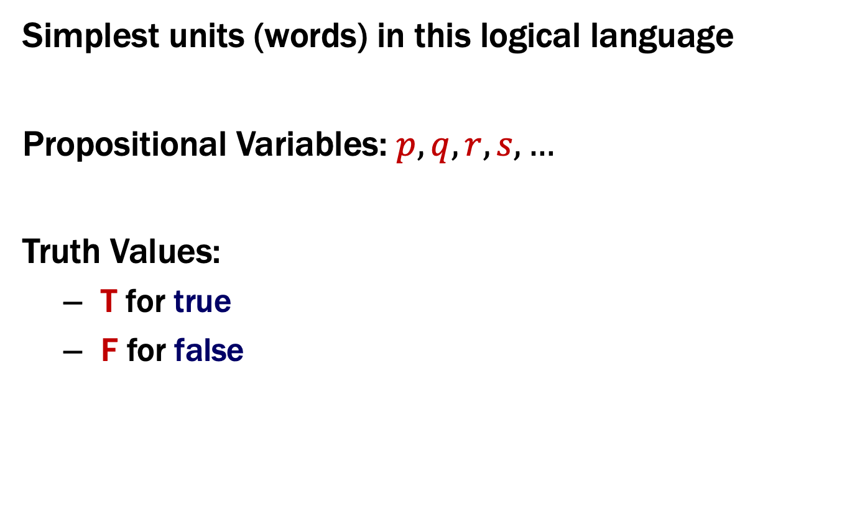
Last class: Atomic Propositions
Simplest units (words) in this logical language
Propositional Variables: $p, q, r, s,…$
Truth Values:
T for true
F for false

Slide 3
Last class: Some Connectives & Truth Tables
Negation (not)
Conjunction (and)
p | ¬p
T | F
F | T
p | q | p ∧ q
T | T | T
T | F | F
F | T | F
F | F | F
Disjunction (or)
Exclusive Or
p | q | p ∨ q
T | T | T
T | F | T
F | T | T
F | F | F
p | q | p ⊕ q
T | T | F
T | F | T
F | T | T
F | F | F

Slide 4
Last class: Implication
“If it’s raining, then I have my umbrella”
In English, we can also write
“I have my umbrella if it is raining”
p | q | p → q
T | T | T
T | F | F
F | T | T
F | F | T

Slide 5

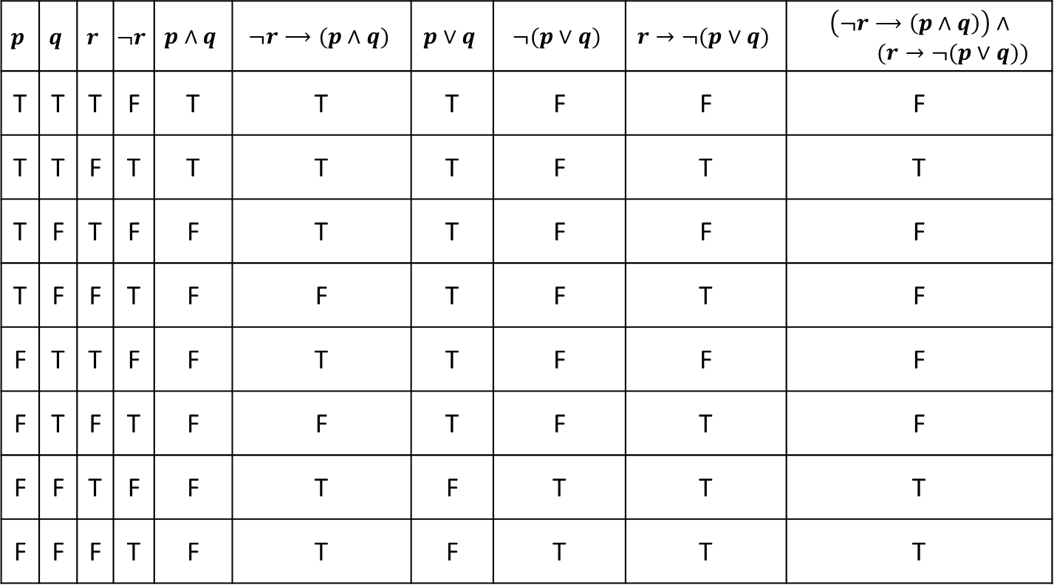
Last class: Truth Table for Vaccine Sentence
($¬r$ $→$ ($p$ $∧$ $q$)) $∧$ ($r$ $→¬$($p$ $∨$ $q$))
$$p$$ | $$q$$ | $$r$$ | $$¬r$$ | $$p∧q$$ | $$¬r⟶(p∧q)$$ | $$p∨q$$ | $$¬(p∨q)$$ | $$r→¬(p∨q)$$ | $$\left(¬r⟶\left(p∧q\right)\right)∧$$ $(r→¬(p∨q))$
T | T | T | F | T | T | T | F | F | F
T | T | F | T | T | T | T | F | T | T
T | F | T | F | F | T | T | F | F | F
T | F | F | T | F | F | T | F | T | F
F | T | T | F | F | T | T | F | F | F
F | T | F | T | F | F | T | F | T | F
F | F | T | F | F | T | F | T | T | T
F | F | F | T | F | T | F | T | T | T
Notes:
To see if a claim like this is correct, you need to check all the F rows.

Slide 6
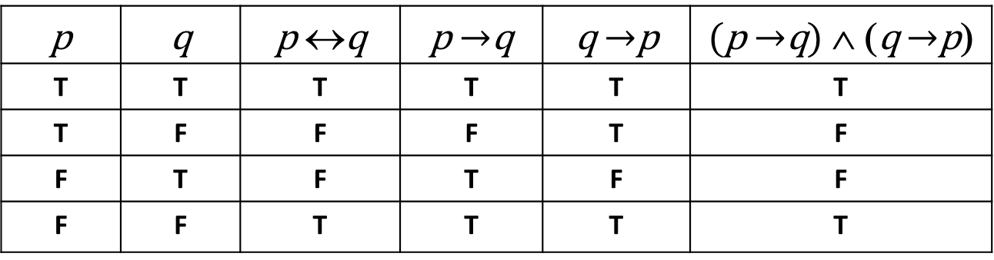

Last class: Biconditional: $p↔q$
p if and only if q (p iff q)
p is true exactly when q is true
p implies q and q implies p
p is necessary and sufficient for q
p | q | p ↔q | p $→$q | q $→$p | (p $→$q) ∧ (q $→$p)
T | T | T | T | T | T
T | F | F | F | T | F
F | T | F | T | F | F
F | F | T | T | T | T

Slide 7
Converse, Contrapositive
Implication:
p → q
Converse:
q → p
Contrapositive:
¬q → ¬p
Inverse:
¬p → ¬q
Consider
p: x is divisible by 2
q: x is divisible by 4
p → q
q → p
¬q → ¬p
¬p → ¬q

Slide 8
Converse, Contrapositive
Implication:
p → q
Converse:
q → p
Contrapositive:
¬q → ¬p
Inverse:
¬p → ¬q
Consider
p: x is divisible by 2
q: x is divisible by 4
 | Divisible By 2 | Not Divisible By 2
Divisible By 4
Not Divisible By 4
p → q
q → p
¬q → ¬p
¬p → ¬q

Slide 9
Converse, Contrapositive
Implication:
p → q
Converse:
q → p
Contrapositive:
¬q → ¬p
Inverse:
¬p → ¬q
Consider
p: x is divisible by 2
q: x is divisible by 4
 | Divisible By 2 | Not Divisible By 2
Divisible By 4 | 4,8,12,... | Impossible
Not Divisible By 4 | 2,6,10,... | 1,3,5,...
p → q
q → p
¬q → ¬p
¬p → ¬q
Notes:
p=T is first column, r=T is first row

Slide 10
Converse, Contrapositive
Implication:
p → q
Converse:
q → p
Contrapositive:
¬q → ¬p
Inverse:
¬p → ¬q
Consider
p: x is divisible by 2
q: x is divisible by 4
 | Divisible By 2 | Not Divisible By 2
Divisible By 4 | 4,8,12,... | Impossible
Not Divisible By 4 | 2,6,10,... | 1,3,5,...
p → q | F
q → p | T
¬q → ¬p | F
¬p → ¬q | T

Slide 11
Converse, Contrapositive
Implication:
p → q
Converse:
q → p
Contrapositive:
¬q → ¬p
Inverse:
¬p → ¬q
How do these relate to each other?
p | q | p → q | q→ p | ¬p | ¬q | ¬p → ¬q | ¬q → ¬p
T | T
T | F
F | T
F | F

Slide 12
Converse, Contrapositive
Implication:
p → q
Converse:
q → p
Contrapositive:
¬q → ¬p
Inverse:
¬p → ¬q
An implication and it’s contrapositive have the same truth value!
p | q | p → q | q → p | ¬p | ¬q | ¬p → ¬q | ¬q → ¬p
T | T | T | T | F | F | T | T
T | F | F | T | F | T | T | F
F | T | T | F | T | F | F | T
F | F | T | T | T | T | T | T

Slide 13
Tautologies!
Terminology: A compound proposition is a…
Tautology if it is always true
Contradiction if it is always false
Contingency if it can be either true or false
p ∨ ¬p
p ⊕ p
(p → q) ∧ p

Slide 14
Tautologies!
Terminology: A compound proposition is a…
Tautology if it is always true
Contradiction if it is always false
Contingency if it can be either true or false
p ∨ ¬p
p ⊕ p
(p → q) ∧ p
This is a tautology. It’s called the “law of the excluded middle.
If p is true, then p ∨ ¬p is true. If p is false, then p ∨ ¬p is true.
This is a contradiction. It’s always false no matter what truth value p takes on.
This is a contingency. When p is T, q is T, it is true.
When p is F, q is T, it is false.

Slide 15
Logical Equivalence
A = B means A and B are identical “strings”:
p ∧ q = p ∧ q
p ∧ q ≠ q ∧ p

Slide 16
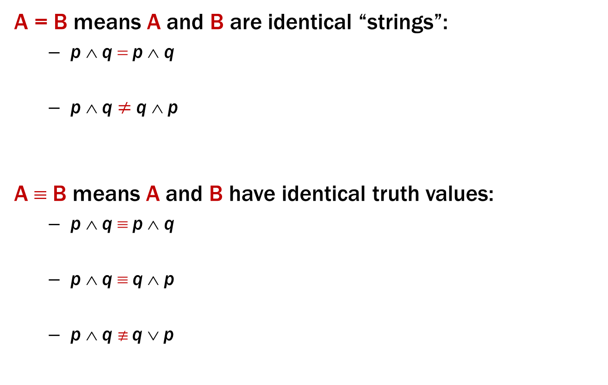
Logical Equivalence
A = B means A and B are identical “strings”:
p ∧ q = p ∧ q
p ∧ q ≠ q ∧ p
A ≡ B means A and B have identical truth values:
p ∧ q ≡ p ∧ q
p ∧ q ≡ q ∧ p
p ∧ q $≢$ q ∨ p
These are equal, because they are character-for-character identical.
These are NOT equal, because they are different sequences of characters. They “mean” the same thing though.

Slide 17
Logical Equivalence
A = B means A and B are identical “strings”:
p ∧ q = p ∧ q
p ∧ q ≠ q ∧ p
A ≡ B means A and B have identical truth values:
p ∧ q ≡ p ∧ q
p ∧ q ≡ q ∧ p
p ∧ q $≢$ q ∨ p
These are equal, because they are character-for-character identical.
These are NOT equal, because they are different sequences of characters. They “mean” the same thing though.
Two formulas that are equal also are equivalent.
These two formulas have the same truth table!
When p=T and q=F, p ∧ q is false, but p ∨ q is true!

Slide 18
A ↔ B vs. A ≡ B
A ↔ B is a proposition that may be true or false depending on the truth values of A and B.
A ≡ B is an assertion over all possible truth values that A and B always have the same truth values.
A ≡ B and (A ↔ B) ≡ T have the same meaning
as does “A ↔ B is a tautology”

Slide 19

Logical Equivalence A ≡ B
A ≡ B is an assertion that two propositions A and B always have the same truth values.
A ≡ B and (A ↔ B) ≡ T have the same meaning.
p ∧ q ≡ q ∧ p
p | q | p ∧ q | q ∧ p | (p ∧ q) ↔ (q ∧ p)
T | T | T | T | T
T | F | F | F | T
F | T | F | F | T
F | F | F | F | T
p ∧ q $≢$ q ∨ p
When p is T and q is F, p ∧ q is false, but q ∨ p is true

Slide 20
De Morgan’s Laws
¬(p ∧ q) ≡ ¬p ∨ ¬q
¬(p ∨ q) ≡ ¬p ∧ ¬q
Negate the statement:
“My code compiles or there is a bug.”
To negate the statement, ask “when is the original statement false”.
It’s false when not(my code compiles) AND not(there is a bug).
Translating back into English, we get:
My code doesn’t compile and there is not a bug.

Slide 21
De Morgan’s Laws
Example: ¬(p ∧ q) ≡ ¬p ∨ ¬q
p | q | ¬p | ¬q | ¬p ∨ ¬q | p ∧ q | ¬(p ∧ q)
T | T | F | F | F | T | F
T | F | F | T | T | F | T
F | T | T | F | T | F | T
F | F | T | T | T | F | T

Slide 22
De Morgan’s Laws
¬(p ∧ q) ≡ ¬p ∨ ¬q
¬(p ∨ q) ≡ ¬p ∧ ¬q
if (!(front != null && value > front.data)) {
front = new ListNode(value, front);
} else {
ListNode current = front;
while (current.next != null && current.next.data < value))
current = current.next;
current.next = new ListNode(value, current.next);
}

Slide 23
De Morgan’s Laws
¬(p ∧ q) ≡ ¬p ∨ ¬q
¬(p ∨ q) ≡ ¬p ∧ ¬q
!(front != null && value > front.data)
≡
front == null || value <= front.data

Slide 24
Law of Implication
p → q ≡ ¬p ∨ q
p | q | p → q | ¬ p | ¬ p ∨ q
T | T
T | F
F | T
F | F

Slide 25
Law of Implication
p → q ≡ ¬p ∨ q
p | q | p → q | ¬ p | ¬ p ∨ q
T | T | T | F | T
T | F | F | F | F
F | T | T | T | T
F | F | T | T | T

Slide 26
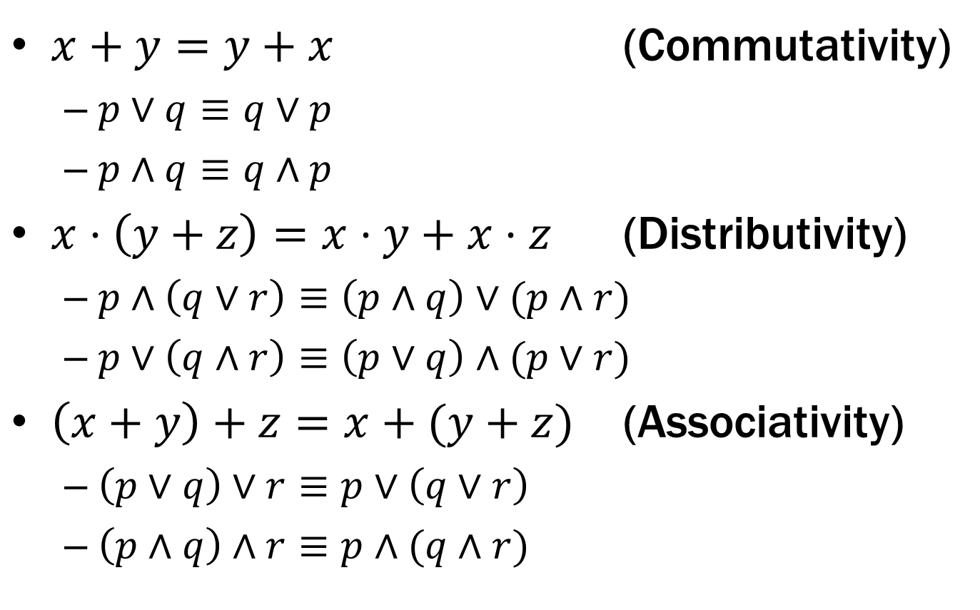

Some Familiar Properties of Arithmetic
$x+y=y+x$ (Commutativity)
$p∨q≡q∨p$
$p∧q≡q∧p$
$x⋅\left(y+z\right)=x⋅y+x⋅z$ (Distributivity)
$p∧\left(q∨r\right)≡\left(p∧q\right)∨(p∧r)$
$p∨\left(q∧r\right)≡\left(p∨q\right)∧(p∨r)$
$\left(x+y\right)+z=x+(y+z)$ (Associativity)
$\left(p∨q\right)∨r≡p∨\left(q∨r\right)$
$\left(p∧q\right)∧r≡p∧(q∧r)$

Slide 27
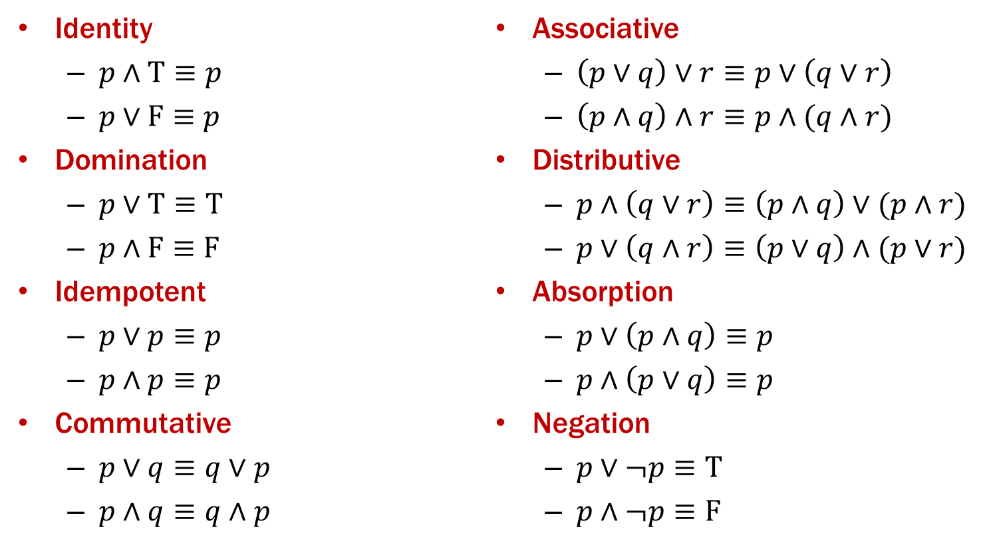
Important Equivalences

Slide 28

Some Familiar Properties of Arithmetic
$x⋅1=x$ (Identity)
$x+0=x$
$x⋅0=0$ (Domination)

Slide 29
Important Equivalences

Slide 30
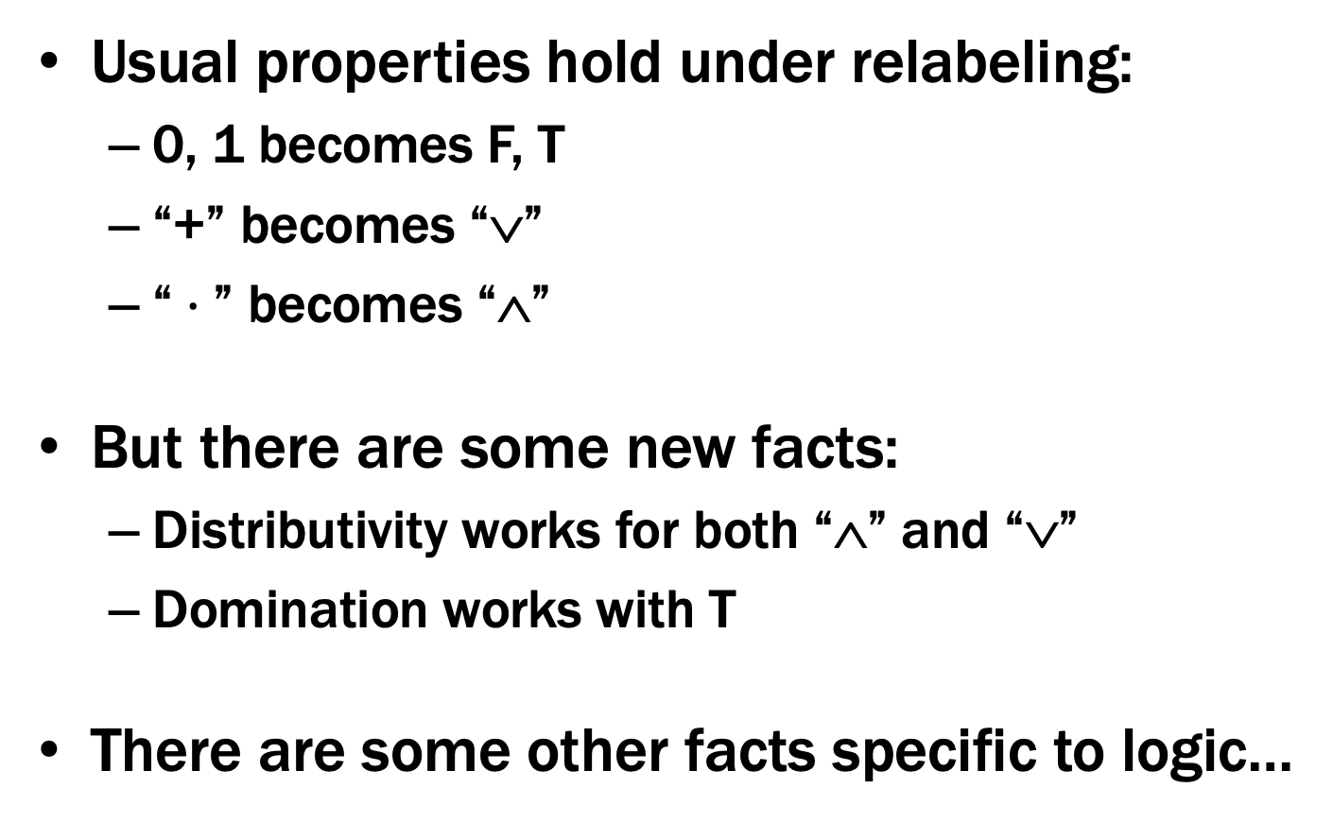
Some Familiar Properties of Arithmetic
Usual properties hold under relabeling:
0, 1 becomes F, T
“+” becomes “∨”
“$⋅$” becomes “∧”
But there are some new facts:
Distributivity works for both “∧” and “∨”
Domination works with T
There are some other facts specific to logic…

Slide 31
Important Equivalences

Slide 32
Important Equivalences

Slide 33
Using Equivalences
Note that p, q, and r can be any propositions (not just atomic propositions)
Ex: (r → s) ∧ (¬t) ≡ (¬t) ∧ (r → s)
apply commutativity: p ∧ q ≡ q ∧ p with p := r → s and q := ¬t

Slide 34

One more easy equivalence
Double Negation
$$p ≡ ➢ ➢ p$$
p | ¬ p | ¬ ¬ p
T | F | T
F | T | F

Slide 35
Understanding logic and circuits
When do two logic formulas mean the same thing?
What logical properties can we infer from other ones?

Slide 36
Basic rules of reasoning and logic
Working with logical formulas
Simplification
Testing for equivalence
Applications
Query optimization
Search optimization and caching
Artificial Intelligence
Program verification

Slide 37
Computing Equivalence
Given two propositions, can we write an algorithm to determine if they are equivalent?
What is the runtime of our algorithm?

Slide 38
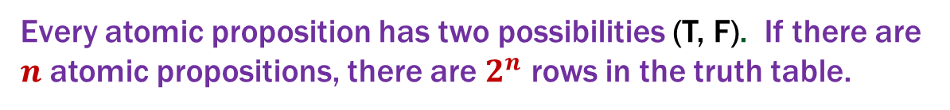
Computing Equivalence
Given two propositions, can we write an algorithm to determine if they are equivalent?
Yes! Generate the truth tables for both propositions and check if they are the same for every entry.
What is the runtime of our algorithm?
Every atomic proposition has two possibilities (T, F). If there are $n$ atomic propositions, there are $2^{n}$ rows in the truth table.

Slide 39
Another approach: Logical Proofs
To show A is equivalent to B
Apply a series of logical equivalences to sub-expressions to convert A to B
To show A is a tautology
Apply a series of logical equivalences to sub-expressions to convert A to T

Slide 40

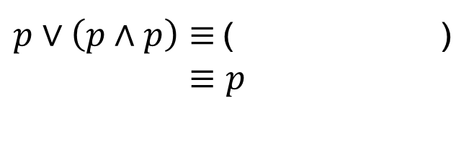
Another approach: Logical Proofs
To show A is equivalent to B
Apply a series of logical equivalences to sub-expressions to convert A to B
Example:
Let A be “$p∨(p∧p)$”, and B be “$p$”.
Our general proof looks like:
$p∨\left(p∧p\right)≡$( )
$≡p$

Slide 41
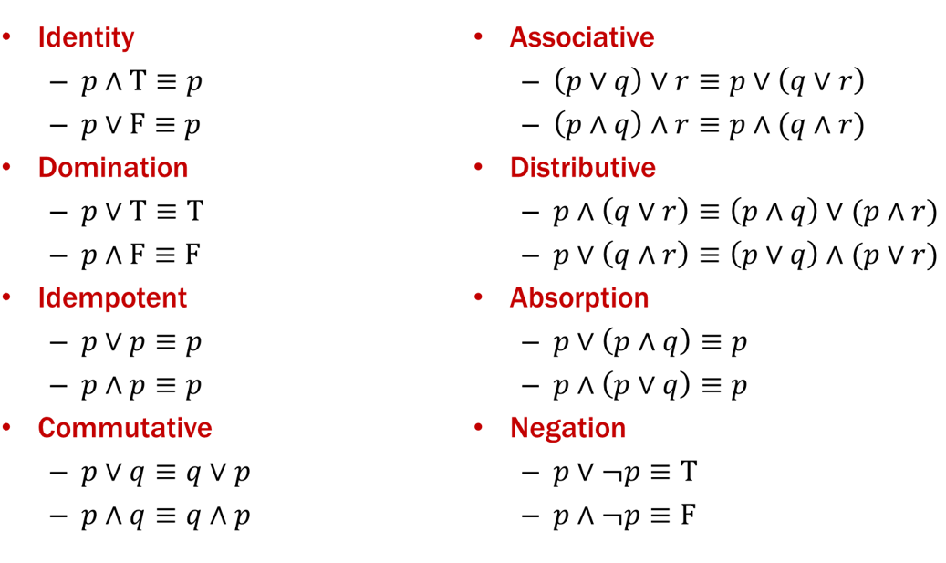
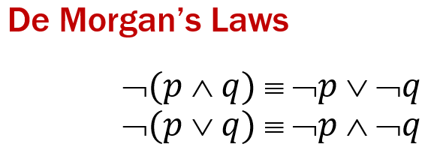
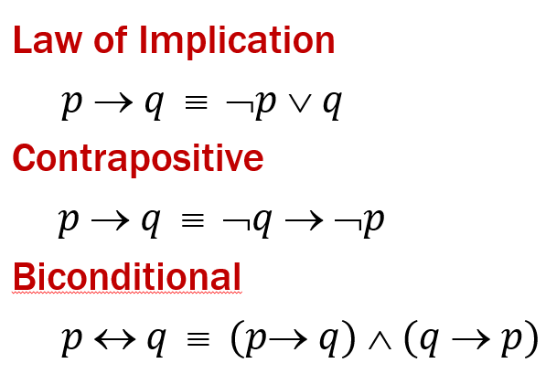
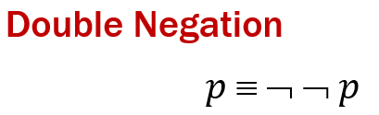
Another approach: Logical Proofs
Example:
Let A be “$p∨(p∧p)$”, and B be “$p$”.
Our general proof looks like:
$p∨\left(p∧p\right)≡$( )
$≡p$

Slide 42

Logical Proofs
Example:
Let A be “$p∨(p∧p)$”, and B be “$p$”.
Our general proof looks like:
$$p∨p$$
$p∨\left(p∧p\right)≡$( )
$≡p$
Idempotent
Idempotent

Slide 43


Logical Proofs
To show A is a tautology
Apply a series of logical equivalences to sub-expressions to convert A to T
Example:
Let A be “$¬p∨(p∨p)$”.
Our general proof looks like:
$¬p∨\left(p∨p\right)≡$( )
$≡$( )
$≡$ T

Slide 44
Logical Proofs
Example:
Let A be “$¬p∨(p∨p)$”.
Our general proof looks like:
$¬p∨\left(p∨p\right)≡$( )
$≡$( )
$≡$ T

Slide 45



Logical Proofs
Example:
Let A be “$¬p∨(p∨p)$”.
Our general proof looks like:
$$¬p∨p$$
$¬p∨\left(p∨p\right)≡$( )
$≡$ ( )
$≡$ T
Idempotent
$$p∨¬p$$
Commutative
Negation

Slide 46
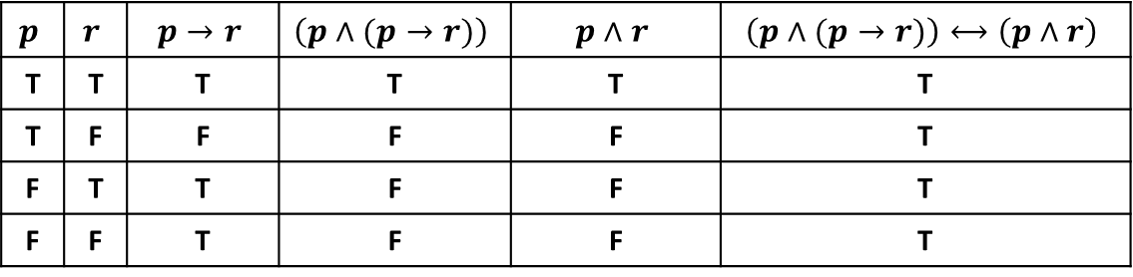
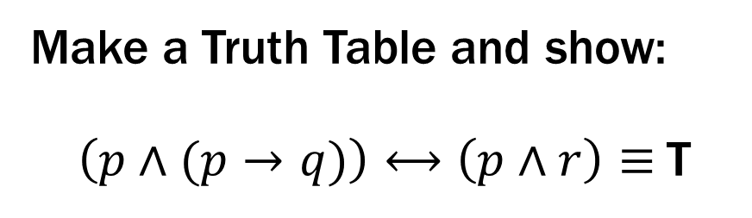
Prove these propositions are equivalent: Option 1
Prove: p ∧ (p → q) ≡ p ∧ q
Make a Truth Table and show:
$\left(p∧(p→q)\right)⟷\left(p∧r\right)≡$T
$$p$$ | $$r$$ | $$p→r$$ | $$\left(p∧(p→r)\right)$$ | $$p∧r$$ | $$\left(p∧(p→r)\right)⟷\left(p∧r\right)$$
T | T | T | T | T | T
T | F | F | F | F | T
F | T | T | F | F | T
F | F | T | F | F | T

Slide 47

Prove these propositions are equivalent: Option 2
Prove: p ∧ (p → q) ≡ p ∧ q
$$p∧\left(p→q\right)≡$$
$≡$
$≡$
$≡$
$≡p∧q$

Slide 48
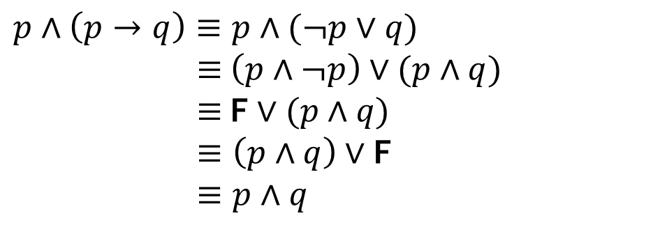
Prove these propositions are equivalent: Option 2
Prove: p ∧ (p → q) ≡ p ∧ q
$$p∧\left(p→q\right)≡p∧(¬p∨q)$$
$≡$ $\left(p∧¬p\right)∨(p∧q)$
$≡$ F $∨(p∧q)$
$≡\left(p∧q\right)∨$F
$≡p∧q$
Law of Implication
Distributive
Negation
Commutative
Identity

Slide 49
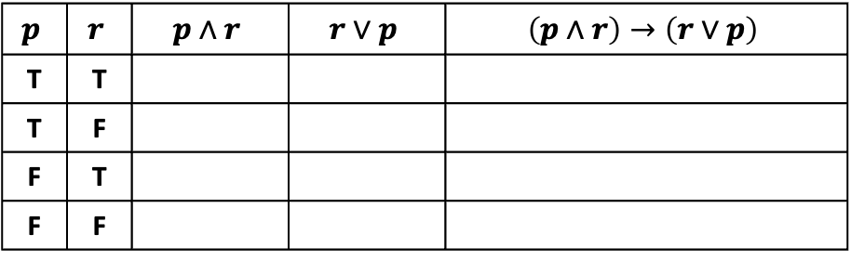
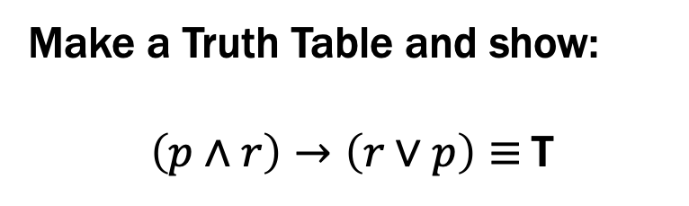
Prove this is a Tautology: Option 1
(p ∧ r) → (r ∨ p)
Make a Truth Table and show:
$\left(p∧r\right)→\left(r∨p\right)≡$T
$$p$$ | $$r$$ | $$p∧r$$ | $$r∨p$$ | $$\left(p∧r\right)→\left(r∨p\right)$$
T | T
T | F
F | T
F | F

Slide 50
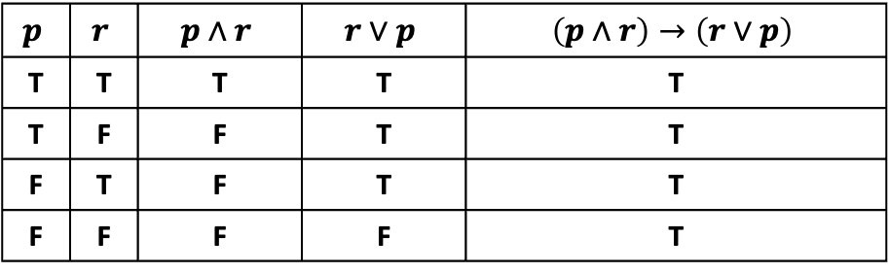
Prove this is a Tautology: Option 1
(p ∧ r) → (r ∨ p)
Make a Truth Table and show:
$\left(p∧r\right)→\left(r∨p\right)≡$T
$$p$$ | $$r$$ | $$p∧r$$ | $$r∨p$$ | $$\left(p∧r\right)→\left(r∨p\right)$$
T | T | T | T | T
T | F | F | T | T
F | T | F | T | T
F | F | F | F | T

Slide 51
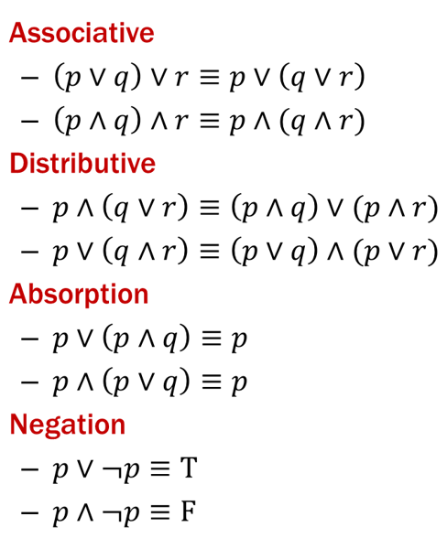
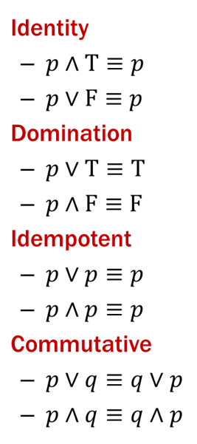

Prove this is a Tautology: Option 2
(p ∧ r) → (r ∨ p)
Use a series of equivalences like so:
$$\left(p∧r\right)→\left(r∨p\right) ≡$$
$≡$
$≡$
$≡$
$≡$
$≡$
$≡$
$≡$
$≡$ T

Slide 52
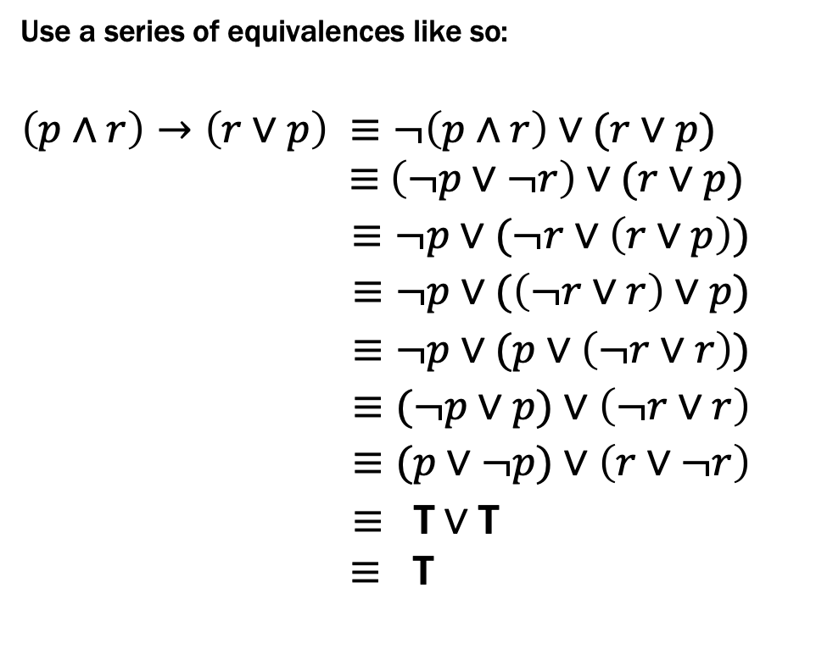
Prove this is a Tautology: Option 2
(p ∧ r) → (r ∨ p)
Use a series of equivalences like so:
$$\left(p∧r\right)→\left(r∨p\right) ≡¬\left(p∧r\right)∨(r∨p)$$
$≡$ $\left(¬p∨¬r\right)∨(r∨p)$
$≡¬p∨(¬r∨\left(r∨p\right))$
$≡¬p∨(\left(¬r∨r\right)∨p)$
$≡¬p∨(p∨\left(¬r∨r\right))$
$≡(¬p∨p)∨\left(¬r∨r\right)$
$≡(p∨¬p)∨\left(r∨¬r\right)$
$≡ \text{T}∨\text{T}$
$≡$ T
Law of Implication
De Morgan
Associative
Associative
Commutative
Associative
Commutative (twice)
Negation (twice)
Domination/Identity

Slide 53
Logical Proofs of Equivalence/Tautology
Not smaller than truth tables when there are only a few propositional variables...
...but usually much shorter than truth table proofs when there are many propositional variables
A big advantage will be that we can extend them to a more in-depth understanding of logic for which truth tables don’t apply.

