Slide 1
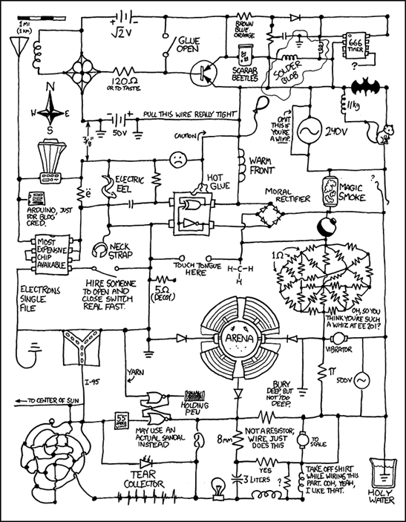
CSE 311: Foundations of Computing
Lecture 4: Boolean Algebra, Circuits, Canonical Forms

Slide 2
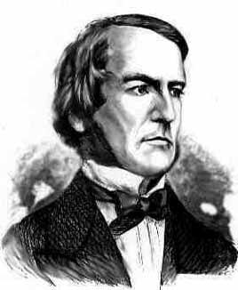
Last Time: Boolean Algebra
Usual notation used in circuit design
Boolean algebra
a set of elements B containing {0, 1}
binary operations { + , • }
and a unary operation { ’ }
such that the following axioms hold:
For any a, b, c in B: 1. closure: a + b is in B a • b is in B 2. commutativity: a + b = b + a a • b = b • a 3. associativity: a + (b + c) = (a + b) + c a • (b • c) = (a • b) • c 4. distributivity: a + (b • c) = (a + b) • (a + c) a • (b + c) = (a • b) + (a • c) 5. identity: a + 0 = a a • 1 = a 6. complementarity: a + a’ = 1 a • a’ = 0
7. null: a + 1 = 1 a • 0 = 0
8. idempotency: a + a = a a • a = a
9. involution: (a’)’ = a

Slide 3
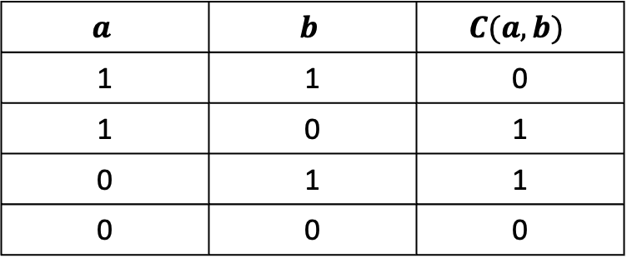


Warm-up Exercise
Create a Boolean Algebra expression for $C$ below in terms of the variables $a$ and $b$
$$a$$ | $$b$$ | $$C(a,b)$$
1 | 1 | 0
1 | 0 | 1
0 | 1 | 1
0 | 0 | 0
$$ab^{′}+a^{′}b$$

Slide 4

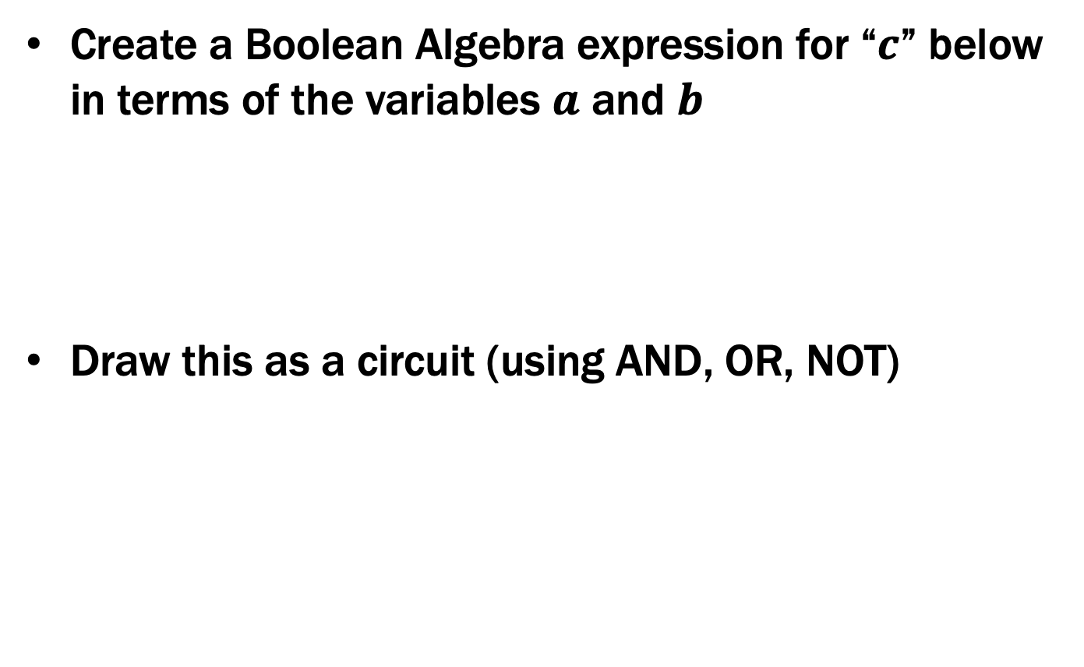
Warm-up Exercise
Create a Boolean Algebra expression for “$c$” below in terms of the variables $a$ and $b$
Draw this as a circuit (using AND, OR, NOT)
$$c=ab^{′}+a^{′}b$$

Slide 5
Last Time: Combinational Logic
Encoding:
Binary number for weekday (Binary encoding)
One bit for each possible output (“1-Hot” encoding)
Weekday
isLecture
0
1
2
3

Slide 6
Last Time: Truth Table to Logic
 | d₂d₁d₀ | L | c₀ | c₁ | c₂ | c₃
SUN | 000 | 0 | 0 | 1 | 0 | 0
SUN | 000 | 1 | 0 | 0 | 0 | 1
MON | 001 | 0 | 0 | 1 | 0 | 0
MON | 001 | 1 | 0 | 0 | 0 | 1
TUE | 010 | 0 | 0 | 1 | 0 | 0
TUE | 010 | 1 | 0 | 0 | 1 | 0
WED | 011 | 0 | 0 | 1 | 0 | 0
WED | 011 | 1 | 0 | 0 | 1 | 0
THU | 100 | - | 0 | 1 | 0 | 0
FRI | 101 | 0 | 1 | 0 | 0 | 0
FRI | 101 | 1 | 0 | 1 | 0 | 0
SAT | 110 | - | 1 | 0 | 0 | 0
- | 111 | - | 1 | 0 | 0 | 0
d₂’•d₁’•d₀’•L
d₂’•d₁’•d₀•L
Either situation causes c₃ to be true. So, we “or” them.
c₃ = d₂’•d₁’•d₀’•L + d₂’•d₁’•d₀•L

Slide 7



Last Time: Truth Table to Logic
c₀ = d₂•d₁’•d₀•L’ + d₂•d₁•d₀’ + d₂•d₁•d₀
c₁ = d₂’•d₁’•d₀’•L’ + d₂’•d₁’•d₀•L’ + d₂’•d₁•d₀’•L’ + d₂’•d₁•d₀•L’ + d₂•d₁’•d₀’ + d₂•d₁’•d₀•L
c₂ = d₂’•d₁•d₀’•L + d₂’•d₁•d₀•L
c₃ = d₂’•d₁’•d₀’•L + d₂’•d₁’•d₀•L
Here’s c₃ as a circuit:
d₂
NOT
AND
d₁
NOT
OR
d₀
AND
NOT
L

Slide 8
Simplifying using Boolean Algebra
c3 = d2’•d1’•d0’•L + d2’•d1’•d0•L
= d2’•d1’•(d0’ + d0)•L
= d2’•d1’•1•L
= d2’•d1’•L
d2
NOT
AND
d1
NOT
L

Slide 9
Important Corollaries of this Construction
¬, ∧, ∨ can implement any Boolean function
we didn’t need any others to do this
Actually, just ¬, ∧ (or ¬, ∨) are enough
follows by De Morgan’s laws
Actually, just NAND (or NOR)
Prime(65353)

Slide 10
1-bit Binary Adder
A
+ B
S
(C_{OUT})
0 + 0 = 0 (with C_{OUT} = 0)
0 + 1 = 1 (with C_{OUT} = 0)
1 + 0 = 1 (with C_{OUT} = 0)
1 + 1 = 0 (with C_{OUT} = 1)

Slide 11
1-bit Binary Adder
A
+ B
S
(C_{OUT})
0 + 0 = 0 (with C_{OUT} = 0)
0 + 1 = 1 (with C_{OUT} = 0)
1 + 0 = 1 (with C_{OUT} = 0)
1 + 1 = 0 (with C_{OUT} = 1)
Idea: chain these together to add larger numbers
Recall from elementary school:
2 4 8
+ 3 7 5

Slide 12
1-bit Binary Adder
A
+ B
S
(C_{OUT})
0 + 0 = 0 (with C_{OUT} = 0)
0 + 1 = 1 (with C_{OUT} = 0)
1 + 0 = 1 (with C_{OUT} = 0)
1 + 1 = 0 (with C_{OUT} = 1)
Idea: These are chained together with a carry-in
(C_{IN})
A
+ B
S
(C_{OUT})
C_{OUT}
C_{IN}
C_{OUT}
C_{IN}
1 1 0 0
A A A A A
0 1 1 1 0
B B B B B
0 1 1 0 1
S S S S S
1 1 0 1 1

Slide 13
1-bit Binary Adder
C_{IN}
Inputs: A, B, Carry-in
Outputs: Sum, Carry-out
C_{OUT}
A A A A A
B B B B B
S S S S S
A | B | C_{IN} | C_{OUT} | S
0 | 0 | 0 | 0 | 0
0 | 0 | 1 | 0 | 1
0 | 1 | 0 | 0 | 1
0 | 1 | 1 | 1 | 0
1 | 0 | 0 | 0 | 1
1 | 0 | 1 | 1 | 0
1 | 1 | 0 | 1 | 0
1 | 1 | 1 | 1 | 1
A
S
B
C_{OUT}
C_{IN}

Slide 14
1-bit Binary Adder
C_{IN}
Inputs: A, B, Carry-in
Outputs: Sum, Carry-out
C_{OUT}
A A A A A
B B B B B
S S S S S
A | B | C_{IN} | C_{OUT} | S
0 | 0 | 0 | 0 | 0
0 | 0 | 1 | 0 | 1
0 | 1 | 0 | 0 | 1
0 | 1 | 1 | 1 | 0
1 | 0 | 0 | 0 | 1
1 | 0 | 1 | 1 | 0
1 | 1 | 0 | 1 | 0
1 | 1 | 1 | 1 | 1
Derive an expression for S
A’•B’•C_{IN}
A’•B•C_{IN}’
S = A’•B’•C_{IN} + A’•B•C_{IN}’ +
A•B’•C_{IN}’ + A•B•C_{IN}
A•B’•C_{IN}’
A•B•C_{IN}

Slide 15
1-bit Binary Adder
C_{IN}
Inputs: A, B, Carry-in
Outputs: Sum, Carry-out
C_{OUT}
A A A A A
B B B B B
S S S S S
A | B | C_{IN} | C_{OUT} | S
0 | 0 | 0 | 0 | 0
0 | 0 | 1 | 0 | 1
0 | 1 | 0 | 0 | 1
0 | 1 | 1 | 1 | 0
1 | 0 | 0 | 0 | 1
1 | 0 | 1 | 1 | 0
1 | 1 | 0 | 1 | 0
1 | 1 | 1 | 1 | 1
Derive an expression for C_{OUT}
A’•B•C_{IN}
C_{OUT} = A’•B•C_{IN} + A•B’•C_{IN} +
A•B•C_{IN}’ + A•B•C_{IN}
A•B’•C_{IN}
A•B•C_{IN}’
A•B•C_{IN}
S = A’•B’•C_{IN} + A’•B•C_{IN}’ + A•B’•C_{IN}’ + A•B•C_{IN}

Slide 16
1-bit Binary Adder
C_{IN}
Inputs: A, B, Carry-in
Outputs: Sum, Carry-out
C_{OUT}
A A A A A
B B B B B
S S S S S
A | B | C_{IN} | C_{OUT} | S
0 | 0 | 0 | 0 | 0
0 | 0 | 1 | 0 | 1
0 | 1 | 0 | 0 | 1
0 | 1 | 1 | 1 | 0
1 | 0 | 0 | 0 | 1
1 | 0 | 1 | 1 | 0
1 | 1 | 0 | 1 | 0
1 | 1 | 1 | 1 | 1
S = A’•B’•C_{IN} + A’•B•C_{IN}’ + A•B’•C_{IN}’ + A•B•C_{IN}
C_{OUT} = A’•B•C_{IN} + A•B’•C_{IN} + A•B•C_{IN}’ + A•B•C_{IN}

Slide 17
Apply Theorems to Simplify Expressions
The theorems of Boolean algebra can simplify expressions
e.g., full adder’s carry-out function
Cout = A’ B Cin + A B’ Cin + A B Cin’ + A B Cin
= A’ B Cin + A B’ Cin + A B Cin’ + A B Cin + A B Cin
= A’ B Cin + A B Cin + A B’ Cin + A B Cin’ + A B Cin
= (A’ + A) B Cin + A B’ Cin + A B Cin’ + A B Cin
= (1) B Cin + A B’ Cin + A B Cin’ + A B Cin
= B Cin + A B’ Cin + A B Cin’ + A B Cin + A B Cin
= B Cin + A B’ Cin + A B Cin + A B Cin’ + A B Cin
= B Cin + A (B’ + B) Cin + A B Cin’ + A B Cin
= B Cin + A (1) Cin + A B Cin’ + A B Cin
= B Cin + A Cin + A B (Cin’ + Cin)
= B Cin + A Cin + A B (1)
= B Cin + A Cin + A B

Slide 18
Apply Theorems to Simplify Expressions
The theorems of Boolean algebra can simplify expressions
e.g., full adder’s carry-out function
Cout = A’ B Cin + A B’ Cin + A B Cin’ + A B Cin
= A’ B Cin + A B’ Cin + A B Cin’ + A B Cin + A B Cin
= A’ B Cin + A B Cin + A B’ Cin + A B Cin’ + A B Cin
= (A’ + A) B Cin + A B’ Cin + A B Cin’ + A B Cin
= (1) B Cin + A B’ Cin + A B Cin’ + A B Cin
= B Cin + A B’ Cin + A B Cin’ + A B Cin + A B Cin
= B Cin + A B’ Cin + A B Cin + A B Cin’ + A B Cin
= B Cin + A (B’ + B) Cin + A B Cin’ + A B Cin
= B Cin + A (1) Cin + A B Cin’ + A B Cin
= B Cin + A Cin + A B (Cin’ + Cin)
= B Cin + A Cin + A B (1)
= B Cin + A Cin + A B
adding extra terms creates new factoring opportunities

Slide 19
A 2-bit Ripple-Carry Adder
A
B
A₀
B₀
A₁
B₁
A₂
B₂
1-Bit Adder
0
C_{in}
C_{out}
C_{in}
C_{out}
C_{in}
C_{out}
C_{in}
C_{out}
Sum₀
Sum₁
Sum₂
Uses the fact that Sum = A’•B’•C_{IN} + A’•B•C_{IN}’ + A•B’•C_{IN}’ + A•B•C_{IN}
is equivalent to Sum = (A ⊕ B) ⊕ C_{IN}
Sum

Slide 20
Mapping Truth Tables to Logic Gates
A B C F
0 0 0 0
0 0 1 0
0 1 0 1
0 1 1 1
1 0 0 0
1 0 1 1
1 1 0 0
1 1 1 1
Given a truth table:
Write the output in a table
Write the Boolean expression
Minimize the Boolean expression
Draw as gates
Map to available gates
2
F = A’BC’+A’BC+AB’C+ABC
= A’B(C’+C)+AC(B’+B)
= A’B+AC
3
4
5

Slide 21
Canonical Forms
Truth table is the unique signature of a 0/1 function
The same truth table can have many gate realizations
We’ve seen this already
Depends on how good we are at Boolean simplification
Canonical forms
Standard forms for a Boolean expression
We all produce the same expression

Slide 22
Sum-of-Products Canonical Form
AKA Disjunctive Normal Form (DNF)
AKA Minterm Expansion
3
Add the minterms together
F= A’B’C + A’BC + AB’C + ABC’ + ABC
A | B | C | F
0 | 0 | 0 | 0
0 | 0 | 1 | 1
0 | 1 | 0 | 0
0 | 1 | 1 | 1
1 | 0 | 0 | 0
1 | 0 | 1 | 1
1 | 1 | 0 | 1
1 | 1 | 1 | 1
1
2
Read T rows off
truth table
Convert to
Boolean Algebra
001
A’B’C
011
A’BC
F
101
AB’C
110
ABC’
111
ABC

Slide 23
Sum-of-Products Canonical Form
Product term (or minterm)
ANDed product of literals – input combination for which output is true
each variable appears exactly once, true or inverted (but not both)
A B C minterms 0 0 0 A’B’C’
0 0 1 A’B’C
0 1 0 A’BC’
0 1 1 A’BC
1 0 0 AB’C’
1 0 1 AB’C
1 1 0 ABC’
1 1 1 ABC
F in canonical form: F(A, B, C) = A’B’C + A’BC + AB’C + ABC’ + ABC
canonical form ≠ minimal form F(A, B, C) = A’B’C + A’BC + AB’C + ABC + ABC’
= (A’B’ + A’B + AB’ + AB)C + ABC’
= ((A’ + A)(B’ + B))C + ABC’ = C + ABC’ = ABC’ + C
= AB + C

Slide 24
Product-of-Sums Canonical Form
AKA Conjunctive Normal Form (CNF)
AKA Maxterm Expansion
4
Multiply the maxterms together
F =
1
2
3
A | B | C | F
0 | 0 | 0 | 0
0 | 0 | 1 | 1
0 | 1 | 0 | 0
0 | 1 | 1 | 1
1 | 0 | 0 | 0
1 | 0 | 1 | 1
1 | 1 | 0 | 1
1 | 1 | 1 | 1
Read F rows off
truth table
Negate all
bits
Convert to
Boolean Algebra
F

Slide 25
Product-of-Sums Canonical Form
AKA Conjunctive Normal Form (CNF)
AKA Maxterm Expansion
4
Multiply the maxterms together
F = (A + B + C)(A + B’ + C)(A’ + B + C)
1
2
3
A | B | C | F
0 | 0 | 0 | 0
0 | 0 | 1 | 1
0 | 1 | 0 | 0
0 | 1 | 1 | 1
1 | 0 | 0 | 0
1 | 0 | 1 | 1
1 | 1 | 0 | 1
1 | 1 | 1 | 1
Read F rows off
truth table
Negate all
bits
Convert to
Boolean Algebra
000
111
A + B + C
F
010
101
A + B’ + C
100
011
A’ + B + C

Slide 26
Product-of-Sums: Why does this procedure work?
Useful Facts:
We know (F’)’ = F
We know how to get a minterm expansion for F’
A | B | C | F
0 | 0 | 0 | 0
0 | 0 | 1 | 1
0 | 1 | 0 | 0
0 | 1 | 1 | 1
1 | 0 | 0 | 0
1 | 0 | 1 | 1
1 | 1 | 0 | 1
1 | 1 | 1 | 1
F’ = A’B’C’ + A’BC’ + AB’C’

Slide 27
Product-of-Sums: Why does this procedure work?
Useful Facts:
We know (F’)’ = F
We know how to get a minterm expansion for F’
A | B | C | F
0 | 0 | 0 | 0
0 | 0 | 1 | 1
0 | 1 | 0 | 0
0 | 1 | 1 | 1
1 | 0 | 0 | 0
1 | 0 | 1 | 1
1 | 1 | 0 | 1
1 | 1 | 1 | 1
F’ = A’B’C’ + A’BC’ + AB’C’
Taking the complement of both sides…
(F’)’ = (A’B’C’ + A’BC’ + AB’C’)’
And using DeMorgan/Comp.…
F = (A’B’C’)’ (A’BC’)’ (AB’C’)’
F = (A + B + C)(A + B’ + C)(A’ + B + C)

Slide 28
Product-of-Sums Canonical Form
Sum term (or maxterm)
ORed sum of literals – input combination for which output is false
each variable appears exactly once, true or inverted (but not both)
A B C maxterms 0 0 0 A+B+C
0 0 1 A+B+C’
0 1 0 A+B’+C
0 1 1 A+B’+C’
1 0 0 A’+B+C
1 0 1 A’+B+C’
1 1 0 A’+B’+C
1 1 1 A’+B’+C’
F in canonical form: F(A, B, C) = (A + B + C) (A + B’ + C) (A’ + B + C)
canonical form ≠ minimal form F(A, B, C) = (A + B + C) (A + B’ + C) (A’ + B + C)
= (A + B + C) (A + B’ + C)
(A + B + C) (A’ + B + C)
= (A + C) (B + C)

