Slide 1
CSE 311: Foundations of Computing
Lecture 6: Predicate Logic, Logical Inference

Slide 2

Last Class: Quantifiers
We use quantifiers to talk about collections of objects.
∀x P(x)
P(x) is true for every x in the domain
read as “for all x, P of x”
∃x P(x)
There is an x in the domain for which P(x) is true
read as “there exists x, P of x”
Relate ∀ and ∃ to ∧ and ∨

Slide 3
Last class: Predicate Logic to English (Natural)
Predicate Definitions
Domain of Discourse
Even(x) ::= “x is even”
Odd(x) ::= “x is odd”
Prime(x) ::= “x is prime”
Greater(x, y) ::= “x > y”
Equal(x, y) ::= “x = y”
Sum(x, y, z) ::= “x + y = z”
Positive Integers
Translate the following statements to English
∀x ∃y Greater(y, x)
∃y ∀x Greater(y, x)
∀x ∃y (Greater(y, x) ∧ Prime(y))
For every positive integer, there is a larger positive integer.
There is a positive integer that is larger than every other positive integer.
For every positive integer, there is a prime that is larger.
Sound more natural without introducing variable names

Slide 4
Last class: English to Predicate Logic (Domain Restriction)
Predicate Definitions
Cat(x) ::= “x is a cat”
Red(x) ::= “x is red”
LikesTofu(x) ::= “x likes tofu”
Domain of Discourse
Mammals
“All red cats like tofu”
“Some red cats don’t like tofu”
∀x ((Red(x) ∧ Cat(x)) → LikesTofu(x))
∃y ((Red(y) ∧ Cat(y)) ∧ ¬LikesTofu(y))

Slide 5
Last class: Negations of Quantifiers
Predicate Definitions
PurpleFruit(x) ::= “x is a purple fruit”
(*) ∀x PurpleFruit(x) (“All fruits are purple”)
What is the negation of (*)?
(a) “there exists a purple fruit”
(b) “there exists a non-purple fruit”
(c) “all fruits are not purple”
Domain of Discourse
{plum, apple}
(*) PurpleFruit(plum) ∧ PurpleFruit(apple)
PurpleFruit(plum) ∨ PurpleFruit(apple)
¬ PurpleFruit(plum) ∨ ¬ PurpleFruit(apple)
¬ PurpleFruit(plum) ∧ ¬ PurpleFruit(apple)

Slide 6
Last class: De Morgan’s Laws for Quantifiers
¬∀x P(x) ≡ ∃x ¬ P(x)
¬ ∃x P(x) ≡ ∀x ¬ P(x)
Intuition: ∀ is like a giant AND over the domain
∃ is like a giant OR over the domain
Notes:
Think of “for all” as an AND over all objects and “exists” as an OR over all objects.

Slide 7
Last class: De Morgan’s Laws for Quantifiers
¬∀x P(x) ≡ ∃x ¬ P(x)
¬ ∃x P(x) ≡ ∀x ¬ P(x)
These are equivalent but not equal
They have different English translations, e.g.:
There is no unicorn
Every animal is not a unicorn
¬ ∃x Unicorn(x)
∀x ¬ Unicorn(x)

Slide 8
Last class: De Morgan’s Laws for Quantifiers
¬∀x P(x) ≡ ∃x ¬ P(x)
¬ ∃x P(x) ≡ ∀x ¬ P(x)
“There is no integer at least as large as every other integer”
¬ ∃ x ∀ y ( x ≥ y)
∀ x ¬ ∀y ( x ≥ y)
∀ x ∃ y ¬ ( x ≥ y)
∀ x ∃ y (y > x)
“For every integer, there is a larger integer”

Slide 9
De Morgan’s Laws for Quantifiers
¬∀x P(x) ≡ ∃x ¬ P(x)
¬ ∃x P(x) ≡ ∀x ¬ P(x)
“No even prime is greater than 2”
¬ ∃x (Even(x) ∧ Prime(x) ∧ Greater(x, 2))
∀x ¬(Even(x) ∧ Prime(x) ∧ Greater(x, 2))
∀x (¬(Even(x) ∧ Prime(x)) ∨ ¬Greater(x, 2))
∀x ((Even(x) ∧ Prime(x)) → ¬Greater(x, 2))
∀x ((Even(x) ∧ Prime(x)) → LessEq(x, 2))
“Every even prime is less than or equal to 2.”

Slide 10
De Morgan’s Laws for Quantifiers
We just saw that
¬ ∃x (P(x) ∧ R(x)) ≡ ∀x (P(x) → ¬ R(x))
Can similarly show that
¬∀x (P(x) → R(x)) ≡ ∃x (P(x) ∧ ¬ R(x))
De Morgan’s Laws respect domain restrictions!
(It leaves them in place and only negates the other parts.)

Slide 11
De Morgan’s Laws for Quantifiers
¬∀x P(x) ≡ ∃x ¬ P(x)
¬ ∃x P(x) ≡ ∀x ¬ P(x)
Remain true when domain restrictions are used:
¬ ∃x (P(x) ∧ R(x)) ≡ ∀x (P(x) → ¬ R(x))
¬∀x (P(x) → R(x)) ≡ ∃x (P(x) ∧ ¬ R(x))
Notes:
Think of “for all” as an AND over all objects and “exists” as an OR over all objects.

Slide 12
Scope of Quantifiers
∃x (P(x) ∧ Q(x)) vs. (∃x P(x)) ∧ (∃x Q(x))

Slide 13
Scope of Quantifiers
∃x (P(x) ∧ Q(x)) vs. (∃x P(x)) ∧ (∃x Q(x))
This one asserts P and Q of the same x.
This one asserts P and Q of potentially different x’s.

Slide 14
Scope of Quantifiers
Example: NotLargest(x) ≡ ∃ y Greater (y, x) ≡ ∃ z Greater (z, x)
truth value:
doesn’t depend on y or z “bound variables”
does depend on x “free variable”
quantifiers only act on free variables of the formula they quantify
∀ x (∃ y (P(x,y) → ∀ x Q(y, x)))

Slide 15
Quantifier “Style”
∀x(∃y (P(x,y) → ∀ x Q(y, x)))
This isn’t “wrong”, it’s just horrible style.
Don’t confuse your reader by using the same variable multiple times…there are a lot of letters…

Slide 16
Nested Quantifiers
Quantified variable names don’t matter
∀x ∃y P(x, y) ≡ ∀a ∃b P(a, b)
Positions of quantifiers can sometimes change
∀x (Q(x) ∧ ∃y P(x, y)) ≡ ∀x ∃y (Q(x) ∧ P(x, y))
But: order is important...

Slide 17
Quantifier Order Can Matter
Domain of Discourse
Predicate Definitions
{1, 2, 3, 4}
GreaterEq(x, y) ::= “x ≥ y”
y
1 2 3 4
1
2
3
4
T | F | F | F
T | T | F | F
T | T | T | F
T | T | T | T
“There is a number greater than or equal to all numbers.”
∃x ∀y GreaterEq(x, y)))
x
x∃y∃z ((Greater(x, 2) ∧ Even(x)) → (Equal(x, y+z) ∧ Prime(y) ∧ Prime(z))

Slide 18
Quantifier Order Can Matter
Domain of Discourse
Predicate Definitions
{1, 2, 3, 4}
GreaterEq(x, y) ::= “x ≥ y”
y
1 2 3 4
1
2
3
4
T | F | F | F
T | T | F | F
T | T | T | F
T | T | T | T
“There is a number greater than or equal to all numbers.”
∃x ∀y GreaterEq(x, y)))
x
“Every number has a number greater than or equal to it.”
∀y ∃x GreaterEq(x, y)))
x∃y∃z ((Greater(x, 2) ∧ Even(x)) → (Equal(x, y+z) ∧ Prime(y) ∧ Prime(z))

Slide 19
Quantifier Order Can Matter
Domain of Discourse
Predicate Definitions
{1, 2, 3, 4}
GreaterEq(x, y) ::= “x ≥ y”
y
1 2 3 4
1
2
3
4
T | F | F | F
T | T | F | F
T | T | T | F
T | T | T | T
“There is a number greater than or equal to all numbers.”
∃x ∀y GreaterEq(x, y)))
x
“Every number has a number greater than or equal to it.”
∀y ∃x GreaterEq(x, y)))
The purple statement requires an entire row to be true.
The red statement requires one entry in each column to be true.
Important: both include the case x = y
Different names does not imply different objects!
x∃y∃z ((Greater(x, 2) ∧ Even(x)) → (Equal(x, y+z) ∧ Prime(y) ∧ Prime(z))

Slide 20
Quantification with Two Variables
1 2 3 4
1
2
3
4
T | F | F | F
T | T | F | F
T | T | T | F
T | T | T | T
expression | when true | when false
∀x ∀ y P(x, y) | Every pair is true. | At least one pair is false.
∃ x ∃ y P(x, y) | At least one pair is true. | All pairs are false.
∀ x ∃ y P(x, y) | We can find a specific y for each x. (x₁, y₁), (x₂, y₂), (x₃, y₃) | Some x doesn’t have a corresponding y.
∃ y ∀ x P(x, y) | We can find ONE y that works no matter what x is. (x₁, y), (x₂, y), (x₃, y) | For any candidate y, there is an x that it doesn’t work for.

Slide 21
Logical Inference
So far we’ve considered:
How to understand and express things using propositional and predicate logic
How to compute using Boolean (propositional) logic
How to show that different ways of expressing or computing them are equivalent to each other
Logic also has methods that let us infer implied properties from ones that we know
Equivalence is a small part of this

Slide 22
New Perspective
Rather than comparing A and B as columns,
zoom in on just the rows where A is true:
p | q | A | B
T | T | T
T | F | T
F | T | F
F | F | F

Slide 23
New Perspective
Rather than comparing A and B as columns,
zoom in on just the rows where A is true:
Given that A is true, we see that B is also true.
p | q | A | B
T | T | T | T
T | F | T | T
F | T | F
F | F | F
A ⇒ B

Slide 24
New Perspective
Rather than comparing A and B as columns,
zoom in on just the rows where A is true:
When we zoom out, what have we proven?
p | q | A | B
T | T | T | T
T | F | T | T
F | T | F | ?
F | F | F | ?

Slide 25
New Perspective
Rather than comparing A and B as columns,
zoom in on just the rows where B is true:
When we zoom out, what have we proven?
p | q | A | B | A → B
T | T | T | T | T
T | F | T | T | T
F | T | F | T | T
F | F | F | F | T
(A → B) ≡ T

Slide 26
New Perspective
Equivalences
A ≡ B and (A ↔ B) ≡ T are the same
Inference
A ⇒ B and (A → B) ≡ T are the same
Can do the inference by zooming in to the rows where A is true

Slide 27
Applications of Logical Inference
Software Engineering
Express desired properties of program as set of logical constraints
Use inference rules to show that program implies that those constraints are satisfied
Artificial Intelligence
Automated reasoning
Algorithm design and analysis
e.g., Correctness, Loop invariants.
Logic Programming, e.g. Prolog
Express desired outcome as set of constraints
Automatically apply logic inference to derive solution

Slide 28
Proofs
Start with given facts (hypotheses)
Use rules of inference to extend set of facts
Result is proved when it is included in the set

Slide 29
An inference rule: Modus Ponens
If A and A → B are both true, then B must be true
Write this rule as
Given:
If it is Friday, then you have a 311 class today.
It is Friday.
Therefore, by Modus Ponens:
You have a 311 class today.
A ; A → B
∴ B

Slide 30
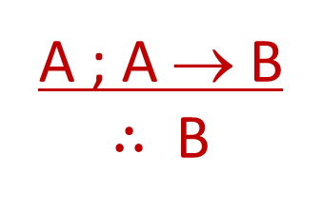
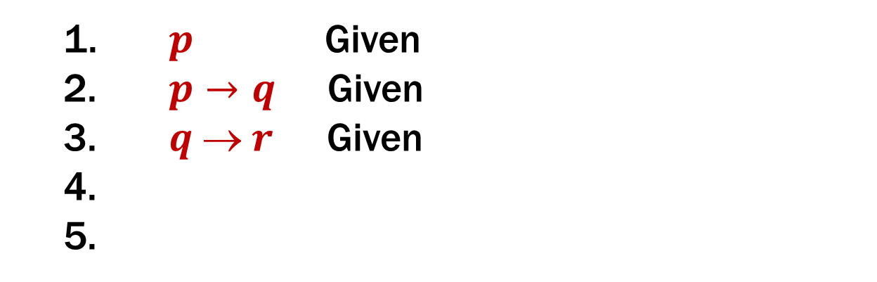
My First Proof!
Show that r follows from p, p → q, and q → r
1. $p$ Given
$p→q$ Given
$q  r$ Given
Modus Ponens

Slide 31
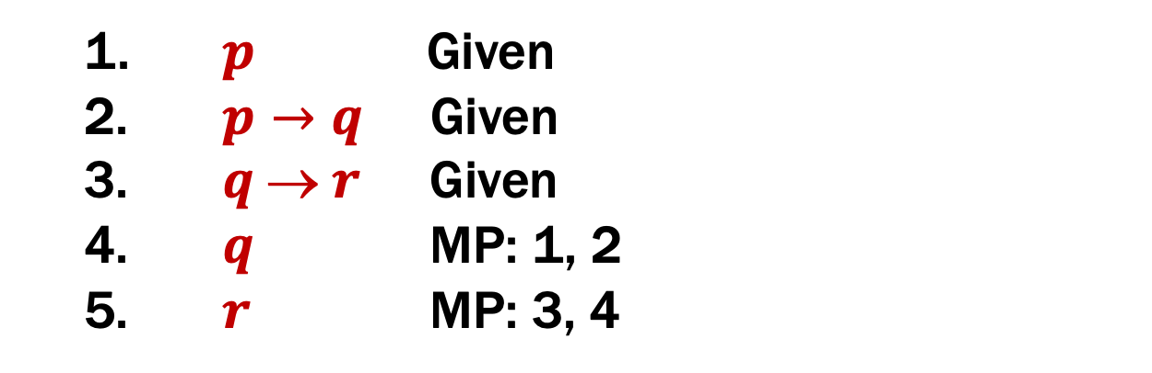
My First Proof!
Show that r follows from p, p → q, and q → r
1. $p$ Given
$p→q$ Given
$q  r$ Given
$q$ MP: 1, 2
$r$ MP: 3, 4
Modus Ponens

Slide 32
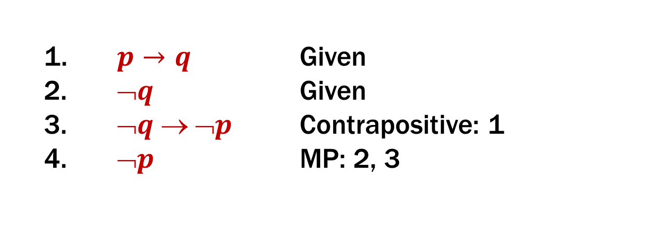
Proofs can use equivalences too
Show that ¬p follows from p → q and ¬q
1. $p→q$ Given
$➢q$ Given
$➢q  ➢p$ Contrapositive: 1
$➢p$ MP: 2, 3
Modus Ponens

Slide 33
Inference Rules
If A is true and B is true ….
Requirements:
A ; B
∴ C , D
Conclusions:
Then, C must be true
Then D must be true
Example (Modus Ponens):
A ; A → B
∴ B
If I have A and A → B both true,
Then B must be true.

Slide 34
Axioms: Special inference rules
If I have nothing…
Requirements:
∴ C , D
Conclusions:
Then, C must be true
Then D must be true
Example (Excluded Middle):
∴ A ∨¬A
A ∨¬A must be true.

Slide 35
Simple Propositional Inference Rules
Two inference rules per binary connective, one to eliminate it and one to introduce it
A ∧ B
∴ A, B
A ; B
∴ A ∧ B
Elim ∧
Intro ∧
A ∨ B ; ¬A
∴ B
A x
∴ A ∨ B, B ∨ A
Elim ∨
Intro ∨
A ; A → B
∴ B
A ⇒ B
∴ A → B
Modus Ponens
Direct Proof
Not like other rules

Slide 36
Proofs
Show that r follows from p, p → q and (p ∧ q) → r
How To Start:
We have givens, find the ones that go
together and use them. Now, treat new
things as givens, and repeat.
A ; A → B
∴ B
A ∧ B
∴ A, B
A ; B
∴ A ∧ B

Slide 37

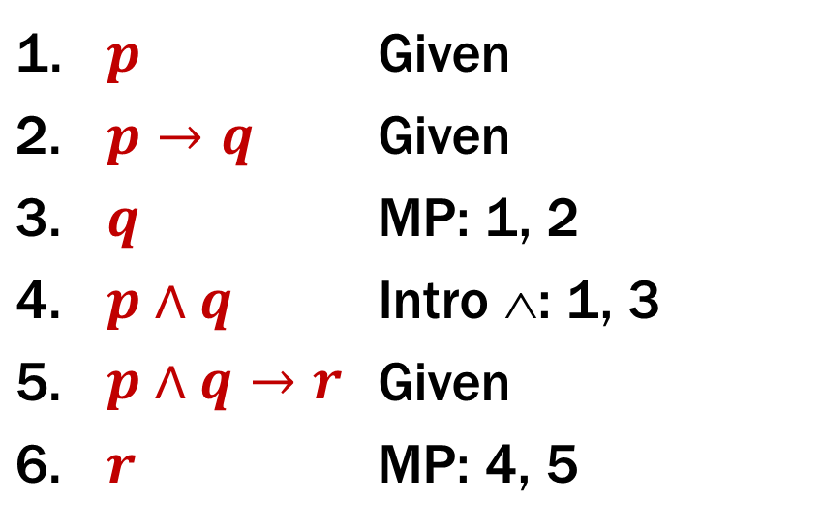


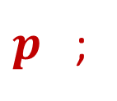


Proofs
Show that $r$ follows from$p, p→q,$ and $p∧q→r$
1. | $$p$$ | Given
2. | $$p→q$$ | Given
3. | $$q$$ | MP: 1, 2
4. | $$p∧q$$ | Intro ∧: 1, 3
5. | $$p∧q→r$$ | Given
6. | $$r$$ | MP: 4, 5
Two visuals of the same proof.
We will use the top one, but if the bottom one helps you think about it, that’s great!
$$p ; p→q$$
MP
$p$ ;
$$q$$
Intro ∧
$$p∧q ;$$
$$p∧q→r$$
MP
$$r$$

Slide 38

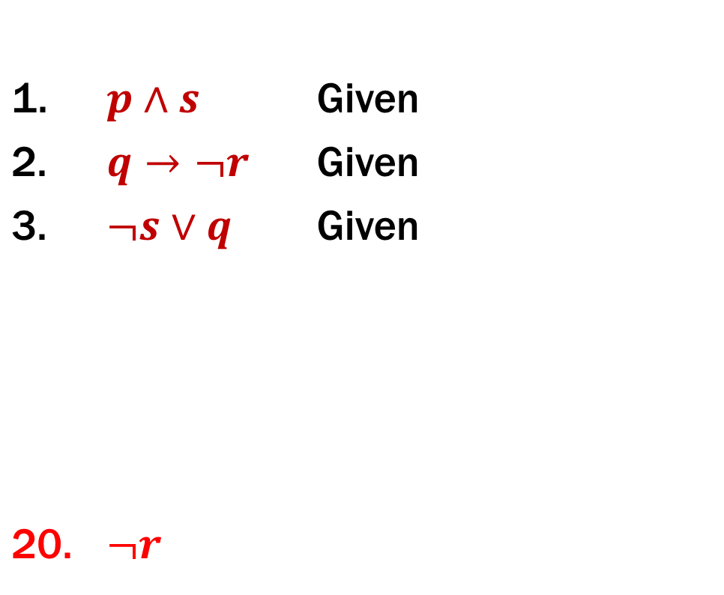
Proofs
Prove that ¬r follows from p ∧ s, q → ¬r, and ¬s ∨ q.
1. | $$p∧s$$ | Given
2. | $$q→¬r$$ | Given
3. | $$¬s∨q$$ | Given
20. | $$¬r$$
First: Write down givens and goal
Idea: Work backwards!

Slide 39

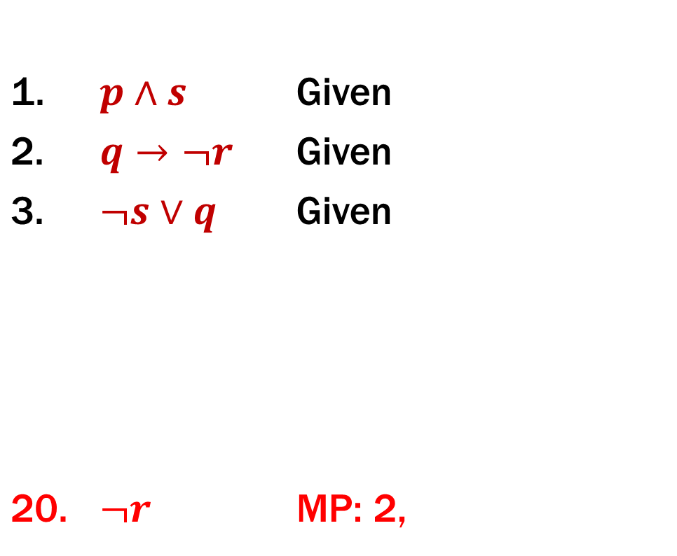


Proofs
Prove that ¬r follows from p ∧ s, q → ¬r, and ¬s ∨ q.
1. | $$p∧s$$ | Given
2. | $$q→¬r$$ | Given
3. | $$¬s∨q$$ | Given
20. | $$¬r$$ | MP: 2,
Idea: Work backwards!
We want to eventually get $➢r$. How?
We can use $q→¬r$ to get there.
The justification between 2 and 20 looks like “elim →” which is MP.

Slide 40
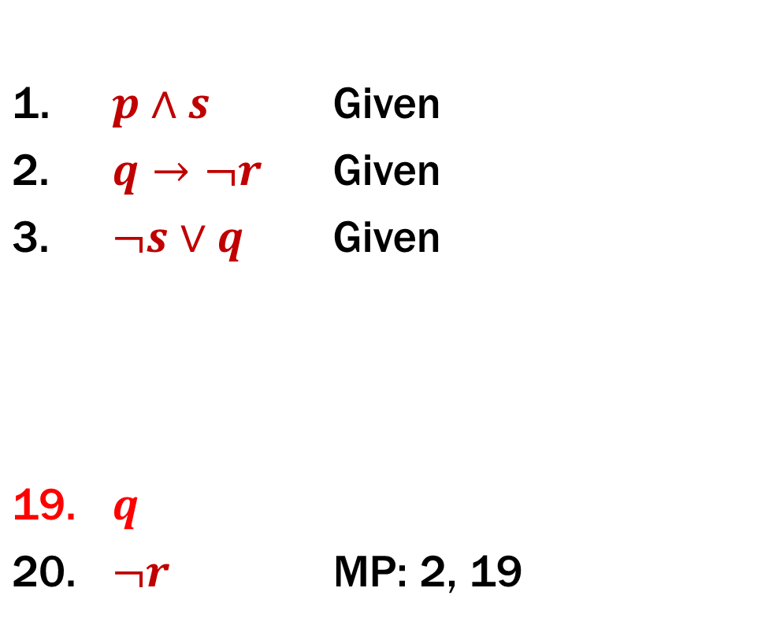
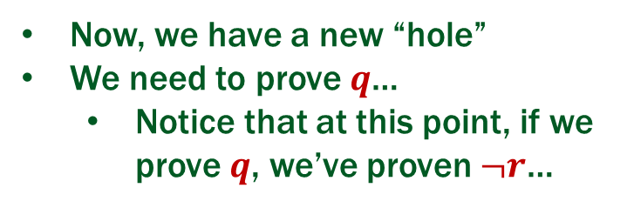

Proofs
Prove that ¬r follows from p ∧ s, q → ¬r, and ¬s ∨ q.
1. | $$p∧s$$ | Given
2. | $$q→¬r$$ | Given
3. | $$¬s∨q$$ | Given
19. | $$q$$
20. | $$¬r$$ | MP: 2, 19
Idea: Work backwards!
We want to eventually get $¬r$. How?
Now, we have a new “hole”
We need to prove $q$…
Notice that at this point, if we prove $q$, we’ve proven $¬r$…

Slide 41
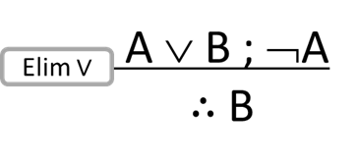
Proofs
Prove that ¬r follows from p ∧ s, q → ¬r, and ¬s ∨ q.
1. | $$p∧s$$ | Given
2. | $$q→¬r$$ | Given
3. | $$¬s∨q$$ | Given
19. | $$q$$
20. | $$¬r$$ | MP: 2, 19
This looks like or-elimination.

Slide 42
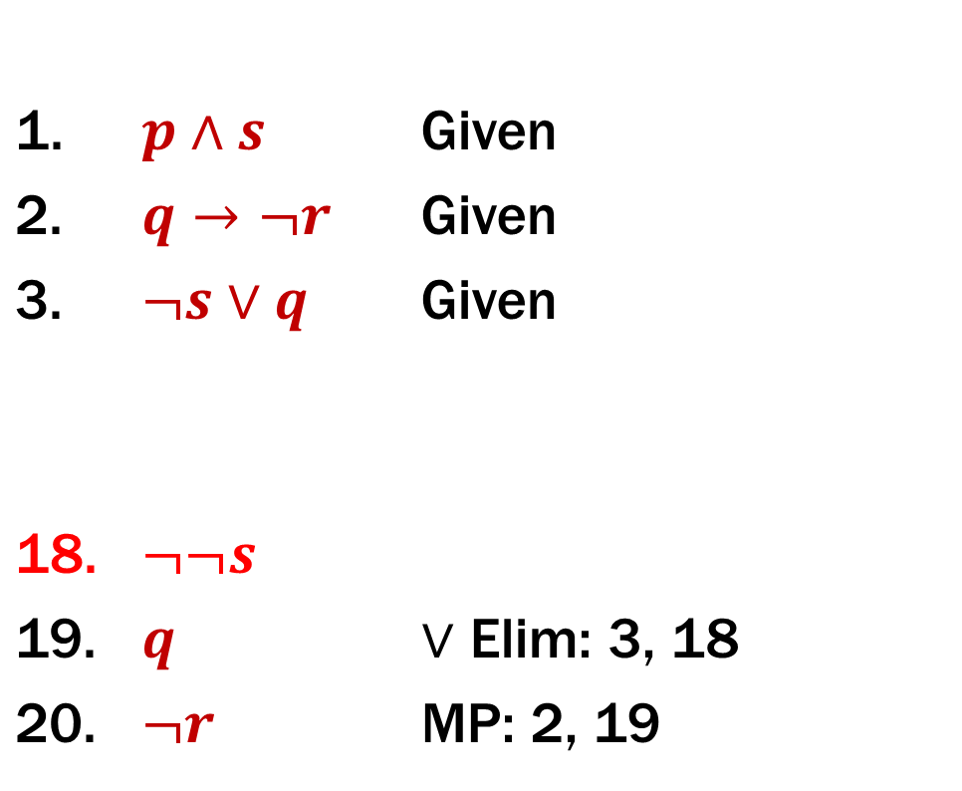
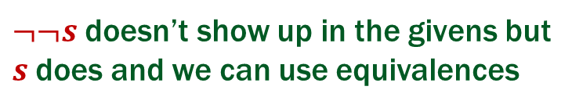
Proofs
Prove that ¬r follows from p ∧ s, q → ¬r, and ¬s ∨ q.
1. | $$p∧s$$ | Given
2. | $$q→¬r$$ | Given
3. | $$¬s∨q$$ | Given
18. | $$¬¬s$$
19. | $$q$$ | $∨$ Elim: 3, 18
20. | $$¬r$$ | MP: 2, 19
$¬¬s$ doesn’t show up in the givens but
$s$does and we can use equivalences

Slide 43
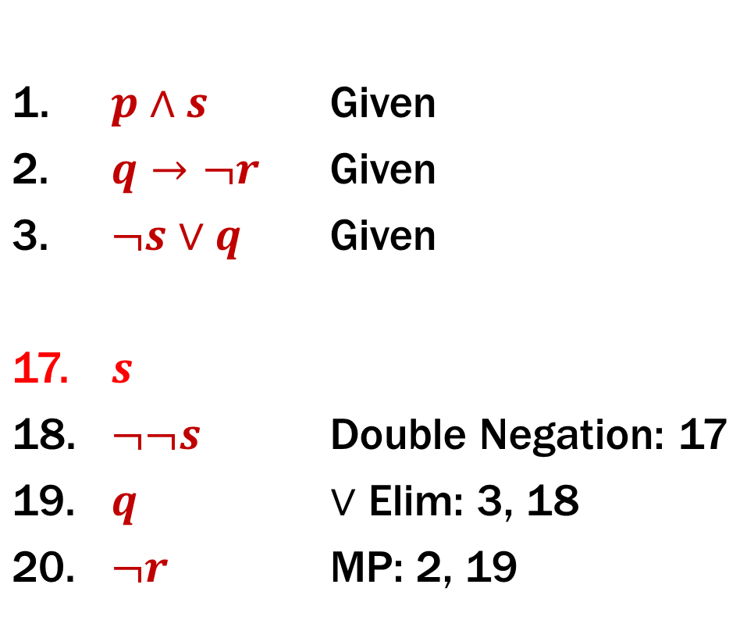
Proofs
Prove that ¬r follows from p ∧ s, q → ¬r, and ¬s ∨ q.
1. | $$p∧s$$ | Given
2. | $$q→¬r$$ | Given
3. | $$¬s∨q$$ | Given
17. | $$s$$
18. | $$¬¬s$$ | Double Negation: 17
19. | $$q$$ | $∨$ Elim: 3, 18
20. | $$¬r$$ | MP: 2, 19

Slide 44
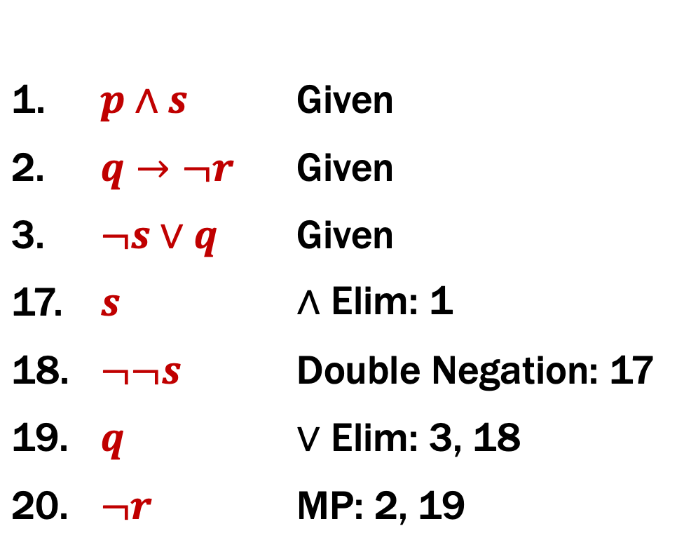
Proofs
Prove that ¬r follows from p ∧ s, q → ¬r, and ¬s ∨ q.
1. | $$p∧s$$ | Given
2. | $$q→¬r$$ | Given
3. | $$¬s∨q$$ | Given
17. | $$s$$ | ∧ Elim: 1
18. | $$¬¬s$$ | Double Negation: 17
19. | $$q$$ | $∨$ Elim: 3, 18
20. | $$¬r$$ | MP: 2, 19
No holes left! We just
need to clean up a bit.

Slide 45
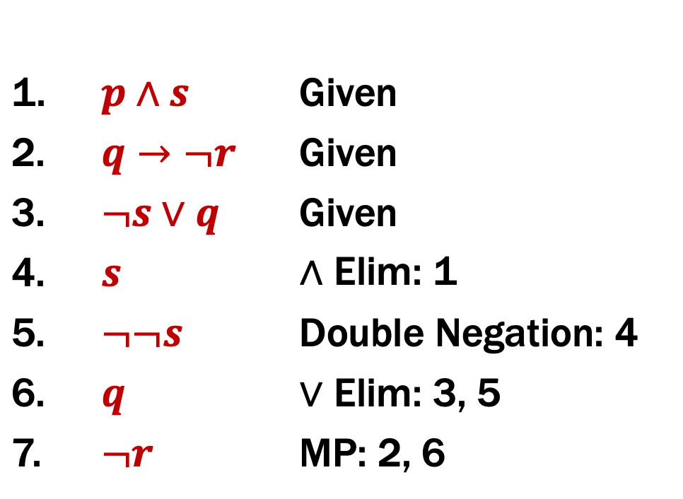
Proofs
Prove that ¬r follows from p ∧ s, q → ¬r, and ¬s ∨ q.
1. | $$p∧s$$ | Given
2. | $$q→¬r$$ | Given
3. | $$¬s∨q$$ | Given
4. | $$s$$ | ∧ Elim: 1
5. | $$¬¬s$$ | Double Negation: 4
6. | $$q$$ | $∨$ Elim: 3, 5
7. | $$¬r$$ | MP: 2, 6

Slide 46
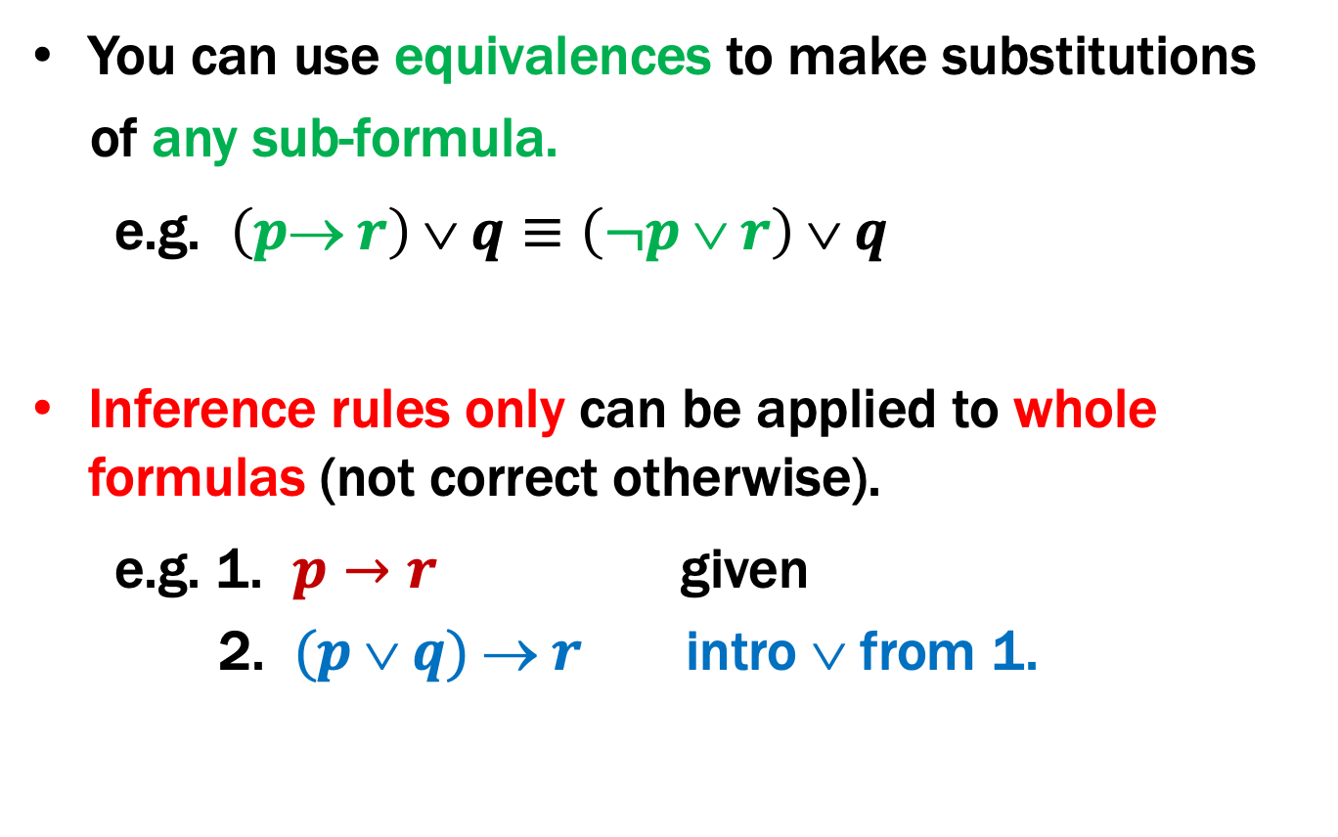
Important: Applications of Inference Rules
You can use equivalences to make substitutions
of any sub-formula.
e.g. $\left(p→ r\right) ∨ q≡\left(¬p ∨ r\right) ∨ q$
Inference rules only can be applied to whole formulas (not correct otherwise).
e.g. 1. $p→r$ given
2. $(p  q)  r$ intro ∨ from 1.
Does not follow! e.g . p=F, q=T, r=F

Slide 47

To Prove An Implication: $A→B$
A ⇒ B
∴ A → B
We use the direct proof rule
The “pre-requisite” A ⇒ B for the direct proof rule is a proof that “Given A, we can prove B.”
The direct proof rule:
If you have such a proof then you can conclude
that A → B is true

Slide 48
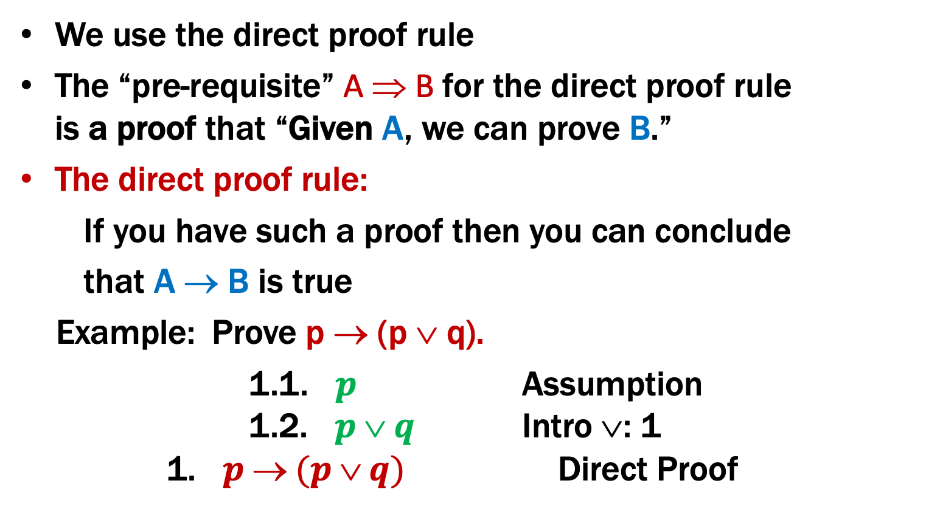
To Prove An Implication: $A→B$
A ⇒ B
∴ A → B
We use the direct proof rule
The “pre-requisite” A ⇒ B for the direct proof rule is a proof that “Given A, we can prove B.”
The direct proof rule:
If you have such a proof then you can conclude
that A → B is true
Example: Prove p → (p ∨ q).
1.1. $p$ Assumption 1.2. $p  q$ Intro ∨: 1 1. $p  (p  q)$ Direct Proof
proof subroutine
Indent proof
subroutine
⇒

Slide 49

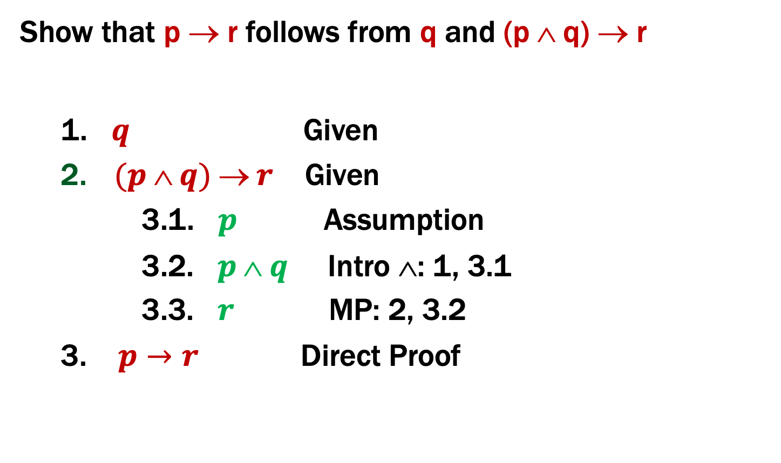
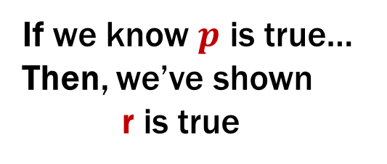
Proofs using the direct proof rule
Show that p → r follows from q and (p ∧ q) → r
1. $q$ Given
$(p  q)  r$ Given
3.1. $p$ Assumption
3.2. $p  q$ Intro ∧: 1, 3.1
3.3. $r$ MP: 2, 3.2
3. $p→r$ Direct Proof
This is a
proof
of $p→r$
If we know $p$ is true…
Then, we’ve shown
r is true

Slide 50
Example
Prove: (p ∧ q) → (p ∨ q)
There MUST be an application of the
Direct Proof Rule (or an equivalence)
to prove this implication.
Where do we start? We have no givens…

Slide 51
Example
Prove: (p ∧ q) → (p ∨ q)

Slide 52
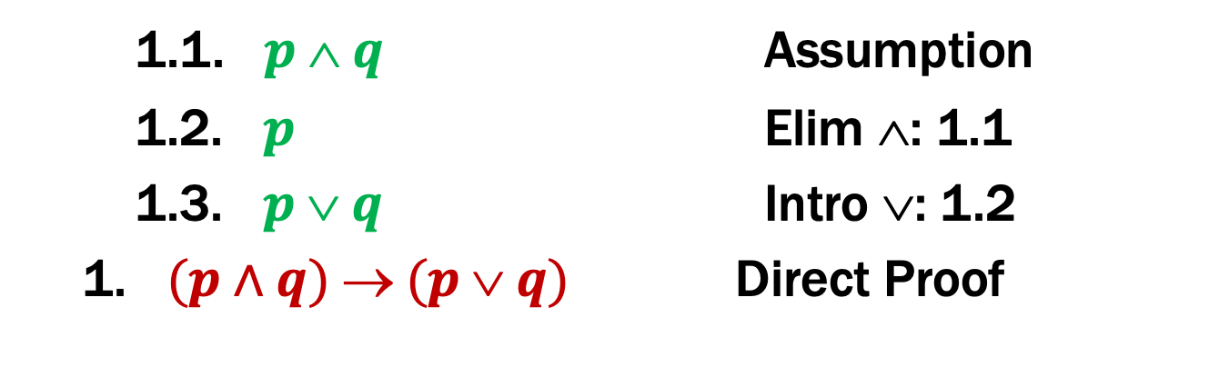
Example
Prove: (p ∧ q) → (p ∨ q)
1.1. $p  q$ Assumption
1.2. $p$ Elim ∧: 1.1
1.3. $p  q$ Intro ∨: 1.2
1. $(p∧q)  (p  q)$ Direct Proof

Slide 53
One General Proof Strategy
Look at the rules for introducing connectives to see how you would build up the formula you want to prove from pieces of what is given
Use the rules for eliminating connectives to break down the given formulas so that you get the pieces you need to do 1.
Write the proof beginning with what you figured out for 2 followed by 1.

