Slide 1
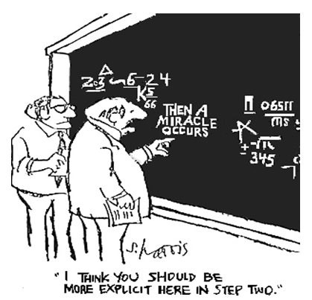
CSE 311: Foundations of Computing
Lecture 8: Predicate Logic Proofs, English Proofs

Slide 2
Last class: Inference Rules for Quantifiers
P(c) for some c
∴ ∃x P(x)
∀x P(x)
∴ P(a) for any a
Intro ∃
Elim ∀
∃x P(x)
∴ P(c) for some special** c
Elim ∃
Intro ∀
** by special, we mean that c is a
name for a value where P(c) is true.
We can’t use anything else about that
value, so c has to be a NEW name!.

Slide 3
A Not so Odd Example
Domain of Discourse
Predicate Definitions
Integers
Even(x) := ∃y (x = 2⋅y)
Odd(x) := ∃y (x = 2⋅y + 1)
Prove “There is an even number”
Formally: prove ∃x Even(x)

Slide 4
A Not so Odd Example
Domain of Discourse
Predicate Definitions
Integers
Even(x) := ∃y (x = 2⋅y)
Odd(x) := ∃y (x = 2⋅y + 1)
Prove “There is an even number”
Formally: prove ∃x Even(x)
1. 2 = 2⋅1 Algebra
∃y (2 = 2⋅y) Intro ∃: 1
Even(2) Definition of Even: 2
4. $\text{}\text{x} \text{E}\text{ven}\text{(}\text{x}\text{)}$ Intro ∃: 3

Slide 5
A Prime Example
Domain of Discourse
Predicate Definitions
Integers
Even(x) := ∃y (x = 2⋅y)
Odd(x) := ∃y (x = 2⋅y + 1)
Prime(x) := “x > 1 and x≠a⋅b for all integers a, b with 1<a<x”
Prove “There is an even prime number”
Formally: prove ∃x (Even(x) ∧ Prime(x))

Slide 6
A Prime Example
Domain of Discourse
Predicate Definitions
Integers
Even(x) := ∃y (x = 2⋅y)
Odd(x) := ∃y (x = 2⋅y + 1)
Prime(x) := “x > 1 and x≠a⋅b for all integers a, b with 1<a<x”
Prove “There is an even prime number”
Formally: prove ∃x (Even(x) ∧ Prime(x))
1. 2 = 2⋅1 Algebra
∃y (2 = 2⋅y) Intro ∃: 1
Even(2) Def of Even: 3
Prime(2) Property of integers
Even(2) ∧ Prime(2) Intro ∧: 2, 4
6. ∃x (Even(x) ∧ Prime(x)) Intro ∃: 5
*
* Later we will further break down “Prime” using quantifiers to prove statements like this

Slide 7
Inference Rules for Quantifiers: First look
P(c) for some c
∴ ∃x P(x)
∀x P(x)
∴ P(a) (for any a)
Intro ∃
Elim ∀
∃x P(x)
∴ P(c) for some special** c
“Let a be arbitrary*”...P(a)
∴ ∀x P(x)
Elim ∃
Intro ∀
* in the domain of P
** c is a NEW name.
Notes:
We can write “Let a be an object” and then apply Elim For All

Slide 8
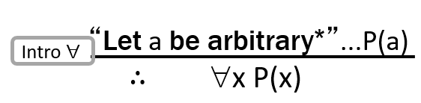
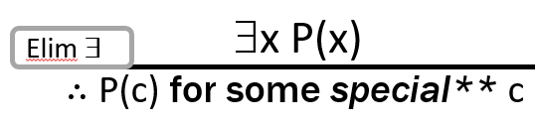

Even and Odd
Even(x) := ∃y (x=2y)
Odd(x) := ∃y (x=2y+1)
Domain: Integers
Prove: “The square of any even number is even.”
Formal proof of: ∀x (Even(x) → Even(x²))
3. ∀x (Even(x)→Even(x²))

Slide 9
Even and Odd
Even(x) := ∃y (x=2y)
Odd(x) := ∃y (x=2y+1)
Domain: Integers
Prove: “The square of any even number is even.”
Formal proof of: ∀x (Even(x) → Even(x²))
Let a be an arbitrary integer
2. Even(a)→Even(a²)
3. ∀x (Even(x)→Even(x²)) Intro ∀: 1,2

Slide 10
Even and Odd
Even(x) := ∃y (x=2y)
Odd(x) := ∃y (x=2y+1)
Domain: Integers
Prove: “The square of any even number is even.”
Formal proof of: ∀x (Even(x) → Even(x²))
Let a be an arbitrary integer
2.1 Even(a) Assumption
2.6 Even(a²)
2. Even(a)→Even(a²) Direct proof
3. ∀x (Even(x)→Even(x²)) Intro ∀: 1,2

Slide 11
Even and Odd
Even(x) := ∃y (x=2y)
Odd(x) := ∃y (x=2y+1)
Domain: Integers
Prove: “The square of any even number is even.”
Formal proof of: ∀x (Even(x) → Even(x²))
Let a be an arbitrary integer
2.1 Even(a) Assumption
2.2 $∃$y (a = 2y) Definition of Even
2.5$∃$y (a² = 2y)
2.6 Even(a²) Definition of Even
2. Even(a)→Even(a²) Direct Proof
3. ∀x (Even(x)→Even(x²)) Intro ∀: 1,2

Slide 12
Even and Odd
Even(x) := ∃y (x=2y)
Odd(x) := ∃y (x=2y+1)
Domain: Integers
Prove: “The square of any even number is even.”
Formal proof of: ∀x (Even(x) → Even(x²))
Let a be an arbitrary integer
2.1 Even(a) Assumption
2.2 $∃$y (a = 2y) Definition of Even
2.5$∃$y (a² = 2y) Intro ∃:
2.6 Even(a²) Definition of Even
2. Even(a)→Even(a²) Direct proof
3. ∀x (Even(x)→Even(x²)) Intro ∀: 1,2
Need a² = 2c
for some c

Slide 13
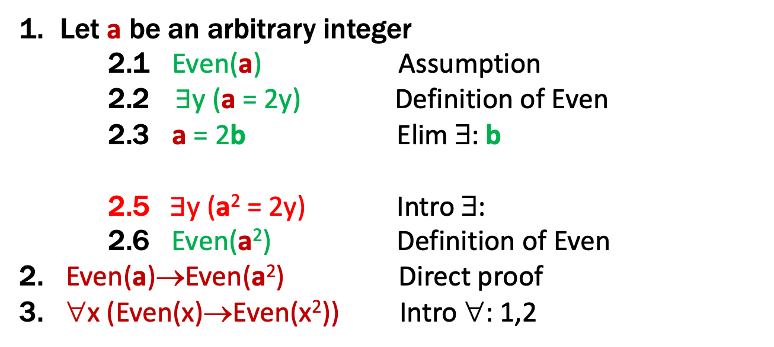
Even and Odd
Even(x) := ∃y (x=2y)
Odd(x) := ∃y (x=2y+1)
Domain: Integers
Prove: “The square of any even number is even.”
Formal proof of: ∀x (Even(x) → Even(x²))
Let a be an arbitrary integer
2.1 Even(a) Assumption
2.2 $∃$y (a = 2y) Definition of Even
2.3 a = 2b Elim ∃: b
2.5$∃$y (a² = 2y) Intro ∃:
2.6 Even(a²) Definition of Even
2. Even(a)→Even(a²) Direct proof
3. ∀x (Even(x)→Even(x²)) Intro ∀: 1,2
Need a² = 2c
for some c

Slide 14
Even and Odd
Even(x) := ∃y (x=2y)
Odd(x) := ∃y (x=2y+1)
Domain: Integers
Prove: “The square of any even number is even.”
Formal proof of: ∀x (Even(x) → Even(x²))
Let a be an arbitrary integer
2.1 Even(a) Assumption
2.2 $∃$y (a = 2y) Definition of Even
2.3 a = 2b Elim ∃: b
2.4 a² = 4b² = 2(2b²) Algebra
2.5$∃$y (a² = 2y) Intro ∃
2.6 Even(a²) Definition of Even
2. Even(a)→Even(a²) Direct Proof
3. ∀x (Even(x)→Even(x²)) Intro ∀: 1,2
Used a² = 2c for c=2b²

Slide 15
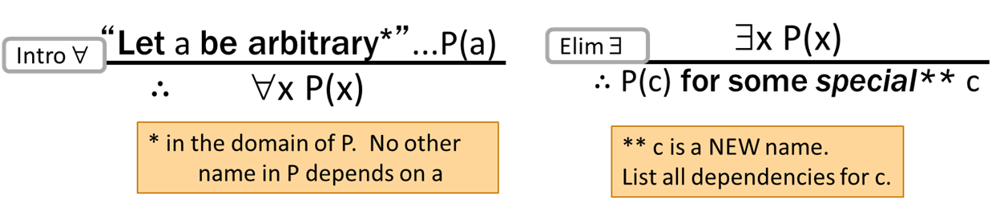
These rules need some caveats…
There are extra conditions on using these rules:
Without those rules, it is possible to infer claims that are false

Slide 16
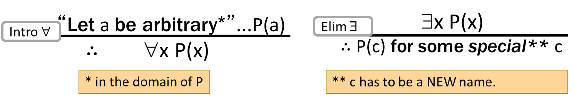
Without the rules, one could infer false claims…
There are extra conditions on using these rules:
Over integer domain: ∀x ∃y (y ≠ x) is True but ∃y∀x (y ≠ x) is False
BAD “PROOF”
∀x ∃y (y ≠ x) Given
Let a be an arbitrary integer
∃y (y ≠ a) Elim ∀: 1
b ≠ a Elim ∃: 3 (b new constant)
∀x (b ≠ x) Intro ∀: 2,4
∃y∀x (y ≠ x) Intro ∃ : 5

Slide 17
With the extra conditions we can kill the bad proof…
There are extra conditions on using these rules:
Over integer domain: ∀x ∃y (y ≠ x) is True but ∃y∀x (y ≠ x) is False
BAD “PROOF” KILLED
∀x ∃y (y ≠ x) Given
Let a be an arbitrary integer
∃y (y ≠ a) Elim ∀: 1
b ≠ a Elim ∃: 3 (b depends on a)
∀x (b ≠ x) Intro ∀: 2,4
∃y∀x (y ≠ x) Intro ∃ : 5
Can’t get rid of a since another name in the same line, b, depends on it!

Slide 18
Inference Rules for Quantifiers: Full version
P(c) for some c
∴ ∃x P(x)
∀x P(x)
∴ P(a) (for any a)
Intro ∃
Elim ∀
∃x P(x)
∴ P(c) for some special** c
“Let a be arbitrary*”...P(a)
∴ ∀x P(x)
Elim ∃
Intro ∀
** c is a NEW name.
List all dependencies for c.
* in the domain of P. No other name in P depends on a.
Notes:
We can write “Let a be an object” and then apply Elim For All

Slide 19
Formal Proofs
In principle, formal proofs are the standard for what it means to be “proven” in mathematics
almost all math (and theory CS) done in Predicate Logic
But they are tedious and impractical
e.g., applications of commutativity and associativity
Russell & Whitehead’s formal proof that 1+1 = 2 appears after more than 100 pages of build up
we allowed ourselves to cite “Arithmetic”, “Algebra”, etc.
Similar situation exists in programming...

Slide 20
Programming
a := ADD(i, 1)
b := MOD(a, n)
c := ADD(arr, b)
d := LOAD(c)
e := ADD(arr, i)
STORE(e, d)
arr[i] = arr[(i+1) % n];
Assembly Language
High-level Language

Slide 21
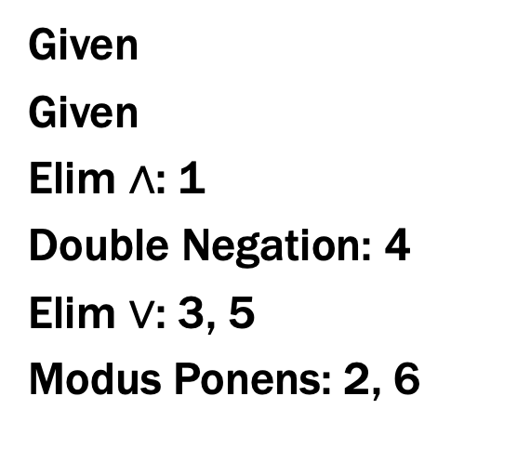
Programming vs Proofs
a := ADD(i, 1)
b := MOD(a, n)
c := ADD(arr, b)
d := LOAD(c)
e := ADD(arr, i)
STORE(e, d)
Given
Given
Elim ∧: 1
Double Negation: 4
Elim $∨$: 3, 5
Modus Ponens: 2, 6
Assembly Language
for Programs
Assembly Language
for Proofs

Slide 22
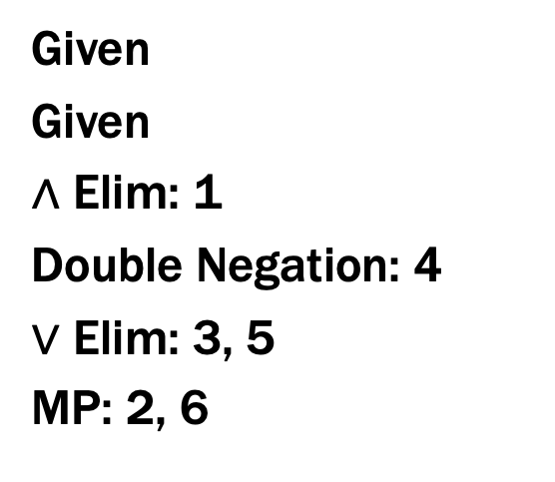
Proofs
Given
Given
∧ Elim: 1
Double Negation: 4
$∨$ Elim: 3, 5
MP: 2, 6
what is the “Java”
for proofs?
Assembly Language
for Proofs
High-level Language
for Proofs

Slide 23
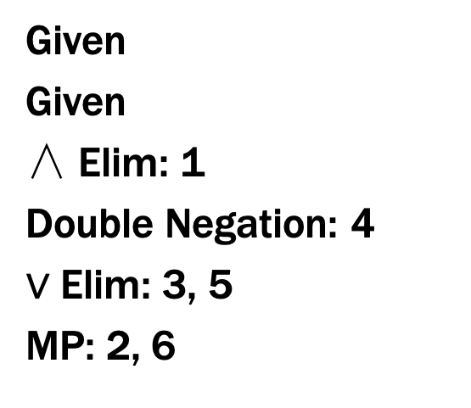
Proofs
Given
Given
∧ Elim: 1
Double Negation: 4
$∨$ Elim: 3, 5
MP: 2, 6
English
?
Assembly Language
for Proofs
High-level Language
for Proofs

Slide 24
Proofs
Given
Given
∧ Elim: 1
Double Negation: 4
$∨$ Elim: 3, 5
MP: 2, 6
Math English
Assembly Language
for Proofs
High-level Language
for Proofs
Notes:
In Math English, “if …, then …” always means implies.

Slide 25
Proofs
Formal proofs follow simple well-defined rules and should be easy for a machine to check
as assembly language is easy for a machine to execute
English proofs correspond to those rules but are designed to be easier for humans to read
also easy to check with practice
(almost all actual math and theory CS is done this way)
English proof is correct if the reader is convinced that they could translate it into a formal proof
(the reader is the “compiler” for English proofs)

Slide 26
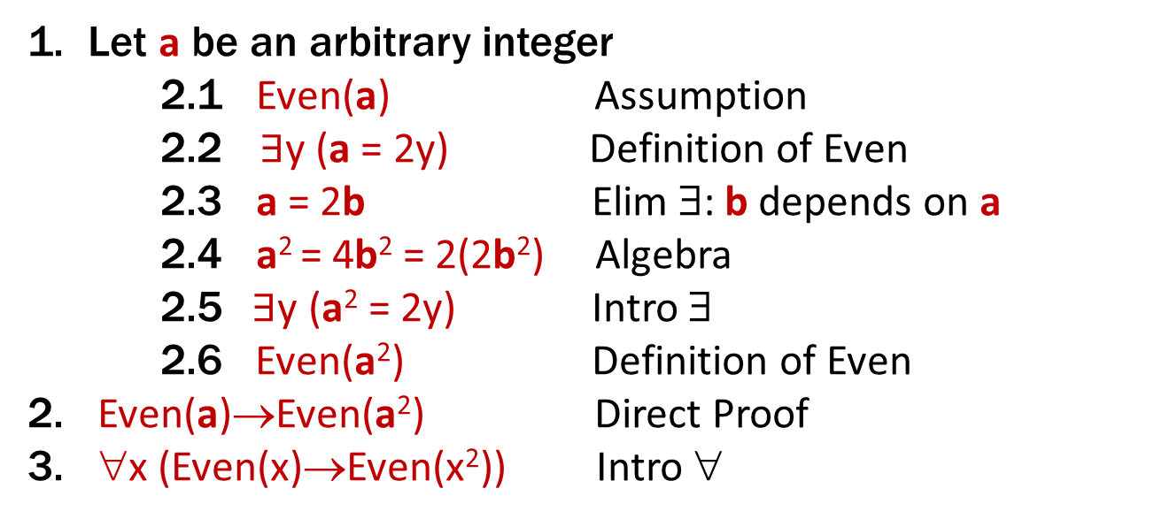
Formal Proof: Even and Odd
Even(x) ≡ ∃y (x=2y)
Odd(x) ≡ ∃y (x=2y+1)
Domain: Integers
Prove: “The square of every even number is even.”
Formal proof of: ∀x (Even(x) → Even(x²))
Let a be an arbitrary integer
2.1 Even(a) Assumption
2.2 $∃$y (a = 2y) Definition of Even
2.3 a = 2b Elim ∃: b depends on a
2.4 a² = 4b² = 2(2b²) Algebra
2.5$∃$y (a² = 2y) Intro ∃
2.6 Even(a²) Definition of Even
2. Even(a)→Even(a²) Direct Proof
3. ∀x (Even(x)→Even(x²)) Intro ∀

Slide 27
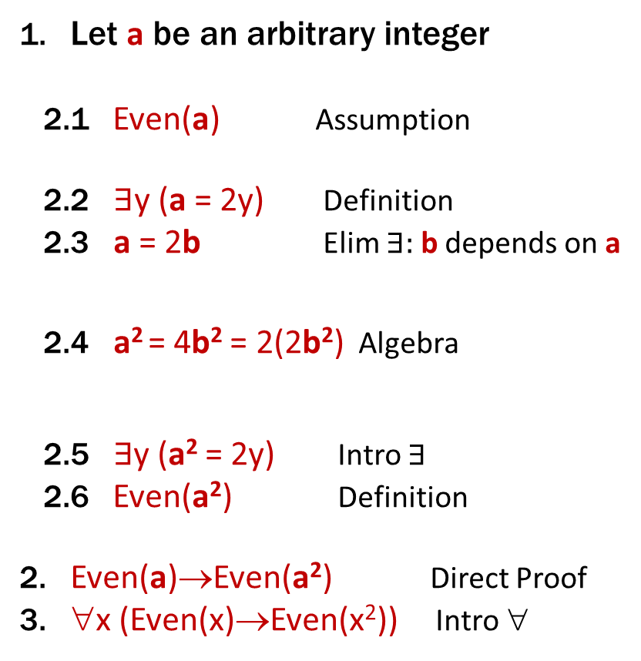
English Proof: Even and Odd
Even(x) ≡ ∃y (x=2y)
Odd(x) ≡ ∃y (x=2y+1)
Domain: Integers
Prove “The square of every even integer is even.”
Let a be an arbitrary integer. Suppose a is even.
Then, by definition, a = 2b for some integer b.
Squaring both sides, we get a² = 4b² = 2(2b²).
So a² is, by definition, even.
Since a was arbitrary, we have shown that the square of every even number is even.
Let a be an arbitrary integer
2.1 Even(a) Assumption
2.2 $∃$y (a = 2y) Definition
2.3 a = 2b Elim $∃:$ b depends on a
2.4 a² = 4b² = 2(2b²) Algebra
2.5$∃$y (a² = 2y) Intro $∃$
2.6 Even(a²) Definition
2. Even(a)→Even(a²) Direct Proof
3. ∀x (Even(x)→Even(x²)) Intro ∀
Notes:
We skip lines stating “there exists” and just immediately name that object.
We skip lines stating implication proven by direct proof rule.

Slide 28
English Proof: Even and Odd
Even(x) ≡ ∃y (x=2y)
Odd(x) ≡ ∃y (x=2y+1)
Domain: Integers
Prove “The square of every even integer is even.”
Proof: Let a be an arbitrary integer.
Suppose a is even. Then, by definition, a = 2b for some integer b. Squaring both sides, we get a² = 4b² = 2(2b²). So a² is, by definition, is even.
Since a was arbitrary, we have shown that the square of every even number is even.
Notes:
Show how to recover the structure from the text: for all a, Even(a) -> Even(a^2).

Slide 29
English Proof: Even and Odd
Even(x) ≡ ∃y (x=2y)
Odd(x) ≡ ∃y (x=2y+1)
Domain: Integers
Prove “The square of every even integer is even.”
Proof: Let a be an arbitrary even integer.
Then, by definition, a = 2b for some integer b. Squaring both sides, we get a² = 4b² = 2(2b²). So a² is, by definition, is even.
Since a was arbitrary, we have shown that the square of every even number is even.
∀x (Even(x) → Even(x²))
Notes:
Show how to recover the structure from the text: for all a, Even(a) -> Even(a^2).

Slide 30
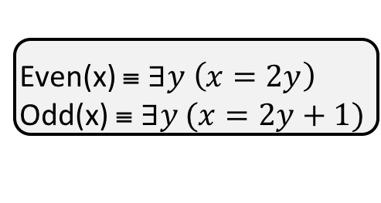
Even and Odd
Predicate Definitions
Even(x) ≡ $∃y \left(x=2y\right)$
Odd(x) ≡ $∃y (x=2y+1)$
Domain of Discourse
Integers
Prove “The sum of two odd numbers is even.”
Formally, prove ∀x ∀y ((Odd(x) ∧ Odd(y))→Even(x+y))

Slide 31
Even and Odd
Predicate Definitions
Even(x) ≡ $∃y \left(x=2y\right)$
Odd(x) ≡ $∃y (x=2y+1)$
Domain of Discourse
Integers
Prove “The sum of two odd numbers is even.”
Formally, prove ∀x ∀y ((Odd(x) ∧ Odd(y))→Even(x+y))
Let x and y be arbitrary integers.
Since x and y were arbitrary, the sum of two odd integers is even.
Let x be an arbitrary integer
Let y be an arbitrary integer
3. (Odd(x) ∧ Odd(y)) → Even(x+y)
∀y ((Odd(x) ∧ Odd(y)) → Even(x+y)) Intro ∀
∀x∀y ((Odd(x) ∧ Odd(y)) → Even(x+y)) Intro ∀

Slide 32
Even and Odd
Predicate Definitions
Even(x) ≡ $∃y \left(x=2y\right)$
Odd(x) ≡ $∃y (x=2y+1)$
Domain of Discourse
Integers
Prove “The sum of two odd numbers is even.”
Formally, prove ∀x ∀y ((Odd(x) ∧ Odd(y))→Even(x+y))
Let x and y be arbitrary integers.
Suppose that both are odd.
so x+y is even.
Since x and y were arbitrary, the sum of two odd integers is even.
Let x be an arbitrary integer
Let y be an arbitrary integer
3.1 Odd(x) ∧ Odd(y) Assumption
3.9 Even(x+y)
3. (Odd(x) ∧ Odd(y)) → Even(x+y) DPR
∀y ((Odd(x) ∧ Odd(y)) → Even(x+y)) Intro ∀
∀x∀y ((Odd(x) ∧ Odd(y)) → Even(x+y)) Intro ∀

Slide 33
Even and Odd
Predicate Definitions
Even(x) ≡ $∃y \left(x=2y\right)$
Odd(x) ≡ $∃y (x=2y+1)$
Domain of Discourse
Integers
Prove “The sum of two odd numbers is even.”
Formally, prove ∀x ∀y ((Odd(x) ∧ Odd(y))→Even(x+y))
Let x and y be arbitrary integers.
Suppose that both are odd.
so x+y is even.
Since x and y were arbitrary, the sum of two odd integers is even.
Let x be an arbitrary integer
Let y be an arbitrary integer
3.1 Odd(x) ∧ Odd(y) Assumption
3.2 Odd(x) Elim ∧: 3.1
3.3 Odd(y) Elim ∧: 3.1
3.9 Even(x+y)
3. (Odd(x) ∧ Odd(y)) → Even(x+y) DPR
∀y ((Odd(x) ∧ Odd(y)) → Even(x+y)) Intro ∀
∀x∀y ((Odd(x) ∧ Odd(y)) → Even(x+y)) Intro ∀

Slide 34
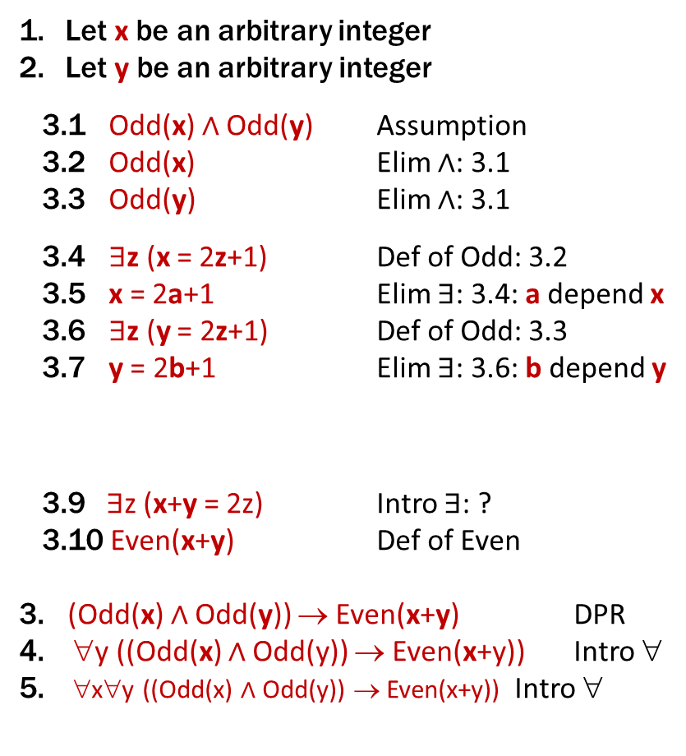
English Proof: Even and Odd
Even(x) ≡ ∃y (x=2y)
Odd(x) ≡ ∃y (x=2y+1)
Domain: Integers
Prove “The sum of two odd numbers is even.”
Let x and y be arbitrary integers.
Suppose that both are odd.
Then, we have x = 2a+1 for some integer a and y = 2b+1 for some integer b.
so x+y is, by definition, even.
Since x and y were arbitrary, the sum of two odd integers is even.
Let x be an arbitrary integer
Let y be an arbitrary integer
3.1 Odd(x) ∧ Odd(y) Assumption
3.2 Odd(x) Elim ∧: 3.1
3.3 Odd(y) Elim ∧: 3.1
3.4 $∃$z (x = 2z+1) Def of Odd: 3.2
3.5 x = 2a+1 Elim ∃: 3.4: a depend x
3.6 $∃$z (y = 2z+1) Def of Odd: 3.3
3.7 y = 2b+1 Elim ∃: 3.6: b depend y
3.9$∃$z (x+y = 2z) Intro ∃: ?
3.10 Even(x+y) Def of Even
3. (Odd(x) ∧ Odd(y)) → Even(x+y) DPR
∀y ((Odd(x) ∧ Odd(y)) → Even(x+y)) Intro ∀
∀x∀y ((Odd(x) ∧ Odd(y)) → Even(x+y)) Intro ∀
Notes:
We skip lines stating “there exists” and just immediately name that object.
We skip lines stating implication proven by direct proof rule.

Slide 35
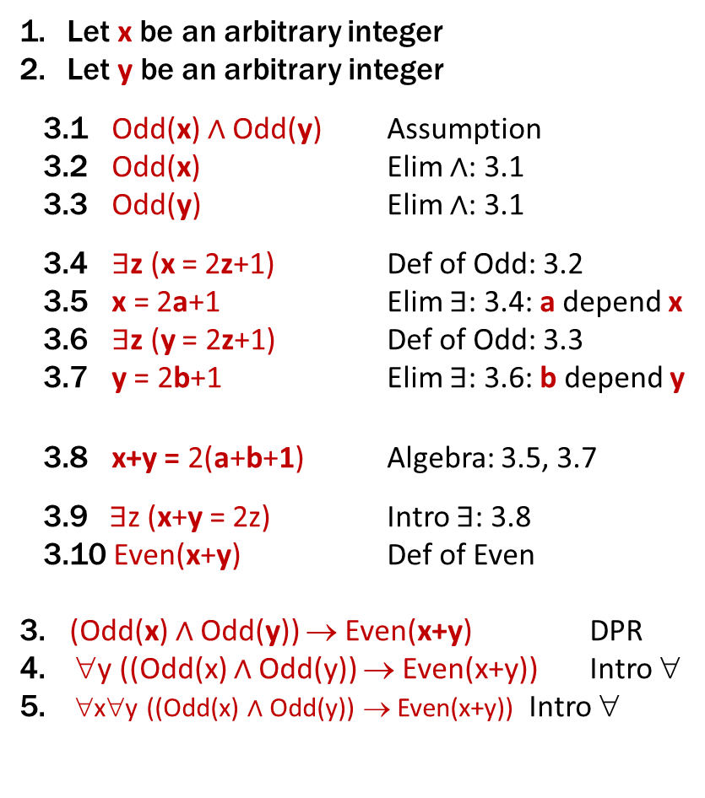
English Proof: Even and Odd
Even(x) ≡ ∃y (x=2y)
Odd(x) ≡ ∃y (x=2y+1)
Domain: Integers
Prove “The sum of two odd numbers is even.”
Let x and y be arbitrary integers.
Suppose that both are odd.
Then, we have x = 2a+1 for some integer a and y = 2b+1 for some integer b.
Their sum is x+y = ... = 2(a+b+1)
so x+y is, by definition, even.
Since x and y were arbitrary, the sum of two odd integers is even.
Let x be an arbitrary integer
Let y be an arbitrary integer
3.1 Odd(x) ∧ Odd(y) Assumption
3.2 Odd(x) Elim ∧: 3.1
3.3 Odd(y) Elim ∧: 3.1
3.4 $∃$z (x = 2z+1) Def of Odd: 3.2
3.5 x = 2a+1 Elim ∃: 3.4: a depend x
3.6 $∃$z (y = 2z+1) Def of Odd: 3.3
3.7 y = 2b+1 Elim ∃: 3.6: b depend y
3.8 x+y = 2(a+b+1) Algebra: 3.5, 3.7
3.9$∃$z (x+y = 2z) Intro ∃: 3.8
3.10 Even(x+y) Def of Even
3. (Odd(x) ∧ Odd(y)) → Even(x+y) DPR
∀y ((Odd(x) ∧ Odd(y)) → Even(x+y)) Intro ∀
∀x∀y ((Odd(x) ∧ Odd(y)) → Even(x+y)) Intro ∀
Notes:
We skip lines stating “there exists” and just immediately name that object.
We skip lines stating implication proven by direct proof rule.

Slide 36
Even and Odd
Predicate Definitions
Even(x) ≡ $∃y \left(x=2y\right)$
Odd(x) ≡ $∃y (x=2y+1)$
Domain of Discourse
Integers
Prove “The sum of two odd numbers is even.”
Proof: Let x and y be arbitrary integers.
Suppose that both are odd. Then, we have x = 2a+1 for some integer a and y = 2b+1 for some integer b. Their sum is x+y = (2a+1) + (2b+1) = 2a+2b+2 = 2(a+b+1), so x+y is, by definition, even.
Since x and y were arbitrary, the sum of any two odd integers is even.

Slide 37
Even and Odd
Predicate Definitions
Even(x) ≡ $∃y \left(x=2y\right)$
Odd(x) ≡ $∃y (x=2y+1)$
Domain of Discourse
Integers
Prove “The sum of two odd numbers is even.”
Proof: Let x and y be arbitrary odd integers.
Then, x = 2a+1 for some integer a and y = 2b+1 for some integer b. Their sum is x+y = (2a+1) + (2b+1) = 2a+2b+2 = 2(a+b+1), so x+y is, by definition, even.
Since x and y were arbitrary, the sum of any two odd integers is even.
∀x ∀y ((Odd(x) ∧ Odd(y))→Even(x+y))

