Slide 1
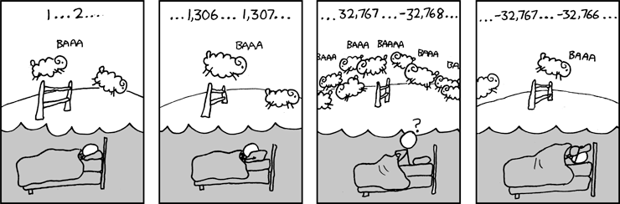
CSE 311: Foundations of Computing
Lecture 10: Modular Arithmetic

Slide 2
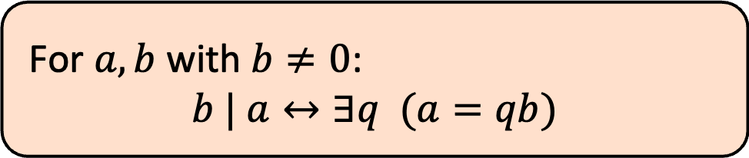

Last Class: Divisibility
Definition: “b divides a”
For $a, b$ with $b≠0$:
$$b | a↔∃q (a=qb)$$
Check Your Understanding. Which of the following are true?
5 | 1 25 | 5 5 | 0 3 | 2
1 | 5 5 | 25 0 | 5 2 | 3
5 | 1 iff 1 = 5k
25 | 5 iff 5 = 25k
5 | 0 iff 0 = 5k
3 | 2 iff 2 = 3k
1 | 5 iff 5 = 1k
5 | 25 iff 25 = 5k
0 | 5 iff 5 = 0k
2 | 3 iff 3 = 2k

Slide 3
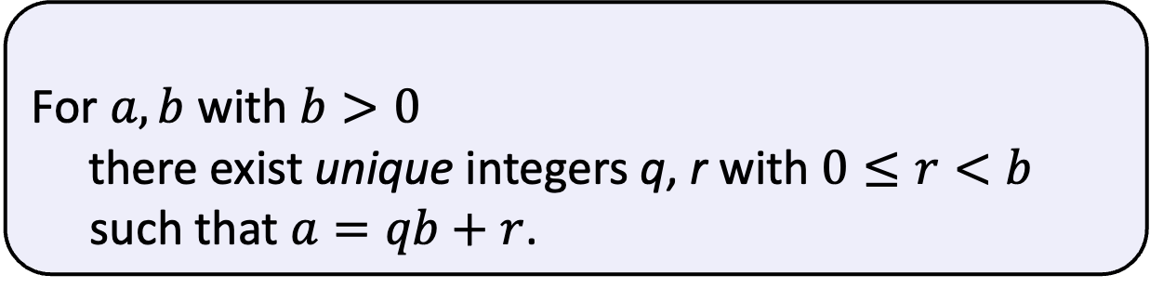

Last class: Division Theorem
Domain of Discourse
Integers
Division Theorem
For $a,b$ with $b>0$
there exist unique integers q, r with $0≤r<b$ such that $a=qb+r$.
To put it another way, if we divide b into a, we get a unique quotient and non-negative remainder
q = a div b
r = a mod b
Note: r ≥ 0 even if a < 0.
Not quite the same as a % d.

Slide 4
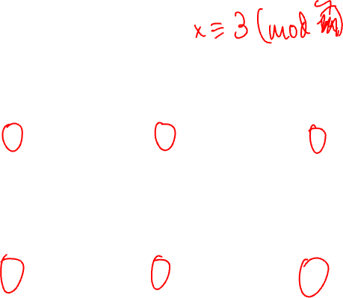
Last class: div and mod
x = 7 · (x div 7) + (x mod 7)
0 1 2 3 4 5 6 0 1 2 3 4 5 6 0 1 2 3 4 5 6 0 1
x mod 7
-1 -1 -1 -1 -1 -1 -1 0 0 0 0 0 0 0 1 1 1 1 1 1 1 2 2
x div 7
-7 -6 -5 -4 -3 -2 -1 0 1 2 3 4 5 6 7 8 9 10 11 12 13 14 15
7 · (-1)
7 · 0
x
7 · 1
7 · 2

Slide 5
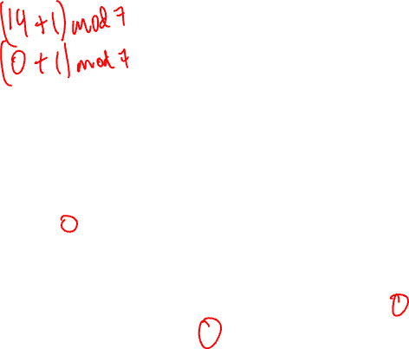
Arithmetic, mod 7
(a + b) mod 7
(a × b) mod 7
+ | 0 | 1 | 2 | 3 | 4 | 5 | 6
0 | 0 | 1 | 2 | 3 | 4 | 5 | 6
1 | 1 | 2 | 3 | 4 | 5 | 6 | 0
2 | 2 | 3 | 4 | 5 | 6 | 0 | 1
3 | 3 | 4 | 5 | 6 | 0 | 1 | 2
4 | 4 | 5 | 6 | 0 | 1 | 2 | 3
5 | 5 | 6 | 0 | 1 | 2 | 3 | 4
6 | 6 | 0 | 1 | 2 | 3 | 4 | 5
X | 0 | 1 | 2 | 3 | 4 | 5 | 6
0 | 0 | 0 | 0 | 0 | 0 | 0 | 0
1 | 0 | 1 | 2 | 3 | 4 | 5 | 6
2 | 0 | 2 | 4 | 6 | 1 | 3 | 5
3 | 0 | 3 | 6 | 2 | 5 | 1 | 4
4 | 0 | 4 | 1 | 5 | 2 | 6 | 3
5 | 0 | 5 | 3 | 1 | 6 | 4 | 2
6 | 0 | 6 | 5 | 4 | 3 | 2 | 1
Notes:
5 = 0 * 7 + 5
6 = 0 * 7 + 6
7 = 1 * 7 + 0

Slide 6

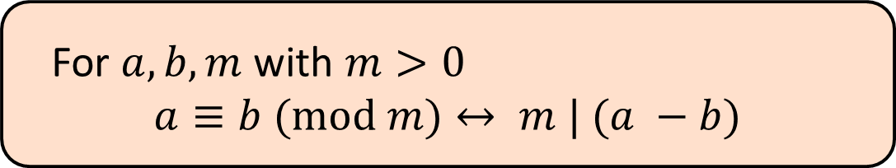
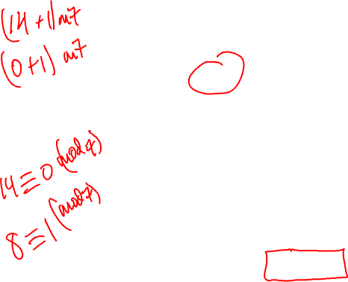
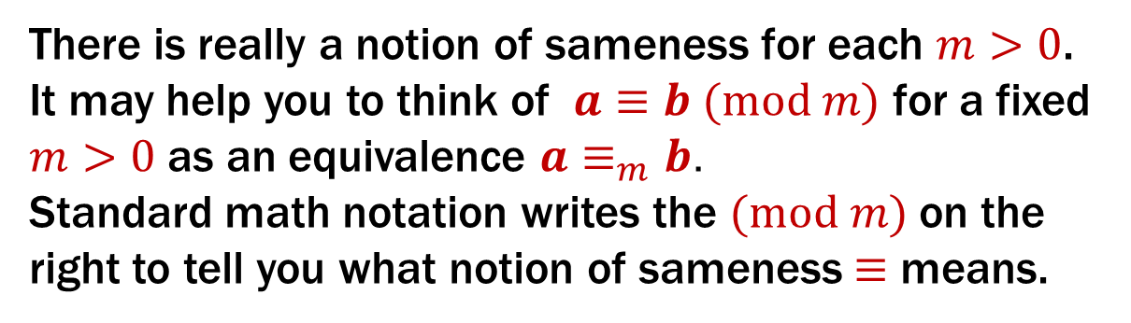
Modular Arithmetic
Domain of Discourse
Integers
Definition: “a is congruent to b modulo m”
For $a, b, m$ with $m>0$
$$a≡b (mod m)↔ m | (a −b)$$
New notion of “sameness” or “equivalence” that will help us understand modular arithmetic.
This is a predicate (T/F values) on integers $a,b,m$. It does not produce numbers as output.
There is really a notion of sameness for each $m>0$.
It may help you to think of $a≡b (mod m)$ for a fixed $m>0$ as an equivalence ${a≡}_{m}b$.
Standard math notation writes the $(mod m)$ on the right to tell you what notion of sameness $≡$ means.

Slide 7
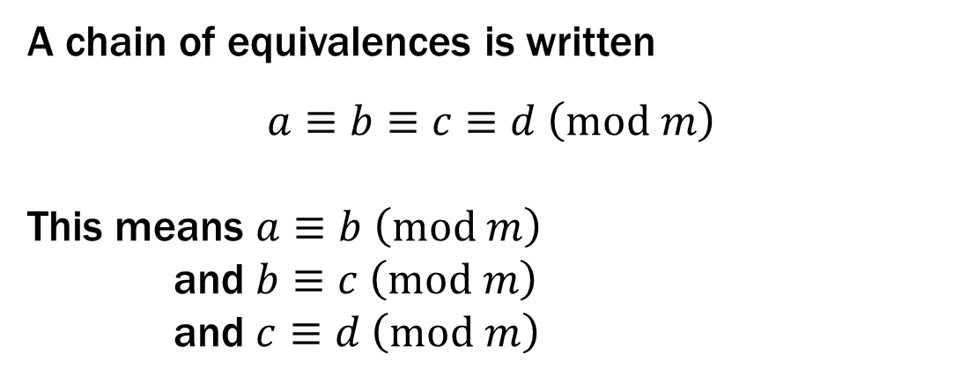
Modular Arithmetic
Domain of Discourse
Integers
Definition: “a is congruent to b modulo m”
For $a, b, m$ with $m>0$
$$a≡b (mod m)↔ m | (a −b)$$
A chain of equivalences is written
$$a≡b≡c≡d \left(mod m\right)$$
This means $a≡b \left(mod m\right)$
and $b≡c \left(mod m\right)$
and $c≡d \left(mod m\right)$

Slide 8
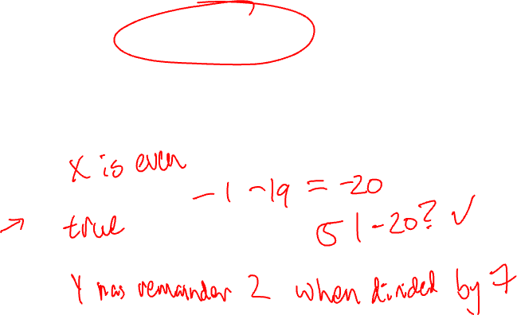
Modular Arithmetic
Domain of Discourse
Integers
Definition: “a is congruent to b modulo m”
For $a, b, m$ with $m>0$
$$a≡b (mod m)↔ m | (a −b)$$
Check Your Understanding. What do each of these mean?
When are they true?
x ≡ 0 (mod 2)
-1 ≡ 19 (mod 5)
y ≡ 2 (mod 7)
This statement is the same as saying “x is even”; so, any x that is even (including negative even numbers) will work.
This statement is true. 19 - (-1) = 20 which is divisible by 5
This statement is true for y in { ..., -12, -5, 2, 9, 16, ...}. In other words, all y of the form 2+7k for k an integer.

Slide 9

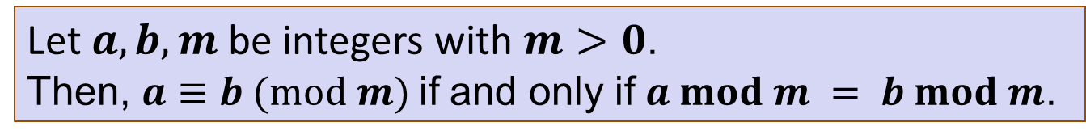
Modular Arithmetic: A Property
$$a≡b (mod m)↔ m | (a −b)$$
Let $a, b, m$be integers with $m>0$. Then, $a≡b (mod m)$if and only if $a mod m = b mod m$.

Slide 10
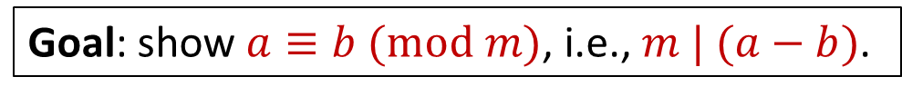
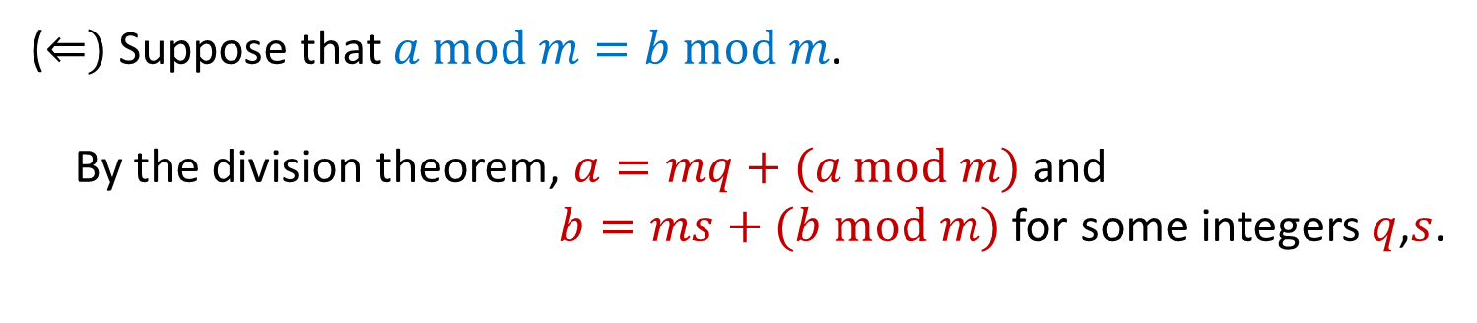
Modular Arithmetic: A Property
$$a≡b (mod m)↔ m | (a −b)$$
Let $a, b, m$be integers with $m>0$. Then, $a≡b (mod m)$if and only if $a mod m = b mod m$.
(⇐) Suppose that $a mod m=b mod m$.
By the division theorem, $a=mq+(a mod m)$ and
$b=ms+(b mod m)$ for some integers $q$,$s$.
Goal: show $a≡b (mod m)$, i.e., $m | (a−b)$.

Slide 11
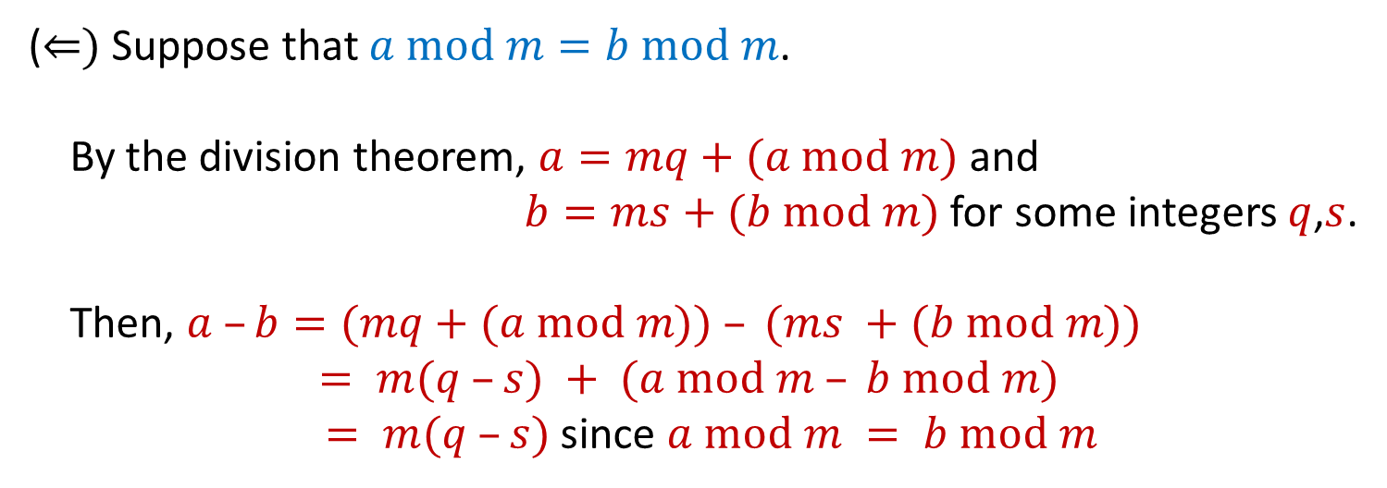
Modular Arithmetic: A Property
$$a≡b (mod m)↔ m | (a −b)$$
Let $a, b, m$be integers with $m>0$. Then, $a≡b (mod m)$if and only if $a mod m = b mod m$.
(⇐) Suppose that $a mod m=b mod m$.
By the division theorem, $a=mq+(a mod m)$ and
$b=ms+(b mod m)$ for some integers $q$,$s$.
Then, $a –b=(mq+(a mod m)) – (ms +(b mod m))$
$= m(q –s) + (a mod m – b mod m)$
$= m(q –s)$since $a mod m = b mod m$
Goal: show $a≡b (mod m)$, i.e., $m | (a−b)$.

Slide 12
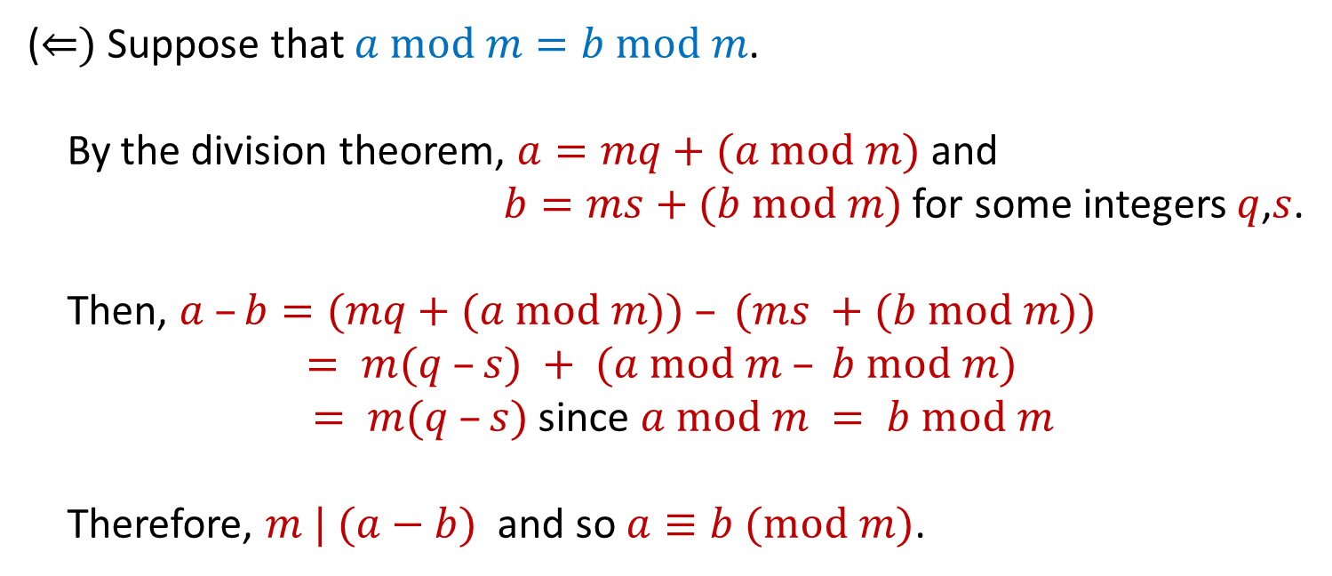
Modular Arithmetic: A Property
$$a≡b (mod m)↔ m | (a −b)$$
Let $a, b, m$be integers with $m>0$. Then, $a≡b (mod m)$if and only if $a mod m = b mod m$.
(⇐) Suppose that $a mod m=b mod m$.
By the division theorem, $a=mq+(a mod m)$ and
$b=ms+(b mod m)$ for some integers $q$,$s$.
Then, $a –b=(mq+(a mod m)) – (ms +(b mod m))$
$= m(q –s) + (a mod m – b mod m)$
$= m(q –s)$since $a mod m = b mod m$
Therefore, $m | (a−b)$ and so $a≡b (mod m)$.
Goal: show $a≡b (mod m)$, i.e., $m | (a−b)$.
(Halfway there)

Slide 13

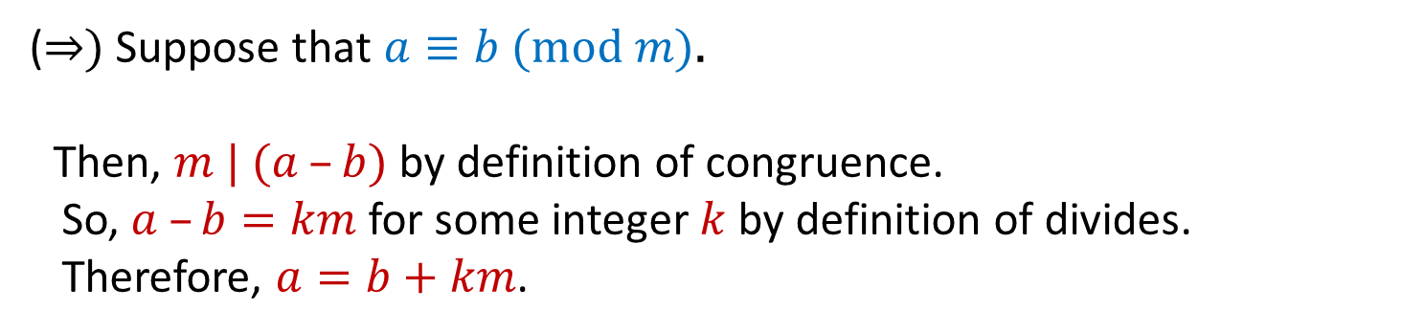

Modular Arithmetic: A Property
$$a≡b (mod m)↔ m | (a −b)$$
Let $a, b, m$be integers with $m>0$. Then, $a≡b (mod m)$if and only if $a mod m = b mod m$.
(⇒) Suppose that $a≡b (mod m)$.
Then, $m | (a –b)$ by definition of congruence.
So, $a –b=km$ for some integer $k$ by definition of divides.
Therefore, $a=b+km$.
Goal: show $a mod m≡b mod m$
Notes:
Alternatively, By the division Theorem,
we have a = mq + (a mod m) = b + km.
That gives us b = m(q + k) + (a mod m)

Slide 14
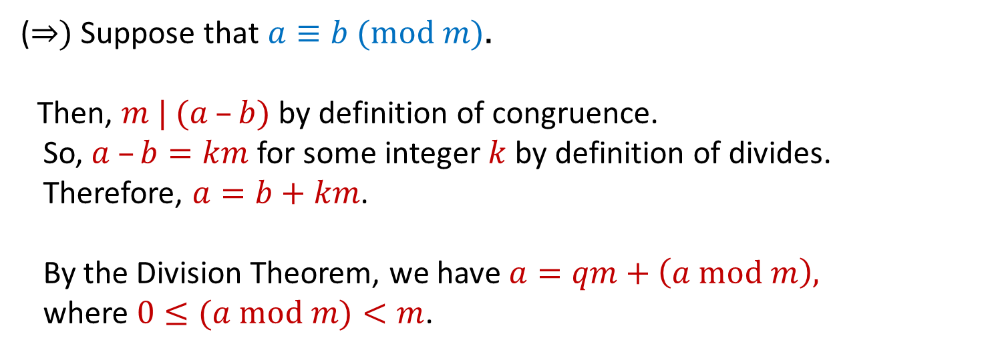
Modular Arithmetic: A Property
$$a≡b (mod m)↔ m | (a −b)$$
Let $a, b, m$be integers with $m>0$. Then, $a≡b (mod m)$if and only if $a mod m = b mod m$.
(⇒) Suppose that $a≡b (mod m)$.
Then, $m | (a –b)$ by definition of congruence.
So, $a –b=km$ for some integer $k$ by definition of divides.
Therefore, $a=b+km$.
By the Division Theorem, we have $a=qm+\left(a mod m\right),$
where $0≤(a mod m)<m$.
Goal: show $a mod m≡b mod m$
Notes:
Alternatively, By the division Theorem,
we have a = mq + (a mod m) = b + km.
That gives us b = m(q + k) + (a mod m)

Slide 15

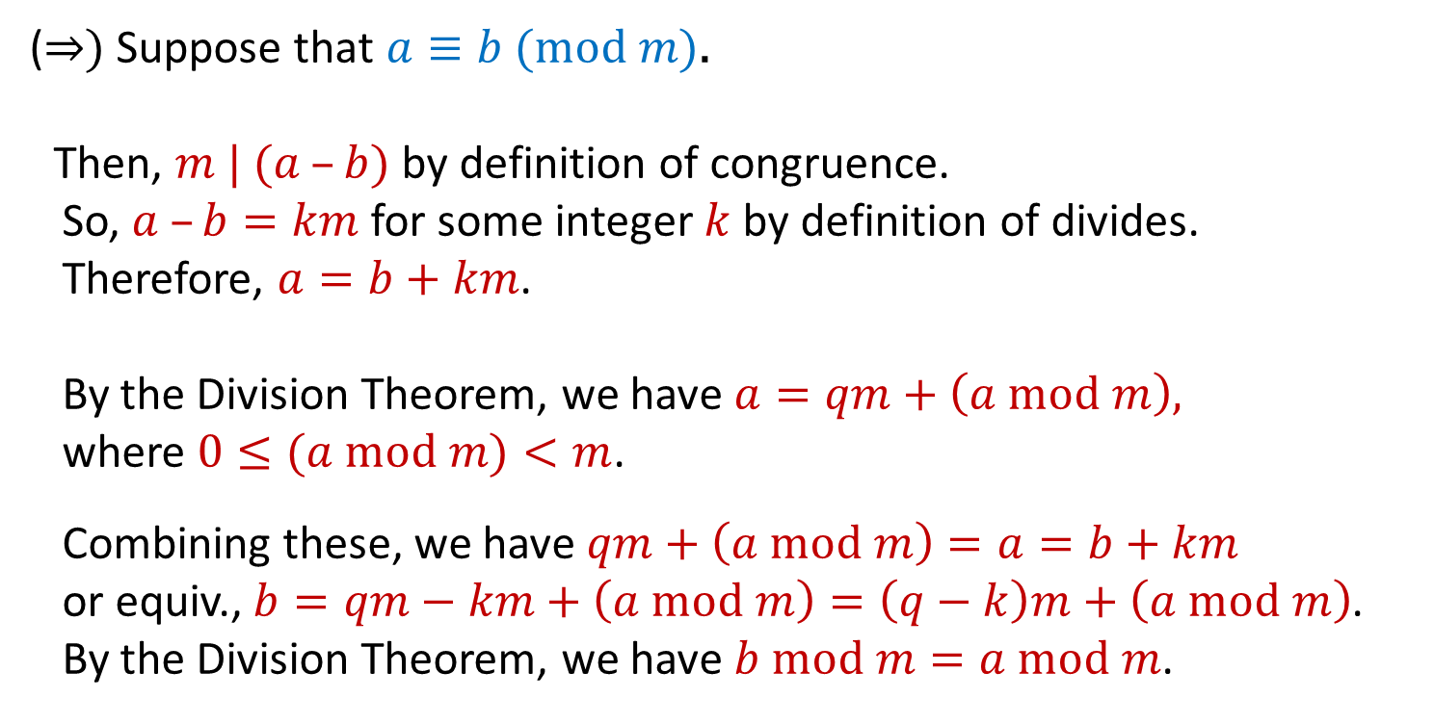

Modular Arithmetic: A Property
$$a≡b (mod m)↔ m | (a −b)$$
Let $a, b, m$be integers with $m>0$. Then, $a≡b (mod m)$if and only if $a mod m = b mod m$.
(⇒) Suppose that $a≡b (mod m)$.
Then, $m | (a –b)$ by definition of congruence.
So, $a –b=km$ for some integer $k$ by definition of divides.
Therefore, $a=b+km$.
By the Division Theorem, we have $a=qm+\left(a mod m\right),$
where $0≤(a mod m)<m$.
Combining these, we have $qm+\left(a mod m\right)=a=b+km$
or equiv., $b=qm−km+\left(a mod m\right)=\left(q−k\right)m+\left(a mod m\right)$.
By the Division Theorem, we have $b mod m=a mod m$.
Goal: show $a mod m≡b mod m$
Notes:
Alternatively, By the division Theorem,
we have a = mq + (a mod m) = b + km.
That gives us b = m(q + k) + (a mod m)

Slide 16

Modular Arithmetic: A Property
$$a≡b (mod m)↔ m | (a −b)$$
Let $a, b, m$be integers with $m>0$. Then, $a≡b (mod m)$if and only if $a mod m = b mod m$.
(⇒) Suppose that $a≡b (mod m)$.
Then, $m | (a –b)$ by definition of congruence.
So, $a –b=km$ for some integer $k$ by definition of divides.
Therefore, $a=b+km$.
By the Division Theorem, we have $a=qm+\left(a mod m\right),$
where $0≤(a mod m)<m$.
Combining these, we have $qm+\left(a mod m\right)=a=b+km$
or equiv., $b=qm−km+\left(a mod m\right)=\left(q−k\right)m+\left(a mod m\right)$.
By the Division Theorem, we have $b mod m=a mod m$.
Goal: show $a mod m≡b mod m$
Notes:
Alternatively, By the division Theorem,
we have a = mq + (a mod m) = b + km.
That gives us b = m(q + k) + (a mod m)

Slide 17
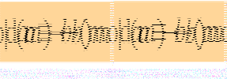
Modular Arithmetic: A Property
Let $a, b, m$be integers with $m>0$. Then, $a≡b (mod m)$if and only if $a mod m = b mod m$.
In future, we will usually go directly between these without discussing “divides” every time.
(⇒) Suppose that $a≡b (mod m)$.
Then, $m | (a –b)$ by definition of congruence.
So, $a –b=km$ for some integer $k$ by definition of divides.
Therefore, $a=b+km$.
By the Division Theorem, we have $a=qm+\left(a mod m\right),$
where $0≤(a mod m)<m$.
Combining these, we have $qm+\left(a mod m\right)=a=b+km$
or equiv., $b=qm−km+\left(a mod m\right)=\left(q−k\right)m+\left(a mod m\right)$.
By the Division Theorem, we have $b mod m=a mod m$.
Notes:
Alternatively, By the division Theorem,
we have a = mq + (a mod m) = b + km.
That gives us b = m(q + k) + (a mod m)

Slide 18
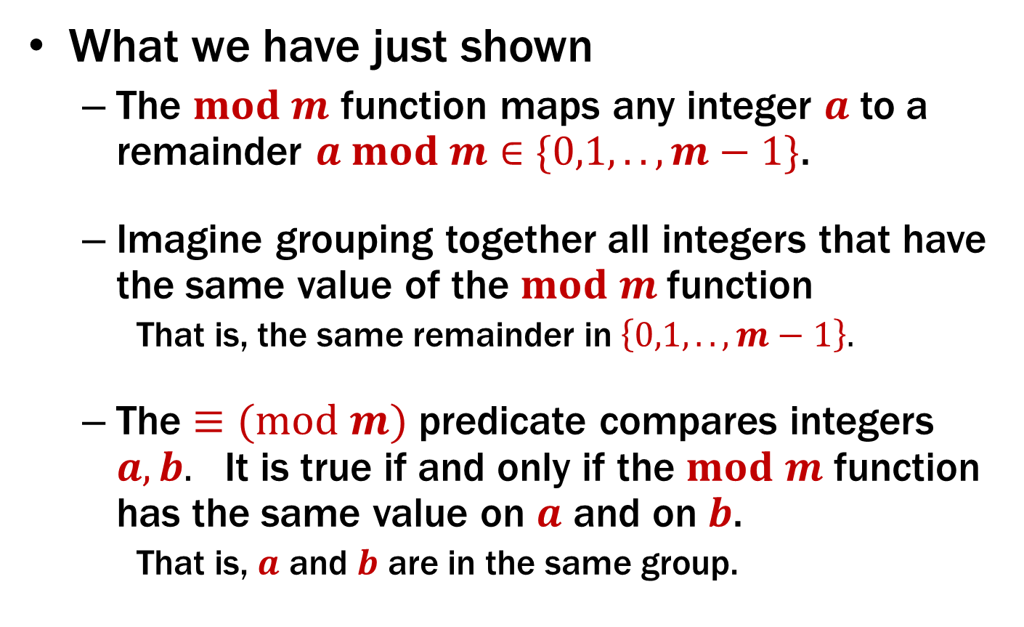
The $mod m$ function vs the $≡(mod m)$ predicate
What we have just shown
The $mod m$ function maps any integer $a$ to a remainder $a mod m∈\{0,1,..,m−1\}$.
Imagine grouping together all integers that have the same value of the $mod m$function
That is, the same remainder in $\left\{0,1,..,m−1\right\}.$
The $≡(mod m)$ predicate compares integers $a, b.$ It is true if and only if the $mod m$ function has the same value on $a$ and on $b$.
That is, $a$ and $b$ are in the same group.

Slide 19
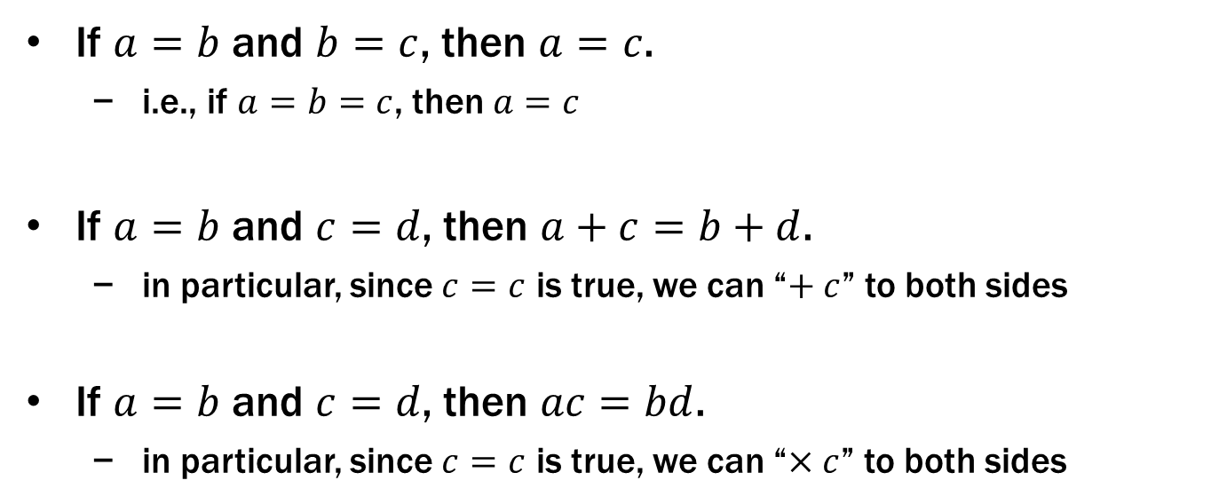

Recall: Familiar Properties of “=”
If $a=b$ and $b=c$, then $a=c$.
i.e., if $a=b=c$, then $a=c$
If $a=b$ and $c=d$, then $a+c=b+d$.
in particular, since $c=c$ is true, we can “$+ c$” to both sides
If $a=b$ and $c=d$, then $ac=bd$.
in particular, since $c=c$ is true, we can “$×c$” to both sides
These are the facts that allow us to use algebra to solve problems

Slide 20
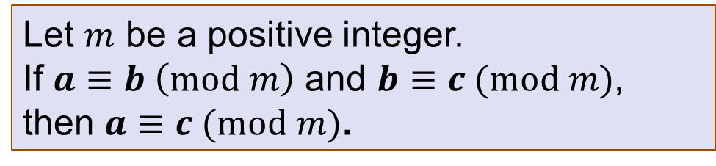
Modular Arithmetic: Basic Property
Let $m$ be a positive integer.
If $a≡b \left(mod m\right)$ and $b≡c (mod m)$, then $a≡c (mod m)$.

Slide 21
Modular Arithmetic: Basic Property
Let $m$ be a positive integer.
If $a≡b \left(mod m\right)$ and $b≡c (mod m)$, then $a≡c (mod m)$.
Suppose that $a≡b (mod m)$ and$b≡c (mod m)$.

Slide 22
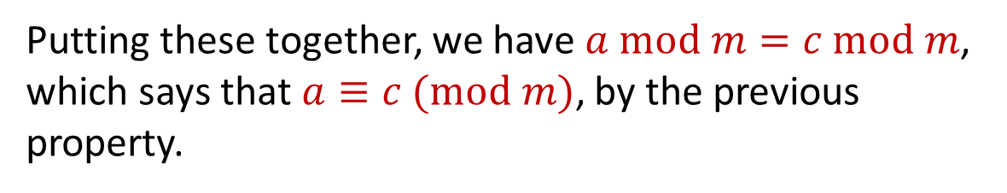
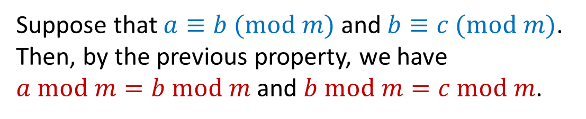
Modular Arithmetic: Basic Property
Let $m$ be a positive integer.
If $a≡b \left(mod m\right)$ and $b≡c (mod m)$, then $a≡c (mod m)$.
Suppose that $a≡b (mod m)$ and$b≡c (mod m)$. Then, by the previous property, we have $a mod m=b mod m$ and $b mod m=c mod m$.
Putting these together, we have $a mod m=c mod m$, which says that$a≡c (mod m)$, by the previous property.

Slide 23
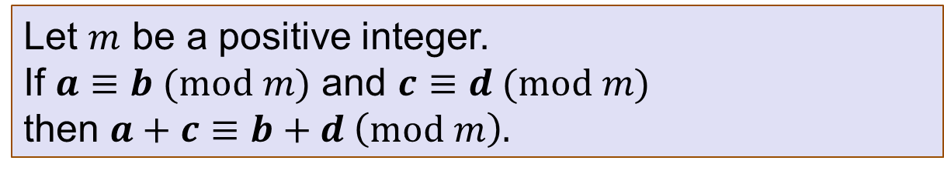
Modular Arithmetic: Addition Property
Let $m$ be a positive integer.
If $a≡b (mod m)$ and $c≡d (mod m)$ then $a+c≡b+d \left(mod m\right).$

Slide 24
Modular Arithmetic: Addition Property
Let $m$ be a positive integer.
If $a≡b (mod m)$ and $c≡d (mod m)$ then $a+c≡b+d \left(mod m\right).$
Suppose that $a≡b (mod m)$ and $c≡d (mod m)$.

Slide 25
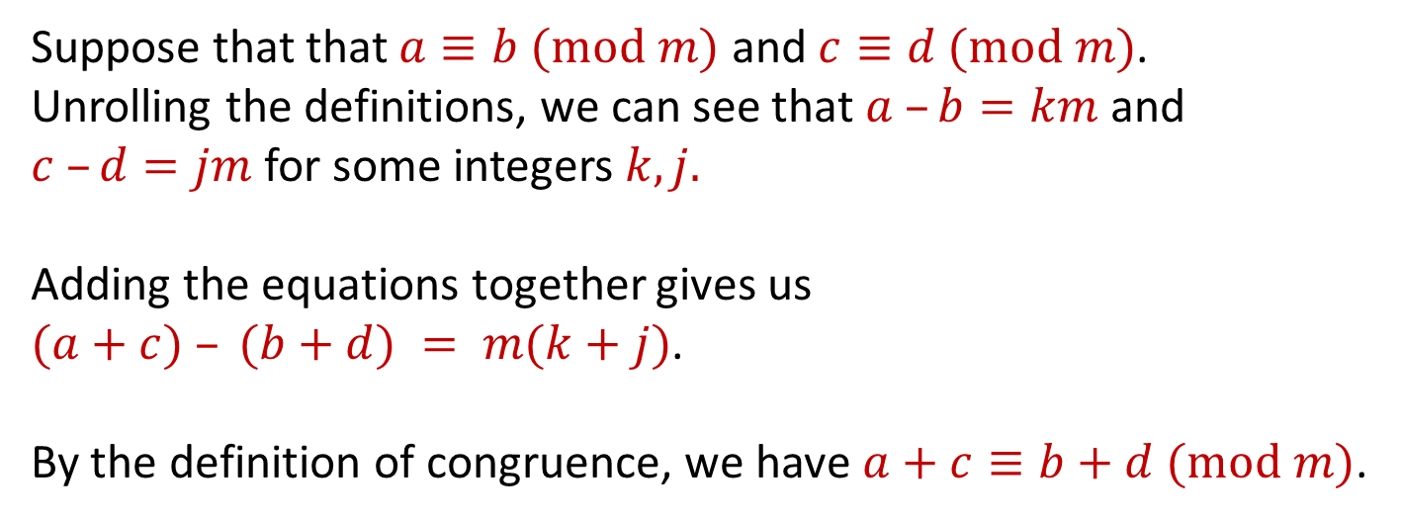

Modular Arithmetic: Addition Property
Let $m$ be a positive integer.
If $a≡b (mod m)$ and $c≡d (mod m)$ then $a+c≡b+d \left(mod m\right).$
Suppose that that $a≡b (mod m)$ and $c≡d (mod m)$.
Unrolling the definitions, we can see that $a –b=km$ and $c –d=jm$for some integers $k,j.$
Adding the equations together gives us
$(a+c) – (b+d) = m(k+j)$.
By the definition of congruence, we have $a+c≡b+d (mod m)$.

Slide 26
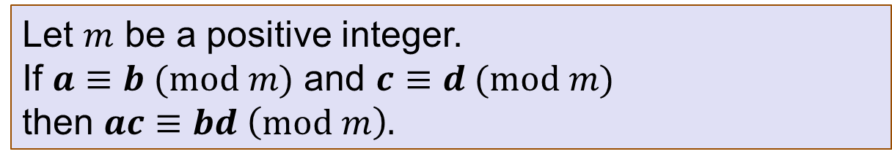
Modular Arithmetic: Multiplication Property
Let $m$ be a positive integer.
If $a≡b (mod m)$ and $c≡d (mod m)$ then $ac≡bd \left(mod m\right).$
Suppose that $a≡b (mod m)$ and $c≡d (mod m)$.

Slide 27
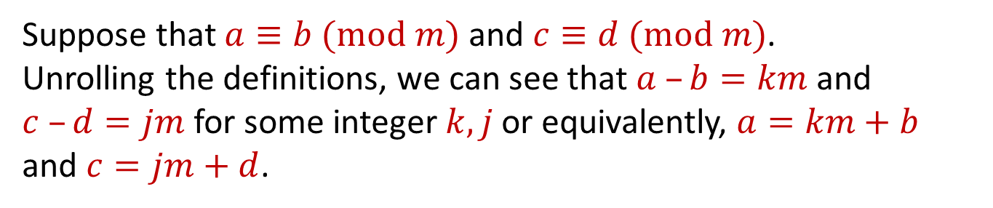
Modular Arithmetic: Multiplication Property
Let $m$ be a positive integer.
If $a≡b (mod m)$ and $c≡d (mod m)$ then $ac≡bd \left(mod m\right).$
Suppose that $a≡b (mod m)$ and $c≡d (mod m)$.
Unrolling the definitions, we can see that $a –b=km$ and $c –d=jm$for some integer $k,j$or equivalently, $a=km+b$ and $c=jm+d$.

Slide 28
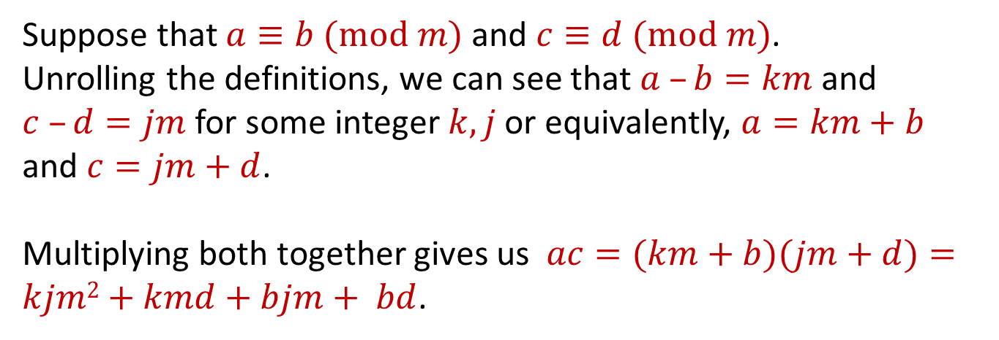

Modular Arithmetic: Multiplication Property
Let $m$ be a positive integer.
If $a≡b (mod m)$ and $c≡d (mod m)$ then $ac≡bd \left(mod m\right).$
Suppose that $a≡b (mod m)$ and $c≡d (mod m)$.
Unrolling the definitions, we can see that $a –b=km$ and $c –d=jm$for some integer $k,j$or equivalently, $a=km+b$ and $c=jm+d$.
Multiplying both together gives us $ac=(km+b)(jm+d)=kjm2+kmd+bjm+ bd$.

Slide 29
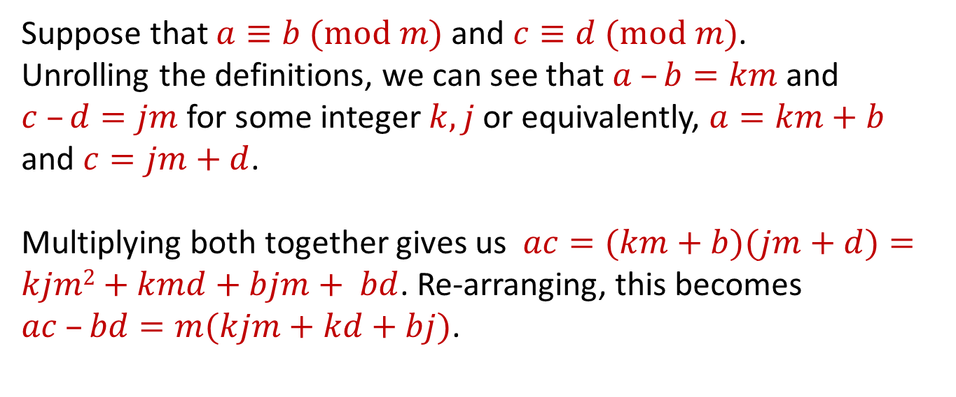
Modular Arithmetic: Multiplication Property
Let $m$ be a positive integer.
If $a≡b (mod m)$ and $c≡d (mod m)$ then $ac≡bd \left(mod m\right).$
Suppose that $a≡b (mod m)$ and $c≡d (mod m)$.
Unrolling the definitions, we can see that $a –b=km$ and $c –d=jm$for some integer $k,j$or equivalently, $a=km+b$ and $c=jm+d$.
Multiplying both together gives us $ac=(km+b)(jm+d)=kjm2+kmd+bjm+ bd$. Re-arranging, this becomes $ac –bd=m(kjm+kd+bj)$.

Slide 30
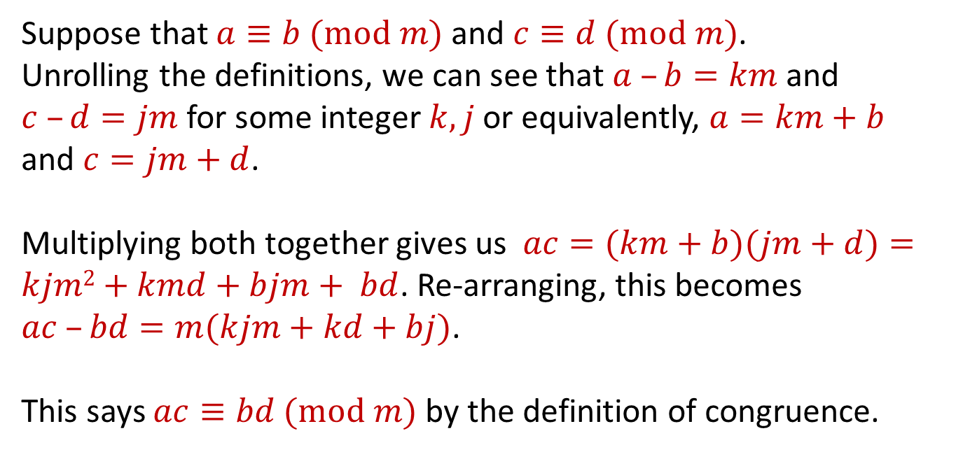
Modular Arithmetic: Multiplication Property
Let $m$ be a positive integer.
If $a≡b (mod m)$ and $c≡d (mod m)$ then $ac≡bd \left(mod m\right).$
Suppose that $a≡b (mod m)$ and $c≡d (mod m)$.
Unrolling the definitions, we can see that $a –b=km$ and $c –d=jm$for some integer $k,j$or equivalently, $a=km+b$ and $c=jm+d$.
Multiplying both together gives us $ac=(km+b)(jm+d)=kjm2+kmd+bjm+ bd$. Re-arranging, this becomes $ac –bd=m(kjm+kd+bj)$.
This says $ac≡bd (mod m)$ by the definition of congruence.

Slide 31
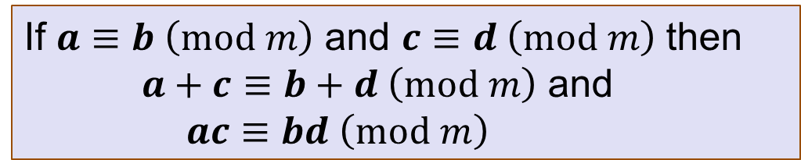
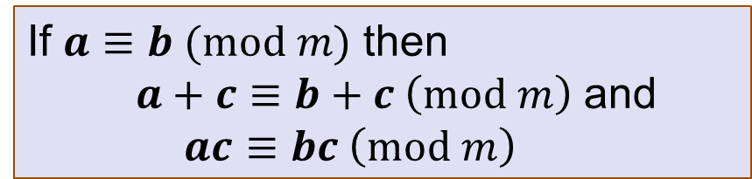

Modular Arithmetic: Properties
If $a≡b (mod m)$ and $b≡c (mod m)$ then $a≡c (mod m)$
If $a≡b \left(mod m\right)$ and $c≡d \left(mod m\right)$ then $a+c≡b+d \left(mod m\right)$ and
$ac≡bd \left(mod m\right)$
Corollary:
If $a≡b (mod m)$ then
$a+c≡b+c \left(mod m\right)$ and
$ac≡bc \left(mod m\right)$
These allow us to solve problems in modular arithmetic, e.g.
add/subtract numbers from both sides of equations
multiply numbers on both sides of equations.
use chains of equivalences

Slide 32



Slide 33
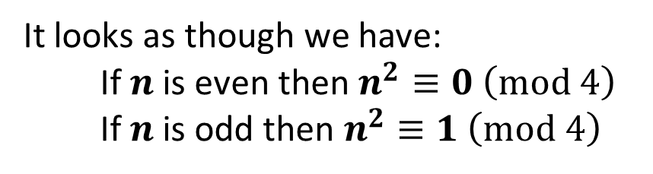
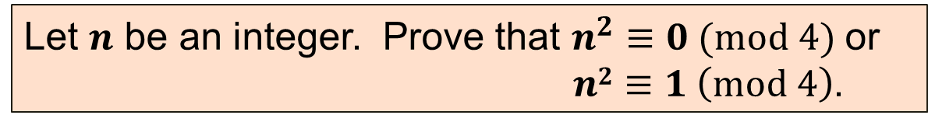

Example: Proof by Cases with mod
Let $n$ be an integer. Prove that $n^{2}≡0 (mod 4)$ or
$n2≡1 \left(mod 4\right)$.
Let’s start by looking at small examples:
0² = 0 ≡ 0 (mod 4)
1² = 1 ≡ 1 (mod 4)
2² = 4 ≡ 0 (mod 4)
3² = 9 ≡ 1 (mod 4)
4² = 16 ≡ 0 (mod 4)
It looks as though we have:
If $n$ is even then $n^{2}≡0 \left(mod 4\right)$
If $n$ is odd then $n^{2}≡1 \left(mod 4\right)$

Slide 34
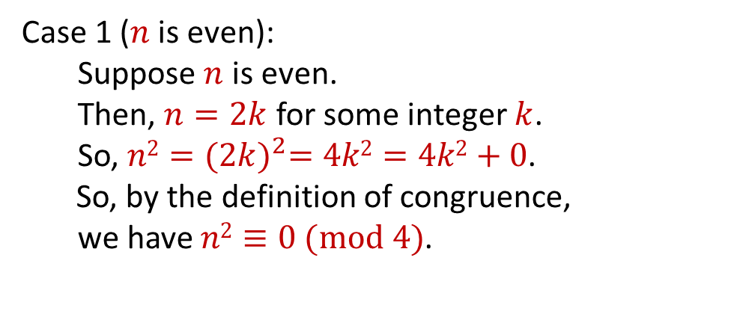

Example: Proof by Cases with mod
Let $n$ be an integer. Prove that $n^{2}≡0 (mod 4)$ or
$n2≡1 \left(mod 4\right)$.
Case 1 ($n$ is even):
Suppose $n$ is even.
Then, $n=2k$ for some integer $k$.
So, $n2={(2k)}^{2}=4k2=4k2+0$.
So, by the definition of congruence,
we have $n2≡0 (mod 4)$.

Slide 35
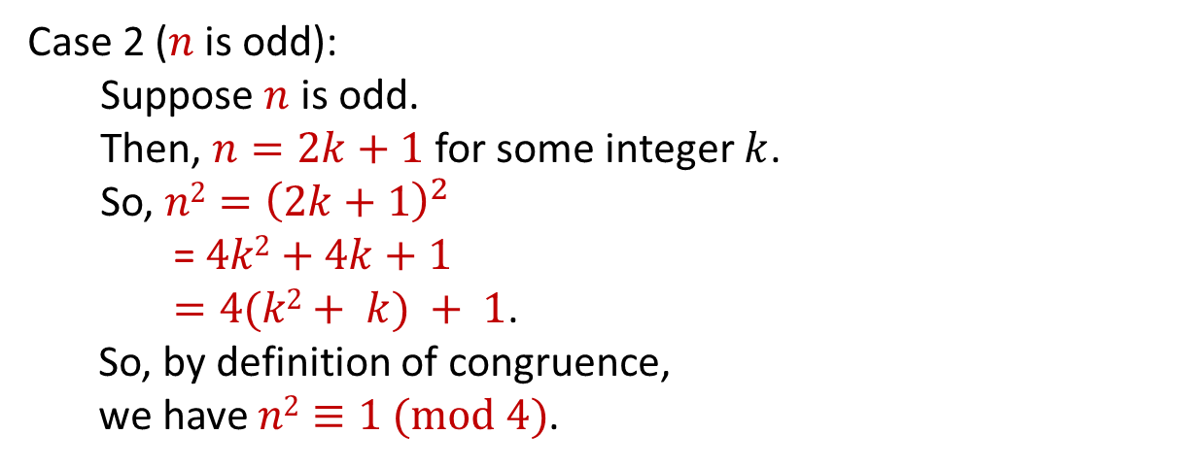
Example: Proof by Cases with mod
Let $n$ be an integer. Prove that $n^{2}≡0 (mod 4)$ or
$n2≡1 \left(mod 4\right)$.
Case 1 ($n$ is even): Done.
Case 2 ($n$ is odd):
Suppose $n$ is odd.
Then, $n=2k+1$ for some integer $k$.
So, $n2={\left(2k+1\right)}^{2}$
= $4k2+4k+1$
$=4(k2+ k) + 1$.
So, by definition of congruence,
we have $n2≡1 (mod 4)$.
Result follows by proof by cases since $n$ is either even or odd

