Slide 1
CSE 311: Foundations of Computing
Lecture 12: Modular Exponentiation, Set Theory

Slide 2
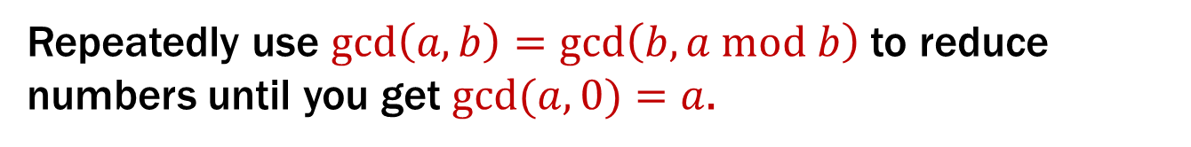
Last class: Euclid’s Algorithm for GCD
Repeatedly use $\gcd\left(a, b\right)=\gcd\left(b, a mod b\right)$ to reduce numbers until you get $gcd⁡(a,0)=a$.
Equations with recursive calls:
gcd(660,126) = gcd(126, 660 mod 126) = gcd(126, 30)
= gcd(30, 126 mod 30) = gcd(30, 6)
= gcd(6, 30 mod 6) = gcd(6, 0)
= 6
Tableau form (which is much easier to work with and will be more useful):
660 = 5 * 126 + 30
126 = 4 * 30 + 6
30 = 5 * 6 + 0
Each line computes both quotient and remainder of the shifted numbers

Slide 3
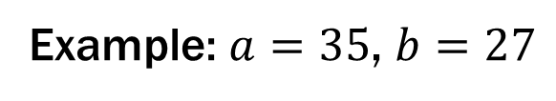

Last class: Extended Euclidean algorithm
Can use Euclid’s Algorithm to find $s, t$ such that
$\gcd\left(a,b\right)=sa+tb$
Example: $a=35$, $b=27$
Compute gcd(35, 27):
35 = 1 * 27 + 8
27 = 3 * 8 + 3
8 = 2 * 3 + 2
3 = 1 * 2 + 1
2 = 2 * 1 + 0
8 = 35 – 1 * 27
3 = 27 – 3 * 8
2 = 8 – 2 * 3
1 = 3 – 1 * 2

Slide 4

Last class: Extended Euclidean algorithm
Can use Euclid’s Algorithm to find $s, t$ such that
$\gcd\left(a,b\right)=sa+tb$
Example: $a=35$, $b=27$
1 = 3 – 1 * 2
= 3 – 1 * (8 – 2 * 3)
= 3 – 8 + 2 * 3
= (–1) * 8 + 3 * 3
= (–1) * 8 + 3 * (27 – 3 * 8)
= (–1) * 8 + 3 * 27 + (–9) * 8
= 3 * 27 + (–10) * 8
= 3 * 27 + (–10) * (35 – 1 * 27)
= 3 * 27 + (–10) * 35 + 10 * 27
= (–10) * 35 + 13 * 27
Use equations to substitute
back
8 = 35 – 1 * 27
3 = 27 – 3 * 8
2 = 8 – 2 * 3
1 = 3 – 1 * 2
Optional Check:
(–10) * 35 = –350
13 * 27 = 351

Slide 5

Last class: Multiplicative inverse $(mod m)$
Let $0≤a,b<m$. Then, $b$ is the multiplicative inverse of $a$ (modulo $m$) iff $ab≡1 (mod m)$.
X | 0 | 1 | 2 | 3 | 4 | 5 | 6 | 7 | 8 | 9
0 | 0 | 0 | 0 | 0 | 0 | 0 | 0 | 0 | 0 | 0
1 | 0 | 1 | 2 | 3 | 4 | 5 | 6 | 7 | 8 | 9
2 | 0 | 2 | 4 | 6 | 8 | 0 | 2 | 4 | 6 | 8
3 | 0 | 3 | 6 | 9 | 2 | 5 | 8 | 1 | 4 | 7
4 | 0 | 4 | 8 | 2 | 6 | 0 | 4 | 8 | 2 | 6
5 | 0 | 5 | 0 | 5 | 0 | 5 | 0 | 5 | 0 | 5
6 | 0 | 6 | 2 | 8 | 4 | 0 | 6 | 2 | 8 | 4
7 | 0 | 7 | 4 | 1 | 8 | 5 | 2 | 9 | 6 | 3
8 | 0 | 8 | 6 | 4 | 2 | 0 | 8 | 6 | 4 | 2
9 | 0 | 9 | 8 | 7 | 6 | 5 | 4 | 3 | 2 | 1
X | 0 | 1 | 2 | 3 | 4 | 5 | 6
0 | 0 | 0 | 0 | 0 | 0 | 0 | 0
1 | 0 | 1 | 2 | 3 | 4 | 5 | 6
2 | 0 | 2 | 4 | 6 | 1 | 3 | 5
3 | 0 | 3 | 6 | 2 | 5 | 1 | 4
4 | 0 | 4 | 1 | 5 | 2 | 6 | 3
5 | 0 | 5 | 3 | 1 | 6 | 4 | 2
6 | 0 | 6 | 5 | 4 | 3 | 2 | 1
mod 7
mod 10
Notes:
With 7, every non-zero number has an inverse. With 10, not every non-zero number has an inverse.
0, 2, 4, 5, 6, 8 do not have an inverse because they have a common factor with 10

Slide 6
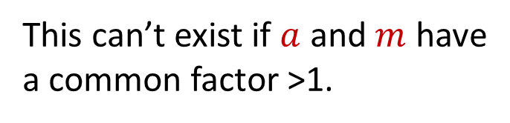

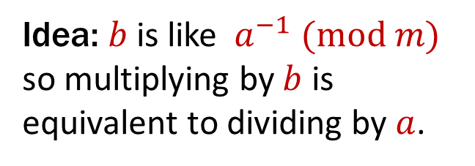
Last class: Multiplicative inverse $(mod m)$
Let $0≤a,b<m$. Then, $b$ is the multiplicative inverse of $a$ (modulo $m$) iff $ab≡1 (mod m)$.
This can’t exist if $a$ and $m$ have
a common factor >1.
X | 0 | 1 | 2 | 3 | 4 | 5 | 6 | 7 | 8 | 9
0 | 0 | 0 | 0 | 0 | 0 | 0 | 0 | 0 | 0 | 0
1 | 0 | 1 | 2 | 3 | 4 | 5 | 6 | 7 | 8 | 9
2 | 0 | 2 | 4 | 6 | 8 | 0 | 2 | 4 | 6 | 8
3 | 0 | 3 | 6 | 9 | 2 | 5 | 8 | 1 | 4 | 7
4 | 0 | 4 | 8 | 2 | 6 | 0 | 4 | 8 | 2 | 6
5 | 0 | 5 | 0 | 5 | 0 | 5 | 0 | 5 | 0 | 5
6 | 0 | 6 | 2 | 8 | 4 | 0 | 6 | 2 | 8 | 4
7 | 0 | 7 | 4 | 1 | 8 | 5 | 2 | 9 | 6 | 3
8 | 0 | 8 | 6 | 4 | 2 | 0 | 8 | 6 | 4 | 2
9 | 0 | 9 | 8 | 7 | 6 | 5 | 4 | 3 | 2 | 1
Idea: $b$ is like $a^{−1}$ $(mod m)$ so multiplying by $b$ is equivalent to dividing by$a$.
mod 10
Notes:
With 7, every non-zero number has an inverse. With 10, not every non-zero number has an inverse.
0, 2, 4, 5, 6, 8 do not have an inverse because they have a common factor with 10

Slide 7

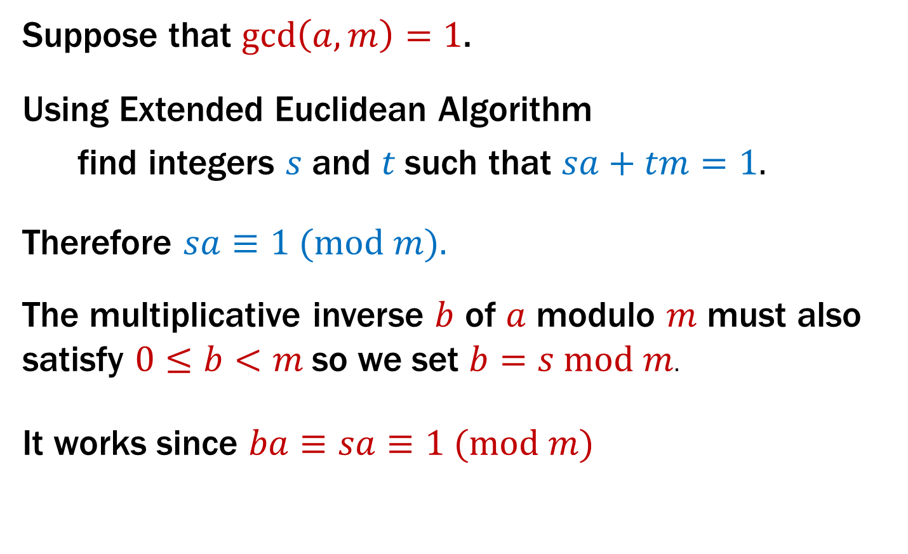
Finding multiplicative inverse $mod m$
Suppose that $gcd\left(a,m\right)=1$.
Using Extended Euclidean Algorithm
find integers $s$ and $t$such that $sa+tm=1.$
Therefore $sa≡1 (mod m).$
The multiplicative inverse $b$ of $a$ modulo $m$ must also satisfy $0≤b<m$ so we set $b=s mod m$.
It works since $ba≡sa≡1 (mod m)$

Slide 8
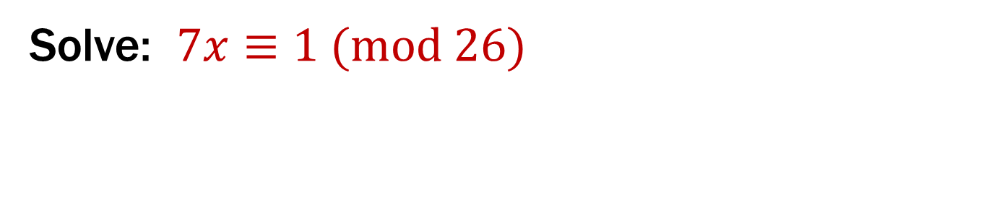
Example
Solve: $7x≡1 (mod 26)$

Slide 9
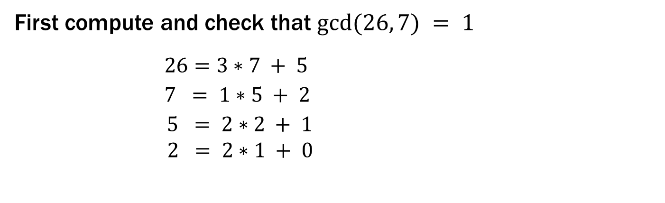
Example
Solve: $7x≡1 (mod 26)$
First compute and check that $gcd⁡(26, 7) = 1$
$$26 =3∗7 + 5 5= 26 – 3∗7$$
$$7 = 1∗5 + 2 2= 7 – 1∗5$$
$$5 = 2∗2 + 1 1= 5 – 2∗2$$
$2 = 2∗1 + 0$
Notes:
Find GCD
Write tableau (showing remainders)
Rewrite tableau to put remainders on left
Back-substitute

Slide 10
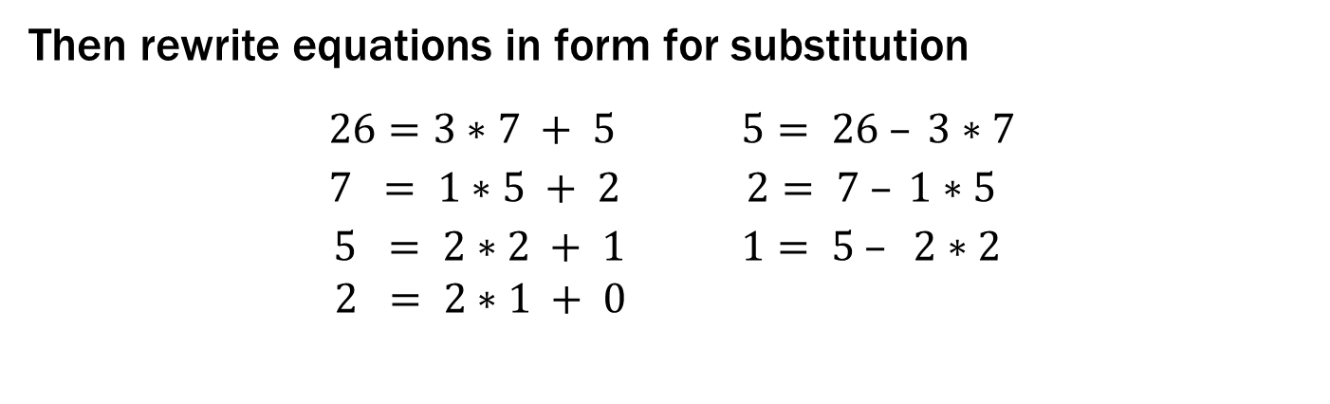
Example
Solve: $7x≡1 (mod 26)$
Then rewrite equations in form for substitution
$$26 =3∗7 + 5 5= 26 – 3∗7$$
$$7 = 1∗5 + 2 2= 7 – 1∗5$$
$$5 = 2∗2 + 1 1= 5 – 2∗2$$
$2 = 2∗1 + 0$
Notes:
Find GCD
Write tableau (showing remainders)
Rewrite tableau to put remainders on left
Back-substitute

Slide 11
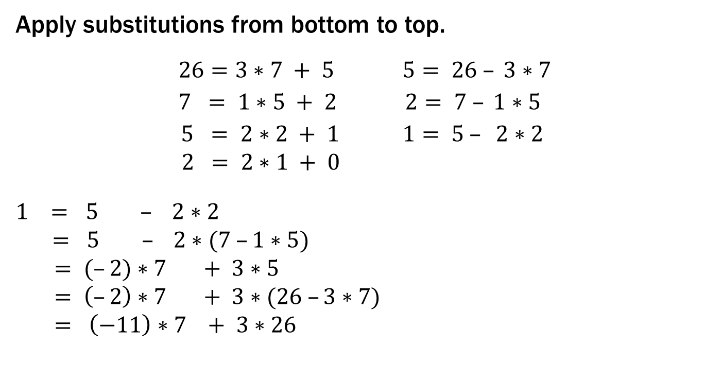
Example
Solve: $7x≡1 (mod 26)$
Apply substitutions from bottom to top.
$$26 =3∗7 + 5 5= 26 – 3∗7$$
$$7 = 1∗5 + 2 2= 7 – 1∗5$$
$$5 = 2∗2 + 1 1= 5 – 2∗2$$
$2 = 2∗1 + 0$
$$1 = 5 – 2∗2$$
$$= 5 – 2∗(7 –1∗5)$$
$= (–2)∗7 + 3∗5$
$= \left(–2\right)∗7 + 3∗(26 –3∗7)$
$= \left(−11\right)∗7 + 3∗26$
Notes:
Find GCD
Write tableau (showing remainders)
Rewrite tableau to put remainders on left
Back-substitute

Slide 12
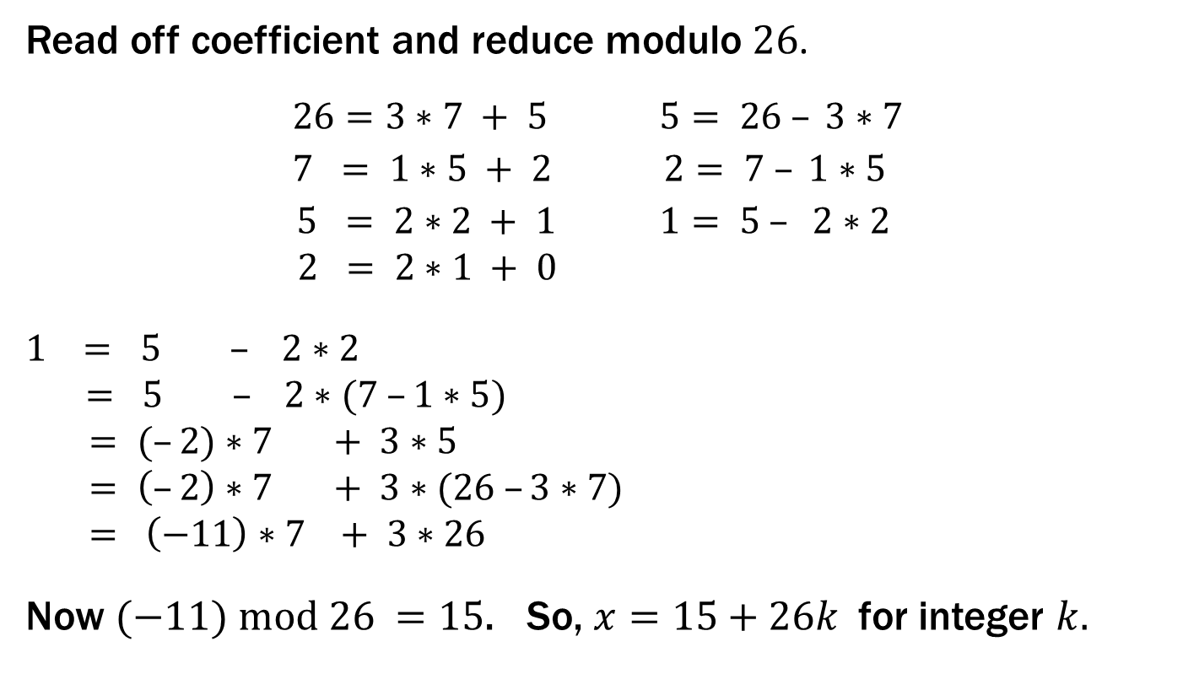
Example
Solve: $7x≡1 (mod 26)$
Read off coefficient and reduce modulo $26$.
$$26 =3∗7 + 5 5= 26 – 3∗7$$
$$7 = 1∗5 + 2 2= 7 – 1∗5$$
$$5 = 2∗2 + 1 1= 5 – 2∗2$$
$2 = 2∗1 + 0$
$$1 = 5 – 2∗2$$
$$= 5 – 2∗(7 –1∗5)$$
$= (–2)∗7 + 3∗5$
$= \left(–2\right)∗7 + 3∗(26 –3∗7)$
$= \left(−11\right)∗7 + 3∗26$
Now $(−11) mod 26 =15$. So, $x=15+26k$for integer $k.$
Multiplicative inverse of 7 modulo 26
Notes:
Find GCD
Write tableau (showing remainders)
Rewrite tableau to put remainders on left
Back-substitute

Slide 13
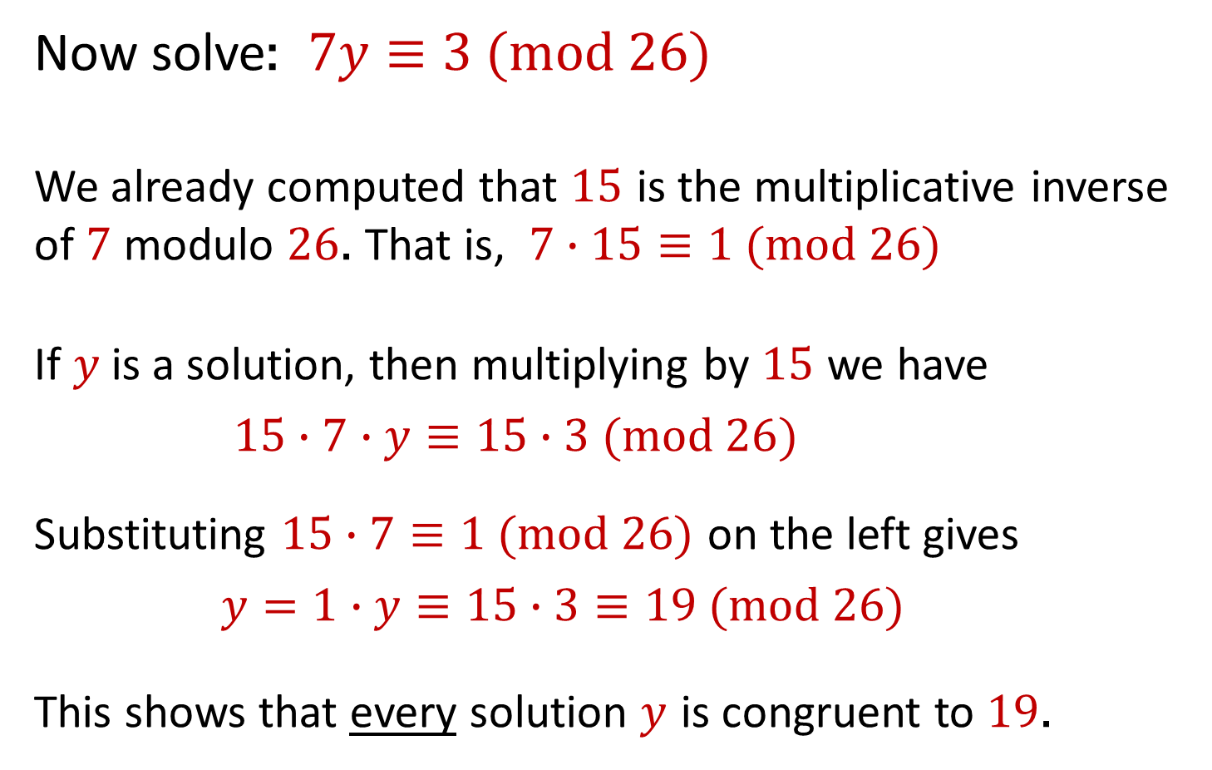
Example of a more general equation
Now solve: $7y≡3 (mod 26)$
We already computed that $15$ is the multiplicative inverse of $7$ modulo $26$. That is, $7∙15≡1 (mod 26)$
If $y$is a solution, then multiplying by $15$ we have
$15∙7∙y≡15∙3 (mod 26)$
Substituting $15∙7≡1 (mod 26)$ on the left gives
$y=1∙y≡15∙3≡19 (mod 26)$
This shows that every solution $y$ is congruent to $19$.

Slide 14
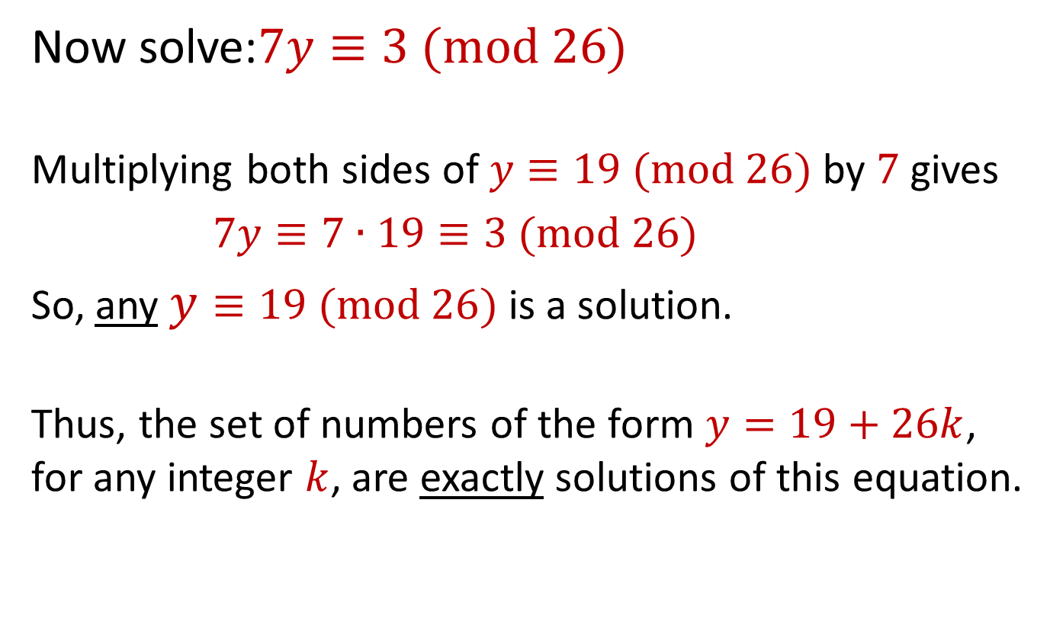
Example of a more general equation
Now solve:$7y≡3 (mod 26)$
Multiplying both sides of $y≡19 (mod 26)$ by $7$ gives
$7y≡7∙19≡3 (mod 26)$
So, any $y≡19 (mod 26)$ is a solution.
Thus, the set of numbers of the form $y=19+26k$, for any integer $k$, are exactly solutions of this equation.

Slide 15

Math mod a prime is especially nice
$gcd⁡(a,m)=1$ if $m$ is prime and $0<a<m$ so can always solve these equations mod a prime.
+ | 0 | 1 | 2 | 3 | 4 | 5 | 6
0 | 0 | 1 | 2 | 3 | 4 | 5 | 6
1 | 1 | 2 | 3 | 4 | 5 | 6 | 0
2 | 2 | 3 | 4 | 5 | 6 | 0 | 1
3 | 3 | 4 | 5 | 6 | 0 | 1 | 2
4 | 4 | 5 | 6 | 0 | 1 | 2 | 3
5 | 5 | 6 | 0 | 1 | 2 | 3 | 4
6 | 6 | 0 | 1 | 2 | 3 | 4 | 5
X | 0 | 1 | 2 | 3 | 4 | 5 | 6
0 | 0 | 0 | 0 | 0 | 0 | 0 | 0
1 | 0 | 1 | 2 | 3 | 4 | 5 | 6
2 | 0 | 2 | 4 | 6 | 1 | 3 | 5
3 | 0 | 3 | 6 | 2 | 5 | 1 | 4
4 | 0 | 4 | 1 | 5 | 2 | 6 | 3
5 | 0 | 5 | 3 | 1 | 6 | 4 | 2
6 | 0 | 6 | 5 | 4 | 3 | 2 | 1
mod 7

Slide 16
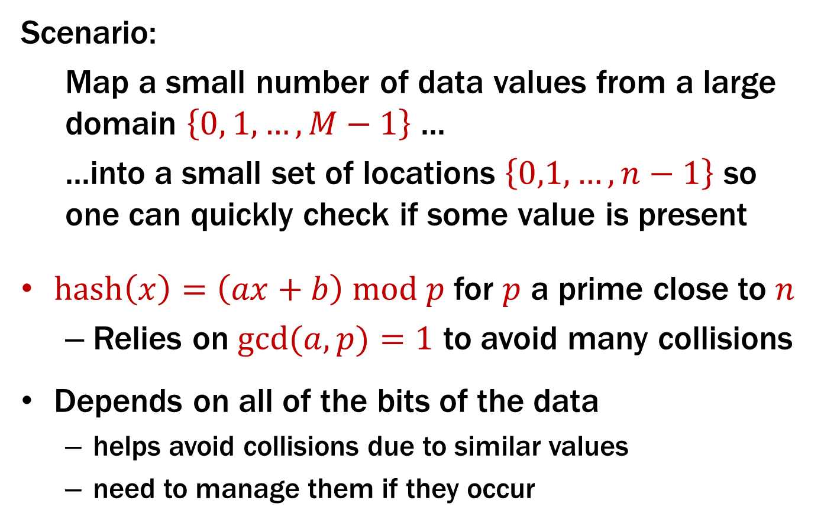
Hashing
Scenario:
Map a small number of data values from a large domain $\left\{0, 1, …, M−1\right\}$ ...
...into a small set of locations $\left\{0,1,…,n−1\right\}$ so one can quickly check if some value is present
$hash\left(x\right)=\left(ax+b\right) mod p$ for $p$ a prime close to $n$
Relies on $gcd⁡(a,p)=1$ to avoid many collisions
Depends on all of the bits of the data
helps avoid collisions due to similar values
need to manage them if they occur

Slide 17
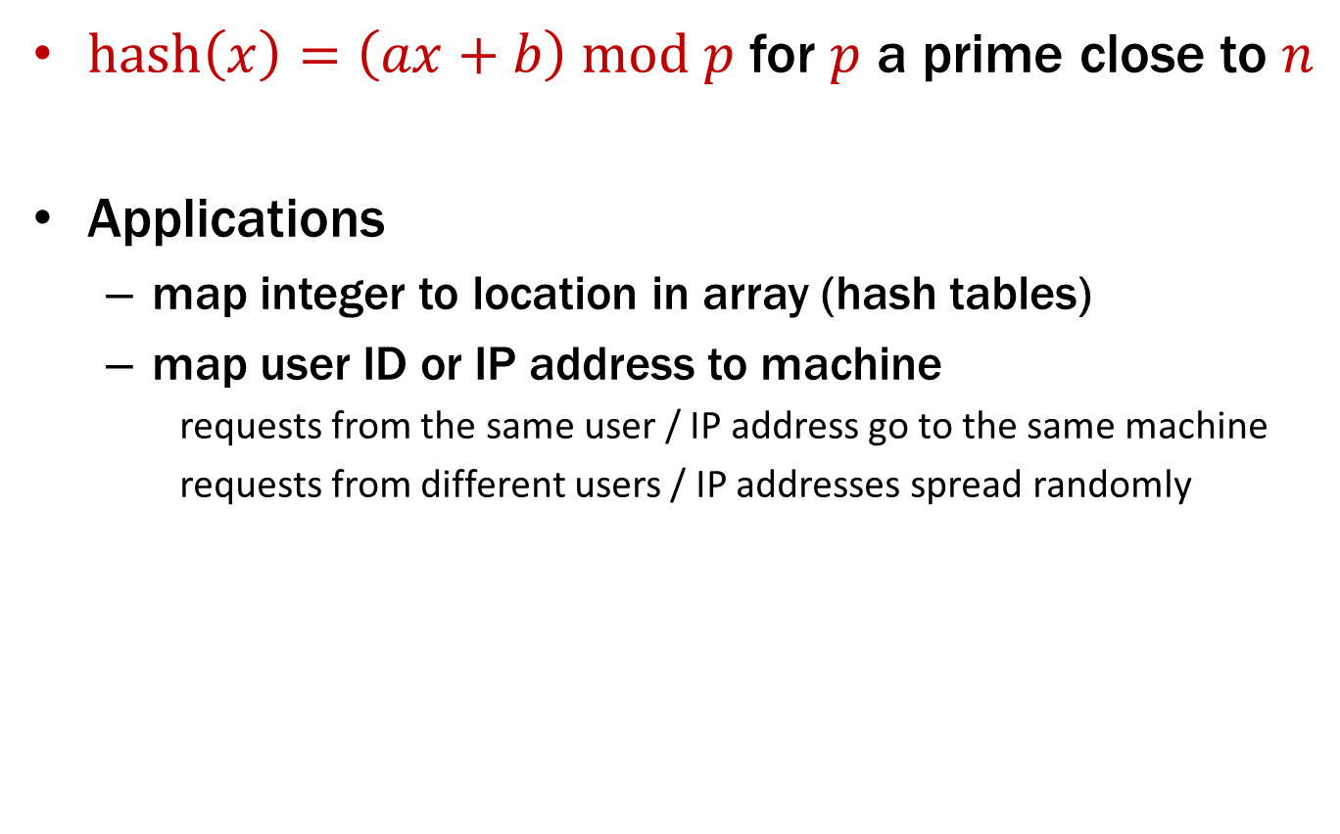
Hashing
$hash\left(x\right)=\left(ax+b\right) mod p$ for $p$ a prime close to $n$
Applications
map integer to location in array (hash tables)
map user ID or IP address to machine
requests from the same user / IP address go to the same machine
requests from different users / IP addresses spread randomly

Slide 18
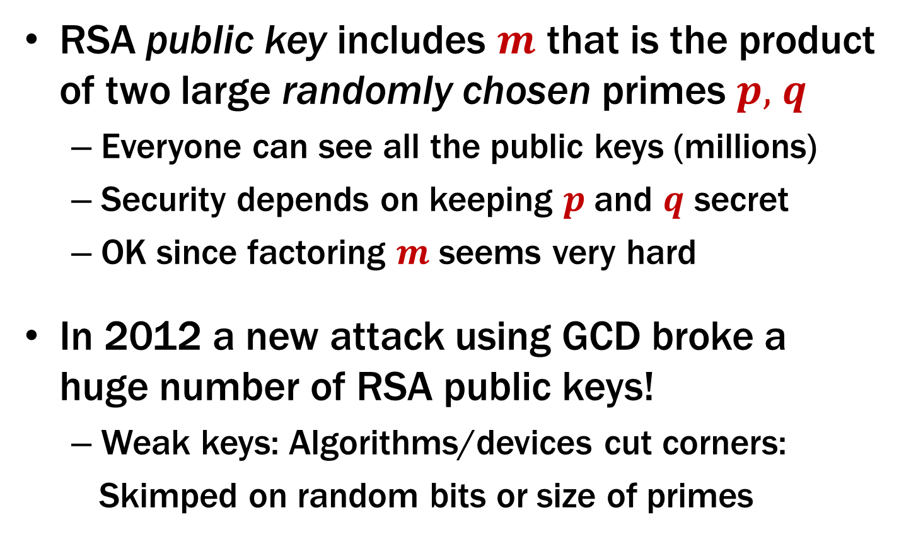
Attack on RSA security with GCD
RSA public key includes $m$ that is the product of two large randomly chosen primes $p,$ $q$
Everyone can see all the public keys (millions)
Security depends on keeping $p$and $q$ secret
OK since factoring $m$ seems very hard
In 2012 a new attack using GCD broke a huge number of RSA public keys!
Weak keys: Algorithms/devices cut corners:
Skimped on random bits or size of primes

Slide 19
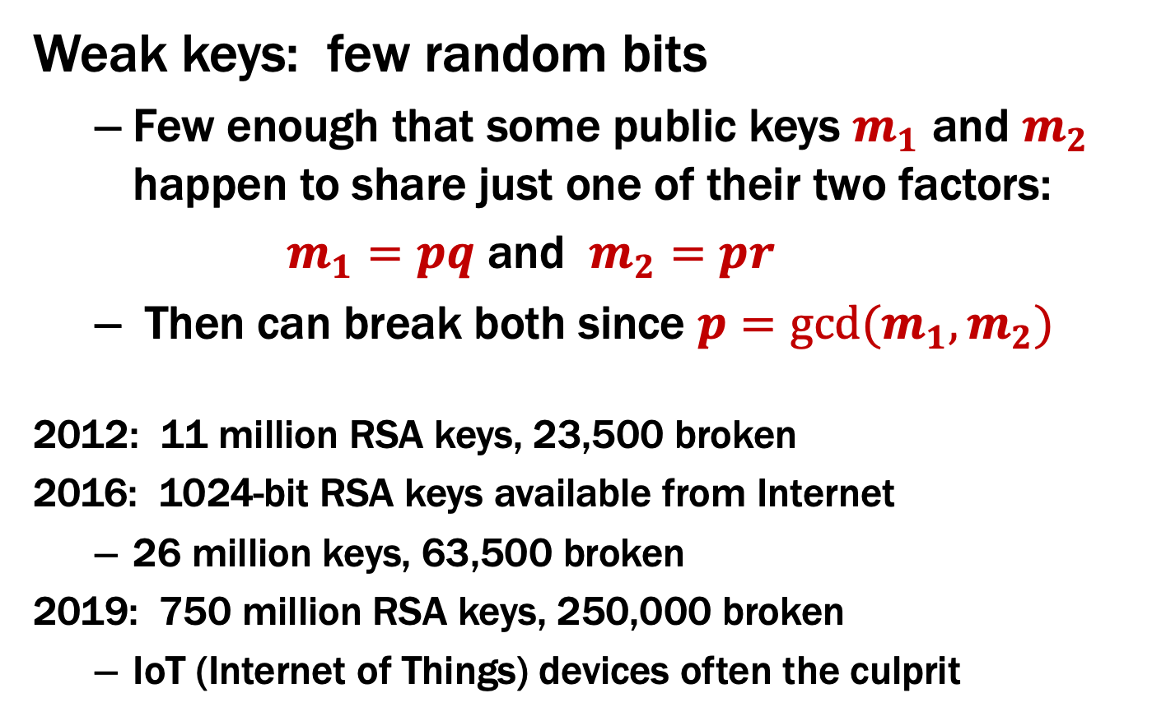
Attack on RSA security with GCD
Weak keys: few random bits
Few enough that some public keys $m_{1}$ and $m_{2}$ happen to share just one of their two factors:
$m_{1}=pq$ and $m_{2}=pr$
Then can break both since $p=gcd⁡(m_{1},m_{2})$
2012: 11 million RSA keys, 23,500 broken
2016: 1024-bit RSA keys available from Internet
26 million keys, 63,500 broken
2019: 750 million RSA keys, 250,000 broken
IoT (Internet of Things) devices often the culprit

Slide 20
RSA Relies on Modular Exponentiation
X | 1 | 2 | 3 | 4 | 5 | 6
1 | 1 | 2 | 3 | 4 | 5 | 6
2 | 2 | 4 | 6 | 1 | 3 | 5
3 | 3 | 6 | 2 | 5 | 1 | 4
4 | 4 | 1 | 5 | 2 | 6 | 3
5 | 5 | 3 | 1 | 6 | 4 | 2
6 | 6 | 5 | 4 | 3 | 2 | 1
a | a¹ | a² | a³ | a⁴ | a⁵ | a⁶
1 | 1 | 1 | 1 | 1 | 1 | 1
2 | 2 | 4 | 1 | 2 | 4 | 1
3 | 3 | 2 | 6 | 4 | 5 | 1
4 | 4 | 2 | 1 | 4 | 2 | 1
5 | 5 | 4 | 6 | 2 | 3 | 1
6 | 6 | 1 | 6 | 1 | 6 | 1
mod 7
Notes:
1 1 1 1 1 1
2 4 1 2 4 1
...

Slide 21
Modular Exponentiation: (Essential for RSA)
Compute 78365⁸⁰⁴²⁹
Compute 78365⁸⁰⁴²⁹ mod 104729
Output is small
need to keep intermediate results small
104,729 is the 10,000th prime

Slide 22
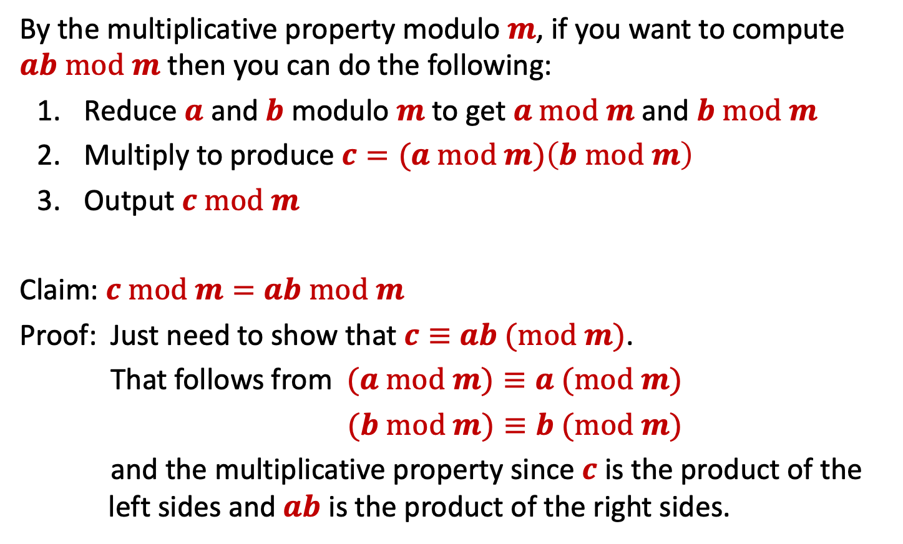

Small Multiplications
By the multiplicative property modulo $m$, if you want to compute $ab mod m$ then you can do the following:
Reduce $a$ and $b$ modulo $m$ to get $a mod m$ and $b mod m$
Multiply to produce $c=(a mod m)\left(b mod m\right)$
Output $c mod m$
Claim: $c mod m=$ $ab mod m$
Proof: Just need to show that $c≡$ $ab (mod m)$.
That follows from $(a mod m)≡a (mod m)$
$(b mod m)≡b (mod m)$
and the multiplicative property since $c$ is the product of the left sides and $ab$ is the product of the right sides.
$$a=qm+r$$
Notes:
Solves the case where k is a power of 2

Slide 23
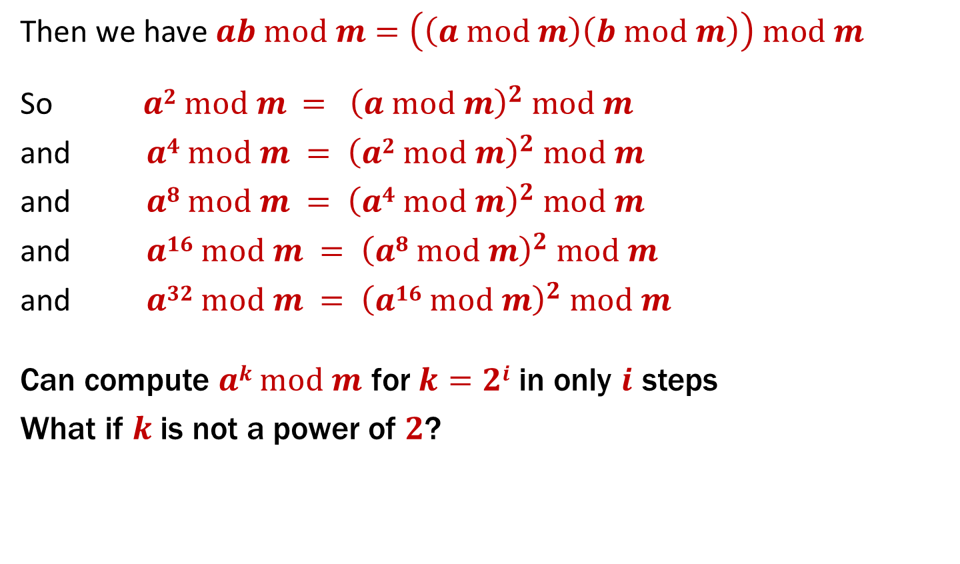
Repeated Squaring – small and fast
Then we have $ab mod m=\left(\left(a mod m\right)\left(b mod m\right)\right) mod m$
So $a2 mod m{ = \left(a mod m\right)}^{2} mod m$
and $a4 mod m = {\left(a2 mod m\right)}^{2} mod m$
and $a8 mod m = {\left(a4 mod m\right)}^{2} mod m$
and $a16 mod m = {\left(a8 mod m\right)}^{2} mod m$
and $a32 mod m = {\left(a16 mod m\right)}^{2} mod m$
Can compute $ak mod m$ for $k=2i$ in only $i$ steps
What if $k$ is not a power of $2$?
Notes:
Solves the case where k is a power of 2

Slide 24
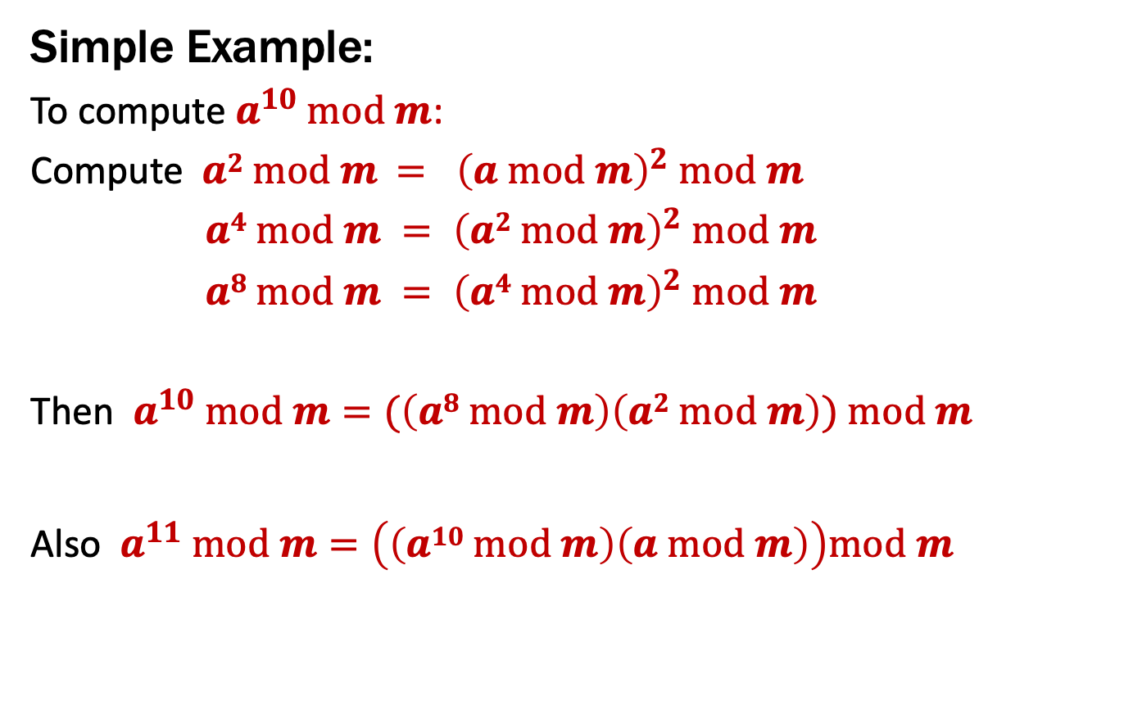
Fast Modular Exponentiation
Simple Example:
To compute $a^{10} mod m$:
Compute $a2 mod m{ = \left(a mod m\right)}^{2} mod m$
$a4 mod m = {\left(a2 mod m\right)}^{2} mod m$
$a8 mod m = {\left(a4 mod m\right)}^{2} mod m$
Then $a^{10} mod m=(\left(a8 mod m\right)\left(a2 mod m\right)) mod m$
Also $a^{11} mod m=\left(\left(a10 mod m\right)\left(a mod m\right)\right)mod m$

Slide 25
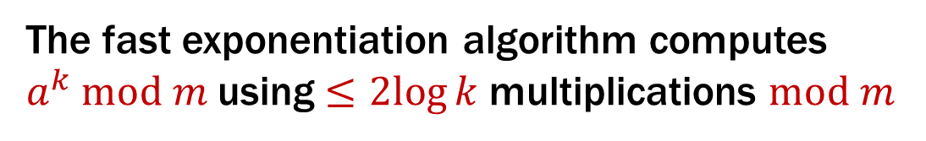
Fast Exponentiation Algorithm
80429 in binary is 10011101000101101
80429 = 2¹⁶ + 2¹³ + 2¹² + 2¹¹ + 2⁹ + 2⁵ + 2³ + 2² + 2⁰
a⁸⁰⁴²⁹ = a²¹⁶⁺²¹³⁺²¹²⁺²¹¹⁺²⁹⁺²⁵⁺²³⁺²²⁺²⁰
= a²¹⁶ · a²¹³ · a²¹² · a²¹¹ · a²⁹ · a²⁵ · a²³ · a²² · a²⁰
a⁸⁰⁴²⁹ mod m= (a²¹⁶ · a²¹³ · a²¹² · a²¹¹ · a²⁹ · a²⁵ · a²³ · a²² · a²⁰) mod m
= (…(((((a²¹⁶ mod m ·
a²¹³ mod m ) mod m ·
a²¹² mod m) mod m ·
a²¹¹ mod m) mod m ·
a²⁹ mod m) mod m ·
a²⁵ mod m) mod m ·
a²³ mod m) mod m ·
a²² mod m) mod m ·
a²⁰ mod m) mod m
Uses only 16 + 8 = 24 multiplications
The fast exponentiation algorithm computes
$a^{k} mod m$using $≤2log{k}$ multiplications $mod m$

Slide 26
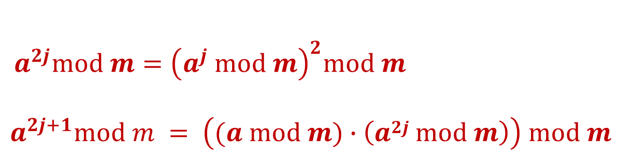

Fast Exponentiation: $ak mod m$ for all $k$
Another way....
$a^{2j}mod m={\left(a^{j} mod m\right)}^{2}mod m$
$$a^{2j+1}mod m = \left((a mod m)∙\left(a2j mod m\right)\right) mod m$$

Slide 27
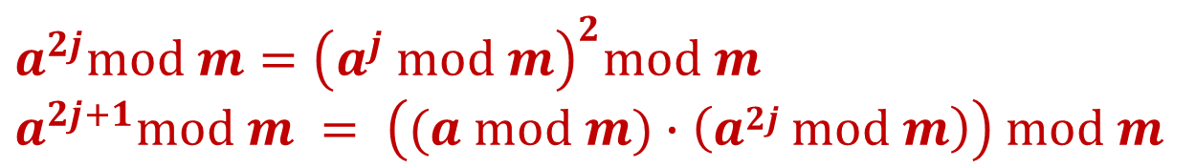
Recursive Fast Exponentiation
public static int FastModExp(int a, int k, int modulus) {
if (k == 0) {
return 1;
} else if ((k % 2) == 0) {
long temp = FastModExp(a,k/2,modulus);
return (temp * temp) % modulus;
} else {
long temp = FastModExp(a,k-1,modulus);
return (a * temp) % modulus;
}
}
$$a^{2j}mod m={\left(a^{j} mod m\right)}^{2}mod m$$
$$a^{2j+1}mod m = \left((a mod m)∙\left(a2j mod m\right)\right) mod m$$

Slide 28
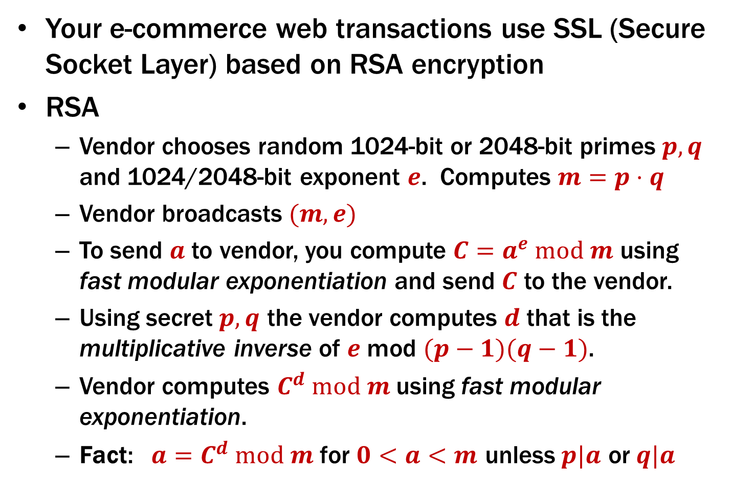
Using Fast Modular Exponentiation
Your e-commerce web transactions use SSL (Secure Socket Layer) based on RSA encryption
RSA
Vendor chooses random 1024-bit or 2048-bit primes $p, q$ and 1024/2048-bit exponent $e$. Computes $m=p⋅q$
Vendor broadcasts $(m,e)$
To send $a$ to vendor, you compute $C=a^{e} mod m$ using fast modular exponentiation and send $C$ to the vendor.
Using secret $p, q$ the vendor computes $d$ that is the multiplicative inverse of $e$ mod $(p−1)(q−1)$.
Vendor computes $C^{d} mod m$ using fast modular exponentiation.
Fact: $a=C^{d} mod m$ for $0<a<m$ unless $p|a$ or $q|a$
…as of 2023

Slide 29
Sets

Slide 30
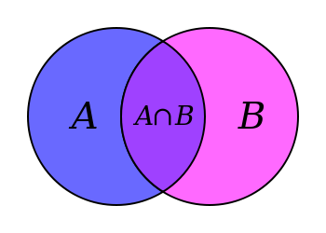
Sets
Sets are collections of objects called elements.
Write a ∈ B to say that a is an element of set B,
and a ∉ B to say that it is not.
Some simple examples
A = {1}
B = {1, 3, 2}
C = {☐, 1}
D = {{17}, 17}
E = {1, 2, 7, cat, dog, ∅, α}
Notes:
Set can answer the question “Is this an element?”

Slide 31
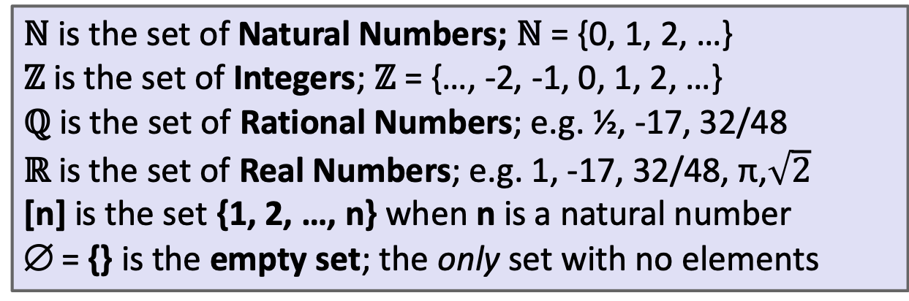
Some Common Sets
ℕ is the set of Natural Numbers; ℕ = {0, 1, 2, …}
ℤ is the set of Integers; ℤ = {…, -2, -1, 0, 1, 2, …}
ℚ is the set of Rational Numbers; e.g. ½, -17, 32/48
ℝ is the set of Real Numbers; e.g. 1, -17, 32/48, π,$\sqrt{2}$
[n] is the set {1, 2, …, n} when n is a natural number
∅ = {} is the empty set; the only set with no elements
Give some examples:
Finite sets,
Multiple domains
N, Z, Q, R
Emptyset
Sets containing sets

Slide 32
Sets can be elements of other sets
For example
A = {{1},{2},{1,2},∅}
B = {1,2}
Then B ∈ A.

Slide 33
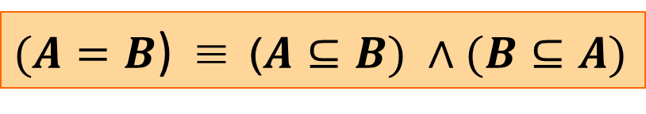
Definitions
A and B are equal if they have the same elements
A is a subset of B if every element of A is also in B
Notes:
A = B := ∀ x (x ∈ A ↔ x ∈ B)
A ⊆ B := ∀ x (x ∈ A → x ∈ B)
A ⊇ B means B ⊆ A
A ⊂ B means A ⊆ B but A ≠ B
A ⊂ B

Slide 34
Definition: Equality
A and B are equal if they have the same elements
A = B := ∀ x (x ∈ A ↔ x ∈ B)
A = {1, 2, 3}
B = {3, 4, 5}
C = {3, 4}
D = {4, 3, 3}
E = {3, 4, 3}
F = {4, {3}}
Which sets are equal to each other?
A ⊂ B
Notes:
C = D = E

Slide 35
Definition: Subset
A is a subset of B if every element of A is also in B
A ⊆ B := ∀ x (x ∈ A → x ∈ B)
A = {1, 2, 3}
B = {3, 4, 5}
C = {3, 4}
QUESTIONS
∅ ⊆ A?
A ⊆ B?
C ⊆ B?
A ⊂ B
Notes:
Note the domain restriction!

Slide 36
Definition: Subset
A is a subset of B if every element of A is also in B
A ⊆ B := ∀ x (x ∈ A → x ∈ B)
Note the domain restriction.
We will use a shorthand restriction to a set
∀x∈A, P(x) := ∀x (x ∈ A → P(x))
Restricting all quantified variables improves clarity
A ⊂ B

Slide 37
Sets & Logic

Slide 38
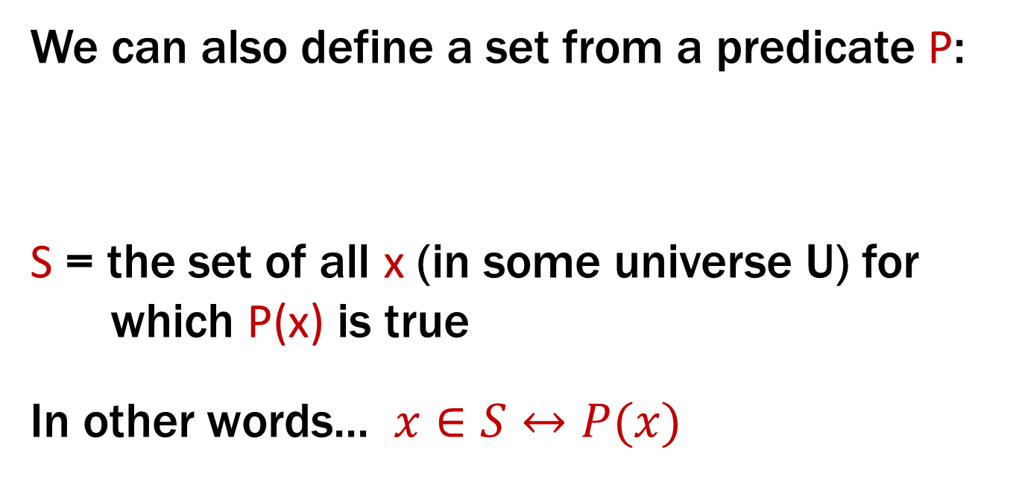
Building Sets from Predicates
Every set S defines a predicate “x ∈ S”.
We can also define a set from a predicate P:
S = the set of all x (in some universe U) for which P(x) is true
In other words... $x∈S↔P(x)$
S := {x : P(x)}
A ⊂ B

Slide 39
Proofs About Sets
Suppose we want to prove A ⊆ B.
A := {x : P(x)}
B := {x : Q(x)}
This is a predicate:
A ⊆ B := ∀x (x ∈ A → x ∈ B)
Typically: use direct proof of the implication
A ⊂ B

Slide 40
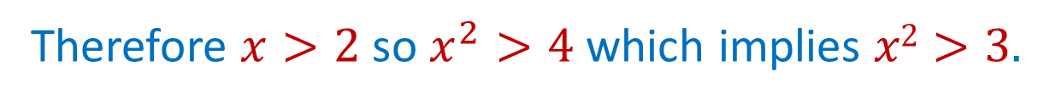
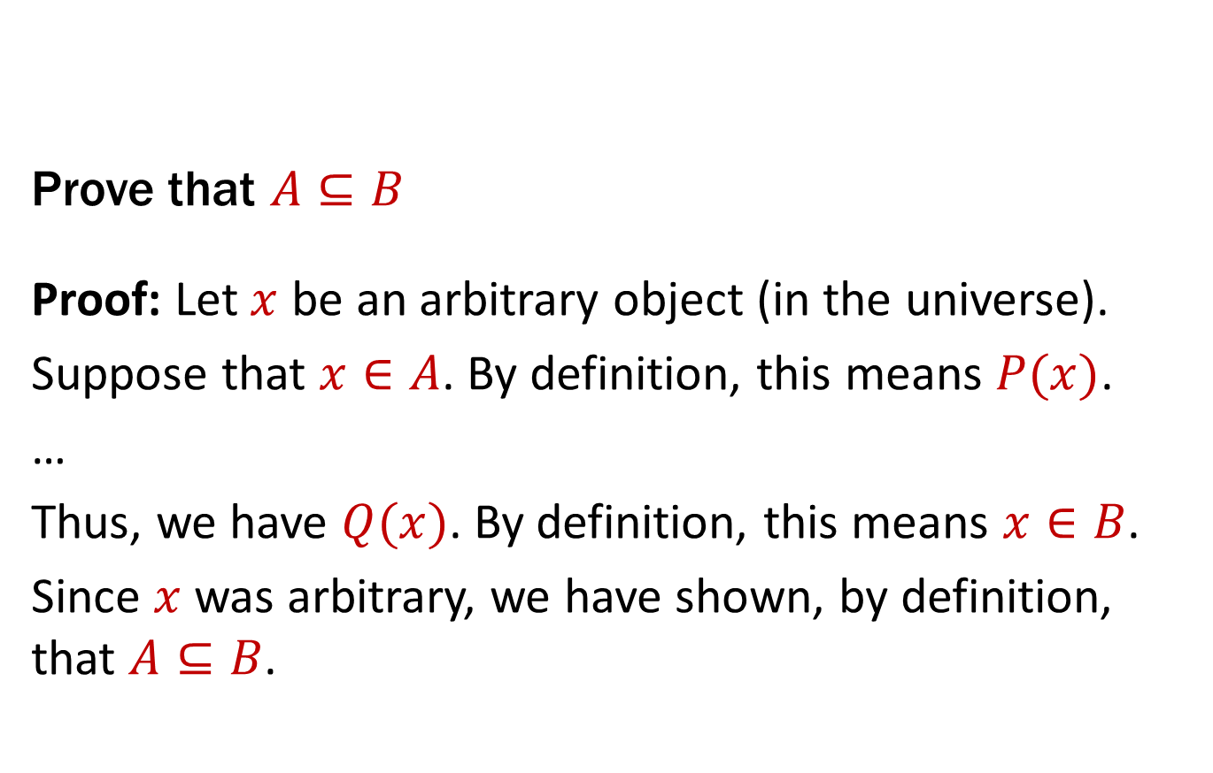
Proofs About Sets
A ⊆ B := ∀x (x ∈ A → x ∈ B)
Prove that $A⊆B$
Proof: Let $x$ be an arbitrary object (in the universe).
Suppose that $x∈A$. By definition, this means $P(x)$.
…
Thus, we have $Q(x)$. By definition, this means $x∈B$.
Since $x$ was arbitrary, we have shown, by definition, that $A⊆B$.
A := {x : P(x)}
B := {x : Q(x)}
for P(x):= “x>2” and Q(x):=“x²>3”
Therefore $x>2$ so $x^{2}>4$ which implies $x2>3.$
A ⊂ B

