Slide 1
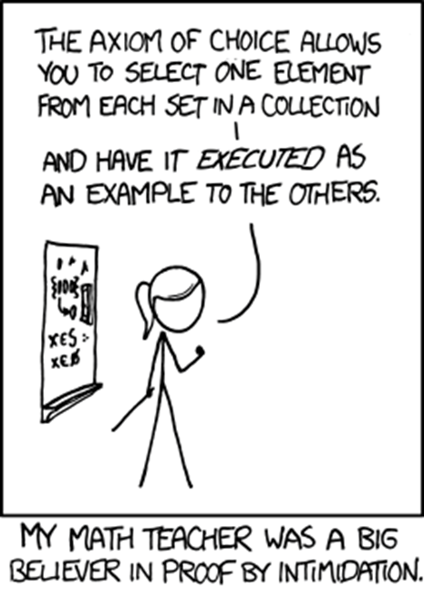
CSE 311: Foundations of Computing
Lecture 13: Set Theory

Slide 2
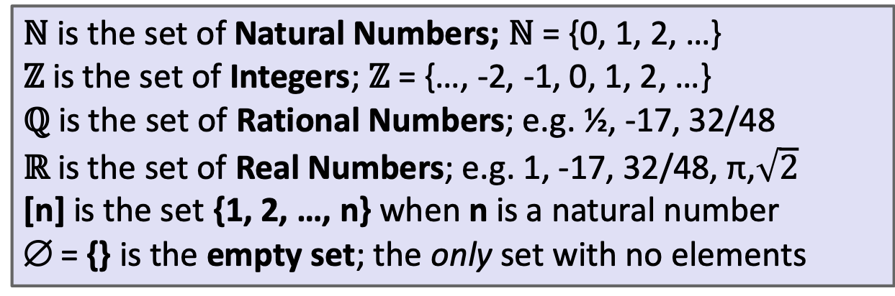
Last class: Some Common Sets
ℕ is the set of Natural Numbers; ℕ = {0, 1, 2, …}
ℤ is the set of Integers; ℤ = {…, -2, -1, 0, 1, 2, …}
ℚ is the set of Rational Numbers; e.g. ½, -17, 32/48
ℝ is the set of Real Numbers; e.g. 1, -17, 32/48, π,$\sqrt{2}$
[n] is the set {1, 2, …, n} when n is a natural number
∅ = {} is the empty set; the only set with no elements
Give some examples:
Finite sets,
Multiple domains
N, Z, Q, R
Emptyset
Sets containing sets

Slide 3
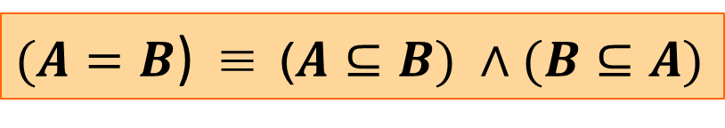
Last class: Definitions
A and B are equal if they have the same elements
A is a subset of B if every element of A is also in B
Notes:
A = B := ∀ x (x ∈ A ↔ x ∈ B)
A ⊆ B := ∀ x (x ∈ A → x ∈ B)
A ⊇ B means B ⊆ A
A ⊂ B means A ⊆ B but A ≠ B
A ⊂ B

Slide 4
Definition: Subset
A is a subset of B if every element of A is also in B
A ⊆ B := ∀ x (x ∈ A → x ∈ B)
A = {1, 2, 3}
B = {3, 4, 5}
C = {3, 4}
QUESTIONS
∅ ⊆ A?
A ⊆ B?
C ⊆ B?
A ⊂ B
Notes:
Note the domain restriction!

Slide 5
Definition: Subset
A is a subset of B if every element of A is also in B
A ⊆ B := ∀ x (x ∈ A → x ∈ B)
Another way to write domain restriction.
We will use a shorthand for restriction to a set
∀x∈A, P(x) := ∀x (x ∈ A → P(x))
Restricting all quantified variables improves clarity
A ⊂ B

Slide 6
Sets & Logic

Slide 7
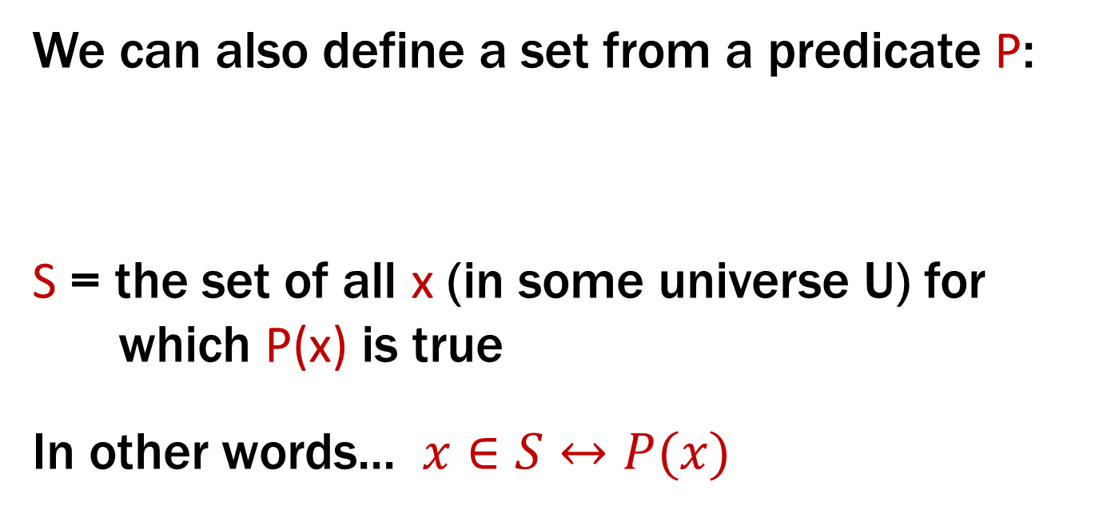
Building Sets from Predicates
Every set S defines a predicate “x ∈ S”.
We can also define a set from a predicate P:
S = the set of all x (in some universe U) for which P(x) is true
In other words... $x∈S↔P(x)$
S := {x : P(x)}
A ⊂ B

Slide 8
Proofs About Sets
Suppose we want to prove A ⊆ B.
A := {x : P(x)}
B := {x : Q(x)}
This is a predicate:
A ⊆ B := ∀x (x ∈ A → x ∈ B)
Typically: use direct proof of the implication
A ⊂ B

Slide 9
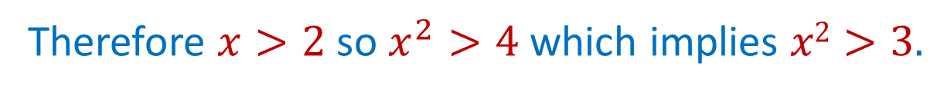
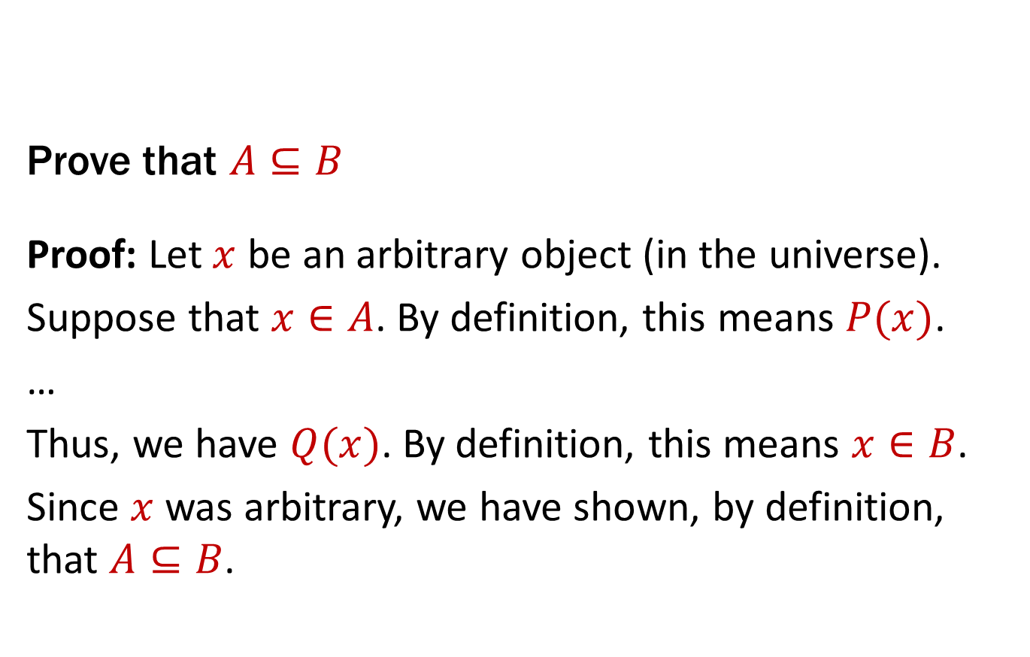
Proofs About Sets
A ⊆ B := ∀x (x ∈ A → x ∈ B)
Prove that $A⊆B$
Proof: Let $x$ be an arbitrary object (in the universe).
Suppose that $x∈A$. By definition, this means $P(x)$.
…
Thus, we have $Q(x)$. By definition, this means $x∈B$.
Since $x$ was arbitrary, we have shown, by definition, that $A⊆B$.
A := {x : P(x)}
B := {x : Q(x)}
for P(x):= “x>2” and Q(x):=“x²>3”
Therefore $x>2$ so $x^{2}>4$ which implies $x2>3.$
A ⊂ B

Slide 10
Operations on Sets

Slide 11
Set Operations
$$A∪B :=\{ x :\left(x∈A\right)∨\left(x ∈B\right)\}$$
Union
$$A∩B :=\{ x :\left(x∈A\right)∧\left(x∈B\right)\}$$
Intersection
$$A \backslash B :=\{ x :\left(x∈A\right)∧\left(x∉B\right)\}$$
Set Difference
A = {1, 2, 3}
B = {3, 5, 6} C = {3, 4}
QUESTIONS
Using A, B, C and set operations, make…
[6] =
{3} =
{1,2} =

Slide 12
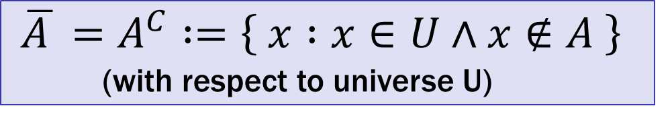
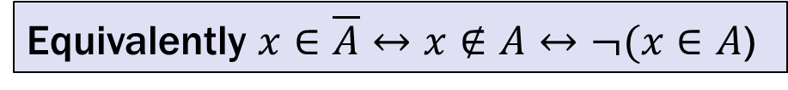
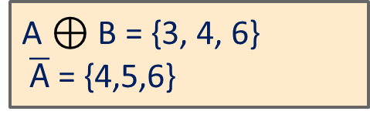
More Set Operations
$$A⊕B :=\{ x :\left(x∈A\right)⊕\left(x∈B\right)\}$$
Symmetric
Difference
$\overline{A }=A^{C} :=\left\{ x :x∈U∧x∉A \right\}$
(with respect to universe U)
Complement
Equivalently $x∈\overline{A}↔x∉A↔¬(x∈A$)
A = {1, 2, 3}
B = {1, 2, 4, 6}
Universe:
U = {1, 2, 3, 4, 5, 6}
A $⊕$ B = {3, 4, 6}
$\overline{A}$ = {4,5,6}

Slide 13
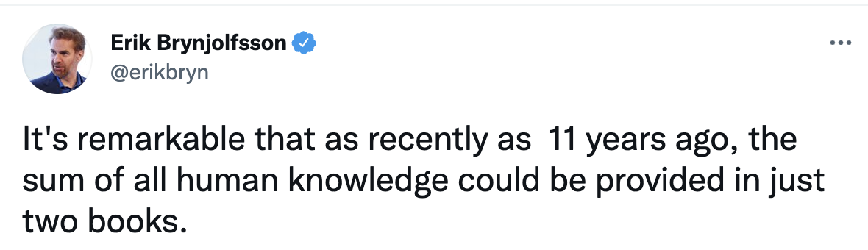



Set Complement

Slide 14
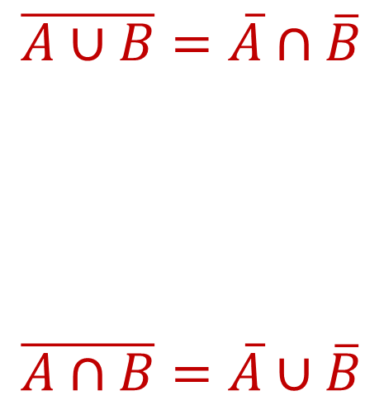
De Morgan’s Laws
Prove A ∪ B = A ∩ B
Begin with x ∈ A ∪ B ↔ x ∈ A ∨ x ∈ B

Slide 15
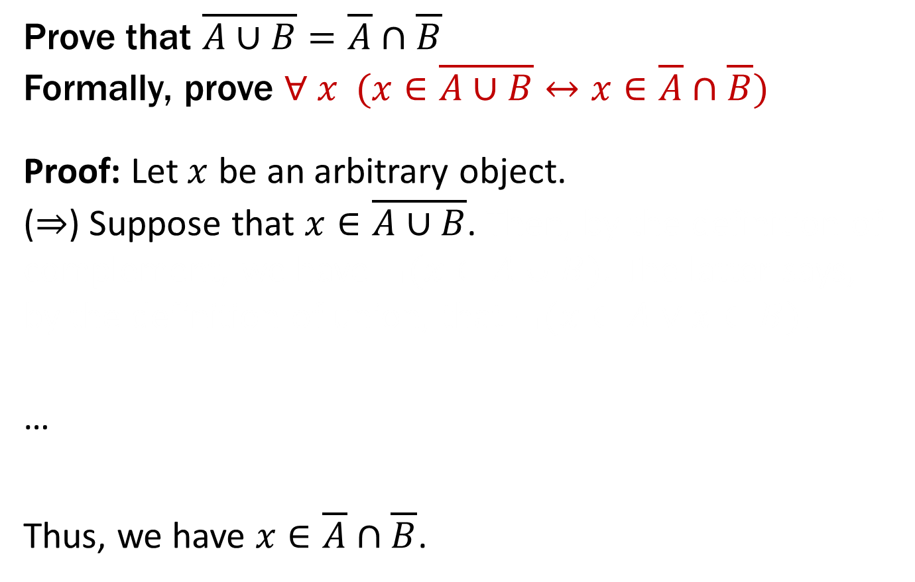
De Morgan’s Laws
Prove that $\overline{A∪B}=\overline{A}∩\overline{B}$
Formally, prove ∀ $x$ ($x∈\overline{A∪B}↔x∈\overline{A}∩\overline{B}$)
Proof: Let $x$ be an arbitrary object.
(⇒) Suppose that $x∈\overline{A∪B}\text{.}$ Then, by the definition of complement, we have $¬(x∈A∪B)$. The latter says, by the definition of union, that $¬(x∈A∨x∈B)$.
…
Thus, we have $x∈\overline{A}∩\overline{B}$.
Prove A ∪ B = A ∩ B
Begin with x ∈ A ∪ B ↔ x ∈ A ∨ x ∈ B
Proof technique:
To show C = D show
x ∈ C → x ∈ D and
x ∈ D → x ∈ C

Slide 16
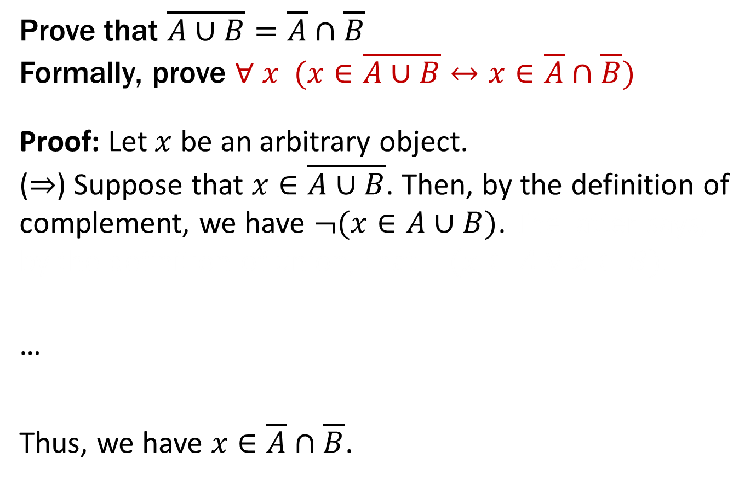
De Morgan’s Laws
Prove that $\overline{A∪B}=\overline{A}∩\overline{B}$
Formally, prove ∀ $x$ ($x∈\overline{A∪B}↔x∈\overline{A}∩\overline{B}$)
Proof: Let $x$ be an arbitrary object.
(⇒) Suppose that $x∈\overline{A∪B}\text{.}$ Then, by the definition of complement, we have $¬(x∈A∪B)$. The latter says, by the definition of union, that $¬(x∈A∨x∈B)$.
…
Thus, we have $x∈\overline{A}∩\overline{B}$.
Prove A ∪ B = A ∩ B
Begin with x ∈ A ∪ B ↔ x ∈ A ∨ x ∈ B

Slide 17
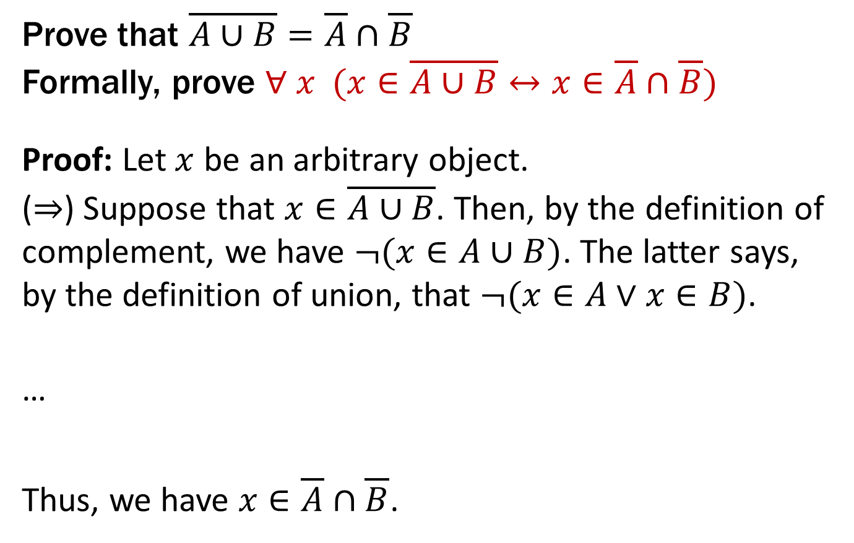
De Morgan’s Laws
Prove that $\overline{A∪B}=\overline{A}∩\overline{B}$
Formally, prove ∀ $x$ ($x∈\overline{A∪B}↔x∈\overline{A}∩\overline{B}$)
Proof: Let $x$ be an arbitrary object.
(⇒) Suppose that $x∈\overline{A∪B}\text{.}$ Then, by the definition of complement, we have $¬(x∈A∪B)$. The latter says, by the definition of union, that $¬(x∈A∨x∈B)$.
…
Thus, we have $x∈\overline{A}∩\overline{B}$.
Prove A ∪ B = A ∩ B
Begin with x ∈ A ∪ B ↔ x ∈ A ∨ x ∈ B

Slide 18
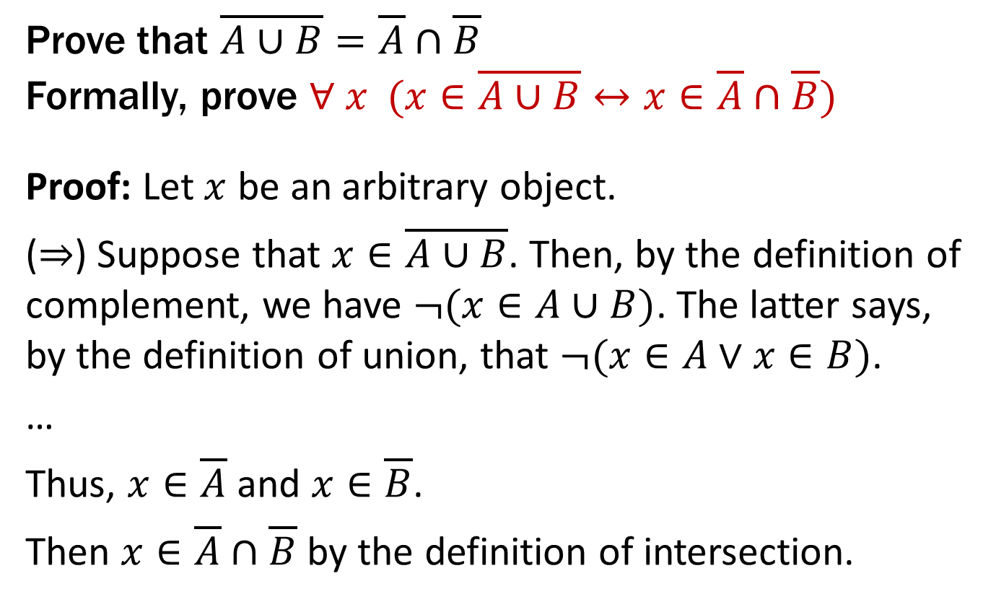
De Morgan’s Laws
Prove that $\overline{A∪B}=\overline{A}∩\overline{B}$
Formally, prove ∀ $x$ ($x∈\overline{A∪B}↔x∈\overline{A}∩\overline{B}$)
Proof: Let $x$ be an arbitrary object.
(⇒) Suppose that $x∈\overline{A∪B}$. Then, by the definition of complement, we have $¬(x∈A∪B)$. The latter says, by the definition of union, that $¬(x∈A∨x∈B)$.
…
Thus, $x∈\overline{A}$ and $x∈\overline{B}$.
Then $x∈\overline{A}∩\overline{B}$ by the definition of intersection.
Prove A ∪ B = A ∩ B
Begin with x ∈ A ∪ B ↔ x ∈ A ∨ x ∈ B

Slide 19
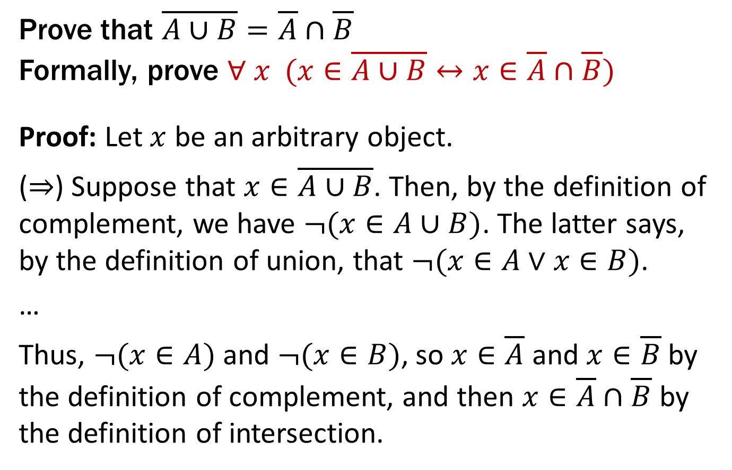
De Morgan’s Laws
Prove that $\overline{A∪B}=\overline{A}∩\overline{B}$
Formally, prove ∀ $x$ ($x∈\overline{A∪B}↔x∈\overline{A}∩\overline{B}$)
Proof: Let $x$ be an arbitrary object.
(⇒) Suppose that $x∈\overline{A∪B}$. Then, by the definition of complement, we have $¬(x∈A∪B)$. The latter says, by the definition of union, that $¬(x∈A∨x∈B)$.
…
Thus, $¬(x∈A)$ and $¬(x∈B)$, so $x∈\overline{A}$ and $x∈\overline{B}$ by the definition of complement, and then $x∈\overline{A}∩\overline{B}$ by the definition of intersection.
Prove A ∪ B = A ∩ B
Begin with x ∈ A ∪ B ↔ x ∈ A ∨ x ∈ B

Slide 20
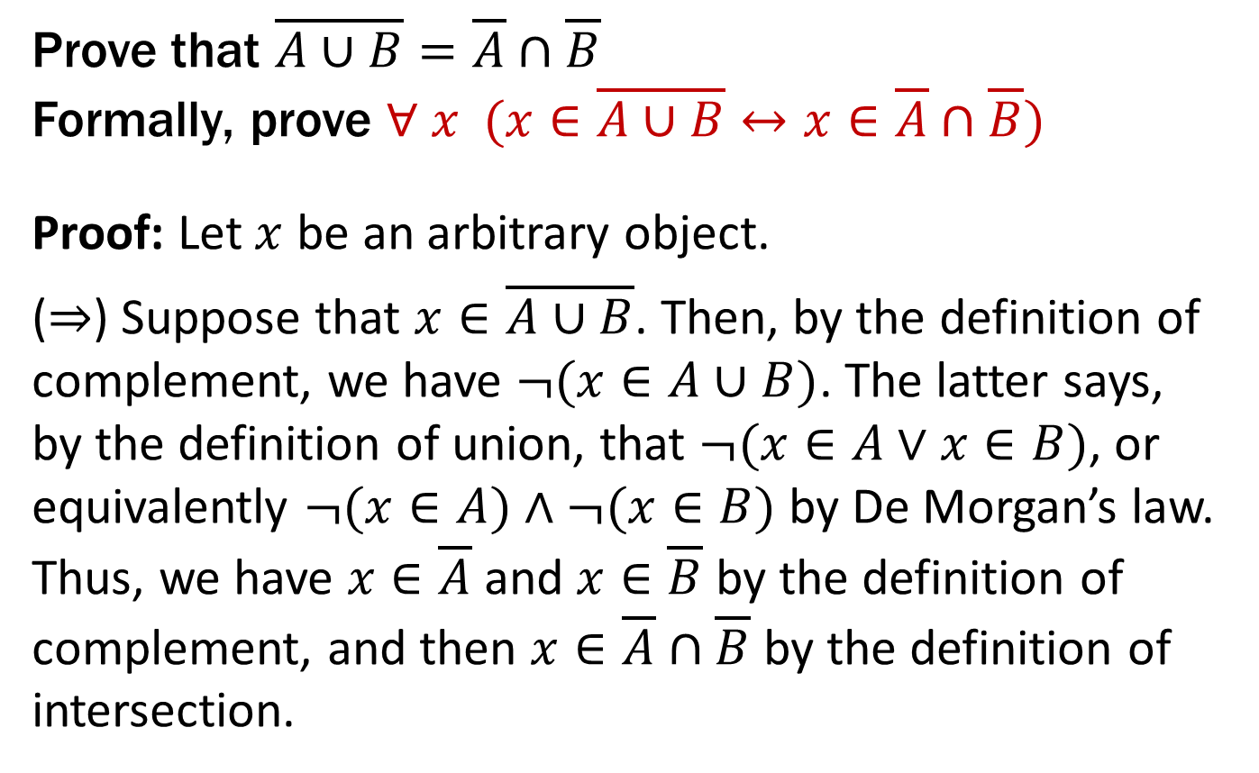
De Morgan’s Laws
Prove that $\overline{A∪B}=\overline{A}∩\overline{B}$
Formally, prove ∀ $x$ ($x∈\overline{A∪B}↔x∈\overline{A}∩\overline{B}$)
Proof: Let $x$ be an arbitrary object.
(⇒) Suppose that $x∈\overline{A∪B}$. Then, by the definition of complement, we have $¬(x∈A∪B)$. The latter says, by the definition of union, that $¬(x∈A∨x∈B)$, or equivalently $¬(x∈A)∧¬(x∈B)$ by De Morgan’s law. Thus, we have $x∈\overline{A}$ and $x∈\overline{B}$ by the definition of complement, and then $x∈\overline{A}∩\overline{B}$ by the definition of intersection.
Prove A ∪ B = A ∩ B
Begin with x ∈ A ∪ B ↔ x ∈ A ∨ x ∈ B
To show C = D show
x ∈ C → x ∈ D and
x ∈ D → x ∈ C

Slide 21

De Morgan’s Laws
Prove that $\overline{A∪B}=\overline{A}∩\overline{B}$
Formally, prove ∀ $x$ ($x∈\overline{A∪B}↔x∈\overline{A}∩\overline{B}$)
Proof: Let $x$ be an arbitrary object.
(⇒) Suppose that $x∈\overline{A∪B}$.... Then, $x∈\overline{A}∩\overline{B}$.
(⇐) Suppose that $x∈\overline{A}∩\overline{B}$. Then, by the definition of intersection, we have $x∈\overline{A}$ and $x∈\overline{B}$. That is, we have $¬(x∈A)∧¬(x∈B)$, which is equivalent to $¬(x∈A∨x∈B)$ by De Morgan’s law. The last is equivalent to $¬(x∈A∪B)$, by the definition of union, so we have shown $x∈\overline{A∪B}$, by the definition of complement.
Prove A ∪ B = A ∩ B
Begin with x ∈ A ∪ B ↔ x ∈ A ∨ x ∈ B

Slide 22
Proofs About Set Equality
A lot of repetitive work to show → and ←.
Do we have a way to prove ↔︎ directly?
We can use an equivalence chain to prove that a biconditional holds.
Recall that P ≡ Q and (P ↔ Q) ≡ T are the same

Slide 23
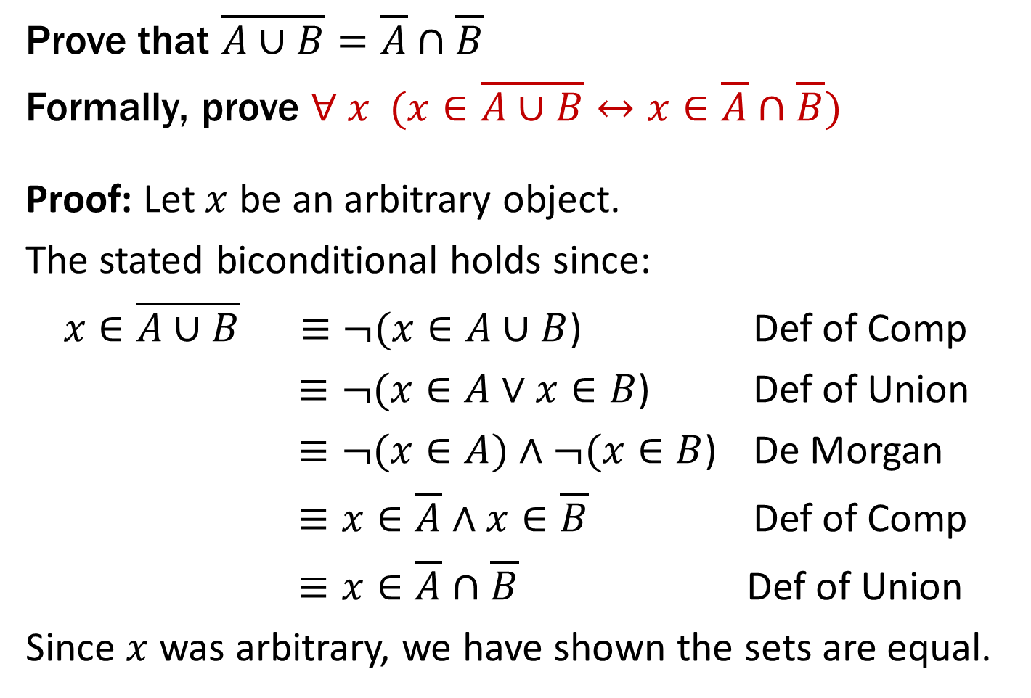
De Morgan’s Laws
Prove that $\overline{A∪B}=\overline{A}∩\overline{B}$
Formally, prove ∀ $x$ ($x∈\overline{A∪B}↔x∈\overline{A}∩\overline{B}$)
Proof: Let $x$ be an arbitrary object.
The stated biconditional holds since:
$x∈\overline{A∪B}$ $≡¬(x∈A∪B$) Def of Comp
$≡¬(x∈A∨x∈B$) Def of Union
$≡¬(x∈A)∧¬(x∈B$) De Morgan
$≡x∈\overline{A}∧x∈\overline{B}$ Def of Comp
$≡x∈\overline{A}∩\overline{B}$ Def of Union
Since $x$ was arbitrary, we have shown the sets are equal.
Chains of equivalences are often easier to read like this rather than as English text
Prove A ∪ B = A ∩ B
Begin with x ∈ A ∪ B ↔ x ∈ A ∨ x ∈ B

Slide 24
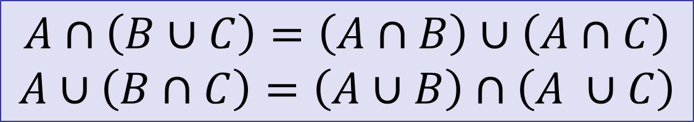
Distributive Laws
$$A∩\left(B∪C\right)=\left(A∩B\right)∪\left(A∩C\right)$$
$$A∪\left(B∩C\right)=\left(A∪B\right)∩\left(A ∪C\right)$$
A
B
A
B
C
C

Slide 25
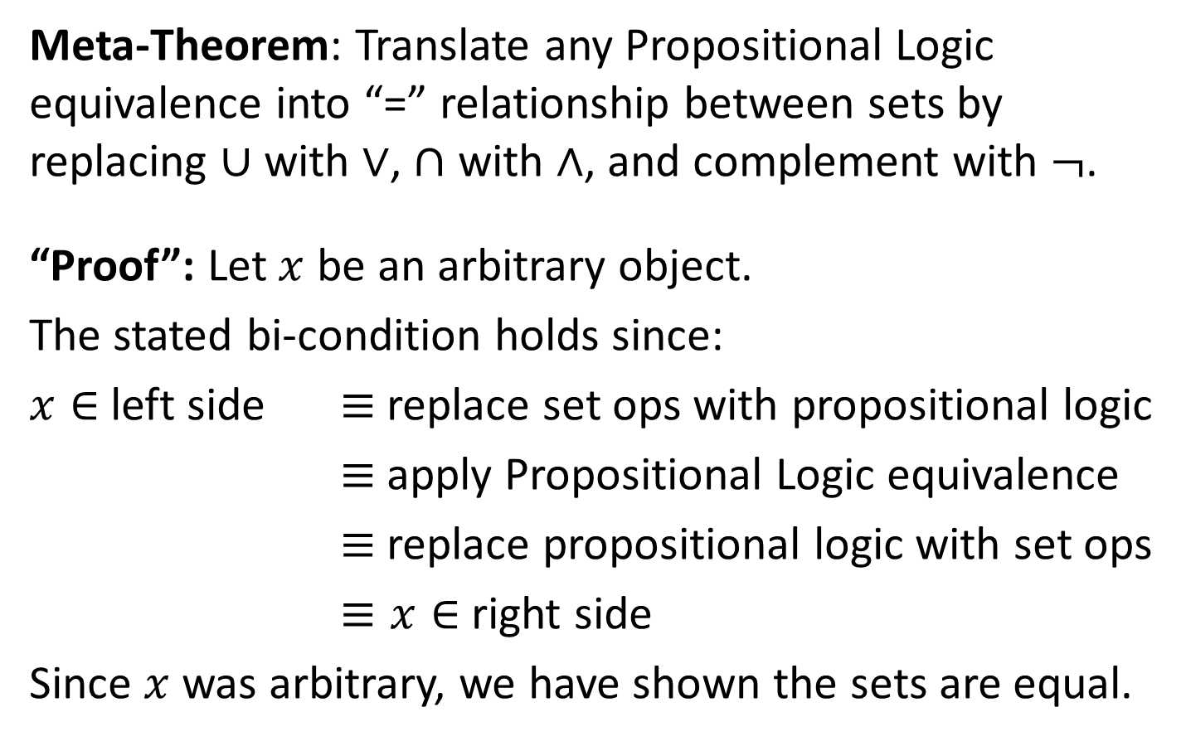
It’s Propositional Logic Again!
Meta-Theorem: Translate any Propositional Logic equivalence into “=” relationship between sets by replacing $∪$ with $∨$, $∩$ with $∧$, and complement with $¬$.
“Proof”: Let $x$ be an arbitrary object.
The stated bi-condition holds since:
$x∈$ left side $≡$ replace set ops with propositional logic
$≡$ apply Propositional Logic equivalence
$≡$ replace propositional logic with set ops
$≡x∈$ right side
Since $x$ was arbitrary, we have shown the sets are equal.
Prove A ∪ B = A ∩ B
Begin with x ∈ A ∪ B ↔ x ∈ A ∨ x ∈ B

Slide 26
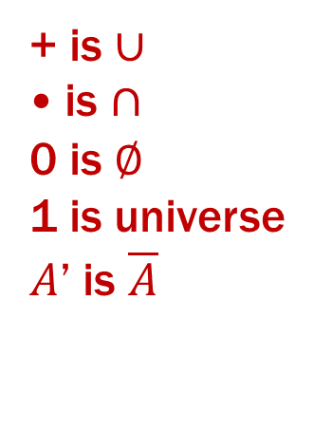
It’s Boolean Algebra Again!
Usual notation used in circuit design
Boolean algebra
a set of elements B containing {0, 1}
binary operations { + , • }
and a unary operation { ’ }
such that the following axioms hold:
For any a, b, c in B: 1. closure: a + b is in B a • b is in B 2. commutativity: a + b = b + a a • b = b • a 3. associativity: a + (b + c) = (a + b) + c a • (b • c) = (a • b) • c 4. distributivity: a + (b • c) = (a + b) • (a + c) a • (b + c) = (a • b) + (a • c) 5. identity: a + 0 = a a • 1 = a 6. complementarity: a + a’ = 1 a • a’ = 0
7. null: a + 1 = 1 a • 0 = 0
8. idempotency: a + a = a a • a = a
9. involution: (a’)’ = a
+ is $∪$
• is $∩$
0 is $∅$
1 is universe
$A$’ is $\overline{A}$

Slide 27
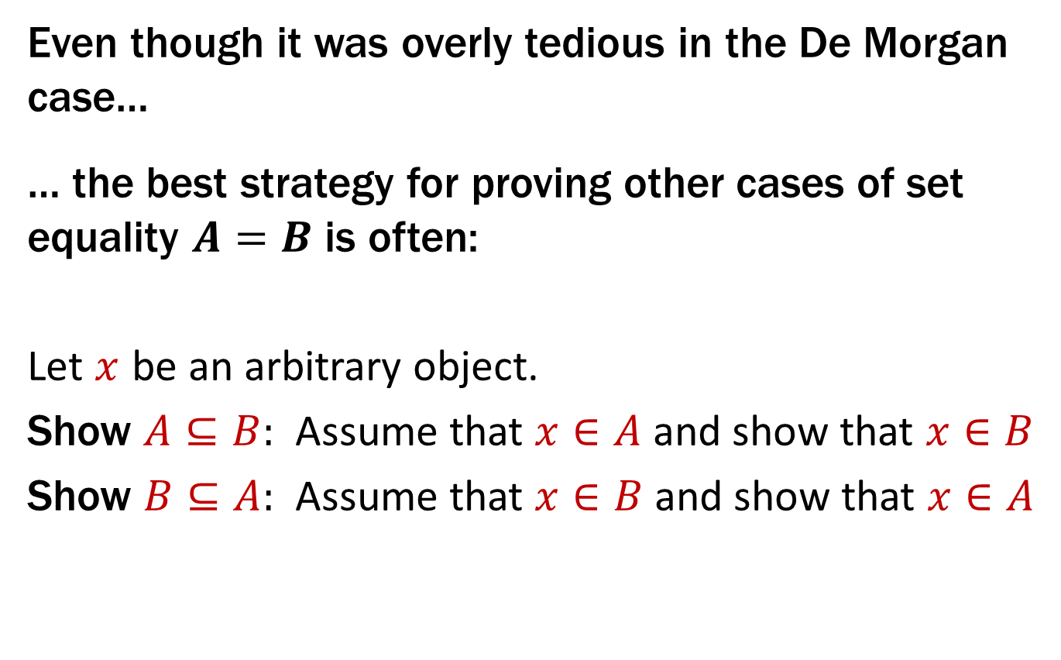
Note on Proofs of Set Equality
Even though it was overly tedious in the De Morgan case…
… the best strategy for proving other cases of set equality $A=B$ is often:
Let $x$ be an arbitrary object.
Show $A⊆B:$ Assume that $x∈A$ and show that $x∈B$
Show $B⊆A:$ Assume that $x∈B$ and show that $x∈A$

Slide 28

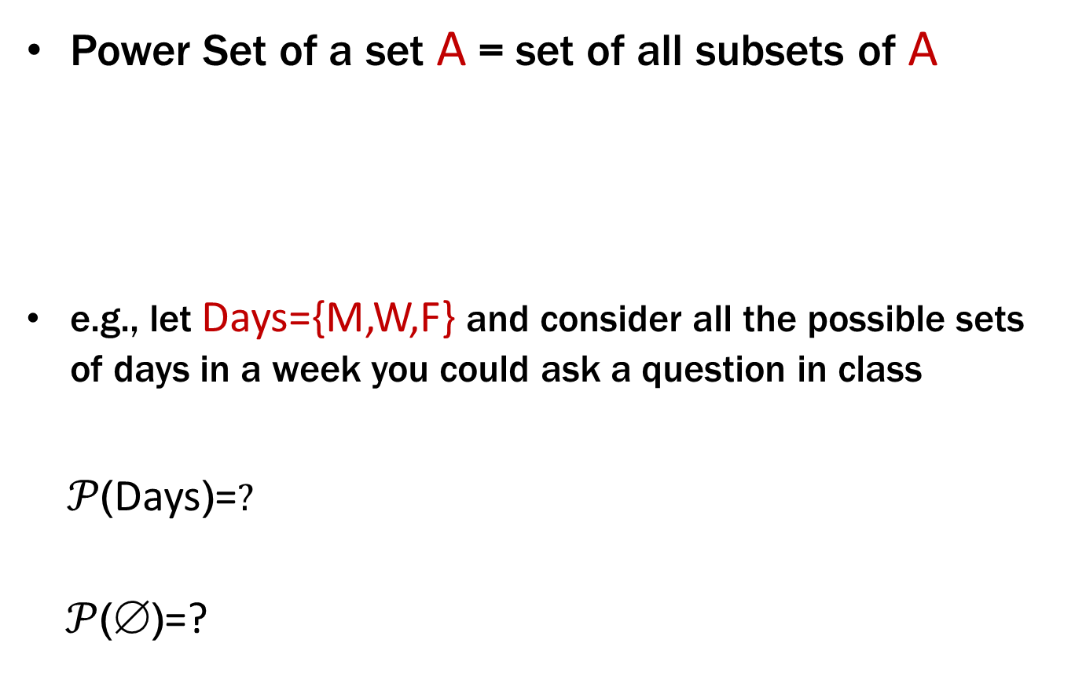
Power Set
Power Set of a set A = set of all subsets of A
e.g., let Days={M,W,F} and consider all the possible sets of days in a week you could ask a question in class
$𝒫$(Days)=$?$
$𝒫$($\text{}$)=?
$$𝒫\left(A\right) :=\{B :B⊆A \}$$

Slide 29
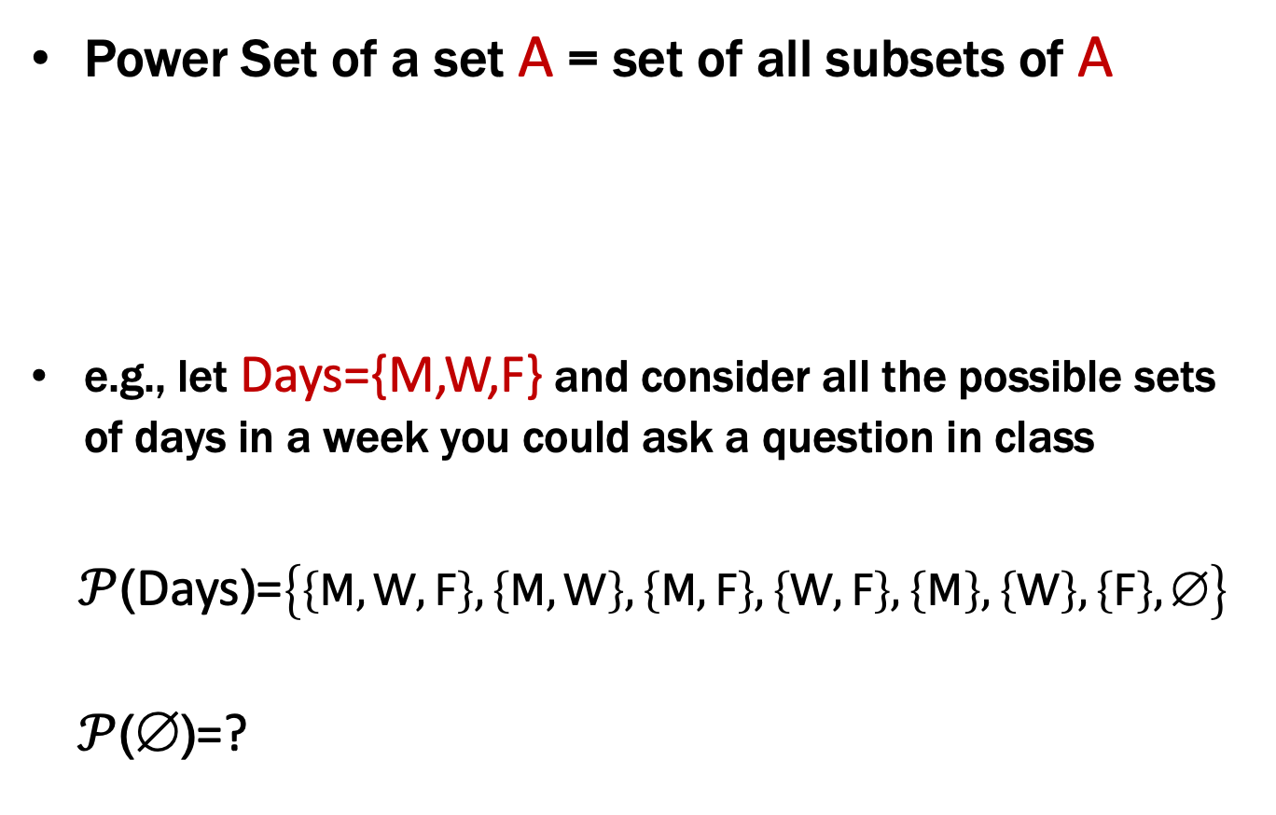
Power Set
Power Set of a set A = set of all subsets of A
e.g., let Days={M,W,F} and consider all the possible sets of days in a week you could ask a question in class
$𝒫$(Days)=$\left\{\left\{M,W,F\right\},\left\{M,W\right\},\left\{M,F\right\},\left\{W,F\right\},\left\{M\right\},\left\{W\right\},\left\{F\right\},\text{∅}\right\}$
$𝒫$($\text{}$)=?
$$𝒫\left(A\right) :=\{B :B⊆A \}$$

Slide 30
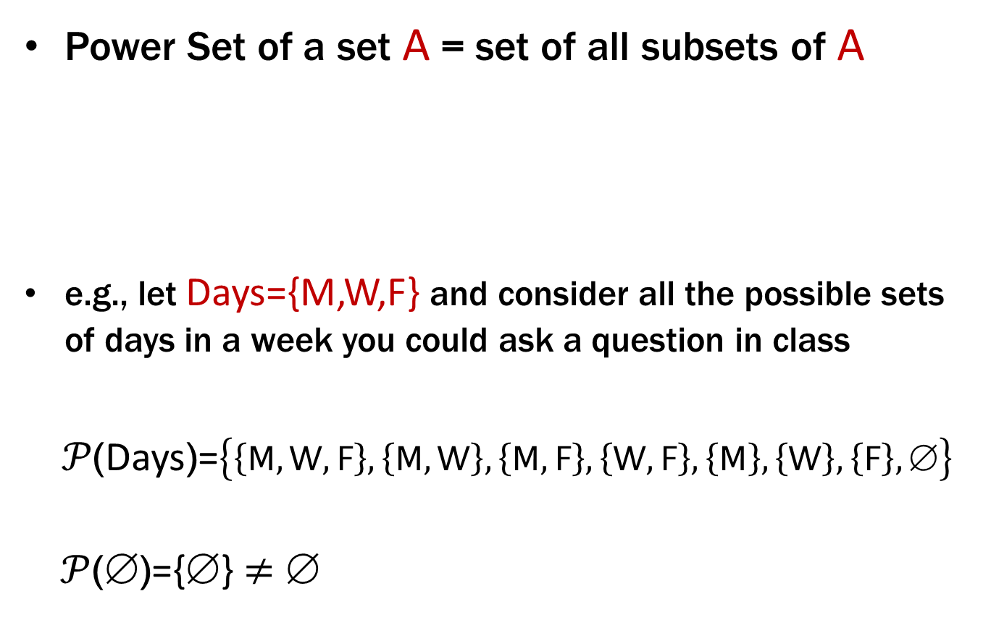
Power Set
Power Set of a set A = set of all subsets of A
e.g., let Days={M,W,F} and consider all the possible sets of days in a week you could ask a question in class
$𝒫$(Days)=$\left\{\left\{M,W,F\right\},\left\{M,W\right\},\left\{M,F\right\},\left\{W,F\right\},\left\{M\right\},\left\{W\right\},\left\{F\right\},\text{∅}\right\}$
$𝒫$($\text{}$)={$\text{}$} ≠ $\text{}$
$$𝒫\left(A\right) :=\{B :B⊆A \}$$

Slide 31
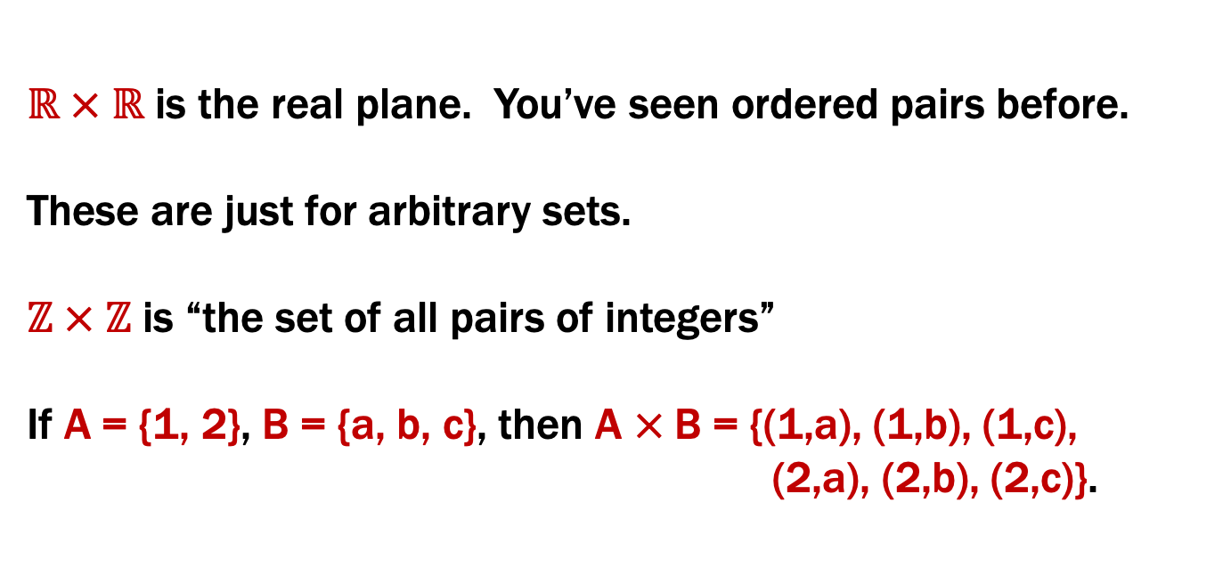
Cartesian Product
$$A×B :=\{x :∃a∈A, ∃b∈B (x=(a,b)) \}$$
$ℝ × ℝ$ is the real plane. You’ve seen ordered pairs before.
These are just for arbitrary sets.
$ℤ × ℤ$ is “the set of all pairs of integers”
If A = {1, 2}, B = {a, b, c}, then A × B = {(1,a), (1,b), (1,c),
(2,a), (2,b), (2,c)}.

Slide 32
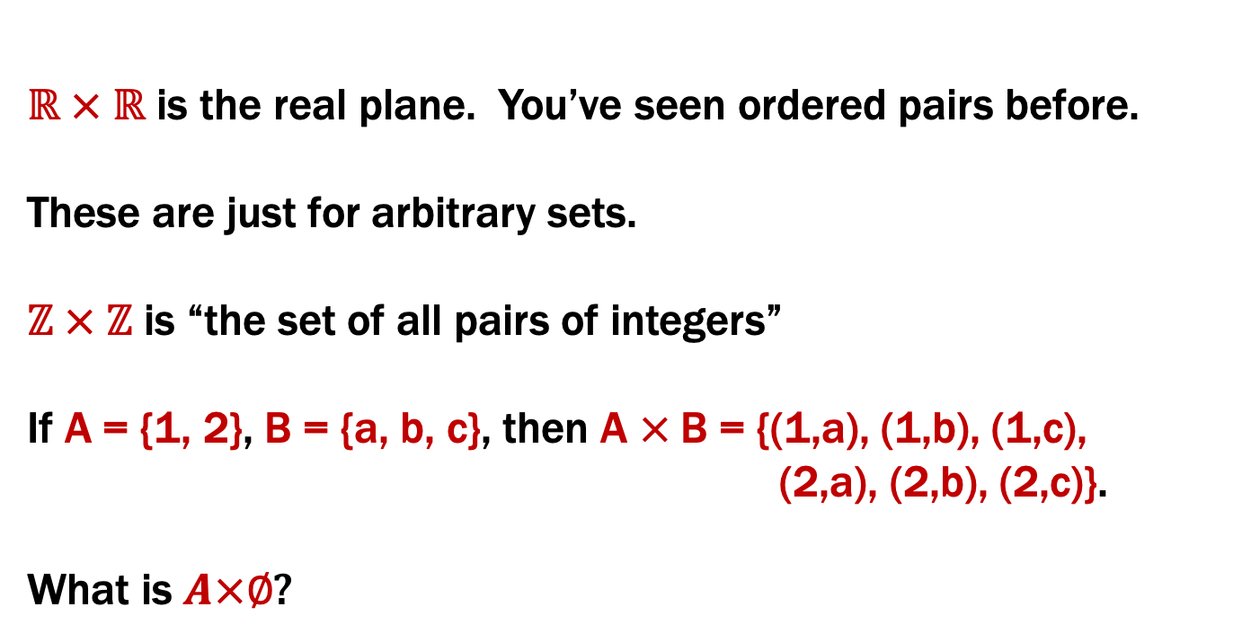
Cartesian Product
$$A×B :=\{x :∃a∈A, ∃b∈B (x=(a,b)) \}$$
$ℝ × ℝ$ is the real plane. You’ve seen ordered pairs before.
These are just for arbitrary sets.
$ℤ × ℤ$ is “the set of all pairs of integers”
If A = {1, 2}, B = {a, b, c}, then A × B = {(1,a), (1,b), (1,c),
(2,a), (2,b), (2,c)}.
What is $A×∅$?

Slide 33
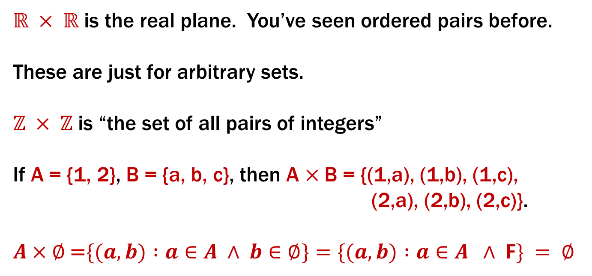
Cartesian Product
$$A×B :=\{x :∃a∈A, ∃b∈B (x=(a,b)) \}$$
$ℝ × ℝ$ is the real plane. You’ve seen ordered pairs before.
These are just for arbitrary sets.
$ℤ × ℤ$ is “the set of all pairs of integers”
If A = {1, 2}, B = {a, b, c}, then A × B = {(1,a), (1,b), (1,c),
(2,a), (2,b), (2,c)}.
$A×∅$ =$\{(a, b) :a∈A ∧ b∈∅\}=\{(a, b) :a∈A ∧ F\} = ∅$

Slide 34
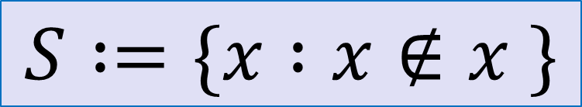
Russell’s Paradox
$$S :=\{x :x∉x \}$$
Suppose that $S∈S$…

Slide 35
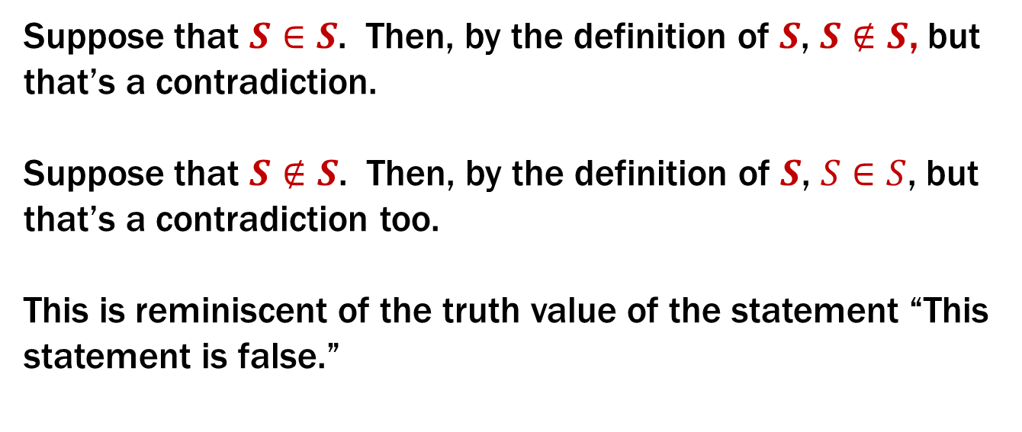
Russell’s Paradox
$$S :=\{x :x∉x \}$$
Suppose that $S∈S$. Then, by the definition of $S$, $S∉S$, but that’s a contradiction.
Suppose that $S∉S$. Then, by the definition of $S$, $S∈S$, but that’s a contradiction too.
This is reminiscent of the truth value of the statement “This statement is false.”

Slide 36
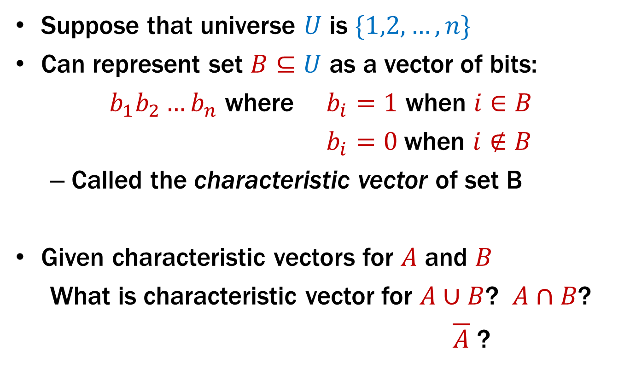
Representing Sets Using Bits
Suppose that universe $U$ is $\{1,2,…,n\}$
Can represent set $B⊆U$ as a vector of bits:
$b_{1}b_{2}…b_{n}$ where $b_{i}=1$ when $i∈B$
$b_{i}=0$when $i∉B$
Called the characteristic vector of set B
Given characteristic vectors for $A$ and $B$
What is characteristic vector for $A∪B$? $A∩B$?
$\overline{A}$ ?

Slide 37
Bitwise Operations
01101101 Java: z=x|y ∨ 00110111
01111111
00101010 Java: z=x&y ∧ 00001111
00001010
01101101 Java: z=x^y
⊕ 00110111
01011010

Slide 38
A Useful Identity
If x and y are bits: (x ⊕ y) ⊕ y = ?
What if x and y are bit-vectors?

Slide 39
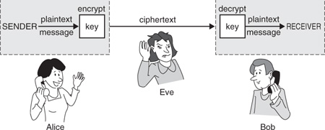
Private Key Cryptography
Alice wants to communicate message secretly to Bob so that eavesdropper Eve who hears their conversation cannot tell what Alice’s message is.
Alice and Bob can get together and privately share a secret key K ahead of time.

Slide 40
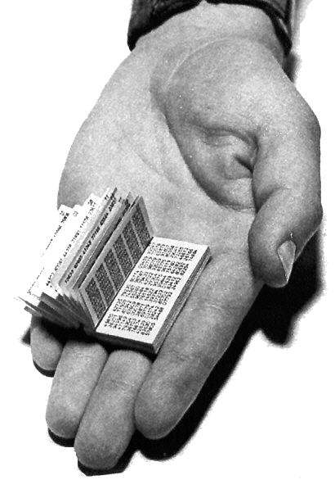
One-Time Pad
Alice and Bob privately share random n-bit vector K
Eve does not know K
Later, Alice has n-bit message m to send to Bob
Alice computes C = m ⊕ K
Alice sends C to Bob
Bob computes m = C ⊕ K which is (m ⊕ K) ⊕ K
Eve cannot figure out m from C unless she can guess K

