Slide 1
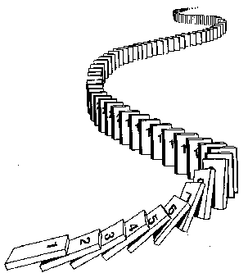
CSE 311: Foundations of Computing
Lecture 14: Induction

Slide 2
Mathematical Induction
Method for proving statements about all natural numbers
A new logical inference rule!
It only applies over the natural numbers
The idea is to use the special structure of the naturals to prove things more easily
Particularly useful for reasoning about programs!
for (int i=0; i < n; n++) { … }
Show P(i) holds after i times through the loop

Slide 3
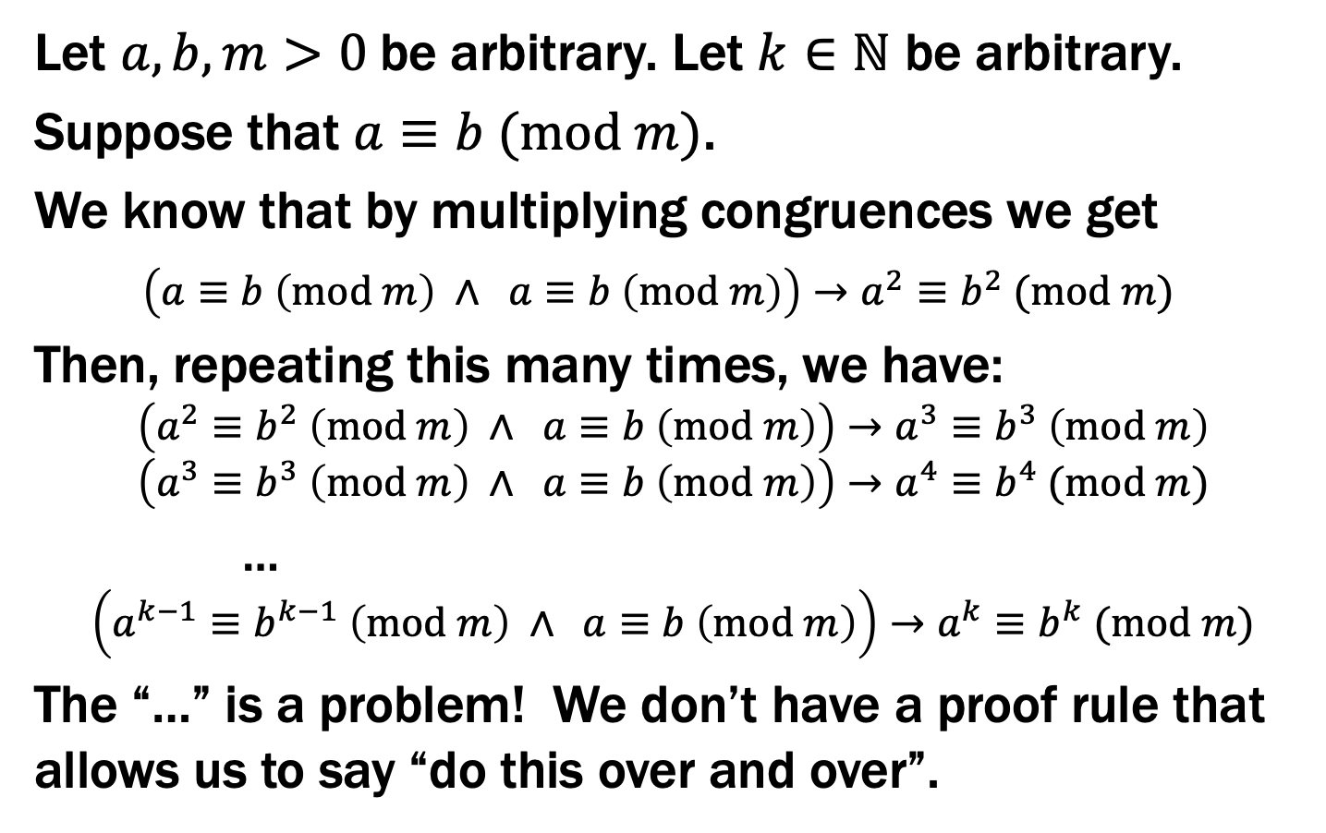
Prove $∀a,b, m>0 ∀ k∈ℕ ((a≡b (mod m))→(a^{k}≡b^{k} (mod m))$
Let $a, b,m>0$ be arbitrary. Let $k∈ℕ$ be arbitrary.
Suppose that $a≡b (mod m)$.
We know that by multiplying congruences we get
$\left(a≡b \left(mod m\right) ∧ a≡b \left(mod m\right)\right)→a^{2}≡b^{2} (mod m)$
Then, repeating this many times, we have:
$$\left(a^{2}≡b^{2} \left(mod m\right) ∧ a≡b \left(mod m\right)\right)→a^{3}≡b^{3} \left(mod m\right)$$
$$\left(a^{3}≡b^{3} \left(mod m\right) ∧ a≡b \left(mod m\right)\right)→a^{4}≡b^{4} (mod m)$$
…
$$\left(a^{k−1}≡b^{k−1} \left(mod m\right) ∧ a≡b \left(mod m\right)\right)→a^{k}≡b^{k} (mod m)$$
The “…” is a problem! We don’t have a proof rule that allows us to say “do this over and over”.

Slide 4
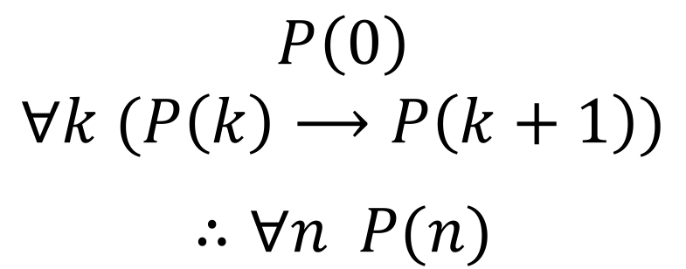
But there such a property of the natural numbers!
Domain: Natural Numbers
$$P\left(0\right)$$
$$∀k (P\left(k\right)⟶P\left(k+1\right))$$
$$∴∀n P(n)$$
Formal steps
Show P(0)
Assume P(k), Prove P(k+1), Conclude P(k)→ P(k+1)
Conclude ∀ k (P(k)→ P(k+1))
Conclude ∀ n P(n)

Slide 5
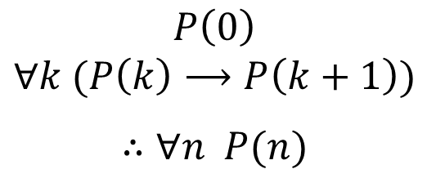
Induction Is A Rule of Inference
Domain: Natural Numbers
$$P\left(0\right)$$
$$∀k (P\left(k\right)⟶P\left(k+1\right))$$
$$∴∀n P(n)$$
How do the givens prove P(5)?
Formal steps
Show P(0)
Assume P(k), Prove P(k+1), Conclude P(k)→ P(k+1)
Conclude ∀ k (P(k)→ P(k+1))
Conclude ∀ n P(n)

Slide 6



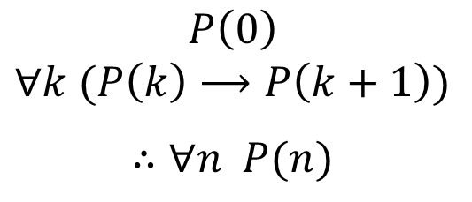



Induction Is A Rule of Inference
Domain: Natural Numbers
$$P\left(0\right)$$
$$∀k (P\left(k\right)⟶P\left(k+1\right))$$
$$∴∀n P(n)$$
How do the givens prove P(5)?
P(0)→P(1) P(1)→P(2) P(2)→P(3) P(3)→P(4 ) P(4)→P(5)
$$P(0)$$
$$P(1)$$
$$P(2)$$
$$P(3)$$
$$P(4)$$
$$P(5)$$
First, we have P(0).
Since P(n) → P(n+1) for all n, we have P(0) → P(1).
Since P(0) is true and P(0) → P(1), by Modus Ponens, P(1) is true.
Since P(n) → P(n+1) for all n, we have P(1) → P(2).
Since P(1) is true and P(1) → P(2), by Modus Ponens, P(2) is true.
…
Formal steps
Show P(0)
Assume P(k), Prove P(k+1), Conclude P(k)→ P(k+1)
Conclude ∀ k (P(k)→ P(k+1))
Conclude ∀ n P(n)
Notes:
P(0) Given
P(0) -> P(1) Elim forall
P(1) MP
…

Slide 7
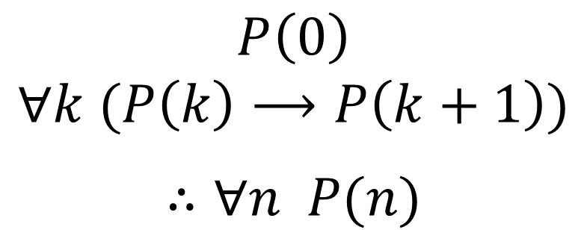
Using The Induction Rule In A Formal Proof
$$P\left(0\right)$$
$$∀k (P\left(k\right)⟶P\left(k+1\right))$$
$$∴∀n P(n)$$

Slide 8
Using The Induction Rule In A Formal Proof
$$P\left(0\right)$$
$$∀k (P\left(k\right)⟶P\left(k+1\right))$$
$$∴∀n P(n)$$
1. P(0)
Let k be an arbitrary integer ≥ 0
3.1. Assume that P(k) is true
3.2. ...
3.3. Prove P(k+1) is true
P(k) → P(k+1) Direct Proof Rule
∀k (P(k) → P(k+1)) Intro ∀: 2, 3
∀n P(n) Induction: 1, 4

Slide 9
Using The Induction Rule In A Formal Proof
$$P\left(0\right)$$
$$∀k (P\left(k\right)⟶P\left(k+1\right))$$
$$∴∀n P(n)$$
1. P(0)
Let k be an arbitrary integer ≥ 0
3.1. Assume that P(k) is true
3.2. ...
3.3. Prove P(k+1) is true
P(k) → P(k+1) Direct Proof Rule
∀k (P(k) → P(k+1)) Intro ∀: 2, 3
∀n P(n) Induction: 1, 4

Slide 10
Using The Induction Rule In A Formal Proof
$$P\left(0\right)$$
$$∀k (P\left(k\right)⟶P\left(k+1\right))$$
$$∴∀n P(n)$$
1. P(0)
Let k be an arbitrary integer ≥ 0
3.1. P(k) Assumption
3.2. ...
3.3. P(k+1)
P(k) → P(k+1) Direct Proof Rule
∀k (P(k) → P(k+1)) Intro ∀: 2, 3
∀n P(n) Induction: 1, 4

Slide 11
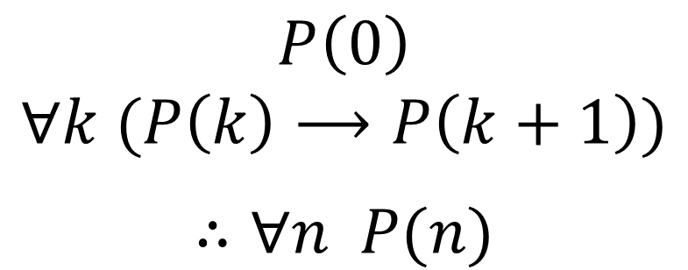
Translating to an English Proof
$$P\left(0\right)$$
$$∀k (P\left(k\right)⟶P\left(k+1\right))$$
$$∴∀n P(n)$$
Base Case
1. Prove P(0)
Let k be an arbitrary integer ≥ 0
3.1. Suppose that P(k) is true
3.2. ...
3.3. Prove P(k+1) is true
P(k) → P(k+1) Direct Proof Rule
∀k (P(k) → P(k+1)) Intro ∀: 2, 3
∀n P(n) Induction: 1, 4
Inductive
Hypothesis
Inductive
Step
Conclusion

Slide 12
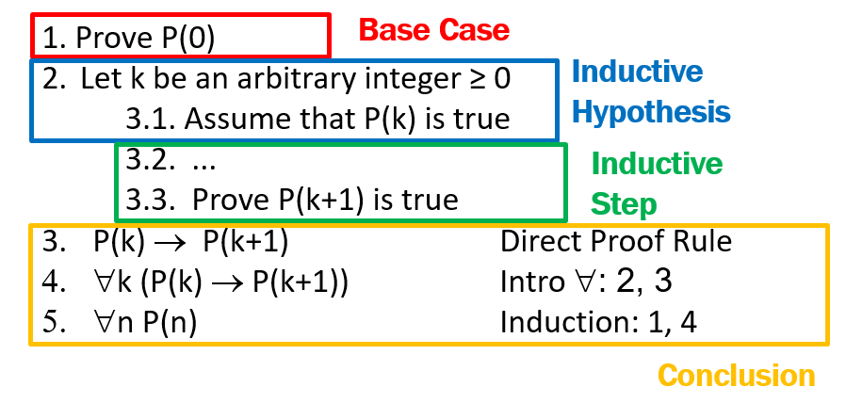
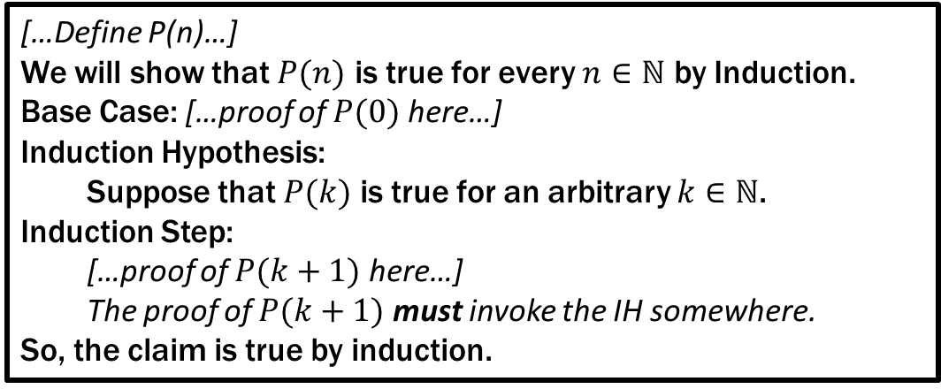
Translating to an English Proof
Induction English Proof Template
[…Define P(n)…]
We will show that $P(n)$ is true for every $n∈ℕ$ by Induction.
Base Case: […proof of $P(0)$ here…]
Induction Hypothesis:
Suppose that $P(k)$ is true for an arbitrary $k∈ℕ$.
Induction Step:
[…proof of $P(k+1)$ here…]
The proof of $P(k+1)$ must invoke the IH somewhere.
So, the claim is true by induction.

Slide 13
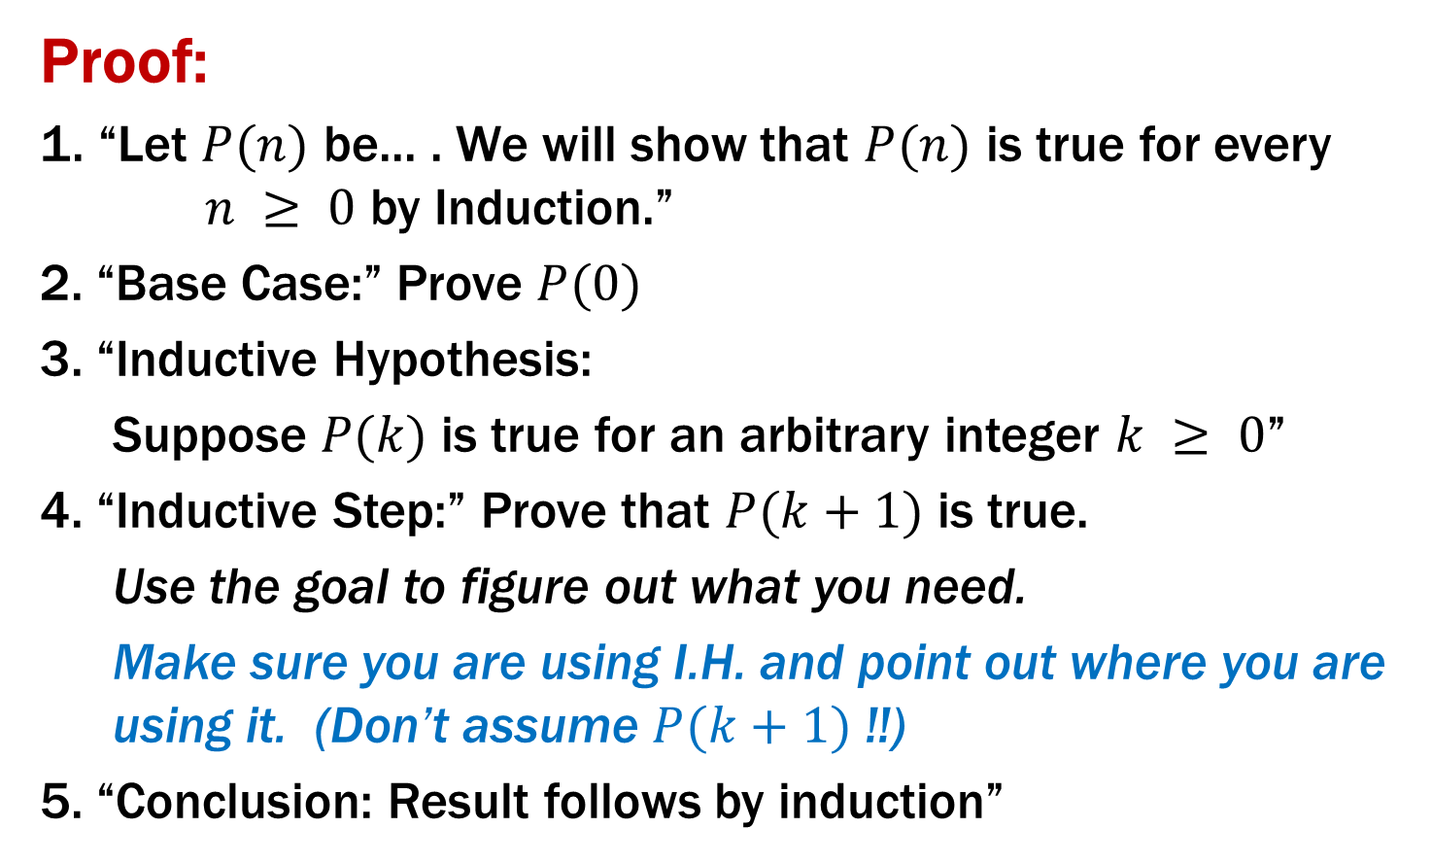
Inductive Proofs In 5 Easy Steps
Proof:
1. “Let $P(n)$ be... . We will show that $P(n)$ is true for every $n ≥ 0$ by Induction.”
2. “Base Case:” Prove $P(0)$
3. “Inductive Hypothesis:
Suppose $P(k)$ is true for an arbitrary integer $k ≥ 0$”
4. “Inductive Step:” Prove that $P(k+1)$ is true.
Use the goal to figure out what you need.
Make sure you are using I.H. and point out where you are using it. (Don’t assume $P(k+1)$ !!)
5. “Conclusion: Result follows by induction”

Slide 14
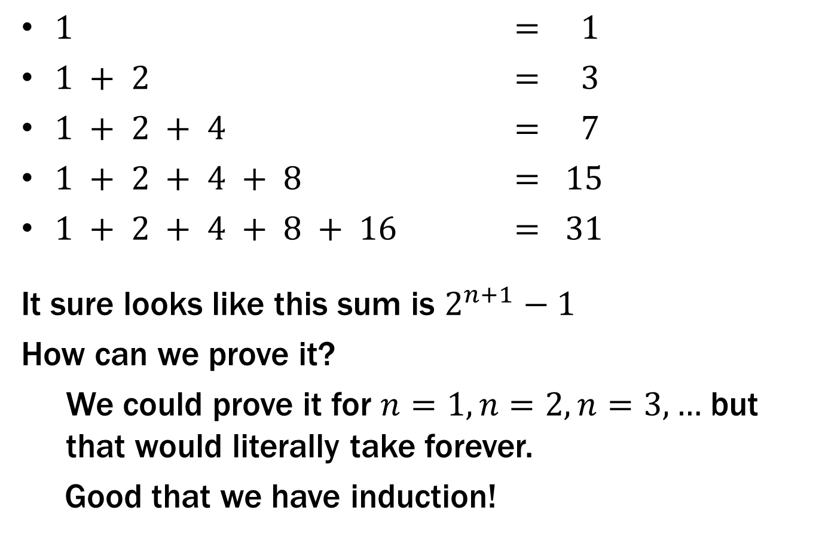
What is $1 + 2 + 4 + … + 2n$ ?
$1 + 2 + 4 + 8 + 16 = 1$
$1 + 2 + 4 + 8 + 16 = 3$
$1 + 2 + 4 + 8 + 16 = 7$
$1 + 2 + 4 + 8 + 16 = 15$
$1 + 2 + 4 + 8 + 16 = 31$
It sure looks like this sum is $2^{n+1}−1$
How can we prove it?
We could prove it for $n=1, n=2, n=3,…$ but that would literally take forever.
Good that we have induction!

Slide 15
Prove $1 + 2 + 4 + … + 2n =2^{n+1}– 1$

Slide 16
Prove $1 + 2 + 4 + … + 2n =2^{n+1}– 1$
Let P(n) be “2⁰ + 2¹ + … + 2^{n} = 2^{n+1} – 1”. We will show P(n) is true for all natural numbers by induction.
Base Case (n=0): 2⁰ = 1 = 2 – 1 = 2⁰⁺¹ – 1
Induction Hypothesis: Suppose that P(k) is true for some arbitrary integer k ≥ 0.
Induction Step:
Goal: Show P(k+1), i.e. show 1 + 2 + … + 2^{k} + 2^{k+1} = 2^{k+2} – 1
1 + 2 + … + 2^{k} = 2^{k+1} – 1 by IH
Adding 2^{k+1} to both sides, we get:
1 + 2 + … + 2^{k} + 2^{k+1} = 2^{k+1} + 2^{k+1} – 1
Note that 2^{k+1} + 2^{k+1} = 2(2^{k+1}) = 2^{k+2}.
So, we have 1 + 2 + … + 2^{k} + 2^{k+1} = 2^{k+2} – 1, which is
exactly P(k+1).
5. Thus P(k) is true for all k ∈ℕ, by induction.
Examples to show its true
P(0)
P(k) → P(k+1)

Slide 17
Prove $1 + 2 + 4 + … + 2n =2^{n+1}– 1$
Let P(n) be “2⁰ + 2¹ + … + 2^{n} = 2^{n+1} – 1”. We will show P(n) is true for all natural numbers by induction.
Base Case (n=0): 2⁰ = 1 = 2 – 1 = 2⁰⁺¹ – 1 so P(0) is true.
Induction Hypothesis: Suppose that P(k) is true for some arbitrary integer k ≥ 0.
Induction Step:
Goal: Show P(k+1), i.e. show 1 + 2 + … + 2^{k} + 2^{k+1} = 2^{k+2} – 1
1 + 2 + … + 2^{k} = 2^{k+1} – 1 by IH
Adding 2^{k+1} to both sides, we get:
1 + 2 + … + 2^{k} + 2^{k+1} = 2^{k+1} + 2^{k+1} – 1
Note that 2^{k+1} + 2^{k+1} = 2(2^{k+1}) = 2^{k+2}.
So, we have 1 + 2 + … + 2^{k} + 2^{k+1} = 2^{k+2} – 1, which is
exactly P(k+1).
5. Thus P(k) is true for all k ∈ℕ, by induction.
Examples to show its true
P(0)
P(k) → P(k+1)

Slide 18
Prove $1 + 2 + 4 + … + 2n =2^{n+1}– 1$
Let P(n) be “2⁰ + 2¹ + … + 2^{n} = 2^{n+1} – 1”. We will show P(n) is true for all natural numbers by induction.
Base Case (n=0): 2⁰ = 1 = 2 – 1 = 2⁰⁺¹ – 1 so P(0) is true.
Induction Hypothesis: Suppose that P(k) is true for some arbitrary integer k ≥ 0, i.e., that 2⁰ + 2¹ + … + 2^{k} = 2^{k+1} – 1.
Goal: Show P(k+1I.e.,), i.e. show 1 + 2 + … + 2^{k} + 2^{k+1} = 2^{k+2} – 1
1 + 2 + … + 2^{k} = 2^{k+1} – 1 by IH
Adding 2^{k+1} to both sides, we get:
1 + 2 + … + 2^{k} + 2^{k+1} = 2^{k+1} + 2^{k+1} – 1
Note that 2^{k+1} + 2^{k+1} = 2(2^{k+1}) = 2^{k+2}.
So, we have 1 + 2 + … + 2^{k} + 2^{k+1} = 2^{k+2} – 1, which is
exactly P(k+1).
5. Thus P(k) is true for all k ∈ℕ, by induction.
Examples to show its true
P(0)
P(k) → P(k+1)

Slide 19
Prove $1 + 2 + 4 + … + 2n =2^{n+1}– 1$
Let P(n) be “2⁰ + 2¹ + … + 2^{n} = 2^{n+1} – 1”. We will show P(n) is true for all natural numbers by induction.
Base Case (n=0): 2⁰ = 1 = 2 – 1 = 2⁰⁺¹ – 1 so P(0) is true.
Induction Hypothesis: Suppose that P(k) is true for some arbitrary integer k ≥ 0, i.e., that 2⁰ + 2¹ + … + 2^{k} = 2^{k+1} – 1.
Induction Step:
Goal: Show P(k+1), i.e. show 2⁰ + 2¹ + … + 2^{k} + 2^{k+1} = 2^{k+2} – 1
1 + 2 + … + 2^{k} = 2^{k+1} – 1 by IH
Adding 2^{k+1} to both sides, we get:
1 + 2 + … + 2^{k} + 2^{k+1} = 2^{k+1} + 2^{k+1} – 1
Note that 2^{k+1} + 2^{k+1} = 2(2^{k+1}) = 2^{k+2}.
So, we have 1 + 2 + … + 2^{k} + 2^{k+1} = 2^{k+2} – 1, which is
exactly P(k+1).
5. Thus P(k) is true for all k ∈ℕ, by induction.
Examples to show its true
P(0)
P(k) → P(k+1)

Slide 20
Prove $1 + 2 + 4 + … + 2n =2^{n+1}– 1$
Let P(n) be “2⁰ + 2¹ + … + 2^{n} = 2^{n+1} – 1”. We will show P(n) is true for all natural numbers by induction.
Base Case (n=0): 2⁰ = 1 = 2 – 1 = 2⁰⁺¹ – 1 so P(0) is true.
Induction Hypothesis: Suppose that P(k) is true for some arbitrary integer k ≥ 0, i.e., that 2⁰ + 2¹ + … + 2^{k} = 2^{k+1} – 1.
Induction Step:
2⁰ + 2¹ + … + 2^{k} = 2^{k+1} – 1 by IH
Adding 2^{k+1} to both sides, we get:
2⁰ + 2¹ + … + 2^{k} + 2^{k+1} = 2^{k+1} + 2^{k+1} – 1
Note that 2^{k+1} + 2^{k+1} = 2(2^{k+1}) = 2^{k+2}.
So, we have 2⁰ + 2¹ + … + 2^{k} + 2^{k+1} = 2^{k+2} – 1, which is
exactly P(k+1).
5. Thus P(k) is true for all k ∈ℕ, by induction.
Examples to show its true
P(0)
P(k) → P(k+1)

Slide 21
Prove $1 + 2 + 4 + … + 2n =2^{n+1}– 1$
Let P(n) be “2⁰ + 2¹ + … + 2^{n} = 2^{n+1} – 1”. We will show P(n) is true for all natural numbers by induction.
Base Case (n=0): 2⁰ = 1 = 2 – 1 = 2⁰⁺¹ – 1 so P(0) is true.
Induction Hypothesis: Suppose that P(k) is true for some arbitrary integer k ≥ 0, i.e., that 2⁰ + 2¹ + … + 2^{k} = 2^{k+1} – 1.
Induction Step:
We can calculate
2⁰ + 2¹ + … + 2^{k} + 2^{k+1} = (2⁰+2¹+ … + 2^{k}) + 2^{k+1}
= (2^{k+1} – 1) + 2^{k+1} by the IH
= 2(2^{k+1}) – 1
= 2^{k+2} – 1,
which is exactly P(k+1).
5. Thus P(k) is true for all k ∈ℕ, by induction.
Examples to show its true
P(0)
P(k) → P(k+1)
Alternative way of writing the inductive step

Slide 22
Prove $1 + 2 + 4 + … + 2n =2^{n+1}– 1$
Let P(n) be “2⁰ + 2¹ + … + 2^{n} = 2^{n+1} – 1”. We will show P(n) is true for all natural numbers by induction.
Base Case (n=0): 2⁰ = 1 = 2 – 1 = 2⁰⁺¹ – 1 so P(0) is true.
Induction Hypothesis: Suppose that P(k) is true for some arbitrary integer k ≥ 0, i.e., that 2⁰ + 2¹ + … + 2^{k} = 2^{k+1} – 1.
Induction Step:
We can calculate
2⁰ + 2¹ + … + 2^{k} + 2^{k+1} = (2⁰+2¹+ … + 2^{k}) + 2^{k+1}
= (2^{k+1} – 1) + 2^{k+1} by the IH
= 2(2^{k+1}) – 1
= 2^{k+2} – 1,
which is exactly P(k+1).
5. Thus P(n) is true for all n ∈ℕ, by induction.
Examples to show its true
P(0)
P(k) → P(k+1)

Slide 23
Prove$1 + 2 + 3 + … + n = n(n+1)/2$

Slide 24
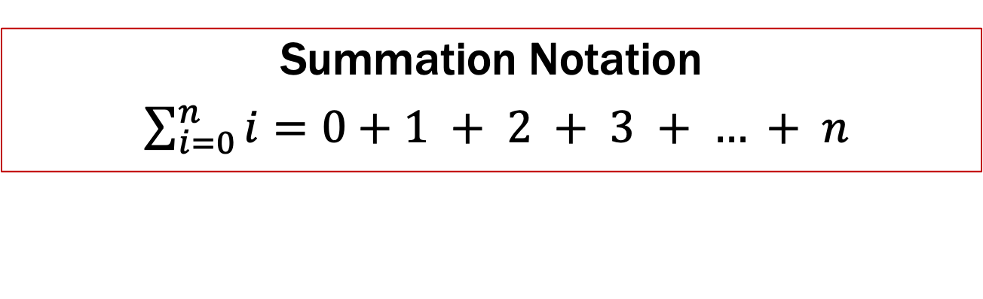
Prove$1 + 2 + 3 + … + n = n(n+1)/2$
Let P(n) be “0 + 1 + 2 + … + n = n(n+1)/2”. We will show P(n) is true for all natural numbers by induction.
Base Case (n=0): 0 = 0(0+1)/2. Therefore P(0) is true.
Induction Hypothesis: Suppose that P(k) is true for some arbitrary integer k ≥ 0.
Induction Step:
Goal: Show P(k+1), i.e. show 1 + 2 + … + (n+1) = (n+1)(n+2)/2
1 + 2 + … + n = n(n+1)/2 by IH
Adding n+1 to both sides, we get:
1 + 2 + … + n + (n+1) = n(n+1)/2 + (n+1)
Now n(n+1)/2 + (n+1) = (n+1)(n/2 + 1) = (n+1)(n+2)/2.
So, we have 1 + 2 + … + n + (n+1) = (n+1)(n+2)/2, which is
exactly P(k+1).
5. Thus P(k) is true for all k ∈ℕ, by induction.
Summation Notation
$\sum_{i=0}^{n}{i}=0+1 + 2 + 3 + … + n$
Examples to show its true
P(0)
P(k) → P(k+1)

Slide 25
Prove$1 + 2 + 3 + … + n = n(n+1)/2$
Let P(n) be “0 + 1 + 2 + … + n = n(n+1)/2”. We will show P(n) is true for all natural numbers by induction.
Base Case (n=0): 0 = 0(0+1)/2. Therefore P(0) is true.
Induction Hypothesis: Suppose that P(k) is true for some arbitrary integer k ≥ 0.
Induction Step:
Goal: Show P(k+1), i.e. show 1 + 2 + … + (n+1) = (n+1)(n+2)/2
1 + 2 + … + n = n(n+1)/2 by IH
Adding n+1 to both sides, we get:
1 + 2 + … + n + (n+1) = n(n+1)/2 + (n+1)
Now n(n+1)/2 + (n+1) = (n+1)(n/2 + 1) = (n+1)(n+2)/2.
So, we have 1 + 2 + … + n + (n+1) = (n+1)(n+2)/2, which is
exactly P(k+1).
5. Thus P(k) is true for all k ∈ℕ, by induction.
Summation Notation
$\sum_{i=0}^{n}{i}=0+1 + 2 + 3 + … + n$
Examples to show its true
P(0)
P(k) → P(k+1)

Slide 26
Prove$1 + 2 + 3 + … + n = n(n+1)/2$
Let P(n) be “0 + 1 + 2 + … + n = n(n+1)/2”. We will show P(n) is true for all natural numbers by induction.
Base Case (n=0): 0 = 0(0+1)/2. Therefore P(0) is true.
Induction Hypothesis: Suppose that P(k) is true for some arbitrary integer k ≥ 0. I.e., suppose 1 + 2 + …+ k = k(k+1)/2
1 + 2 + … + n n(n+1)/2 by IH
Adding n+1 to both sides, we get:
1 + 2 + … + n + (n+1) = n(n+1)/2 + (n+1)
Now n(n+1)/2 + (n+1) = (n+1)(n/2 + 1) = (n+1)(n+2)/2.
So, we have 1 + 2 + … + n + (n+1) = (n+1)(n+2)/2, which is
exactly P(k+1).
5. Thus P(k) is true for all k ∈ℕ, by induction.
“some” or “an”
not any!
Examples to show its true
P(0)
P(k) → P(k+1)

Slide 27
Prove$1 + 2 + 3 + … + n = n(n+1)/2$
Let P(n) be “0 + 1 + 2 + … + n = n(n+1)/2”. We will show P(n) is true for all natural numbers by induction.
Base Case (n=0): 0 = 0(0+1)/2. Therefore P(0) is true.
Induction Hypothesis: Suppose that P(k) is true for some arbitrary integer k ≥ 0. I.e., suppose 1 + 2 + …+ k = k(k+1)/2
1 + 2 + … + n n(n+1)/2 by IH
Adding n+1 to both sides, we get:
1 + 2 + … + n + (n+1) = n(n+1)/2 + (n+1)
Now n(n+1)/2 + (n+1) = (n+1)(n/2 + 1) = (n+1)(n+2)/2.
So, we have 1 + 2 + … + n + (n+1) = (n+1)(n+2)/2, which is
exactly P(k+1).
5. Thus P(k) is true for all k ∈ℕ, by induction.
Examples to show its true
P(0)
P(k) → P(k+1)

Slide 28
Prove$1 + 2 + 3 + … + n = n(n+1)/2$
Let P(n) be “0 + 1 + 2 + … + n = n(n+1)/2”. We will show P(n) is true for all natural numbers by induction.
Base Case (n=0): 0 = 0(0+1)/2. Therefore P(0) is true.
Induction Hypothesis: Suppose that P(k) is true for some arbitrary integer k ≥ 0. I.e., suppose 1 + 2 + …+ k = k(k+1)/2
Induction Step:
Goal: Show P(k+1), i.e. show 1 + 2 + …+ k+ (k+1) = (k+1)(k+2)/2
1 + 2 + … + n = n(n+1)/2 by IH
Adding n+1 to both sides, we get:
1 + 2 + … + n + (n+1) = n(n+1)/2 + (n+1)
Now n(n+1)/2 + (n+1) = (n+1)(n/2 + 1) = (n+1)(n+2)/2.
So, we have 1 + 2 + … + n + (n+1) = (n+1)(n+2)/2, which is
exactly P(k+1).
5. Thus P(k) is true for all k ∈ℕ, by induction.
Examples to show its true
P(0)
P(k) → P(k+1)

Slide 29
Prove$1 + 2 + 3 + … + n = n(n+1)/2$
Let P(n) be “0 + 1 + 2 + … + n = n(n+1)/2”. We will show P(n) is true for all natural numbers by induction.
Base Case (n=0): 0 = 0(0+1)/2. Therefore P(0) is true.
Induction Hypothesis: Suppose that P(k) is true for some arbitrary integer k ≥ 0. I.e., suppose 1 + 2 + …+ k = k(k+1)/2
Induction Step:
1 + 2 + … + k + (k+1) = (1 + 2 + … + k) + (k+1)
= k(k+1)/2 + (k+1) by IH
= (k+1)(k/2 + 1)
= (k+1)(k+2)/2
So, we have shown 1 + 2 + … + k + (k+1) = (k+1)(k+2)/2,
which is exactly P(k+1).
5. Thus P(n) is true for all n ∈ℕ, by induction.
Examples to show its true
P(0)
P(k) → P(k+1)

Slide 30
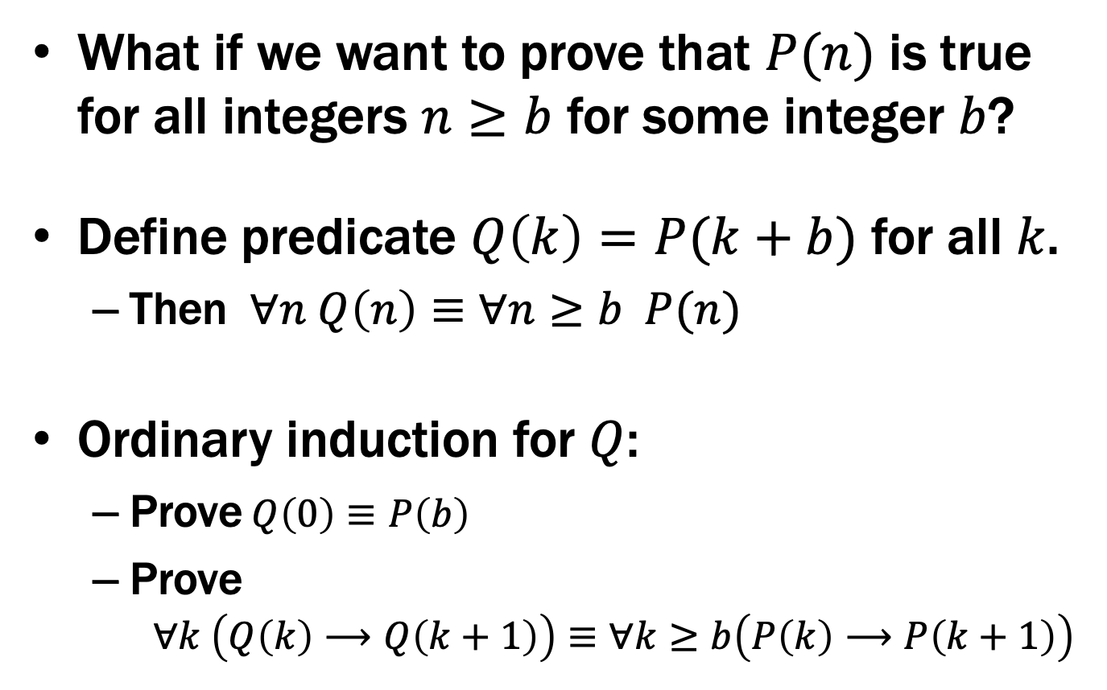
Induction: Changing the start line
What if we want to prove that $P(n)$ is true for all integers $n≥b$ for some integer $b$?
Define predicate $Q\left(k\right)=P(k+b)$ for all $k$.
Then $∀n Q\left(n\right)≡∀n≥b P(n)$
Ordinary induction for $Q$:
Prove$Q\left(0\right)≡P\left(b\right)$
Prove $∀k \left(Q\left(k\right)⟶Q\left(k+1\right)\right)≡∀k≥b\left(P\left(k\right)⟶P\left(k+1\right)\right)$

Slide 31
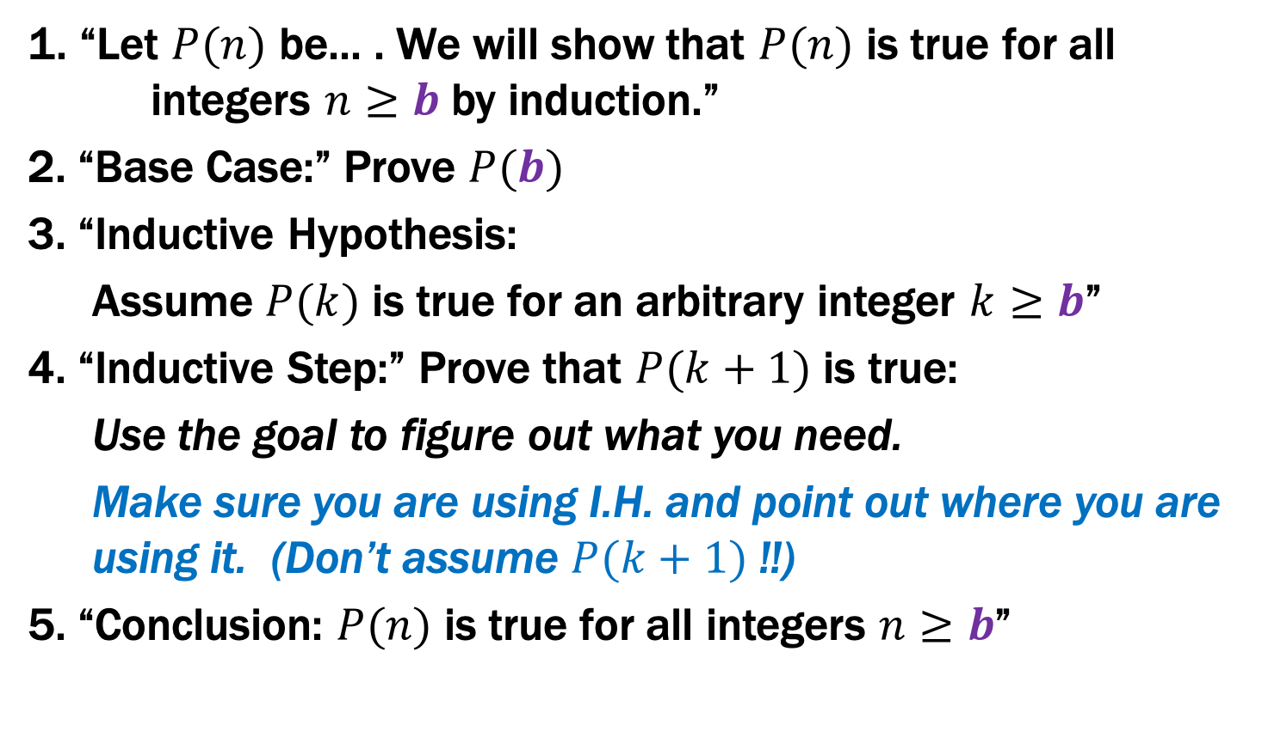

Inductive Proofs starting at $b$ in 5 Easy Steps
1. “Let $P(n)$ be... . We will show that $P(n)$ is true for all integers $n≥b$ by induction.”
2. “Base Case:” Prove $P(b)$
3. “Inductive Hypothesis:
Assume $P(k)$ is true for an arbitrary integer $k≥b$”
4. “Inductive Step:” Prove that $P(k+1)$ is true:
Use the goal to figure out what you need.
Make sure you are using I.H. and point out where you are using it. (Don’t assume $P(k+1)$ !!)
5. “Conclusion: $P(n)$ is true for all integers $n≥b$”

Slide 32

Prove $3n≥n^{2}+3$ for all $n≥2$
Examples to show its true
P(0)
P(k) → P(k+1)

Slide 33
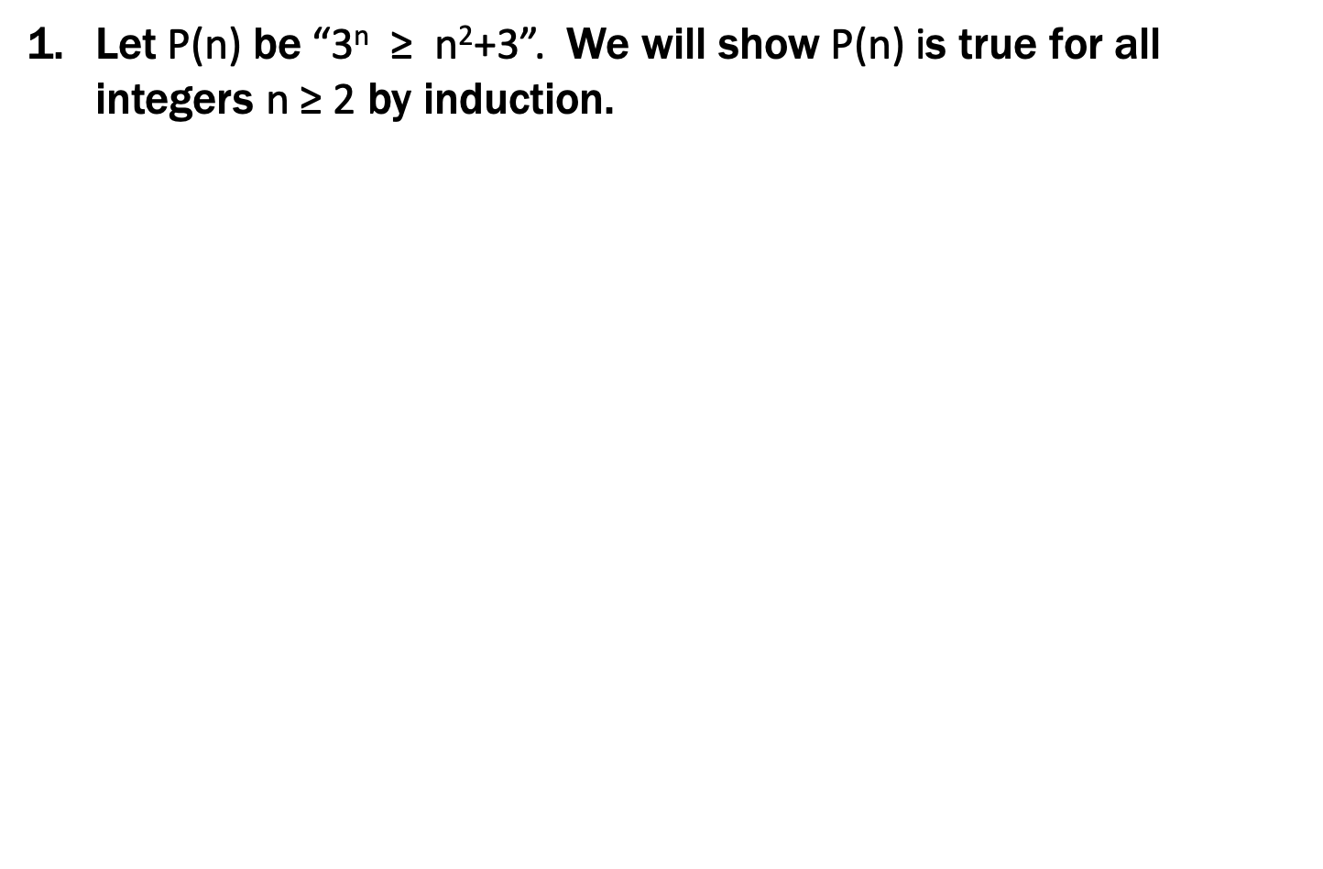
Prove $3n≥n^{2}+3$ for all $n≥2$
Let P(n) be “3^{n} ≥ n²+3”. We will show P(n) is true for all integers n ≥ 2 by induction.
Base Case (n=2): 3² = 9 $≥$7 = 4+3 = 2²+3 so P(2) is true.
Hypothesis: Suppose that P(k) is true for some arbitrary integer k ≥ 2.
Induction Step:
Goal: Show P(k+1), i.e. show 3^{k+1} ≥ (k+1)²+3=k²+2k+4
3^{k+1} = 3(3^{k})
≥ 3(k²+3) by the IH
= k²+2k²+9
≥ k²+2k+1 = (k+1)² since k ≥ 1.
Therefore P(k+1) is true.
5. Thus P(n) is true for all n ∈ℕ, by induction.
Examples to show its true
P(0)
P(k) → P(k+1)

Slide 34
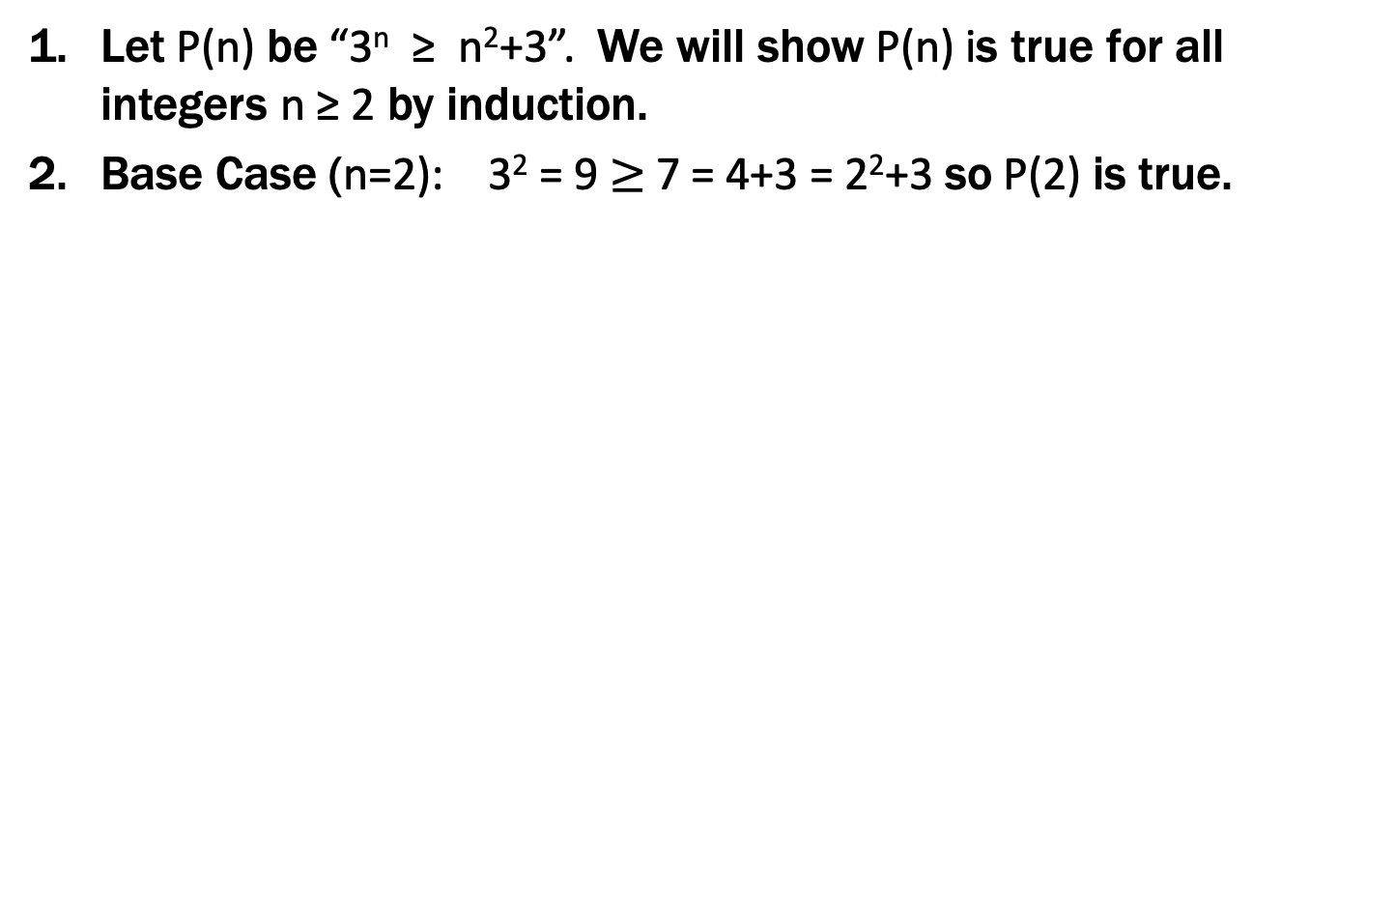
Prove $3n≥n^{2}+3$ for all $n≥2$
Let P(n) be “3^{n} ≥ n²+3”. We will show P(n) is true for all integers n ≥ 2 by induction.
Base Case (n=2): 3² = 9 $≥$7 = 4+3 = 2²+3 so P(2) is true.
Inductive Hypothesis: Suppose that P(k) is true for some arbitrary integer k ≥ 2.
Inductive Step:
Goal: Show P(k+1), i.e. show 3^{k+1} ≥ (k+1)²+3=k²+2k+4
3^{k+1} = 3(3^{k})
≥ 3(k²+3) by the IH
= k²+2k²+9
≥ k²+2k+1 = (k+1)² since k ≥ 1.
Therefore P(k+1) is true.
5. Thus P(n) is true for all n ∈ℕ, by induction.
Examples to show its true
P(0)
P(k) → P(k+1)

Slide 35

Prove $3n≥n^{2}+3$ for all $n≥2$
Let P(n) be “3^{n} ≥ n²+3”. We will show P(n) is true for all integers n ≥ 2 by induction.
Base Case (n=2): 3² = 9 $≥$7 = 4+3 = 2²+3 so P(2) is true.
Inductive Hypothesis: Suppose that P(k) is true for some arbitrary integer k ≥ 2. I.e., suppose 3^{k} ≥ k²+3.
=k²+2k+4
3^{k+1} = 3(3^{k})
≥ 3(k²+3) by the IH
= k²+2k²+9
≥ k²+2k+1 = (k+1)² since k ≥ 1.
Therefore P(k+1) is true.
5. Thus P(n) is true for all n ∈ℕ, by induction.
Examples to show its true
P(0)
P(k) → P(k+1)

Slide 36
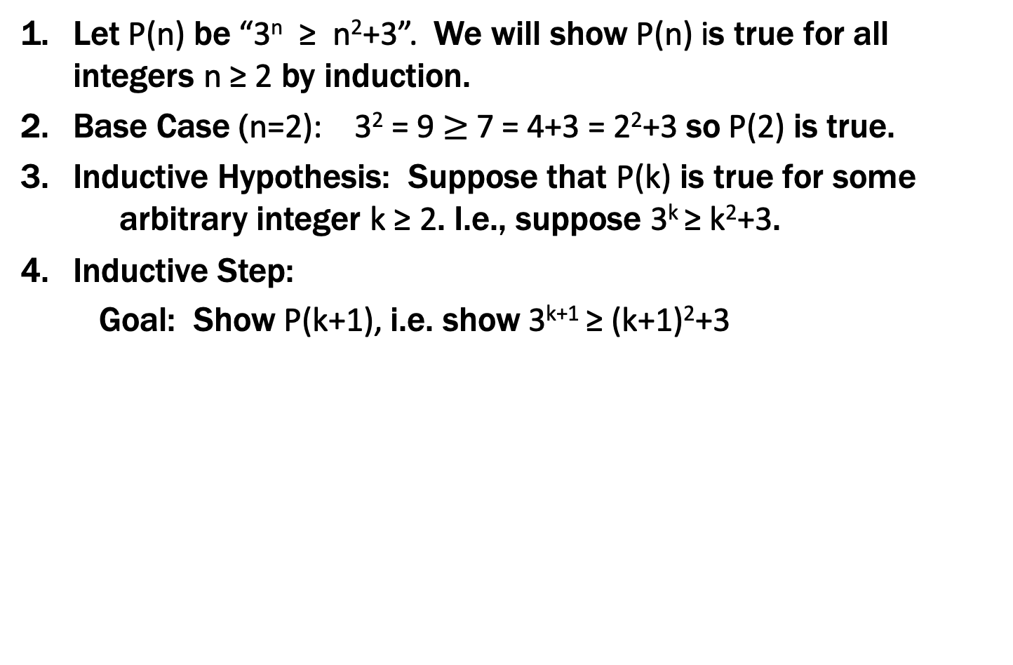
Prove $3n≥n^{2}+3$ for all $n≥2$
Let P(n) be “3^{n} ≥ n²+3”. We will show P(n) is true for all integers n ≥ 2 by induction.
Base Case (n=2): 3² = 9 $≥$7 = 4+3 = 2²+3 so P(2) is true.
Inductive Hypothesis: Suppose that P(k) is true for some arbitrary integer k ≥ 2. I.e., suppose 3^{k} ≥ k²+3.
Inductive Step:
Goal: Show P(k+1), i.e. show 3^{k+1} ≥ (k+1)²+3=k²+2k+4
3^{k+1} = 3(3^{k})
≥ 3(k²+3) by the IH
= k²+2k²+9
≥ k²+2k+1 = (k+1)² since k ≥ 1.
Therefore P(k+1) is true.
5. Thus P(n) is true for all n ∈ℕ, by induction.
Examples to show its true
P(0)
P(k) → P(k+1)

Slide 37
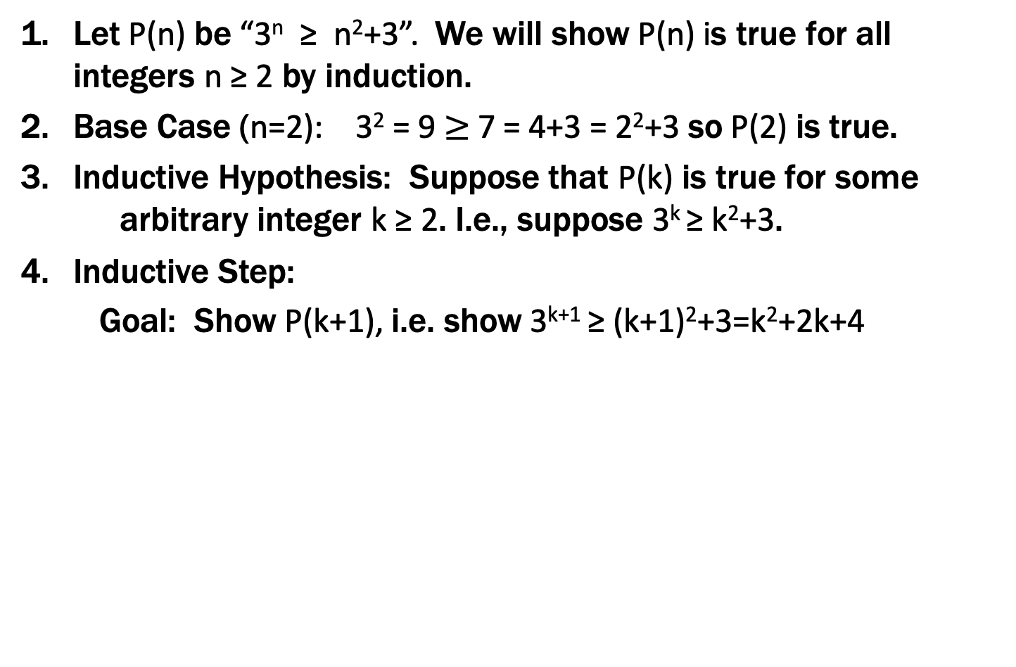
Prove $3n≥n^{2}+3$ for all $n≥2$
Let P(n) be “3^{n} ≥ n²+3”. We will show P(n) is true for all integers n ≥ 2 by induction.
Base Case (n=2): 3² = 9 $≥$7 = 4+3 = 2²+3 so P(2) is true.
Inductive Hypothesis: Suppose that P(k) is true for some arbitrary integer k ≥ 2. I.e., suppose 3^{k} ≥ k²+3.
Inductive Step:
Goal: Show P(k+1), i.e. show 3^{k+1} ≥ (k+1)²+3=k²+2k+4
3^{k+1} = 3(3^{k})
≥ 3(k²+3) by the IH
= k²+2k²+9
≥ k²+2k+1 = (k+1)² since k ≥ 1.
Therefore P(k+1) is true.
5. Thus P(n) is true for all n ∈ℕ, by induction.
Examples to show its true
P(0)
P(k) → P(k+1)

Slide 38
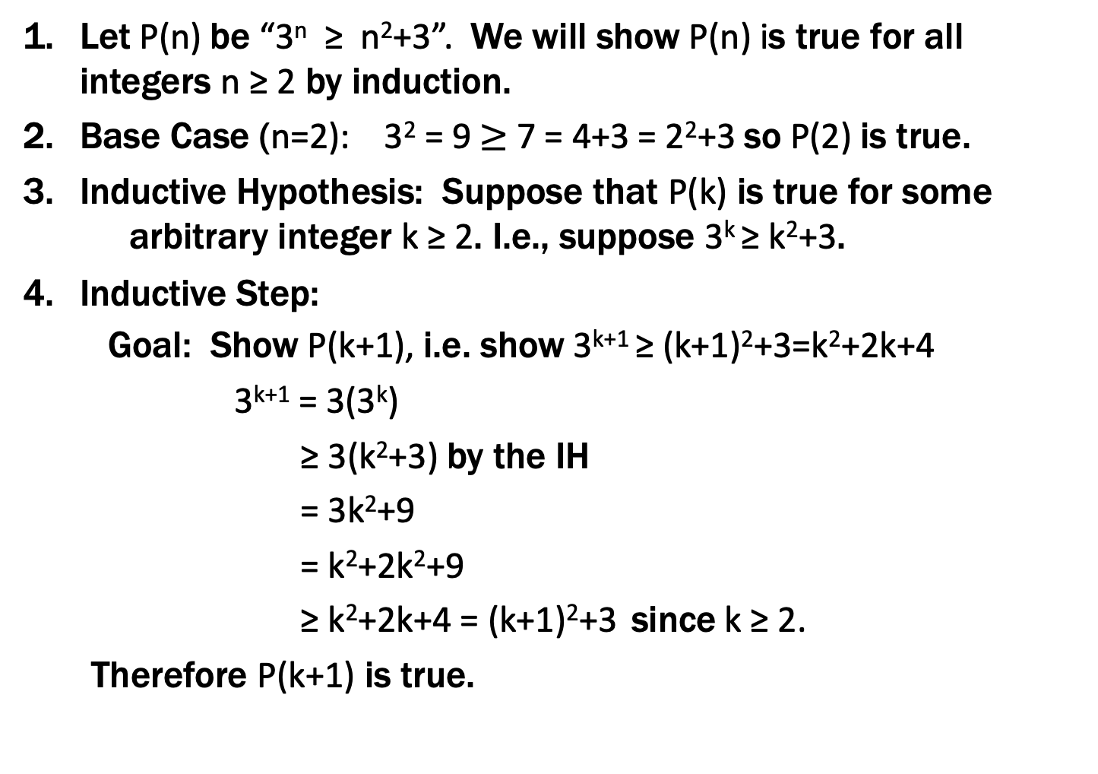
Prove $3n≥n^{2}+3$ for all $n≥2$
Let P(n) be “3^{n} ≥ n²+3”. We will show P(n) is true for all integers n ≥ 2 by induction.
Base Case (n=2): 3² = 9 $≥$7 = 4+3 = 2²+3 so P(2) is true.
Inductive Hypothesis: Suppose that P(k) is true for some arbitrary integer k ≥ 2. I.e., suppose 3^{k} ≥ k²+3.
Inductive Step:
Goal: Show P(k+1), i.e. show 3^{k+1} ≥ (k+1)²+3=k²+2k+4
3^{k+1} = 3(3^{k})
≥ 3(k²+3) by the IH
= 3k²+9
= k²+2k²+9
≥ k²+2k+4 = (k+1)²+3 since k ≥ 2.
Therefore P(k+1) is true.
5. Thus P(n) is true for all integers n ≥ 2, by induction.
Examples to show its true
P(0)
P(k) → P(k+1)

Slide 39
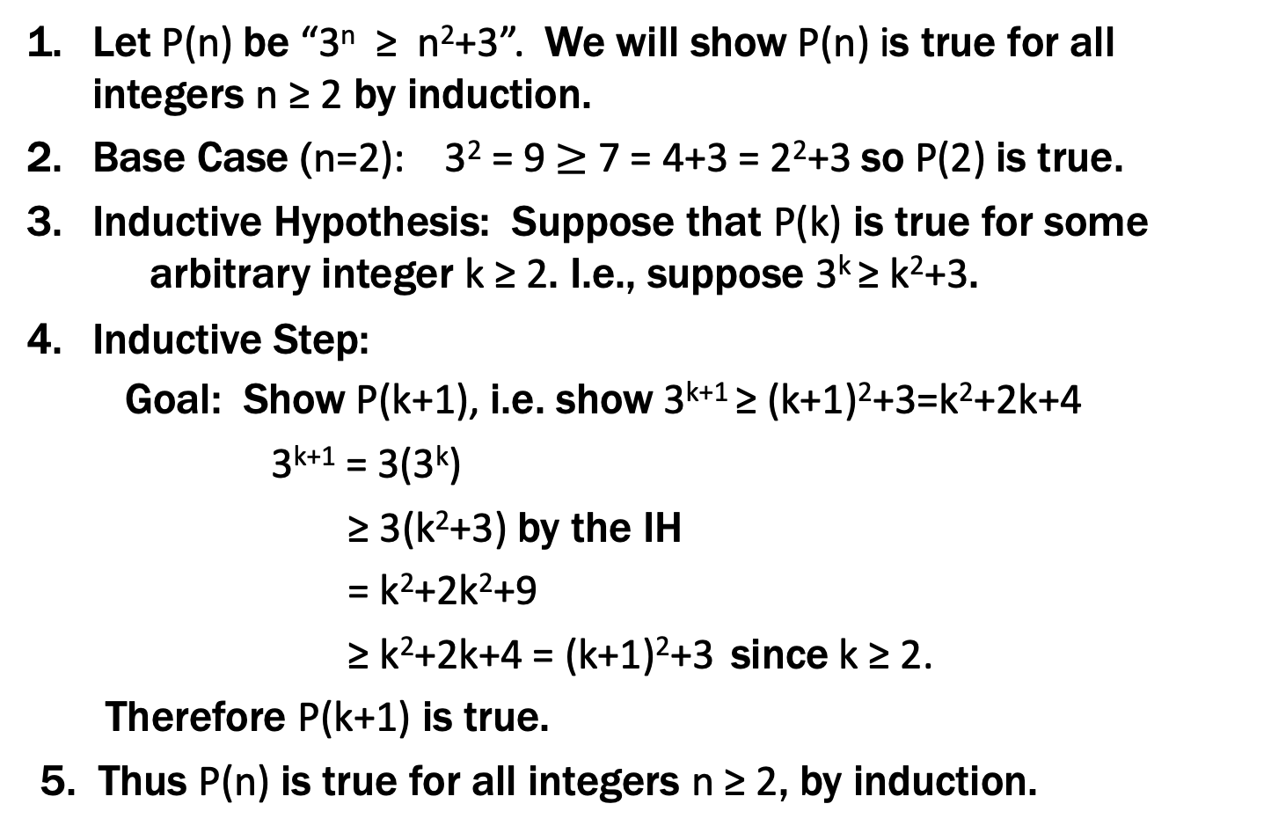
Prove $3n≥n^{2}+3$ for all $n≥2$
Let P(n) be “3^{n} ≥ n²+3”. We will show P(n) is true for all integers n ≥ 2 by induction.
Base Case (n=2): 3² = 9 $≥$7 = 4+3 = 2²+3 so P(2) is true.
Inductive Hypothesis: Suppose that P(k) is true for some arbitrary integer k ≥ 2. I.e., suppose 3^{k} ≥ k²+3.
Inductive Step:
Goal: Show P(k+1), i.e. show 3^{k+1} ≥ (k+1)²+3=k²+2k+4
3^{k+1} = 3(3^{k})
≥ 3(k²+3) by the IH
= k²+2k²+9
≥ k²+2k+4 = (k+1)²+3 since k ≥ 2.
Therefore P(k+1) is true.
5. Thus P(n) is true for all integers n ≥ 2, by induction.
Examples to show its true
P(0)
P(k) → P(k+1)

Slide 40

Checkerboard Tiling
Prove that a $2n  2n$checkerboard with one square removed can be tiled with:

Slide 41
Checkerboard Tiling
Let P(n) be any 2^{n} × 2^{n} checkerboard with one square removed can be tiled with . We prove P(n) for all n ≥ 1 by induction on n.

Slide 42
Checkerboard Tiling
Let P(n) be any 2^{n} × 2^{n} checkerboard with one square removed can be tiled with . We prove P(n) for all n ≥ 1 by induction on n.
Base Case: n=1

Slide 43
Checkerboard Tiling
Let P(n) be any 2^{n} × 2^{n} checkerboard with one square removed can be tiled with . We prove P(n) for all n ≥ 1 by induction on n.
Base Case: n=1
Inductive Hypothesis: Assume P(k) for some arbitrary integer k≥1

Slide 44
Checkerboard Tiling
Let P(n) be any 2^{n} × 2^{n} checkerboard with one square removed can be tiled with . We prove P(n) for all n ≥ 1 by induction on n.
Base Case: n=1
Inductive Hypothesis: Assume P(k) for some arbitrary integer k≥1
Inductive Step: Prove P(k+1)
Apply IH to each quadrant then fill with extra tile.

