Slide 1
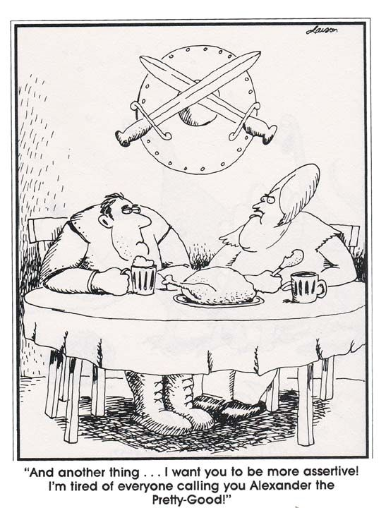
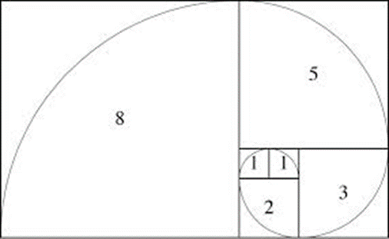
CSE 311: Foundations of Computing
Lecture 15: Recursion & Strong Induction Applications: Fibonacci & Euclid
See Edstem post about 1-1 meetings with TAs not about current HW

Slide 2
Last class: Inductive Proofs In 5 Easy Steps
1. “Let $P(n)$ be... . We will show that $P(n)$ is true for all integers $n≥b$ by induction.”
2. “Base Case:” Prove $P(b)$
3. “Inductive Hypothesis:
Assume that for some arbitrary integer $k≥b,$
$P(k) \text{is} \text{true}$”
4. “Inductive Step:” Prove that $P(k+1)$ is true:
Use the goal to figure out what you need.
Make sure you are using I.H. and point out where you are using it. (Don’t assume $P(k+1)$ !!)
5. “Conclusion: $P(n)$ is true for all integers $n≥b$”

Slide 3

Checkerboard Tiling
Prove that a $2n  2n$checkerboard with one square removed can be tiled with:

Slide 4
Checkerboard Tiling
Let P(n) be “Any 2^{n} × 2^{n} checkerboard with one square removed can be tiled with ” . We prove P(n) for all n ≥ 1 by induction on n.

Slide 5
Checkerboard Tiling
Let P(n) be “Any 2^{n} × 2^{n} checkerboard with one square removed can be tiled with ” . We prove P(n) for all n ≥ 1 by induction on n.
Base Case: n=1

Slide 6
Checkerboard Tiling
Let P(n) be “Any 2^{n} × 2^{n} checkerboard with one square removed can be tiled with ” . We prove P(n) for all n ≥ 1 by induction on n.
Base Case: n=1
Inductive Hypothesis: Assume P(k) for some arbitrary integer k≥1

Slide 7
Checkerboard Tiling
Let P(n) be “Any 2^{n} × 2^{n} checkerboard with one square removed can be tiled with ” . We prove P(n) for all n ≥ 1 by induction on n.
Base Case: n=1
Inductive Hypothesis: Assume P(k) for some arbitrary integer k≥1
Inductive Step: Prove P(k+1)
Apply IH to each quadrant then fill with extra tile.

Slide 8
Recall: Induction Rule of Inference
Domain: Natural Numbers
$$P\left(0\right)$$
$$∀k (P\left(k\right)⟶P\left(k+1\right))$$
$$∴∀n P(n)$$
How do the givens prove P(5)?
P(0)→P(1) P(1)→P(2) P(2)→P(3) P(3)→P(4 ) P(4)→P(5)
$$P(0)$$
$$P(1)$$
$$P(2)$$
$$P(3)$$
$$P(4)$$
$$P(5)$$
Formal steps
Show P(0)
Assume P(k), Prove P(k+1), Conclude P(k)→ P(k+1)
Conclude ∀ k (P(k)→ P(k+1))
Conclude ∀ n P(n)

Slide 9
Recall: Induction Rule of Inference
Domain: Natural Numbers
$$P\left(0\right)$$
$$∀k (P\left(k\right)⟶P\left(k+1\right))$$
$$∴∀n P(n)$$
How do the givens prove P(5)?
P(0)→P(1) P(1)→P(2) P(2)→P(3) P(3)→P(4 ) P(4)→P(5)
$$P(0)$$
$$P(1)$$
$$P(2)$$
$$P(3)$$
$$P(4)$$
$$P(5)$$
We made it harder than we needed to ...
When we proved $P(2)$ we knew BOTH $P(0)$ and $P(1)$
When we proved $P(3)$ we knew $P(0)$ and $P(1)$ and $P\left(2\right)$
When we proved $P(4)$ we knew $P(0)$,$P(1)$,$P\left(2\right), P(3)$
etc.
That’s the essence of the idea of Strong Induction.
Formal steps
Show P(0)
Assume P(k), Prove P(k+1), Conclude P(k)→ P(k+1)
Conclude ∀ k (P(k)→ P(k+1))
Conclude ∀ n P(n)

Slide 10
Strong Induction
$P\left(0\right) ∀k \left(∀j \left(0≤j≤k→P\left(j\right)\right)→P\left(k+1\right)\right)$
$∴∀n P(n)$

Slide 11
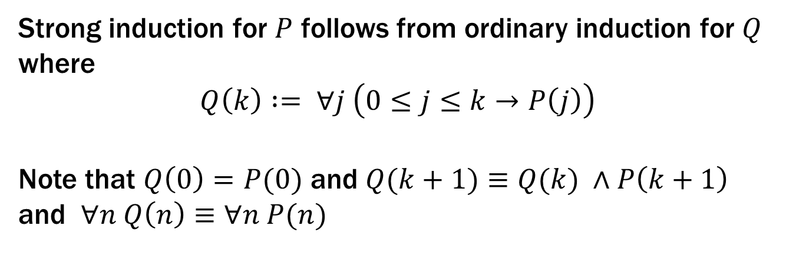
Strong Induction
$P\left(0\right) ∀k \left(∀j \left(0≤j≤k→P\left(j\right)\right)→P\left(k+1\right)\right)$
$∴∀n P(n)$
Strong induction for $P$ follows from ordinary induction for $Q$
where
$$Q\left(k\right) := ∀j \left(0≤j≤k→P\left(j\right)\right)$$
Note that $Q\left(0\right)=P(0)$ and $Q(k+1)≡Q(k) ∧P\left(k+1\right)$
and $∀n Q\left(n\right)≡∀n P(n)$

Slide 12
Last class: Inductive Proofs In 5 Easy Steps
1. “Let $P(n)$ be... . We will show that $P(n)$ is true for all integers $n≥b$ by induction.”
2. “Base Case:” Prove $P(b)$
3. “Inductive Hypothesis:
Assume that for some arbitrary integer $k≥b,$
$P(k) \text{is} \text{true}$”
4. “Inductive Step:” Prove that $P(k+1)$ is true:
Use the goal to figure out what you need.
Make sure you are using I.H. and point out where you are using it. (Don’t assume $P(k+1)$ !!)
5. “Conclusion: $P(n)$ is true for all integers $n≥b$”

Slide 13
Strong Inductive Proofs In 5 Easy Steps
1. “Let $P(n)$ be... . We will show that $P(n)$ is true for all integers $n≥b$ by strong induction.”
2. “Base Case:” Prove $P(b)$
3. “Inductive Hypothesis:
Assume that for some arbitrary integer $k≥b,$
$P(j)$ is true for every integer $j$from $b$to $k$”
4. “Inductive Step:” Prove that $P(k+1)$ is true:
Use the goal to figure out what you need.
Make sure you are using I.H. (that $P(b),…,P(k)$ are true) and point out where you are using it. (Don’t assume $P(k+1)$ !!)
5. “Conclusion: $P(n)$ is true for all integers $n≥b$”

Slide 14
Recall: Fundamental Theorem of Arithmetic
Every integer > 1 has a unique prime factorization
48 = 2 • 2 • 2 • 2 • 3
591 = 3 • 197
45,523 = 45,523
321,950 = 2 • 5 • 5 • 47 • 137
1,234,567,890 = 2 • 3 • 3 • 5 • 3,607 • 3,803
We use strong induction to prove that a factorization into
primes exists, but not that it is unique.

Slide 15
Every integer $≥2$ is a product of (one or more) primes.
Examples to show its true
P(0)
P(k) → P(k+1)

Slide 16
Every integer $≥2$ is a product of (one or more) primes.
Let P(n) be “n is a product of some list of primes”. We will show that P(n) is true for all integers n $≥$2 by strong induction.
Base Case (n=2): 2 is prime, so it is a product of primes. Therefore P(2) is true.
Inductive : Suppose that for some arbitrary integer k ≥ 2, P(j) is true for every integer j between 2 and k
Inductive Step:
Goal: Show P(k+1); i.e. k+1 is a product of primes
Case: k+1 is prime: Then by definition k+1 is a product of primes
Case: k+1 is composite: Then k+1=ab for some integers a and b where 2 ≤ a, b ≤ k. By our IH, P(a) and P(b) are true so we have a = p₁p₂ $⋯$p_{m} and b = q₁q₂ $⋯$ for some primes p₁,p₂,..., p_{m}, q₁,q₂,..., q_{n}.
Thus, k+1 = ab = p₁p₂ $⋯$ p_{m}q₁q₂ $⋯$q_{n} which is a product of primes. Since k ≥ 1, one of these cases must happen and so P(k+1) is true:
5. Thus P(n) is true for all integers n $≥$2, by induction.
Examples to show its true
P(0)
P(k) → P(k+1)

Slide 17
Every integer $≥2$ is a product of (one or more) primes.
Let P(n) be “n is a product of some list of primes”. We will show that P(n) is true for all integers n $≥$2 by strong induction.
Base Case (n=2): 2 is prime, so it is a product of (one) prime. Therefore P(2) is true.
Inductive : Suppose that for some arbitrary integer k ≥ 2, P(j) is true for every integer j between 2 and k
Inductive Step:
Goal: Show P(k+1); i.e. k+1 is a product of primes
Case: k+1 is prime: Then by definition k+1 is a product of primes
Case: k+1 is composite: Then k+1=ab for some integers a and b where 2 ≤ a, b ≤ k. By our IH, P(a) and P(b) are true so we have a = p₁p₂ $⋯$p_{m} and b = q₁q₂ $⋯$ for some primes p₁,p₂,..., p_{m}, q₁,q₂,..., q_{n}.
Thus, k+1 = ab = p₁p₂ $⋯$ p_{m}q₁q₂ $⋯$q_{n} which is a product of primes. Since k ≥ 1, one of these cases must happen and so P(k+1) is true:
5. Thus P(n) is true for all integers n $≥$2, by induction.
Examples to show its true
P(0)
P(k) → P(k+1)

Slide 18
Every integer $≥2$ is a product of (one or more) primes.
Let P(n) be “n is a product of some list of primes”. We will show that P(n) is true for all integers n $≥$2 by strong induction.
Base Case (n=2): 2 is prime, so it is a product of (one) prime. Therefore P(2) is true.
Inductive Hyp: Suppose that for some arbitrary integer k ≥ 2, P(j) is true for every integer j between 2 and k
Inductive Step:
Goal: Show P(k+1); i.e. k+1 is a product of primes
Case: k+1 is prime: Then by definition k+1 is a product of primes
Case: k+1 is composite: Then k+1=ab for some integers a and b where 2 ≤ a, b ≤ k. By our IH, P(a) and P(b) are true so we have a = p₁p₂ $⋯$p_{m} and b = q₁q₂ $⋯$q_{n} for some primes p₁,p₂,..., p_{m}, q₁,q₂,..., q_{n}.
Thus, k+1 = ab = p₁p₂ $⋯$ p_{m}q₁q₂ $⋯$q_{n} which is a product of primes. Since k ≥ 1, one of these cases must happen and so P(k+1) is true:
5. Thus P(n) is true for all integers n $≥$2, by induction.
Examples to show its true
P(0)
P(k) → P(k+1)

Slide 19
Every integer $≥2$ is a product of (one or more) primes.
Let P(n) be “n is a product of some list of primes”. We will show that P(n) is true for all integers n $≥$2 by strong induction.
Base Case (n=2): 2 is prime, so it is a product of (one) prime. Therefore P(2) is true.
Inductive Hyp: Suppose that for some arbitrary integer k ≥ 2, P(j) is true for every integer j between 2 and k
Inductive Step:
Goal: Show P(k+1); i.e. k+1 is a product of primes
Case: k+1 is prime: Then by definition k+1 is a product of primes
Case: k+1 is composite: Then k+1=ab for some integers a and b where 2 ≤ a, b ≤ k. By our IH, P(a) and P(b) are true so we have a = p₁p₂ $⋯$p_{m} and b = q₁q₂ $⋯$q_{n} for some primes p₁,p₂,..., p_{m}, q₁,q₂,..., q_{n}.
Thus, k+1 = ab = p₁p₂ $⋯$ p_{m}q₁q₂ $⋯$q_{n} which is a product of primes. Since k ≥ 1, one of these cases must happen and so P(k+1) is true:
5. Thus P(n) is true for all integers n $≥$2, by induction.
Examples to show its true
P(0)
P(k) → P(k+1)

Slide 20
Every integer $≥2$ is a product of (one or more) primes.
Let P(n) be “n is a product of some list of primes”. We will show that P(n) is true for all integers n $≥$2 by strong induction.
Base Case (n=2): 2 is prime, so it is a product of (one) prime. Therefore P(2) is true.
Inductive Hyp: Suppose that for some arbitrary integer k ≥ 2, P(j) is true for every integer j between 2 and k
Inductive Step:
Goal: Show P(k+1); i.e. k+1 is a product of primes
Case: k+1 is prime: Then by definition k+1 is a product of primes
Case: k+1 is composite: Then k+1=ab for some integers a and b where 2 ≤ a, b ≤ k. By our IH, P(a) and P(b) are true so we have a = p₁p₂ $⋯$p_{m} and b = q₁q₂ $⋯$ for some primes p₁,p₂,..., p_{m}, q₁,q₂,..., q_{n}.
Thus, k+1 = ab = p₁p₂ $⋯$ p_{m}q₁q₂ $⋯$q_{n} which is a product of primes. Since k ≥ 1, one of these cases must happen and so P(k+1) is true:
5. Thus P(n) is true for all integers n $≥$2, by induction.
Examples to show its true
P(0)
P(k) → P(k+1)

Slide 21
Every integer $≥2$ is a product of (one or more) primes.
Let P(n) be “n is a product of some list of primes”. We will show that P(n) is true for all integers n $≥$2 by strong induction.
Base Case (n=2): 2 is prime, so it is a product of (one) prime. Therefore P(2) is true.
Inductive Hyp: Suppose that for some arbitrary integer k ≥ 2, P(j) is true for every integer j between 2 and k
Inductive Step:
Goal: Show P(k+1); i.e. k+1 is a product of primes
Case: k+1 is prime: Then by definition k+1 is a product of primes
Case: k+1 is composite: Then k+1=ab for some integers a and b where 2 ≤ a, b ≤ k. By our IH, P(a) and P(b) are true so we have a = p₁p₂ $⋯$p_{m} and b = q₁q₂ $⋯$q_{n} for some primes p₁,p₂,..., p_{m}, q₁,q₂,..., q_{n}.
Thus, k+1 = ab = p₁p₂ $⋯$ p_{m}q₁q₂ $⋯$q_{n} which is a product of primes. Since k ≥ 1, one of these cases must happen and so P(k+1) is true:
5. Thus P(n) is true for all integers n $≥$2, by induction.
Examples to show its true
P(0)
P(k) → P(k+1)

Slide 22
Every integer $≥2$ is a product of (one or more) primes.
Let P(n) be “n is a product of some list of primes”. We will show that P(n) is true for all integers n $≥$2 by strong induction.
Base Case (n=2): 2 is prime, so it is a product of (one) prime. Therefore P(2) is true.
Inductive Hyp: Suppose that for some arbitrary integer k ≥ 2, P(j) is true for every integer j between 2 and k
Inductive Step:
Goal: Show P(k+1); i.e. k+1 is a product of primes
Case: k+1 is prime: Then by definition k+1 is a product of primes
Case: k+1 is composite: Then k+1=ab for some integers a and b where 2 ≤ a, b ≤ k. By our IH, P(a) and P(b) are true so we have a = p₁p₂ $⋯$p_{r} and b = q₁q₂ $⋯$q_{s} for some primes p₁,p₂,..., p_{r}, q₁,q₂,..., q_{s}.
Thus, k+1 = ab = p₁p₂ $⋯$ p_{r}q₁q₂ $⋯$q_{s} which is a product of primes. Since k ≥ 2, one of these cases must happen and so P(k+1) is true.
5. Thus P(n) is true for all integers n $≥$2, by induction.
Examples to show its true
P(0)
P(k) → P(k+1)

Slide 23
Every integer $≥2$ is a product of (one or more) primes.
Let P(n) be “n is a product of some list of primes”. We will show that P(n) is true for all integers n $≥$2 by strong induction.
Base Case (n=2): 2 is prime, so it is a product of (one) prime. Therefore P(2) is true.
Inductive Hyp: Suppose that for some arbitrary integer k ≥ 2, P(j) is true for every integer j between 2 and k
Inductive Step:
Goal: Show P(k+1); i.e. k+1 is a product of primes
Case: k+1 is prime: Then by definition k+1 is a product of primes
Case: k+1 is composite: Then k+1=ab for some integers a and b where 2 ≤ a, b ≤ k. By our IH, P(a) and P(b) are true so we have a = p₁p₂ $⋯$p_{r} and b = q₁q₂ $⋯$q_{s} for some primes p₁,p₂,..., p_{r}, q₁,q₂,..., q_{s}.
Thus, k+1 = ab = p₁p₂ $⋯$ p_{r}q₁q₂ $⋯$q_{s} which is a product of primes. Since k ≥ 2, one of these cases must happen and so P(k+1) is true.
5. Thus P(n) is true for all integers n $≥$2, by strong induction.
Examples to show its true
P(0)
P(k) → P(k+1)

Slide 24
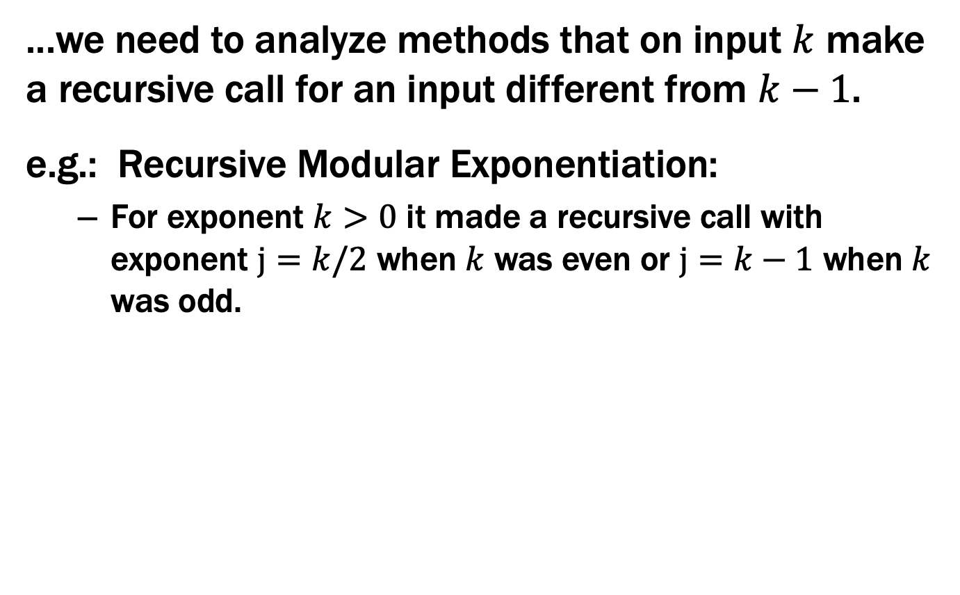
Strong Induction is particularly useful when...
...we need to analyze methods that on input $k$ make a recursive call for an input different from $k−1$.
e.g.: Recursive Modular Exponentiation:
For exponent $k>0$ it made a recursive call with exponent $j=k/2$ when $k$ was even or $j=k−1$ when $k$ was odd.

Slide 25
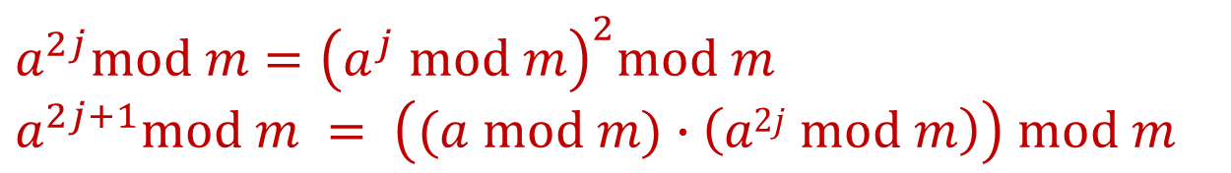
Fast Exponentiation
public static int FastModExp(int a, int k, int modulus) {
if (k == 0) {
return 1;
} else if ((k % 2) == 0) {
long temp = FastModExp(a,k/2,modulus);
return (temp * temp) % modulus;
} else {
long temp = FastModExp(a,k-1,modulus);
return (a * temp) % modulus;
}
}
$$a^{2j}mod m={\left(a^{j} mod m\right)}^{2}mod m$$
$$a^{2j+1}mod m = \left((a mod m)∙\left(a2j mod m\right)\right) mod m$$

Slide 26
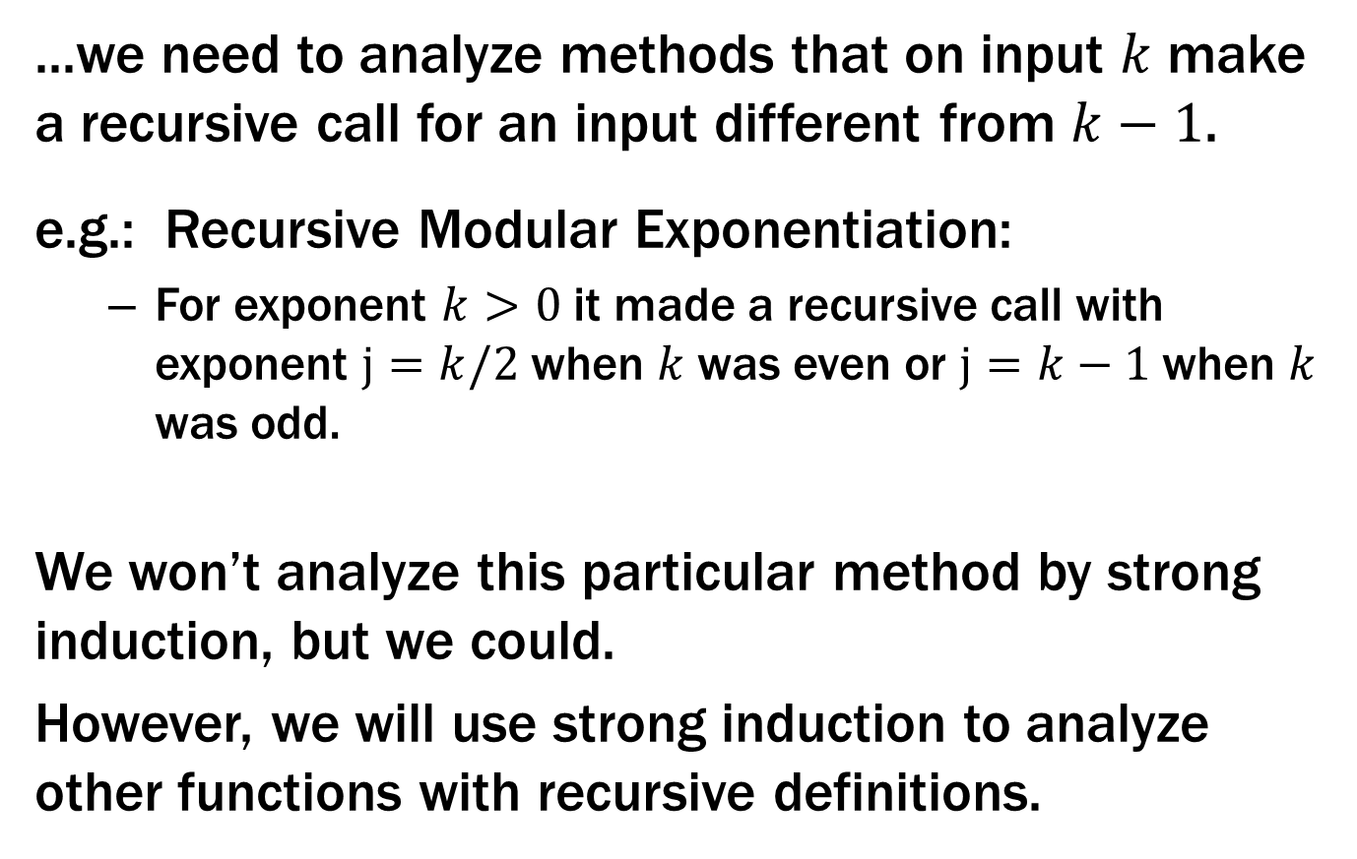
Strong Induction is particularly useful when...
...we need to analyze methods that on input $k$ make a recursive call for an input different from $k−1$.
e.g.: Recursive Modular Exponentiation:
For exponent $k>0$ it made a recursive call with exponent $j=k/2$ when $k$ was even or $j=k−1$ when $k$ was odd.
We won’t analyze this particular method by strong induction, but we could.
However, we will use strong induction to analyze other functions with recursive definitions.

Slide 27
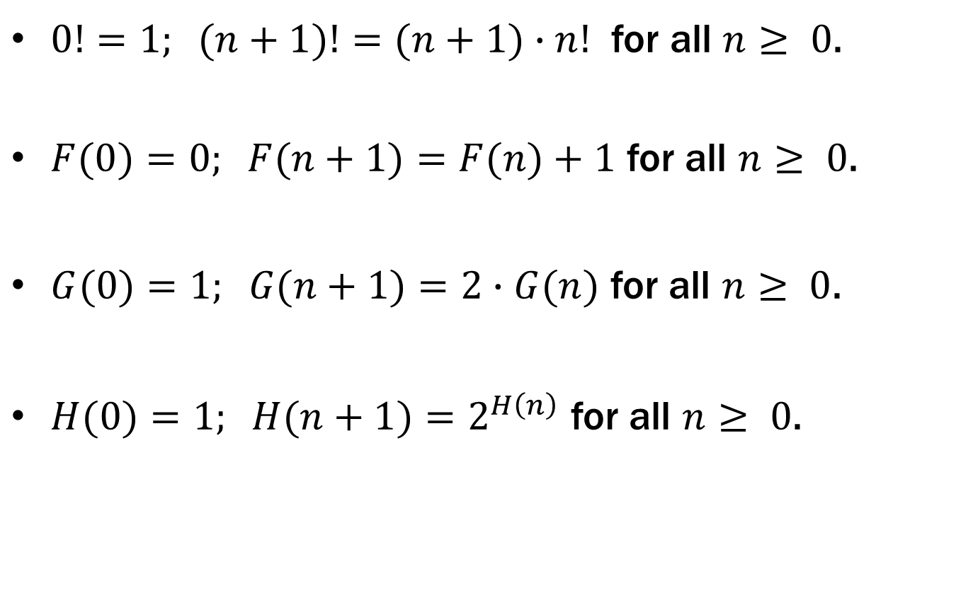
Recursive definitions of functions
$0!=1; (n+1)!=(n+1)∙n!$ for all $n≥ 0$.
$F(0)=0; F(n+1)=F(n)+1$ for all $n≥ 0$.
$G(0)=1; G(n+1)=2∙G(n)$ for all $n≥ 0$.
$H(0)=1; H(n+1)=2^{H\left(n\right)}$ for all $n≥ 0$.

Slide 28

Prove $n!≤nn$ for all $n≥1$
Let P(n) be “n! ≤ n^{n}”. We will show that P(n) is true for all integers n ≥ 1 by induction.
Base Case (n=1): 1!=1∙0!=1∙1=1=1¹ so P(1) is true.
Inductive Hypothesis: Suppose that P(k) is true for some arbitrary integer k ≥ 1. I.e., suppose k! ≤ k^{k}.
Examples to show its true
P(0)
P(k) → P(k+1)

Slide 29
Prove $n!≤nn$ for all $n≥1$
Let P(n) be “n! ≤ n^{n}”. We will show that P(n) is true for all integers n ≥ 1 by induction.
Base Case (n=1): 1!=1∙0!=1∙1=1=1¹ so P(1) is true.
Inductive Hypothesis: Suppose that P(k) is true for some arbitrary integer k ≥ 1. I.e., suppose k! ≤ k^{k}.
Inductive Step:
Goal: Show P(k+1), i.e. show (k+1)! ≤ (k+1)^{k+1}
(k+1)! = (k+1)∙k! by definition of !
≤ (k+1)∙ k^{k} by the IH
≤ (k+1)∙ (k+1)^{k} since k ≥ 0
= (k+1)^{k+1}
Therefore P(k+1) is true.
5. Thus P(n) is true for all n ≥ 1, by induction.
Examples to show its true
P(0)
P(k) → P(k+1)

Slide 30
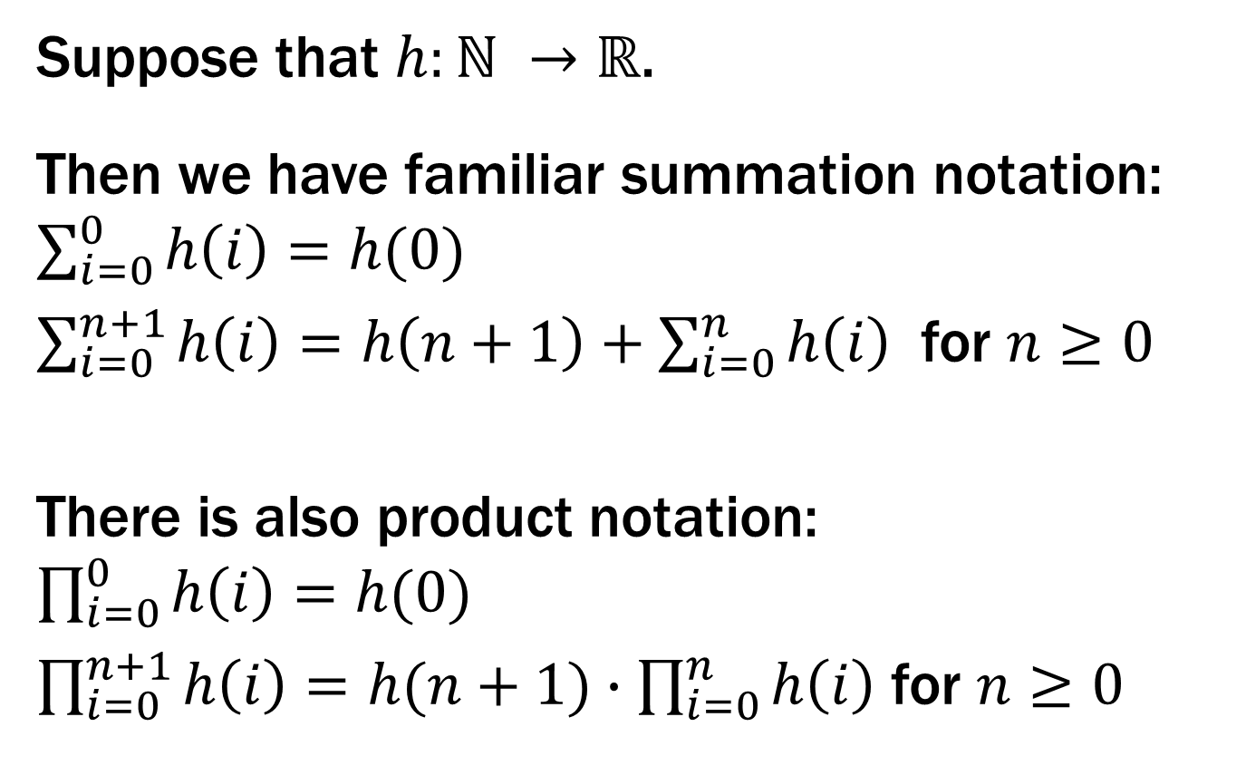
More Recursive Definitions
Suppose that $h:ℕ →ℝ$.
Then we have familiar summation notation: $\sum_{i=0}^{0}{h\left(i\right)=h(0)}$
$\sum_{i=0}^{n+1}{h\left(i\right)=h\left(n+1\right)+\sum_{i=0}^{n}{h\left(i\right)}}$ for $n≥0$
There is also product notation: $\prod_{i=0}^{0}{h\left(i\right)=h(0)}$
$\prod_{i=0}^{n+1}{h\left(i\right)=h(n+1)∙\prod_{i=0}^{n}{h\left(i\right)}}$ for $n≥0$

Slide 31
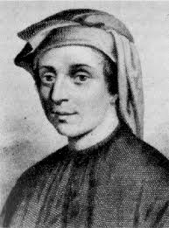


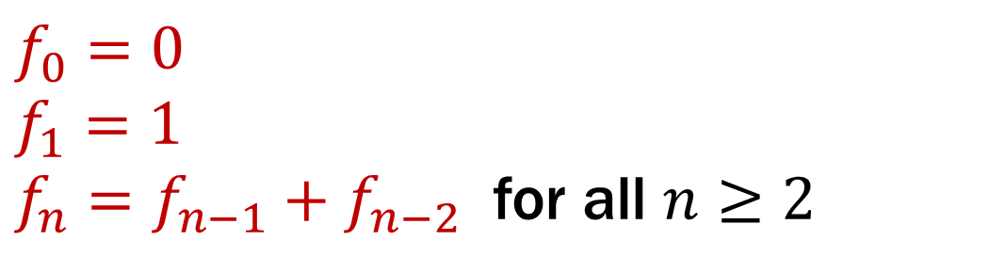
Fibonacci Numbers
$f_{0}=0$
$f_{1}=1$
$f_{n}=f_{n−1}+f_{n−2}$ for all $n≥2$

Slide 32
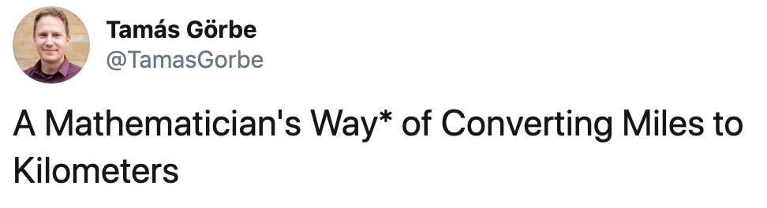
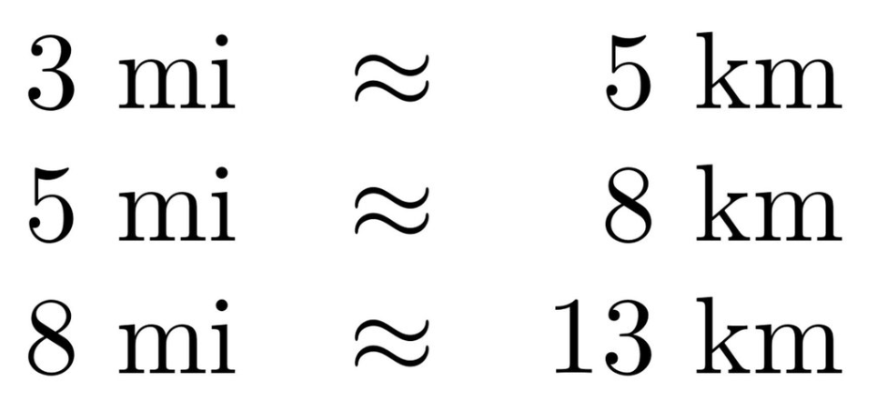
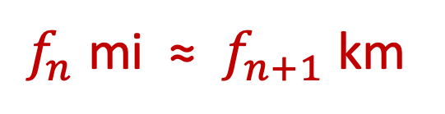
Fibonacci Numbers
$f_{0}=0$
$f_{1}=1$
$f_{n}=f_{n−1}+f_{n−2}$ for all $n≥2$
$f_{n}$ mi ≈ $f_{n+1}$ km

Slide 33
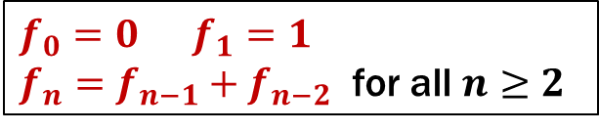
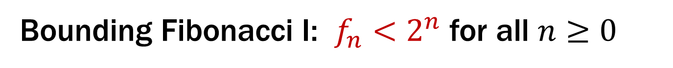
Bounding Fibonacci I: $f_{n}<2^{n}$ for all $n≥0$
Let P(n) be “f_{n} < 2^{n}”. We prove that P(n) is true for all integers n ≥ 0 by strong induction.
Base Case: f₀=0 < 1= 2⁰ so P(0) is true.
Inductive Hypothesis: Assume that for some arbitrary integer k ≥ 0, P(j) is true for every integer j from 0 to k.
Inductive Step: Goal: Show P(k+1); that is, f_{k+1} ≤ 2^{k+1}
Case k+1 = 1: Then f₁ = 1 ≤ 2¹ so P(k+1) is true here.
Case k+1 ≥ 2: Then f_{k+1} = f_{k} + f_{k-1} by definition
≤ 2^{k} + 2^{k-1} by the IH ≤ 2^{k} + 2^{k} = 2∙2^{k} = 2^{k+1} so P(k+1) is true in this case.
5. Therefore by strong induction, f_{n} ≤ 2^{n} for all integers n ≥ 0.
$f_{0}=0 f_{1}=1$
$f_{n}=f_{n−1}+f_{n−2}$ for all $n≥2$

Slide 34
Bounding Fibonacci I: $f_{n}<2^{n}$ for all $n≥0$
Let P(n) be “f_{n} < 2^{n}”. We prove that P(n) is true for all integers n ≥ 0 by strong induction.
Base Case: f₀=0 < 1= 2⁰ so P(0) is true.
Inductive Hypothesis: Assume that for some arbitrary integer k ≥ 0, P(j) is true for every integer j from 0 to k.
Inductive Step: Goal: Show P(k+1); that is, f_{k+1} ≤ 2^{k+1}
Case k+1 = 1: Then f₁ = 1 ≤ 2¹ so P(k+1) is true here.
Case k+1 ≥ 2: Then f_{k+1} = f_{k} + f_{k-1} by definition
≤ 2^{k} + 2^{k-1} by the IH ≤ 2^{k} + 2^{k} = 2∙2^{k} = 2^{k+1} so P(k+1) is true in this case.
5. Therefore by strong induction, f_{n} ≤ 2^{n} for all integers n ≥ 0.
$f_{0}=0 f_{1}=1$
$f_{n}=f_{n−1}+f_{n−2}$ for all $n≥2$

Slide 35
Bounding Fibonacci I: $f_{n}<2^{n}$ for all $n≥0$
Let P(n) be “f_{n} < 2^{n}”. We prove that P(n) is true for all integers n ≥ 0 by strong induction.
Base Case: f₀=0 < 1= 2⁰ so P(0) is true.
Inductive Hypothesis: Assume that for some arbitrary integer k ≥ 0, we have f_{j} < 2^{j} for every integer j from 0 to k.
Inductive Step: Goal: Show P(k+1); that is, f_{k+1} < 2^{k+1}
Case k+1 = 1: Then f₁ = 1 ≤ 2¹ so P(k+1) is true here.
Case k+1 ≥ 2: Then f_{k+1} = f_{k} + f_{k-1} by definition
≤ 2^{k} + 2^{k-1} by the IH ≤ 2^{k} + 2^{k} = 2∙2^{k} = 2^{k+1} so P(k+1) is true in this case.
5. Therefore by strong induction, f_{n} ≤ 2^{n} for all integers n ≥ 0.
$f_{0}=0 f_{1}=1$
$f_{n}=f_{n−1}+f_{n−2}$ for all $n≥2$

Slide 36
Bounding Fibonacci I: $f_{n}<2^{n}$ for all $n≥0$
Let P(n) be “f_{n} < 2^{n}”. We prove that P(n) is true for all integers n ≥ 0 by strong induction.
Base Case: f₀=0 < 1= 2⁰ so P(0) is true.
Inductive Hypothesis: Assume that for some arbitrary integer k ≥ 0, we have f_{j} < 2^{j} for every integer j from 0 to k.
Inductive Step: Goal: Show P(k+1); that is, f_{k+1} < 2^{k+1}
Case k+1 = 1: Then f₁ = 1 ≤ 2¹ so P(k+1) is true here.
Case k+1 ≥ 2: Then f_{k+1} = f_{k} + f_{k-1} by definition
≤ 2^{k} + 2^{k-1} by the IH ≤ 2^{k} + 2^{k} = 2∙2^{k} = 2^{k+1} so P(k+1) is true in this case.
5. Therefore by strong induction, f_{n} ≤ 2^{n} for all integers n ≥ 0.
$f_{0}=0 f_{1}=1$
$f_{n}=f_{n−1}+f_{n−2}$ for all $n≥2$

Slide 37
Bounding Fibonacci I: $f_{n}<2^{n}$ for all $n≥0$
Let P(n) be “f_{n} < 2^{n}”. We prove that P(n) is true for all integers n ≥ 0 by strong induction.
Base Case: f₀=0 < 1= 2⁰ so P(0) is true.
Inductive Hypothesis: Assume that for some arbitrary integer k ≥ 0, we have f_{j} < 2^{j} for every integer j from 0 to k.
Inductive Step: Goal: Show P(k+1); that is, f_{k+1} < 2^{k+1}
Case k+1 = 1: Then f₁ = 1 ≤ 2¹ so P(k+1) is true here.
Case k+1 ≥ 2: Then f_{k+1} = f_{k} + f_{k-1} by definition
≤ 2^{k} + 2^{k-1} by the IH ≤ 2^{k} + 2^{k} = 2∙2^{k} = 2^{k+1} so P(k+1) is true in this case.
5. Therefore by strong induction, f_{n} ≤ 2^{n} for all integers n ≥ 0.
$f_{0}=0 f_{1}=1$
$f_{n}=f_{n−1}+f_{n−2}$ for all $n≥2$

Slide 38
Bounding Fibonacci I: $f_{n}<2^{n}$ for all $n≥0$
Let P(n) be “f_{n} < 2^{n}”. We prove that P(n) is true for all integers n ≥ 0 by strong induction.
Base Case: f₀=0 < 1= 2⁰ so P(0) is true.
Inductive Hypothesis: Assume that for some arbitrary integer k ≥ 0, we have f_{j} < 2^{j} for every integer j from 0 to k.
Inductive Step: Goal: Show P(k+1); that is, f_{k+1} < 2^{k+1}
Case k+1 = 1: Then f₁ = 1 < 2 = 2¹ so P(k+1) is true here.
Case k+1 ≥ 2: Then f_{k+1} = f_{k} + f_{k-1} by definition
< 2^{k} + 2^{k-1} by the IH since k-1 ≥ 0 < 2^{k} + 2^{k} = 2∙2^{k} = 2^{k+1} so P(k+1) is true in this case.
These are the only cases so P(k+1) follows.
Therefore by strong induction,
f_{n} < 2^{n} for all integers n ≥ 0.
$f_{0}=0 f_{1}=1$
$f_{n}=f_{n−1}+f_{n−2}$ for all $n≥2$

Slide 39
Bounding Fibonacci I: $f_{n}<2^{n}$ for all $n≥0$
Let P(n) be “f_{n} < 2^{n}”. We prove that P(n) is true for all integers n ≥ 0 by strong induction.
Base Case: f₀=0 < 1= 2⁰ so P(0) is true.
Inductive Hypothesis: Assume that for some arbitrary integer k ≥ 0, we have f_{j} < 2^{j} for every integer j from 0 to k.
Inductive Step: Goal: Show P(k+1); that is, f_{k+1} < 2^{k+1}
Case k+1 = 1: Then f₁ = 1 < 2 = 2¹ so P(k+1) is true here.
Case k+1 ≥ 2: Then f_{k+1} = f_{k} + f_{k-1} by definition
< 2^{k} + 2^{k-1} by the IH since k-1 ≥ 0
< 2^{k} + 2^{k} = 2∙2^{k}
= 2^{k+1}
so P(k+1) is true in this case.
These are the only cases so P(k+1) follows.
$f_{0}=0 f_{1}=1$
$f_{n}=f_{n−1}+f_{n−2}$ for all $n≥2$

Slide 40
Bounding Fibonacci I: $f_{n}<2^{n}$ for all $n≥0$
Let P(n) be “f_{n} < 2^{n}”. We prove that P(n) is true for all integers n ≥ 0 by strong induction.
Base Case: f₀=0 < 1= 2⁰ so P(0) is true.
Inductive Hypothesis: Assume that for some arbitrary integer k ≥ 0, we have f_{j} < 2^{j} for every integer j from 0 to k.
Inductive Step: Goal: Show P(k+1); that is, f_{k+1} < 2^{k+1}
Case k+1 = 1: Then f₁ = 1 < 2 = 2¹ so P(k+1) is true here.
Case k+1 ≥ 2: Then f_{k+1} = f_{k} + f_{k-1} by definition
< 2^{k} + 2^{k-1} by the IH since k-1 ≥ 0 < 2^{k} + 2^{k} = 2∙2^{k} = 2^{k+1} so P(k+1) is true in this case.
These are the only cases so P(k+1) follows.
Therefore by strong induction,
f_{n} < 2^{n} for all integers n ≥ 0.
$f_{0}=0 f_{1}=1$
$f_{n}=f_{n−1}+f_{n−2}$ for all $n≥2$

Slide 41
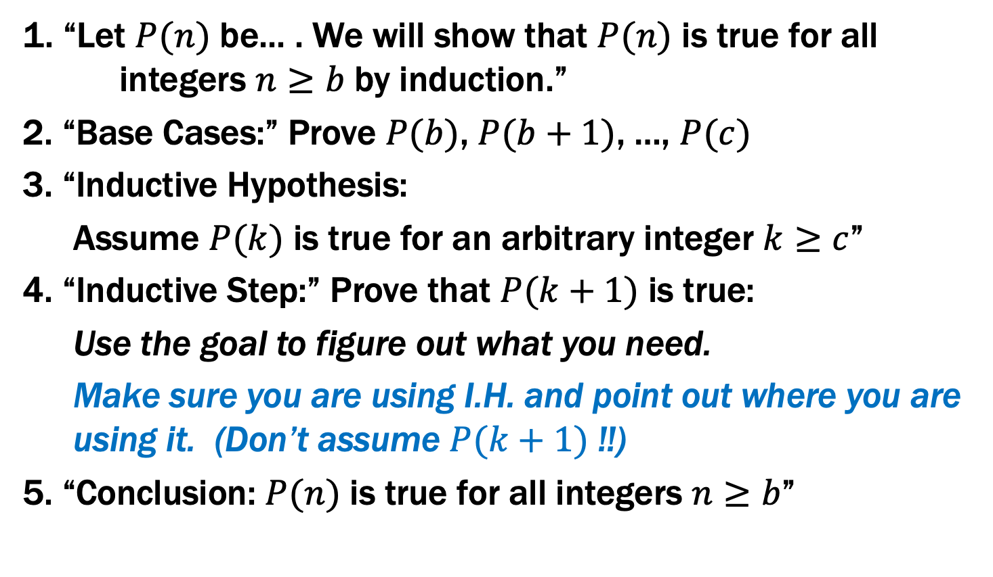
Inductive Proofs with Multiple Base Cases
1. “Let $P(n)$ be... . We will show that $P(n)$ is true for all integers $n≥b$ by induction.”
2. “Base Cases:” Prove $P(b)$, $P(b+1)$, …, $P(c)$
3. “Inductive Hypothesis:
Assume $P(k)$ is true for an arbitrary integer $k≥c$”
4. “Inductive Step:” Prove that $P(k+1)$ is true:
Use the goal to figure out what you need.
Make sure you are using I.H. and point out where you are using it. (Don’t assume $P(k+1)$ !!)
5. “Conclusion: $P(n)$ is true for all integers $n≥b$”

Slide 42
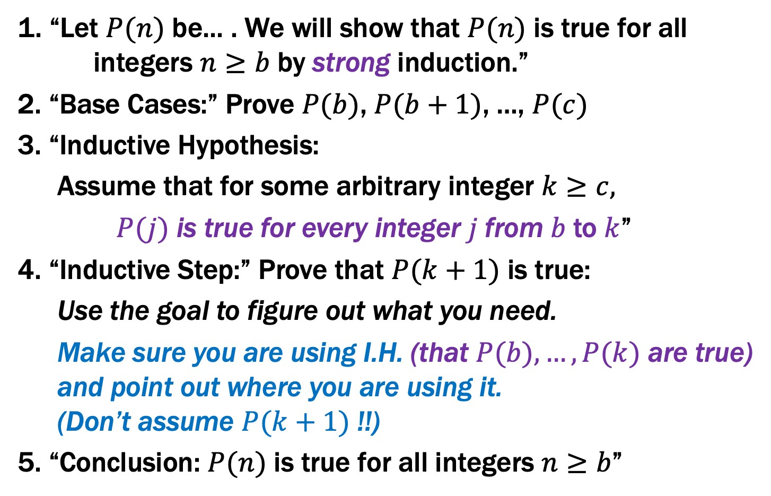
Inductive Proofs With Multiple Base Cases
1. “Let $P(n)$ be... . We will show that $P(n)$ is true for all integers $n≥b$ by strong induction.”
2. “Base Cases:” Prove $P(b)$, $P(b+1)$, …, $P(c)$
3. “Inductive Hypothesis:
Assume that for some arbitrary integer $k≥c,$
$P(j)$ is true for every integer $j$from $b$to $k$”
4. “Inductive Step:” Prove that $P(k+1)$ is true:
Use the goal to figure out what you need.
Make sure you are using I.H. (that $P(b),…,P(k)$ are true) and point out where you are using it. (Don’t assume $P(k+1)$ !!)
5. “Conclusion: $P(n)$ is true for all integers $n≥b$”

Slide 43
Bounding Fibonacci I: $f_{n}<2^{n}$ for all $n≥0$
Original Version
Let P(n) be “f_{n} < 2^{n}”. We prove that P(n) is true for all integers n ≥ 0 by strong induction.
Base Case: f₀=0 < 1= 2⁰ so P(0) is true.
Inductive Hypothesis: Assume that for some arbitrary integer k ≥ 0, we have f_{j} < 2^{j} for every integer j from 0 to k.
Inductive Step: Goal: Show P(k+1); that is, f_{k+1} < 2^{k+1}
Case k+1 = 1: Then f₁ = 1 < 2 = 2¹ so P(k+1) is true here.
Case k+1 ≥ 2: Then f_{k+1} = f_{k} + f_{k-1} by definition
< 2^{k} + 2^{k-1} by the IH since k-1 ≥ 0 < 2^{k} + 2^{k} = 2∙2^{k} = 2^{k+1} so P(k+1) is true in this case.
These are the only cases so P(k+1) follows.
Therefore by strong induction,
f_{n} < 2^{n} for all integers n ≥ 0.
First case in inductive step didn’t need IH
$f_{0}=0 f_{1}=1$
$f_{n}=f_{n−1}+f_{n−2}$ for all $n≥2$

Slide 44
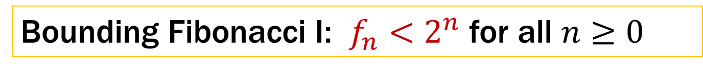
Bounding Fibonacci I: $f_{n}<2^{n}$ for all $n≥0$
Multiple Base Case Version
Let P(n) be “f_{n} < 2^{n}”. We prove that P(n) is true for all integers n ≥ 0 by strong induction.
Base Cases: f₀ = 0 < 1 = 2⁰ so P(0) is true. f₁ = 1 < 2 = 2¹ so P(1) is true.
Inductive Hypothesis: Assume that for some arbitrary integer k ≥ 1, we have f_{j} < 2^{j} for every integer j from 0 to k.
Inductive Step: Goal: Show P(k+1); that is, f_{k+1} < 2^{k+1}
We have f_{k+1} = f_{k} + f_{k-1} by definition since k+1 ≥ 2
< 2^{k} + 2^{k-1} by the IH since k-1 ≥ 0 < 2^{k} + 2^{k} = 2∙2^{k} = 2^{k+1} so P(k+1) is true.
Therefore, by strong induction, f_{n} < 2^{n} for all integers n ≥ 0.
Two base cases
Largest base case
Smallest base case
Two base cases, and two previous values used
$f_{0}=0 f_{1}=1$
$f_{n}=f_{n−1}+f_{n−2}$ for all $n≥2$

Slide 45
Bounding Fibonacci II: $f_{n}≥2^{n/2 − 1}$ for all $n≥2$
Let P(n) be “f_{n} ≥ 2^{n/2 -1} ”. We prove that P(n) is true for all integers n ≥ 2 by strong induction.
Two base cases, and two previous values used
$f_{0}=0 f_{1}=1$
$f_{n}=f_{n−1}+f_{n−2}$ for all $n≥2$

Slide 46
Bounding Fibonacci II: $f_{n}≥2^{n/2 − 1}$ for all $n≥2$
Let P(n) be “f_{n} ≥ 2^{n/2 -1} ”. We prove that P(n) is true for all integers n ≥ 2 by strong induction.
Base Cases: f₂ = f₁ + f₀ = 1 and 2^{2/2 – 1} = 2⁰ = 1 so P(2) holds f₃ = f₂ + f₁ = 2 ≥ 2^{1/2} = 2^{3/2-1} so P(3) holds
$f_{0}=0 f_{1}=1$
$f_{n}=f_{n−1}+f_{n−2}$ for all $n≥2$

Slide 47

Bounding Fibonacci II: $f_{n}≥2^{n/2 − 1}$ for all $n≥2$
Let P(n) be “f_{n} ≥ 2^{n/2 -1} ”. We prove that P(n) is true for all integers n ≥ 2 by strong induction.
Base Cases: f₂ = f₁ + f₀ = 1 and 2^{2/2 – 1} = 2⁰ = 1 so P(2) holds f₃ = f₂ + f₁ = 2 ≥ 2^{1/2} = 2^{3/2-1} so P(3) holds
Inductive Hypothesis: Assume that for some arbitrary integer k ≥ 3, P(j) is true for every integer j from 2 to k.
$f_{0}=0 f_{1}=1$
$f_{n}=f_{n−1}+f_{n−2}$ for all $n≥2$

Slide 48
Bounding Fibonacci II: $f_{n}≥2^{n/2 − 1}$ for all $n≥2$
Let P(n) be “f_{n} ≥ 2^{n/2 -1} ”. We prove that P(n) is true for all integers n ≥ 2 by strong induction.
Base Cases: f₂ = f₁ + f₀ = 1 and 2^{2/2 – 1} = 2⁰ = 1 so P(2) holds f₃ = f₂ + f₁ = 2 ≥ 2^{1/2} = 2^{3/2-1} so P(3) holds
Inductive Hypothesis: Assume that for some arbitrary integer k ≥ 3, P(j) is true for every integer j from 2 to k.
Inductive Step: Goal: Show P(k+1); that is, f_{k+1} ≥ 2^{(k+1)/2 -1}
$f_{0}=0 f_{1}=1$
$f_{n}=f_{n−1}+f_{n−2}$ for all $n≥2$

Slide 49
Bounding Fibonacci II: $f_{n}≥2^{n/2 − 1}$ for all $n≥2$
Let P(n) be “f_{n} ≥ 2^{n/2 -1} ”. We prove that P(n) is true for all integers n ≥ 2 by strong induction.
Base Cases: f₂ = f₁ + f₀ = 1 and 2^{2/2 – 1} = 2⁰ = 1 so P(2) holds f₃ = f₂ + f₁ = 2 ≥ 2^{1/2} = 2^{3/2-1} so P(3) holds
Inductive Hypothesis: Assume that for some arbitrary integer k ≥ 3, P(j) is true for every integer j from 2 to k.
Inductive Step: Goal: Show P(k+1); that is, f_{k+1} ≥ 2^{(k+1)/2 -1}
We have f_{k+1} = f_{k} + f_{k-1} by definition since k+1 ≥ 2
≥ 2^{k/2-1} + 2^{(k-1)/2-1} by the IH since k-1 ≥ 2 ≥ 2^{(k-1)/2-1} + 2^{(k-1)/2-1} = 2^{(k-1)/2} = 2^{(k+1)/2 -1} so P(k+1) is true.
Therefore by strong induction, f_{n} ≥ 2^{n/2 -1} for all integers n ≥ 2.
$f_{0}=0 f_{1}=1$
$f_{n}=f_{n−1}+f_{n−2}$ for all $n≥2$

Slide 50
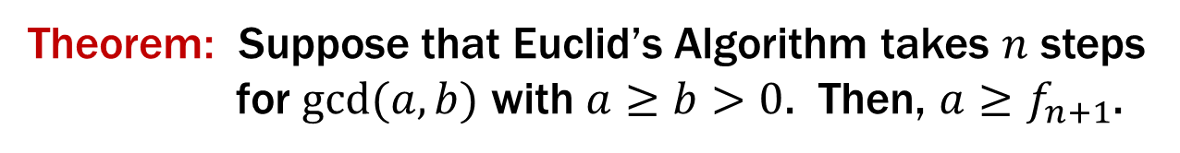
Running time of Euclid’s algorithm
Theorem: Suppose that Euclid’s Algorithm takes $n$ steps
for $gcd⁡(a,b)$ with $a≥b>0$. Then, $a≥f_{n+1}$.

Slide 51
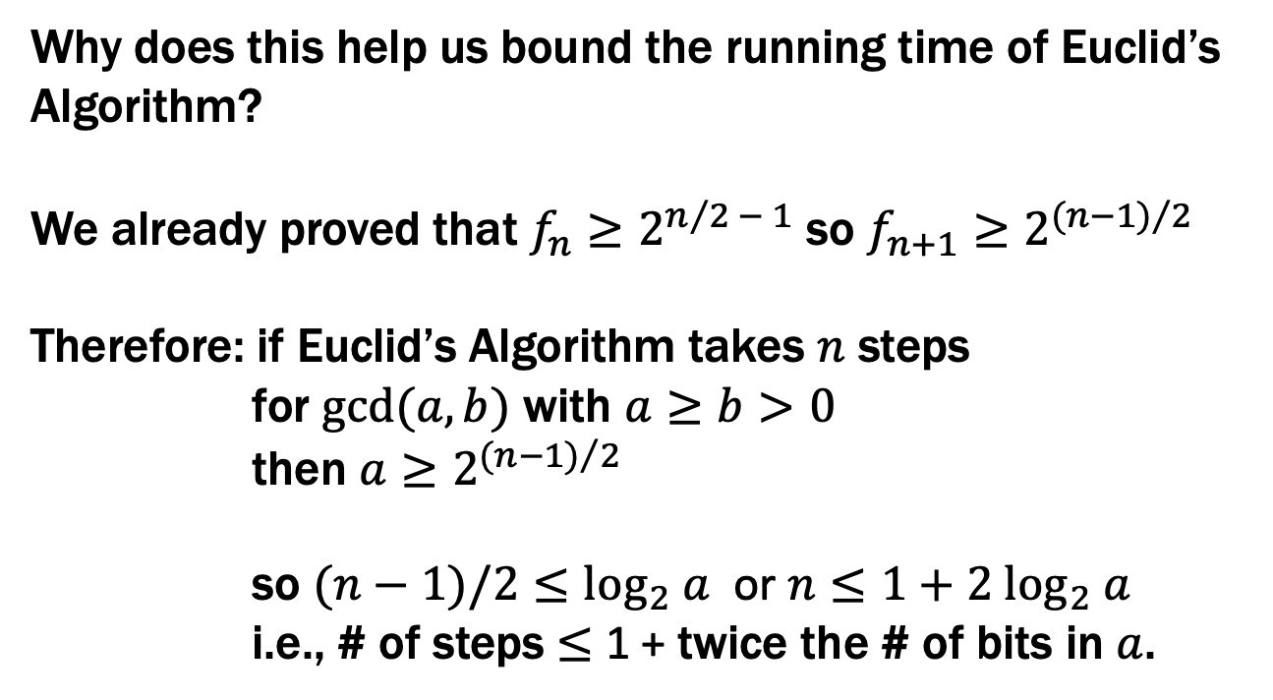
Running time of Euclid’s algorithm
Theorem: Suppose that Euclid’s Algorithm takes $n$ steps
for $gcd⁡(a,b)$ with $a≥b>0$. Then, $a≥f_{n+1}$.
Why does this help us bound the running time of Euclid’s Algorithm?
We already proved that $f_{n}≥2^{n/2 − 1}$ so $f_{n+1}≥2^{{(n−1)}/2}$
Therefore: if Euclid’s Algorithm takes $n$ steps
for $gcd⁡(a,b)$ with $a≥b>0$
then $a≥2^{{(n−1)}/2}$
so $(n−1)/2≤\log_{2} a$ or $n≤1+2 \log_{2} a$
i.e., # of steps ≤ 1 + twice the # of bits in $a$.

Slide 52
Running time of Euclid’s algorithm
Theorem: Suppose that Euclid’s Algorithm takes $n$ steps
for $gcd⁡(a,b)$ with $a≥b>0$. Then, $a≥f_{n+1}$.
An informal way to get the idea: Consider an n step gcd calculation starting with r_{n+1}=a and r_{n}=b:
r_{n+1} = q_{n}r_{n} + r_{n-1}
r_{n} = q_{n-1}r_{n-1} + r_{n-2}
…
r₃ = q₂r₂ + r₁
r₂ = q₁r₁ + 0
Now r₁ ≥ 1 and each q_{k} must be ≥ 1. If we replace all the q_{K}’s by 1 and replace r₁ by 1 , we can only reduce the r_{k}’s. After that reduction, r_{k}=f_{k} for every k.
For all k ≥ 2, r_{k-1}= r_{k+1} mod r_{k}
“Euclid’s algorithm is slowest on Fibonacci numbers and it takes only n steps for gcd(f_{n+1},f_{n})”
f₀

Slide 53
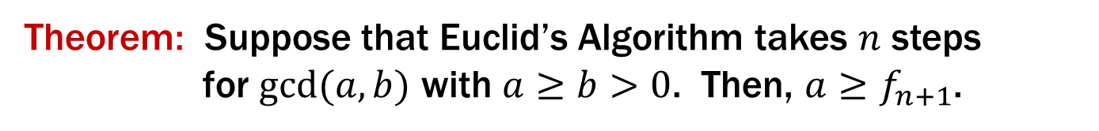
Running time of Euclid’s algorithm
Theorem: Suppose that Euclid’s Algorithm takes $n$ steps
for $gcd⁡(a,b)$ with $a≥b>0$. Then, $a≥f_{n+1}$.
We go by strong induction on n.
Let P(n) be “gcd(a,b) with a ≥ b>0 takes n steps → a ≥ f_{n+1}” for all n ≥ 1.
Base Case: n=1 Suppose Euclid’s Algorithm with a ≥ b > 0 takes 1 step. By assumption, a ≥ b ≥ 1 = f₂ so P(1) holds.
n=2 Suppose Euclid’s Algorithm with a ≥ b > 0 takes 2 steps.
Then a = q b + r
b = q’ r + 0 for r ≥ 1.
Since a ≥ b > 0, we must have q ≥ 1 and b ≥1 so
a = qb + r ≥ b + r ≥ 1+1 = 2 = f₃ and P(2) holds
Induction Hypothesis: Suppose that for some integer k ≥ 2, P(j) is true for all integers j s.t. 1 ≤ j ≤ k

Slide 54
Running time of Euclid’s algorithm
Induction Hypothesis: Suppose that for some integer k ≥ 2, P(j) is true for all integers j s.t. 1 ≤ j ≤ k
Inductive Step: Goal: if gcd(a,b) with a ≥ b>0 takes k+1 steps, then a ≥ f_{k+2.}
Since k ≥ 2, if gcd(a,b) with a ≥ b>0 takes k+1 ≥ 3 steps, the first 3 steps of Euclid’s algorithm on a and b give us
a = q b + r
b = q’ r + r’
r = q” r’ + r”
and there are k-2 more steps after this. Note that this means that the gcd(b, r) takes k steps and gcd(r, r’) takes k-1 steps.
So since k, k-1 ≥ 1, by the IH we have b ≥ f_{k+1} and r ≥ f_{k}.

Slide 55
Running time of Euclid’s algorithm
Induction Hypothesis: Suppose that for some integer k ≥ 2, P(j) is true for all integers j s.t. 1 ≤ j ≤ k
Inductive Step: Goal: if gcd(a,b) with a ≥ b>0 takes k+1 steps, then a ≥ f_{k+2.}
Since k ≥ 2, if gcd(a,b) with a ≥ b>0 takes k+1 ≥ 3 steps, the first 3 steps of Euclid’s algorithm on a and b give us
a = q b + r
b = q’ r + r’
r = q” r’ + r”
and there are k-2 more steps after this. Note that this means that the gcd(b, r) takes k steps and gcd(r, r’) takes k-1 steps.
So since k, k-1 ≥ 1, by the IH we have b ≥ f_{k+1} and r ≥ f_{k}.
Also, since a ≥ b, we must have q ≥ 1.
So a = q b + r ≥ b + r ≥ f_{k+1}+ f_{k}= f_{k+2} as required.

