Slide 1
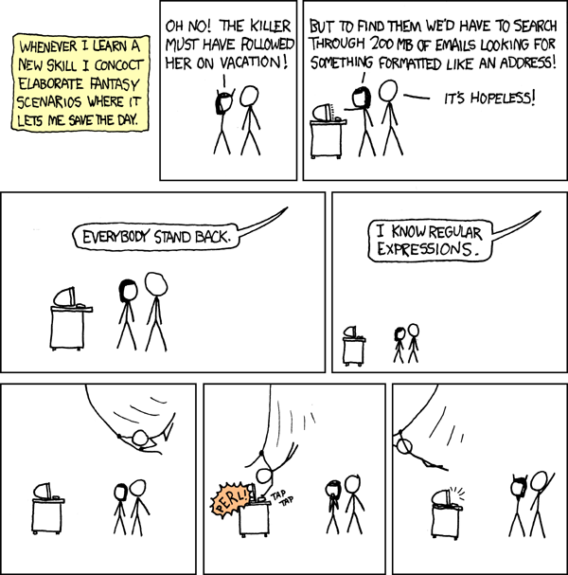
CSE 311: Foundations of Computing
Lecture 18: Strings and Regular Expressions

Slide 2
Last time: Rooted Binary Trees
Basis: • is a rooted binary tree
Recursive step:
If and are rooted binary trees,
then also is a rooted binary tree.
T₁
T₂
T₂
T₁

Slide 3
Defining Functions on Rooted Binary Trees
size(•) := 1
size ( ) := 1 + size(T₁) + size(T₂)
height(•) := 0
height ( ) := 1 + max{height(T₁), height(T₂)}
T₁
T₂
T₁
T₂

Slide 4
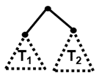
Claim: For every rooted binary tree T, size(T) ≤ 2^{height(T) + 1} - 1
1. Let P(T) be “size(T) ≤ 2^{height(T)+1}–1”. We prove P(T) for all rooted binary trees T by structural induction.
2. Base Case: size(•)=1, height(•)=0, and 2⁰⁺¹–1=2¹–1=1 so P(•) is true.
3. Inductive Hypothesis: Suppose that P(T₁) and P(T₂) are true for some rooted binary trees T₁ and T₂, i.e., size(T_{k}) ≤ 2^{height(Tk) + 1} – 1 for k=1,2
4. Inductive Step: Goal: Prove P( ).
By defn, size( ) =1+size(T₁)+size(T₂)
≤ 1+2^{height(T1)+1}–1+2^{height(T2)+1}-1 by IH for T₁ and T₂
≤ 2^{height(T1)+1}+2^{height(T2)+1}–1
≤ 2(2^{max(height(T1),height(T2))+1})–1
≤ 2(2^{height(} ⁾)–1 ≤ 2^{height( )+1} –1
which is what we wanted to show.
5. So, the P(T) is true for all rooted bin. trees by structural induction.

Slide 5
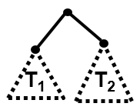
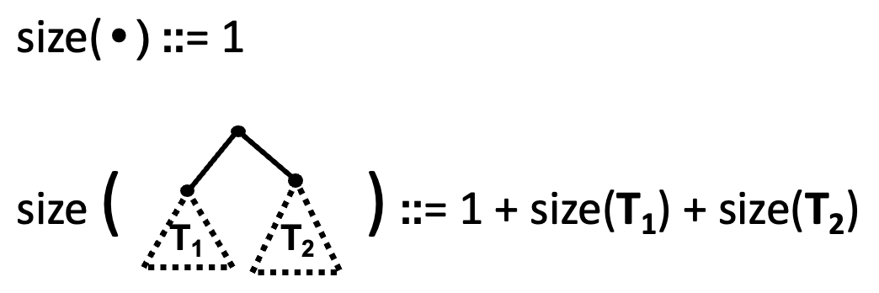
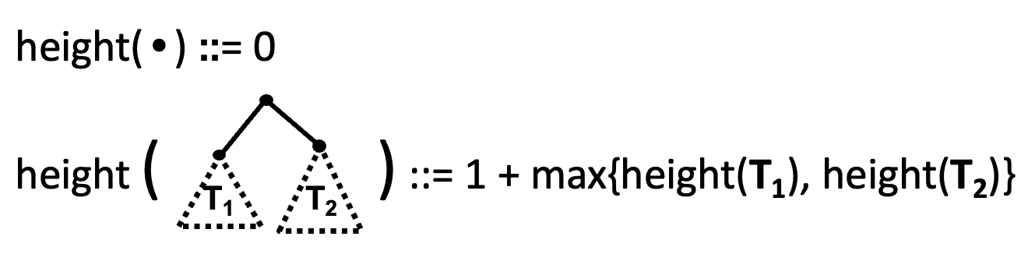

Claim: For every rooted binary tree T, size(T) ≤ 2^{height(T) + 1} - 1
1. Let P(T) be “size(T) ≤ 2^{height(T)+1}–1”. We prove P(T) for all rooted binary trees T by structural induction.
2. Base Case: size(•)=1, height(•)=0, and 2⁰⁺¹–1=2¹–1=1 so P(•) is true.
3. Inductive Hypothesis: Suppose that P(T₁) and P(T₂) are true for some rooted binary trees T₁ and T₂, i.e., size(T_{k}) ≤ 2^{height(Tk) + 1} – 1 for k=1,2
4. Inductive Step: Goal: Prove P( ).
size( ) ≤ 2^{height( )+1} – 1

Slide 6
Claim: For every rooted binary tree T, size(T) ≤ 2^{height(T) + 1} - 1
1. Let P(T) be “size(T) ≤ 2^{height(T)+1}–1”. We prove P(T) for all rooted binary trees T by structural induction.
2. Base Case: size(•)=1, height(•)=0, and 2⁰⁺¹–1=2¹–1=1 so P(•) is true.
3. Inductive Hypothesis: Suppose that P(T₁) and P(T₂) are true for some rooted binary trees T₁ and T₂, i.e., size(T_{k}) ≤ 2^{height(Tk) + 1} – 1 for k=1,2
4. Inductive Step: Goal: Prove P( ).
By def, size( ) =1+size(T₁)+size(T₂)
≤ 1+2^{height(T1)+1}–1+2^{height(T2)+1}-1 by IH for T₁ and T₂
= 2^{height(T1)+1}+2^{height(T2)+1}–1
≤ 2·max(2^{height(T1)+1,}2^{height(T2)+1})–1
= 2(2^{max(height(T1),height(T2))+1})–1
= 2(2^{height(} ⁾) – 1 = 2^{height( )+1} – 1
which is what we wanted to show.
5. So, the P(T) is true for all rooted binary trees by structural induction.

Slide 7
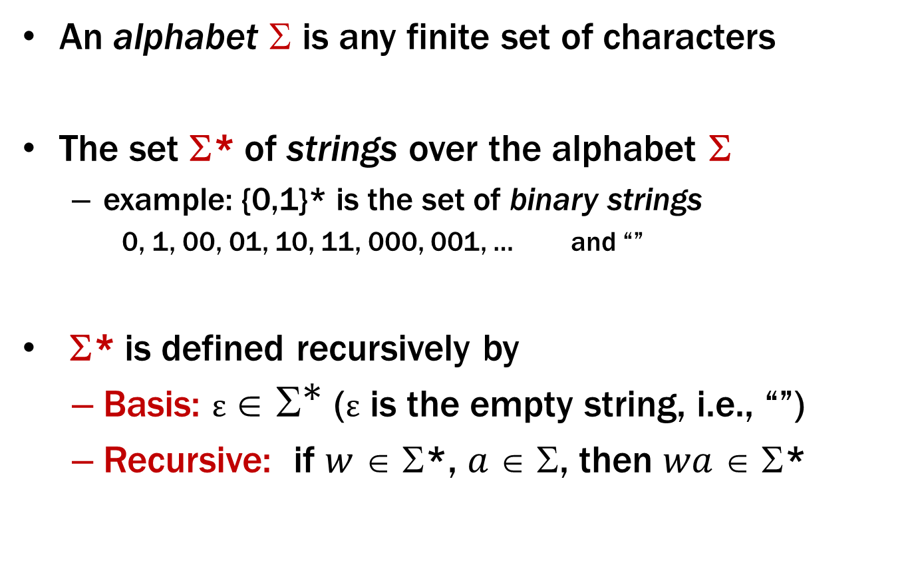
Strings
An alphabet $$ is any finite set of characters
The set Σ* of strings over the alphabet Σ
example: {0,1}* is the set of binary strings
0, 1, 00, 01, 10, 11, 000, 001, … and “”
Σ* is defined recursively by
Basis: $ε ∈ {\text{Σ}}^{\text{∗}}$ (ε is the empty string, i.e., “”)
Recursive: if $w$ ∈ Σ*, $a$ ∈ Σ, then $wa$ ∈ Σ*

Slide 8
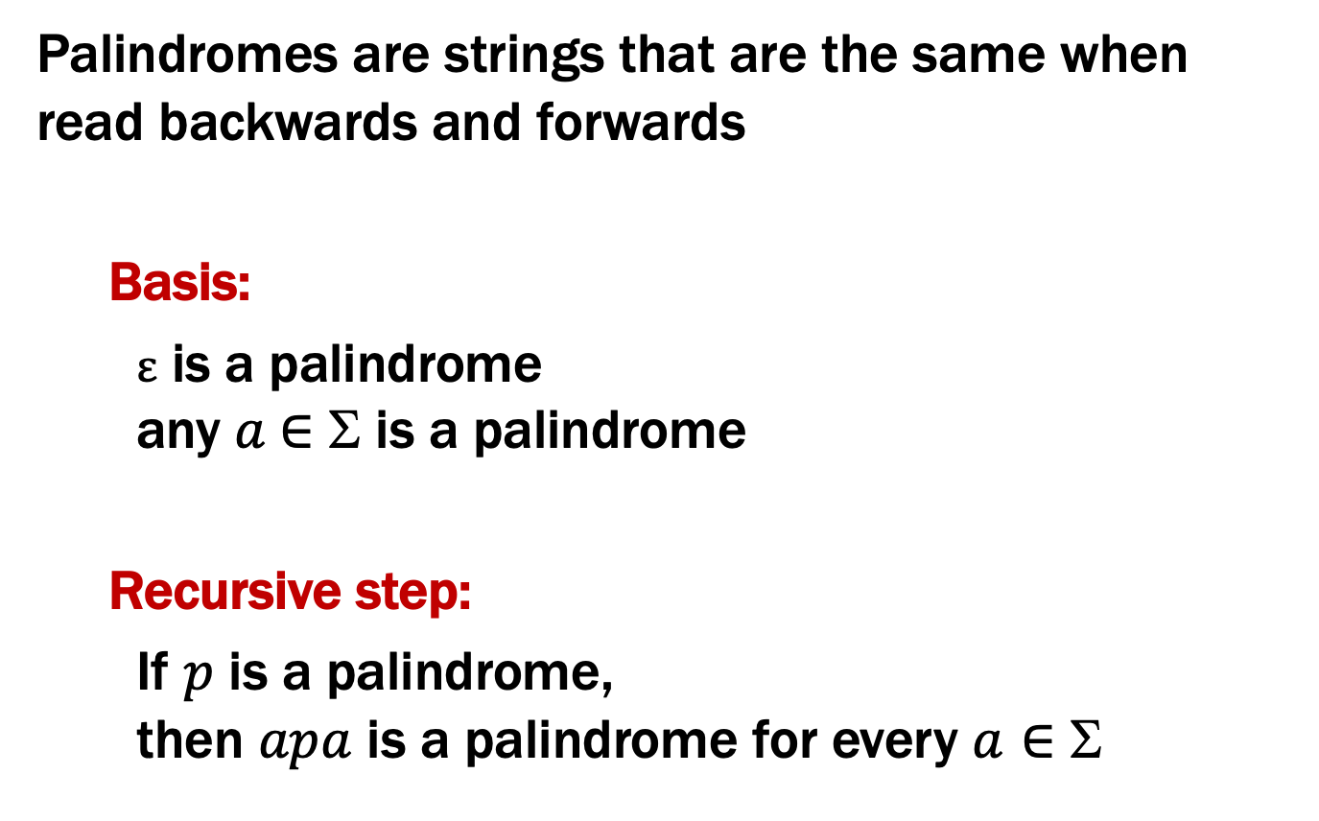
Palindromes
Palindromes are strings that are the same when read backwards and forwards
Basis:
ε is a palindrome any $a$∈ Σ is a palindrome
Recursive step:
If $p$ is a palindrome, then $apa$ is a palindrome for every $a∈$ Σ

Slide 9
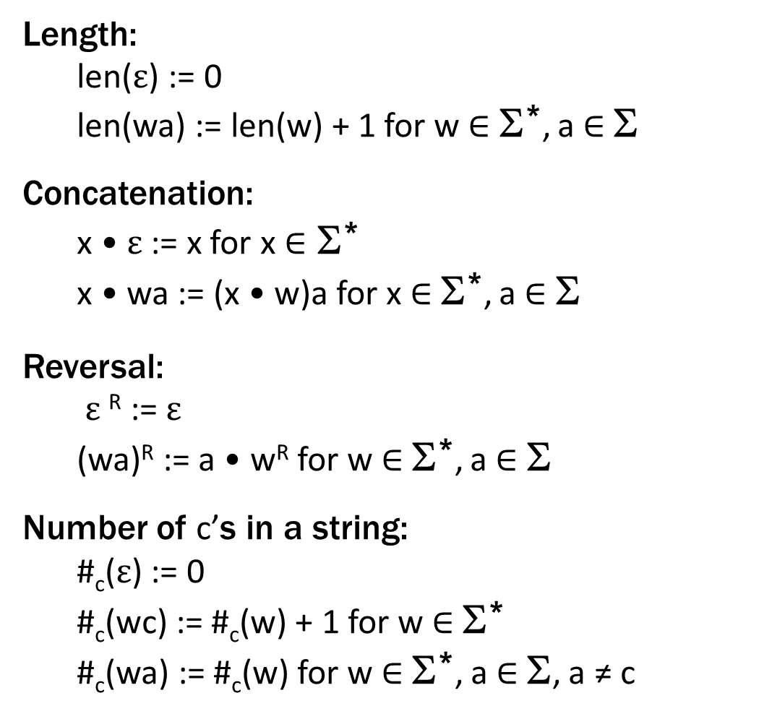
Functions on Recursively Defined Sets (on Σ*)
Length:
len($ε$) := 0
len(wa) := len(w) + 1 for w ∈ Σ*, a ∈ Σ
Concatenation:
x • $ε$ := x for x ∈ Σ*
x • wa := (x • w)a for x ∈ Σ*, a ∈ Σ
Reversal:
$ε$^{R} := $ε$
(wa)^{R} := a • w^{R} for w ∈ Σ*, a ∈ Σ
Number of c’s in a string:
#_{c}($ε$) := 0
#_{c}(wc) := #_{c}(w) + 1 for w ∈ Σ*
#_{c}(wa) := #_{c}(w) for w ∈ Σ*, a ∈ Σ, a ≠ c
separate cases for
c vs a ≠ c
Notes:
These are defined by cases

Slide 10
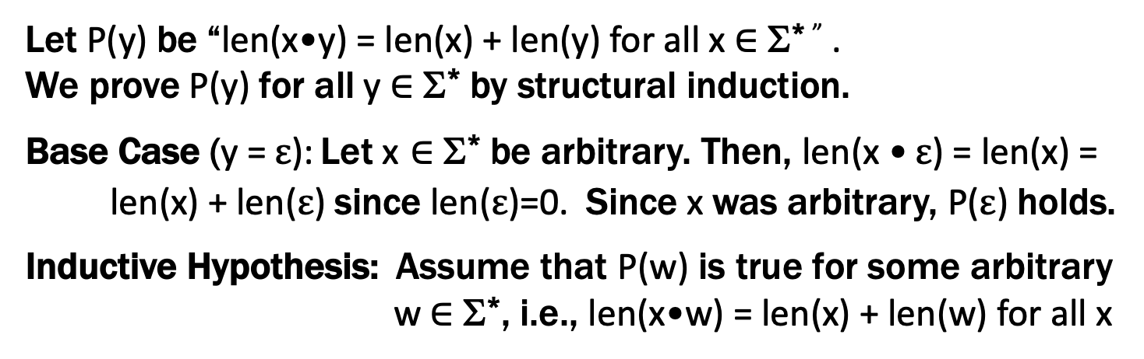
Claim: len(x•y) = len(x) + len(y) for all x,y ∈ Σ*
Let P(y) be “len(x•y) = len(x) + len(y) for all x ∈ Σ* ” .
We prove P(y) for all y ∈ Σ* by structural induction.
Base Case (y = $ε$): Let x ∈ Σ* be arbitrary. Then, len(x • $ε$) = len(x) =
len(x) + len($ε$) since len($ε$)=0. Since x was arbitrary, P($ε$) holds.
Inductive Hypothesis: Assume that P(w) is true for some arbitrary w ∈ Σ*, i.e., len(x•w) = len(x) + len(w) for all x

Slide 11
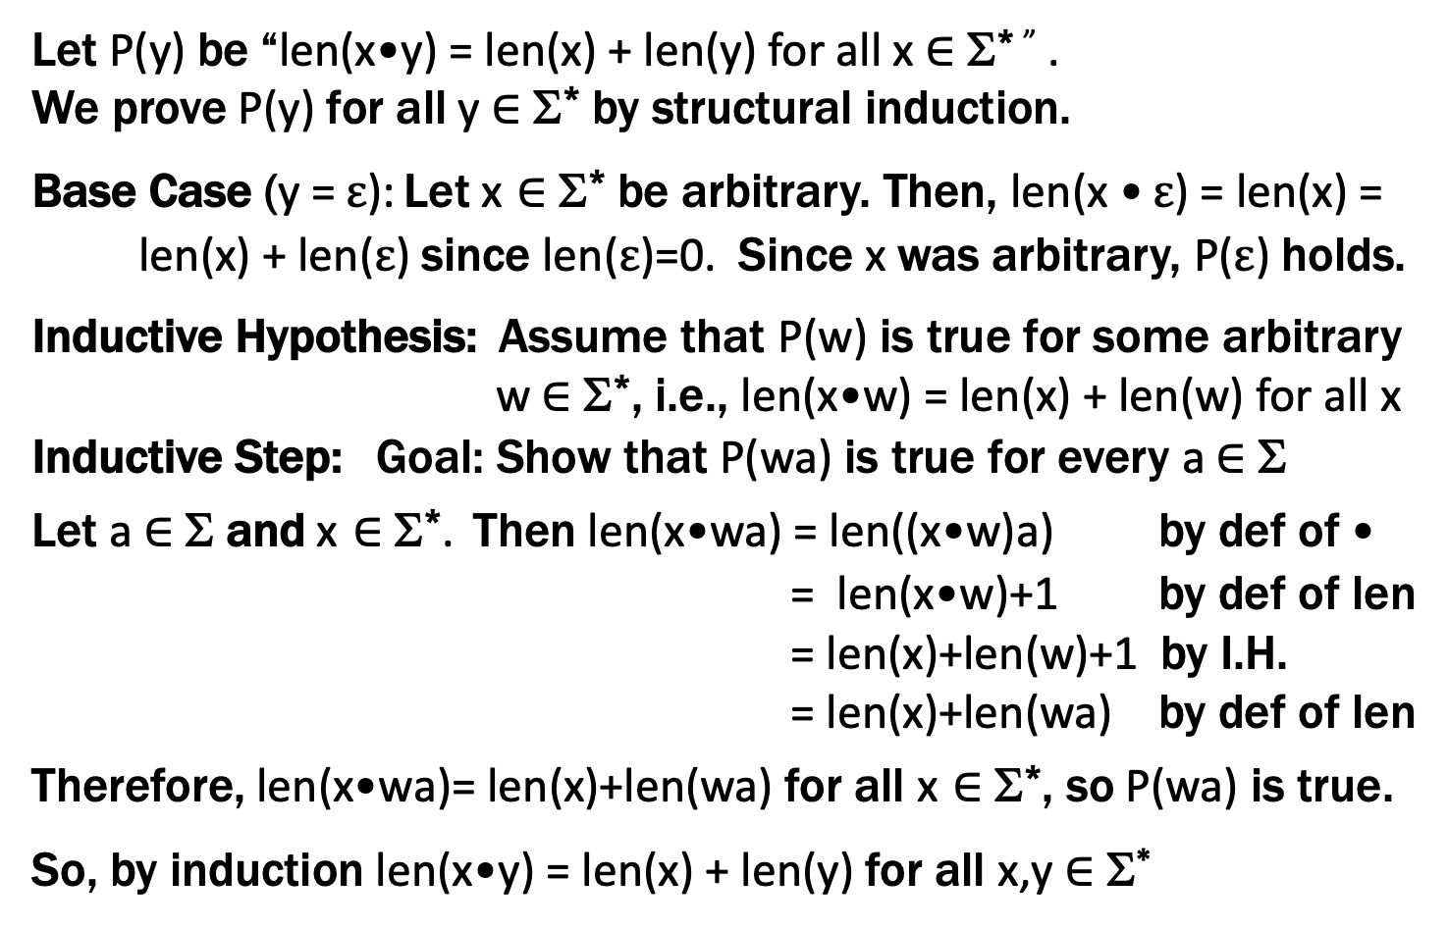
Claim: len(x•y) = len(x) + len(y) for all x,y ∈ Σ*
Does this look familiar?
Let P(y) be “len(x•y) = len(x) + len(y) for all x ∈ Σ* ” .
We prove P(y) for all y ∈ Σ* by structural induction.
Base Case (y = $ε$): Let x ∈ Σ* be arbitrary. Then, len(x • $ε$) = len(x) =
len(x) + len($ε$) since len($ε$)=0. Since x was arbitrary, P($ε$) holds.
Inductive Hypothesis: Assume that P(w) is true for some arbitrary w ∈ Σ*, i.e., len(x•w) = len(x) + len(w) for all x
Inductive Step: Goal: Show that P(wa) is true for every a ∈ Σ
Let a ∈ Σ and x ∈ Σ*. Then len(x•wa) = len((x•w)a) by def of •
= len(x•w)+1 by def of len
= len(x)+len(w)+1 by I.H.
= len(x)+len(wa) by def of len
Therefore, len(x•wa)= len(x)+len(wa) for all x ∈ Σ*, so P(wa) is true.
So, by induction len(x•y) = len(x) + len(y) for all x,y ∈ Σ*

Slide 12
Theoretical Computer Science

Slide 13
Languages: Sets of Strings
Subsets of strings are called languages
Examples:
Σ* = All strings over alphabet Σ
Palindromes over Σ
Binary strings that don’t have a 0 after a 1
Binary strings with an equal # of 0’s and 1’s
Legal variable names in Java/C/C++
Syntactically correct Java/C/C++ programs
Valid English sentences

Slide 14
Foreword on Intro to Theory C.S.
Look at different ways of defining languages
See which are more expressive than others
i.e., which can define more languages
Later: connect ways of defining languages to different types of (restricted) computers
computers capable of recognizing those languages i.e., distinguishing strings in the language from not
Consequence: computers that recognize more expressive languages are more powerful

Slide 15
Regular Expressions
Regular expressions over Σ
Basis:
ε is a regular expression (could also include ∅)
a is a regular expression for any a ∈ Σ
Recursive step:
If A and B are regular expressions, then so are:
A ∪ B
AB
A*

Slide 16
Each Regular Expression is a “pattern”
ε matches only the empty string
a matches only the one-character string a
A ∪ B matches all strings that either A matches or B matches (or both)
AB matches all strings that have a first part that A matches followed by a second part that B matches
A* matches all strings that have any number of strings (even 0) that A matches, one after another (ε ∪ A ∪ AA ∪ AAA ∪ …)
Definition of the language matched by a regular expression

Slide 17
Examples
001*
0*1*

Slide 18
Examples
001*
0*1*
{00, 001, 0011, 00111, …}
Any number of 0’s followed by any number of 1’s

Slide 19
Examples
(0 ∪ 1) 0 (0 ∪ 1) 0
(0*1*)*

Slide 20
Examples
(0 ∪ 1) 0 (0 ∪ 1) 0
(0*1*)*
{0000, 0010, 1000, 1010}
All binary strings

Slide 21
Examples
All binary strings that contain 0110

Slide 22
Examples
All binary strings that contain 0110
(0 ∪ 1)* 0110 (0 ∪ 1)*

Slide 23
Examples
All binary strings that contain 0110
All binary strings that begin with a string of doubled characters (00 or 11) followed by 01010 or 10001
(0 ∪ 1)* 0110 (0 ∪ 1)*

Slide 24
Examples
All binary strings that contain 0110
All binary strings that begin with a string of doubled characters (00 or 11) followed by 01010 or 10001
(0 ∪ 1)* 0110 (0 ∪ 1)*
(00 ∪ 11)* (01010 ∪ 10001) (0 ∪ 1)*

Slide 25
Regular Expressions in Practice
Used to define the tokens of a programming language
legal variable names, keywords, etc.
Used in grep, a program that does pattern matching searches in UNIX/LINUX
We can use regular expressions in programs to process strings!

Slide 26
Regular Expressions in Java
Pattern p = Pattern.compile("a*b");
Matcher m = p.matcher("aaaaab");
boolean b = m.matches();
[01] a 0 or a 1 ^ start of string $ end of string
[0-9] any single digit \. period \, comma \- minus
. any single character
ab a followed by b (AB)
(a|b) a or b (A ∪ B) a? zero or one of a (A ∪ ε) a* zero or more of a A*
a+ one or more of a AA*
e.g. ^[\-+]?[0-9]*(\.|\,)?[0-9]+$
General form of decimal number e.g. 9.12 or -9,8 (Europe)

Slide 27
Examples
All binary strings that have an even # of 1’s

Slide 28
Examples
All binary strings that have an even # of 1’s
e.g., 0* (10*10*)*

Slide 29
Examples
All binary strings that have an even # of 1’s
All binary strings that don’t contain 101
e.g., 0* (10*10*)*
Notes:
Every pair of 1s are separated by 0 or 2+ 0s.
Alternatively, can take a state machine approach (0 union 11 union 100)* (empty union 1 union 10)

Slide 30
Examples
All binary strings that have an even # of 1’s
All binary strings that don’t contain 101
e.g., 0* (10*10*)*
e.g., 0* (1 ∪ 000*)* 0*
at least two 0s between 1s

Slide 31
Limitations of Regular Expressions
Not all languages can be specified by regular expressions
Even some easy things like
Palindromes
Strings with equal number of 0’s and 1’s
But also more complicated structures in programming languages
Matched parentheses
Properly formed arithmetic expressions
etc.

Slide 32
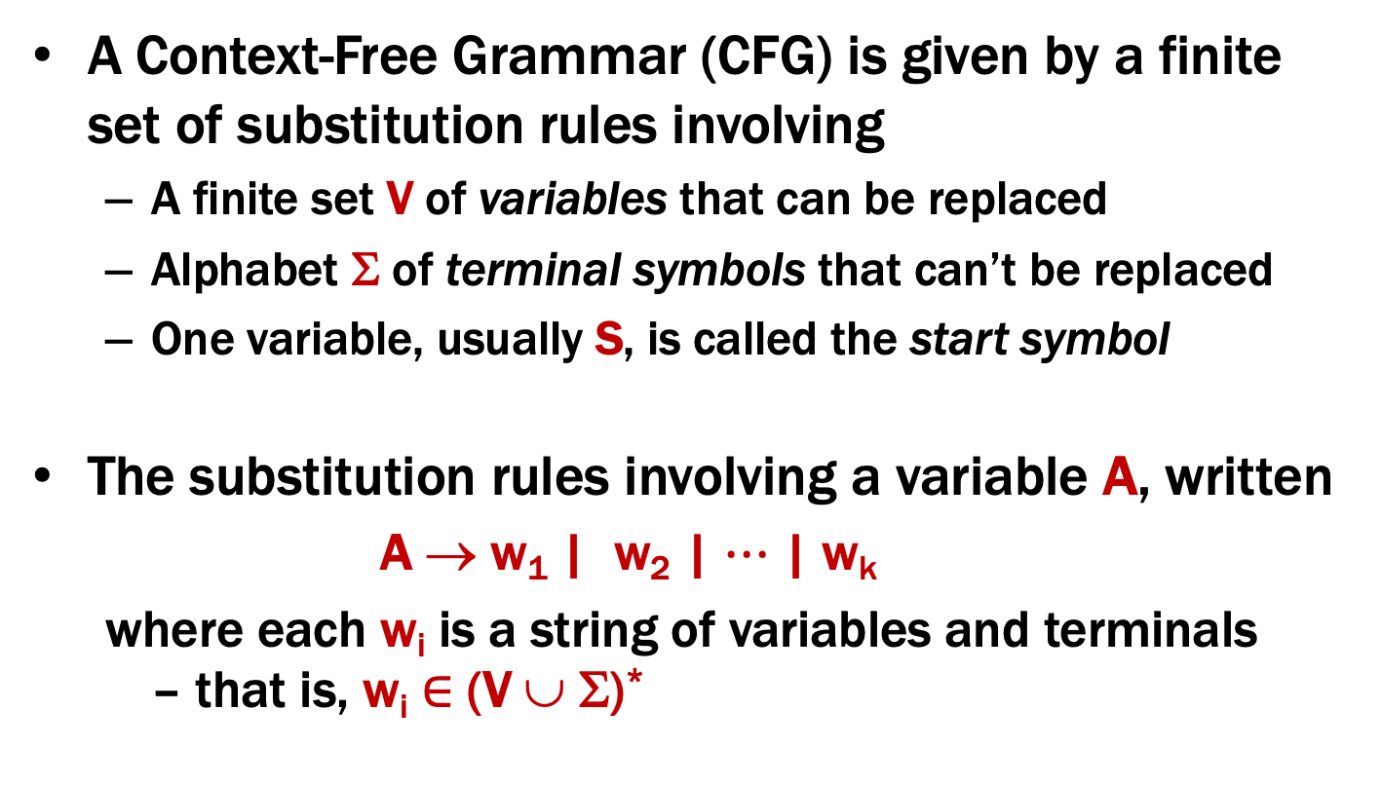
Context-Free Grammars
A Context-Free Grammar (CFG) is given by a finite set of substitution rules involving
A finite set V of variables that can be replaced
Alphabet Σ of terminal symbols that can’t be replaced
One variable, usually S, is called the start symbol
The substitution rules involving a variable A, written
A → w₁ | w₂ | $⋯$ | w_{k}
where each w_{i} is a string of variables and terminals – that is, w_{i} ∈ (V ∪ Σ)*

Slide 33
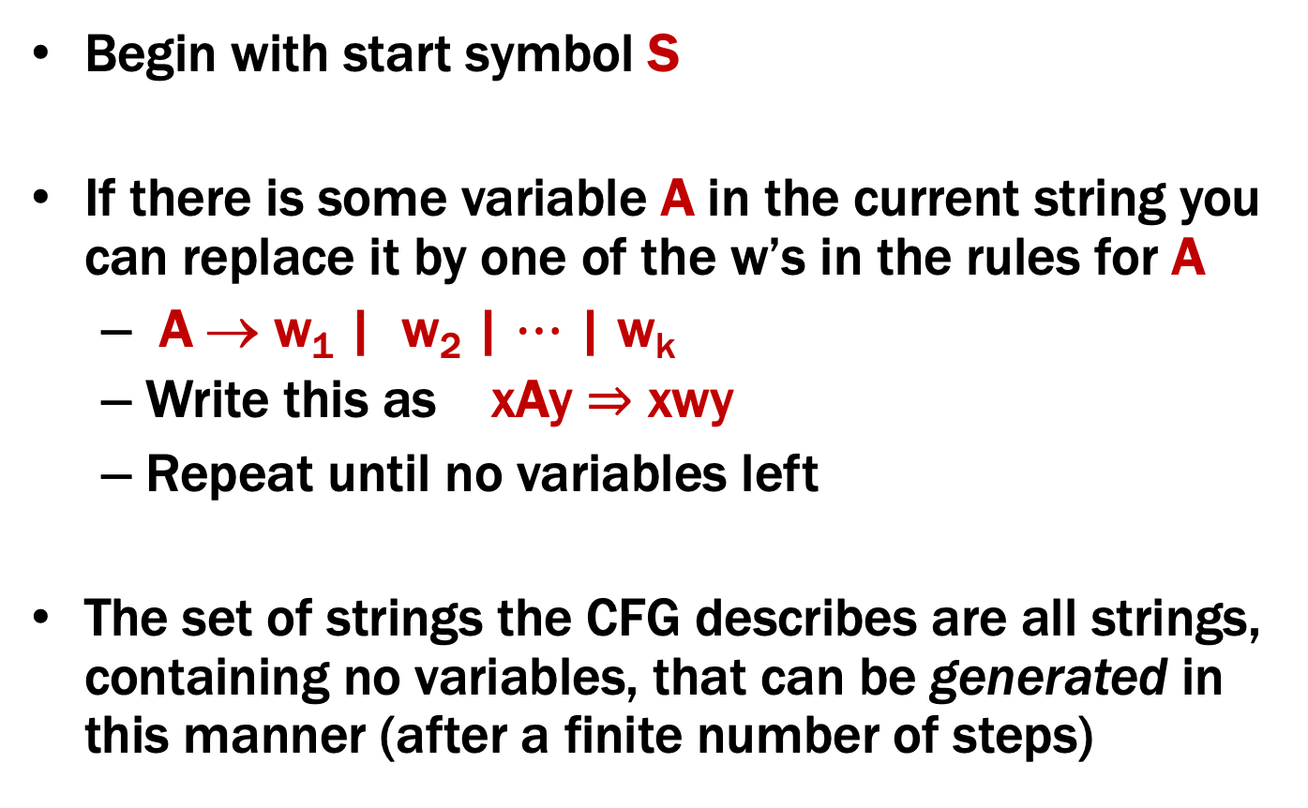
How CFGs generate strings
Begin with start symbol S
If there is some variable A in the current string you can replace it by one of the w’s in the rules for A
A → w₁ | w₂ | $⋯$ | w_{k}
Write this as xAy ⇒ xwy
Repeat until no variables left
The set of strings the CFG describes are all strings, containing no variables, that can be generated in this manner (after a finite number of steps)
Notes:
Note that A can appear in x and y.

Slide 34
Example Context-Free Grammars
Example: S → 0S0 | 1S1 | 0 | 1 | ε

Slide 35
Example Context-Free Grammars
Example: S → 0S0 | 1S1 | 0 | 1 | ε
The set of all binary palindromes

Slide 36
Example Context-Free Grammars
Example: S → 0S0 | 1S1 | 0 | 1 | ε
Example: S → 0S | S1 | ε
The set of all binary palindromes

Slide 37
Example Context-Free Grammars
Example: S → 0S0 | 1S1 | 0 | 1 | ε
Example: S → 0S | S1 | ε
The set of all binary palindromes
0*1*

