Slide 1
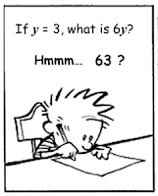
CSE 311: Foundations of Computing
Lecture 20: CFGs, Relations

Slide 2
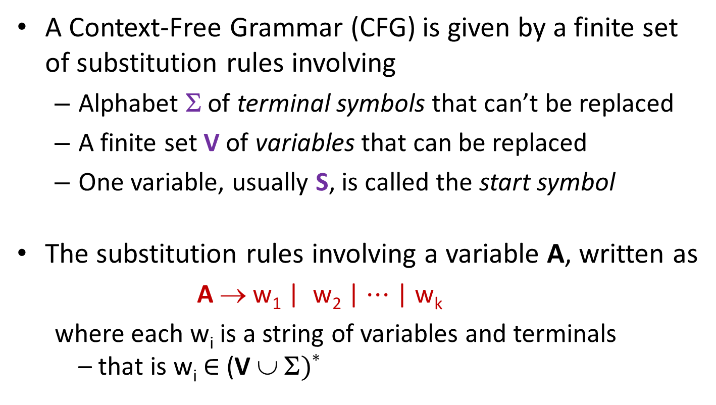
Last class: Context-Free Grammars
A Context-Free Grammar (CFG) is given by a finite set of substitution rules involving
Alphabet Σ of terminal symbols that can’t be replaced
A finite set V of variables that can be replaced
One variable, usually S, is called the start symbol
The substitution rules involving a variable A, written as
A → w₁ | w₂ | $⋯$ | w_{k}
where each w_{i} is a string of variables and terminals – that is w_{i} ∈ (V ∪ Σ)*

Slide 3
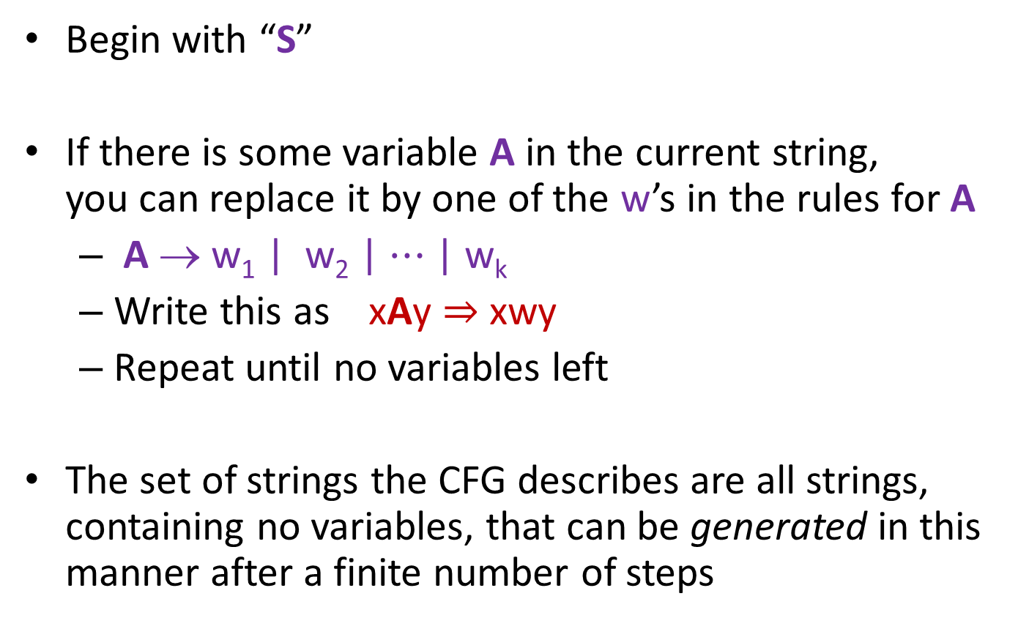
Last class: How CFGs generate strings
Begin with “S”
If there is some variable A in the current string, you can replace it by one of the w’s in the rules for A
A → w₁ | w₂ | $⋯$ | w_{k}
Write this as xAy ⇒ xwy
Repeat until no variables left
The set of strings the CFG describes are all strings, containing no variables, that can be generated in this manner after a finite number of steps
Notes:
Note that A can appear in x and y.

Slide 4
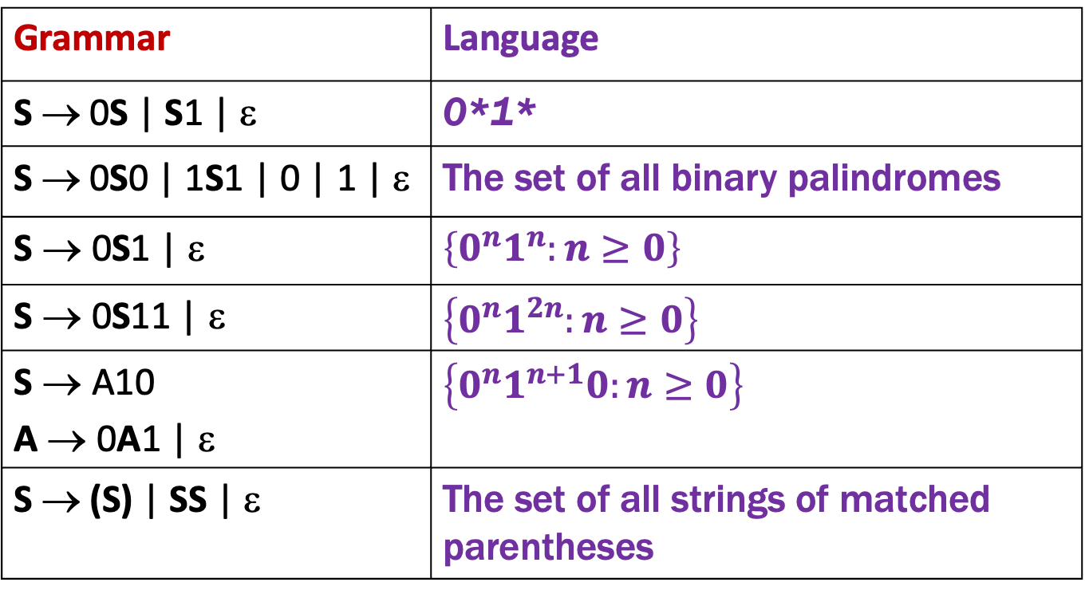
Last class: Examples
Grammar | Language
S → 0S | S1 | ε | 0*1*
S → 0S0 | 1S1 | 0 | 1 | ε | The set of all binary palindromes
S → 0S1 | ε | $$\left\{0^{n}1^{n}:n≥0\right\}$$
S → 0S11 | ε | $$\left\{0^{n}1^{2n}:n≥0\right\}$$
S → A10 A → 0A1 | ε | $$\left\{0^{n}1^{n+1}0:n≥0\right\}$$
S → (S) | SS | ε | The set of all strings of matched parentheses

Slide 5
Example Context-Free Grammars
Binary strings with equal numbers of 0s and 1s (not just 0^{n}1^{n}, also 0101, 0110, etc.)

Slide 6
Example Context-Free Grammars
Binary strings with equal numbers of 0s and 1s (not just 0^{n}1^{n}, also 0101, 0110, etc.)
S → SS | 0S1 | 1S0 | ε
A standard structural induction can show that everything generated by S has an equal # of 0s and 1s
Intuitively, why does this generate all such strings?

Slide 7

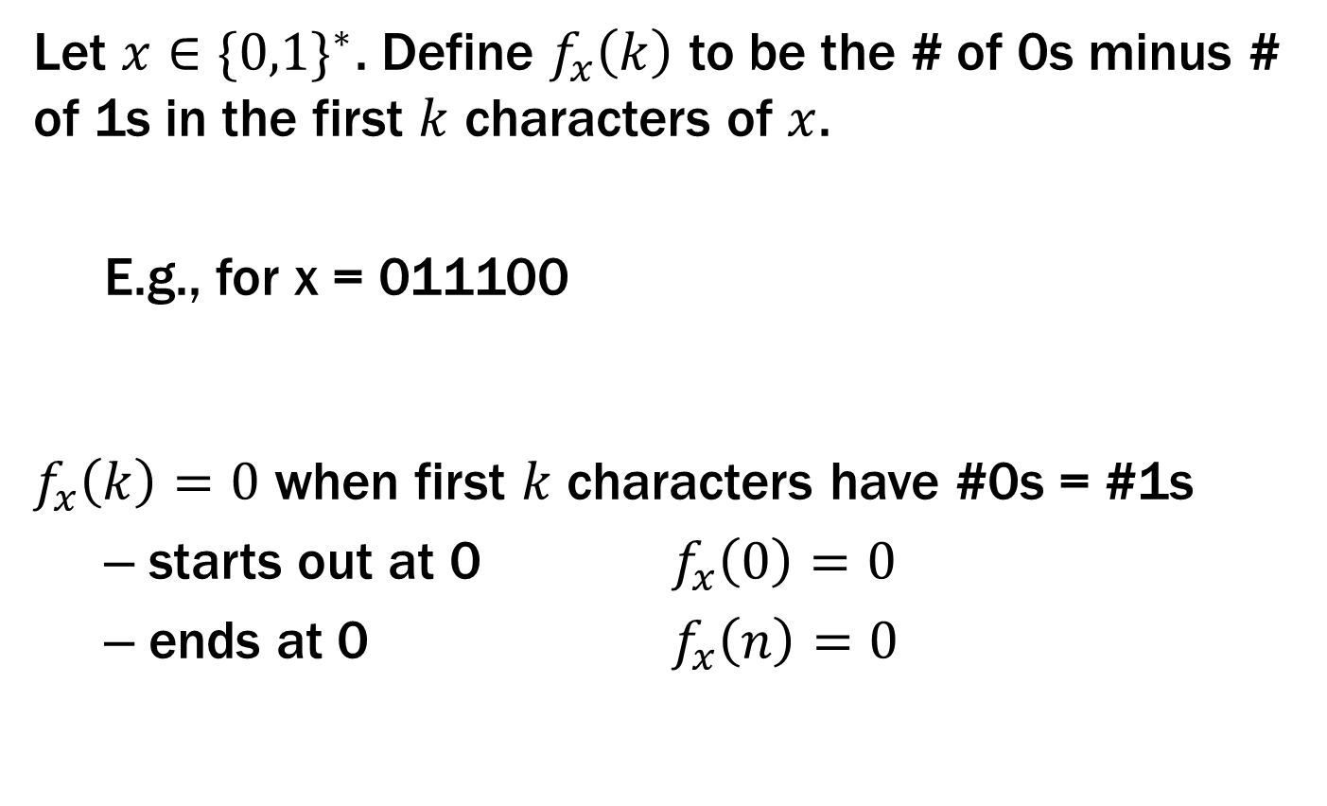

Example Context-Free Grammars
Let $x∈{\{0,1\}}^{∗}$. Define $f_{x}\left(k\right)$ to be the # of 0s minus # of 1s in the first $k$ characters of $x$.
E.g., for x = 011100
$f_{x}\left(k\right)=0$ when first $k$ characters have #0s = #1s
starts out at 0 $f_{x}\left(0\right)=0$
ends at 0 $f_{x}\left(n\right)=0$
# 0s $−$ # 1s so far
$$f$$
0 1 2 3 4 5 6

Slide 8
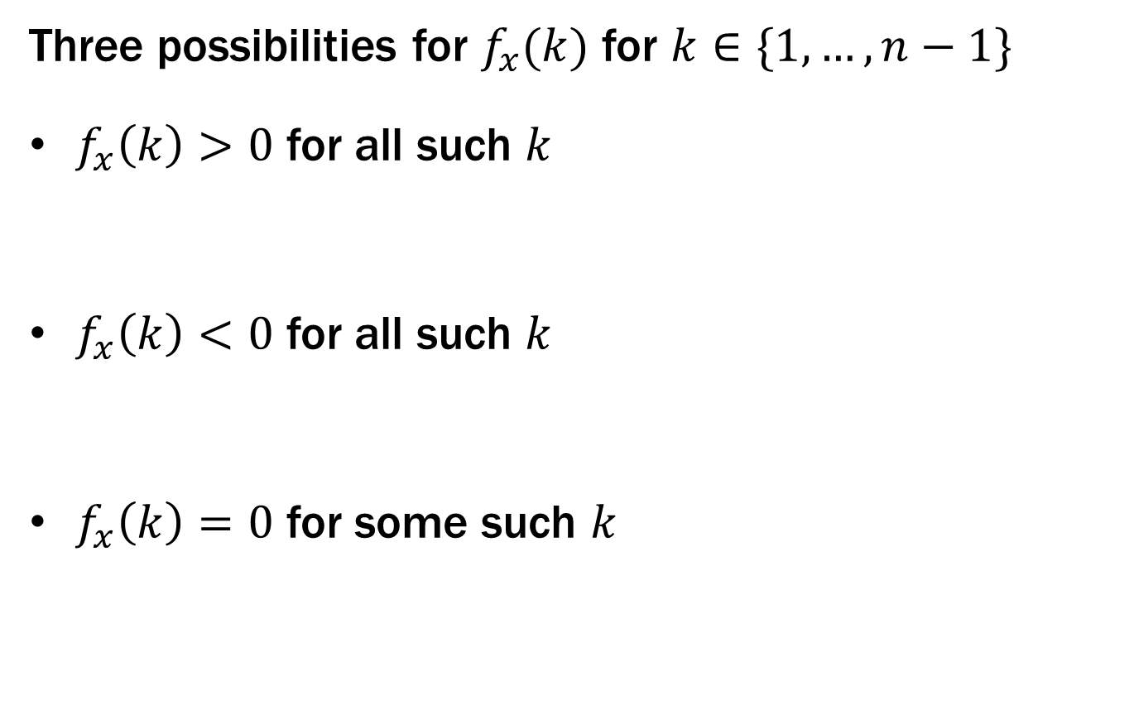
Example Context-Free Grammars
Three possibilities for $f_{x}(k)$ for $k∈\{1, …,n−1\}$
$f_{x}\left(k\right)>0$ for all such $k$
$f_{x}\left(k\right)<0$ for all such $k$
$f_{x}\left(k\right)=0$ for some such $k$
1
0 1 n-1 n
S → 0S1
0 1 n-1 n
S → 1S0
1
0 1 n-1 n
S → SS

Slide 9
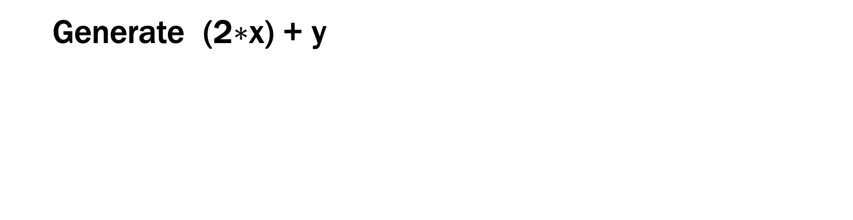
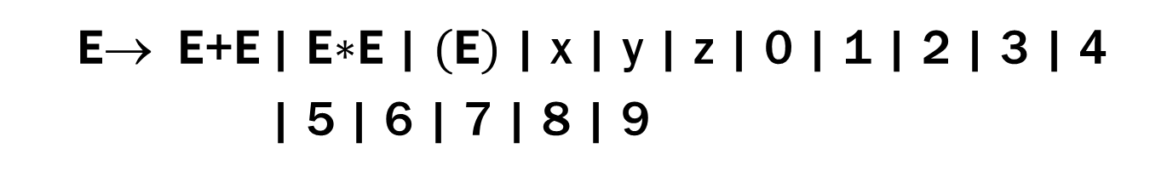
Simple Arithmetic Expressions
E→ E+E | E$∗$E | (E) | x | y | z | 0 | 1 | 2 | 3 | 4
| 5 | 6 | 7 | 8 | 9
Generate (2$∗$x) + y

Slide 10

Simple Arithmetic Expressions
E→ E+E | E$∗$E | (E) | x | y | z | 0 | 1 | 2 | 3 | 4
| 5 | 6 | 7 | 8 | 9
Generate (2$∗$x) + y
E ⇒ E+E ⇒ (E)+E ⇒ (E$∗$E)+E ⇒ (2$∗$E)+E ⇒ (2$∗$x)+E ⇒ (2$∗$x)+y

Slide 11
Parse Trees
Suppose that grammar G generates a string x
A parse tree of x for G has
Root labeled S (start symbol of G)
The children of any node labeled A are labeled by symbols of w left-to-right for some rule A → w
The symbols of x label the leaves ordered left-to-right
S
S → 0S0 | 1S1 | 0 | 1 | ε
0
S
0
1
S
1
Parse tree of 01110
1

Slide 12
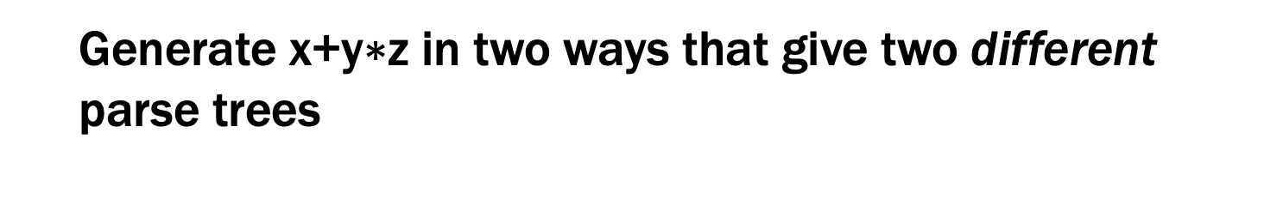
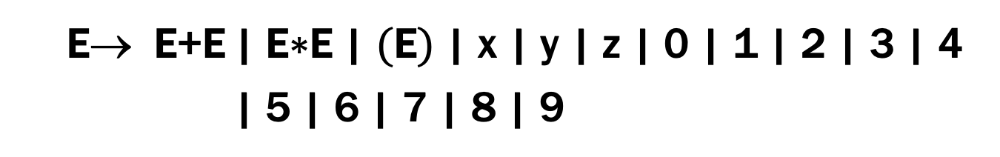
Simple Arithmetic Expressions
E→ E+E | E$∗$E | (E) | x | y | z | 0 | 1 | 2 | 3 | 4
| 5 | 6 | 7 | 8 | 9
Generate x+y$∗$z in two ways that give two different parse trees

Slide 13

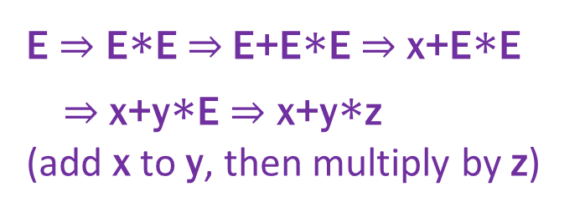
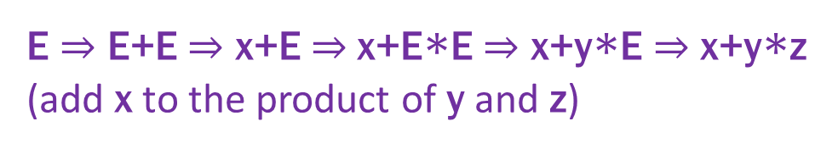
Simple Arithmetic Expressions
E→ E+E | E$∗$E | (E) | x | y | z | 0 | 1 | 2 | 3 | 4
| 5 | 6 | 7 | 8 | 9
Generate x+y$∗$z in ways that give two different parse trees
E
E ⇒ E+E ⇒ x+E ⇒ x+E$∗$E ⇒ x+y$∗$E ⇒ x+y$∗$z
(add x to the product of y and z)
E
+
E
E
x
E
E
E ⇒ E$∗$E ⇒ E+E$∗$E ⇒ x+E$∗$E
⇒ x+y$∗$E ⇒ x+y$∗$z
(add x to y, then multiply by z)
*
E
*
E
y
z
E
+
E
z
x
y

Slide 14
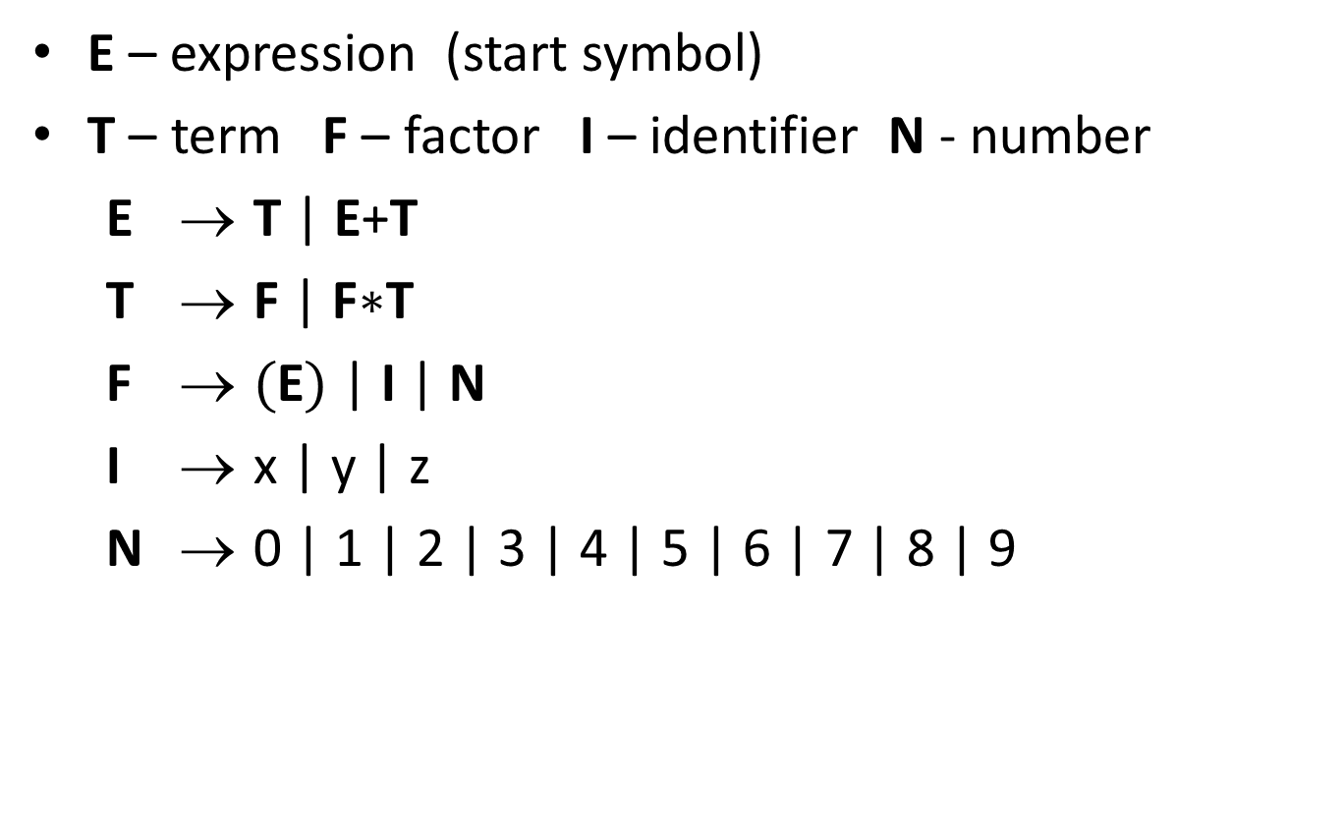
building precedence in simple arithmetic expressions
E – expression (start symbol)
T – term F – factor I – identifier N - number
E → T | E+T
T → F | F$∗$T
F → (E) | I | N
I → x | y | z
N → 0 | 1 | 2 | 3 | 4 | 5 | 6 | 7 | 8 | 9
E
E
+
T
x
F
*
T
y
z
Notes:
Children of T are only F or T, neither of which matches a “+”.

Slide 15
building precedence in simple arithmetic expressions
E – expression (start symbol)
T – term F – factor I – identifier N - number
E → T | E+T
T → F | F$∗$T
F → (E) | I | N
I → x | y | z
N → 0 | 1 | 2 | 3 | 4 | 5 | 6 | 7 | 8 | 9
No longer
allows:
E
T
F
*
T
?
z
Notes:
Children of T are only F or T, neither of which matches a “+”.

Slide 16
CFGs and recursively-defined sets of strings
A CFG with the start symbol S as its only variable recursively defines the set of strings of terminals that S can generate
A CFG with more than one variable is a simultaneous recursive definition of the sets of strings generated by each of its variables
sometimes necessary to use more than one

Slide 17
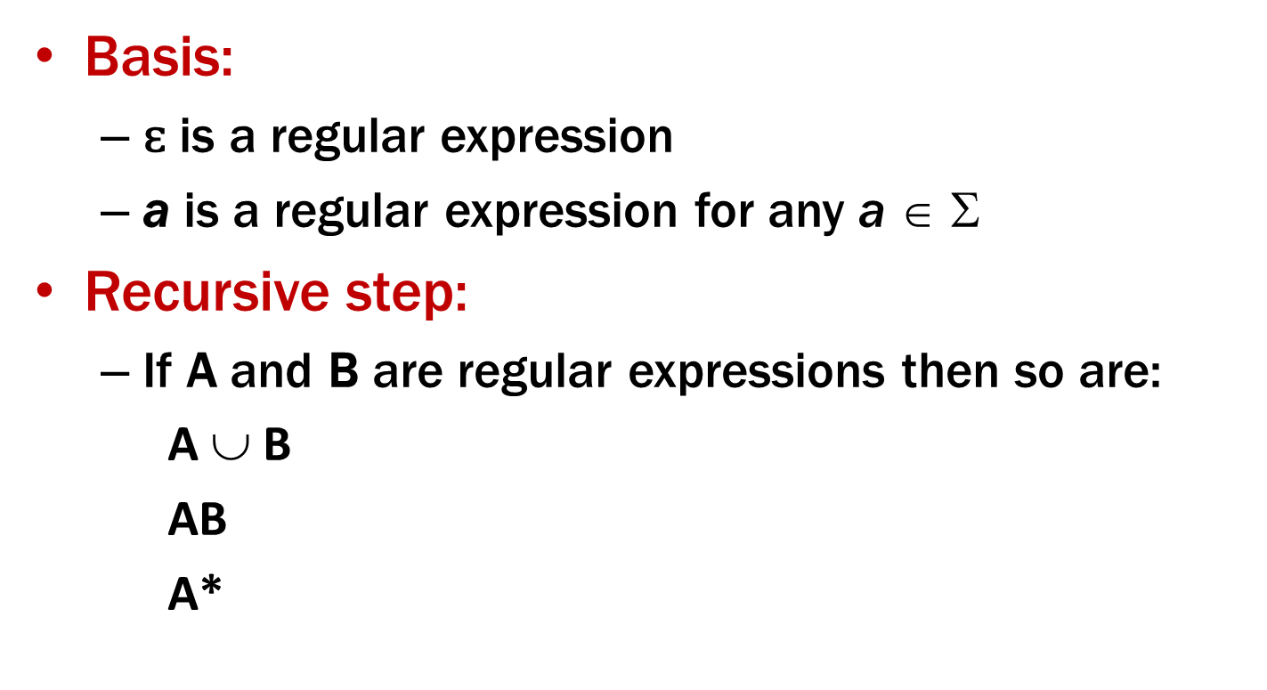
CFGs and regular expressions
Theorem: For all regular expressions A there is a CFG that generates precisely the strings A matches
Proof: Structural Induction

Slide 18
CFGs can do everything REs can
CFG to match RE ε
S → ε
CFG to match RE a (for any a ∈ Σ)
S → a

Slide 19
CFGs can do everything REs can
Suppose CFG with start symbol S_{A} matches RE A CFG with start symbol S_{B} matches RE B
(Then rename variables so no vars used in both)
CFG to match RE A ∪ B
Add S → S_{A} | S_{B}
+ rules from both CFGs
CFG to match RE AB
Add S → S_{A} S_{B}
+ rules from both CFGs

Slide 20
CFGs can do everything that REs can
CFG to match RE A*
Add S → S_{A} S | ε
+ rules from CFG with S_{A}

Slide 21
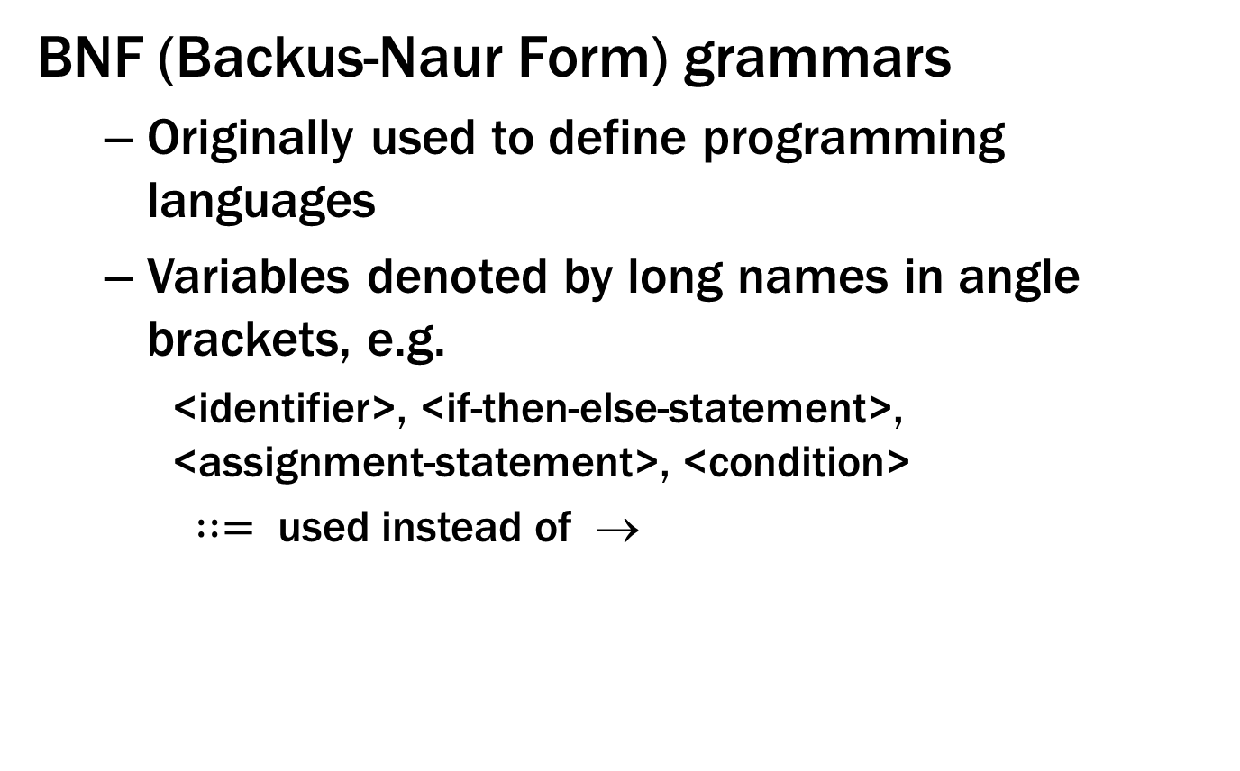
Backus-Naur Form (The same thing…)
BNF (Backus-Naur Form) grammars
Originally used to define programming languages
Variables denoted by long names in angle brackets, e.g.
<identifier>, <if-then-else-statement>, <assignment-statement>, <condition>
$∷=$ used instead of →

Slide 22
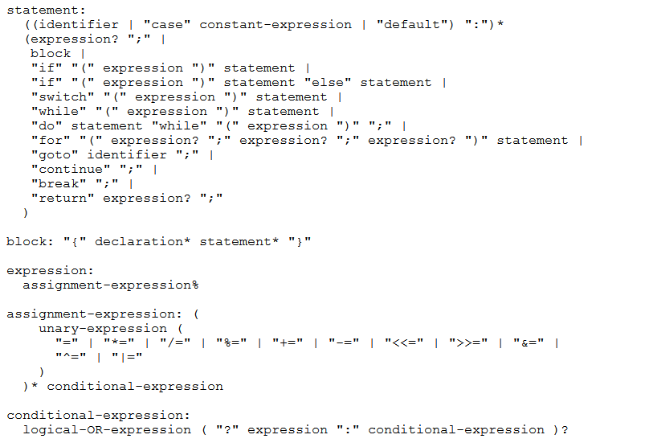
BNF for C

Slide 23
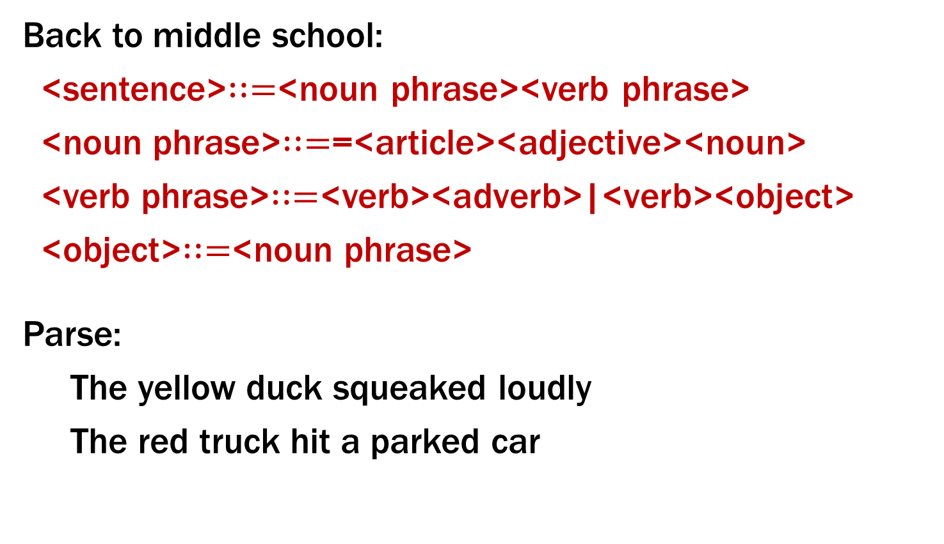
BNF for (Simple) English
Back to middle school:
<sentence>$∷=$<noun phrase><verb phrase>
<noun phrase>$∷=$=<article><adjective><noun>
<verb phrase>$∷=$<verb><adverb>|<verb><object>
<object>$∷=$<noun phrase>
Parse:
The yellow duck squeaked loudly
The red truck hit a parked car
Notes:
Issues about parse trees and meaning matter here also.

Slide 24
So far: Languages — REs and CFGs
Two new ways of defining languages
Regular Expressions (0 ∪ 1)* 0110 (0 ∪ 1)*
easy to understand (declarative)
Context-free Grammars S → SS | 0S1 | 1S0 | ε
more expressive
(a way of recursively-defining sets)
We will connect these to machines shortly.
But first, we need some new math terminology….

Slide 25

Relations and Directed Graphs

Slide 26
Relations
Let A and B be sets,
A binary relation from A to B is a subset of A × B
Let A be a set,
A binary relation on A is a subset of A × A

Slide 27
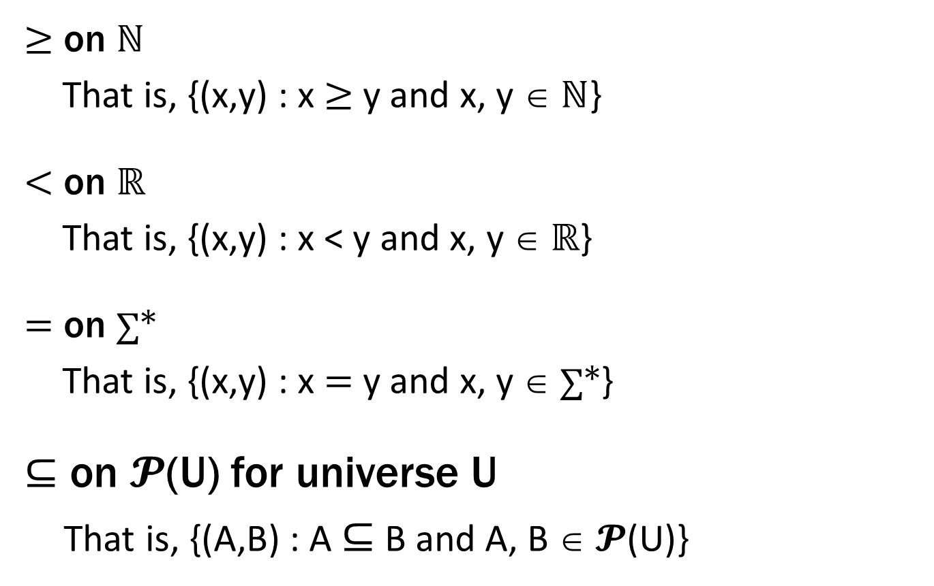
Relations You Already Know
≥ on ℕ
That is, {(x,y) : x ≥ y and x, y ∈ ℕ}
< on ℝ
That is, {(x,y) : x < y and x, y ∈ ℝ}
= on ∑*
That is, {(x,y) : x = y and x, y ∈ ∑*}
$⊆$ on 𝓟(U) for universe U
That is, {(A,B) : A $⊆$ B and A, B ∈ 𝓟(U)}
Notes:
Alternative notation. Name “relation” comes from examples like these

Slide 28
More Relation Examples
R₁ = {(a, 1), (a, 2), (b, 1), (b, 3), (c, 3)}
R₂ = {(x, y) : x ≡ y (mod 5) }
R₃ = {(c₁, c₂) : c₁ is a prerequisite of c₂ }
R₄ = {(s, c) : student s has taken course c }

Slide 29
Properties of Relations
Let R be a relation on A.
R is reflexive iff (a,a) ∈ R for every a ∈ A
R is symmetric iff (a,b) ∈ R implies (b,a) ∈ R
R is antisymmetric iff (a,b) ∈ R and a ≠ b implies (b,a) $∉$ R
R is transitive iff (a,b)∈ R and (b,c)∈ R implies (a,c) ∈ R

Slide 30

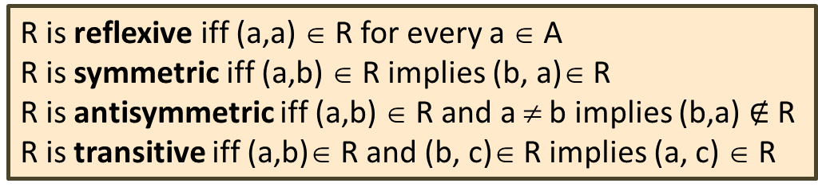
Which relations have which properties?
≥ on ℕ :
< on ℝ :
= on ∑* :
$⊆$ on 𝓟(U):
R₂ = {(x, y) : x ≡ y (mod 5)}:
R₃ = {(c₁, c₂) : c₁ is a prerequisite of c₂ }:
R is reflexive iff (a,a) ∈ R for every a ∈ A
R is symmetric iff (a,b) ∈ R implies (b, a)∈ R
R is antisymmetric iff (a,b) ∈ R and a ≠ b implies (b,a) $∉$ R
R is transitive iff (a,b)∈ R and (b, c)∈ R implies (a, c) ∈ R

Slide 31
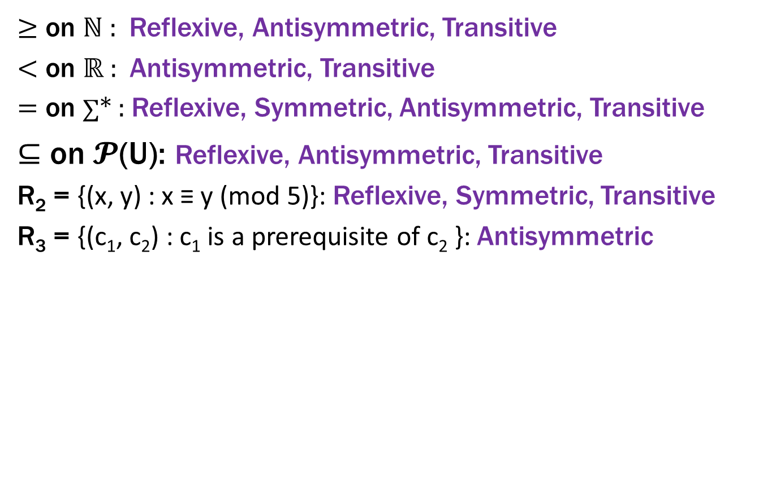
Which relations have which properties?
≥ on ℕ : Reflexive, Antisymmetric, Transitive
< on ℝ : Antisymmetric, Transitive
= on ∑* : Reflexive, Symmetric, Antisymmetric, Transitive
$⊆$ on 𝓟(U): Reflexive, Antisymmetric, Transitive
R₂ = {(x, y) : x ≡ y (mod 5)}: Reflexive, Symmetric, Transitive
R₃ = {(c₁, c₂) : c₁ is a prerequisite of c₂ }: Antisymmetric
R is reflexive iff (a,a) ∈ R for every a ∈ A
R is symmetric iff (a,b) ∈ R implies (b, a)∈ R
R is antisymmetric iff (a,b) ∈ R and a ≠ b implies (b,a) $∉$ R
R is transitive iff (a,b)∈ R and (b, c)∈ R implies (a, c) ∈ R

Slide 32
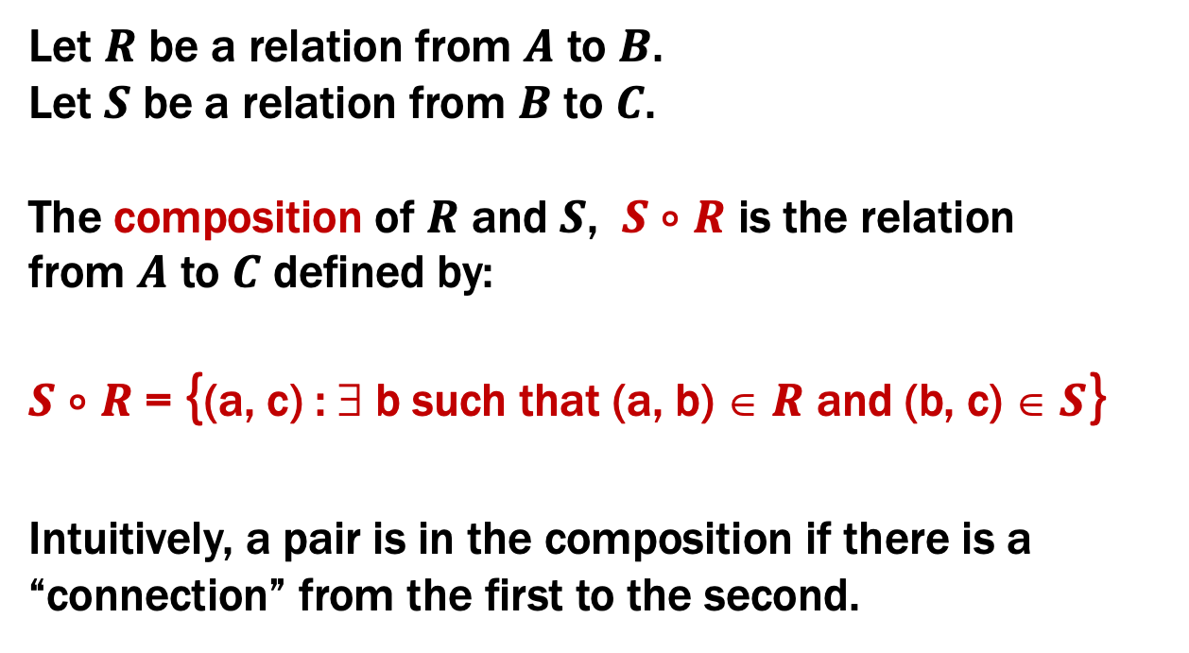
Combining Relations
Let $R$ be a relation from $A$ to $B$.
Let $S$ be a relation from $B$ to $C$.
The composition of $R$ and $S$, $S$ $∘$ $R$ is the relation
from $A$ to $C$ defined by:
$S$ $∘$ $R$ = {(a, c) : ∃ b such that (a, b) ∈ $R$ and (b, c) ∈ $S$}
Intuitively, a pair is in the composition if there is a “connection” from the first to the second.

Slide 33
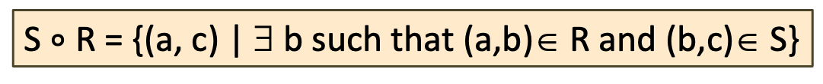
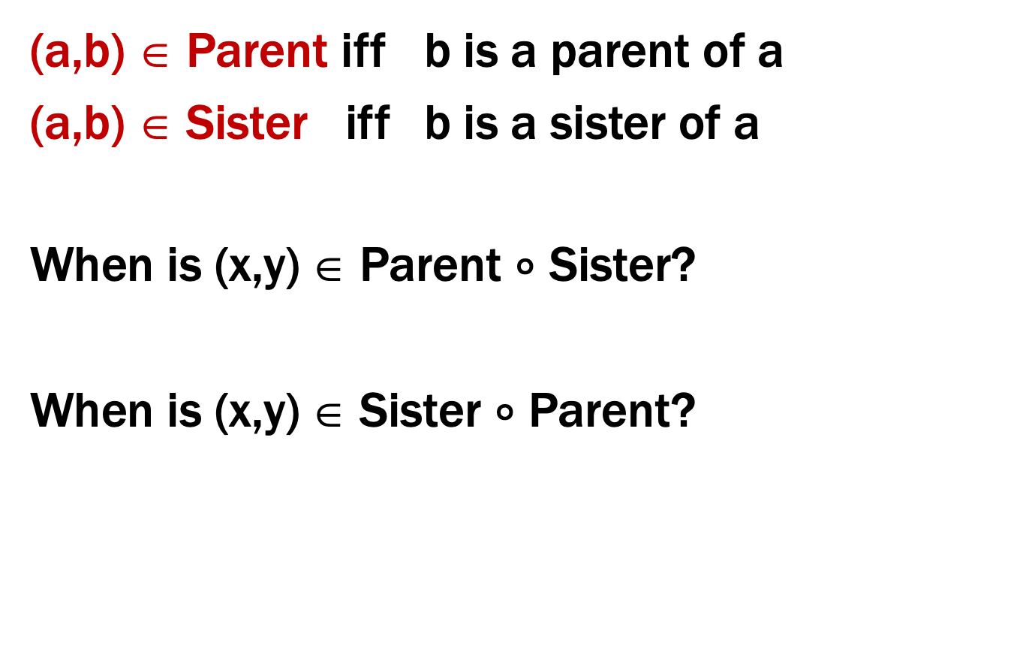
Examples
(a,b) ∈ Parent iff b is a parent of a
(a,b) ∈ Sister iff b is a sister of a
When is (x,y) ∈ Parent $∘$ Sister?
When is (x,y) ∈ Sister $∘$ Parent?
S $∘$ R = {(a, c) | ∃ b such that (a,b)∈ R and (b,c)∈ S}
Notes:
1. Aunt
2. Is it Parent? No, Parent cap HasSister

Slide 34
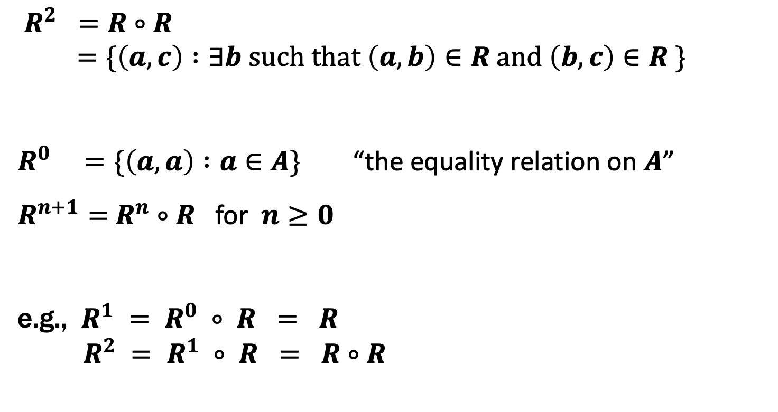
Powers of a Relation
$R^{2} =R∘R$
$=\{\left(a,c\right) :∃b such that \left(a,b\right)∈R and \left(b,c\right)∈R \}$
$R^{0} =\{\left(a,a\right) :a∈A\}$ “the equality relation on $A$”
$R^{n+1}=$ $R^{n}$ $∘$ $R$ for $n≥0$
e.g., $R^{1} = R^{0} ∘ R = R$
$R^{2} = R^{1} ∘ R = R∘R$

Slide 35
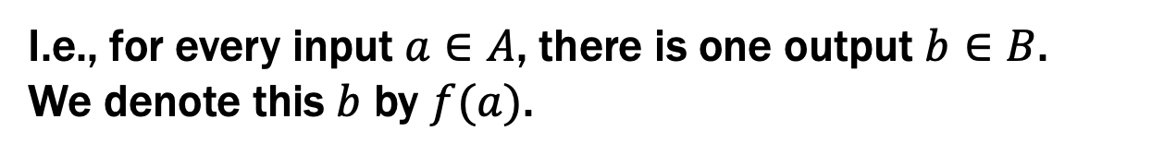
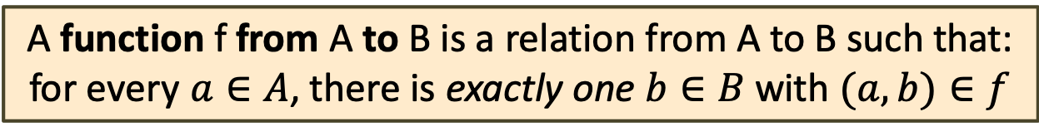
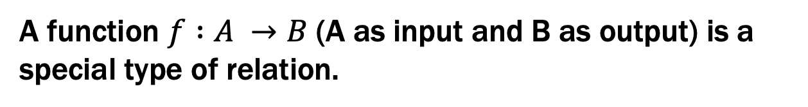
Functions
A function $f :A →B$ (A as input and B as output) is a special type of relation.
A function f from A to B is a relation from A to B such that:
for every $a∈A$, there is exactly one $b∈B$ with $(a,b)∈f$
I.e., for every input $a∈A$, there is one output $b∈B$.
We denote this $b$ by $f(a)$.
(When attempting to define a function this way, we sometimes say the function is “well defined” if the exactly one part holds)

Slide 36
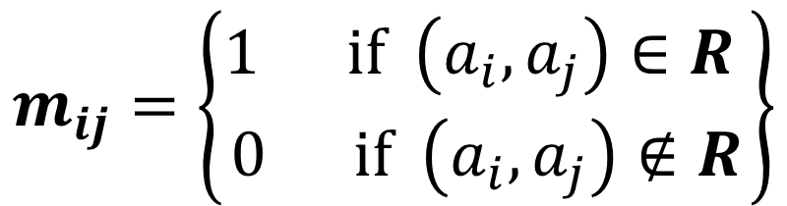
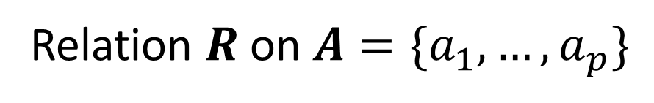
Matrix Representation
Relation $R$ on $A=\{a_{1},…, a_{p}\}$
$$m_{ij}=\left\{\begin{matrix}1 if \left(a_{i},a_{j}\right)∈R \\ 0 if \left(a_{i},a_{j}\right)∉R\end{matrix}\right\}$$
{ (1, 1), (1, 2), (1, 4), (2, 1), (2, 3), (3, 2), (3, 3), (4, 2), (4, 3) }
 | 1 | 2 | 3 | 4
1 | 1 | 1 | 0 | 1
2 | 1 | 0 | 1 | 0
3 | 0 | 1 | 1 | 0
4 | 0 | 1 | 1 | 0

Slide 37
Properties using matrix representation
1
1
reflexive
1
1
1
1
1
1
1
1
1
Same when rows & columns swapped
symmetric
1
0
0
0
0
No 1-1 pairs
0
1
1
anti-symmetric
0

