Slide 1
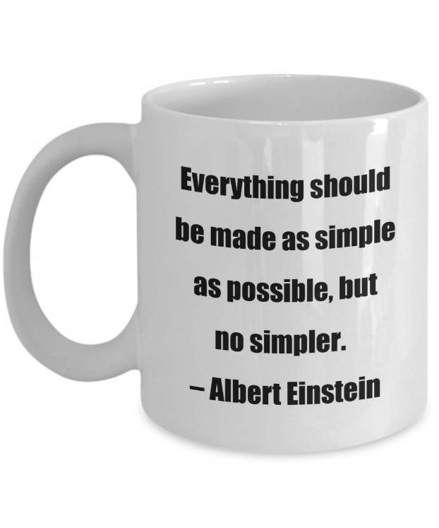
CSE 311: Foundations of Computing
Lecture 23: FSMs with Output, Minimization

Slide 2


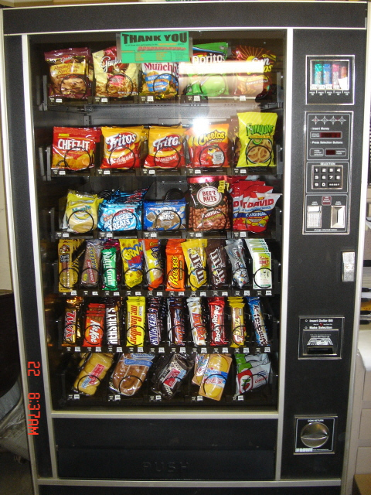
Vending Machine
Enter 15 cents in dimes or nickels
Press S or B for a candy bar

Slide 3
Vending Machine, v0.1
D
D
0
N
5
N
10
N, D
15
B, S
Basic transitions on N (nickel), D (dime), B (butterfinger), S (snickers)

Slide 4
Vending Machine, v0.2
0
D
N
15
D
D
B
0’ [B]
5
10
N
S
N
N
D
15’ [N]
B
S
N
0” [S]
D
Adding output to states: N – Nickel, S – Snickers, B – Butterfinger

Slide 5
Vending Machine, v1.0
B,S
0
D
N
15
B,S
D
B,S
B
D
B,S
D
N
S
N
0’ [B]
N
5
10
N
D
15’ [N]
B
N
S
D
B,S
N
N
0” [S]
D
B
15” [D]
S
D
Adding additional “unexpected” transitions to cover all symbols for each state

Slide 6
State Minimization
Many different FSMs (DFAs) for the same problem
Take a given FSM and try to reduce its state set by combining states
Algorithm will always produce the unique minimal equivalent machine (up to renaming of states) but we won’t prove this
Notes:
When running into problems building the machine, we usually solve it by add more states. What if we add too many?

Slide 7
State Minimization Algorithm
Put states into groups
Try to find groups that can be collapsed into one state
states can keep track of information that isn’t necessary to determine whether to accept or reject
Group states together until we can prove that collapsing them can change the accept/reject result
find a specific string x such that:
starting from state A, following edges according to x ends in accept
starting from state B, following edges according to x ends in reject
(algorithm below could be modified to show these strings)
Notes:
Idea: Groups of states that could be collapsed. Wait until we have proof that we need to keep track of which we are in.

Slide 8
State Minimization Algorithm
Put states into groups based on their outputs (whether they accept or reject)
Notes:
Idea: Groups of states that could be collapsed. Wait until we have proof that we need to keep track of which we are in.

Slide 9
State Minimization Algorithm
Put states into groups based on their outputs (whether they accept or reject)
Repeat the following until no change happens
If there is a symbol a so that not all states in a group G agree on which group a leads to, split G into smaller groups based on which group the states go to on a
Finally, convert groups to states
a
a
a
G₂
G₁₀
G₂
a
G₁
a
a
a
G₃
G₁₁
G₃
a
Notes:
Idea: Groups of states that could be collapsed. Wait until we have proof that we need to keep track of which we are in.

Slide 10
State Minimization Example
present next state output state 0 1 2 3 S0 S0 S1 S2 S3 1 S1 S0 S3 S1 S5 0 S2 S1 S3 S2 S4 1 S3 S1 S0 S4 S5 0 S4 S0 S1 S2 S5 1 S5 S1 S4 S0 S5 0
0
2
S0
0
S1
1
2
3
3
0
1
0
1
S2
S3
state transition table
1
2
3
2
3
Put states into groups based on their
outputs (or whether they accept or reject)
1
2
2
S4
3
S5
0
0
1
3

Slide 11
State Minimization Example
present next state output state 0 1 2 3 S0 S0 S1 S2 S3 1 S1 S0 S3 S1 S5 0 S2 S1 S3 S2 S4 1 S3 S1 S0 S4 S5 0 S4 S0 S1 S2 S5 1 S5 S1 S4 S0 S5 0
0
2
S0
0
S1
1
2
3
3
0
1
0
1
state transition table
S2
S3
1
2
Put states into groups based on their
outputs (or whether they accept or reject)
2
3
3
1
2
2
S4
3
S5
0
0
1
3

Slide 12
State Minimization Example
present next state output state 0 1 2 3 S0 S0 S1 S2 S3 1 S1 S0 S3 S1 S5 0 S2 S1 S3 S2 S4 1 S3 S1 S0 S4 S5 0 S4 S0 S1 S2 S5 1 S5 S1 S4 S0 S5 0
0
2
S0
0
S1
1
2
3
3
0
1
0
1
state transition table
S2
S3
1
2
Put states into groups based on their
outputs (or whether they accept or reject)
2
3
3
1
2
2
S4
3
S5
0
If there is a symbol a so that not all states in
a group G agree on which group a leads to,
split G based on which group the states go
to on a
0
1
3

Slide 13
State Minimization Example
present next state output state 0 1 2 3 S0 S0 S1 S2 S3 1 S1 S0 S3 S1 S5 0 S2 S1 S3 S2 S4 1 S3 S1 S0 S4 S5 0 S4 S0 S1 S2 S5 1 S5 S1 S4 S0 S5 0
0
2
S0
0
S1
1
2
3
3
0
1
0
1
state transition table
S2
S3
1
2
Put states into groups based on their
outputs (or whether they accept or reject)
2
3
3
1
2
2
S4
3
S5
0
If there is a symbol a so that not all states in
a group G agree on which group a leads to,
split G based on which group the states go
to on a
0
1
3

Slide 14
State Minimization Example
present next state output state 0 1 2 3 S0 S0 S1 S2 S3 1 S1 S0 S3 S1 S5 0 S2 S1 S3 S2 S4 1 S3 S1 S0 S4 S5 0 S4 S0 S1 S2 S5 1 S5 S1 S4 S0 S5 0
0
2
S0
0
S1
1
2
3
3
0
1
0
1
state transition table
S2
S3
1
2
Put states into groups based on their
outputs (or whether they accept or reject)
2
3
3
1
2
2
S4
3
S5
0
If there is a symbol a so that not all states in
a group G agree on which group a leads to,
split G based on which group the states go
to on a
0
1
3

Slide 15
State Minimization Example
present next state output state 0 1 2 3 S0 S0 S1 S2 S3 1 S1 S0 S3 S1 S5 0 S2 S1 S3 S2 S4 1 S3 S1 S0 S4 S5 0 S4 S0 S1 S2 S5 1 S5 S1 S4 S0 S5 0
0
2
S0
0
S1
1
2
3
3
0
1
0
1
state transition table
S2
S3
1
2
Put states into groups based on their
outputs (or whether they accept or reject)
2
3
3
1
2
2
S4
3
S5
0
If there is a symbol a so that not all states in
a group G agree on which group a leads to,
split G based on which group the states go
to on a
0
1
3

Slide 16
State Minimization Example
present next state output state 0 1 2 3 S0 S0 S1 S2 S3 1 S1 S0 S3 S1 S5 0 S2 S1 S3 S2 S4 1 S3 S1 S0 S4 S5 0 S4 S0 S1 S2 S5 1 S5 S1 S4 S0 S5 0
0
2
S0
0
S1
1
2
3
3
0
1
0
1
state transition table
S2
S3
1
2
Put states into groups based on their
outputs (or whether they accept or reject)
2
3
3
1
2
2
S4
3
S5
0
If there is a symbol a so that not all states in
a group G agree on which group a leads to,
split G based on which group the states go
to on a
0
1
3

Slide 17
State Minimization Example
present next state output state 0 1 2 3 S0 S0 S1 S2 S3 1 S1 S0 S3 S1 S5 0 S2 S1 S3 S2 S4 1 S3 S1 S0 S4 S5 0 S4 S0 S1 S2 S5 1 S5 S1 S4 S0 S5 0
0
2
S0
0
S1
1
2
3
3
0
1
0
1
state transition table
S2
S3
1
2
3
2
3
1
Finally convert groups to states:
Can combine states S0-S4 and
S3-S5.
In table replace all S4 with S0
and all S5 with S3
2
2
S4
3
S5
0
0
1
3

Slide 18
Minimized Machine
present next state output state 0 1 2 3 S0 S0 S1 S2 S3 1 S1 S0 S3 S1 S3 0 S2 S1 S3 S2 S0 1 S3 S1 S0 S0 S3 0
0
2
S0
0
S1
1
2
3
0
1,3
3
1,2
state transition table
0
S2
S3
1
2
3

Slide 19
A Simpler Minimization Example
1
s₀
s₁
1
0
0
0
0
1
s₂
s₃
1
The set of all binary strings with # of 1’s ≣ # of 0’s (mod 2).
Notes:
Machine keeps track of whether #1s is odd and whether #0s is odd. (Product construction)

Slide 20
A Simpler Minimization Example
1
Split states into accept/reject groups
s₀
s₁
1
0
0
0
0
Every symbol causes the DFA to go from one group to the other so neither group needs to be split
1
s₂
s₃
1

Slide 21
Minimized DFA
0,1
s₀s₃
s₁s₂
0,1
The set of all binary strings with # of 1’s ≣ # of 0’s (mod 2).
= The set of all binary strings with even length.

Slide 22
Nondeterministic Finite Automata (NFA)
Graph with start state, final states, edges labeled by symbols (like DFA) but
Not required to have exactly 1 edge out of each state labeled by each symbol--- can have 0 or >1
Also can have edges labeled by empty string ε
Definition: x is in the language recognized by an NFA if and only if some valid execution of the machine gets to an accept state
s₀
1
s₁
1
s₂
1
s₃
0,1
0,1

Slide 23
Consider This NFA
0,1
1
1
s₁
s₂
s₃
1
s₀
0
1
s₅
s₄
1
What language does this NFA accept?

Slide 24
Consider This NFA
0,1
1
1
s₁
s₂
s₃
1
s₀
0
1
s₅
s₄
1
What language does this NFA accept?
10(10)* ⋃ 111 (0 ⋃ 1)*

Slide 25
NFA ε-moves
2
0,1
0,1
s₀
s₁
ε
2
q
0
t₁
1
1
0
ε
2
2
0
t₀
2
t₂
1

Slide 26
NFA ε-moves
Strings over {0,1,2} w/even # of 2’s OR sum to 0 mod 3
2
0,1
0,1
s₀
s₁
ε
2
q
0
t₁
1
1
0
ε
2
2
0
t₀
2
t₂
1

Slide 27
NFA for set of binary strings with a 1 in the 3rd position from the end

Slide 28
NFA for set of binary strings with a 1 in the 3rd position from the end
0,1
1
0,1
0,1
s₃
s₂
s₁
s₀

Slide 29
Compare with the smallest DFA
0,1
1
0,1
0,1
s₃
s₂
s₁
s₀
001
1
011
1
0
1
1
1
0
000
1
010
101
0
111
1
0
0
1
0
0
100
0
110

Slide 30
Summary of NFAs
Generalization of DFAs
drop two restrictions of DFAs
every DFA is an NFA
Seem to be more powerful
designing is easier than with DFAs
Seem related to regular expressions

