Slide 1
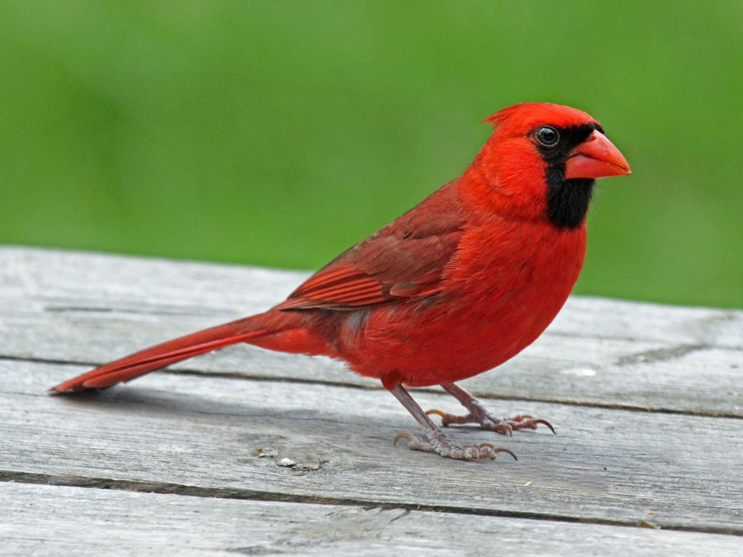
CSE 311: Foundations of Computing
Lecture 26: Cardinality, Uncomputability

Slide 2
Last time: Showing that L is not regular
“Suppose for contradiction that some DFA M recognizes L.”
Consider an INFINITE set S of prefixes (which we intend to complete later). It is imperative that for every pair of strings in our set there is an “accept” completion that the two strings DO NOT SHARE.
“Since S is infinite and M has finitely many states, there must be two strings s_{a} and s_{b} in S for s_{a} ≠ s_{b} that end up at the same state of M.”
Consider appending the (hard) completion t to each of the two strings.
“Since s_{a} and s_{b} both end up at the same state of M, and we appended the same string t, both s_{a}t and s_{b}t end at the same state q of M. Since s_{a}t ∈ L and s_{b}t ∉ L, M does not recognize L.”
“Thus, no DFA recognizes L.”
(You need to come up with S.)
(You need to come up with a hard t for s_{a}, s_{b})

Slide 3
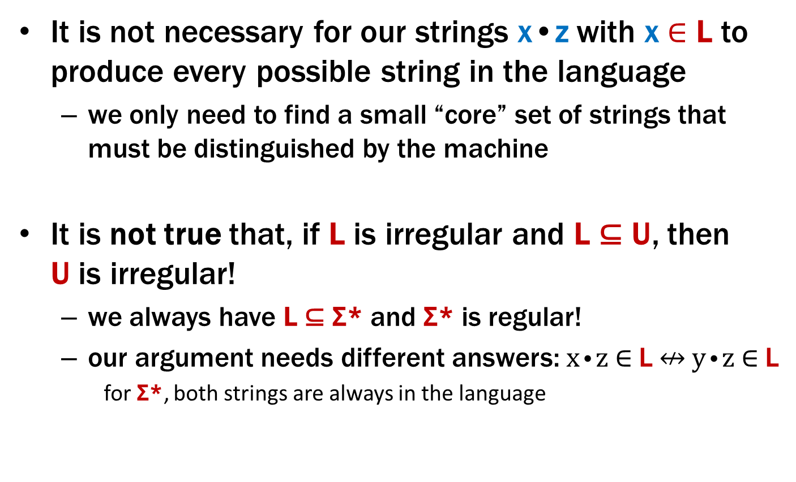
Important Notes
It is not necessary for our strings x•z with x ∈ L to produce every possible string in the language
we only need to find a small “core” set of strings that must be distinguished by the machine
It is not true that, if L is irregular and L ⊆ U, then U is irregular!
we always have L ⊆ Σ* and Σ* is regular!
our argument needs different answers: x•z ∈ L $↮$ y•z ∈ L
for Σ*, both strings are always in the language
Do not claim in your proof that, because L ⊆ U, U is also irregular

Slide 4
Last time: Languages and Representations
All
?
Context-Free
e.g. palindromes, balanced parens, {0^{n}1^{n}:n≥0}
Regular
DFA
NFA
Regex
0*
Finite
{001, 10, 12}

Slide 5
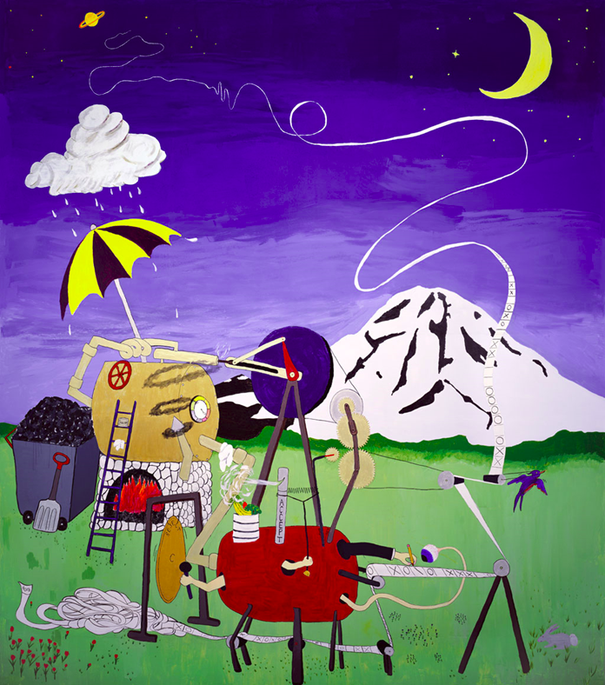
General Computation

Slide 6
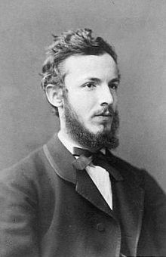
Computers from Thought
Computers as we know them grew out of a desire to avoid bugs in mathematical reasoning.
Hilbert in a famous speech at the International Congress of Mathematicians in 1900 set out the goal to mechanize all of mathematics.
In the 1930s, work of Gödel and Turing showed that Hilbert’s program is impossible.
Gödel’s Incompleteness Theorem
Undecidability of the Halting Problem
Both of these employ an idea we will see called diagonalization.
The ideas are simple but so revolutionary that their inventor Georg Cantor
was initially shunned by the mathematical leaders of the time:
Poincaré referred to them as a “grave disease infecting mathematics.”
Kronecker fought to keep Cantor’s papers out of his journals.
Full employment for mathematicians and computer scientists!!
Notes:
Corollary: full employment for mathematicians and programmers!

Slide 7










Cardinality
What does it mean that two sets have the same size?

Slide 8

Cardinality
What does it mean that two sets have the same size?

Slide 9

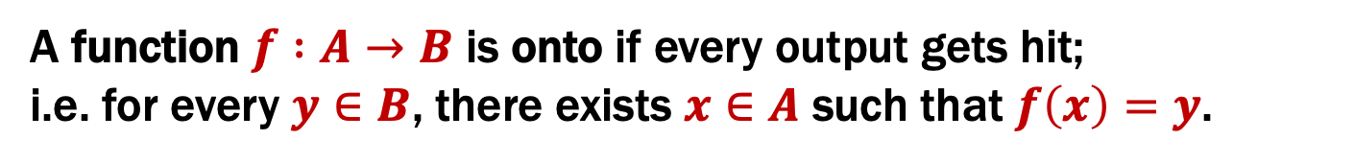
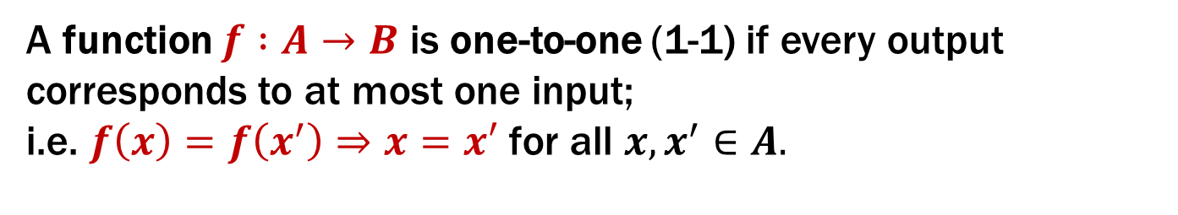

1-1 and onto
A function $f :A→B$ is one-to-one (1-1) if every output corresponds to at most one input; i.e. $f\left(x\right)=f\left(x^{′}\right)⇒x=x′$ for all $x,x^{′}∈A.$
A function $f :A→B$ is onto if every output gets hit; i.e. for every $y∈B$, there exists $x∈A$ such that $f\left(x\right)=y$.
a
1
1-1 but not onto
b
2
c
3
d
4
e
5
$$A$$
6
$$B$$
Notes:
Note the type syntax “A -> B” is new.

Slide 10

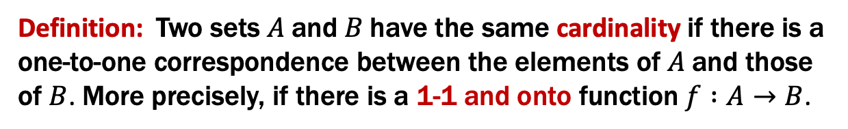

Cardinality
Definition: Two sets $A$ and $B$ have the same cardinality if there is a one-to-one correspondence between the elements of $A$ and those of $B$. More precisely, if there is a 1-1 and onto function $f :A→B$.
a
1
b
2
c
3
1-1 proves ≤
onto proves ≥
d
4
e
5
f
6
$$A$$
$$B$$
The definition also makes sense for infinite sets!

Slide 11


Cardinality
Do the natural numbers and the even natural numbers have the same cardinality?
Yes!
0 1 2 3 4 5 6 7 8 9 10 11 12 13 14 ...
0 2 4 6 8 10 12 14 16 18 20 22 24 26 28 ...
What’s the map $f :ℕ→2ℕ$ ?
$$f\left(n\right)=2n$$

Slide 12
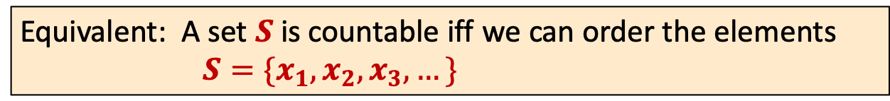
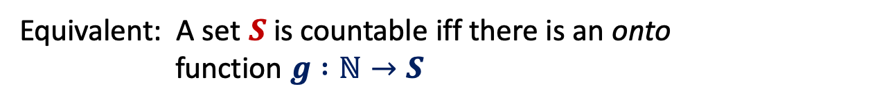
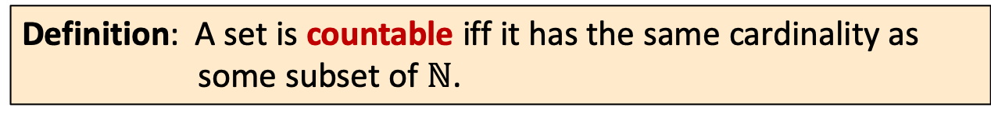
Countable sets
Definition: A set is countable iff it has the same cardinality as some subset of $ℕ$.
Equivalent: A set $S$ is countable iff there is an onto function $g :ℕ→S$
Equivalent: A set $S$ is countable iff we can order the elements
$S=\{x_{1},x_{2},x_{3},…\}$
Notes:
0. Says there is a one-to-one map from S to N.
1. Make g one-to-one by choosing one n in N from each group mapping to s in S.
2. Indexes in final form show the correspondence with natural numbers: i -> x_i [Note there can be repeats!]
Having 3 definitions lets us pick whichever is easiest for the task at hand.

Slide 13

The set $ℤ$ of all integers

Slide 14
The set $ℤ$ of all integers
0 1 2 3 4 5 6 7 8 9 10 11 12 13 14 ...
0 1 -1 2 -2 3 -3 4 -4 5 -5 6 -6 7 -7 ...

Slide 15

The set $ℚ$ of rational numbers
We can’t do the same thing we did for the integers.
Between any two rational numbers there are an infinite number of others.

Slide 16
The set of positive rational numbers
1/1 | 1/2 | 1/3 | 1/4 | 1/5 | 1/6 | 1/7 | 1/8 | ...
2/1 | 2/2 | 2/3 | 2/4 | 2/5 | 2/6 | 2/7 | 2/8 | ...
3/1 | 3/2 | 3/3 | 3/4 | 3/5 | 3/6 | 3/7 | 3/8 | ...
4/1 | 4/2 | 4/3 | 4/4 | 4/5 | 4/6 | 4/7 | 4/8 | ...
5/1 | 5/2 | 5/3 | 5/4 | 5/5 | 5/6 | 5/7 | ...
6/1 | 6/2 | 6/3 | 6/4 | 6/5 | 6/6 | ...
7/1 | 7/2 | 7/3 | 7/4 | 7/5 | ....
... | ... | ... | ... | ...
Notes:
Recall: repeats are okay

Slide 17
The set of positive rational numbers
1/1 | 1/2 | 1/3 | 1/4 | 1/5 | 1/6 | 1/7 | 1/8 | ...
2/1 | 2/2 | 2/3 | 2/4 | 2/5 | 2/6 | 2/7 | 2/8 | ...
3/1 | 3/2 | 3/3 | 3/4 | 3/5 | 3/6 | 3/7 | 3/8 | ...
4/1 | 4/2 | 4/3 | 4/4 | 4/5 | 4/6 | 4/7 | 4/8 | ...
5/1 | 5/2 | 5/3 | 5/4 | 5/5 | 5/6 | 5/7 | ...
6/1 | 6/2 | 6/3 | 6/4 | 6/5 | 6/6 | ...
7/1 | 7/2 | 7/3 | 7/4 | 7/5 | ....
... | ... | ... | ... | ...

Slide 18
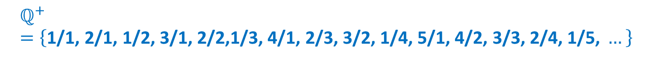

The set of positive rational numbers
The set of all positive rational numbers is countable.
$$ℚ^{+}=\left\{\text{1/1, 2/1,} \text{1/2, 3/1,} \text{2/2,1/3, 4/1,} \text{2/3,} \text{3/2,} \text{1/4, 5/1,} \text{4/2,} \text{3/3,} \text{2/4,} \text{1/5, }…\right\}$$
List elements in order of numerator+denominator, breaking ties according to denominator.
Only $k$ numbers have total of sum of $k+1$, so every positive rational number comes up some point.
The technique is called “dovetailing.”
More generally:
Put all elements into finite groups
Order the groups
List elements in order by group (arbitrary order within each group)

Slide 19
The set $ℚ$ of rational numbers

Slide 20
Claim: $Σ^{∗}$ is countable for every finite $Σ$
Dictionary/Alphabetical/Lexicographical order is bad
Never get past the A’s
A, AA, AAA, AAAA, AAAAA, AAAAAA, ....

Slide 21
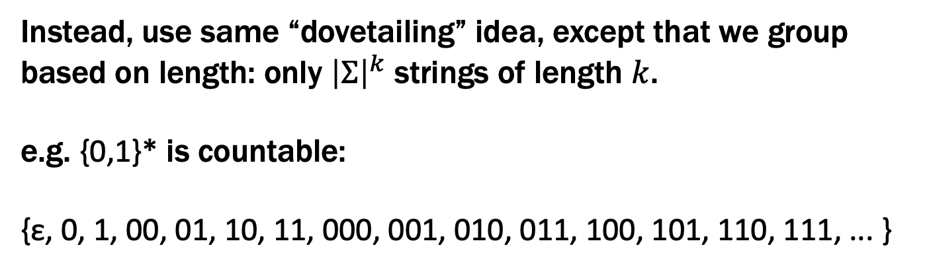
Claim: $Σ^{∗}$ is countable for every finite $Σ$
Dictionary/Alphabetical/Lexicographical order is bad
Never get past the A’s
A, AA, AAA, AAAA, AAAAA, AAAAAA, ....
Instead, use same “dovetailing” idea, except that we group based on length: only ${\left|Σ\right|}^{k}$ strings of length $k$.
e.g. {0,1}* is countable:
{ε, 0, 1, 00, 01, 10, 11, 000, 001, 010, 011, 100, 101, 110, 111, ... }

Slide 22
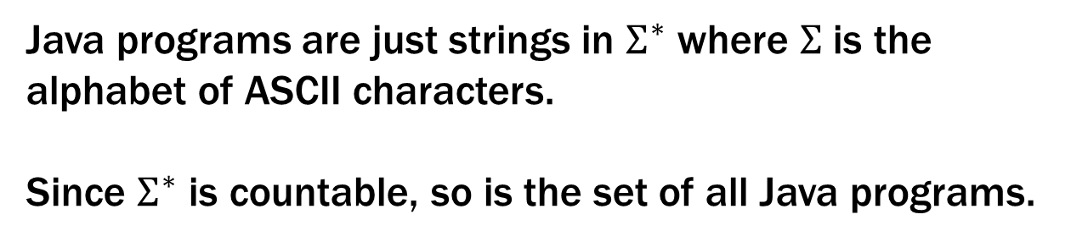
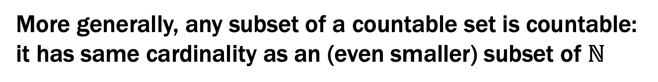
The set of all Java programs is countable
Java programs are just strings in $Σ^{∗}$ where $Σ$ is the alphabet of ASCII characters.
Since $Σ^{∗}$ is countable, so is the set of all Java programs.
More generally, any subset of a countable set is countable:
it has same cardinality as an (even smaller) subset of $ℕ$
Notes:
Last point: the larger set has 1-1 correspondence with a subset of N, so this set has a 1-1 correspondence with an (even smaller) subset of N.

Slide 23
OK OK... Is Everything Countable ?!!

Slide 24
Are the real numbers countable?
Theorem [Cantor]:
The set of real numbers between 0 and 1 is not countable.
Proof will be by contradiction.
Uses a new method called diagonalization.

Slide 25
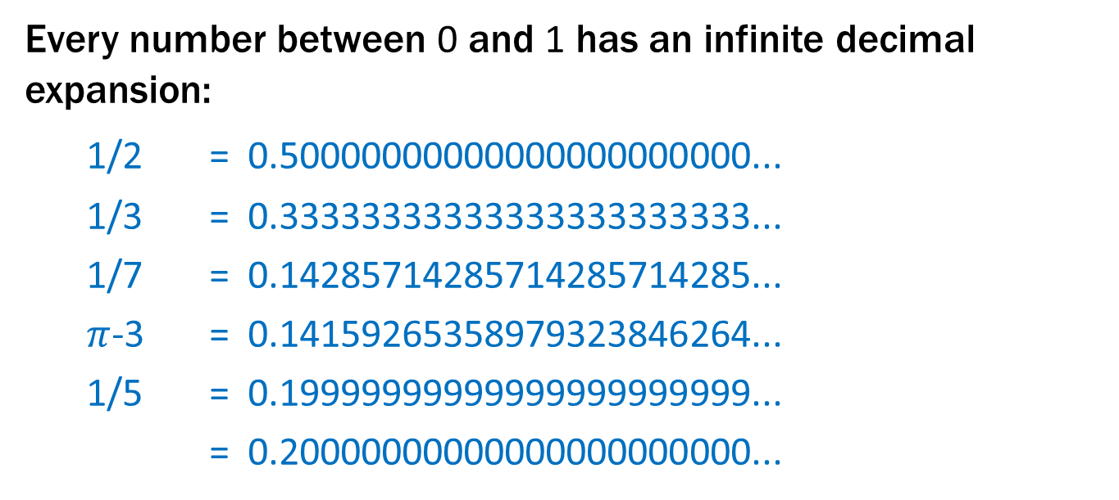

Real numbers between $0$ and $1$: $[0,1)$
Every number between 0 and 1 has an infinite decimal expansion:
1/2 = 0.50000000000000000000000...
1/3 = 0.33333333333333333333333...
1/7 = 0.14285714285714285714285...
$π$-3 = 0.14159265358979323846264...
1/5 = 0.19999999999999999999999...
= 0.20000000000000000000000...
Representation is unique except for the cases that the decimal expansion ends in all 0’s or all 9’s. We will never use the all 9’s representation.

Slide 26

Proof that $[0,1)$ is not countable
Suppose, for a contradiction, that there is a list of them:
r₁ 0.50000000… r₂ 0.33333333… r₃ 0.14285714… r₄ 0.14159265… r₅ 0.12122122… r₆ 0.25000000… r₇ 0.71828182… r₈ 0.61803394… ... ...

Slide 27
Proof that $[0,1)$ is not countable
Suppose, for a contradiction, that there is a list of them:
 |  | 1 | 2 | 3 | 4 | 5 | 6 | 7 | 8 | 9 | ...
r₁ | 0. | 5 | 0 | 0 | 0 | 0 | 0 | 0 | 0 | ... | ...
r₂ | 0. | 3 | 3 | 3 | 3 | 3 | 3 | 3 | 3 | ... | ...
r₃ | 0. | 1 | 4 | 2 | 8 | 5 | 7 | 1 | 4 | ... | ...
r₄ | 0. | 1 | 4 | 1 | 5 | 9 | 2 | 6 | 5 | ... | ...
r₅ | 0. | 1 | 2 | 1 | 2 | 2 | 1 | 2 | 2 | ... | ...
r₆ | 0. | 2 | 5 | 0 | 0 | 0 | 0 | 0 | 0 | ... | ...
r₇ | 0. | 7 | 1 | 8 | 2 | 8 | 1 | 8 | 2 | ... | ...
r₈ | 0. | 6 | 1 | 8 | 0 | 3 | 3 | 9 | 4 | ... | ...
... | .... | ... | .... | .... | ... | ... | ... | ... | ... | ...

Slide 28
Proof that $[0,1)$ is not countable
Suppose, for a contradiction, that there is a list of them:
 |  | 1 | 2 | 3 | 4 | 5 | 6 | 7 | 8 | 9 | ...
r₁ | 0. | 5 | 0 | 0 | 0 | 0 | 0 | 0 | 0 | ... | ...
r₂ | 0. | 3 | 3 | 3 | 3 | 3 | 3 | 3 | 3 | ... | ...
r₃ | 0. | 1 | 4 | 2 | 8 | 5 | 7 | 1 | 4 | ... | ...
r₄ | 0. | 1 | 4 | 1 | 5 | 9 | 2 | 6 | 5 | ... | ...
r₅ | 0. | 1 | 2 | 1 | 2 | 2 | 1 | 2 | 2 | ... | ...
r₆ | 0. | 2 | 5 | 0 | 0 | 0 | 0 | 0 | 0 | ... | ...
r₇ | 0. | 7 | 1 | 8 | 2 | 8 | 1 | 8 | 2 | ... | ...
r₈ | 0. | 6 | 1 | 8 | 0 | 3 | 3 | 9 | 4 | ... | ...
... | .... | ... | .... | .... | ... | ... | ... | ... | ... | ...

Slide 29
Proof that $[0,1)$ is not countable
Suppose, for a contradiction, that there is a list of them:
 |  | 1 | 2 | 3 | 4 | 5 | 6 | 7 | 8 | 9 | ...
r₁ | 0. | 5 | 0 | 0 | 0 | 0 | 0 | 0 | 0 | ... | ...
r₂ | 0. | 3 | 3 | 3 | 3 | 3 | 3 | 3 | 3 | ... | ...
r₃ | 0. | 1 | 4 | 2 | 8 | 5 | 7 | 1 | 4 | ... | ...
r₄ | 0. | 1 | 4 | 1 | 5 | 9 | 2 | 6 | 5 | ... | ...
r₅ | 0. | 1 | 2 | 1 | 2 | 2 | 1 | 2 | 2 | ... | ...
r₆ | 0. | 2 | 5 | 0 | 0 | 0 | 0 | 0 | 0 | ... | ...
r₇ | 0. | 7 | 1 | 8 | 2 | 8 | 1 | 8 | 2 | ... | ...
r₈ | 0. | 6 | 1 | 8 | 0 | 3 | 3 | 9 | 4 | ... | ...
... | .... | ... | .... | .... | ... | ... | ... | ... | ... | ...
Flipping rule:
Only if the other driver deserves it.

Slide 30
Proof that $[0,1)$ is not countable
Suppose, for a contradiction, that there is a list of them:
 |  | 1 | 2 | 3 | 4 | 5 | 6 | 7 | 8 | 9 | ...
r₁ | 0. | 5 | 0 | 0 | 0 | 0 | 0 | 0 | 0 | ... | ...
r₂ | 0. | 3 | 3 | 3 | 3 | 3 | 3 | 3 | 3 | ... | ...
r₃ | 0. | 1 | 4 | 2 | 8 | 5 | 7 | 1 | 4 | ... | ...
r₄ | 0. | 1 | 4 | 1 | 5 | 9 | 2 | 6 | 5 | ... | ...
r₅ | 0. | 1 | 2 | 1 | 2 | 2 | 1 | 2 | 2 | ... | ...
r₆ | 0. | 2 | 5 | 0 | 0 | 0 | 0 | 0 | 0 | ... | ...
r₇ | 0. | 7 | 1 | 8 | 2 | 8 | 1 | 8 | 2 | ... | ...
r₈ | 0. | 6 | 1 | 8 | 0 | 3 | 3 | 9 | 4 | ... | ...
... | .... | ... | .... | .... | ... | ... | ... | ... | ... | ...
Flipping rule:
If digit is 5, make it 1.
If digit is not 5, make it 5.
1
5
5
1
5
5
5
5

Slide 31
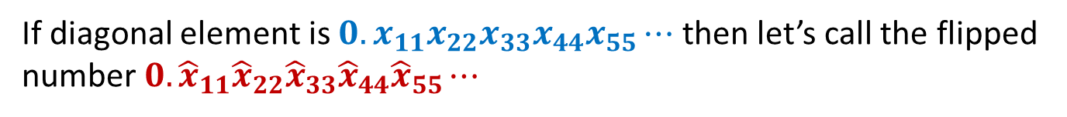
Proof that $[0,1)$ is not countable
Suppose, for a contradiction, that there is a list of them:
 |  | 1 | 2 | 3 | 4 | 5 | 6 | 7 | 8 | 9 | ...
r₁ | 0. | 5 | 0 | 0 | 0 | 0 | 0 | 0 | 0 | ... | ...
r₂ | 0. | 3 | 3 | 3 | 3 | 3 | 3 | 3 | 3 | ... | ...
r₃ | 0. | 1 | 4 | 2 | 8 | 5 | 7 | 1 | 4 | ... | ...
r₄ | 0. | 1 | 4 | 1 | 5 | 9 | 2 | 6 | 5 | ... | ...
r₅ | 0. | 1 | 2 | 1 | 2 | 2 | 1 | 2 | 2 | ... | ...
r₆ | 0. | 2 | 5 | 0 | 0 | 0 | 0 | 0 | 0 | ... | ...
r₇ | 0. | 7 | 1 | 8 | 2 | 8 | 1 | 8 | 2 | ... | ...
r₈ | 0. | 6 | 1 | 8 | 0 | 3 | 3 | 9 | 4 | ... | ...
... | .... | ... | .... | .... | ... | ... | ... | ... | ... | ...
Flipping rule:
If digit is 5, make it 1.
If digit is not 5, make it 5.
1
5
5
1
5
5
5
5
If diagonal element is $0.x_{11}x_{22}x_{33}x_{44}x_{55}⋯$ then let’s call the flipped number $0.{\hat{x}}_{11}{\hat{x}}_{22}{\hat{x}}_{33}{\hat{x}}_{44}{\hat{x}}_{55}⋯$
It cannot appear anywhere on the list!

Slide 32
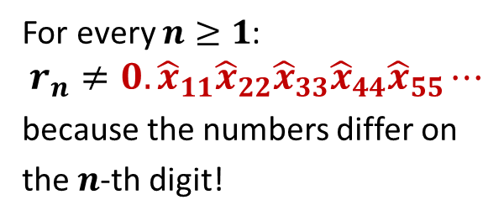
Proof that $[0,1)$ is not countable
Suppose, for a contradiction, that there is a list of them:
 |  | 1 | 2 | 3 | 4 | 5 | 6 | 7 | 8 | 9 | ...
r₁ | 0. | 5 | 0 | 0 | 0 | 0 | 0 | 0 | 0 | ... | ...
r₂ | 0. | 3 | 3 | 3 | 3 | 3 | 3 | 3 | 3 | ... | ...
r₃ | 0. | 1 | 4 | 2 | 8 | 5 | 7 | 1 | 4 | ... | ...
r₄ | 0. | 1 | 4 | 1 | 5 | 9 | 2 | 6 | 5 | ... | ...
r₅ | 0. | 1 | 2 | 1 | 2 | 2 | 1 | 2 | 2 | ... | ...
r₆ | 0. | 2 | 5 | 0 | 0 | 0 | 0 | 0 | 0 | ... | ...
r₇ | 0. | 7 | 1 | 8 | 2 | 8 | 1 | 8 | 2 | ... | ...
r₈ | 0. | 6 | 1 | 8 | 0 | 3 | 3 | 9 | 4 | ... | ...
... | .... | ... | .... | .... | ... | ... | ... | ... | ... | ...
Flipping rule:
If digit is 5, make it 1.
If digit is not 5, make it 5.
1
5
5
1
5
For every $n≥1$:
$$r_{n}≠0.{\hat{x}}_{11}{\hat{x}}_{22}{\hat{x}}_{33}{\hat{x}}_{44}{\hat{x}}_{55}⋯$$
because the numbers differ on
the $n$-th digit!
5
5
5
If diagonal element is $0.x_{11}x_{22}x_{33}x_{44}x_{55}⋯$ then let’s call the flipped number $0.{\hat{x}}_{11}{\hat{x}}_{22}{\hat{x}}_{33}{\hat{x}}_{44}{\hat{x}}_{55}⋯$
It cannot appear anywhere on the list!

Slide 33
Proof that $[0,1)$ is not countable
Suppose, for a contradiction, that there is a list of them:
 |  | 1 | 2 | 3 | 4 | 5 | 6 | 7 | 8 | 9 | ...
r₁ | 0. | 5 | 0 | 0 | 0 | 0 | 0 | 0 | 0 | ... | ...
r₂ | 0. | 3 | 3 | 3 | 3 | 3 | 3 | 3 | 3 | ... | ...
r₃ | 0. | 1 | 4 | 2 | 8 | 5 | 7 | 1 | 4 | ... | ...
r₄ | 0. | 1 | 4 | 1 | 5 | 9 | 2 | 6 | 5 | ... | ...
r₅ | 0. | 1 | 2 | 1 | 2 | 2 | 1 | 2 | 2 | ... | ...
r₆ | 0. | 2 | 5 | 0 | 0 | 0 | 0 | 0 | 0 | ... | ...
r₇ | 0. | 7 | 1 | 8 | 2 | 8 | 1 | 8 | 2 | ... | ...
r₈ | 0. | 6 | 1 | 8 | 0 | 3 | 3 | 9 | 4 | ... | ...
... | .... | ... | .... | .... | ... | ... | ... | ... | ... | ...
Flipping rule:
If digit is 5, make it 1.
If digit is not 5, make it 5.
1
5
5
1
5
For every $n≥1$:
$$r_{n}≠0.{\hat{x}}_{11}{\hat{x}}_{22}{\hat{x}}_{33}{\hat{x}}_{44}{\hat{x}}_{55}⋯$$
because the numbers differ on
the $n$-th digit!
5
5
5
So the list is incomplete, which is a contradiction.
Thus the real numbers between 0 and 1 are not countable: “uncountable”

Slide 34
The set of all functions $f :ℕ→\{0,…,9\}$ is uncountable

Slide 35
The set of all functions $f :ℕ→\{0,…,9\}$ is uncountable
Supposed listing of all the functions:
 |  | 1 | 2 | 3 | 4 | 5 | 6 | 7 | 8 | 9 | ...
f₁ | 0. | 5 | 0 | 0 | 0 | 0 | 0 | 0 | 0 | ... | ...
f₂ | 0. | 3 | 3 | 3 | 3 | 3 | 3 | 3 | 3 | ... | ...
f₃ | 0. | 1 | 4 | 2 | 8 | 5 | 7 | 1 | 4 | ... | ...
f₄ | 0. | 1 | 4 | 1 | 5 | 9 | 2 | 6 | 5 | ... | ...
f₅ | 0. | 1 | 2 | 1 | 2 | 2 | 1 | 2 | 2 | ... | ...
f₆ | 0. | 2 | 5 | 0 | 0 | 0 | 0 | 0 | 0 | ... | ...
f₇ | 0. | 7 | 1 | 8 | 2 | 8 | 1 | 8 | 2 | ... | ...
f₈ | 0. | 6 | 1 | 8 | 0 | 3 | 3 | 9 | 4 | ... | ...
... | .... | ... | .... | .... | ... | ... | ... | ... | ... | ...

Slide 36
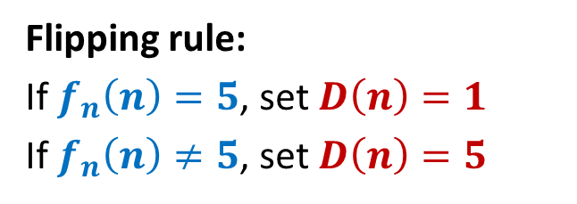
The set of all functions $f :ℕ→\{0,…,9\}$ is uncountable
Supposed listing of all the functions:
 |  | 1 | 2 | 3 | 4 | 5 | 6 | 7 | 8 | 9 | ...
f₁ | 0. | 5 | 0 | 0 | 0 | 0 | 0 | 0 | 0 | ... | ...
f₂ | 0. | 3 | 3 | 3 | 3 | 3 | 3 | 3 | 3 | ... | ...
f₃ | 0. | 1 | 4 | 2 | 8 | 5 | 7 | 1 | 4 | ... | ...
f₄ | 0. | 1 | 4 | 1 | 5 | 9 | 2 | 6 | 5 | ... | ...
f₅ | 0. | 1 | 2 | 1 | 2 | 2 | 1 | 2 | 2 | ... | ...
f₆ | 0. | 2 | 5 | 0 | 0 | 0 | 0 | 0 | 0 | ... | ...
f₇ | 0. | 7 | 1 | 8 | 2 | 8 | 1 | 8 | 2 | ... | ...
f₈ | 0. | 6 | 1 | 8 | 0 | 3 | 3 | 9 | 4 | ... | ...
... | .... | ... | .... | .... | ... | ... | ... | ... | ... | ...
Flipping rule:
If $f_{n}\left(n\right)=5$, set $D\left(n\right)=1$
If $f_{n}\left(n\right)≠5$, set $D\left(n\right)=5$
1
5
5
1
5
5
5
5

Slide 37
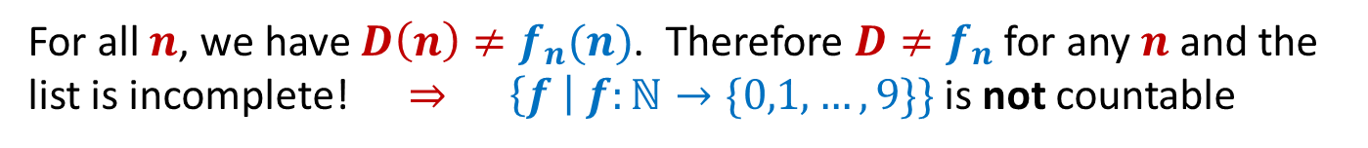
The set of all functions $f :ℕ→\{0,…,9\}$ is uncountable
Supposed listing of all the functions:
 |  | 1 | 2 | 3 | 4 | 5 | 6 | 7 | 8 | 9 | ...
f₁ | 0. | 5 | 0 | 0 | 0 | 0 | 0 | 0 | 0 | ... | ...
f₂ | 0. | 3 | 3 | 3 | 3 | 3 | 3 | 3 | 3 | ... | ...
f₃ | 0. | 1 | 4 | 2 | 8 | 5 | 7 | 1 | 4 | ... | ...
f₄ | 0. | 1 | 4 | 1 | 5 | 9 | 2 | 6 | 5 | ... | ...
f₅ | 0. | 1 | 2 | 1 | 2 | 2 | 1 | 2 | 2 | ... | ...
f₆ | 0. | 2 | 5 | 0 | 0 | 0 | 0 | 0 | 0 | ... | ...
f₇ | 0. | 7 | 1 | 8 | 2 | 8 | 1 | 8 | 2 | ... | ...
f₈ | 0. | 6 | 1 | 8 | 0 | 3 | 3 | 9 | 4 | ... | ...
... | .... | ... | .... | .... | ... | ... | ... | ... | ... | ...
Flipping rule:
If $f_{n}\left(n\right)=5$, set $D\left(n\right)=1$
If $f_{n}\left(n\right)≠5$, set $D\left(n\right)=5$
1
5
5
1
5
5
5
5
For all $n$, we have $D\left(n\right)≠f_{n}(n)$. Therefore $D≠f_{n}$ for any $n$ and the list is incomplete! $⇒$ $\left\{f \right| f:ℕ→\{0,1,…,9\}\}$ is not countable

Slide 38
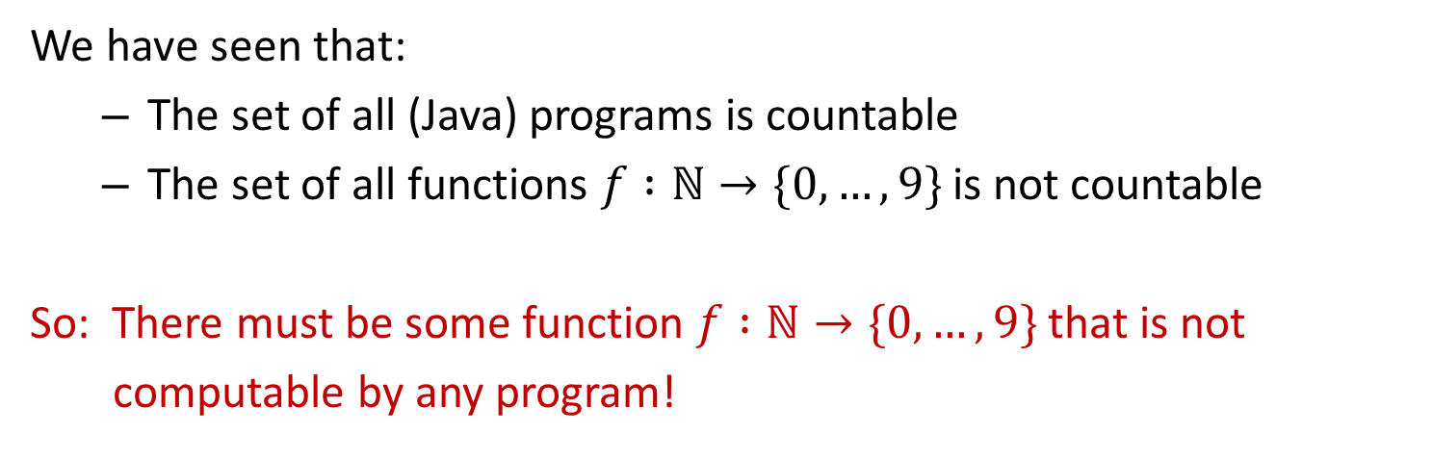
Uncomputable functions
We have seen that:
The set of all (Java) programs is countable
The set of all functions $f :ℕ→\{0,…,9\}$ is not countable
So: There must be some function $f :ℕ→\{0,…,9\}$ that is not
computable by any program!

Slide 39
Recall our language picture
All
Java
Context-Free
Binary Palindromes
Regular
DFA
NFA
Regex
0*
Finite
{001, 10, 12}

Slide 40
Uncomputable functions
Interesting… maybe.
Can we come up with an explicit function that is uncomputable?

