Slide 1
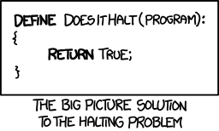
CSE 311: Foundations of Computing
Lecture 27: Undecidability

Slide 2
Final exam Monday, Review session Sunday
Monday at either 2:30-4:20 or 4:30-6:20
JHN 102
Must select your exam time by Saturday
No changes permitted after that
Bring your UW ID
Comprehensive: Full probs only on topics that were covered in homework. May have small probs on other topics.
May includes pre-midterm topics, e.g., formal proofs.
Reference sheets will be included. Closed book. No notes.
Review session: Sunday starting at 1 pm on Zoom
Bring your questions !!

Slide 3
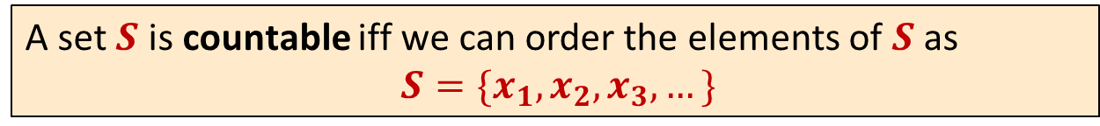
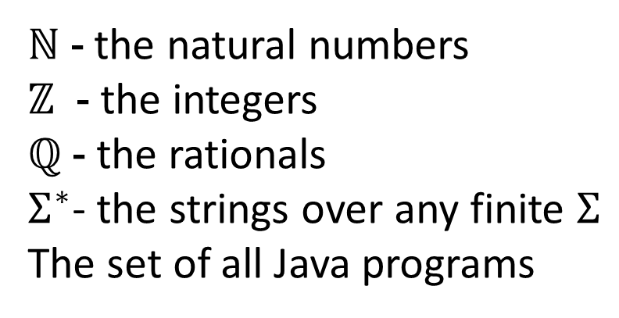
Last time: Countable sets
A set $S$ is countable iff we can order the elements of $S$ as
$S=\{x_{1},x_{2},x_{3},…\}$
Countable sets:
ℕ - the natural numbers
$ℤ$ - the integers
ℚ - the rationals
$Σ^{∗}$- the strings over any finite $Σ$
The set of all Java programs
}
Shown
by
“dovetailing”

Slide 4
Last time: Not every set is countable
Theorem [Cantor]:
The set of real numbers between 0 and 1 is not countable.
Proof using “diagonalization”.

Slide 5
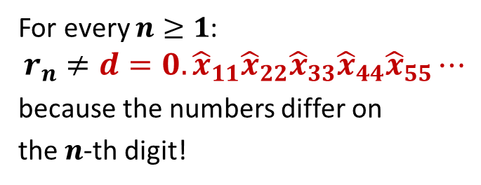

Last time: Proof that $[0,1)$ is not countable
Suppose, for the sake of contradiction, that there is a list of them:
 |  | 1 | 2 | 3 | 4 | 5 | 6 | 7 | 8 | 9 | ...
r₁ | 0. | 5 | 0 | 0 | 0 | 0 | 0 | 0 | 0 | ... | ...
r₂ | 0. | 3 | 3 | 3 | 3 | 3 | 3 | 3 | 3 | ... | ...
r₃ | 0. | 1 | 4 | 2 | 8 | 5 | 7 | 1 | 4 | ... | ...
r₄ | 0. | 1 | 4 | 1 | 5 | 9 | 2 | 6 | 5 | ... | ...
r₅ | 0. | 1 | 2 | 1 | 2 | 2 | 1 | 2 | 2 | ... | ...
r₆ | 0. | 2 | 5 | 0 | 0 | 0 | 0 | 0 | 0 | ... | ...
r₇ | 0. | 7 | 1 | 8 | 2 | 8 | 1 | 8 | 2 | ... | ...
r₈ | 0. | 6 | 1 | 8 | 0 | 3 | 3 | 9 | 4 | ... | ...
... | .... | ... | .... | .... | ... | ... | ... | ... | ... | ...
Flipping rule:
If digit is 5, make it 1.
If digit is not 5, make it 5.
1
5
5
1
5
For every $n≥1$:
$$r_{n}≠d=0.{\hat{x}}_{11}{\hat{x}}_{22}{\hat{x}}_{33}{\hat{x}}_{44}{\hat{x}}_{55}⋯$$
because the numbers differ on
the $n$-th digit!
5
5
5
So the list is incomplete, which is a contradiction.
Thus the real numbers between 0 and 1 are not countable: “uncountable”

Slide 6
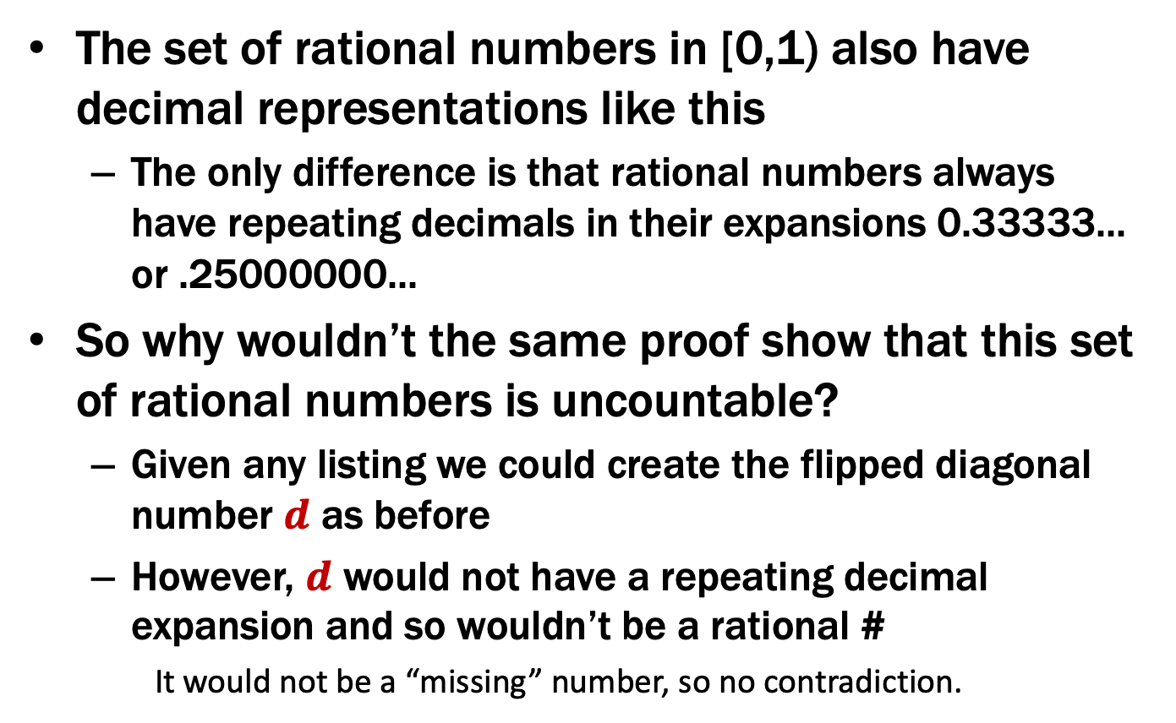
A note on this proof
The set of rational numbers in [0,1) also have decimal representations like this
The only difference is that rational numbers always have repeating decimals in their expansions 0.33333... or .25000000...
So why wouldn’t the same proof show that this set of rational numbers is uncountable?
Given any listing we could create the flipped diagonal number $d$ as before
However, $d$ would not have a repeating decimal expansion and so wouldn’t be a rational #
It would not be a “missing” number, so no contradiction.

Slide 7
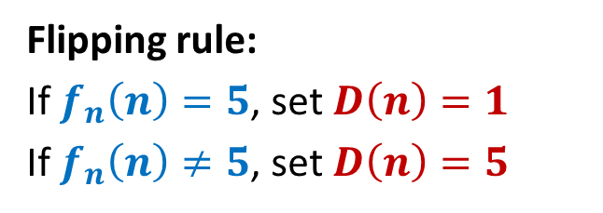


Last time: The set of all functions $f :ℕ→\{0,…,9\}$ is uncountable
Supposed listing of all the functions:
 |  | 1 | 2 | 3 | 4 | 5 | 6 | 7 | 8 | 9 | ...
f₁ | 0. | 5 | 0 | 0 | 0 | 0 | 0 | 0 | 0 | ... | ...
f₂ | 0. | 3 | 3 | 3 | 3 | 3 | 3 | 3 | 3 | ... | ...
f₃ | 0. | 1 | 4 | 2 | 8 | 5 | 7 | 1 | 4 | ... | ...
f₄ | 0. | 1 | 4 | 1 | 5 | 9 | 2 | 6 | 5 | ... | ...
f₅ | 0. | 1 | 2 | 1 | 2 | 2 | 1 | 2 | 2 | ... | ...
f₆ | 0. | 2 | 5 | 0 | 0 | 0 | 0 | 0 | 0 | ... | ...
f₇ | 0. | 7 | 1 | 8 | 2 | 8 | 1 | 8 | 2 | ... | ...
f₈ | 0. | 6 | 1 | 8 | 0 | 3 | 3 | 9 | 4 | ... | ...
... | .... | ... | .... | .... | ... | ... | ... | ... | ... | ...
Flipping rule:
If $f_{n}\left(n\right)=5$, set $D\left(n\right)=1$
If $f_{n}\left(n\right)≠5$, set $D\left(n\right)=5$
1
5
5
1
5
5
5
5
For all $n$, we have $D\left(n\right)≠f_{n}(n)$. Therefore $D≠f_{n}$ for any $n$ and the list is incomplete! $⇒$ $\left\{f \right| f:ℕ→\{0,1,…,9\}\}$ is not countable

Slide 8
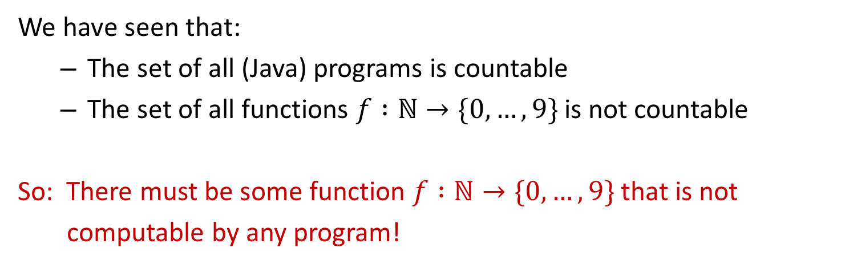
Last time: Uncomputable functions
We have seen that:
The set of all (Java) programs is countable
The set of all functions $f :ℕ→\{0,…,9\}$ is not countable
So: There must be some function $f :ℕ→\{0,…,9\}$ that is not
computable by any program!

Slide 9
Uncomputable functions
Interesting… maybe.
Can we come up with an explicit function that is uncomputable?

Slide 10
A “Simple” Program
11
34
17
52
26
13
40
20
10
5
16
8
4
2
1
public static void collatz(n) {
if (n == 1) {
return 1;
}
if (n % 2 == 0) {
return collatz(n/2)
}
else {
return collatz(3*n + 1)
}
}
What does this program do?
… on n=11?
… on n=10000000000000000001?

Slide 11
A “Simple” Program
public static void collatz(n) {
if (n == 1) {
return 1;
}
if (n % 2 == 0) {
return collatz(n/2)
}
else {
return collatz(3*n + 1)
}
}
What does this program do?
… on n=11?
… on n=10000000000000000001?
Nobody knows whether or not this program halts on all inputs!

Slide 12
Recall our language picture
All
Java
Context-Free
Binary Palindromes
Regular
DFA
NFA
Regex
0*
Finite
{001, 10, 12}

Slide 13
Some Notation
We’re going to be talking about Java code.
CODE(P) will mean “the code of the program P”
So, consider the following function:
public String P(String x) {
return new String(Arrays.sort(x.toCharArray());
}
What is P(CODE(P))?
“(((())))..;AACPSSaaabceeggghiiiilnnnnnooprrrrrrrrrrrsssttttttuuwxxyy{}”

Slide 14
The Halting Problem
CODE(P) means “the code of the program P”
The Halting Problem
Given: - CODE(P) for any program P
- input x
Output: true if P halts on input x
false if P does not halt on input x

Slide 15
Undecidability of the Halting Problem
CODE(P) means “the code of the program P”
Theorem [Turing]: There is no program that solves the Halting Problem
The Halting Problem
Given: - CODE(P) for any program P
- input x
Output: true if P halts on input x
false if P does not halt on input x

Slide 16
Terminology
With state machines, we say that a machine “recognizes” the language L iff
it accepts x ∈ Σ* if x ∈ L
it rejects x ∈ Σ* if x ∉ L
With Java programs / general computation, we say that the computer “decides” the language L iff
it halts with output 1 on input x ∈ Σ* if x ∈ L
it halts with output 0 on input x ∈ Σ* if x ∉ L
(ordinary machines might not always halt)
If no machine decides L, then L is “undecidable”
[Turing]: “The Halting Problem is undecidable”

Slide 17
Proof by contradiction
Suppose that H is a Java program that solves the Halting problem.
x

Slide 18
Proof by contradiction
Suppose that H is a Java program that solves the Halting problem.
Then we can write this program:
public static void D(String s) {
if (H(s,s) == true) {
while (true); // don’t halt
} else {
return; // halt
}
}
public static bool H(String s, String x) { ... }
Does D(CODE(D)) halt?

Slide 19
public static void D(s) {
...
...
...
...
...
}
Does D(CODE(D)) halt?
H solves the halting problem implies that H(CODE(D),s) is true iff D(s) halts, H(CODE(D),s) is false iff not
Suppose that D(CODE(D)) halts.
Then, by definition of H it must be that
H(CODE(D), CODE(D)) is true
Which by the definition of D means D(CODE(D)) doesn’t halt
Suppose that D(CODE(D)) doesn’t halt.
Then, by definition of H it must be that
H(CODE(D), CODE(D)) is false
Which by the definition of D means D(CODE(D)) halts

Slide 20
public static void D(s) {
if (H(s,s) == true) {
while (true); // don’t halt
} else {
...
}
}
Does D(CODE(D)) halt?
H solves the halting problem implies that H(CODE(D),s) is true iff D(s) halts, H(CODE(D),s) is false iff not
Suppose that D(CODE(D)) halts.
Then, by definition of H it must be that
H(CODE(D), CODE(D)) is true
Which by the definition of D means D(CODE(D)) doesn’t halt
Suppose that D(CODE(D)) doesn’t halt.
Then, by definition of H it must be that
H(CODE(D), CODE(D)) is false
Which by the definition of D means D(CODE(D)) halts

Slide 21
public static void D(s) {
if (H(s,s) == true) {
while (true); // don’t halt
} else {
return; // halt
}
}
Does D(CODE(D)) halt?
H solves the halting problem implies that H(CODE(D),s) is true iff D(s) halts, H(CODE(D),s) is false iff not
Suppose that D(CODE(D)) halts.
Then, by definition of H it must be that
H(CODE(D), CODE(D)) is true
Which by the definition of D means D(CODE(D)) doesn’t halt
Suppose that D(CODE(D)) doesn’t halt.
Then, by definition of H it must be that
H(CODE(D), CODE(D)) is false
Which by the definition of D means D(CODE(D)) halts

Slide 22
public static void D(s) {
if (H(s,s) == true) {
while (true); // don’t halt
} else {
return; // halt
}
}
Does D(CODE(D)) halt?
H solves the halting problem implies that H(CODE(D),s) is true iff D(s) halts, H(CODE(D),s) is false iff not
Suppose that D(CODE(D)) halts.
Then, by definition of H it must be that
H(CODE(D), CODE(D)) is true
Which by the definition of D means D(CODE(D)) doesn’t halt
Suppose that D(CODE(D)) doesn’t halt.
Then, by definition of H it must be that
H(CODE(D), CODE(D)) is false
Which by the definition of D means D(CODE(D)) halts

Slide 23
public static void D(s) {
if (H(s,s) == true) {
while (true); // don’t halt
} else {
return; // halt
}
}
Does D(CODE(D)) halt?
H solves the halting problem implies that H(CODE(D),s) is true iff D(s) halts, H(CODE(D),s) is false iff not
Suppose that D(CODE(D)) halts.
Then, by definition of H it must be that
H(CODE(D), CODE(D)) is true
Which by the definition of D means D(CODE(D)) doesn’t halt
Suppose that D(CODE(D)) doesn’t halt.
Then, by definition of H it must be that
H(CODE(D), CODE(D)) is false
Which by the definition of D means D(CODE(D)) halts
The ONLY assumption was that the program H exists so that assumption must have been false.
Contradiction!

Slide 24
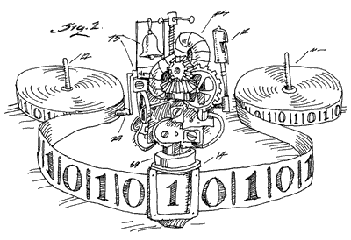
Done
We proved that there is no computer program that can solve the Halting Problem.
There was nothing special about Java* [Church-Turing thesis]
This tells us that there is no compiler that can check our programs and guarantee to find any infinite loops they might have.

Slide 25
Where did the idea for creating D come from?
public static void D(s) {
if (H(s,s) == true) {
while (true); // don’t halt
} else {
return; // halt
}
}
D halts on input code(P) iff H(code(P),code(P)) outputs false
iff P doesn’t halt on input code(P)

Slide 26
Connection to diagonalization
Write <P> for CODE(P)
<P₁> <P₂> <P₃> <P₄> <P₅> <P₆> ....
Some possible inputs x
P₁
P₂
P₃
P₄
P₅
P₆
P₇
P₈
P₉
.
.
This listing of all programs really does exist since the set of all Java programs is countable
All programs P
The goal of this “diagonal” argument is not to show that the listing is incomplete but rather to show that a “flipped” diagonal element is not in the listing

Slide 27
Connection to diagonalization
Write <P> for CODE(P)
<P₁> <P₂> <P₃> <P₄> <P₅> <P₆> ....
Some possible inputs x
P₁
P₂
P₃
P₄
P₅
P₆
P₇
P₈
P₉
.
.
0 1 1 0 1 1 1 0 0 0 1 ...
1 1 0 1 0 1 1 0 1 1 1 ...
1 0 1 0 0 0 0 0 0 0 1 ...
0 1 1 0 1 0 1 1 0 1 0 ...
0 1 1 1 1 1 1 0 0 0 1 ...
1 1 0 0 0 1 1 0 1 1 1 ...
1 0 1 1 0 0 0 0 0 0 1 ...
0 1 1 1 1 0 1 1 0 1 0 ...
. . . . . . . . . . . .
. . . . . . . . . . . .
All programs P
(P,x) entry is 1 if program P halts on input x
and 0 if it runs forever

Slide 28
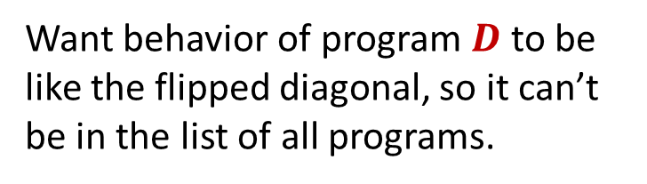
Connection to diagonalization
Write <P> for CODE(P)
<P₁> <P₂> <P₃> <P₄> <P₅> <P₆> ....
Some possible inputs x
P₁
P₂
P₃
P₄
P₅
P₆
P₇
P₈
P₉
.
.
1
0 1 1 0 1 1 1 0 0 0 1 ...
1 1 0 1 0 1 1 0 1 1 1 ...
1 0 1 0 0 0 0 0 0 0 1 ...
0 1 1 0 1 0 1 1 0 1 0 ...
0 1 1 1 1 1 1 0 0 0 1 ...
1 1 0 0 0 1 1 0 1 1 1 ...
1 0 1 1 0 0 0 0 0 0 1 ...
0 1 1 1 1 0 1 1 0 1 0 ...
. . . . . . . . . . . .
. . . . . . . . . . . .
Want behavior of program $D$to be like the flipped diagonal, so it can’t be in the list of all programs.
0
0
1
0
All programs P
0
All programs P
1
0
(P,x) entry is 1 if program P halts on input x
and 0 if it runs forever
(P,x) entry is 1 if program P halts on input x
and 0 if it runs forever

Slide 29
Where did the idea for creating D come from?
public static void D(s) {
if (H(s,s) == true) {
while (true); /* don’t halt */
}
else {
return; /* halt */
}
}
D halts on input code(P) iff H(code(P),code(P)) outputs false
iff P doesn’t halt on input code(P)
Therefore, for any program P, D differs from P on input code(P)

