Slide 1
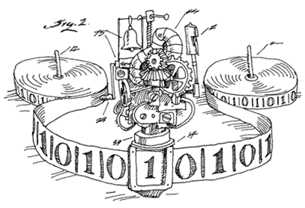
CSE 311: Foundations of Computing
Lecture 28: Undecidability, Reductions, and Turing Machines

Slide 2
Final exam Monday, Review session Sunday
Monday at either 2:30-4:20 or 4:30-6:20
JHN 102
Must select your exam time by Saturday
No changes permitted after that
Bring your UW ID
Comprehensive: Full probs only on topics that were covered in homework. May have small probs on other topics.
May includes pre-midterm topics, e.g., formal proofs.
Reference sheets will be included. Closed book. No notes.
Review session: Sunday starting at 1 pm on Zoom
Bring your questions !!

Slide 3
Review: Countability vs Uncountability
To prove a set A countable you must show
There exists a listing x₁,x₂,x₃, ... such that every element of A is in the list.
To prove a set B uncountable you must show
For every listing x₁,x₂,x₃, ... there exists some element in B that is not in the list.
The diagonalization proof shows how to describe a missing element d in B based on the listing x₁,x₂,x₃, ... . Important: the proof produces a d no matter what the listing is.

Slide 4
Last time: Undecidability of the Halting Problem
CODE(P) means “the code of the program P”
Theorem [Turing]: There is no program that solves the Halting Problem
Proof: By contradiction.
Assume that a program H solving the Halting program does exist. Then program D must exist
The Halting Problem
Given: - CODE(P) for any program P
- input x
Output: true if P halts on input x
false if P does not halt on input x

Slide 5
public static void D(x) {
if (H(x,x) == true) {
while (true); /* don’t halt */
}
else {
return; /* halt */
}
}
Does D(CODE(D)) halt?
H solves the halting problem implies that H(CODE(D),x) is true iff D(x) halts, H(CODE(D),x) is false iff not
Suppose that D(CODE(D)) halts.
Then, by definition of H it must be that
H(CODE(D), CODE(D)) is true
Which by the definition of D means D(CODE(D)) doesn’t halt
Suppose that D(CODE(D)) doesn’t halt.
Then, by definition of H it must be that
H(CODE(D), CODE(D)) is false
Which by the definition of D means D(CODE(D)) halts
The ONLY assumption was the program H exists so that assumption must have been false.
Contradiction!

Slide 6
SCOOPING THE LOOP SNOOPER A proof that the Halting Problem is undecidable by Geoffrey K. Pullum (U. Edinburgh)
No general procedure for bug checks succeeds. Now, I won’t just assert that, I’ll show where it leads: I will prove that although you might work till you drop, you cannot tell if computation will stop.
For imagine we have a procedure called P that for specified input permits you to see whether specified source code, with all of its faults, defines a routine that eventually halts.
You feed in your program, with suitable data, and P gets to work, and a little while later (in finite compute time) correctly infers whether infinite looping behavior occurs...

Slide 7
SCOOPING THE LOOP SNOOPER
...
Here’s the trick that I’ll use -- and it’s simple to do. I’ll define a procedure, which I will call Q, that will use P’s predictions of halting success to stir up a terrible logical mess.
...
And this program called Q wouldn’t stay on the shelf; I would ask it to forecast its run on itself. When it reads its own source code, just what will it do? What’s the looping behavior of Q run on Q?
...
Full poem at:
http://www.lel.ed.ac.uk/~gpullum/loopsnoop.html

Slide 8
The Halting Problem isn’t the only hard problem
Can use the fact that the Halting Problem is undecidable to show that other problems are undecidable
General method:
Prove that if there were a program deciding B then you can use it to build a program deciding the Halting Problem.
“B decidable → Halting Problem decidable” Shown by general method
“Halting problem undecidable” Turing
“Halting Problem undecidable → B undecidable” Contrapositive from 1
“B undecidable” Modus Ponens 2 & 3

Slide 9
A CSE 121 assignment
Students should write a Java program that:
Prints “Hello” to the console
Eventually exits
Our auto-grading program needs to grade the students.
How do we write that grading program?
We can’T: THIS IS IMPOSSIBLE!

Slide 10
A related undecidable problem
HelloWorldTesting Problem:
Input: CODE(Q) and x
Output:
True if Q outputs “HELLO WORLD” on input x
False if Q does not output “HELLO WORLD” on input x
Theorem: The HelloWorldTesting Problem is undecidable.
Proof idea: Show that if there is a program T to decide HelloWorldTesting then there is a program H to decide the Halting Problem for code(P) and x.

Slide 11
A related undecidable problem
Suppose there is a program T that solves the HelloWorldTesting problem. Define program H that takes input CODE(P) and x and does the following:
Creates CODE(Q) from CODE(P) by
removing all output statements from CODE(P), and
adding a System.out.println(“HELLO WORLD”) immediately before any spot where P could halt
Then runs T on input CODE(Q) and x.
If P halts on input x then Q prints HELLO WORLD and halts and so H outputs true (because T outputs true on input CODE(Q))
If P doesn’t halt on input x then Q won’t print anything since we removed any other print statement from CODE(Q) so H outputs false
We know that such an H cannot exist. Therefore T cannot exist.

Slide 12
The HaltsNoInput Problem
Input: CODE(R) for program R
Output: True if R halts without reading input
False otherwise.
Theorem: HaltsNoInput is undecidable
General idea “hard-coding the input”:
Show how to use CODE(P) and x to build CODE(R) so P halts on input x ⇔ R halts without reading input

Slide 13
The HaltsNoInput Problem
“Hard-coding the input”:
Show how to use CODE(P) and x to build CODE(R) so P halts on input x ⇔ R halts without reading input
Replace input statement in CODE(P) that reads input x into variable var, by a hard-coded assignment statement:
var = x
to produce CODE(R).
So if we have a program N to decide HaltsNoInput then we can use it as a subroutine as follows to decide the Halting Problem, which we know is impossible:
On input CODE(P) and x, produce CODE(R). Then run N on input CODE(R) and output the answer that N gives.

Slide 14
The impossibility of writing the CSE 121 grading program follows by combining the ideas from the undecidability of HaltsNoInput and HelloWorld.

Slide 15

More Reductions
Can use undecidability of these problems to show that other problems are undecidable.
For instance:
$EQUIV(P,Q)$ : True if $P\left(x\right)$ and $Q(x)$ have the same
behavior for every input $x$
False otherwise

Slide 16
Rice’s theorem
Not every problem on programs is undecidable!
Which of these is decidable?
Input CODE(P) and x Output: true if P prints “ERROR” on input x after less than 100 steps false otherwise
Input CODE(P) and x Output: true if P prints “ERROR” on input x after more than 100 steps false otherwise
Rice’s Theorem (a.k.a. Compilers Suck Theorem - informal):
Any “non-trivial” property of the input-output behavior of Java programs is undecidable.

Slide 17
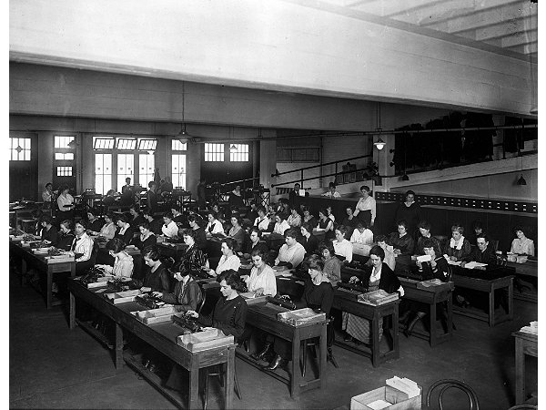
Computers and algorithms
Does Java (or any programming language) cover all possible computation? Every possible algorithm?
There was a time when computers were people who did calculations on sheets paper to solve computational problems
Computers as we known them arose from trying to understand everything these people could do.

Slide 18
Before Java
1930’s:
How can we formalize what algorithms are possible?
Turing machines (Turing, Post)
basis of modern computers
Lambda Calculus (Church)
basis for functional programming, LISP
μ-recursive functions (Kleene)
alternative functional programming basis

Slide 19
Turing machines
Church-Turing Thesis:
Any reasonable model of computation that includes all possible algorithms is equivalent in power to a Turing machine
Evidence
Intuitive justification
Huge numbers of models based on radically different ideas turned out to be equivalent to TMs

Slide 20
Turing machines
Finite Control
Brain/CPU that has only a finite # of possible “states of mind”
Recording medium
An unlimited supply of blank “scratch paper” on which to write & read symbols, each chosen from a finite set of possibilities
Input also supplied on the scratch paper
Focus of attention
Finite control can only focus on a small portion of the recording medium at once
Focus of attention can only shift a small amount at a time

Slide 21
Turing machines
Recording medium
An infinite read/write “tape” marked off into cells
Each cell can store one symbol or be “blank”
Tape is initially all blank except a few cells of the tape containing the input string
Read/write head can scan one cell of the tape - starts on input
In each step, a Turing machine
Reads the currently scanned cell
Based on current state and scanned symbol
Overwrites symbol in scanned cell
Moves read/write head left or right one cell
Changes to a new state
Each Turing Machine is specified by its finite set of rules

Slide 22
Turing machines
 | _ | 0 | 1
s₁ | (1, L, s₃) | (1, L, s₄) | (0, R, s₂)
s₂ | (0, R, s₁) | (1, R, s₁) | (0, R, s₁)
s₃
s₄
_ | _ | 1 | 1 | 0 | 1 | 1 | _ | _

Slide 23
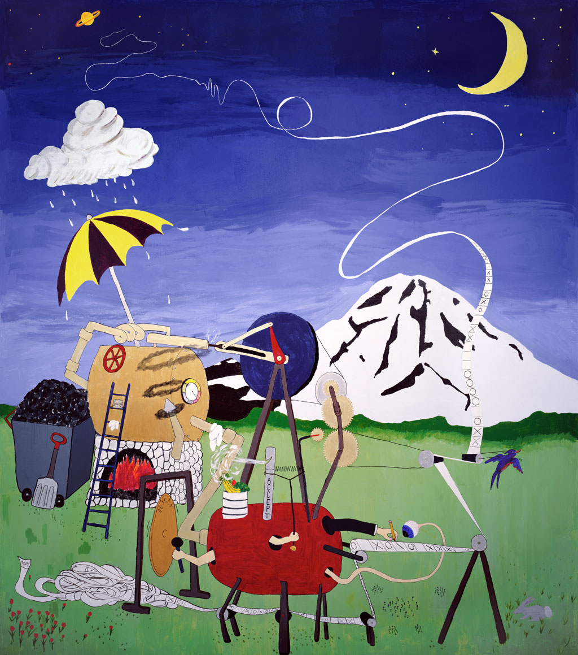
UW CSE’s Steam-Powered Turing Machine
Original in Sieg Hall stairwell

Slide 24
Turing machines
Ideal Java/C programs:
Just like the Java/C you’re used to programming with, except you never run out of memory
Constructor methods always succeed
malloc in C never fails
Equivalent to Turing machines except a lot easier to program:
Turing machine definition is useful for breaking computation down into simplest steps
We only care about high level so we use programs

Slide 25
Turing’s big idea part 1: Machines as data
Original Turing machine definition:
A different “machine” M for each task
Each machine M is defined by a finite set of possible operations on finite set of symbols
So... M has a finite description as a sequence of symbols, its “code”, which we denote <M>
You already are used to this idea with the notion of the program code or text but this was a new idea in Turing’s time.

Slide 26
Turing’s big idea part 2: A Universal TM
A Turing machine interpreter U
On input <M> and its input x, U outputs the same thing as M does on input x
At each step it decodes which operation M would have performed and simulates it.
One Turing machine is enough
Basis for modern stored-program computer
Von Neumann studied Turing’s UTM design
input
output
x
output
M
U
M(x)
x
M(x)
<M>

Slide 27
Takeaway from undecidability
You can’t rely on the idea of improved compilers and programming languages to eliminate major programming errors
truly safe languages can’t possibly do general computation
Document your code
there is no way you can expect someone else to figure out what your program does with just your code; since in general it is provably impossible to do this!

Slide 28
We’ve come a long way!
Propositional Logic.
Boolean logic and circuits.
Boolean algebra.
Predicates, quantifiers and predicate logic.
Inference rules and formal proofs for propositional and predicate logic.
English proofs.
Modular arithmetic.
Prime numbers.
GCD, Euclid's algorithm, modular inverse, and exponentiation.
Set theory.

Slide 29
We’ve come a long way!
Induction and Strong Induction.
Recursively defined functions and sets.
Structural induction.
Regular expressions.
Context-free grammars and languages.
Relations and composition.
Transitive-reflexive closure.
Graph representation of relations and their closures.

Slide 30
We’ve come a long way!
DFAs, NFAs and language recognition.
Product construction for DFAs.
Finite state machines with outputs at states.
Minimization algorithm for finite state machines
Conversion of regular expressions to NFAs.
Subset construction to convert NFAs to DFAs.
Equivalence of DFAs, NFAs, Regular Expressions
Finite automata for pattern matching.
Method to prove languages not accepted by DFAs.
Cardinality, countability and diagonalization
Undecidability: Halting problem and evaluating properties of programs.

Slide 31
What’s next? ...after the final exam...
Foundations II (312)
Fundamentals of counting, discrete probability, applications of randomness to computing, statistical algorithms and analysis
Ideas critical for machine learning, algorithms
Data Abstractions (332)
Data structures, a few key algorithms, parallelism
Brings programming and theory together
Makes heavy use of induction and recursive defns

Slide 32
Course Evaluation Online
Fill this out by Sunday night!
Your ability to fill it out will disappear at 11:59 p.m. on Sunday.
We really value your feedback!

Slide 33
Final exam Monday, Review session Sunday
Monday at either 2:30-4:20 or 4:30-6:20
JHN 102
Must select your exam time by Saturday
No changes permitted after that
Bring your UW ID
Comprehensive: Full probs only on topics that were covered in homework. May have small probs on other topics.
May includes pre-midterm topics, e.g., formal proofs.
Reference sheets will be included. Closed book. No notes.
Review session: Sunday starting at 1 pm on Zoom
Bring your questions !!

