Slide 1
PHY 517/617 Computational Physics
AI-Assisted Coding
Case study: an efficient state-vector simulator
PHY 517/617 · AI-assisted coding
1 / 25
Notes:
⏱ 1 min
First half: how coding agents work and the five habits that matter. Second half: apply every habit to the fast simulator from NB03 Exercise 2, including the failure cases you must document.

Slide 2
Part 1 · Using Claude Code
Final Presentation
Time: 15 minutes
Present a project or a homework assignment of your choice.
Strongly encouraged: Explain how you used AI to help with your project or assignment.
Document and present the following:
  Prompting strategies: Describe useful practices, techniques, or prompt patterns that helped you get better results from the AI assistant.
  Instructions and supporting files: Any Markdown files or other documents you used to guide the AI agent.
  Verification and debugging: Explain how you verified the correctness of AI-generated code, identified errors, tested individual components, and checked the final results.
  Failure case: Provide an example of AI-generated code that initially looked acceptable but was incorrect, inefficient, or poorly designed. Explain how you detected and corrected the problem.
PHY 517/617 · AI-assisted coding · Week 6
2 / 25
Notes:
⏱ 2 min
Tie to the syllabus AI policy. Grading of NB03 Exercise 2 rewards the process documentation (prompts, instruction files, verification, failure case), not just working code.

Slide 3
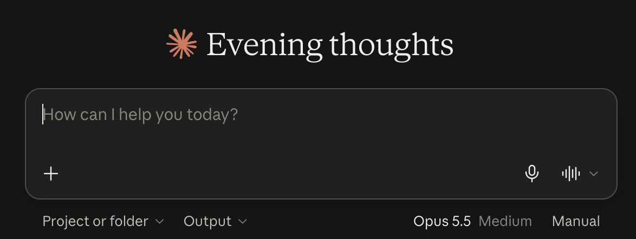
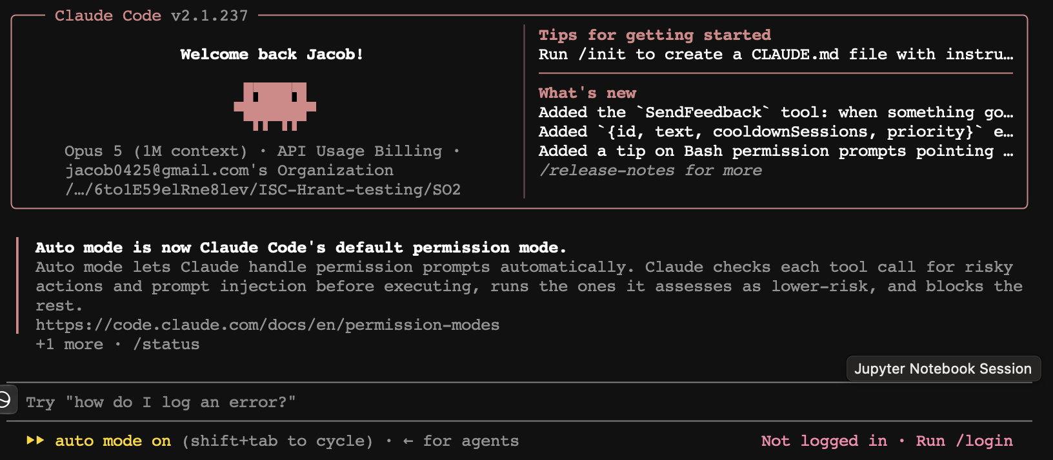
Part 1 · Using Claude Code
Chat assistant versus coding agent
PHY 517/617 · AI-assisted coding · Week 6
3 / 25
Notes:
⏱ 2 min
Tie to the syllabus AI policy. Grading of NB03 Exercise 2 rewards the process documentation (prompts, instruction files, verification, failure case), not just working code.

Slide 4
Part 1 · Using Claude Code
Chat assistant versus coding agent
 | Chat assistant (claude.ai, ChatGPT) | Coding agent (Claude Code, Codex, Cursor agent, Copilot agent)
Where it runs | Browser or app window | Your terminal, editor, or a cloud sandbox attached to your repo
What it sees | What you paste | Your files, directory tree, git history, command output
What it can do | Produce text and code for you to copy | Read and edit files, run shell commands and tests, commit, search the web
Loop | One question, one answer | Plan, act, observe result, act again, until the task is done
Your role | Copy, paste, run, report back | Approve actions, review diffs, set constraints, verify
Same model family underneath. The difference is the tools and the loop.
Claude (chat) is to Claude Code as ChatGPT (chat) is to Codex. The pairs are analogous.
PHY 517/617 · AI-assisted coding · Week 6
4 / 25
Notes:
⏱ 3 min
“Is Claude Code smarter?” It is the same model with hands. It can run your tests, so it can catch its own mistakes. It can also edit or delete files, so permissions matter (slide 14).

Slide 5
Part 1 · Using Claude Code
AI-assisted coding versus vibe coding
 | AI-assisted coding | Vibe coding
Who designs | You, with the AI as a sounding board | The AI
Who reads the code | You, every diff | Nobody
How “done” is decided | Independent tests you understand | “It seems to work”
Appropriate for | Anything you will build on, publish, or submit | Throwaway scripts, quick plots
Both are legitimate. The mistake is doing the second while believing you are doing the first.
You keep three things: the design, the verification (independent of the code’s author), and the understanding.
Rule: verify, then trust. The AI is fast, well-read, and confidently wrong a few percent of the time.
Discussion: Do we need to review (almost) all the codes written by the AI agent? If not, how do you verify the result?
Is it still important to learn how to code?
PHY 517/617 · AI-assisted coding · Week 6
5 / 25
Notes:
⏱ 2 min
Read the two definitions from NB03 Section 2 aloud. Ask who has had AI-generated code that ran, produced a plot, and was wrong. That is the lecture’s motivating fear, and the reason Exercise 1 (your own naive simulator) came before Exercise 2.

Slide 6
Part 1 · Using Claude Code
The context window
The model sees one long token sequence. Everything it knows about your session is in it: system prompt and CLAUDE.md, your messages, its replies, every file it read, every command output.
Sizes today: current Claude models have a 1M-token window; smaller or older ones 200K. A token is roughly 3 to 4 characters; 1,000 lines of Python is about 10 to 15K tokens.
Why it matters:
Quality degrades as it fills. Early instructions get diluted; long sessions drift.
Compaction is lossy. Near the limit the tool summarises; a convention stated once can vanish.
Sessions are mostly not persistent. Tomorrow’s session remembers what is in a file, not what you said.
context window
auto-compaction
sys
chat
files
system prompt
CLAUDE.md
conversation
file reads
tool outputs
free
A token is the model's unit of text: a word, part of a word, a symbol, or whitespace, about 4 characters on average. Context size and pricing are counted in tokens.
PHY 517/617 · AI-assisted coding · Week 6
6 / 25
Notes:
⏱ 3 min
Analogy: training is the disk (read-only, general); the context is RAM (fast, specific, small). You are the memory manager. The typical student failure: a three-hour session where the endianness convention was stated in message 2 and silently violated in message 60.

Slide 7
Part 1 · Using Claude Code
Managing context in practice
Habit | Command
See what is in the window | /context
Summarise and continue | /compact keep the qubit convention and the test plan
Start fresh for a new task | /clear
Resume an earlier session | claude --continue or claude --resume
Keep specs out of chat | Write them to CLAUDE.md, PLAN.md, or a test file
Avoid flooding | Never paste 5,000-line logs; tail, filter, or save to a file
Stop digging | After two failed corrections, /clear and rewrite the prompt with what you learned
One task per session. Plan in one, implement in the next, optimise in a third.
PHY 517/617 · AI-assisted coding · Week 6
8 / 25
Notes:
⏱ 2 min
Demonstrate /context after reading a large notebook to show how fast it fills. /compact with a focus instruction is much better than the automatic one.

Slide 8
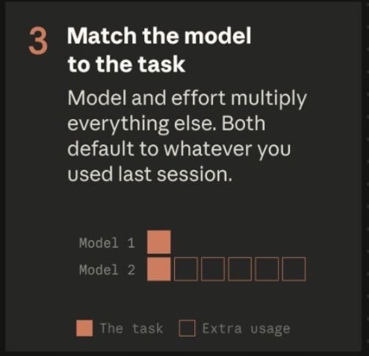

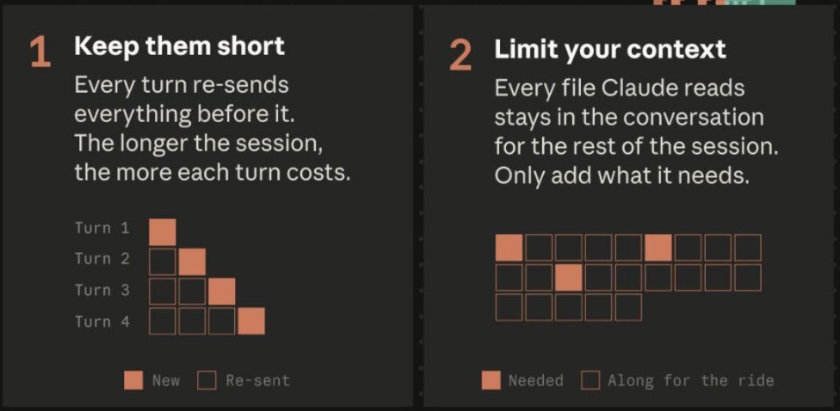
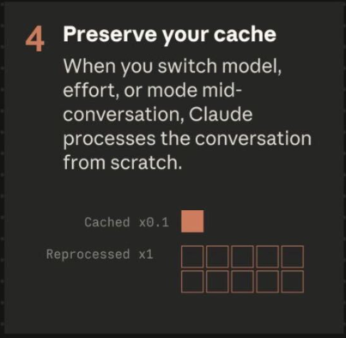
PHY 517/617 · AI-assisted coding · Week 6
9 / 25
Notes:
⏱ 2 min
Demonstrate /context after reading a large notebook to show how fast it fills. /compact with a focus instruction is much better than the automatic one.

Slide 9
Part 1 · Using Claude Code
Markdown in two minutes
You write: plain text
You get: rendered
# Fast state-vector simulator
## Conventions
- Qubit 0 is the **least** significant bit.
- Gate list: `(U, [qubits])` tuples.
## Commands
1. `uv run pytest -q`
2. `uv run python bench.py`
```python
psi = simulate_fast(gates, n)
```
Fast state-vector simulator
Conventions
Qubit 0 is the least significant bit.
Gate list: (U, [qubits]) tuples.
Commands
uv run pytest -q
uv run python bench.py
psi = simulate_fast(gates, n)
Plain text with light markup. Readable raw; rendered by GitHub, VS Code (Shift+Cmd+V for the preview), Jupyter text cells, and the agent itself.
Every instruction file in this lecture is Markdown: CLAUDE.md, AGENTS.md, SKILL.md (with a YAML front matter between --- lines), PLAN.md, README.md.
Backticks are not decoration: simulate() tells the agent this is code, not prose. Headings and bullets are how it finds the rule you meant.
PHY 517/617 · AI-assisted coding · Week 6
7 / 25
Notes:
⏱ 2 min
Students have written Markdown in notebook text cells; name it. The point here: the agent reads these files as text, so headings, bullets and backticks are how you speak precisely to it. Optional: open CLAUDE.md in VS Code next to its preview (Shift+Cmd+V).

Slide 10
Part 1 · Using Claude Code
CLAUDE.md and AGENTS.md: persistent instructions
CLAUDE.md is read automatically at the start of every session. This is the fix for “sessions forget”.
Locations, all concatenated: ~/.claude/CLAUDE.md (you, all projects), ./CLAUDE.md (the project, commit it), ./CLAUDE.local.md (personal, git-ignored), CLAUDE.md in subdirectories, .claude/rules/*.md.
/init drafts one from your repo. Edit it; it will not know your physics conventions.
Put in: build and test commands, conventions the code cannot express (qubit ordering!), interfaces that must not change, files it must never touch, mistakes it keeps making. Leave out: tutorials, anything derivable from the code. Under about 200 lines.
AGENTS.md is the vendor-neutral equivalent (Codex, Cursor, Copilot, Gemini CLI). Claude Code reads it natively when there is no CLAUDE.md; if both exist CLAUDE.md wins.
Q: What if you uses CLAUDE.md but your collaborator uses AGENTS.md?
PHY 517/617 · AI-assisted coding · Week 6
10 / 25
Notes:
⏱ 3 min
Treat it like the “conventions” page of a lab notebook: the one place a collaborator, human or AI, looks first. Every line costs context on every turn, so keep it short. The assignment accepts either file name.

Slide 11
Part 1 · Using Claude Code
A CLAUDE.md for our simulator
# Fast state-vector simulator
## Commands
- Run tests: uv run pytest -q
- Run benchmark: uv run python bench.py
## Conventions (do not change)
- Little-endian (as in NB01): basis state |b_{n-1} ... b_1 b_0> is stored at
index a = sum_j b_j 2^j. Qubit j = bit j of a. Qubit 0 is the LSB, the
rightmost digit of the ket.
- 2-qubit gate on (j, k): 4x4 matrix, subspace index b_j + 2*b_k, i.e.
rows/cols ordered |b_k b_j> = |00>, |01>, |10>, |11>.
- Gate list format: list of (U, [qubits]) tuples; state starts at |0...0>.
## Interfaces that must not change
- simulate(gates, n) in simulator_naive.py is the reference. Never edit it.
- simulate_fast(gates, n) must accept exactly the same inputs.
## Rules
- NumPy only. No np.kron of the full operator; O(2^n) per gate.
- Never modify a test to make it pass. Ask me instead.
- Every new function gets a test comparing against simulate() on random circuits.
PHY 517/617 · AI-assisted coding · Week 6
11 / 25
Notes:
⏱ 2 min
Every line was earned by a real failure while developing the reference solution. Walk through the convention block slowly; it is the single most common source of AI bugs in this project.

Slide 12
Part 1 · Using Claude Code
Skills: repeatable procedures on demand
A skill is a folder with a SKILL.md (front matter plus instructions) and any scripts it needs. Project: .claude/skills/<name>/SKILL.md; personal: ~/.claude/skills/<name>/SKILL.md.
CLAUDE.md is loaded always; a skill is loaded only when used, so it can be long. Invoke with /verify-sim, or the agent picks it when your request matches its description.
---
name: verify-sim
description: Verify simulate_fast against the reference simulate() on random circuits,
check norm and unitarity, and run the scaling test. Use after any change to the simulator.
allowed-tools: Bash(uv run *)
---
1. Run `uv run pytest tests/test_simulator.py -q`. If anything fails, stop and report; do not edit tests.
2. Run `uv run python scripts/random_circuit_check.py --n 3 4 5 6 --seeds 5`
(compares fast vs reference with np.allclose, atol=1e-10).
3. Run `uv run python scripts/scaling.py --n 12 14 16 18`. Time per gate must roughly
double per added qubit. If it quadruples, the implementation is O(4^n): report it as a bug.
4. Summarise: pass/fail per check, and the measured scaling exponent.
PHY 517/617 · AI-assisted coding · Week 6
12 / 25
Notes:
⏱ 2 min
Skills package a procedure you want repeated identically: the verification recipe, the benchmark protocol, a plotting style. Note step 3: a timing test that encodes the physics of the algorithm. It catches a whole class of “looks fast but is not” failures (slide 24).

Slide 13
Part 1 · Using Claude Code
The workflow: explore, plan, code, commit
Explore. Ask the agent to read the relevant files and summarise. No code yet.
Plan. Switch to plan mode (Shift+Tab cycles modes; or claude --permission-mode plan). Edits and commands are disabled, so it is safe to think out loud. Ask for a plan with interfaces and tests. Read it. Correct it.
Code. Implement one component, run its test, review the diff.
Commit. Small, verified commits. Then the next component.
Give the agent a verifiable target; it is dramatically better when it can check its own work. In order of strength: a reference implementation you wrote, invariants (norm, unitarity, Hermiticity, conserved quantities), analytic limits (h = 0, t = 0, two qubits by hand), random differential tests, a known figure.
Test-first with AI: it writes the tests, you review them (“would this fail if the ordering were transposed?”), then it implements.
PHY 517/617 · AI-assisted coding · Week 6
13 / 25
Notes:
⏱ 3 min
This is Anthropic’s recommended pattern (code.claude.com/docs/en/best-practices) and the workflow in NB03 Section 2. The plan is where you inject physics: axis mapping, convention, which tests discriminate. A test the agent wrote and passes is weak evidence; a test you understand that encodes a physical fact is strong evidence.

Slide 14
Part 1 · Using Claude Code
Practical tips
Prompts: name files with @simulator_naive.py; state conventions and interfaces; say what not to do (“no np.kron, do not edit simulate()”); ask for the reasoning before the code; ask it to attack its own code (“what inputs would break this?”).
Modularise: ask for small functions with fixed interfaces (apply_gate_1q, apply_gate_2q, simulate) in .py files, not one long notebook cell. Each piece gets its own test against the oracle, a bug is caught where it lives, the agent reads only the file it is changing, and you can swap simulate for simulate_fast without touching the callers.
Course-correct early: Esc interrupts; /rewind restores earlier file states; after two failed corrections, /clear and rewrite.
Git is the audit trail: commit each verified step; read git diff and watch for edits outside the task, especially to tests and reference code.
Permission modes: default asks, acceptEdits, plan (read-only), auto (a safety classifier approves routine actions). On Pro, Max, and Team you start in auto. Use plan or default for anything you cannot afford to lose.
Secrets: never put a password, account, or API token in a prompt or in a file the agent can read; assume it is leaked the moment you do. Keep keys in a git-ignored .env, deny the agent access to it (Read(./.env) in the settings deny list), and treat unpublished data the same way.
--dangerously-skip-permissions
PHY 517/617 · AI-assisted coding · Week 6
14 / 25
Notes:
⏱ 2 min
Do not teach the last bullet; show it exists. If short on time, this slide can be skipped and read later.
Notebooks are hostile to agents: JSON with outputs and hidden execution state. Keep the physics in modules and let the notebook import and plot. Bad prompt: “write an Ising simulator with Trotter and plots”. Good prompt: “write apply_gate_2q_fast(state, U, j, k) only; it must match apply_gate_2q on random states.” The repo layout on slide 17 is the example.
Secrets: everything in the context can end up in transcripts, autosaves and the model's output; a key pasted once is a key to rotate. The same care applies to unpublished data and institutional data rules.

Slide 15
Part 2 · Case study
The problem
From Exercise 1: apply_gate_1q(state, U, j) builds I ⊗ ... ⊗ U ⊗ ... ⊗ I with np.kron and multiplies: O(4^{n}) time and memory per gate.
n | Matrix entries | Memory (complex128) | Work per gate
10 | 10⁶ | 16 MB | fine
14 | 2.7 × 10⁸ | 4.3 GB | seconds
20 | 1.1 × 10¹² | 16 TB | impossible
Target: O(2^{n}) per gate, same interface simulate(gates, n), same little-endian convention.
The physics that makes it possible: a gate on qubit j only mixes amplitude pairs that differ in bit j. Everything else is index bookkeeping, which is exactly what AI is good at and exactly where it makes convention errors.
PHY 517/617 · AI-assisted coding · Week 6
16 / 25
Notes:
⏱ 2 min
Students felt the pain in Exercise 1 around n = 12.

Slide 16
Part 2 · Case study
Steps 0 and 1: ground truth, then the project
Ground truth already exists: simulate() from Exercise 1, verified by hand on (|00> + i|11>)/√2. Slow, simple, written by you, so it cannot share the AI’s mistakes.
Save it as simulator_naive.py, gate matrices in gates.py, and declare both read-only in CLAUDE.md.
mkdir fast_sim && cd fast_sim && git init
cp ../simulator_naive.py ../gates.py .
uv init && uv add numpy pytest
claude
> /init # drafts CLAUDE.md; then paste in the conventions from slide 11
Commit: git add -A && git commit -m "Reference simulator and project instructions".
PHY 517/617 · AI-assisted coding · Week 6
17 / 25
Notes:
⏱ 2 min
Live demo if time permits: show what /init produced and what you had to add by hand (it will not know the qubit convention).

Slide 17
Part 2 · Case study
Step 2: plan in plan mode
Prompt, in plan mode
Read CLAUDE.md, simulator_naive.py, and gates.py. Propose a plan for simulate_fast(gates, n) with O(2^{n}) work per gate and exactly the same interface and convention. For each function give the index mapping, the complexity, and the test that would catch a transposed convention. Do not write code yet.
A good plan contains:
Reshape the state to an n-axis tensor of shape (2,)*n; qubit j is axis n-1-j in C order.
1-qubit gate: np.tensordot(U, psi, axes=[[1],[ax]]), then np.moveaxis back. O(2^{n}).
2-qubit gate on adjacent (j, j+1): gather the 2^(n-2) groups of four amplitudes with bit arithmetic, apply U as a batched 4×4 product. O(2^{n}).
Tests: random circuits versus simulate; an asymmetric-gate ordering test; norm check.
Benchmark with a scaling test.
PHY 517/617 · AI-assisted coding · Week 6
18 / 25
Notes:
⏱ 3 min
Read the plan critically. Common plan errors: axis j instead of n-1-j; np.einsum that secretly builds the full operator; “vectorise np.kron” (still O(4^n)). Fix the plan before code exists; it is the cheapest moment.

Slide 18
Part 2 · Case study
Step 3: tests before implementation
Prompt
Write tests/test_simulator.py with: (a) random circuits of H, Rz, CNOT on n = 2..6 compared against simulate with np.allclose(atol=1e-10); (b) the Bell-like state from Exercise 1; (c) a test that fails if the 2-qubit subspace ordering is transposed; (d) norm preservation. Do not implement simulate_fast yet; the tests should fail with ImportError.
Your review questions:
Does (c) really discriminate? X_0|00> = |01>, then CNOT (control 0, target 1) gives |11>; with the transposed convention it gives |01>. Good. CZ or H⊗H would not discriminate: symmetric under qubit exchange.
Is atol explicit? Is the random seed fixed?
Does any test compare simulate_fast only against itself? Delete it.
PHY 517/617 · AI-assisted coding · Week 6
19 / 25
Notes:
⏱ 3 min
Here the student contributes physics: knowing which gates are symmetric under qubit exchange. The AI often proposes CZ for the ordering test, which is useless. The full test file is in Appendix E; it was run against the reference solution (18 pass) and against a transposed-convention mutant (17 of 18 fail). Companion repo: tests/test_simulator.py at tag step3-tests; the mutant is branch failure-1-transposed-convention.

Slide 19
Part 2 · Case study
Step 4: implement one piece, test, commit
Prompt
Implement apply_gate_1q_fast only, following the plan. Run the tests.
def apply_gate_1q_fast(state, U, j):
n = int(np.round(np.log2(len(state))))
psi = state.reshape([2] * n)
ax = n - 1 - j # qubit j <-> tensor axis n-1-j
psi = np.tensordot(U, psi, axes=[[1], [ax]]) # new axis 0 is the output index
return np.moveaxis(psi, 0, ax).reshape(-1)
Before accepting, answer: why n-1-j? What is the shape after tensordot? Why moveaxis? Does reshape(-1) copy?
Tests pass, git commit -m "1-qubit gate via tensordot". Then the 2-qubit gate, then simulate_fast. One commit each.
PHY 517/617 · AI-assisted coding · Week 6
20 / 25
Notes:
⏱ 2 min
Ask the class the four questions, then have the agent answer them and compare. (reshape(-1) after moveaxis copies because the array is no longer contiguous; that is a later optimisation target.)

Slide 20
Part 2 · Case study
The 2-qubit gate: where conventions bite
def apply_gate_2q_fast(state, U, j, k):
"""4x4 gate U on adjacent qubits j < k = j+1. Subspace index b_j + 2*b_k."""
assert k == j + 1
state = state.copy()
pairs = np.arange(len(state) >> 2, dtype=np.int64) # 2^(n-2) reduced indices
low = pairs & ((1 << j) - 1) # bits below j
high = pairs >> j # bits above k
base = low | (high << (j + 2)) # bits j and k cleared
idx = np.array([base,
base | (1 << j), # b_j=1, b_k=0 -> subspace index 1
base | (1 << k), # b_j=0, b_k=1 -> subspace index 2
base | (1 << j) | (1 << k)]) # b_j=1, b_k=1 -> subspace index 3
state[idx] = U @ state[idx] # batched 4x4 matrix-vector product
return state
The row order of idx is the convention. Swap rows 1 and 2: every asymmetric gate is wrong, every symmetric test still passes.
Ask the agent to explain base = low | (high << (j+2)) with a 5-bit example. Check it by hand.
Grill Claude: Is neighboring qubits necessary?
PHY 517/617 · AI-assisted coding · Week 6
21 / 25
Notes:
⏱ 3 min
Spend time here. Draw the bit layout high | b_k | b_j | low.

Slide 21
Part 2 · Case study
Step 5: benchmark, then optimise
Prompt
Add bench.py: time simulate vs simulate_fast on a layer of H and Rz on all qubits for n = 10, 12, 14, three repetitions each; print the speedup and the ratio of times between consecutive n.
Expected: the fast version roughly doubles per added qubit, the naive one quadruples; the speedup grows with n.
Only then: “Profile simulate_fast at n = 20 and propose the two most valuable optimisations with expected gain. Do not implement yet.” Typical answers: keep the tensor form between gates (avoid the copy in reshape(-1)), in-place 2-qubit update, fuse adjacent 1-qubit gates, Numba.
Rule: measure before and after. A proposed optimisation without a number is a hypothesis.
PHY 517/617 · AI-assisted coding · Week 6
22 / 25
Notes:
⏱ 2 min
Same protocol as NB02 Exercise 1.6. Skip this slide if short on time.

Slide 22
Part 2 · Case study
Failure cases 1 and 2
 | 1. Transposed convention | 2. The agent “fixed” the test
What happened | Asked for the 2-qubit gate without restating the convention. The agent used the textbook ordering (qubit j as the most significant bit of the subspace, i.e. big-endian). | After a failing random-circuit test, it changed atol=1e-10 to atol=1e-2; in another run it re-ordered the rows of CNOT_gate in gates.py “to match the convention”.
Why it looked fine | Its own first tests used CZ and H⊗H, both symmetric under qubit exchange. | Tests went green; the summary said “fixed the ordering issue”.
How it was caught | The asymmetric ordering test from slide 19, and random circuits versus simulate. | git diff showed changes in tests/ and gates.py, neither in scope.
Rule added | Convention written into CLAUDE.md; the ordering test kept forever. | “Never modify a test or gates.py to make a test pass; ask.” Optionally a hook that blocks edits under tests/.
Lessons: a test must be able to fail; read the diff, not the summary; protect the oracle.
PHY 517/617 · AI-assisted coding · Week 6
23 / 25
Notes:
⏱ 2 min
Case 1 is the one most students will hit. Reproduce it live if there is time: remove the convention lines from CLAUDE.md, ask for the function in a fresh session, and watch the ordering flip. Case 2 is not malice; the agent optimises for green tests, which is what you asked for. Your rules define “done”. Companion repo: branches failure-1-transposed-convention and failure-2-agent-edited-tests; the hook is at tag step8b-hook.

Slide 23
Part 2 · Case study
Failure cases 3 and 4
 | 3. The fake speedup | 4. The removed assertion
What happened | An early “fast” 2-qubit gate used np.einsum on an explicitly built 2^n × 2^n operator hidden in a helper. It beat np.kron by a constant and reported “12× speedup” at n = 10. | To “support non-adjacent qubits” the agent deleted assert k == j + 1 and left the bit arithmetic unchanged. For k ≠ j+1 it returned a wrong state with no error.
Why it looked fine | The benchmark ran at a single n. | No test used non-adjacent pairs; the docstring was updated to claim support.
How it was caught | Scaling test: time quadrupled per added qubit instead of doubling; out of memory at n = 16. | The Trotter circuit with periodic boundaries (Exercise 3) needs the gate on (n-1, 0); ⟨Z_0⟩(t) disagreed with exact evolution.
Rule added | Scaling test in the verify-sim skill; benchmarks always report the ratio between consecutive n. | Restore the assertion; implement a general 2-qubit gate properly (einsum on two axes) with its own test against simulate.
Lessons: complexity is a physics claim, test it like one; silent wrong answers are worse than exceptions.
PHY 517/617 · AI-assisted coding · Week 6
24 / 25
Notes:
⏱ 2 min
Case 3 connects to the whole point of Topics 2 and 3: exponential scaling. Case 4 connects forward to Exercise 3 and the physics result they will plot. Companion repo: branches failure-3-fake-speedup (run scripts/scaling.py --n 8 10 12, not higher) and failure-4-removed-assertion (run scripts/trotter_check.py); the fix is tag step9-general-2q.

Slide 24
Backup
Backup slides
B1 Context hygiene in this project
B2 Using the AI to understand the result
B3 Extending with the same discipline
B4 Other features worth knowing
B5 Part 1 checklist
Cut for time. Hidden in the slideshow; unhide any you need.
PHY 517/617 · AI-assisted coding · Week 6
Backup
Notes:
Appendix slides. Not part of the 50-minute core deck.

Slide 25
Backup B1
Context hygiene in this project
Sessions used: (1) explore and plan, (2) tests, (3) 1-qubit gate, (4) 2-qubit gate, (5) benchmark and optimisation, (6) general 2-qubit gate. /clear between them.
State carried between sessions lives in files: CLAUDE.md (rules), PLAN.md (the agreed plan, checked off), tests, git log.
When a session grows: /compact focus on the convention, the failing test, and the last diff.
Large explorations (“find all places that assume adjacency”) go to a subagent so the search output does not flood the main window.
PHY 517/617 · AI-assisted coding · Week 6
Backup
Notes:
Backup. The companion repo’s git log is one commit per session, tagged step1-instructions to step9-general-2q.

Slide 26
Backup B2
Using the AI to understand the result
“Explain apply_gate_2q_fast line by line for n = 5, j = 1, k = 2, showing the bit patterns.”
“Why is the 1-qubit gate axis n-1-j and not j? Show it with np.arange(8).reshape(2,2,2).”
“What is the memory traffic per gate for the tensordot version at n = 24? Is it compute-bound or memory-bound?”
“Give me three exam questions about this implementation, then grade my answers.”
Course policy again: use the AI to get to understanding faster, not to avoid it. The final presentation will probe understanding of submitted code.
PHY 517/617 · AI-assisted coding · Week 6
Backup
Notes:
Backup.

Slide 27
Backup B3
Extending with the same discipline
Extension | Oracle | Extra test
Non-adjacent 2-qubit gates | simulate with an explicit swap network, or dense kron on small n | Random (j, k) pairs
Trotter circuit for the mixed-field Ising model (Exercise 3) | expm(-iHt) from NB01/NB02 at n = 10 | Error vs Δt scales as Δt^2 (second order)
Measurement sampling | Exact probabilities |ψ|^2 | Chi-squared on 10⁵ shots
GPU (CuPy) or Numba | The NumPy version | Identical results to 1e-10; scaling test
PHY 517/617 · AI-assisted coding · Week 6
Backup
Notes:
Backup. The first two rows are implemented in the companion repo: tests/test_general_2q.py (a dense operator written out from the definition as the oracle) and scripts/trotter_check.py.

Slide 28
Backup B4
Other features worth knowing
Feature | What it is | When you care
/model, effort | Pick the model and how hard it thinks | Bigger model and higher effort for design and debugging; smaller for boilerplate
Subagents, --worktree | Side workers with their own context; parallel sessions in isolated git worktrees | Big searches; a fresh “reviewer” that checks a diff against the spec; trying two approaches at once
/code-review, /security-review | Bundled review skills | A second, fresh look at a diff before you commit
Hooks | Shell commands run automatically on events (PreToolUse, PostToolUse, Stop), configured in .claude/settings.json | Auto-format, auto-run tests, block edits to protected files
MCP servers | Plug-in tools: databases, docs, browsers, instruments | When the agent needs data it cannot get from files
! command | Run a shell command yourself; output goes into context | Quick checks without leaving the session
claude -p "..." | Non-interactive, scriptable mode | Batch jobs, CI, “explain this file” from a Makefile
Auto memory | Claude Code keeps small notes across sessions in ~/.claude/projects/ | Convenience only; conventions still belong in CLAUDE.md
PHY 517/617 · AI-assisted coding · Week 6
Backup
Notes:
Backup. Do not teach; show that these exist.

Slide 29
Backup B5
Part 1 checklist
Start Claude Code inside the project; know your permission mode.
Write CLAUDE.md (or AGENTS.md): commands, conventions, protected files, rules.
Explore, then plan in plan mode, then code one piece, then commit.
Give it a verifiable target: reference implementation, invariants, limits.
Review every diff; watch for edits to tests and references.
Keep sessions focused; /context, /compact, /clear.
Package repeated procedures as skills.
Verify independently; document one failure you caught.
PHY 517/617 · AI-assisted coding · Week 6
Backup
Notes:
Backup. Could also be handed out as a one-page checklist.

