Slide 1

Pressure Prediction by a Convolutional Neural Net
Jacob Child

Slide 2
Motivation
Clearly defines the problem, provides context, and explains significance.
Particle Image Velocimetry- An experimental method that returns velocity fields, and pressure fields can only be predicted through estimating boundary conditions and then using computationally expensive numerical methods
Super-resolution and denoising of fluid flow using physics-informed convolutional neural networks without high-resolution labels (The HW 8 Paper) –

Slide 3
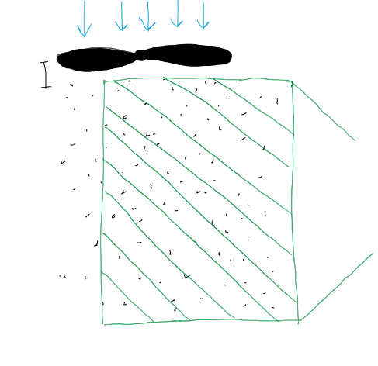
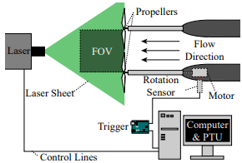
Particle Image Velocimetry
A laser sheet is shined through a particle laden flow
Two highspeed images are taken in quick succession
A computer is used to track the particle movement and create a velocity field
No pressure data

Slide 4
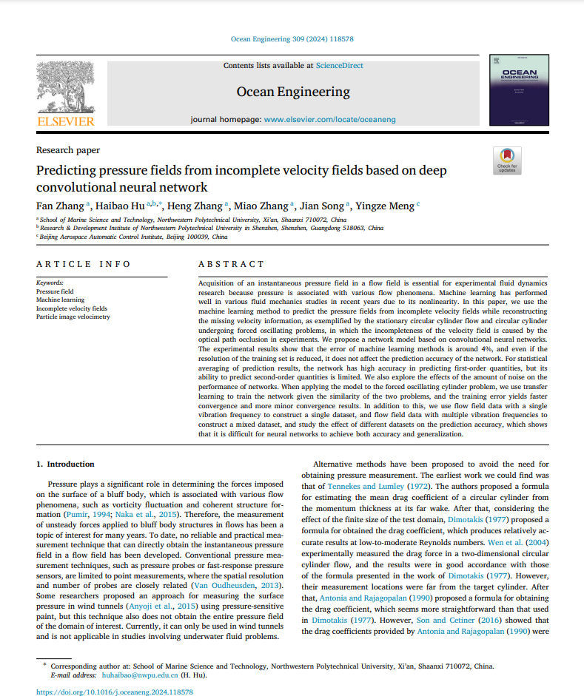
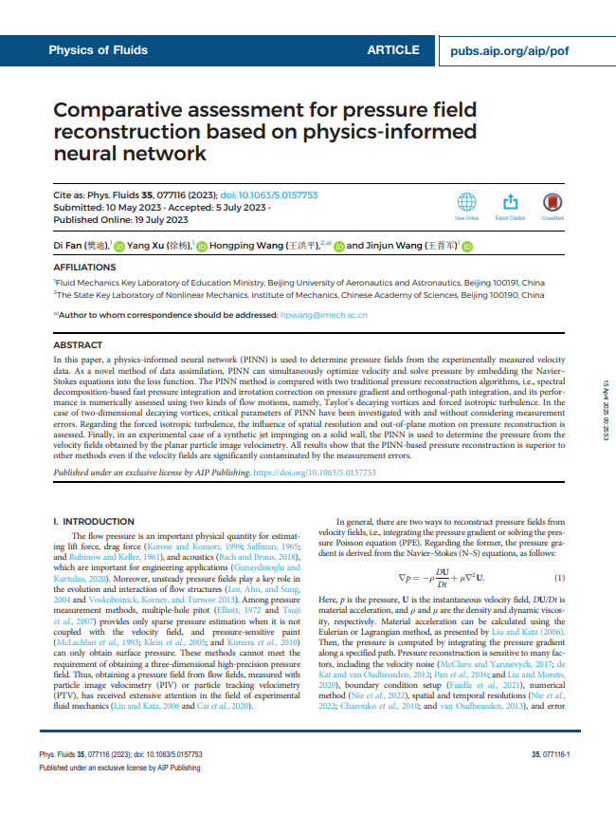



Relevant Literature
ResearchRabbit suggested paper collection (not curated)

Slide 5
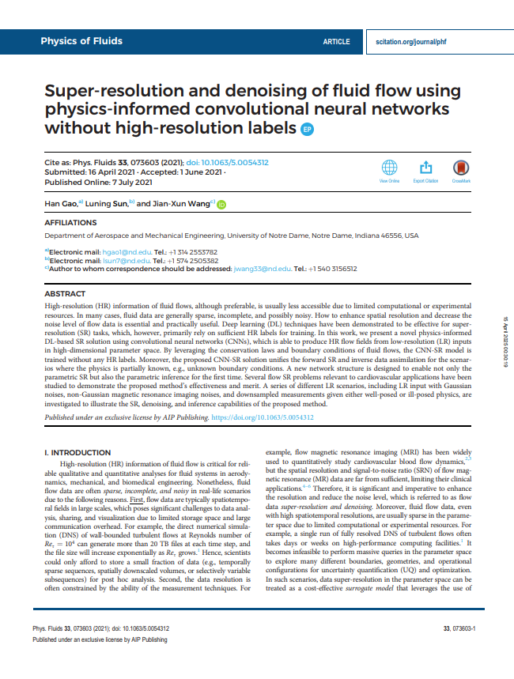

Approach: Vascular Flow (done in class)
Convolutional Neural Net to upscale x and y components of velocity, also predict a pressure field
Governing Equations: x and y momentum from 2D Navier-Stokes, continuity from 2D Navier Stokes
Incorrect pressure field
“The current framework cannot accurately recover the hidden pressure field because of the implicit coupling of pressure and velocity (i.e., the pressure appears as a source term in the momentum equations). The governing equation needs to be reformulated to strongly couple the pressure and velocity predictions based on, e.g., elliptic equation of pressure 81 and Rhie–Chow interpolation.75”

Slide 6
Methods
Uses appropriate methods and best practices. Explains approach with technical rigor (e.g., model architecture, loss functions, training details).

Slide 7
Methods
Convolutional Neural Net: Good for spatially correlated data (flow fields)
Activation Function: ReLU
Layer Channels: 2 (input) -> 16 -> 32 -> 64 -> 32 -> 3 (output)
Kernel Size: 5x5
Padding: 2
Learning Rate: 1e-3, or 1e-4
Modified

Slide 8
Results
Presents results with clear visualizations, proper metrics, and insightful interpretation. Clearly meets or exceeds scope.

Slide 9
Presentation

