Slide 1

STAMP
Peel. Press. Toast.
The Single-Serve Breakfast Spread for Hot Toast
Presenter: Jacob | Course: INFO123 Business AI Project | Date: October 2026
Notes:
TITLE SLIDE (0:00–0:10)
Welcome. I'm Jacob, and this is Stamp: a New Zealand breakfast spread innovation designed for hot toast. Over the next minute, I'll walk you through our product and market opportunity, followed by my personal reflection on building with generative AI.

Slide 2
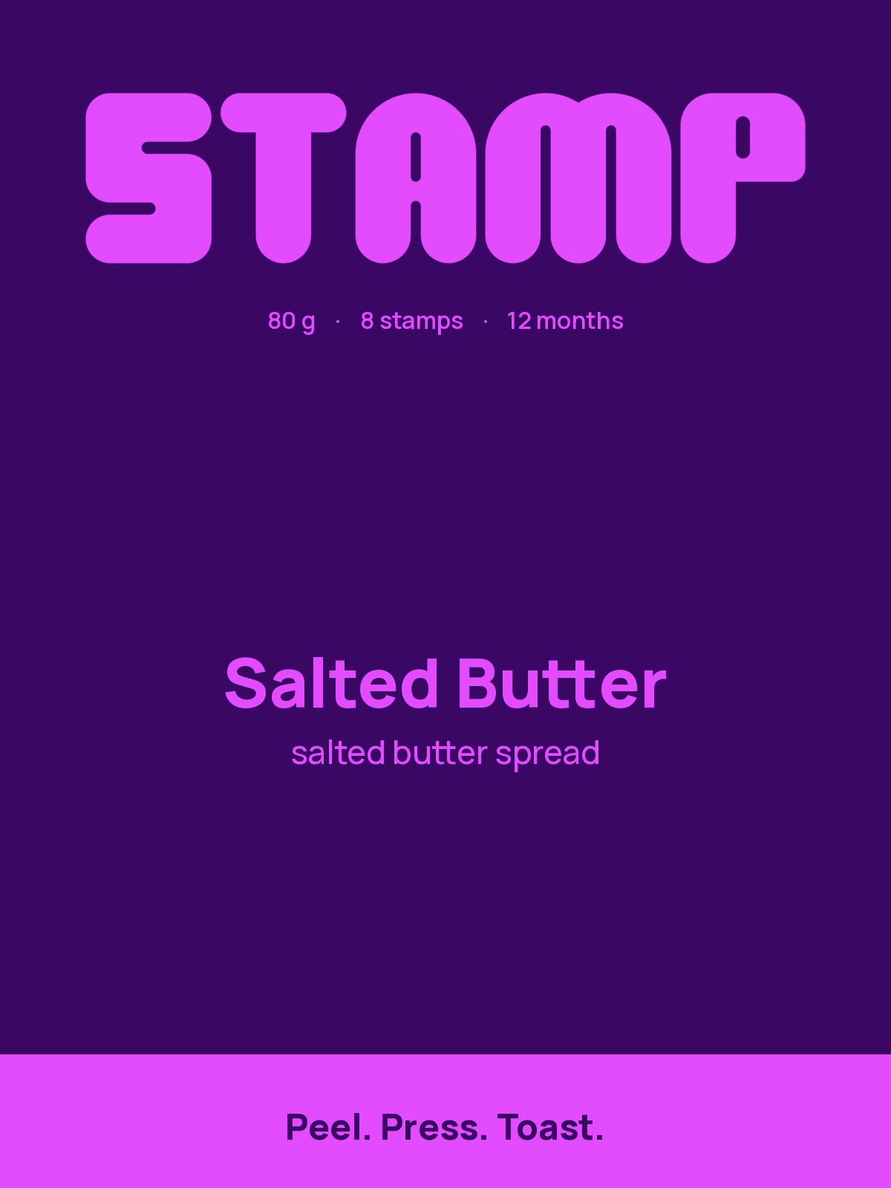
INVESTOR PITCH — PART 1 (30 SECONDS)
Product Innovation: Peel. Press. Toast.
A single-serve 10 g disc on release film: no knife, no open jar, no morning wash-up.
The Problem & The Gesture
• Jars Require Infrastructure: Toast eaten away from home (office desks, flats, university halls) demands a knife, an open tub, and a sink to wash up.
• The Stamp Solution: A thin 10 g disc of real spread on release film nested in a pocketable card sheet. Peel off, press onto hot toast, and residual heat softens it into an even layer in seconds.
• 12-Month Pantry Life: Industrial formulation and sealed release film provide 12 months ambient shelf life without refrigeration.
Four Launch Flavours
✔ Salted Butter: Cultured dairy spread (2 g salt / 78 g fat).
✔ Raspberry: Slow-cooked whole fruit paste (150 g fruit / 100 g).
✔ Yeast Extract: Savory umami paste (80% yeast, 15.5% barley malt).
✔ Peanut: 96% roasted peanuts + hard fat anti-separation stabilizer.
Notes:
PITCH SLIDE 1 (0:10–0:30)
Eating toast away from a kitchen is broken: you have to carry a heavy jar, find a knife, and wash it in an office or hall sink. Stamp fixes this with a peel-and-press spread disc. You peel a 10-gram portion off the release film, press it directly onto hot toast, and the heat melts it into an even layer in seconds. We launch with four distinct flavours: Salted Butter, Raspberry, Yeast extract, and Peanut—all packaged in an 8-stamp card sheet with a 12-month pantry shelf life.

Slide 3
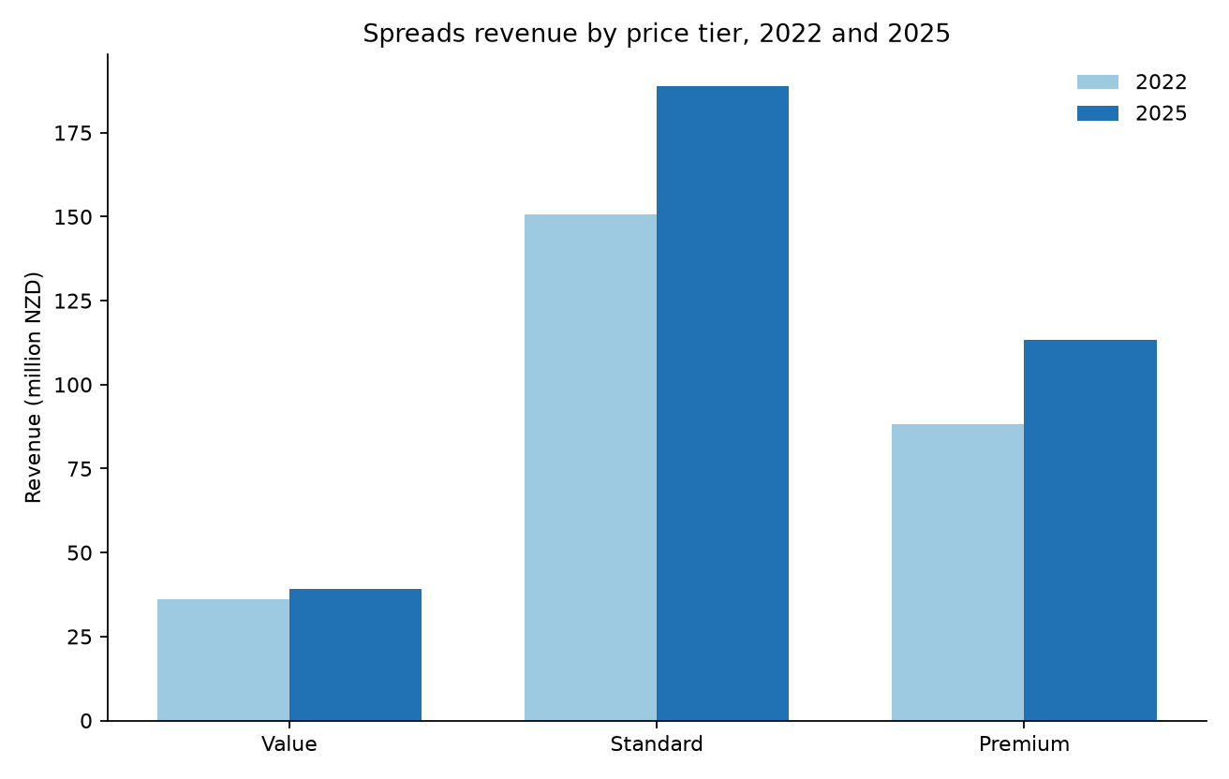
INVESTOR PITCH — PART 2 (30 SECONDS)
Market Opportunity & Competitive Advantage
$341M category with 24% growth, premium tier expansion, and zero portion-format rivals.
Verified NZ Breakfast Data
• Category Expansion: New Zealand spreads revenue grew 24% from $275M (2022) to $341M NZD (2025). Premium spreads grew fastest (+29%, reaching $113M).
• The Format Vacuum: Across 154 spread names in the market, not a single brand offers a single-serve, peel-and-press format.
• Unit Economics: Priced at $5.00 NZD per 80 g sheet ($6.25/100g). Above jar medians ($2.15/100g) because buyers pay for portion control and pocket convenience.
• Attractive Margins: At assumed $1.50 contract manufacturing cost and 35% retail margin, Stamp retains $1.75 contribution per sheet.
Notes:
PITCH SLIDE 2 (0:30–1:00)
Our analysis of New Zealand breakfast retail sales shows spreads grew 24% to 341 million dollars, with the premium tier expanding to 113 million. Yet out of 154 existing spread products, not one offers a portion format. Jars like Fix and Fogg or Pic's are cheaper per 100 grams, but they're bulky and messy. At 5 dollars a sheet, or 63 cents a toast portion, Stamp captures premium convenience for commuters, students, and desk workers. With a healthy 1.75 contribution margin per sheet, Stamp is ready to lead an entirely new format in breakfast.

Slide 4
PERSONAL REFLECTION — PART 2 (STUDENT'S OWN WORDS)
Reflection Q1: Lessons in Working with Generative AI
Prompting techniques, context engineering, session management, and verification.
CRITICAL BRIEF REQUIREMENT: Deliver in your personal voice. AI assistance was strictly prohibited for reflection text.
Context & Steering
• Prompting Beyond Defaults: How role personas, explicit negative constraints, and output formats prevented generic responses.
• Session Partitioning: Why separating data cleaning, visual identity, and copy prevented context drift across 13 stages.
• Prompting Artifact: Carrying locked spec decisions forward rather than re-prompting.
Verification & Pivotal Moment
• Catching Raw Data Errors: Detecting aberrant price outliers (>$40) and missing revenues in raw dataset rather than trusting uncleaned sums.
• The Specific Turning Point: A concrete moment when AI output hallucinated or failed, and the exact steps taken to correct it.
• Independent Sourcing: Verifying real competitor shelf prices directly on New World instead of relying on AI guesses.
Key Lessons Learned
• AI as Junior Drafter, Not Director: Treating model outputs as hypotheses that require rigorous empirical validation.
• Hybrid AI Architecture: Integrating OpenRouter API with a locked system prompt and instant deterministic fallback to eliminate hallucinations.
• What I Would Do Differently: Specific adjustments for future enterprise AI workflows.
Notes:
REFLECTION Q1 (1:00–1:55)
[Jacob's personal reflection: speak directly to camera about your AI steering experience.]
Key speaking cues:
1. Discuss how you structured sessions to avoid context rot across tasks.
2. Detail the pivotal moment where you caught a major AI mistake (e.g. invalid pricing assumptions, unrealistic manufacturing claims, or raw data price spikes) and how you corrected it.
3. Share the single most important lesson you will carry into future professional AI projects.

Slide 5
PERSONAL REFLECTION — PART 2 (STUDENT'S OWN WORDS)
Reflection Q2: Critical Evaluation of AI, Authenticity & Ethics
Combating 'AI slop', regulatory liability, and ethics for future knowledge workers.
CRITICAL BRIEF REQUIREMENT: Deliver in your personal voice. AI assistance was strictly prohibited for reflection text.
Combating 'AI Slop'
• Rejecting Generic Fluff: AI defaults to superlative marketing cliches ('revolutionizing breakfast'). Enforcing concise, plain-spoken prose made Stamp authentic.
• Authentic Physical Design: Anchoring packaging in real industrial constraints (foil release liners, ambient butterfat stability) rather than impossible fantasy designs.
• Human Taste & Tone: Deliberately choosing an off-beat, energetic sound and visual palette.
Regulatory & Legal Risks
• The Hallucination Danger: Left unconstrained, AI frequently invents fake organic labels, false 'gluten-free' badges, or illegal medical claims.
• Strict Enforced Bans: Banning health and therapeutic claims; legally distinguishing 'spread' from refrigerated table butter under FSANZ standards.
• Allergen Responsibility: Ensuring life-threatening peanut and gluten disclosures were never obscured by AI optimism.
Ethics & Future Work
• Accountability Remains Human: When a business deploys AI, legal, moral, and customer accountability cannot be offloaded to an algorithm.
• Value of Critical Thinking: The essential role of the knowledge worker is skepticism, verification, and boundary-setting.
• Personal Perspective: What it means to work ethically alongside AI without surrendering personal agency or judgment.
Notes:
REFLECTION Q2 (1:55–2:50)
[Jacob's personal reflection: speak directly to camera on authenticity and ethics.]
Key speaking cues:
1. How did you actively prevent AI slop from entering Stamp's branding and copy?
2. Address the severe ethical/legal risks of AI generating food claims (allergens, false certifications).
3. Conclude with your personal stance as a future knowledge worker on ethics and responsibility.

