Slide 1
Thyroid Gland

Slide 2
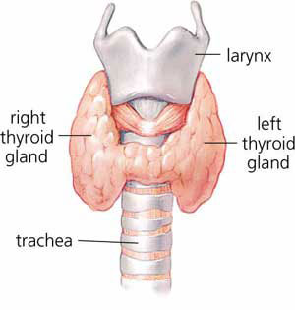
A two lobed gland located at the front part of larynx and trachea.
- A large cartilage of the larynx, a projection of which forms the Adam's apple in humans.
Origin

Slide 3
Function
The thyroid is part of the endocrine system, which is made up of glands that produce, store, and release hormones into the bloodstream so the hormones can reach the body's cells. The thyroid gland uses iodine from the foods you eat to make two main hormones: Triiodothyronine & Thyroxine

Slide 4
Thyroxine & Triiodothyronine – are the two main hormones secreted into the bloodstream by the thyroid gland. It plays vital roles in digestion, heart and muscle function, brain development and maintenance of bones.
Calcitonin - increase bone calcium content and decrease the blood calcium level when it rises above normal.

Slide 5
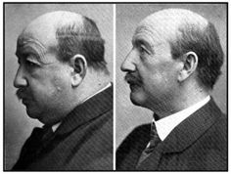
Diseases
Hypothyroidism - abnormally low activity of the thyroid gland, resulting in retardation of growth and mental development in children and adults(cretinism). A severe hypothyroidism may also lead to myxedema coma, a decreased mental status, hypothermia, and other symptoms related to slowing of function in multiple organs.

Slide 6
Hyperthyroidism - overactivity of the thyroid gland, resulting in a rapid heartbeat and an increased rate of metabolism.
Hyperthyroidism may cause swelling of the neck resulting from enlargement of the thyroid gland(Goiter), and swelling of the neck and protrusion of the eyes(Grave’s disease).

Slide 7
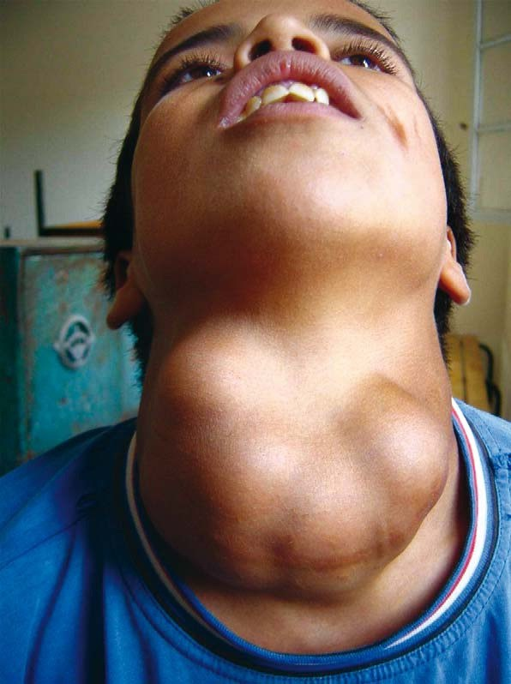
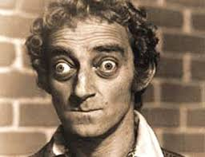
Grave’s Disease
Goiter

Slide 8
Parathyroid glands

Slide 9
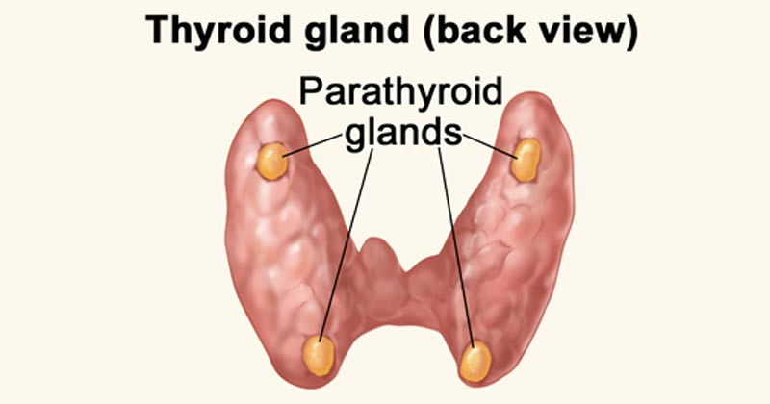
parathyroid glands are four tiny glands, located at the back of the thyroid gland.
The four small tissues are called parathyroids.

Slide 10
Function
The parathyroid glands secretes parathormones that controls and regulate the body's calcium levels.
Oppose the action of calcitonin when it exceeds normal levels

