Slide 1

Jabez Dickson
Digital Forensics Investigation on MS17-010

Slide 2
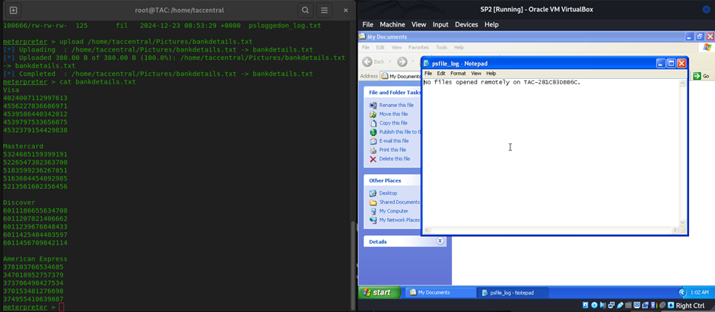
PSFILE eVIDENCE

Slide 3
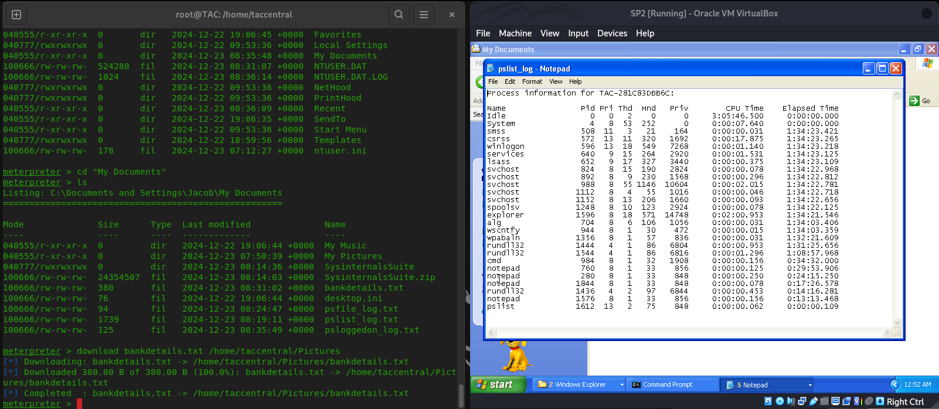
Pslist Evidence

Slide 4
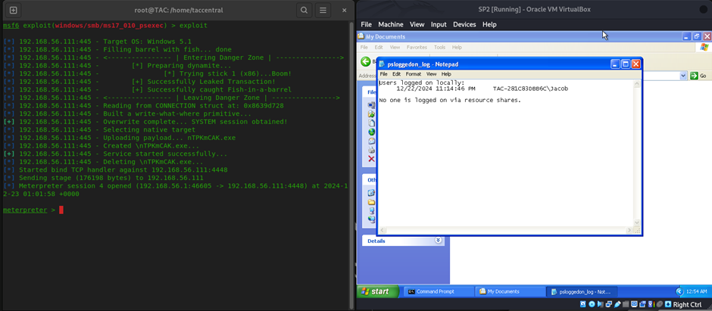
PSLOGGEDON eVIDENCE

Slide 5
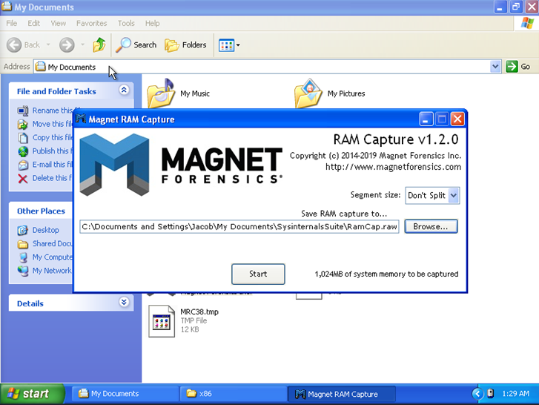
Ram capture using Magnet

Slide 6
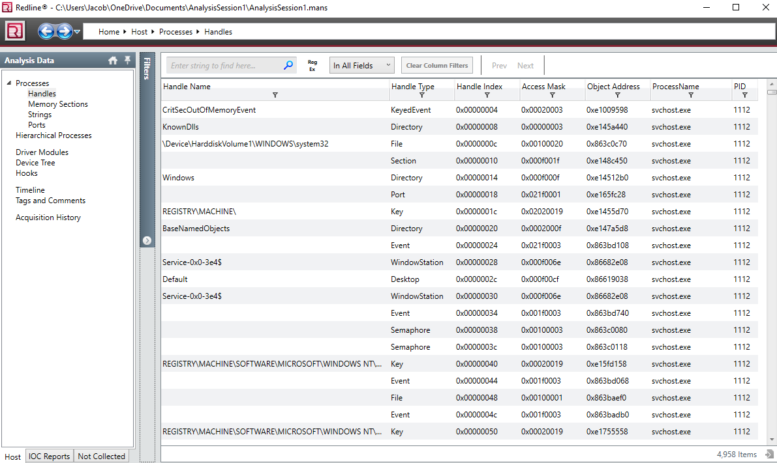
Event Handler Analysis

Slide 7
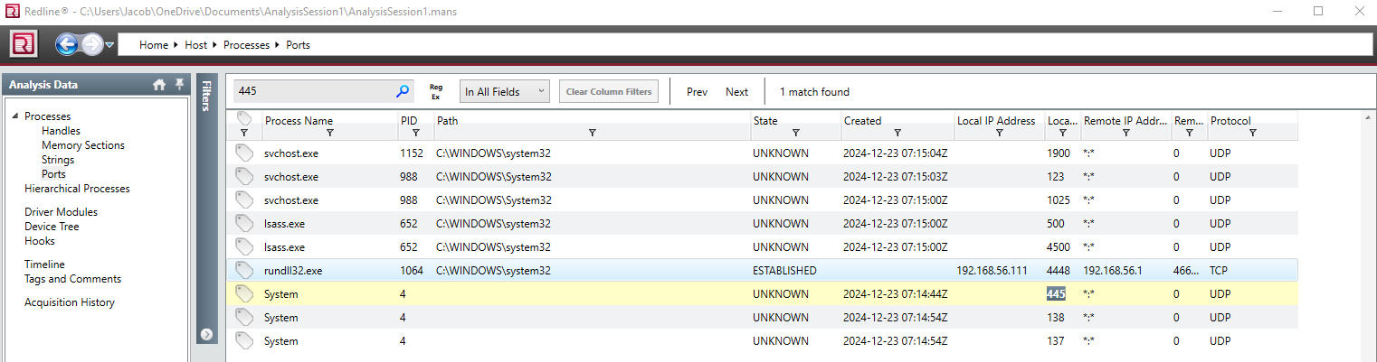
Redline Port Analysis

Slide 8
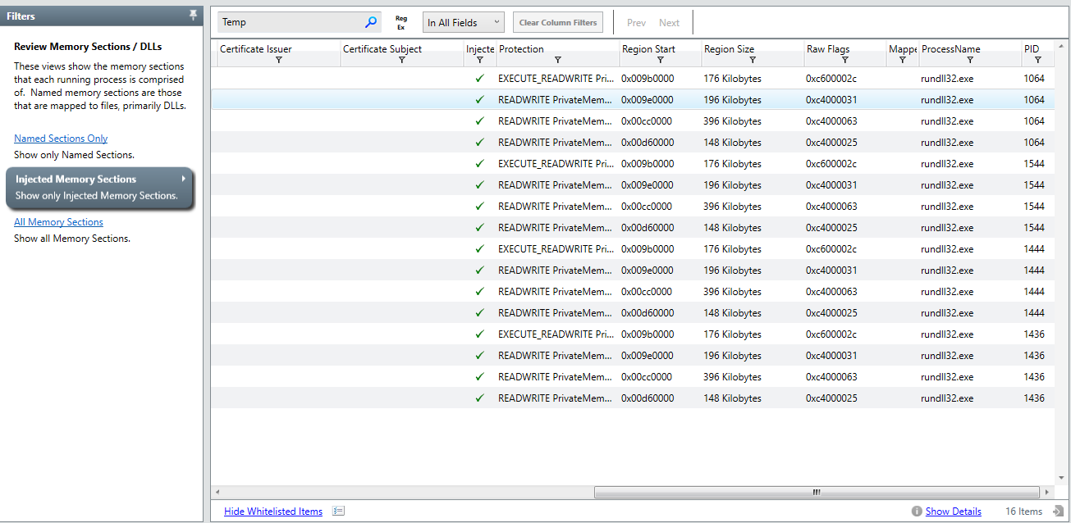
Injected Memory Analysis

Slide 9
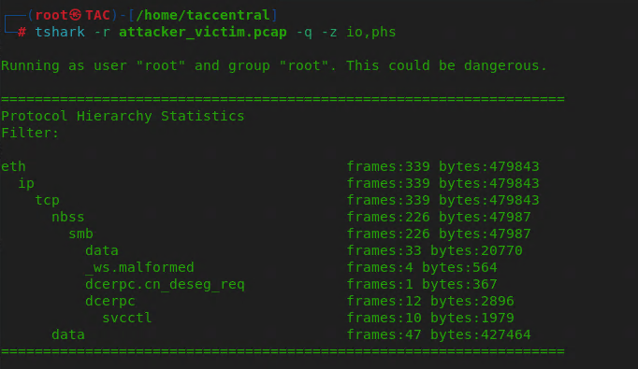
Network Protocol Usage

Slide 10
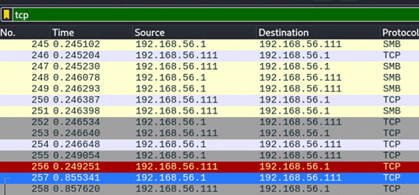
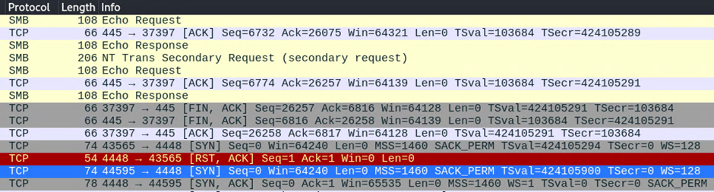
Wireshark Packet analysis

Slide 11
NMAP SCANNING – syn pACKETS

Slide 12
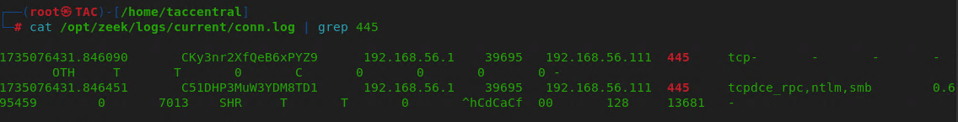
Ids ZEEK LOGS

