Slide 1


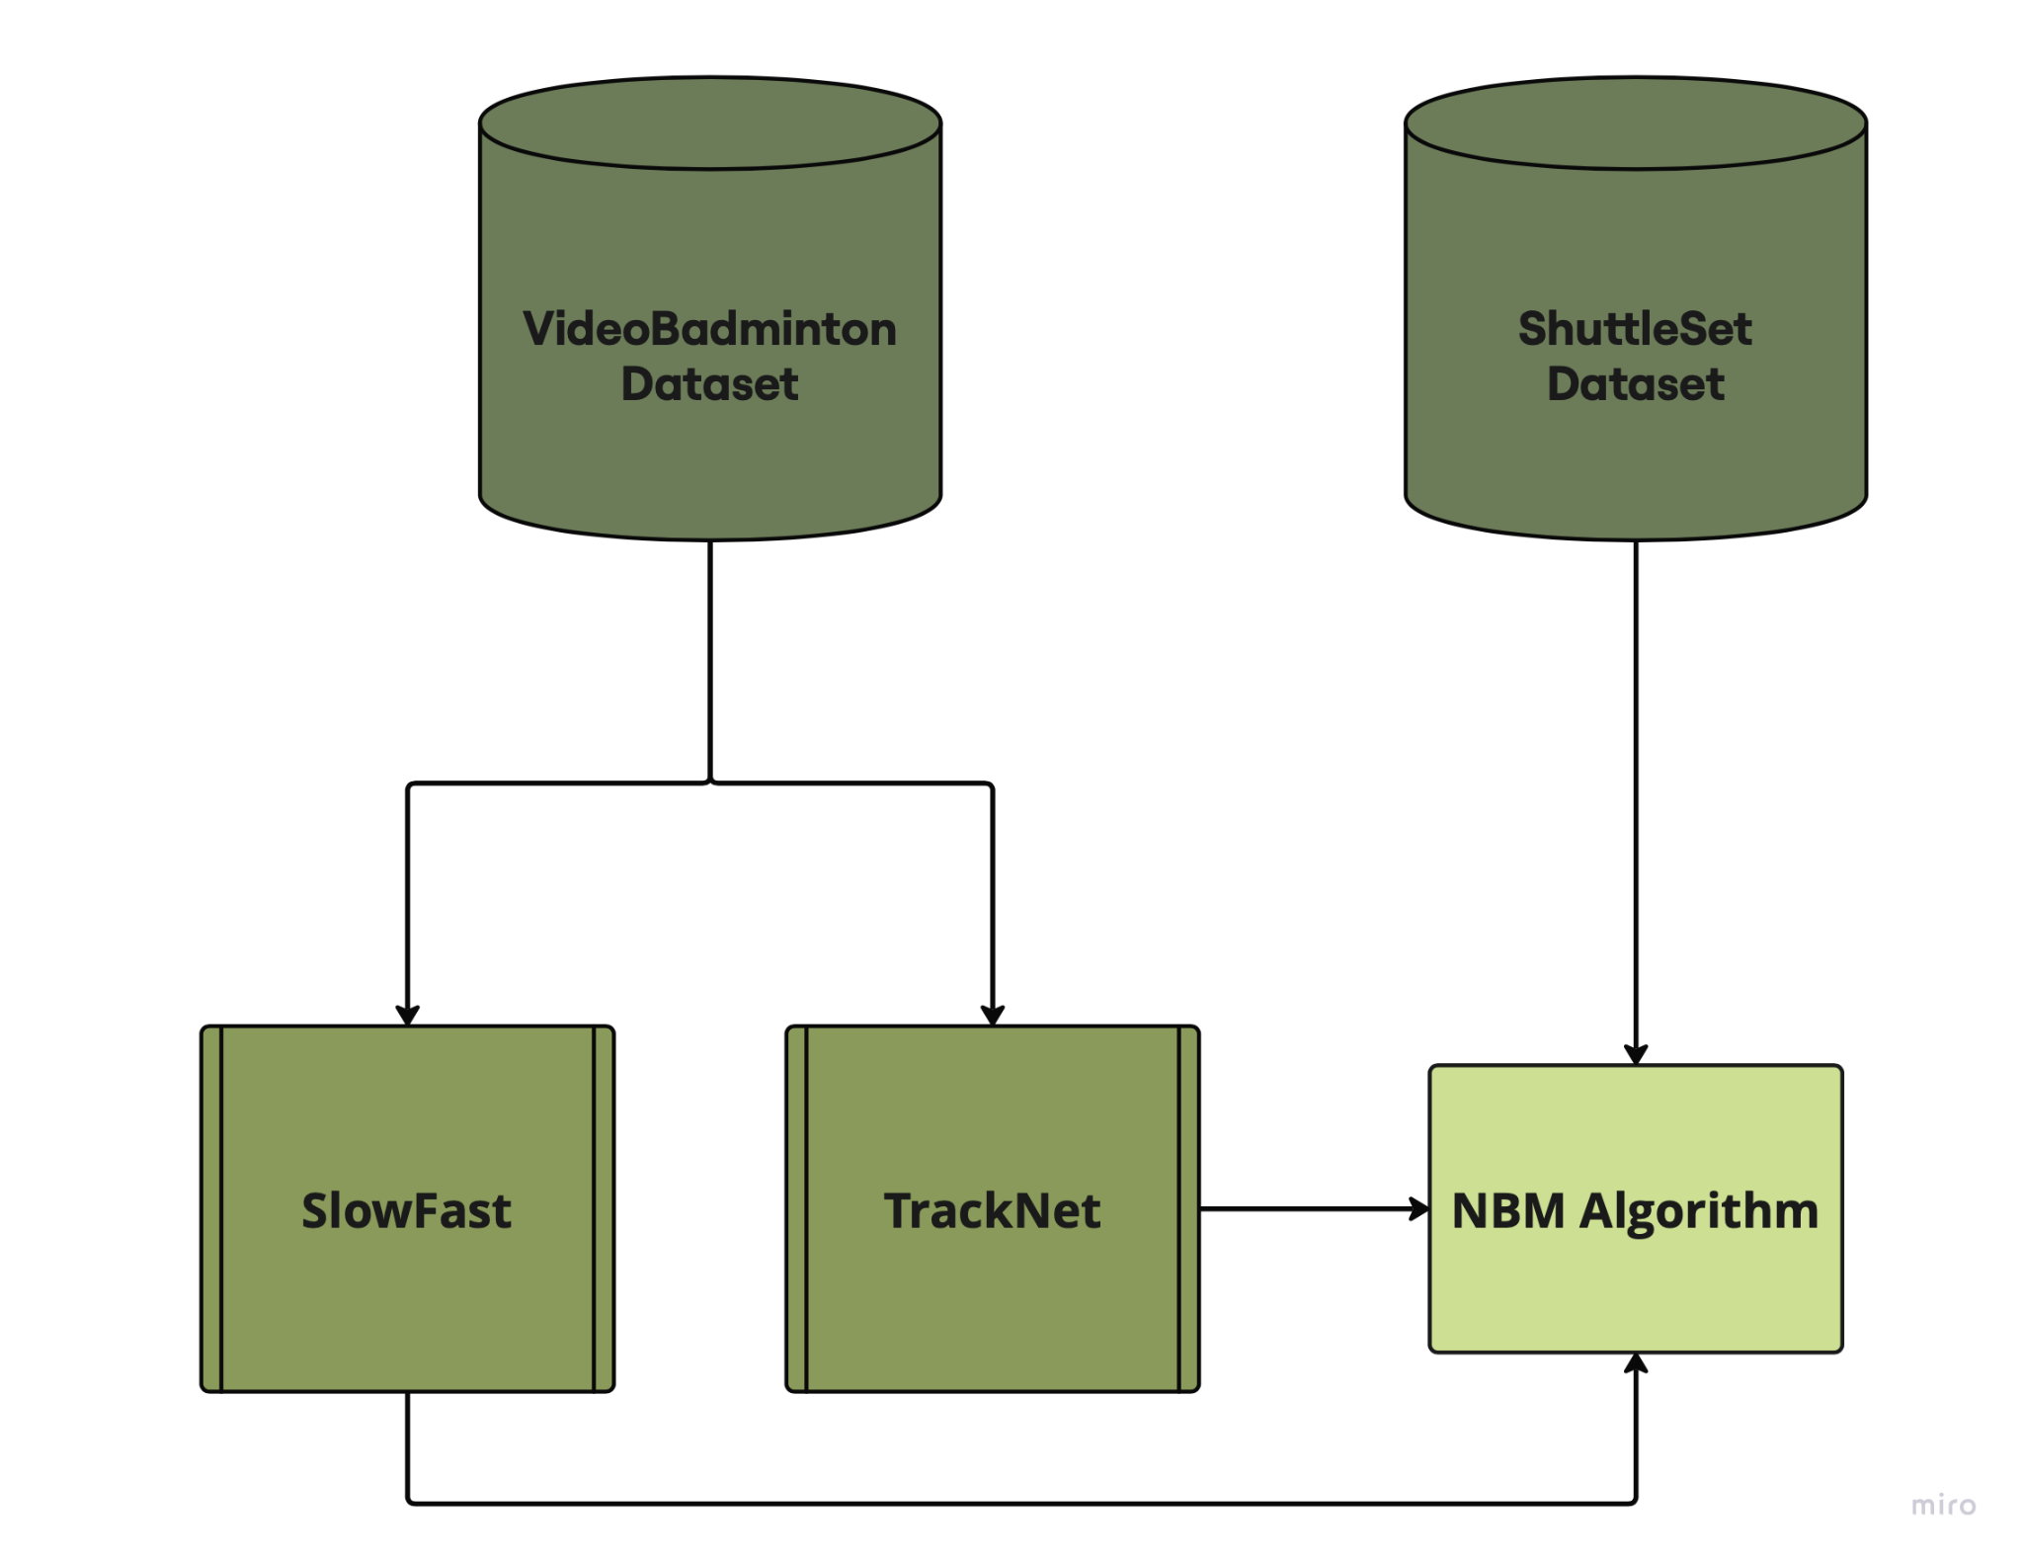
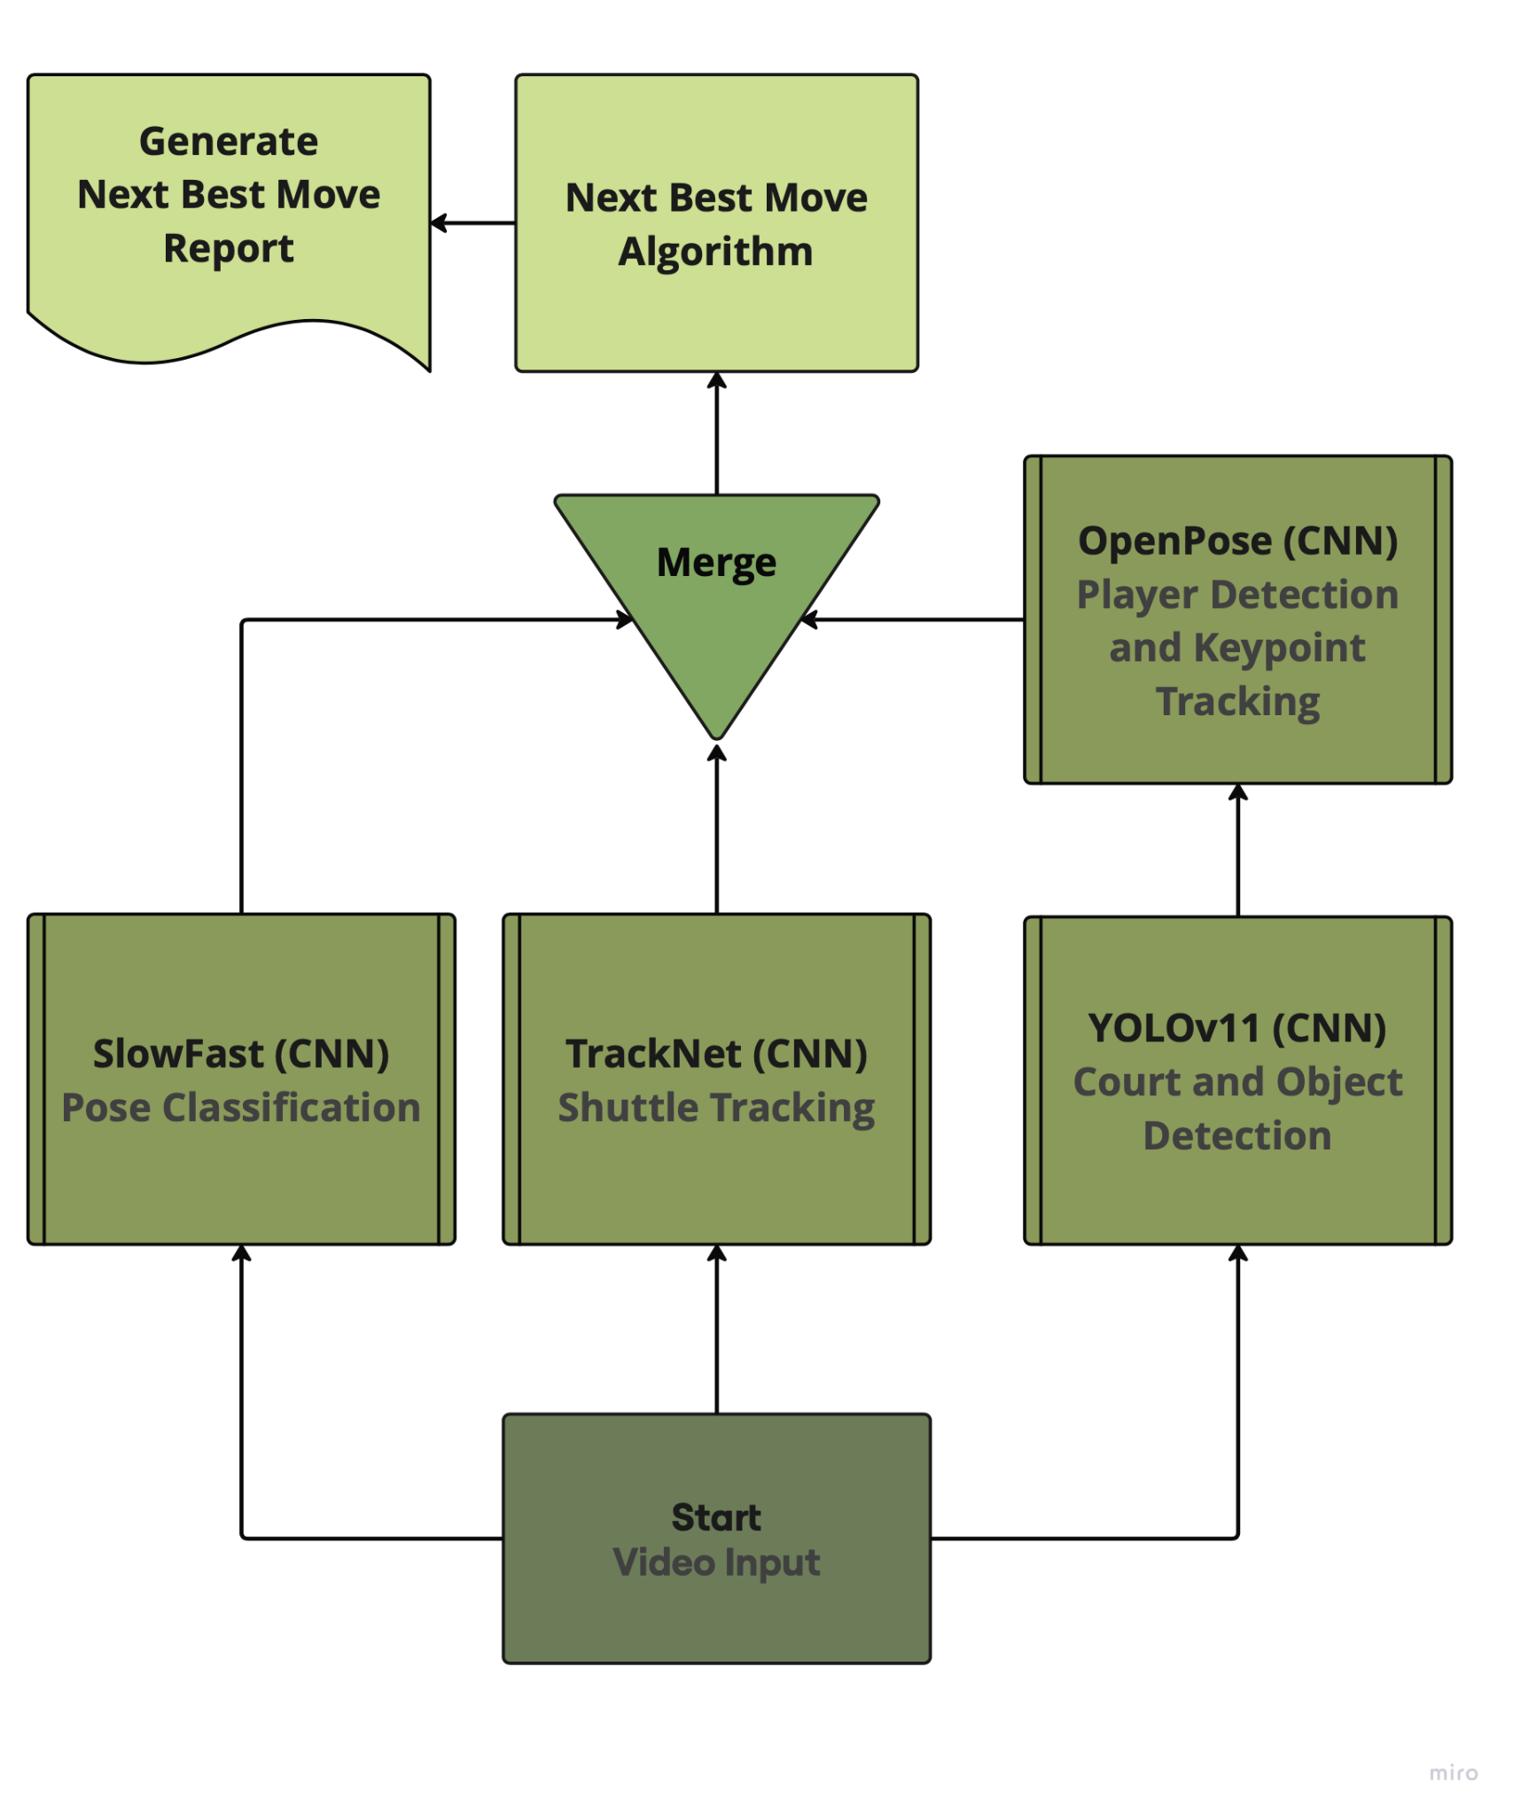
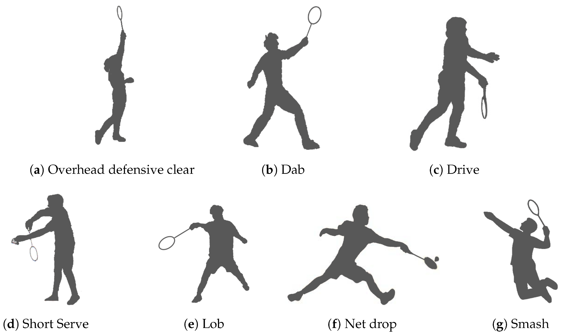
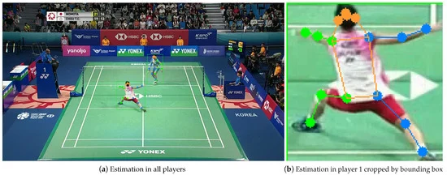
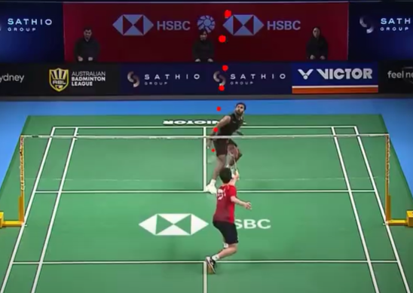
Introduction
Model
Badminton isn’t very popular in the US, and finding places to play or afford coaching can be tough, especially for lower income athletes. With few dedicated facilities and coaching costs as high as $50–100 per hour, many players struggle to get proper training. To make badminton more accessible, we created an AI powered app that uses computer-vision and machine learning techniques to analyze game strategy and give personalized feedback. This will allow players to improve their skills through video analysis without relying on expensive in-person coaching.
AI Approach to Coaching Badminton Strategy with Mobile App
OpenPose and TrackNet are used to track players and the shuttle in real-time. OpenPose detects and players’ keypoints (Figure 4) and the court in each frame, while TrackNet follows the shuttle's trajectory (Figure 5). The VideoBadminton dataset is used to train the TrackNet model and a SlowFast model that detects player strokes throughout the match (Figure 2). The model temporally segments the input video and feeds it to the Next Best Move Algorithm. The Next Best Move Algorithm is trained on the ShuttleSet Dataset, which includes stroke-level records from top ranking singles matches. NBM predicts the best moves for a player based on positions, strokes, and scores, helping build game sense and improve performance.
Computer Systems Lab
2024-2025
İpek Sayar, Jacob Dipasupil
Figure 2. Flowchart of Training
Figure 3. Flowchart of Procedure
Figure 4. Player Tracking
Figure 5. TrackNet
Figure 1. Core Badminton Strokes.
Results
Badminton uses a combination of core strokes (Figure 1) throughout the game. The overhead clear sends the shuttle high and deep to push opponents back, while the drive is a fast, straight shot to keep rallies quick. The smash is the strongest attack, hitting the shuttle down sharply to score points. At the net, the net drop places the shuttle just over the net to force a weak return, while the dab is a quick push used in doubles for control. The lob is a high, defensive shot to reset the rally. The serve starts each point, with different types like the high serve, low serve, flick serve, and drive serve. While learning these strokes should be the among the first few techniques to learn when training badminton, it’s equally important to gain an intuition for when to use each one, so we developed SmartRally.
System Architecture
Every input video to the app is processed through a series of AI models: a SlowFast model trained on the VideoBadminton dataset for pose detection, a TrackNet model for shuttle trajectory tracking, and a YOLOv11 OpenPose model for player localization (Figure 3). The system then predicts the Next Best Move (NBM) using a custom 1-3-1 neural network trained on the ShuttleSet dataset, which analyzes real-time player movement data to determine the optimal sequence of actions during gameplay. Using OpenCV, the system overlays annotations on the video, showing what move the player should have performed and where they should have aimed on the court to maximize their chances of scoring against their opponent at each point in the match. This information is presented through an interactive app, where the user can view separate video clips for each move, navigate between them, and receive detailed feedback. Users can also save the generated videos under custom names in an archive, allowing them to easily access the same feedback later.
In 737 rallies and 7,298 strokes for 27 of the top-ranking singles players in matches from 2018 to 2021, the Next Best Move Algorithm achieved an accuracy of approximately 70%. The SmartRally advice is not absolute, and there are hundreds of way to win a match. However, SmartRally gives the stroke with the most consistent results. With the use of SmartRally, users can gain an intuitive understanding of the types of strokes to use depending on the shuttle trajectory and player positions. Of course, to elevate skill, players should seek proper training by a professional, however SmartRally serves as an accessible resource for those who want to learn, but don’t have the resources to start.
Notes:
Nexshot
SmartRally

Slide 2

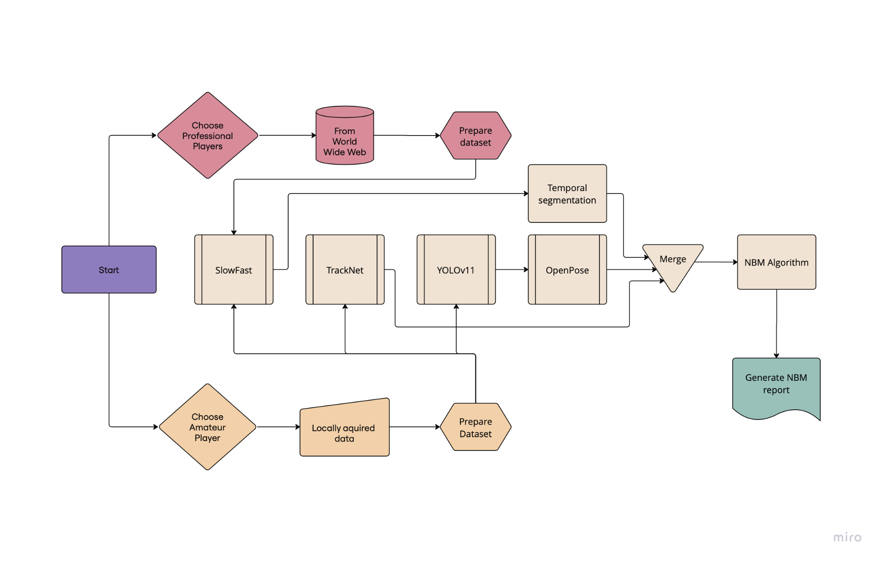
Introduction
Model
Badminton isn’t very popular in the US, and find -ing places to play or afford coaching can be tough, especially for lower-income athletes. With few dedicated facilities and coaching costs as high as $50–100 per hour, many players struggle to get proper training. To make badminton more accessible, we are creating an AI powered app that uses computer-vision and machine learning techniques to analyze stroke techniques and give personalized feedback. This will allow players to improve their skills through video analysis without relying on expensive in-person coaching.
AI Approach to Coaching Badminton Strategy with Mobile App
YOLOv11 and TrackNet are used to track players and the shuttle in real-time. YOLOv11 detects and locates players and the shuttle in each frame, while TrackNet follows the shut -tle's trajectory. This data feeds into the Pose Correction Model, which uses the SlowFast network to analyze both fast shuttle move -ments and slow player actions, correcting posture and stroke technique. The Next Best Move Algorithm is trained on the ShuttleSet Dataset, which includes detailed match data from Olympic games. It predicts the best moves for a player based on positions, strokes, and scores, helping build game sense and improve performance.
Computer Systems Lab
2024-2025
İpek Sayar, Jacob Dipasupil
Figure 2. Flowchart of procedure.
Figure 3. Pose Estimation.
Figure 4. TrackNet.
Figure 1. Core Badminton Strokes.
System Architecture
Results
Badminton uses a combination of core strokes throughout the game. The overhead clear sends the shuttle high and deep to push opponents back, while the drive is a fast, straight shot to keep rallies quick. The smash is the strongest attack, hitting the shuttle down sharply to score points. At the net, the net drop places the shuttle just over the net to force a weak return, while the dab is a quick push used in doubles for control. The lob (lift) is a high, defensive shot to reset the rally. The serve starts each point, with different types like the high serve (deep and slow for singles), low serve (short and precise for dou -bles), flick serve (fast and deceptive), and drive serve (flat and aggressive). Learning these str -okes helps players improve their game and play smarter.
We start by collecting player tracking data (from uploaded videos for amateur and olympics games for professional) and preparing the dataset for training. The training dataset is fed into machine learning models like TrackNet (for trajectory prediction), YOLOv11 (for real- time player detection), and OpenPose (for pose estimation). These models are then merged to improve accuracy. Next, the testing dataset evaluates performance, checking for errors in player movement predictions. The system predicts the Next Best Move (NBM) through a specialized neural network that analyzes real-time player movement data to determine optimal sequences. Finally, the system generates a pose correction report and an NBM report.
Notes:
Nexshot
SmartRally

Slide 3
Introduction
SmartRally
Model
Badminton isn’t very popular in the US, and find -ing places to play or afford coaching can be tough, especially for lower-income athletes. With few dedicated facilities and coaching costs as high as $50–100 per hour, many players struggle to get proper training. To make badminton more accessible, we are creating an AI powered app that uses computer-vision and machine learning techniques to analyze stroke techniques and give personalized feedback. This will allow players to improve their skills through video analysis without relying on expensive in-person coaching.
AI Approach to Coaching Badminton Strategy with Mobile App
YOLOv11 and TrackNet are used to track players and the shuttle in real-time. YOLOv11 detects and locates players and the shuttle in each frame, while TrackNet follows the shut -tle's trajectory. This data feeds into the Pose Correction Model, which uses the SlowFast network to analyze both fast shuttle move -ments and slow player actions, correcting posture and stroke technique. The Next Best Move Algorithm is trained on the ShuttleSet Dataset, which includes detailed match data from Olympic games. It predicts the best moves for a player based on positions, strokes, and scores, helping build game sense and improve performance.
Computer Systems Lab
2024-2025
İpek Sayar, Jacob Dipasupil
Figure 2. Flowchart of procedure.
Figure 3. Pose Estimation.
Figure 4. TrackNet.
Figure 1. Core Badminton Strokes.
System Architecture
Results
Badminton uses a combination of core strokes throughout the game. The overhead clear sends the shuttle high and deep to push opponents back, while the drive is a fast, straight shot to keep rallies quick. The smash is the strongest attack, hitting the shuttle down sharply to score points. At the net, the net drop places the shuttle just over the net to force a weak return, while the dab is a quick push used in doubles for control. The lob (lift) is a high, defensive shot to reset the rally. The serve starts each point, with different types like the high serve (deep and slow for singles), low serve (short and precise for dou -bles), flick serve (fast and deceptive), and drive serve (flat and aggressive). Learning these str -okes helps players improve their game and play smarter.
We start by collecting player tracking data (from uploaded videos for amateur and olympics games for professional) and preparing the dataset for training. The training dataset is fed into machine learning models like TrackNet (for trajectory prediction), YOLOv11 (for real- time player detection), and OpenPose (for pose estimation). These models are then merged to improve accuracy. Next, the testing dataset evaluates performance, checking for errors in player movement predictions. The system predicts the Next Best Move (NBM) through a specialized neural network that analyzes real-time player movement data to determine optimal sequences. Finally, the system generates a pose correction report and an NBM report.
Notes:
Nexshot
SmartRally

Slide 4
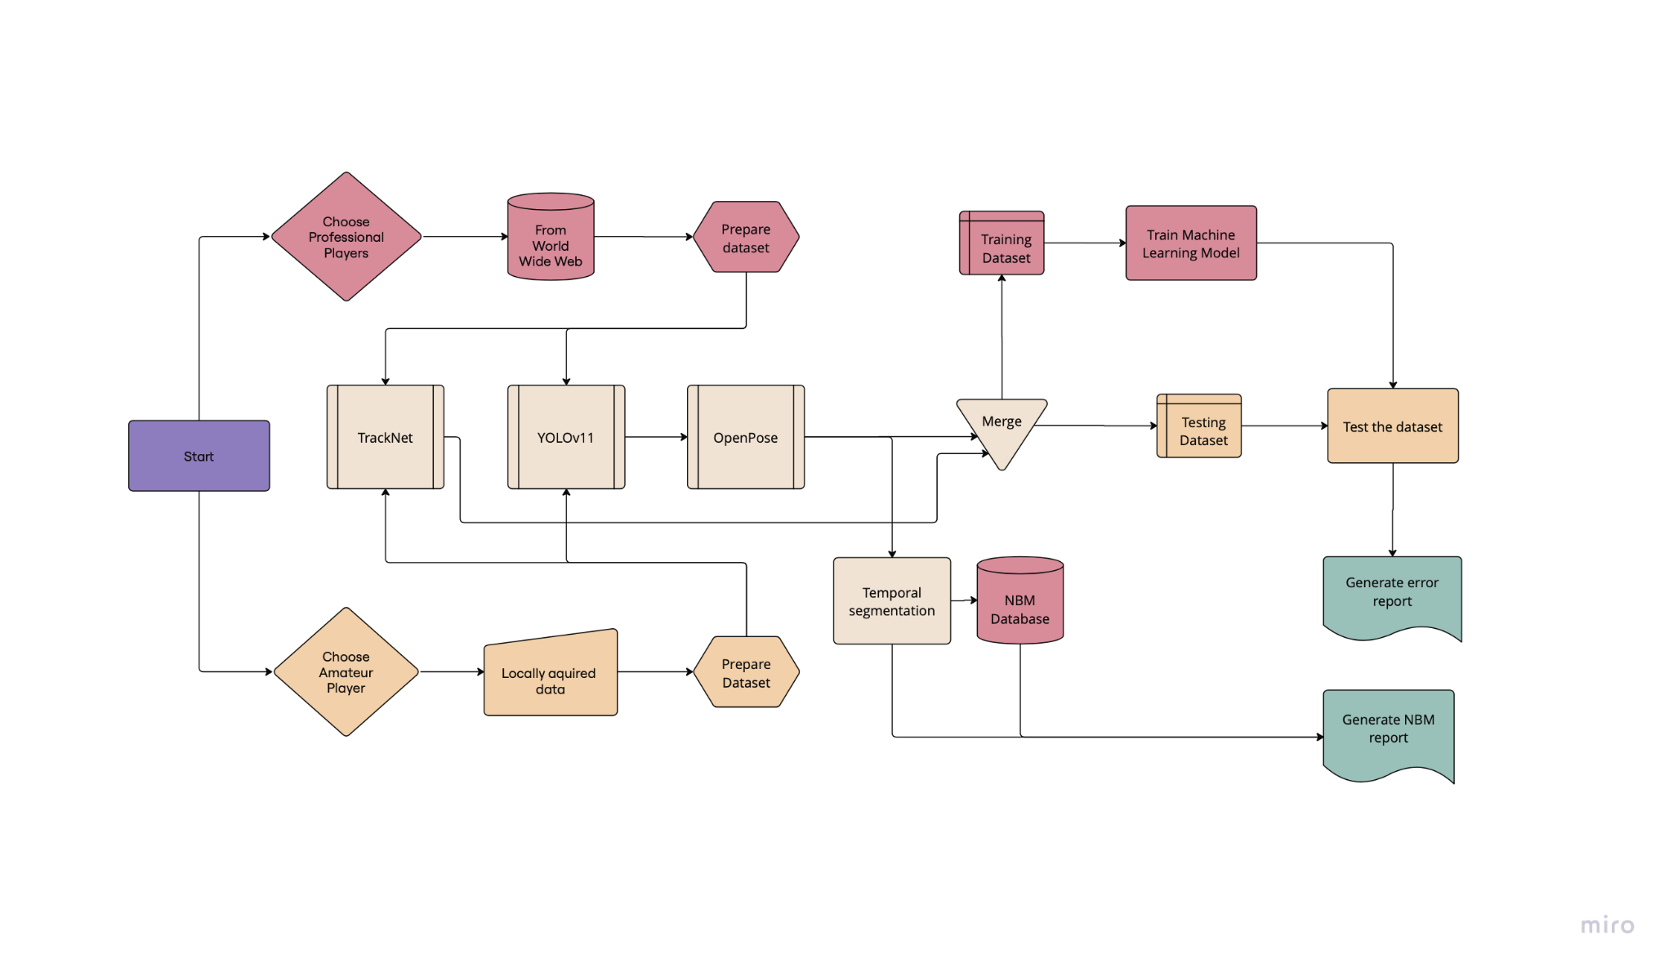
Introduction
AI Badminton Coach
Computer Systems Lab
2024-2025
Ipek Sayar, Jacob Dipasupil
Models
Badminton isn’t very popular in the US, and find -ing places to play or afford coaching can be tough, especially for lower-income athletes. With few dedicated facilities and coaching costs as high as $50–100 per hour, many players struggle to get proper training. To make bad- minton more accessible, we are creating an AI- powered app that uses computer-vision and machine-learning techniques to analyze stroke techniques and give personalized feedback. This will allow players to improve their skills through video analysis—without relying on expensive in-person coaching.
YOLOv11 and TrackNet are used to track players and the shuttle in real-time. YOLOv11 detects and locates players and the shuttle in each frame, while TrackNet follows the shuttle's trajectory. This data feeds into the Pose Correction Model, which uses the SlowFast network to analyze both fast shuttle movements and slow player actions, correcting posture and stroke technique. The Next Best Move Algorithm is trained on the ShuttleSet Dataset, which includes detailed match data from Olympic games. It predicts the best moves for a player based on positions, strokes, and scores, helping build game sense and improve performance.
System Architecture
We start by collecting player tracking data (from uploaded videos for amateur and olympics games for professional) and preparing the dataset for training. The training dataset is fed into machine learning models like TrackNet (for trajectory prediction), YOLOv11(for real- time player detection), and OpenPose (for pose esti- mation). These models are then merged to improve accuracy. Next, the testing dataset evaluates per- formance, checking for errors in player movement pre- dictions. The system predicts the Next Best Move (NBM) through a specialized neural network that ana- lyzes real-time player movement data to determine optimal se- quences. Finally, it generates a pose corr- ection report and an NBM report.
Figure 3. Pose Estimation.
Figure 4. TrackNet.
Figure 1. Core Badminton Strokes.
Results
Badminton uses a combination of core strokes through- out the game. The overhead clear sends the shuttle high and deep to push opponents back, while the drive is a fast, straight shot to keep rallies quick. The smash is the strongest attack, hitting the shuttle down sharply to score points. At the net, the net drop places the shuttle just over the net to force a weak return, while the dab is a quick push used in doubles for control. The lob (lift) is a high, defensive shot to reset the rally. The serve starts each point, with different types like the high serve (deep and slow for singles), low serve (short and precise for doubles), flick serve (fast and deceptive), and drive serve (flat and aggressive). Learning these strokes helps players improve their game and play smarter.
Figure 2. Flowchart of procedure.

