Slide 1


HVAC Proposal App
Jacob Dominski
University of Advancing Technology
Advancing Computer Science, SIP311

Slide 2
Technical Field & Background Information
Within my client’s company, they currently have to use pen and paper to write a proposal for their customers. This process can take upwards to one day and during that time, they have the potential to lose that customer to a competitor. I would like to make an app that shorten the process to only take a couple of minutes.
My project involves the technical fields of programming and computer science.

Slide 3
Project Description
This project aims to create a faster and more efficient workflow within my client’s company. My app is meant for the HVAC industry where is big portion of that industry still use pen and paper.
Currently, there process is to go and check the unit. Then, return back to management where they create a proposal on the computer. This can take up to one day and they might lose the customer during that time.
My idea would let the technician create the proposal while on the job to decreasing the time taken to get the customer to agree to the proposal. This would increase workflow and efficiency by approximately 25% – 30%.
The app works by letting the technician create a form where they select the options the customer needs for an AC unit installation. Then, it will generate a form where both the customer and the technician will sign the document and an email will be sent to both the company and the customer so work can begin.

Slide 4
Innovation Claim
This project is innovative because it will change the way my clients do business and engage with their customers in a new and technological way.

Slide 5
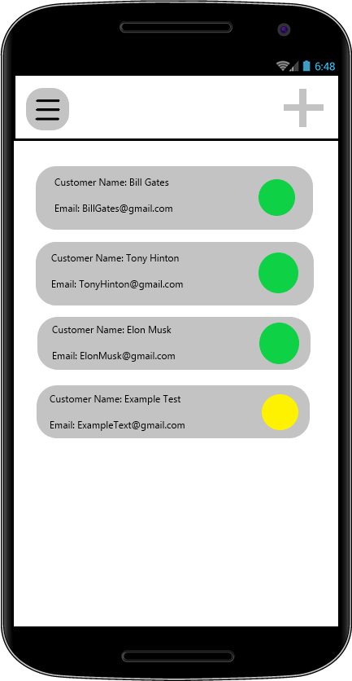
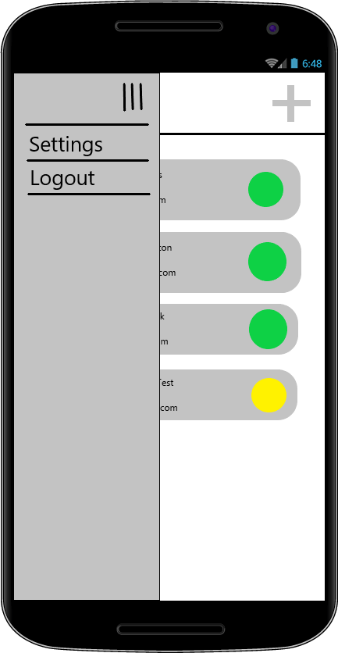
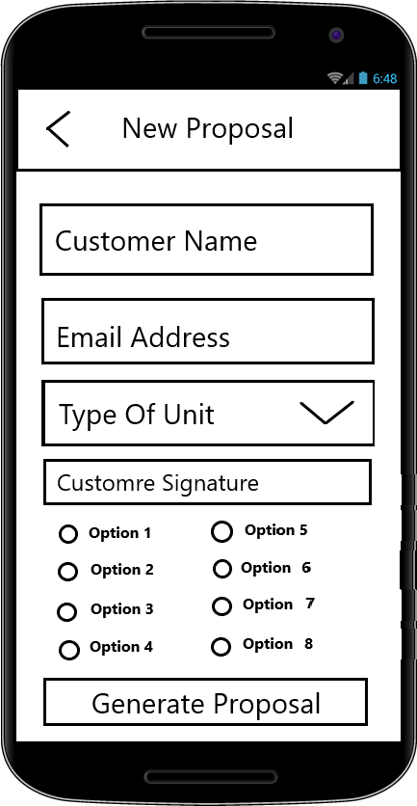
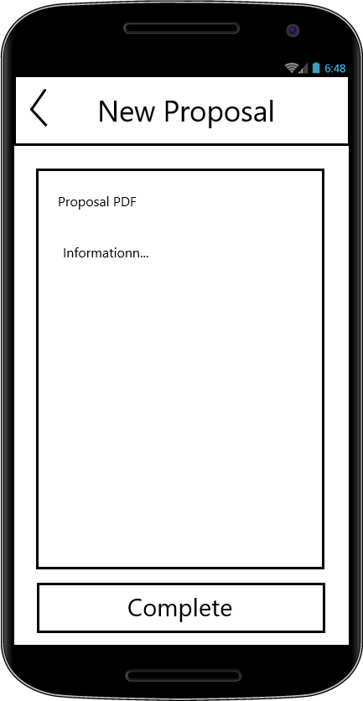
Insert image, sketch/prototype or rendering of idea here.
My scope consists of having multiple iterations of my app starting with a blank app and continuously updating to include all the features necessary. Currently it is only me on the team, so I will be handling the entire project, and the timeline for having a MVP by the SIP404 showcase will be the app that can accept user information and generate a form with that information inside. Additionally, account creation capabilities would not be at the final stages at that point.

Slide 6
Target Market
This project targets the HVAC industry where a significant amount of processes are done on paper.

Slide 7
Prior Art
Go Canvas:
https://www.gocanvas.com/mobile-forms-apps/137-Heating-Ventilation-Air-Conditioning-HVAC-/show_category (Links to an external site.)
Utility Mobile Apps:
https://www.utilitymobileapps.com/hvac-estimates-app/ (Links to an external site.)
Proposal Builder:
https://download.cnet.com/HVAC-Proposal-Builder-Pro/3000-2124_4-76366991.html (Links to an external site.)
Note: Ensure to explain how your idea differentiates from prior art and existing IP.

Slide 8
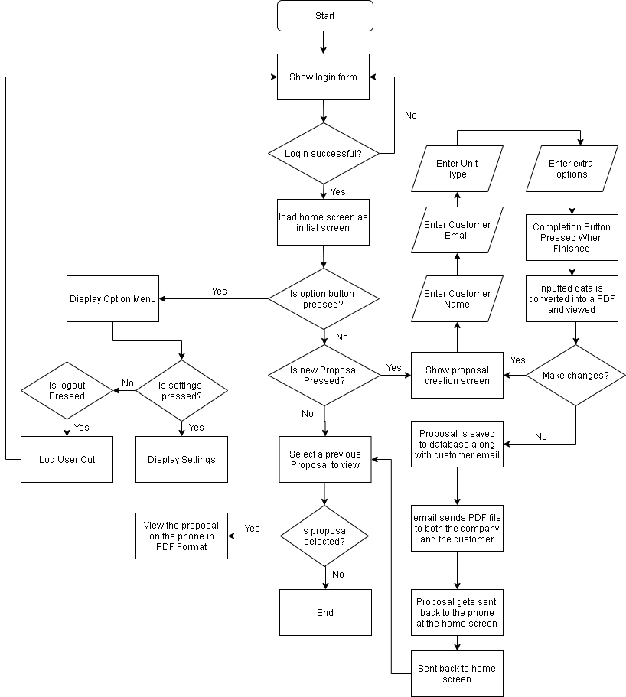
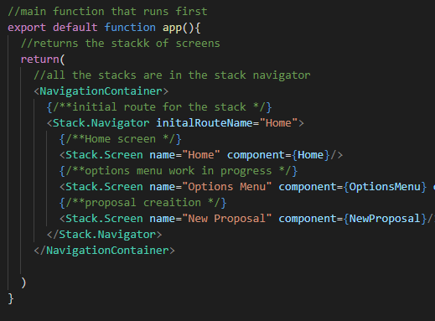
Prototype & Timeline/Scope

Slide 9
Q&A
Jacob Dominski: Computer Science
Innovation Claim: This project is innovative because it will change the way my clients do business and engage with their customers in a new and technological way.

