Slide 1
CP SS19
Work-, Dev-Flow & Architecture

Slide 2
Workflow
Kanban (Backlog, ToDo, In Progress, Done)
Github projects as project mgmt tool
GitHub issues for implementation tasks
Feedback loops as needed
User stories
Regular planning / refinement of stories and issues
GitHub issue templates

Slide 3
Devflow
Simplified GitFlow
Branches: master, feature/…, fix/…, refactor/…
Opening PR into master
Clear and consistent commit messages
Short title: Add, Update, Change, Remove, …
Detailed body if needed
Related issues
At least 1 or 2 reviews before merging
CI checks: linter, tests, ...

Slide 4

Architecture
Lazy
Netting Tx
Produce / Consume Tx
Utility
External
Data
Stream
Smart
Meter
Prosumer
EOA
Authority
Node
Validator
Set
Uses /
Is part of
Local
Web UI
Notes:
ValidatorSet contract to trigger -> netting tx
Interval target ~ 1h, 15 mins
For mock a value each 60 secs
Send produce / consume tx every minute
UI types: household internal view and exposed view: prices

Slide 5
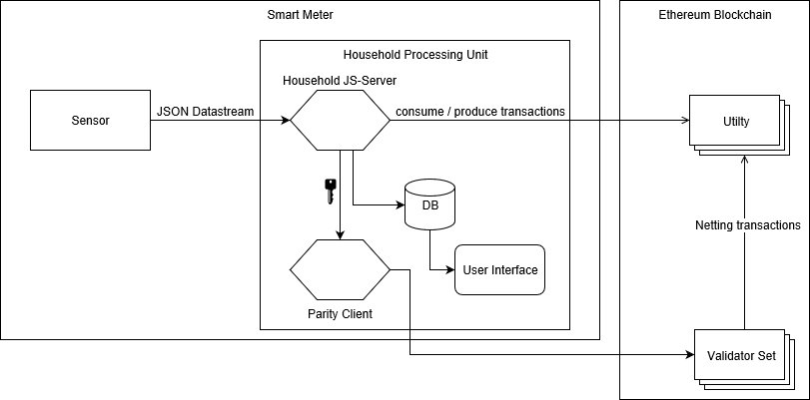
Architecture 2.0
Notes:
Household Processing Unit consisting of
a Node.js server (Household JS-Server; HHS)
The Parity Client/Authority Node providing a private key to the HHS
A database containing all logged data ffrom the HHS
A User Interace displaying (live) data from the HHS
Sensors send data via JSON datastream to the HHS
The HHS sends consume and produce transactions directly to the Utility Contract (Smart Contract, UC)
UC is responsible for netting
Validator Set (Smart Contract; VS) triggers netting by sending a netting trnsaction to the Validator Set
VS contains a list including all authority nodes
Parity client updates regulary its local copy of the validator set

Slide 6
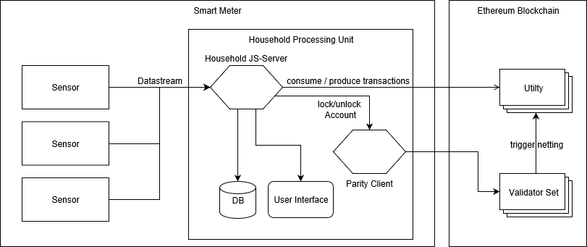
Architecture 3.0
Notes:
Changes (2.0 → 3.0)
3 input sensors (consumed, produced, battery)
No shared private key inside the Household Processing unit → HHS asks the parity client to lock/ unlock the account i.o. to send transactions
User interface comunicates with the HHS and not the DB directly → HHS behaves as central middleware inside the Household processing unit
Netting is triggered by the Validator Set
In the future: either one household or every time a block is created via BlockReward (?)

Slide 7
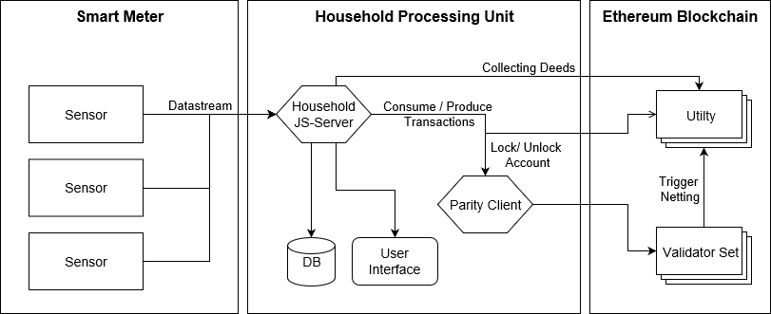
Architecture 4.0
Notes:
Changes (3.0 → 4.0)
Smart Meter contains only the sensors, household processing unit is an independent component
Household now collects its deeds from the UC
Consume/ Produce transactions are sent via Parity Client

Slide 8
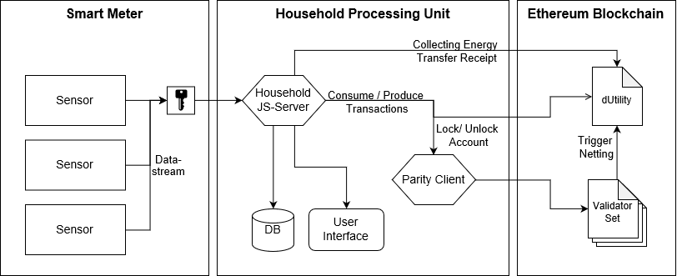
Architecture 5.0
Notes:
Changes (4.0 → 5.0)
New component signing the sensor data within the smart meter
Rename Deeds → Energy Transfer Receipt
dUtility is only one Contract while the Validator Set consists of several contracts
dUtility = only one address
VS includes for example the Block Reward

Slide 9
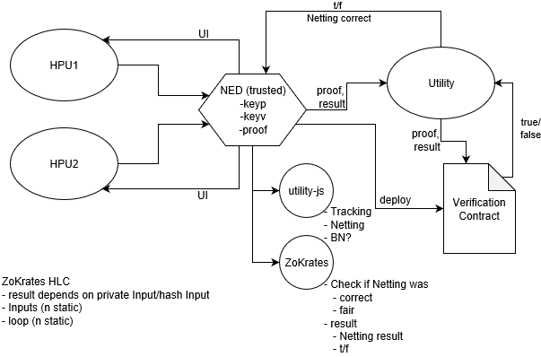
Architecture 6.0 (draft)
Notes:
Draft as discussed in Team meeting 06/18/19

Slide 10
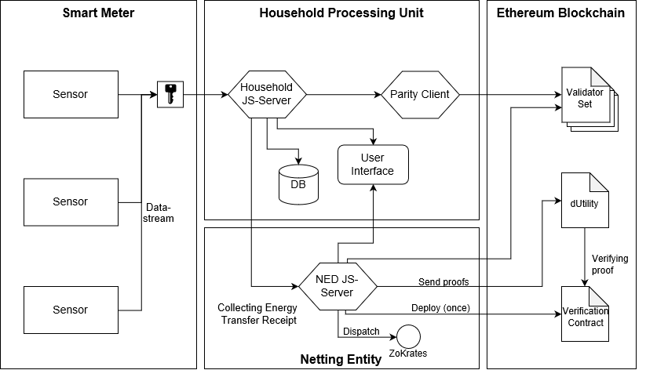
Architecture 6.0
Notes:
Changes (5.0 → 6.0)
Introduction of a Netting entity
Including ZoKrates HLC
Adjustments HPU
New Verification Contract (→ ZoKrates)
User Interface connected to NED Server (and UI for display)

Slide 11
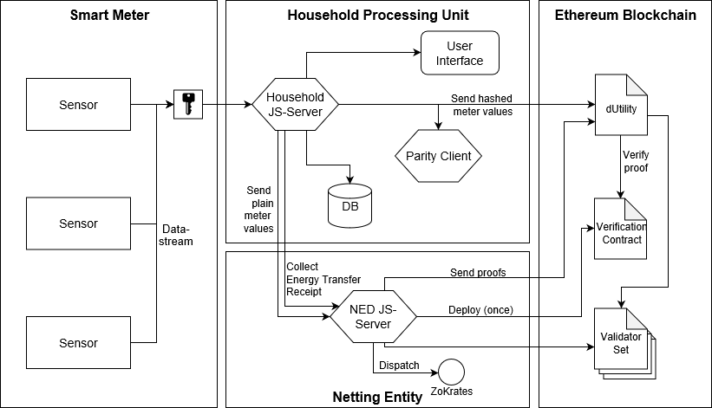
Architecture 7.0
Notes:
Changes (6.0 → 7.0)
UI only connected to HPU
HPU collects Deeds from NED
dUtility conected to VS
HPU sends hashes meter values to dUtility
HPU sends plain values to NED

Slide 12
Tech Stack
Mock Sensor - Node.js, REST API (Koa / Express)
Prosumer - Node.js, web3.js / ethers.js, REST API (Koa / Express)
Authority Node - Parity
UI - React
Contracts - Solidity, truffle
DOCKERFILE for each component and docker-compose
Notes:
Where is sensor data stored?
Why proof of wokr? -> Don't forget to mention
Simpler stack prefered
Test workflow ...Before commiting to it

