Slide 1
Generalizing Between Self and Friends

Slide 2
Methods
Participants indicate five people that come to mind, can be friends, acquaintances, family, coworkers, etc.
Indicate Inclusion of Self, Interpersonal Similarity, and Social Closeness with each of the five people.
Participants are randomly assigned to self-evaluate first or evaluate friends first. 30 traits per friend, and 150 traits for self.
Then, they evaluate friends or self after, respectively.
Analysis
We use an evaluation-weighted similarity measure, reflecting how similar a trait observed during secondary evaluations is to all prior traits, weighted by each trait’s prior descriptiveness. A similar trait to current trait i that was highly descriptive of a friend will be weighted more than a trait that was similar to non-descriptive trait.
Depending on the condition, the similarity-estimate is different. For self-then-other condition, similarity estimate is “Similarity-to-Self” predicting “Other-Evaluations” while for other-then-self condition, similarity estimate is “Similarity-to-Other” predicting “Self-Evaluations”.

Slide 3
Results

Slide 4
Self-then-Others vs. Others-then-Self
Similarity-to-others predicts self-evaluations more than similarity-to-self predicts other-evaluations.

Slide 6
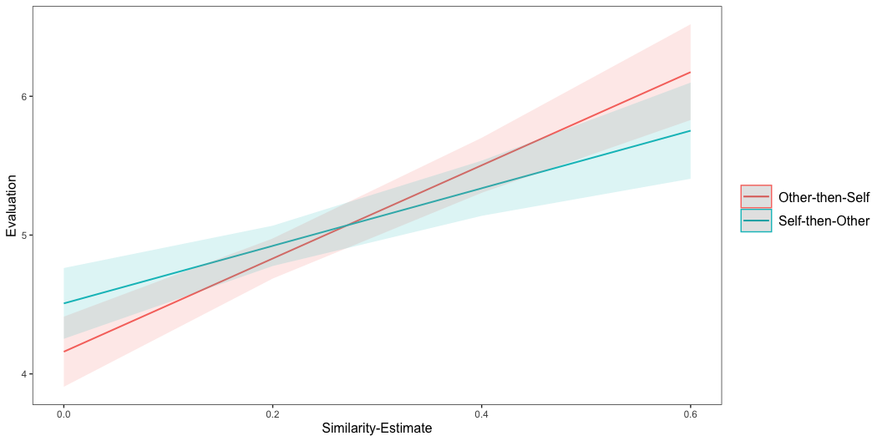

Slide 7
Effect of Similarity-Estimate for Novel Traits
The effect holds for initially evaluated traits as well as novel traits, and then secondarily it may even be stronger for novel traits

Slide 9
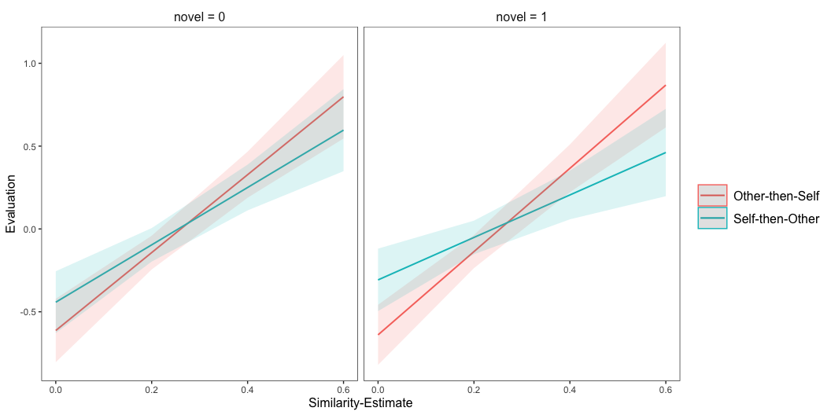

Slide 10
Subsetting Self-then-Other Data

Slide 11
Similarity-to-Self Depends on Relationship Closeness
Effect of similarity-to-self on other-evaluations stronger for closer friends

Slide 13
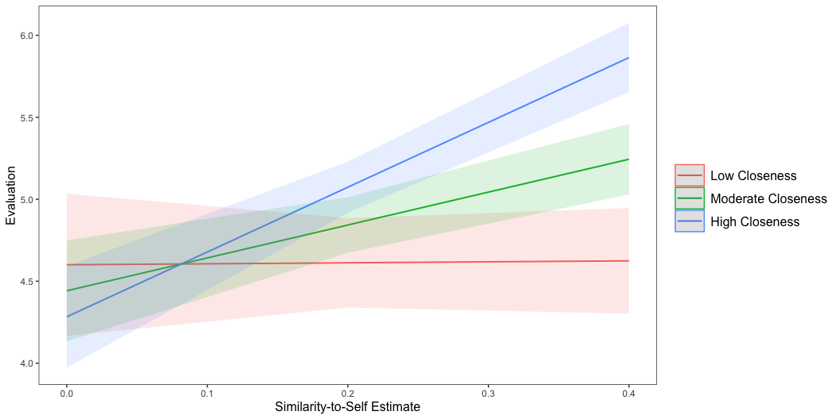

Slide 14
Similarity-to-Self Depends on Interpersonal Similarity
Effect of similarity-to-self on other-evaluations stronger for more similar friends

Slide 16
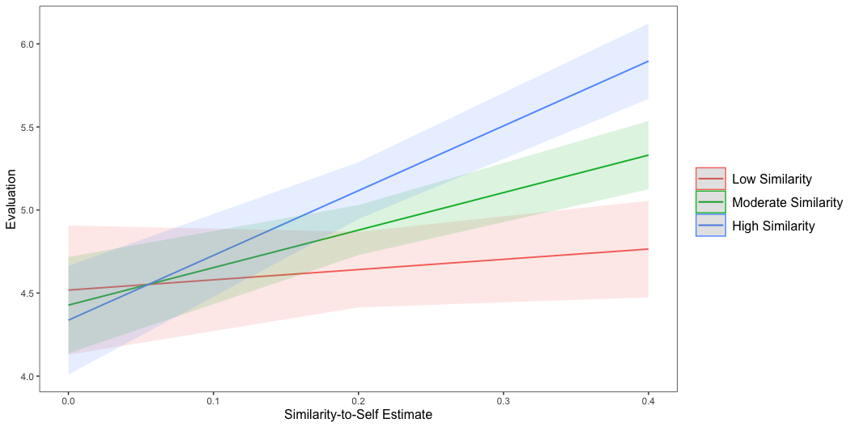

Slide 17
Similarity-to-Self Depends on Interpersonal Overlap
Effect of similarity-to-self on friend evaluations stronger for closer friends

Slide 18
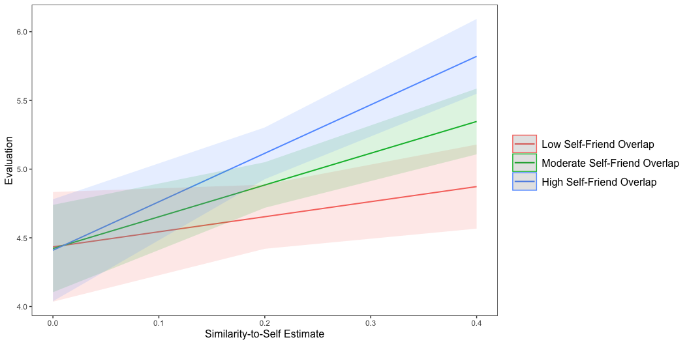

Slide 19
Subsetting Other-then-Self Data
Similarity-Estimate is average across all 90 observations of “training” data, so it’s unclear how to look at a moderator here. I can split up the average separately for each 18 observations per friend but it’s a worse predictor then because the mean is noisier. So right now, unclear how to examine moderator in other direction.

Slide 20
Miscellaneous Individual Differences

Slide 21
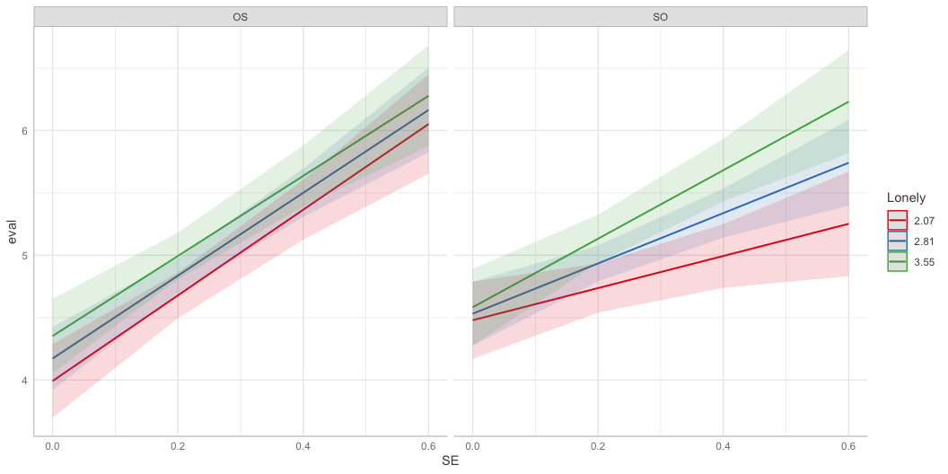
More Lonely people project onto friends more

Slide 22
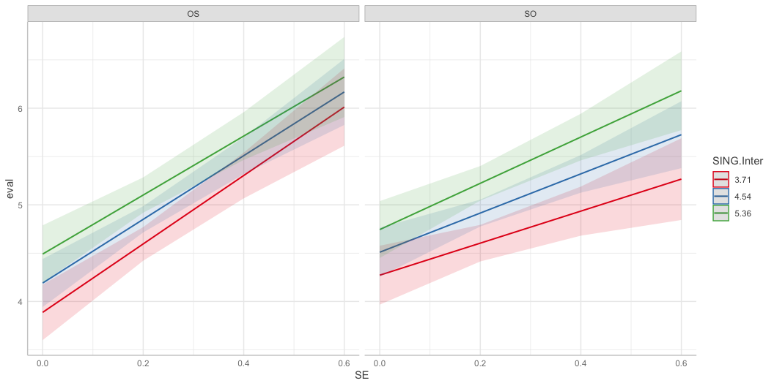
More interdependent people project onto friends more

Slide 23
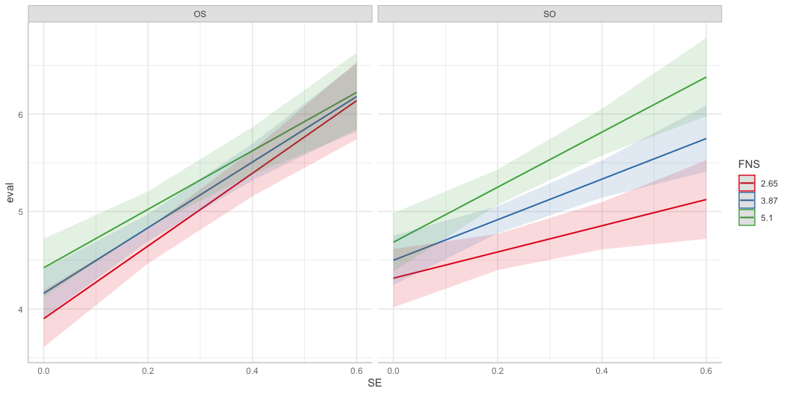
People with stronger social networks project onto friends more

