Slide 1
Midterm Revision
CS 2402 Tutorial 5

Slide 2
Scope
Lectures 1-6
Lecture slides
Inclass exercises
Tutorials
Assignment 1

Slide 3
1. Concepts

Slide 4
An outcome (sample) is a possible result of a random experiment
Outcomes are unique (mutually exclusive, not overlapping)
Sample (Outcome) Space is the set of all the possible outcomes
An event A is a set of outcomes
Random Variable X: its value depends on outcomes of a random experiment
For example: X is the number of a rolling dice
{X=1} is an event; {X>2} is an event

Slide 5
Probability
The probability of an event is the relative frequency of occurrence in the experiment
Probability of event E is
P(E) =
The value of P is between 0 and 1, inclusive
Assume that each outcome has the same relative frequency
The sample space
number of outcomes in E
total number of possible outcomes
event E

Slide 6
Math Definition of Probability
Probability is a way to assign numbers to events, which satisfies:
For any event A
If S is the sample space, P(S) = 1
For a finite or infinite sequences of disjoint events

Slide 7
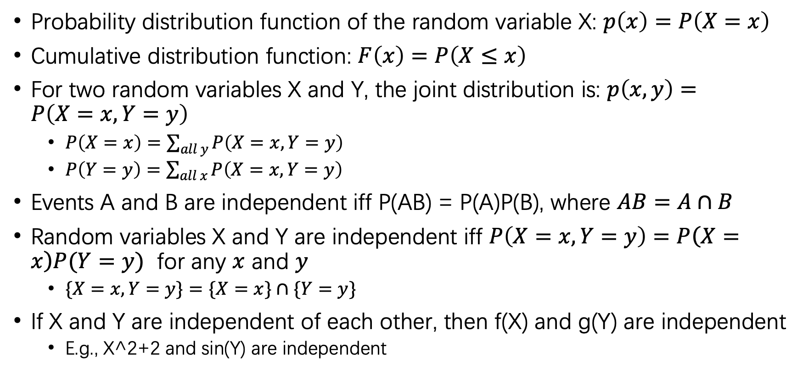
Probability Distribution
Probability distribution function of the random variable X: $p\left(x\right)=P\left(X=x\right)$
Cumulative distribution function: $F\left(x\right)=P\left(X≤x\right)$
For two random variables X and Y, the joint distribution is: $p\left(x,y\right)=P\left(X=x, Y=y\right)$
$P\left(X=x\right)=\sum_{all y}{P\left(X=x, Y=y\right)}$
$P\left(Y=y\right)=\sum_{all x}{P\left(X=x, Y=y\right) }$
Events A and B are independent iff P(AB) = P(A)P(B), where $AB=A∩B$
Random variables X and Y are independent iff $P\left(X=x, Y=y\right)=P\left(X=x\right)P(Y=y)$ for any $x$ and $y$
$\{X=x, Y=y\}=\{X=x\}∩\{Y=y\}$
If X and Y are independent of each other, then f(X) and g(Y) are independent
E.g., X^2+2 and sin(Y) are independent

Slide 8
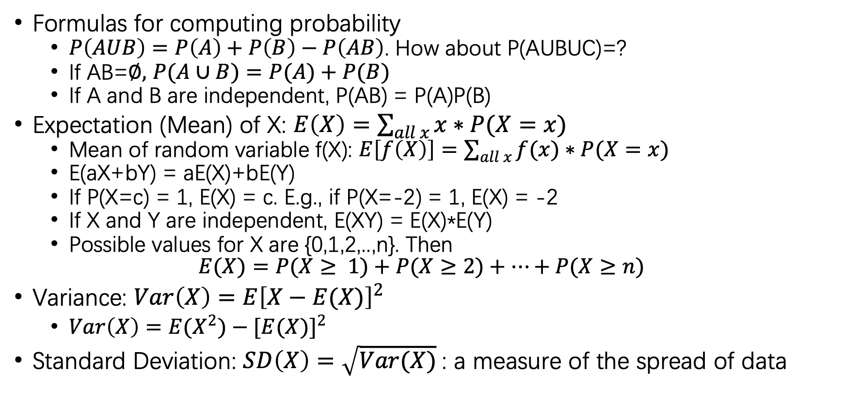
Formulas for computing probability
$P\left(AUB\right)=P\left(A\right)+P\left(B\right)−P\left(AB\right)$. How about P(AUBUC)=?
If AB=$∅,$ $P(A∪B)=P(A)+P(B)$
If A and B are independent, P(AB) = P(A)P(B)
Expectation (Mean) of X: $E\left(X\right)=\sum_{all x}{x∗P(X=x)}$
Mean of random variable f(X): $E\left[f\left(X\right)\right]=\sum_{all x}{f(x)∗P(X=x)}$
E(aX+bY) = aE(X)+bE(Y)
If P(X=c) = 1, E(X) = c. E.g., if P(X=-2) = 1, E(X) = -2
If X and Y are independent, E(XY) = E(X)*E(Y)
Possible values for X are {0,1,2,..,n}. Then
$$E(X)=P(X≥ 1)+P(X≥2)+…+P(X≥n)$$
Variance: $Var\left(X\right)=E{\left[X−E(X)\right]}^{2}$
$Var\left(X\right)=E{(X}^{2})−{[E(X)]}^{2}$
Standard Deviation: $SD\left(X\right)=\sqrt{Var(X)}$: a measure of the spread of data

Slide 9

$X_{1}, X_{2},…, X_{n}$ are independent of each other, $S_{n}=X_{1}+…+X_{n}.$ Then
$$Var\left(S_{n}\right)=Var\left(X_{1}\right)+Var\left(X_{2}\right)+…+Var\left(X_{n}\right)$$
$Var\left(aX+b\right)=a^{2}Var\left(X\right)$. E.g., Var(-2X-7) = 4Var(X)
$SD\left(aX+b\right)=\left|a\right|SD\left(X\right)$. E.g., SD(-2X+6) = 2SD(X)

Slide 10
2. Two Inequalities for Estimating Probability Bounds

Slide 11
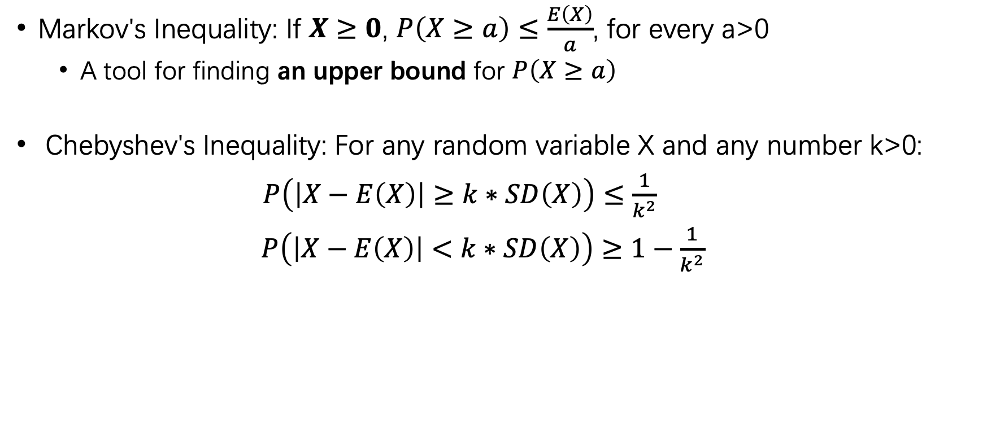
Probability Inequality
Markov's Inequality: If $X≥0$, $P\left(X≥a\right)≤\frac{E\left(X\right)}{a}$, for every a>0
A tool for finding an upper bound for $P\left(X≥a\right)$
Chebyshev's Inequality: For any random variable X and any number k>0:
$P\left(\left|X−E\left(X\right)\right|≥k∗SD\left(X\right)\right)≤\frac{1}{k^{2}}$
$P\left(\left|X−E\left(X\right)\right|<k∗SD\left(X\right)\right)≥1−\frac{1}{k^{2}}$

Slide 12
3. Distributions

Slide 13
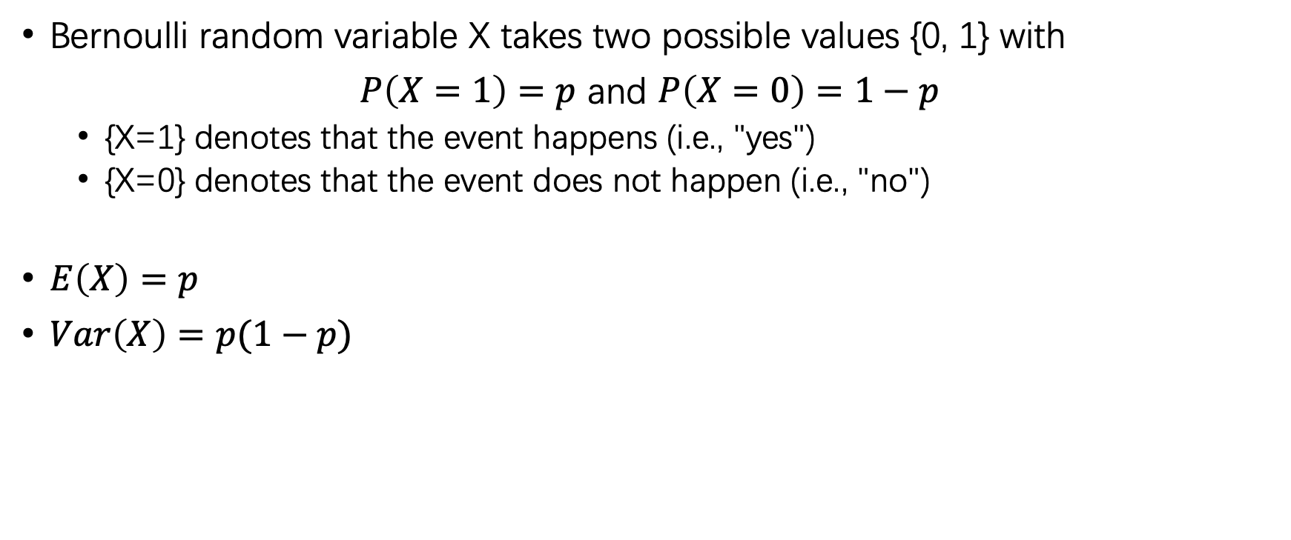
1. Bernoulli Distribution
Bernoulli random variable X takes two possible values {0, 1} with
$P\left(X=1\right)=p$ and $P\left(X=0\right)=1−p$
{X=1} denotes that the event happens (i.e., "yes")
{X=0} denotes that the event does not happen (i.e., "no")
$E\left(X\right)=p$
$Var\left(X\right)=p(1−p)$

Slide 14
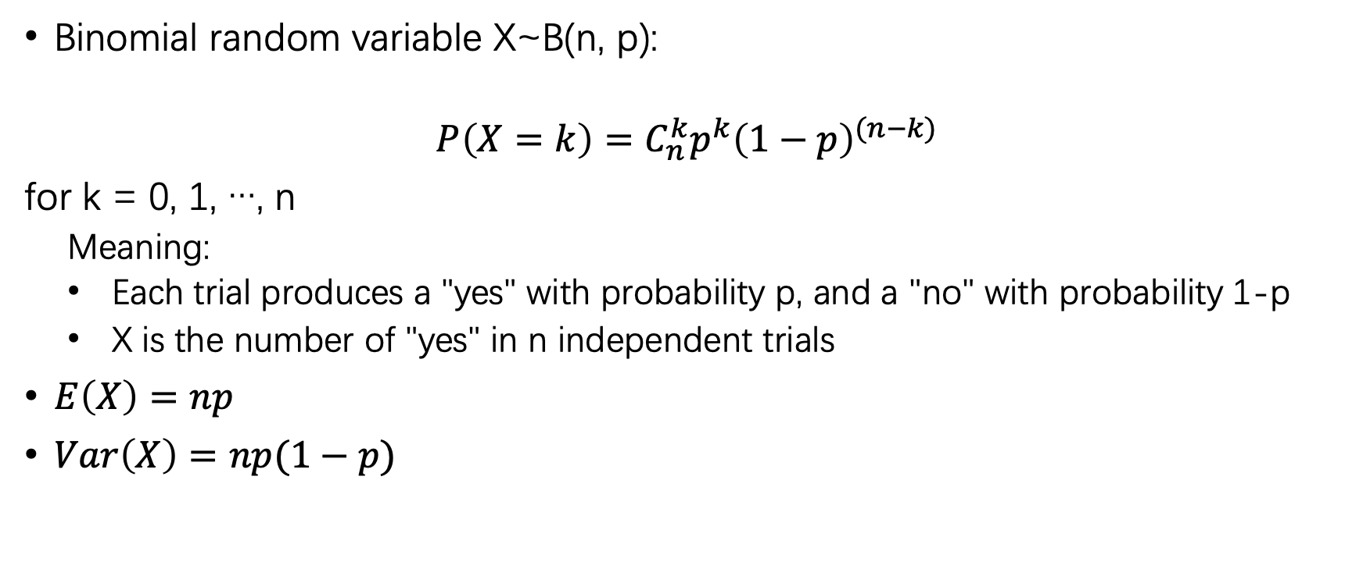
2. Binomial Distribution
Binomial random variable X~B(n, p):
$$P\left(X=k\right)=C_{n}^{k}p^{k}{\left(1−p\right)}^{(n−k)}$$
for k = 0, 1, …, n
Meaning:
Each trial produces a "yes" with probability p, and a "no" with probability 1-p
X is the number of "yes" in n independent trials
$E\left(X\right)=np$
$Var\left(X\right)=np(1−p)$

Slide 15
Others
Unfinished game
Utility
False probability

Slide 16






The Unfinished Game
7/8
1/8
$87.5
$100
$12.5
7:1
6 of 9 rounds already played → 3 rounds left
Possible outcomes of 3 remaining rounds: AAA, AAB, ABA, BAA, ABB, BAB, BBA, BBB
Alice can win 7 ways; Bob can win 1 way
Split the pot 7:1 (outcomes are equally likely)

Slide 17
Expected Utility Change
Rather than look at expected gain, Bernoulli suggested to look at expected change in utility
Change in utility = log( wealth + gain ) – log( wealth )
Represents the significance of the bet to player
For a large amount (relative to the player’s wealth), a loss has more negative utility than a profit
I.e., the player is risk averse if they might lose a large portion of their wealth
A small gain (relative to the player’s wealth) will give change of utility close to 0. i.e., the player has no preference

Slide 18
Example: Disease Test
Disease Info (false positive example)
Incidence rate is 2%
Test accuracy is 92%
Always detects disease if present (true positive)
8% of the time detects false positive
Joint probability of test result and having the disease
Test result
positive
negative
Have disease
Yes
2% | 0%
7.84% | 90.16%
No

