Slide 1
Revision
CS 2402 Lecture 12

Slide 2
1. Concepts

Slide 3
Sample Space and Random Variable
An outcome (sample) is a possible result of a random experiment
Outcomes are unique (mutually exclusive, not overlapping)
Sample Space is the set of all the possible outcomes
An event A is a set of outcomes
Random Variable X: its value depends on outcomes of a random experiment
For example: X is the number of a rolling dice
{X=1} is an event; {X>2} is an event

Slide 4
Probability
The probability of an event is the relative frequency of occurrence in the experiment
Probability of event E is
P(E) =
The value of P is between 0 and 1, inclusive
Assume that each outcome has the same relative frequency
The sample space
number of outcomes in E
total number of possible outcomes
event E

Slide 5
Math Definition of Probability
Probability is a way to assign numbers to events, which satisfies:
For any event A
If S is the sample space, P(S) = 1
For a finite or infinite sequences of disjoint events

Slide 6
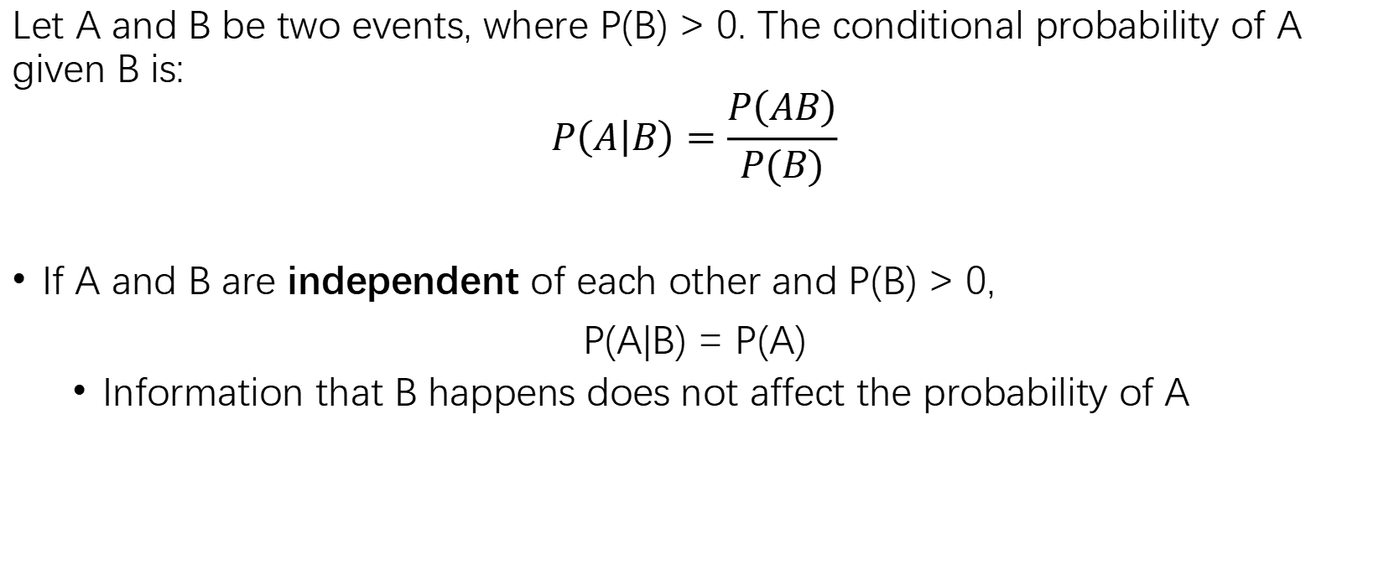
Conditional Probability
Let A and B be two events, where P(B) > 0. The conditional probability of A given B is:
$$P\left(A | B\right)=\frac{P\left(AB\right)}{P(B)}$$
If A and B are independent of each other and P(B) > 0,
P(A|B) = P(A)
Information that B happens does not affect the probability of A

Slide 7
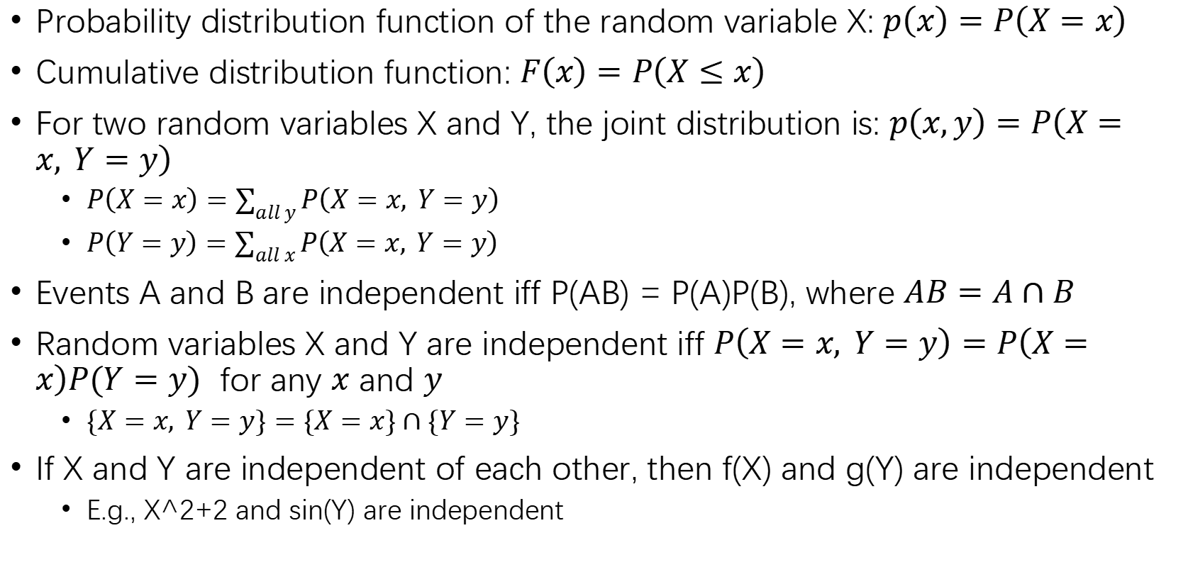
Joint Probability
Probability distribution function of the random variable X: $p\left(x\right)=P\left(X=x\right)$
Cumulative distribution function: $F\left(x\right)=P\left(X≤x\right)$
For two random variables X and Y, the joint distribution is: $p\left(x,y\right)=P\left(X=x, Y=y\right)$
$P\left(X=x\right)=\sum_{all y}{P\left(X=x, Y=y\right)}$
$P\left(Y=y\right)=\sum_{all x}{P\left(X=x, Y=y\right) }$
Events A and B are independent iff P(AB) = P(A)P(B), where $AB=A∩B$
Random variables X and Y are independent iff $P\left(X=x, Y=y\right)=P\left(X=x\right)P(Y=y)$ for any $x$ and $y$
$\{X=x, Y=y\}=\{X=x\}∩\{Y=y\}$
If X and Y are independent of each other, then f(X) and g(Y) are independent
E.g., X^2+2 and sin(Y) are independent

Slide 8
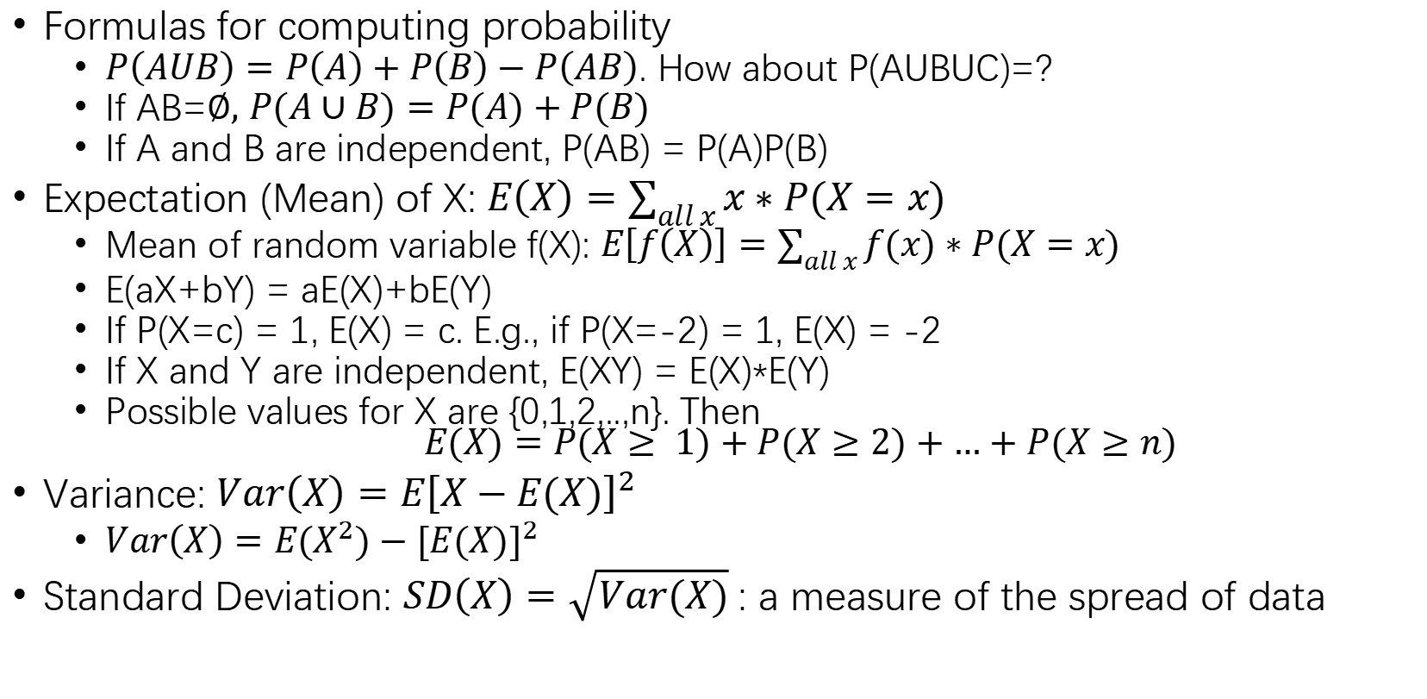
Formulas for computing probability
$P\left(AUB\right)=P\left(A\right)+P\left(B\right)−P\left(AB\right)$. How about P(AUBUC)=?
If AB=$∅,$ $P(A∪B)=P(A)+P(B)$
If A and B are independent, P(AB) = P(A)P(B)
Expectation (Mean) of X: $E\left(X\right)=\sum_{all x}{x∗P(X=x)}$
Mean of random variable f(X): $E\left[f\left(X\right)\right]=\sum_{all x}{f(x)∗P(X=x)}$
E(aX+bY) = aE(X)+bE(Y)
If P(X=c) = 1, E(X) = c. E.g., if P(X=-2) = 1, E(X) = -2
If X and Y are independent, E(XY) = E(X)*E(Y)
Possible values for X are {0,1,2,..,n}. Then
$$E(X)=P(X≥ 1)+P(X≥2)+…+P(X≥n)$$
Variance: $Var\left(X\right)=E{\left[X−E(X)\right]}^{2}$
$Var\left(X\right)=E{(X}^{2})−{[E(X)]}^{2}$
Standard Deviation: $SD\left(X\right)=\sqrt{Var(X)}$: a measure of the spread of data

Slide 9

$X_{1}, X_{2},…, X_{n}$ are independent of each other, $S_{n}=X_{1}+…+X_{n}.$ Then
$$Var\left(S_{n}\right)=Var\left(X_{1}\right)+Var\left(X_{2}\right)+…+Var\left(X_{n}\right)$$
$Var\left(aX+b\right)=a^{2}Var\left(X\right)$. E.g., Var(-2X-7) = 4Var(X)
$SD\left(aX+b\right)=\left|a\right|SD\left(X\right)$. E.g., SD(-2X+6) = 2SD(X)

Slide 10
2. Two Inequalities for Estimating Probability Bounds

Slide 11
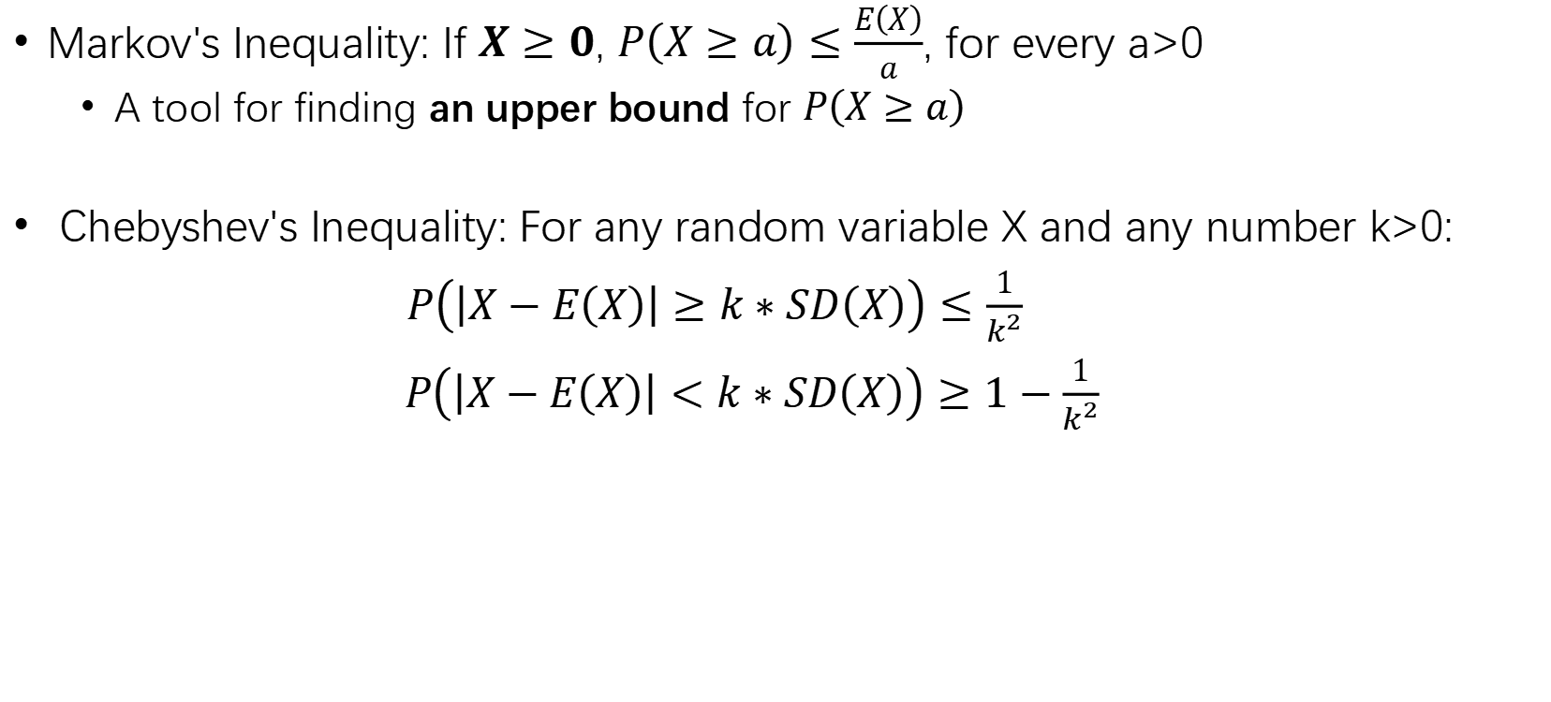
Probability Inequality
Markov's Inequality: If $X≥0$, $P\left(X≥a\right)≤\frac{E\left(X\right)}{a}$, for every a>0
A tool for finding an upper bound for $P\left(X≥a\right)$
Chebyshev's Inequality: For any random variable X and any number k>0:
$P\left(\left|X−E\left(X\right)\right|≥k∗SD\left(X\right)\right)≤\frac{1}{k^{2}}$
$P\left(\left|X−E\left(X\right)\right|<k∗SD\left(X\right)\right)≥1−\frac{1}{k^{2}}$

Slide 12
3. Distributions

Slide 13
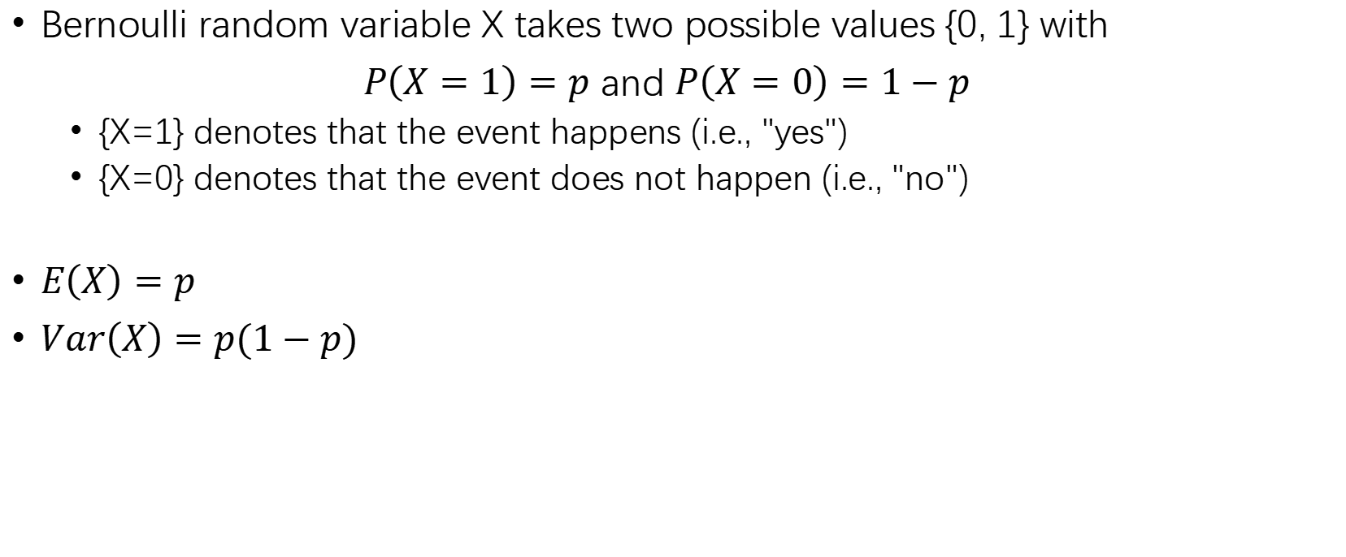
1. Bernoulli Distribution
Bernoulli random variable X takes two possible values {0, 1} with
$P\left(X=1\right)=p$ and $P\left(X=0\right)=1−p$
{X=1} denotes that the event happens (i.e., "yes")
{X=0} denotes that the event does not happen (i.e., "no")
$E\left(X\right)=p$
$Var\left(X\right)=p(1−p)$

Slide 14
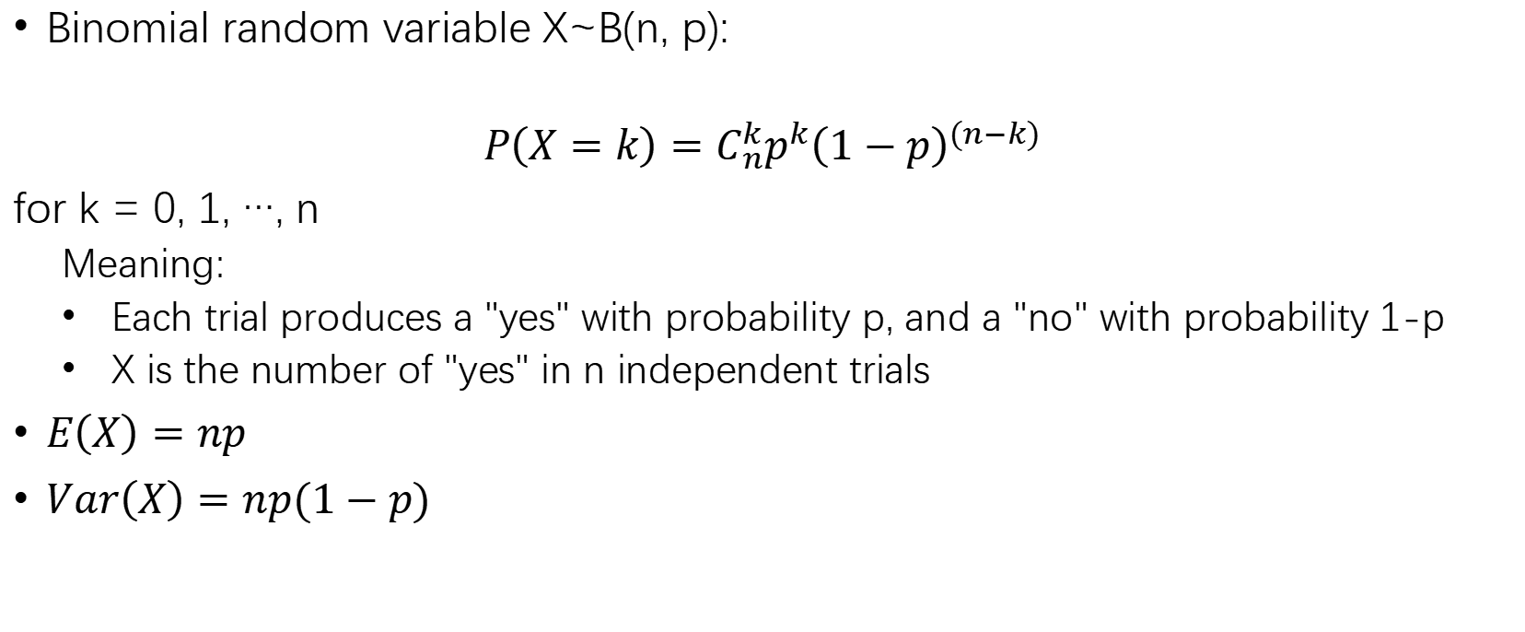
2. Binomial Distribution
Binomial random variable X~B(n, p):
$$P\left(X=k\right)=C_{n}^{k}p^{k}{\left(1−p\right)}^{(n−k)}$$
for k = 0, 1, …, n
Meaning:
Each trial produces a "yes" with probability p, and a "no" with probability 1-p
X is the number of "yes" in n independent trials
$E\left(X\right)=np$
$Var\left(X\right)=np(1−p)$

Slide 15
4. Normal (Gaussian) Distribution
Normal probability density:
E(X) = μ
Var(X) = σ²

Slide 16
4. Approximation

Slide 17
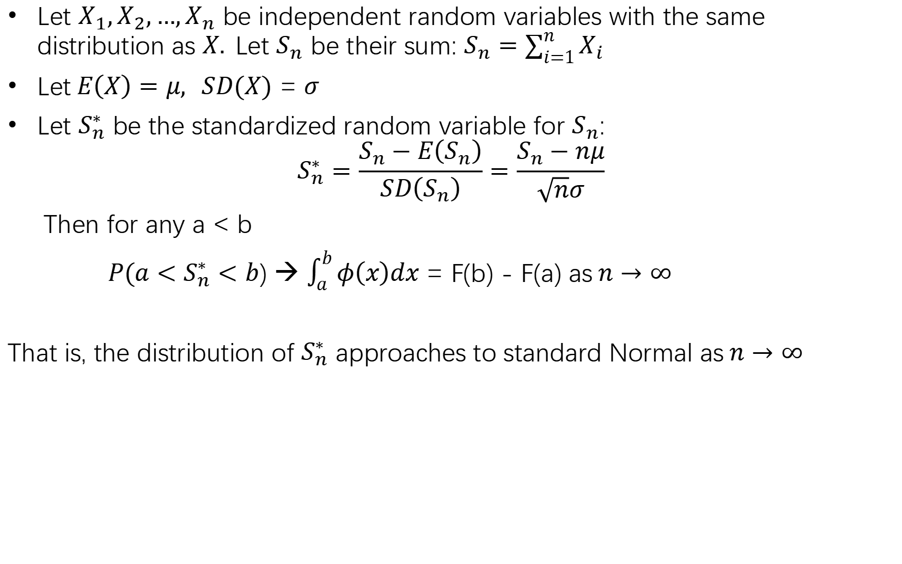
Normal Approximation by CLT
Let $X_{1},X_{2},…,X_{n}$ be independent random variables with the same distribution as $X.$Let $S_{n}$ be their sum: $S_{n}=\sum_{i=1}^{n}{X_{i}}$
Let$E\left(X\right)=μ, SD(X) \text{=} σ$
Let $S_{n}^{∗}$ be the standardized random variable for $S_{n}$:
$$S_{n}^{∗}=\frac{S_{n}−E\left(S_{n}\right)}{SD\left(S_{n}\right)}=\frac{S_{n}−nμ}{\sqrt{n}σ}$$
Then for any a < b
$P({a<S}_{n}^{∗}<b$) → $\int_{a}^{b}{φ\left(x\right)dx}$ = F(b) - F(a) as$n→∞$
That is, the distribution of $S_{n}^{∗}$ approaches to standard Normal as$n→∞$
E(Sn) = nE(x)
Var(Sn) = nVar(x)
E(Xn拔) = E(x)
Var(Xn拔) = Var(x)/n

Slide 18
5. Bayesian Method

Slide 19
Bayesian Method
Goal: Use evidence to update the probability of hypotheses. I.e., compute the probability of hypotheses conditioned on evidence
Basic Steps:
What are hypotheses? Make hypotheses
Compute prior odds (probability) of hypotheses (without evidence)
What is evidence? Compute the likelihood of evidence under different hypotheses (conditional probabilities of evidence given hypotheses)
Compute the posterior odds of hypotheses (conditional probabilities of hypotheses under evidence)

Slide 20
6. Least Squares Estimation

Slide 21

Principle of Least Squares
Estimate $α$ and $β$ to minimize $\sum_{i=1}^{n}{e_{i}^{2}}$
$\sum_{i=1}^{n}{e_{i}^{2}}$ = ${\sum_{i=1}^{n}{(y_{i} −(α+βx_{i})})}^{2}$
$x_{i}, y_{i}$are given
$α$ and $β$ are unknowns

Slide 22
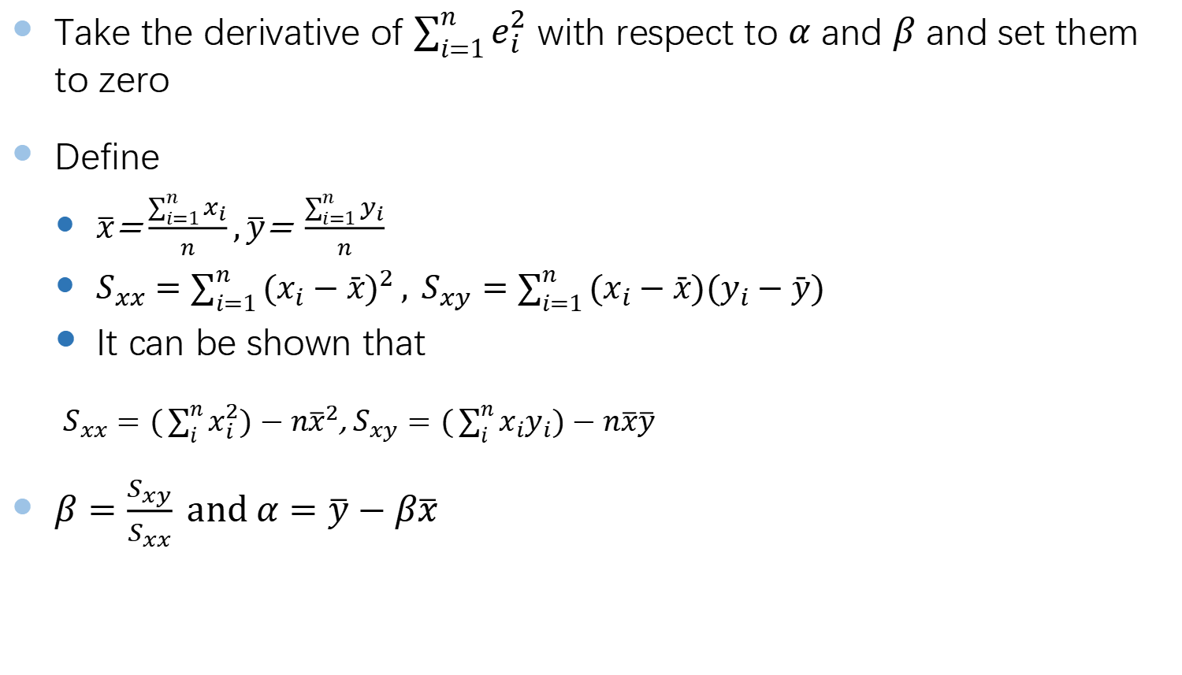
Procedure
Take the derivative of $\sum_{i=1}^{n}{e_{i}^{2}}$ with respect to $α$ and $β$ and set them to zero
Define
$\overline{x}$= $\frac{\sum_{i=1}^{n}{x_{i}}}{n},\overline{y}\text{= }\frac{\sum_{i=1}^{n}{y_{i}}}{n}$
$S_{xx}=\sum_{i=1}^{n}{(x_{i}−\bar{x})^{2}}, S_{xy}=\sum_{i=1}^{n}{(x_{i}−\bar{x})(y_{i}−\bar{y})}$
It can be shown that
$S_{xx}=(\sum_{i}^{n}{x_{i}^{2})−n{\overline{x}}^{2}}$, $S_{xy}=(\sum_{i}^{n}{x_{i}y_{i})−n{\overline{x}\overline{y}}^{}}$
$β=\frac{S_{xy}}{S_{xx}} and α=\overline{y}−β\overline{x}$

Slide 23
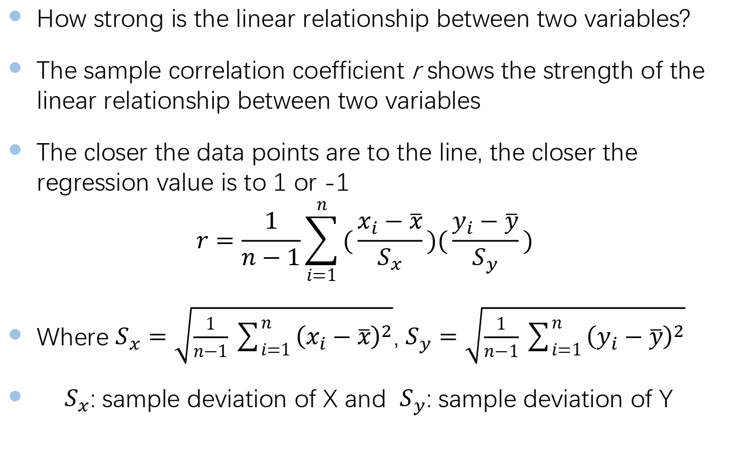
Correlation Coefficient
How strong is the linear relationship between two variables?
The sample correlation coefficient r shows the strength of the linear relationship between two variables
The closer the data points are to the line, the closer the regression value is to 1 or -1
$$r=\frac{1}{n−1}\sum_{i=1}^{n}{(\frac{x_{i}−\overline{x}}{S_{x}})(\frac{y_{i}−\overline{y}}{S_{y}})}$$
Where $S_{x}=\sqrt{\frac{1}{n−1}\sum_{i=1}^{n}{{\left(x_{i}−\overline{x}\right)}^{2}}}$, $S_{y}=\sqrt{\frac{1}{n−1}\sum_{i=1}^{n}{{\left(y_{i}−\overline{y}\right)}^{2}}}$
$S_{x}$: sample deviation of X and $S_{y}$: sample deviation of Y

Slide 24
7. Maximum Likelihood Estimation

Slide 25
Maximum Likelihood Estimation
Probability:
Knowing probability model → distribution of outcomes
Maximum Likelihood
Observation of data → Estimation of parameters in probability model
The aim of maximum likelihood estimation is to find the parameter value(s) that makes the observed data most likely

Slide 26
Procedure
Step 1: write down the probability of each observation by using the model parameters
Step 2: write down the probability of all the data
Step 3: Find the values of the parameters that maximize this probability

Slide 27
Others
Unfinished game
Utility
False probability

Slide 28
How to prepare final exam:
Go through
lecture notes
in-class exercises
tutorial questions and
assignments
Final exam paper covers all course materials
Python will not be tested in the final exam

