Slide 1
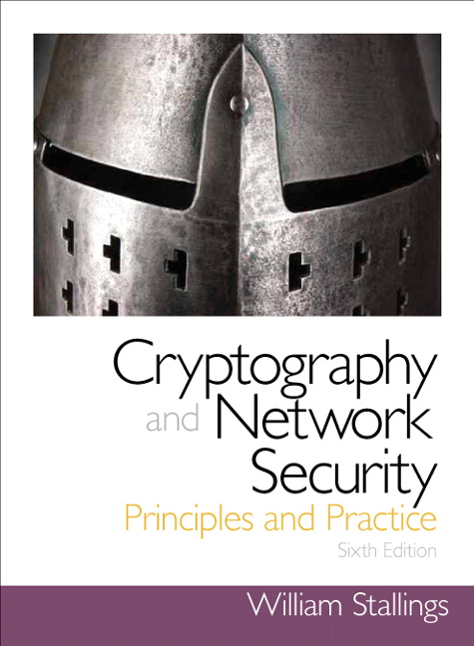
Chapter 3
Classical Encryption Techniques
Notes:
Symmetric encryption, also referred to as conventional encryption or single-key
encryption, was the only type of encryption in use prior to the development of publickey
encryption in the 1970s. It remains by far the most widely used of the two types
of encryption. Part One examines a number of symmetric ciphers. In this chapter, we
begin with a look at a general model for the symmetric encryption process; this will
enable us to understand the context within which the algorithms are used. Next, we
examine a variety of algorithms in use before the computer era. Finally, we look briefly
at a different approach known as steganography. Chapters 4 and 6 introduce the two
most widely used symmetric cipher: DES and AES.

Slide 2
Polyalphabetic Ciphers
Polyalphabetic substitution cipher
Improves on the simple monoalphabetic technique by using different monoalphabetic substitutions as one proceeds through the plaintext message
All these techniques have the following features in common:
A set of related monoalphabetic substitution rules is used
A key determines which particular rule is chosen for a given transformation
Notes:
Another way to improve on the simple monoalphabetic technique is to use different
monoalphabetic substitutions as one proceeds through the plaintext message.
The general name for this approach is polyalphabetic substitution cipher . All these
techniques have the following features in common:
1. A set of related monoalphabetic substitution rules is used.
2. A key determines which particular rule is chosen for a given transformation.

Slide 3
Vigenère Cipher
Best known and one of the simplest polyalphabetic substitution ciphers
In this scheme the set of related monoalphabetic substitution rules consists of the 26 Caesar ciphers with shifts of 0 through 25
Each cipher is denoted by a key letter which is the ciphertext letter that substitutes for the plaintext letter a
Notes:
The best known, and one of the simplest, polyalphabetic ciphers
is the Vigenère cipher. In this scheme, the set of related monoalphabetic substitution
rules consists of the 26 Caesar ciphers with shifts of 0 through 25. Each cipher is
denoted by a key letter, which is the ciphertext letter that substitutes for the plaintext
letter a. Thus, a Caesar cipher with a shift of 3 is denoted by the key value 3.

Slide 4
Example of Vigenère Cipher
To encrypt a message, a key is needed that is as long as the message
Usually, the key is a repeating keyword
For example, if the keyword is deceptive, the message “we are discovered save yourself” is encrypted as:
key: deceptivedeceptivedeceptive
plaintext: wearediscoveredsaveyourself
ciphertext: ZICVTWQNGRZGVTWAVZHCQYGLMGJ
Notes:
To encrypt a message, a key is needed that is as long as the message. Usually,
the key is a repeating keyword. For example, if the keyword is deceptive , the
message “we are discovered save yourself” is encrypted as
key: deceptivedeceptivedeceptive
plaintext: wearediscoveredsaveyourself
ciphertext: ZICVTWQNGRZGVTWAVZHCQYGLMGJ
The strength of this cipher is that there are multiple ciphertext letters for
each plaintext letter, one for each unique letter of the keyword. Thus, the letter
frequency information is obscured. However, not all knowledge of the plaintext
structure is lost. For example, Figure 3.6 shows the frequency distribution for a
Vigenère cipher with a keyword of length 9. An improvement is achieved over the
Playfair cipher, but considerable frequency information remains.

Slide 5
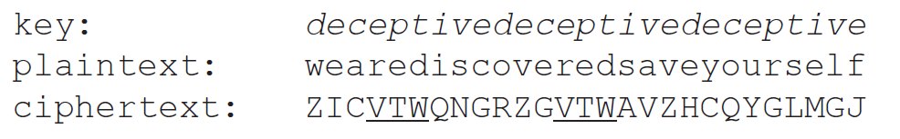
Cryptanalysis: Vigenère Cipher
Notes:
The attacker assume either monoalphabetic or Vigenere
For monoalphabetic, the statistical characteristic can be used
If, on the other hand, a Vigenère cipher is suspected, then progress depends on determining the length of the keyword, THEN: how this can be done.
The important note here is that : If two identical sequences of plaintext letters happen at a distance that is an integer multiple of the keyword length, they will produce the same ciphertext sequences.
As we can see here in this example, two instances of the sequence “red” are separated by nine character positions. Based on this , in both cases, r is encrypted using key letter e, e is encrypted using key letter p, and d
is encrypted using key letter t. Thus, in both cases, the ciphertext sequence is VTW. We indicate this above by underlining the relevant ciphertext letters and shading the relevant ciphertext numbers.
An analyst looking at only the ciphertext would detect the repeated sequences VTW at a displacement of 9 and make the assumption that the keyword is either three or nine letters in length.
Solution of the cipher now depends on an important insight. If the keyword length is m, then the cipher, in effect, consists of m monoalphabetic substitution ciphers. For example, with the keyword DECEPTIVE, the letters in positions 1, 10,
19, and so on are all encrypted with the same monoalphabetic cipher. Thus, we can use the known frequency characteristics of the plaintext language to attack each of the monoalphabetic ciphers separately

Slide 6
Vigenère Autokey System
A keyword is concatenated with the plaintext itself to provide a running key
Example:
key: deceptivewearediscoveredsav
plaintext: wearediscoveredsaveyourself
ciphertext: ZICVTWQNGKZEIIGASXSTSLVVWLA
Even this scheme is vulnerable to cryptanalysis
Because the key and the plaintext share the same frequency distribution of letters, a statistical technique can be applied
Notes:
The periodic nature of the keyword can be eliminated by using a nonrepeating
keyword that is as long as the message itself. Vigenère proposed what is referred to
as an autokey system , in which a keyword is concatenated with the plaintext itself to
provide a running key. For our example,
key: deceptivewearediscoveredsav
plaintext: wearediscoveredsaveyourself
ciphertext: ZICVTWQNGKZEIIGASXSTSLVVWLA
Even this scheme is vulnerable to cryptanalysis. Because the key and the
plaintext share the same frequency distribution of letters, a statistical technique
can be applied. For example, e enciphered by e , by Figure 3.5, can be expected to
occur with a frequency of (0.127⁾² = 0.016, whereas t enciphered by t would occur
only about half as often. These regularities can be exploited to achieve successful
cryptanalysis.

Slide 7
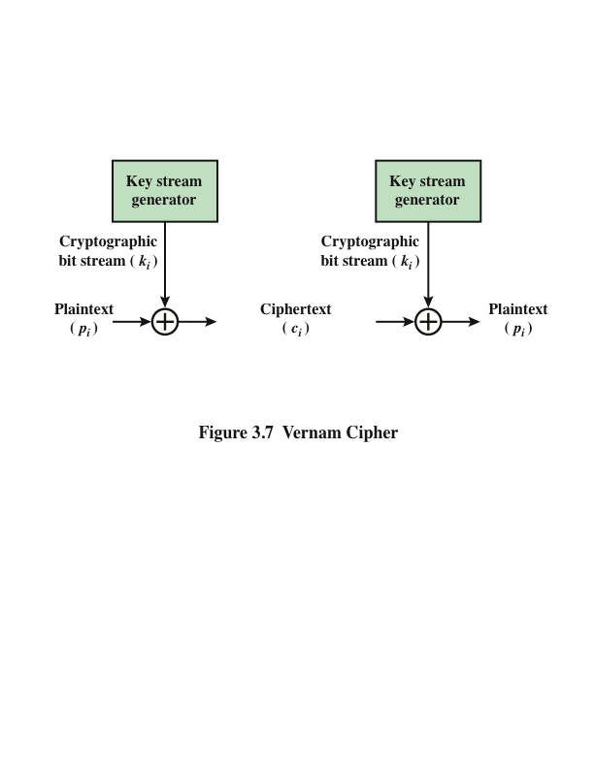
Vernam Cipher
Notes:
The ultimate defense against such a cryptanalysis is to choose a
keyword that is as long as the plaintext and has no statistical relationship to it. Such
a system was introduced by an AT&T engineer named Gilbert Vernam in 1918.
His system works on binary data (bits) rather than letters.
The essence of this technique is the means of construction of the key. Vernam
proposed the use of a running loop of tape that eventually repeated the key, so
that in fact the system worked with a very long but repeating keyword. Although
such a scheme, with a long key, presents formidable cryptanalytic difficulties, it
can be broken with sufficient ciphertext, the use of known or probable plaintext
sequences, or both.

Slide 8
Vernam Cipher
key: $e1
plaintext: hhi
ciphertext:

Slide 9
One-Time Pad
Improvement to Vernam cipher proposed by an Army Signal Corp officer, Joseph Mauborgne
Use a random key that is as long as the message so that the key need not be repeated
Key is used to encrypt and decrypt a single message and then is discarded
Each new message requires a new key of the same length as the new message
Scheme is unbreakable
Produces random output that bears no statistical relationship to the plaintext
Because the ciphertext contains no information whatsoever about the plaintext, there is simply no way to break the code
Notes:
An Army Signal Corp officer, Joseph Mauborgne, proposed an improvement to the
Vernam cipher that yields the ultimate in security. Mauborgne suggested using a
random key that is as long as the message, so that the key need not be repeated. In
addition, the key is to be used to encrypt and decrypt a single message, and then is
discarded. Each new message requires a new key of the same length as the new message.
Such a scheme, known as a one-time pad , is unbreakable. It produces random
output that bears no statistical relationship to the plaintext. Because the ciphertext
contains no information whatsoever about the plaintext, there is simply no way to
break the code.
In fact, given any plaintext of equal length to the ciphertext, there is a key that
produces that plaintext. Therefore, if you did an exhaustive search of all possible
keys, you would end up with many legible plaintexts, with no way of knowing which
was the intended plaintext. Therefore, the code is unbreakable.
The security of the one-time pad is entirely due to the randomness of
the key. If the stream of characters that constitute the key is truly random, then the
stream of characters that constitute the ciphertext will be truly random. Thus, there
are no patterns or regularities that a cryptanalyst can use to attack the ciphertext.

Slide 10
Difficulties
The one-time pad offers complete security but, in practice, has two fundamental difficulties:
There is the practical problem of making large quantities of random keys
Any heavily used system might require millions of random characters on a regular basis
Mammoth key distribution problem
For every message to be sent, a key of equal length is needed by both sender and receiver
Because of these difficulties, the one-time pad is of limited utility
Useful primarily for low-bandwidth channels requiring very high security
The one-time pad is the only cryptosystem that exhibits perfect secrecy (see Appendix F)
Notes:
In theory, we need look no further for a cipher. The one-time pad offers complete
security but, in practice, has two fundamental difficulties:
1. There is the practical problem of making large quantities of random keys.
Any heavily used system might require millions of random characters
on a regular basis. Supplying truly random characters in this volume is a
significant task.
2. Even more daunting is the problem of key distribution and protection. For
every message to be sent, a key of equal length is needed by both sender and
receiver. Thus, a mammoth key distribution problem exists.
Because of these difficulties, the one-time pad is of limited utility and is useful
primarily for low-bandwidth channels requiring very high security.
The one-time pad is the only cryptosystem that exhibits what is referred to as
perfect secrecy . This concept is explored in Appendix F.

Slide 11
Rail Fence Cipher
Simplest transposition cipher
Plaintext is written down as a sequence of diagonals and then read off as a sequence of rows
To encipher the message “meet me after the toga party” with a rail fence of depth 2, we would write:
m e m a t r h t g p r y
e t e f e t e o a a t
Encrypted message is:
MEMATRHTGPRYETEFETEOAAT
Notes:
All the techniques examined so far involve the substitution of a ciphertext symbol
for a plaintext symbol. A very different kind of mapping is achieved by performing
some sort of permutation on the plaintext letters. This technique is referred to as a
transposition cipher.
The simplest such cipher is the rail fence technique, in which the plaintext is
written down as a sequence of diagonals and then read off as a sequence of rows.
For example, to encipher the message “meet me after the toga party” with a rail
fence of depth 2, we write the following:
m e m a t r h t g p r y
e t e f e t e o a a t
The encrypted message is
MEMATRHTGPRYETEFETEOAAT

Slide 12
Row Transposition Cipher
Is a more complex transposition
Write the message in a rectangle, row by row, and read the message off, column by column, but permute the order of the columns
The order of the columns then becomes the key to the algorithm
Key: 4 3 1 2 5 6 7
Plaintext: a t t a c k p
o s t p o n e
d u n t i l t
w o a mx y z
Ciphertext: TTNAAPTMTSUOAODWCOIXKNLYPETZ
Notes:
This sort of thing would be trivial to cryptanalyze.
A more complex scheme is
to write the message in a rectangle, row by row, and read the message off, column
by column, but permute the order of the columns. The order of the columns then
becomes the key to the algorithm. For example,
Key: 4 3 1 2 5 6 7
Plaintext: a t t a c k p
o s t p o n e
d u n t i l t
w o a m x y z
Ciphertext: TTNAAPTMTSUOAODWCOIXKNLYPETZ
Thus, in this example, the key is 4312567. To encrypt, start with the column
that is labeled 1, in this case column 3. Write down all the letters in that column.
Proceed to column 4, which is labeled 2, then column 2, then column 1, then
columns 5, 6, and 7.
A pure transposition cipher is easily recognized because it has the same letter
frequencies as the original plaintext. For the type of columnar transposition just
shown, cryptanalysis is fairly straightforward and involves laying out the ciphertext
in a matrix and playing around with column positions. Digram and trigram
frequency tables can be useful.
The transposition cipher can be made significantly more secure by performing
more than one stage of transposition. The result is a more complex permutation
that is not easily reconstructed.

Slide 13
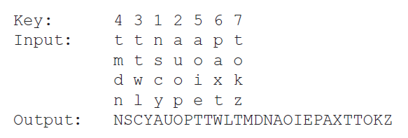
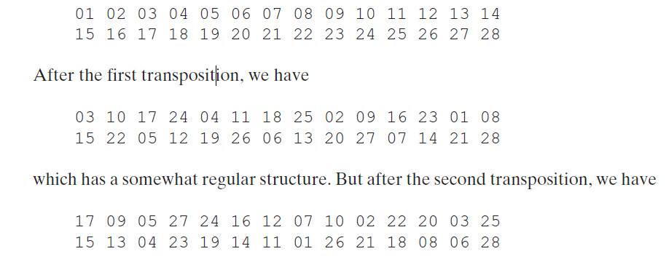
Row Transposition Cipher
Notes:
To visualize the result of this double transposition, designate the letters in the original plaintext message by the numbers designating their position. Thus, with 28
letters in the message, the original sequence of letters is
This is a much less structured permutation and is much more difficult to cryptanalyze.

Slide 14
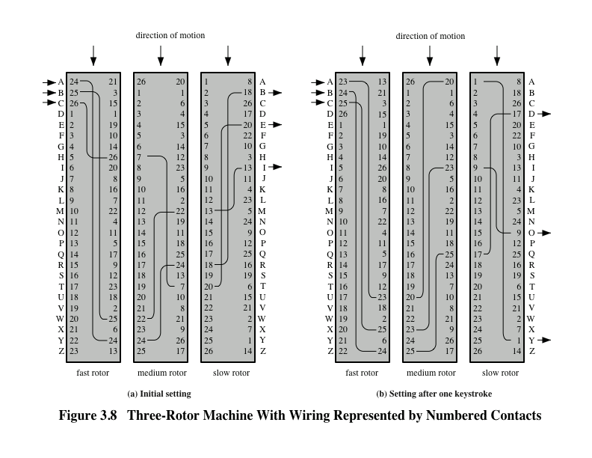
Notes:
The example just given suggests that multiple stages of encryption can produce an
algorithm that is significantly more difficult to cryptanalyze. This is as true of substitution
ciphers as it is of transposition ciphers. Before the introduction of DES, the
most important application of the principle of multiple stages of encryption was a
class of systems known as rotor machines.
The basic principle of the rotor machine is illustrated in Figure 3.8. The machine
consists of a set of independently rotating cylinders through which electrical
pulses can flow. Each cylinder has 26 input pins and 26 output pins, with internal
wiring that connects each input pin to a unique output pin. For simplicity, only three
of the internal connections in each cylinder are shown.
If we associate each input and output pin with a letter of the alphabet, then a
single cylinder defines a monoalphabetic substitution. For example, in Figure 3.8,
if an operator depresses the key for the letter A, an electric signal is applied to
the first pin of the first cylinder and flows through the internal connection to the
twenty-fifth output pin.
Consider a machine with a single cylinder. After each input key is depressed,
the cylinder rotates one position, so that the internal connections are shifted
accordingly. Thus, a different monoalphabetic substitution cipher is defined. After
26 letters of plaintext, the cylinder would be back to the initial position. Thus, we
have a polyalphabetic substitution algorithm with a period of 26.
A single-cylinder system is trivial and does not present a formidable cryptanalytic
task. The power of the rotor machine is in the use of multiple cylinders, in
which the output pins of one cylinder are connected to the input pins of the next.
Figure 3.8 shows a three-cylinder system. The left half of the figure shows a position
in which the input from the operator to the first pin (plaintext letter a) is routed
through the three cylinders to appear at the output of the second pin (ciphertext
letter B).
With multiple cylinders, the one closest to the operator input rotates one
pin position with each keystroke. The right half of Figure .8 shows the system’s
configuration after a single keystroke. For every complete rotation of the inner
cylinder, the middle cylinder rotates one pin position. Finally, for every complete
rotation of the middle cylinder, the outer cylinder rotates one pin position. This
is the same type of operation seen with an odometer. The result is that there are
26 * 26 * 26 = 17,576 different substitution alphabets used before the system
repeats. The addition of fourth and fifth rotors results in periods of 456,976 and
11,881,376 letters, respectively.
The significance of the rotor machine today is that it points the way to the
most widely used cipher ever: the Data Encryption Standard (DES), which is introduced
in Chapter 3.

Slide 15
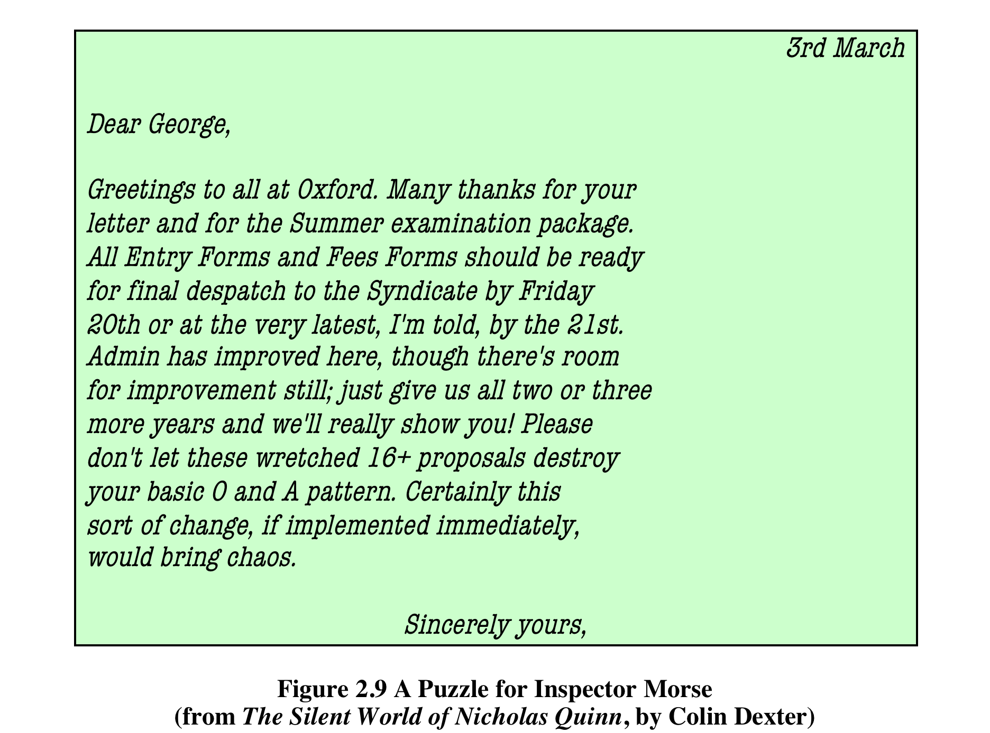
Steganography
Notes:
We conclude with a discussion of a technique that (strictly speaking), is not encryption,
namely, steganography .
A plaintext message may be hidden in one of two ways. The methods of
steganography conceal the existence of the message, whereas the methods of
cryptography render the message unintelligible to outsiders by various transformations
of the text.
A simple form of steganography, but one that is time-consuming to construct,
is one in which an arrangement of words or letters within an apparently innocuous
text spells out the real message. For example, the sequence of first letters of each
word of the overall message spells out the hidden message. Figure 3.9 shows an
example in which a subset of the words of the overall message is used to convey the
hidden message. See if you can decipher this; it’s not too hard.

Slide 16
Other Steganography Techniques
Character marking
Selected letters of printed or typewritten text are over-written in pencil
The marks are ordinarily not visible unless the paper is held at an angle to bright light
Invisible ink
A number of substances can be used for writing but leave no visible trace until heat or some chemical is applied to the paper
Pin punctures
Small pin punctures on selected letters are ordinarily not visible unless the paper is held up in front of a light
Typewriter correction ribbon
Used between lines typed with a black ribbon, the results of typing with the correction tape are visible only under a strong light
Notes:
Various other techniques have been used historically; some examples are the
following [MYER91]:
• Character marking: Selected letters of printed or typewritten text are overwritten
in pencil. The marks are ordinarily not visible unless the paper is held
at an angle to bright light.
• Invisible ink: A number of substances can be used for writing but leave no
visible trace until heat or some chemical is applied to the paper.
• Pin punctures: Small pin punctures on selected letters are ordinarily not
visible unless the paper is held up in front of a light.
• Typewriter correction ribbon: Used between lines typed with a black
ribbon, the results of typing with the correction tape are visible only under
a strong light.

Slide 17
Steganography vs. Encryption
Steganography has a number of drawbacks when compared to encryption
It requires a lot of overhead to hide a relatively few bits of information
Once the system is discovered, it becomes virtually worthless
The advantage of steganography
It can be employed by parties who have something to lose should the fact of their secret communication (not necessarily the content) be discovered
Encryption flags traffic as important or secret or may identify the sender or receiver as someone with something to hide
Notes:
Although these techniques may seem archaic, they have contemporary equivalents.
[WAYN09] proposes hiding a message by using the least significant bits of
frames on a CD. For example, the Kodak Photo CD format’s maximum resolution
is 3096 * 6144 pixels, with each pixel containing 24 bits of RGB color information.
The least significant bit of each 24-bit pixel can be changed without greatly affecting
the quality of the image. The result is that you can hide a 130-kB message in a single
digital snapshot. There are now a number of software packages available that take
this type of approach to steganography.
Steganography has a number of drawbacks when compared to encryption.
It requires a lot of overhead to hide a relatively few bits of information, although
using a scheme like that proposed in the preceding paragraph may make it more
effective. Also, once the system is discovered, it becomes virtually worthless. This
problem, too, can be overcome if the insertion method depends on some sort of key
(e.g., see Problem 3.22). Alternatively, a message can be first encrypted and then
hidden using steganography.
The advantage of steganography is that it can be employed by parties who
have something to lose should the fact of their secret communication (not necessarily
the content) be discovered. Encryption flags traffic as important or secret or may
identify the sender or receiver as someone with something to hide.

Slide 18
Summary
Symmetric Cipher Model
Cryptography
Cryptanalysis and Brute-Force Attack
Transposition techniques
Rotor machines
Substitution techniques
Caesar cipher
Monoalphabetic ciphers
Playfair cipher
Hill cipher
Polyalphabetic ciphers
One-time pad
Steganography
Notes:
Chapter 3 summary.

