Slide 1
Revision: Link the following scenarios to the security objectives
Confidentiality
Integrity
Authenticity
Availability
Accountability
Notes:
These three concepts form what is often referred to as the CIA triad . The three
concepts embody the fundamental security objectives for both data and for information
and computing services. For example, the NIST standard FIPS 199 (Standards
for Security Categorization of Federal Information and Information Systems ) lists
confidentiality, integrity, and availability as the three security objectives for information
and for information systems. FIPS 199 provides a useful characterization of
these three objectives in terms of requirements and the definition of a loss of security
in each category:
• Confidentiality: Preserving authorized restrictions on information access
and disclosure, including means for protecting personal privacy and proprietary
information. A loss of confidentiality is the unauthorized disclosure of
information.
• Integrity: Guarding against improper information modification or destruction,
including ensuring information nonrepudiation and authenticity. A loss
of integrity is the unauthorized modification or destruction of information.
• Availability: Ensuring timely and reliable access to and use of information.
A loss of availability is the disruption of access to or use of information or an
information system.
Although the use of the CIA triad to define security objectives is well established,
some in the security field feel that additional concepts are needed to present
a complete picture. Two of the most commonly mentioned are as follows:
• Authenticity: The property of being genuine and being able to be verified and
trusted; confidence in the validity of a transmission, a message, or message
originator. This means verifying that users are who they say they are and that
each input arriving at the system came from a trusted source.
• Accountability: The security goal that generates the requirement for actions
of an entity to be traced uniquely to that entity. This supports nonrepudiation,
deterrence, fault isolation, intrusion detection and prevention, and after action
recovery and legal action. Because truly secure systems are not yet an
achievable goal, we must be able to trace a security breach to a responsible
party. Systems must keep records of their activities to permit later forensic
analysis to trace security breaches or to aid in transaction disputes.

Slide 2
User A transmits a file to user B. The file contains sensitive information (e.g., payroll records) that is to be protected from disclosure. User C, who is not authorized to read the file, is able to monitor the transmission and capture a copy of the file during its transmission.
A network manager, D, transmits a message to a computer, E, under its management. The message instructs computer E to update an authorization file to include the identities of a number of new users who are to be given access to that computer. User F intercepts the message, alters its contents to add or delete entries, and then forwards the message to E, which accepts the message as coming from manager D and updates its authorization file accordingly.
Rather than intercept a message, user F constructs its own message with the desired entries and transmits that message to E as if it had come from manager D. Computer E accepts the message as coming from manager D and updates its authorization file accordingly.

Slide 3
A message is sent from a customer to a stockbroker with instructions for various transactions. Subsequently, the investments lose value and the customer denies sending the message.
A piece of malware that corrupts some of the system files required to “boot” the computer
Imagine that you have a website and you sell products on that site. Now imagine that an attacker can shop on your web site and maliciously alter the prices of your products, so that they can buy anything for whatever price they choose.

Slide 4
Fundamental Security Design Principles
Least common mechanism
Psychological acceptability
Isolation
Encapsulation
Modularity
Layering
Least astonishment
Economy of mechanism
Fail-safe defaults
Complete meditation
Open design
Separation of privilege
Least privilege
Notes:
Despite years of research and development, it has not been possible to develop
security design and implementation techniques that systematically exclude security
flaws and prevent all unauthorized actions. In the absence of such foolproof techniques,
it is useful to have a set of widely agreed design principles that can guide
the development of protection mechanisms. The National Centers of Academic
Excellence in Information Assurance/Cyber Defense, which is jointly sponsored by
the U.S. National Security Agency and the U.S. Department of Homeland Security,
list the following as fundamental security design principles [NCAE13]:
■■ Economy of mechanism
■■ Fail-safe defaults
■■ Complete mediation
■■ Open design
■■ Separation of privilege
■■ Least privilege
■■ Least common mechanism
■■ Psychological acceptability
■■ Isolation
■■ Encapsulation
■■ Modularity
■■ Layering
■■ Least astonishment
The first eight listed principles were first proposed in [SALT75] and have withstood
the test of time.

Slide 5
Fundamental Security Design Principles
Economy of mechanism
Fail-safe defaults
Means that the design of security measures embodied in both hardware and software should be as simple and small as possible
Relatively simple, small design is easier to test and verify thoroughly
With a complex design, there are many more opportunities for an adversary to discover subtle weaknesses to exploit that may be difficult to spot ahead of time
Means that access decisions should be based on permission rather than exclusion
The default situation is lack of access, and the protection scheme identifies conditions under which access is permitted
Most file access systems and virtually all protected services on client/server use fail-safe defaults
Notes:
Economy of mechanism means that the design of security measures embodied
in both hardware and software should be as simple and small as possible.
The motivation for this principle is that relatively simple, small design is easier
to test and verify thoroughly. With a complex design, there are many more
opportunities for an adversary to discover subtle weaknesses to exploit that may
be difficult to spot ahead of time. The more complex the mechanism, the more
likely it is to possess exploitable flaws. Simple mechanisms tend to have fewer
exploitable flaws and require less maintenance. Further, because configuration
management issues are simplified, updating or replacing a simple mechanism
becomes a less intensive process. In practice, this is perhaps the most difficult
principle to honor. There is a constant demand for new features in both hardware
and software, complicating the security design task. The best that can be
done is to keep this principle in mind during system design to try to eliminate
unnecessary complexity.
Fail-safe defaults means that access decisions should be based on permission
rather than exclusion. That is, the default situation is lack of access, and the protection
scheme identifies conditions under which access is permitted. This approach
exhibits a better failure mode than the alternative approach, where the default is
to permit access. A design or implementation mistake in a mechanism that gives
explicit permission tends to fail by refusing permission, a safe situation that can
be quickly detected. On the other hand, a design or implementation mistake in a
mechanism that explicitly excludes access tends to fail by allowing access, a failure
that may long go unnoticed in normal use. Most file access systems and virtually all
protected services on client/server systems use fail-safe defaults.

Slide 6
Attack Surfaces
An attack surface consists of the reachable and exploitable vulnerabilities in a system
Examples:
Open ports on outward facing Web and other servers, and code listening on those ports
Services available on the inside of a firewall
Code that processes incoming data, email, XML, office documents, and industry-specific custom data exchange formats
Interfaces, SQL, and Web forms
An employee with access to sensitive information vulnerable to a social engineering attack
Notes:
An attack surface consists of the reachable and exploitable vulnerabilities in a system
[MANA11, HOWA03]. Examples of attack surfaces are the following:
■ Open ports on outward facing Web and other servers, and code listening on
those ports
■ Services available on the inside of a firewall
■ Code that processes incoming data, email, XML, office documents, and industry-
specific custom data exchange formats
■ Interfaces, SQL, and Web forms
■ An employee with access to sensitive information vulnerable to a social
Engineering attack

Slide 7
Attack Surface Categories
Network attack surface
Refers to vulnerabilities over an enterprise network, wide-area network, or the Internet
Software attack surface
Refers to vulnerabilities in application, utility, or operating system code
Human attack surface
Refers to vulnerabilities created by personnel or outsiders
Notes:
Attack surfaces can be categorized as follows:
■ Network attack surface: This category refers to vulnerabilities over an enterprise
network, wide-area network, or the Internet. Included in this category are network
protocol vulnerabilities, such as those used for a denial-of-service attack,
disruption of communications links, and various forms of intruder attacks.
■ Software attack surface: This refers to vulnerabilities in application, utility,
or operating system code. A particular focus in this category is Web server
Software.
■ Human attack surface: This category refers to vulnerabilities created by
personnel or outsiders, such as social engineering, human error, and trusted
insiders.

Slide 8
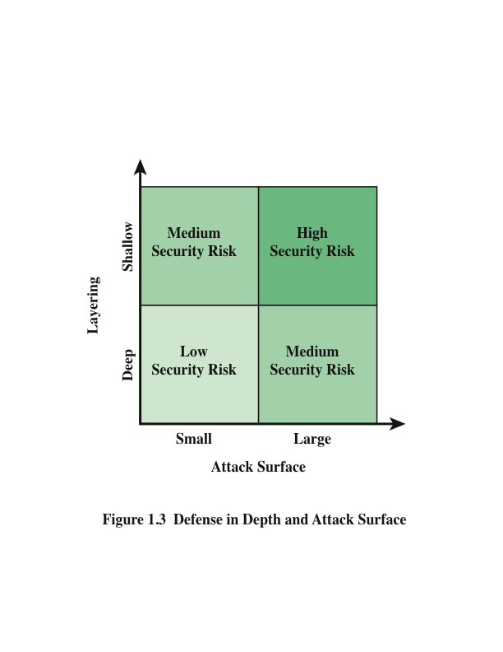
Notes:
An attack surface analysis is a useful technique for assessing the scale and
severity of threats to a system. A systematic analysis of points of vulnerability
makes developers and security analysts aware of where security mechanisms are
required. Once an attack surface is defined, designers may be able to find ways to
make the surface smaller, thus making the task of the adversary more difficult. The
attack surface also provides guidance on setting priorities for testing, strengthening
security measures, and modifying the service or application.
As illustrated in Figure 1.3, the use of layering, or defense in depth, and attack
surface reduction complement each other in mitigating security risk.

Slide 9
Attack Tree
A branching, hierarchical data structure that represents a set of potential techniques for exploiting security vulnerabilities
The security incident that is the goal of the attack is represented as the root node of the tree, and the ways that an attacker could reach that goal are represented as branches and subnodes of the tree
The final nodes on the paths outward from the root, (leaf nodes), represent different ways to initiate an attack
The motivation for the use of attack trees is to effectively exploit the information available on attack patterns
Notes:
An attack tree is a branching, hierarchical data structure that represents a set of potential
techniques for exploiting security vulnerabilities [MAUW05, MOOR01, SCHN99].
The security incident that is the goal of the attack is represented as the root node of
the tree, and the ways that an attacker could reach that goal are iteratively and incrementally
represented as branches and subnodes of the tree. Each subnode defines a
subgoal, and each subgoal may have its own set of further subgoals, and so on. The
final nodes on the paths outward from the root, that is, the leaf nodes, represent different
ways to initiate an attack. Each node other than a leaf is either an AND-node or an
OR-node. To achieve the goal represented by an AND-node, the subgoals represented
by all of that node’s subnodes must be achieved; and for an OR-node, at least one of
the subgoals must be achieved. Branches can be labeled with values representing difficulty,
cost, or other attack attributes, so that alternative attacks can be compared.
The motivation for the use of attack trees is to effectively exploit the information
available on attack patterns. Organizations such as CERT publish security
advisories that have enabled the development of a body of knowledge about both
general attack strategies and specific attack patterns. Security analysts can use the
attack tree to document security attacks in a structured form that reveals key vulnerabilities.
The attack tree can guide both the design of systems and applications,
and the choice and strength of countermeasures.

Slide 10
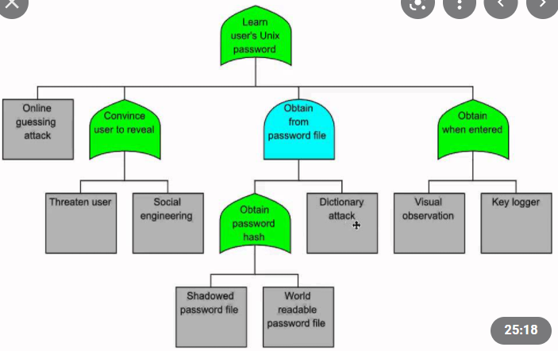
Source: YouTube

Slide 11
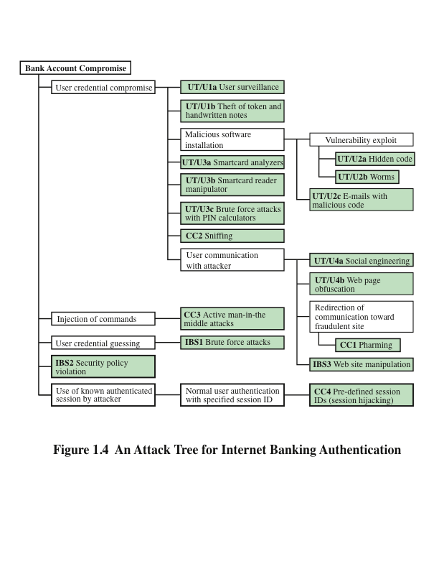
Notes:
Figure 1.4, based on a figure in [DIMI07], is an example of an attack tree
analysis for an Internet banking authentication application. The root of the tree is
the objective of the attacker, which is to compromise a user’s account. The shaded
boxes on the tree are the leaf nodes, which represent events that comprise the
attacks. Note that in this tree, all the nodes other than leaf nodes are OR-nodes.
The analysis to generate this tree considered the three components involved in
authentication:
■ User terminal and user (UT/U): These attacks target the user equipment,
including the tokens that may be involved, such as smartcards or other password
generators, as well as the actions of the user.
■ Communications channel (CC): This type of attack focuses on communication
links.
■ Internet banking server (IBS): These types of attacks are offline attacks against
the servers that host the Internet banking application.
Five overall attack strategies can be identified, each of which exploits one or
more of the three components. The five strategies are as follows:
■ User credential compromise: This strategy can be used against many elements
of the attack surface. There are procedural attacks, such as monitoring
a user’s action to observe a PIN or other credential, or theft of the user’s
token or handwritten notes. An adversary may also compromise token
information using a variety of token attack tools, such as hacking the smartcard
or using a brute force approach to guess the PIN. Another possible
strategy is to embed malicious software to compromise the user’s login and
password. An adversary may also attempt to obtain credential information
via the communication channel (sniffing). Finally, an adversary may use
various means to engage in communication with the target user, as shown
in Figure 1.4.
■ Injection of commands: In this type of attack, the attacker is able to intercept
communication between the UT and the IBS. Various schemes can be used
to be able to impersonate the valid user and so gain access to the banking
system.
■ User credential guessing: It is reported in [HILT06] that brute force attacks
against some banking authentication schemes are feasible by sending random
usernames and passwords. The attack mechanism is based on distributed
zombie personal computers, hosting automated programs for username- or
password-based calculation.
■ Security policy violation: For example, violating the bank’s security policy
in combination with weak access control and logging mechanisms, an employee
may cause an internal security incident and expose a customer’s
account.
■ Use of known authenticated session: This type of attack persuades or forces
the user to connect to the IBS with a preset session ID. Once the user authenticates
to the server, the attacker may utilize the known session ID to send
packets to the IBS, spoofing the user’s identity.
Figure 1.4 provides a thorough view of the different types of attacks on an
Internet banking authentication application. Using this tree as a starting point, security
analysts can assess the risk of each attack and, using the design principles outlined
in the preceding section, design a comprehensive security facility. [DIMO07]
provides a good account of the results of this design effort.

Slide 12
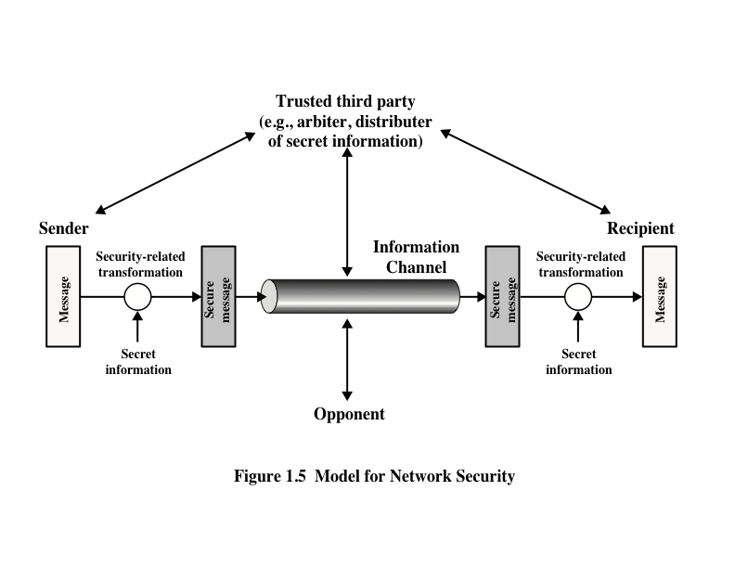
Model for Network Security
Notes:
A model for much of what we will be discussing is captured, in very general terms, in
Figure 1.5. A message is to be transferred from one party to another across some sort
of Internet service. The two parties, who are the principals in this transaction, must
cooperate for the exchange to take place. A logical information channel is established
by defining a route through the Internet from source to destination and by the cooperative
use of communication protocols (e.g., TCP/IP) by the two principals.
Security aspects come into play when it is necessary or desirable to protect the
information transmission from an opponent who may present a threat to confidentiality,
authenticity, and so on. All the techniques for providing security have two components:
■ A security-related transformation on the information to be sent. Examples
include the encryption of the message, which scrambles the message so that it
is unreadable by the opponent, and the addition of a code based on the contents
of the message, which can be used to verify the identity of the sender.
■ Some secret information shared by the two principals and, it is hoped,
Unknown to the opponent. An example is an encryption key used in conjunction
with the transformation to scramble the message before transmission and unscramble it on reception.
A trusted third party may be needed to achieve secure transmission. For
example, a third party may be responsible for distributing the secret information
to the two principals while keeping it from any opponent. Or a third party may be
needed to arbitrate disputes between the two principals concerning the authenticity
of a message transmission.
This general model shows that there are four basic tasks in designing a particular
security service:
1. Design an algorithm for performing the security-related transformation. The
algorithm should be such that an opponent cannot defeat its purpose.
2. Generate the secret information to be used with the algorithm.
3. Develop methods for the distribution and sharing of the secret information.
Specify a protocol to be used by the two principals that makes use of the
security algorithm and the secret information to achieve a particular security
service.

Slide 13
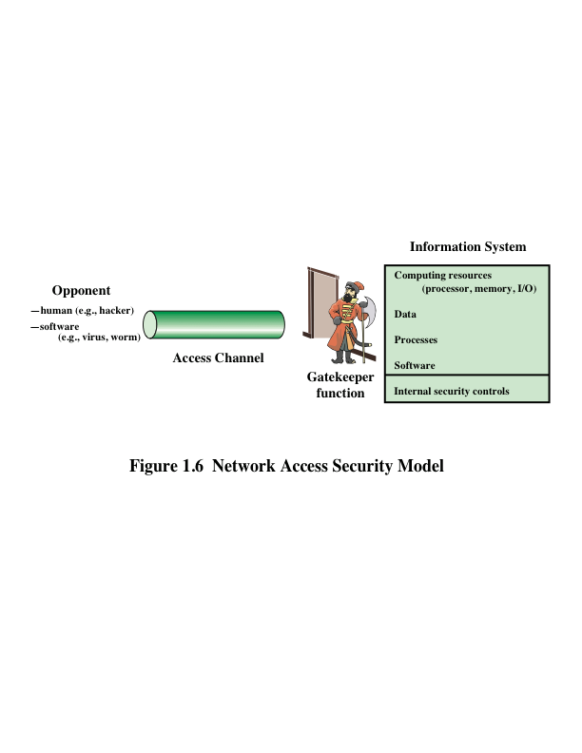
Network Access Security Model
Notes:
Parts One through Five of this book concentrate on the types of security mechanisms
and services that fit into the model shown in Figure 1.5. However, there are
other security-related situations of interest that do not neatly fit this model but are
considered in this book. A general model of these other situations is illustrated in
Figure 1.6, which reflects a concern for protecting an information system from unwanted
access. Most readers are familiar with the concerns caused by the existence
of hackers, who attempt to penetrate systems that can be accessed over a network.
The hacker can be someone who, with no malign intent, simply gets satisfaction
from breaking and entering a computer system. The intruder can be a disgruntled
employee who wishes to do damage or a criminal who seeks to exploit computer
assets for financial gain (e.g., obtaining credit card numbers or performing illegal
money transfers).

Slide 14
Standards
National Institute of Standards and Technology
NIST is a U.S. federal agency that deals with measurement science, standards, and technology related to U.S. government use and to the promotion of U.S. private-sector innovation
Despite its national scope, NIST Federal Information Processing Standards (FIPS) and Special Publications (SP) have a worldwide impact
Internet Society
ISOC is a professional membership society with world-wide organizational and individual membership
Provides leadership in addressing issues that confront the future of the Internet and is the organization home for the groups responsible for Internet infrastructure standards
ITU-T
The International Telecommunication Union (ITU) is an international organization within the United Nations System in which governments and the private sector coordinate global telecom networks and services
The ITU Telecommunication Standardization Sector (ITU-T) is one of the three sectors of the ITU and whose mission is the development of technical standards covering all fields of telecommunications
ISO
The International Organization for Standardization is a world-wide federation of national standards bodies from more than 140 countries
ISO is a nongovernmental organization that promotes the development of standardization and related activities with a view to facilitating the international exchange of goods and services and to developing cooperation in the spheres of intellectual, scientific, technological, and economic activity
Notes:
Many of the security techniques and applications described in this book have been
specified as standards. Additionally, standards have been developed to cover management
practices and the overall architecture of security mechanisms and services.
Throughout this book, we describe the most important standards in use or that are
being developed for various aspects of cryptography and network security. Various
organizations have been involved in the development or promotion of these standards.
The most important (in the current context) of these organizations are as
follows:
■ National Institute of Standards and Technology: NIST is a U.S. federal agency
that deals with measurement science, standards, and technology related to
U.S. government use and to the promotion of U.S. private-sector innovation.
Despite its national scope, NIST Federal Information Processing Standards
(FIPS) and Special Publications (SP) have a worldwide impact.
■ Internet Society: ISOC is a professional membership society with worldwide
organizational and individual membership. It provides leadership in
addressing issues that confront the future of the Internet and is the organization
home for the groups responsible for Internet infrastructure standards,
including the Internet Engineering Task Force (IETF) and the Internet
Architecture Board (IAB). These organizations develop Internet standards
and related specifications, all of which are published as Requests for
Comments (RFCs).
■ ITU-T: The International Telecommunication Union (ITU) is an international
organization within the United Nations System in which governments
and the private sector coordinate global telecom networks and services. The
ITU Telecommunication Standardization Sector (ITU-T) is one of the three
sectors of the ITU. ITU-T’s mission is the development of technical standards
covering all fields of telecommunications. ITU-T standards are referred to as
Recommendations.
■ ISO: The International Organization for Standardization (ISO) is a worldwide
federation of national standards bodies from more than 140 countries,
one from each country. ISO is a nongovernmental organization that promotes
the development of standardization and related activities with a view to facilitating
the international exchange of goods and services and to developing
cooperation in the spheres of intellectual, scientific, technological, and economic
activity. ISO’s work results in international agreements that are published
as International Standards.

Slide 15
Layering :Network Communication OSI Reference Model
Application
related
services
Application programs
that use the network
Application (7)
Presentation(6)
Standardise data rep.
to application layer
Session(5)
Manage sessions
between applications
Transport(4)
Provide end-to-end
error detection and correction
Network
related
services
Network(3)
Manage connections
across network
Data Link(2)
Provide reliable delivery
across physical links
Physical(1)
Define characteristics
of media

Slide 16
Layering: Internet TCP/IP Model
Programs: X window, mobile
agents, Web applications, Email …
Application
Table of addresses, data and
algorithms to perform reliable check
Transport
(TCP, UDP)
Table of addresses and algorithms
for handling the routing of data
Network (IP)
Data Link
Packets of some length & algorithms
Digital signal (0,1)
Physical
Notes:
Skip this slide

Slide 17
Without Layering
Application
SMTP
FTP
HTTP
Transmission
Media
Coaxial
cable
Fiber
optic
Each application has to be implemented for every network technology!

Slide 18
With Layering
Intermediate layer provides a unique abstraction for various network technologies
Application
SMTP
FTP
HTTP
Intermediate
layer
Transmission
Media
Coaxial
cable
Fiber
optic
Notes:
Organize a network system into logically distinct units
the service provided by one entity is based only on the service provided by the lower level entity
Advantages
Modularity – protocols easier to manage and maintain
Abstract functionality –lower layers can be changed without affecting the upper layers
Reuse – upper layers can reuse the functionality provided by lower layers

Slide 19
Generic Message Format
Sender
Identify
Recipient
Identity
Message
Length
Message
Data
Notes:
Let us see how the attacker can driven away

Slide 20
TCP/IP (e.g)
To communicate with a particular service using TCP/IP,
e.g telnet, at some machine at IP address X, we know that telnet uses TCP, is always assigned to port 23.
So in the IP header you’d specify X as the destination address, and 6 – which means TCP- as the protocol type.
In the TCP header, you’d specify port 23 as destination port (Your process on your machine would be at a dynamically assigned port )

Slide 21
TCP: Connection abstraction (e.g)
TCP uses the connection as its fundamental abstraction; connections are identified by a pair of endpoints
(123.23.4.99, 2343)
Connection 1
(128.34.2.1, 80)
IP - port
server
Clients
Connection 2
(130.194.3.99, 3333)
Because TCP identifies a connection by a pair of endpoints, a given TCP port number can be shared by multiple connections on the same host

Slide 22
TCP/IP & Possible Security Enhancement
Application
FTP, SMTP, HTTP, etc
Kerboros, HTTPS, SMINE, PGP…
TCP UDP
SSL, TLS
IP (ICMP)
IP Sec
Data Link
Ethernet, Token Ring, etc
Encrypting packets
Physical
Hardware chip for Encryption

Slide 23
Why deploy Security at IP Layer?
Security at the IP layer is related to the layer’s function of end-to-end datagram delivery.
The security weakness are:
Network spoofing – e.g: one machine can masquerade as another machine temporarily
Message replay
Authentication issues
Etc.

Slide 24
Why deploy security at Transport Layer?
Applications at higher layers are normally based on socket communications, therefore security can be achieved with:
SSL (Secure Socket Layer)
TLS (Transport Layer Security)

Slide 25
Can we also implement security at Application Layer?
There are many different applications at The Application Layer -> need different ways to secure each type of applications
Secure Mobile Agents
Secure Email (PGP, S/MINE),
Secure Web (HTTPS)
Security with Kerboros

Slide 26
END

