Slide 1
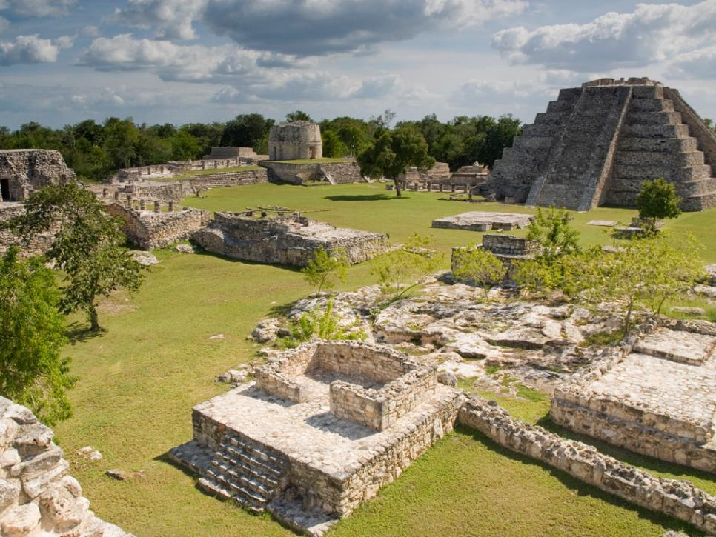
The collapse of the ancient Maya civilization

