Slide 1
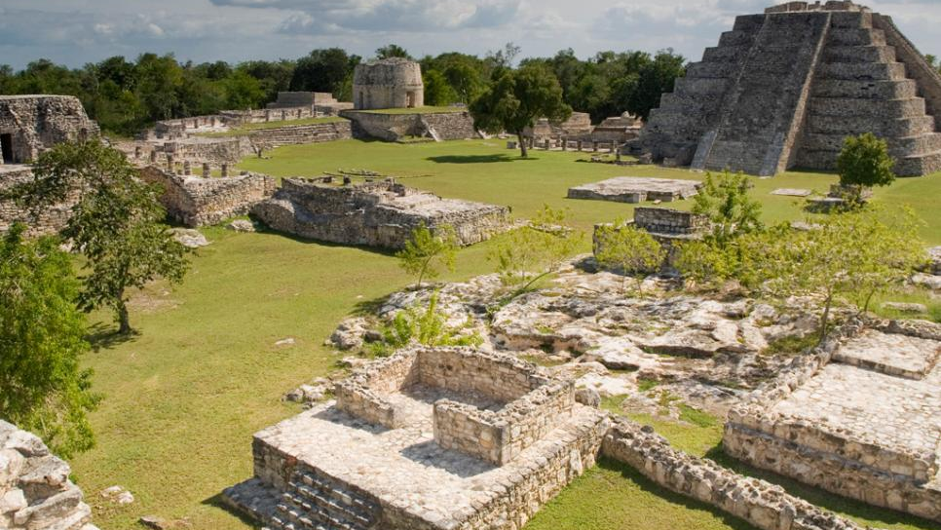
The collapse of the ancient Maya civilization

Slide 2
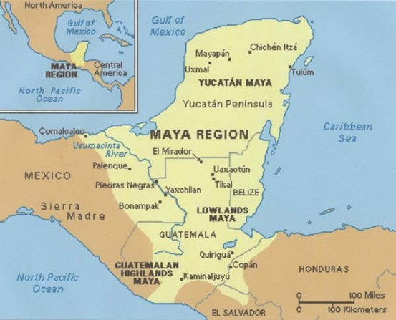
From approximately 1800 B.C. to 1050 A.D., the Maya civilization was one of Mesoamerica's most dominant indigenous societies. Located south of modern-day Mexico and north of modern-day South America, the Maya utilized both agricultural techniques and hunter-gatherer techniques and were centred around the Gulf of Mexico and the Caribbean Sea.
Notes:
<References inserted here>

Slide 3
The Maya lived in three areas with distinct cultural and environmental differences, the first of which was The Northern Maya Lowlands. They were located primarily in the Yucatán Peninsula, near the Yucatán Maya, marked on the map in a red circle.

Slide 4
The next area is known as the Southern Lowlands, mainly in the Peten district of northern Guatemala and adjacent portions of Mexico, Belize and western Honduras, marked on the map in a blue circle.

Slide 5
The third and final area, the Southern Highlands, was in the mountainous region of southern Guatemala, seen here in the black circle.

Slide 6
The Maya civilization occupied Mesoamerica in the three previously-mentioned areas in 3 distinct time periods:
The Preclassic Period (1800 B.C. – 250 A.D.).
During the Preclassic Period, the Maya civilization’s citizens began establishing themselves in Mesoamerica as a hybrid agricultural hunter-gatherer society. Additionally, the construction of cities, sites, and architectural works such as the Mayan pyramids began.

Slide 7
The Classic Period is when the Maya civilization was at its ‘prime’: ideal climate conditions and surplus resources led to population booms and the establishment of trading networks, alliances and military victories led to territorial expansion, and developments in cultural and religious beliefs. Additionally, because of the large population boom, the population of skilled workers increased dramatically, leading to the completion of many architectural and technological marvels in the fields of architecture, mathematics, linguistics, language, and astronomy.
The Preclassic Period (1800 B.C. – 250 A.D.).
The Classic Period (250 A.D. – 800 A.D.).

Slide 8
And lastly is the period on which this presentation will be mainly focusing: The Terminal Classic Period. Directly contrasting The Classic Period, The Terminal Classic Period was a period of sharp decline and eventual collapse of the Maya civilization. Many cities and sites were abandoned because of volcanic activity, poor climate conditions, military losses, or simple abandonment. Large-scale droughts devastated agriculture, local vegetation, and water reserves, and the loss of able workers straining the already waning available resources.
The Preclassic Period (1800 B.C. – 250 A.D.).
The Classic Period (250 A.D. – 800 A.D.).
The Terminal Classic Period (800 A.D. – 1050 A.D.).
The period I am focusing on is in bright red to stand out

Slide 9
And lastly is the period on which this presentation will be mainly focusing: The Terminal Classic Period. Directly contrasting The Classic Period, The Terminal Classic Period was a period of sharp decline and eventual collapse of the Maya civilization. Many cities and sites were abandoned because of volcanic activity, poor climate conditions, military losses, or simple abandonment. Large-scale droughts devastated agriculture, local vegetation, and water reserves, and the loss of able workers strained the already waning available resources.
The Terminal Classic Period (800 A.D. – 1050 A.D.).

Slide 10
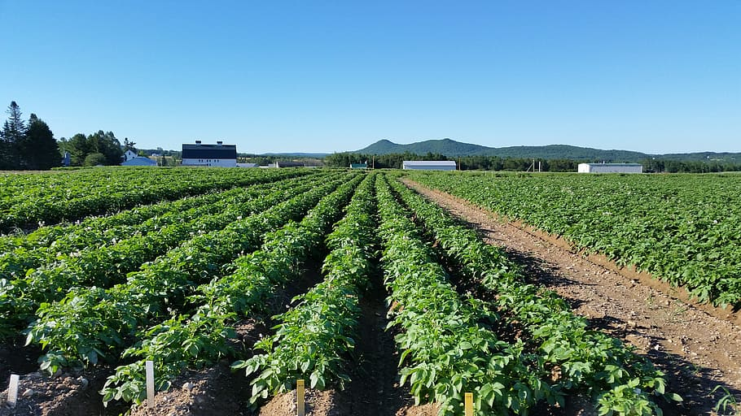
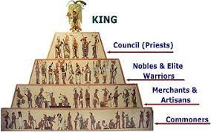
Before we elaborate more on what factors led to the collapse of the Mayan civilization, we must first discuss the characteristics of the Maya civilization. More specifically, we will discuss their social structure, agricultural practices, and resource reclamation and storage methods.
Notes:
Picture of crops: https://www.wallpaperflare.com/maine-potato-field-agriculture-crop-landscape-plant-food-and-drink-wallpaper-wbzzc
Maya social structure picture: http://www.historyshistories.com/the-maya.html

Slide 11
Like many civilizations in Mesoamerica at that time, the Mayans had a monarchy system to hierarchically organize society into six distinct groups: Kings, council members and priests, nobles and elite warriors, merchants and craftsmen, commoners and workers, and lastly, slaves.
Notes:
Maya social structure picture: http://www.historyshistories.com/the-maya.html
Maya social structure information: http://www.historyshistories.com/maya-society.html

Slide 12
Although a monarchy system at its core, the Maya civilization had one noble family ruling over each city. The position of king was completely hereditary, meaning the son of a king could be the only individual appointed king. Larger cities often had kings which controlled smaller ones immediately around them. Because of their absolute power, kings were considered sacred ruler who was believed to a descendant of a god. Eventually, the king was replaced if there was evidence that they lost favour with the gods.
Notes:
Maya social structure picture: http://www.historyshistories.com/the-maya.html
Maya social structure information: http://www.historyshistories.com/maya-society.html

Slide 13
At the bottom of the hierarchy were the commoners, equivalent to lower- or working-class people of today. Because the Maya civilization depended so heavily on agriculture for food and trade, commoners were farmers for the entirety of the growing season, and builders of pyramids and other city structures otherwise. *Continue talk about commoners, warriors, regardless of social rank, what diet mainly consisted of, and how droughts and unfavourable climate conditions lead to the death of many commoners and farms*
Notes:
Maya social structure picture: http://www.historyshistories.com/the-maya.html
Maya social structure information: http://www.historyshistories.com/maya-society.html

Slide 14
Immediately below kings were council members and priests. Because religion was well-grounded in Maya activities, priests were behind only kings in their social rankings, and considered the keepers of knowledge, those who were highly educated in religion, linguistics, mathematics, astronomy, astrology, and history. More importantly, they studied the complex Maya calendar and advised on when to plant crops for optimal harvest. Priests hosted regular religious ceremonies, with offerings or even a sacrifice, to communicate with the gods and interpret the gods’ will.
Notes:
Maya social structure picture: http://www.historyshistories.com/the-maya.html
Maya social structure information: http://www.historyshistories.com/maya-society.html

Slide 15
Like many civilizations in Mesoamerica, the Mayans had a monarchy system to hierarchically organize society into six distinct groups: Kings and queens, council members and priests, nobles and elite warriors, merchants and craftsmen, commoners and workers, and lastly, slaves.
For our purposes, our discussion will mainly include only the highest and lowest levels of the monarchy. Specifically, only kings and queens, council members, and commoners are relevant for our discussion.
Notes:
Maya social structure information: http://www.historyshistories.com/maya-society.html

