Slide 1
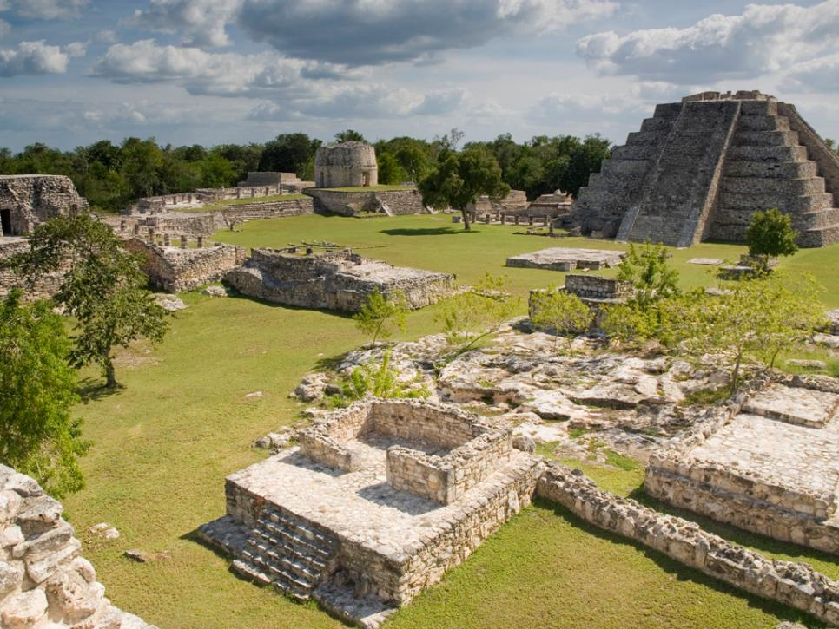
The collapse of the ancient Maya civilization

Slide 2
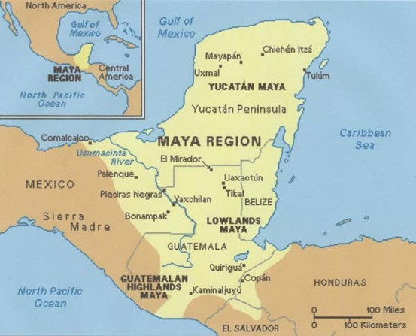
From approximately 1800 B.C. to 1050 A.D., the Maya civilization was one of the most dominant indigenous societies of Mesoamerica. Located south of modern-day Mexico and north of modern-day South America, the Maya utilized both agricultural techniques and hunter-gatherer techniques and were centred around the Gulf of Mexico and the Caribbean Sea.

Slide 3
The Maya lived in three areas with distinct cultural and environmental differences, the first of which was The Northern Maya Lowlands. They were located primarily in the Yucatán Peninsula, near the Yucatán Maya, marked on the map in a red circle.

Slide 4
The next area is known as the Southern Lowlands, mainly in the Peten district of northern Guatemala and adjacent portions of Mexico, Belize and western Honduras, marked on the map in a blue circle.

Slide 5
The third and final area, the Southern Highlands, was in the mountainous region of southern Guatemala, seen here in the black circle.

Slide 6
The Maya civilization occupied Mesoamerica in the three previously-mentioned areas in 3 distinct time periods:
The Preclassic Period (1800 BC – 1000 BC).
During the Preclassic Period, the Maya civilization’s citizens began establishing themselves in Mesoamerica as a hybrid agricultural hunter-gatherer society. Additionally, the construction of cities, sites, and architectural works such as the Mayan pyramids began.

Slide 7
The Classic Period is when the Maya civilization was at its ‘prime’: ideal climate conditions and surplus resources led to population booms and the establishment of trading networks, alliances and military victories led to territorial expansion, and developments in cultural and religious beliefs. Additionally, because of the large population boom, the population of skilled workers increased dramatically, leading to the completion of many architectural and technological marvels in the fields of architecture, mathematics, linguistics, language, and astronomy.
The Preclassic Period (1800 B.C. – 250 A.D.).
The Classic Period (250 A.D. – 800 A.D.).

Slide 8
And lastly is the period on which this presentation will be mainly focusing: The Terminal Classic Period. Directly contrasting The Classic Period, The Terminal Classic Period was a period of sharp decline and eventual collapse of the Maya civilization. Many cities and sites were abandoned because of volcanic activity, poor climate conditions, military losses, or simple abandonment. Large-scale droughts devastated agriculture, local vegetation, and water reserves, and the loss of able workers straining the already waning available resources.
The Preclassic Period (1800 B.C. – 250 A.D.).
The Classic Period (250 A.D. – 800 A.D.).
The Terminal Classic Period (800 A.D. – 1050 A.D.).
The period I am focusing on is in bright red to stand out

