Slide 1
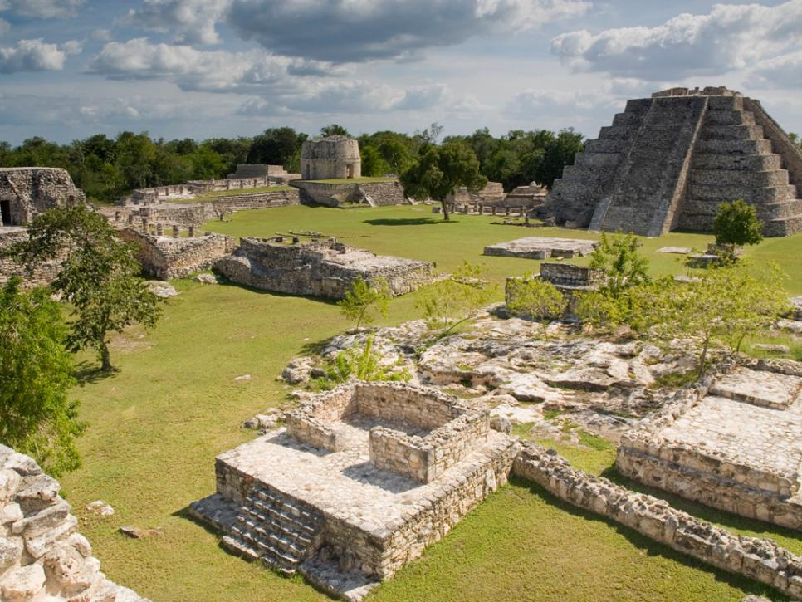
The collapse of the ancient Maya civilization

Slide 2
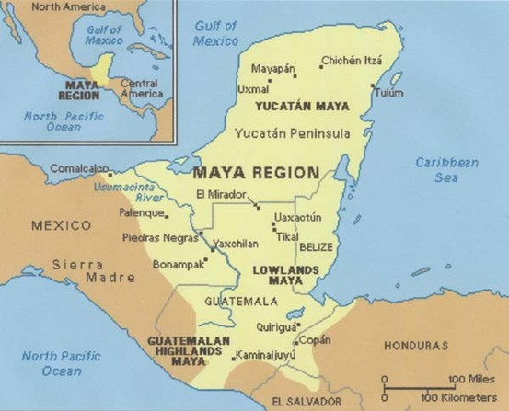
From approximately 1800 B.C. to 1050 A.D., the Maya civilization was one of the most dominant indigenous societies of Mesoamerica. Located south of modern-day Mexico and north of modern-day South America, the Maya utilized both agricultural techniques and hunter-gatherer techniques and were centred around the Gulf of Mexico and the Caribbean Sea.

Slide 3
The Maya lived in three areas with distinct cultural and environmental differences, the first of which was The Northern Maya Lowlands. They were located primarily in the Yucatán Peninsula, near the Yucatán Maya, marked on the map in a red circle.

Slide 4
The next area is known as the Southern Lowlands, mainly in the Peten district of northern Guatemala and adjacent portions of Mexico, Belize and western Honduras, marked on the map in a blue circle.

Slide 5
The third and final area, the Southern Highlands, was in the mountainous region of southern Guatemala, seen here in the black circle.

